Slide 1
Lecture 4
Visual Programming
Control elements.

Slide 2
Agenda
Conditions
Loops
Debugging
Exception handling

Slide 3
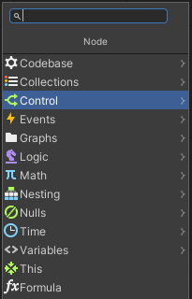
Branching / Conditions
In conventional programming languages Branching or Conditions are the control elements which enable to switch the flow of the program depending on condition’s value.
In Unity VS, control elements can be found with help of Fuzzy Finder.

Slide 4
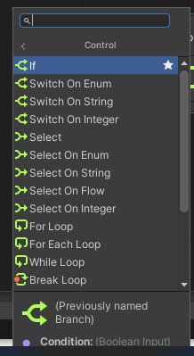
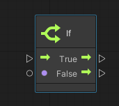
Control elements: If
If + Boolean logic
It has control input and two control outputs (for true and false values)
It has one logical input

Slide 5
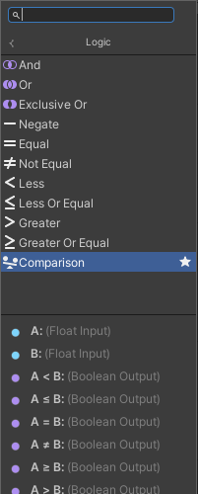
Logical operations
Operator | Operation | Rank | Result | Example
not, ! | Logical Negation | Unary | The opposite of the operand. | not true
- | Numerical Negation | Unary | The negative of the operand. | -5
and, && | Logical And | Binary | True if both operands are true. | (a < 5) and (b > 3)
or, || | Logical Or | Binary | True if either operand is true | (a < 5) or (b > 3)
=, == | Equality | Binary | True if the two operands are equal. | a = b
!=, <> | Inequality | Binary | True if the two operands are not equal. | a != b
<, <=, >, >= | Numeric Comparison | Binary | The result of a numeric comparison | a >= 10
(1)

Slide 6
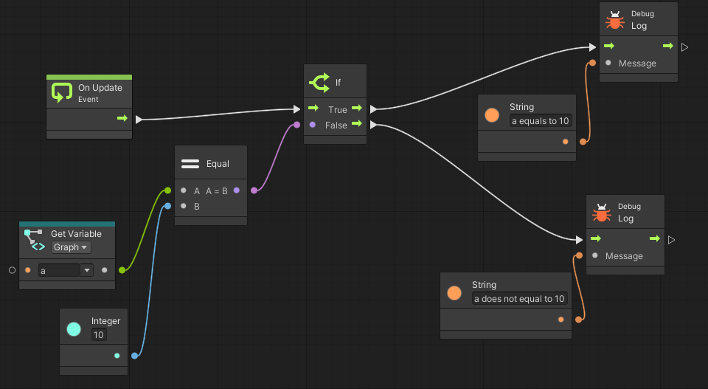
Example: If
Check if variable a equals to 10. Give the corresponding output message.

Slide 7
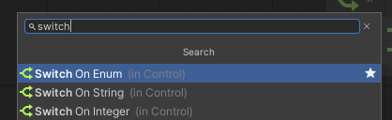
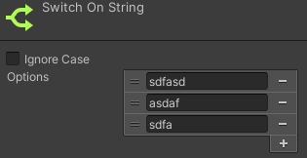
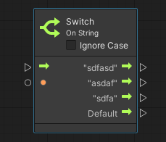
Switch
Create each branch option in the graph inspector. IF – gives only two options, SWITCH – can be checked for many.
The unit is updated with each output port

Slide 8
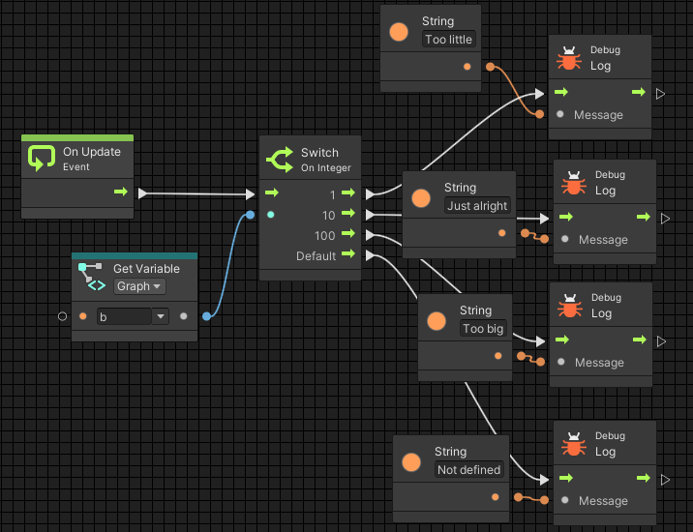
Example: Switch
Checking the value of b:
If it equals to 1 – message “Too little” will be printed
If it equals to 10 – message “Just right” will be printed
If it equals to 100 – message “Too big” will be printed
If it does not equal to 1 or 10 or 100 – message “Not defined” will be printed

Slide 9
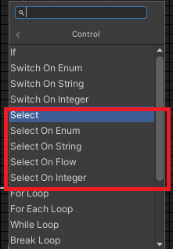
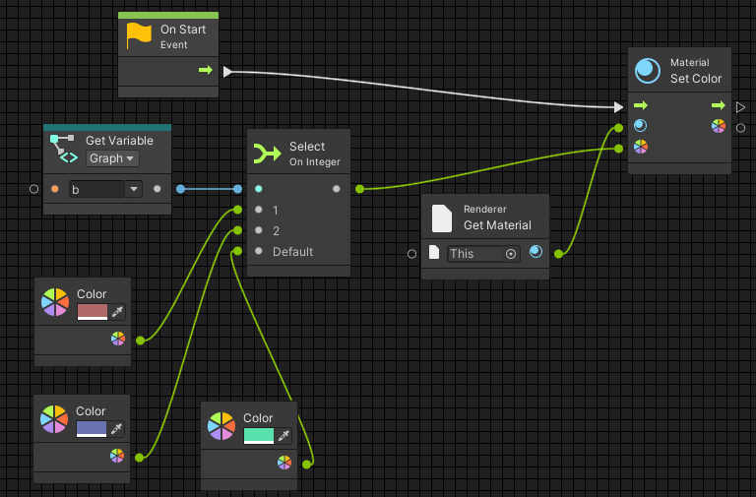
Select
You can select a single value from a set of options based on a selector.
Can work with several datatypes.
Example: Assign color depending on b variable value. Default color is also given.

Slide 10
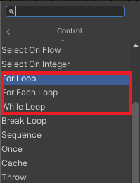
Loops
Loops repeats logic for a certain number of iterations before moving on. The logic to be repeated is called the body of the loop. The body of every loop is called synchronously. Co-routine-like behaviours are achieved by listening to the update event manually.
Types:
  While
  For Each
  For Loop
(1)

Slide 11
While Loop
It repeats its body while its condition remains true and terminates when conditions turns false. If condition is never true, body of the loop is not executed a single time.
Warning: Do not create an infinite loop. If the condition is always true, the editor hangs. As loop bodies are synchronous, not parallel, there are few uses for while loops in visual scripting. Always check Coroutine when working with Loops.

Slide 12
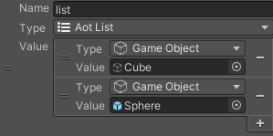
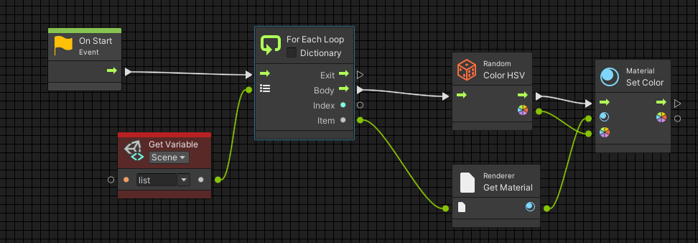

For Each Loop
For Each iterates over every element of a collection. It outputs the current index and item that is being looped over.
Example. Create a list of several GameObjects. Color in random colors all objects after starting the program.

Slide 13
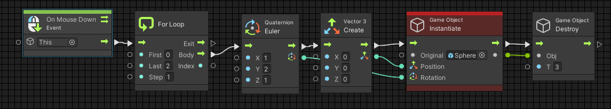

For Loop
Numeric loop and requires three integers: a start index, an end index, and a step.
Example: On clicking on the element, you want to instantiate several objects at once.

Slide 14
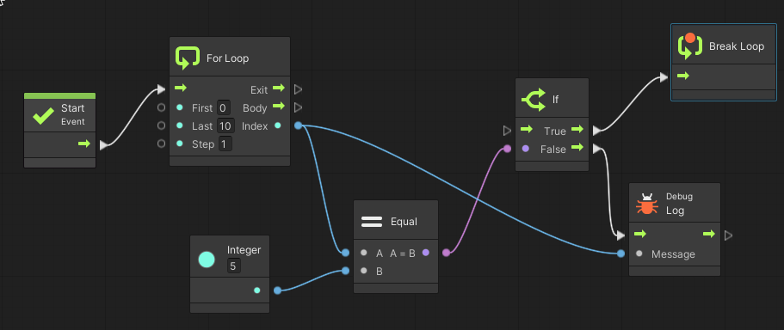
Break Loop
A loop can finish early by using the Break Loop unit. As soon as this unit is entered, the exit port of the loop is called, no matter how many more iterations remain.
https://docs.unity3d.com/Packages/com.unity.visualscripting@1.5/manual/vs-control.html

Slide 15
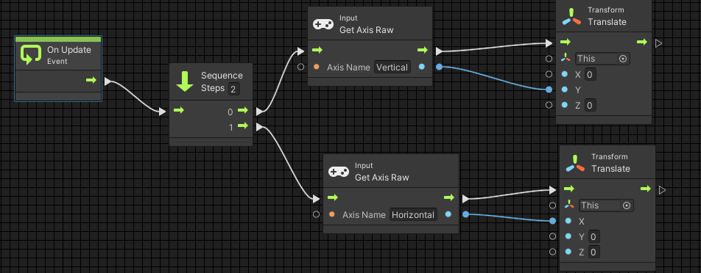
Sequence
Allows execute the flows in order.
Example: Listening to user input and moving object depending on input value.

Slide 16
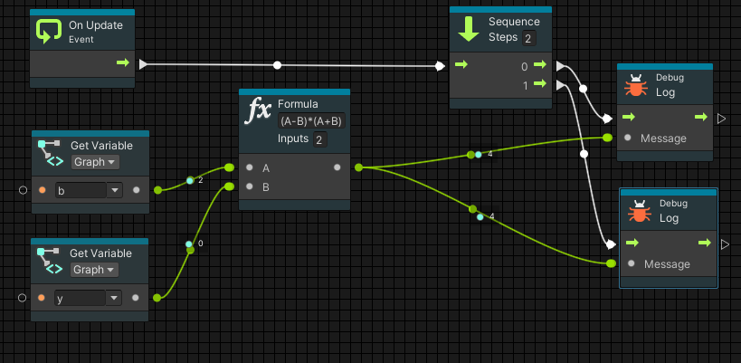
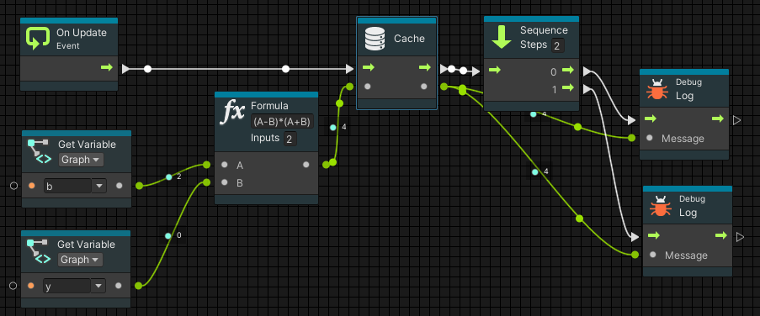
Cache
Cache node saves the result of expensive operation, so it can be reused several times instead of being calculated every time.

Slide 17
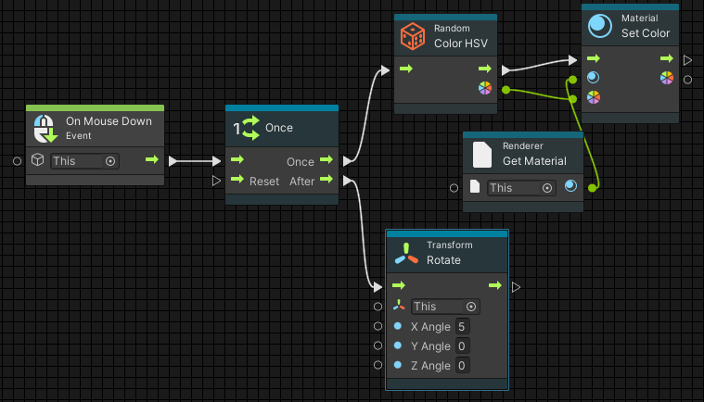
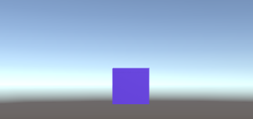
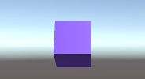
Once
Has two flows. Once is executed only once – first time event happens.
After – is executed all the following cases.
Example: Create scenario, when clicking on Cube first time – it has got random color, clicking on Cube every following time it will be rotating.
New color is given
Color is not changing. Cube is rotating.

Slide 18
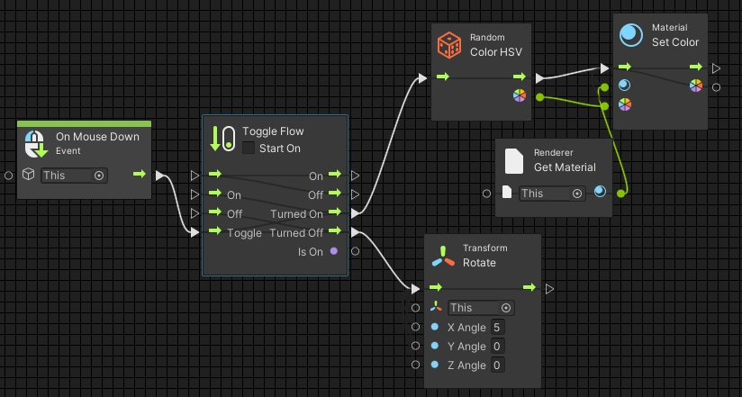
Toggle Flow
Toggle Flow works as a gate or a switch, which can switch between two states.
Example: let’s program the scenario, when clicking on the object odd times it will be changing colors, clicking even times – it will be rotating.

Slide 19
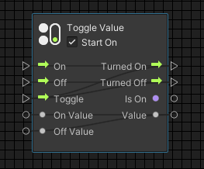
Toggle Value
The Toggle Value unit selects between two different input values depending on whether it is on or off. Its ports work exactly like the Toggle Flow unit.

Slide 20
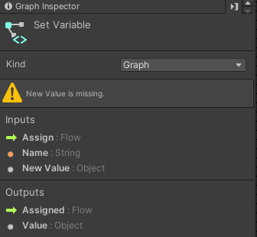
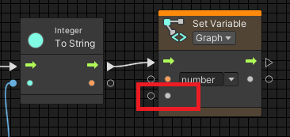
Debugging
Visual scripting can predict an error and inform the programmer.
When the input value is missing, node is highlighted yellow.
You can see the prompt in Graph Inspector

Slide 21
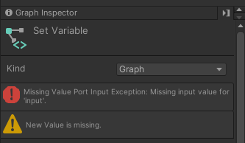
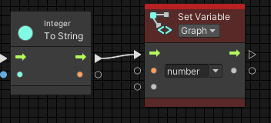
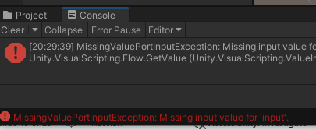
Debugging
If highlighted node is not fixed, when game will start, it most probably will cause an error.
When error node will be highlighted red.
Will see corresponding message in Graph Inspector
Will see corresponding message in Console log

Slide 22
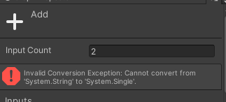
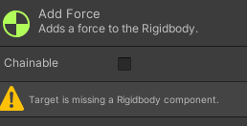

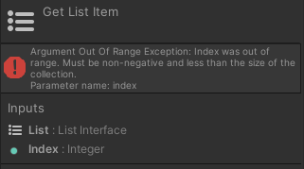
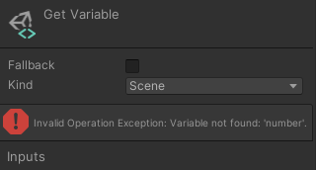
Types of errors
Missing value
Component missing
Conversion error
Game object or variable not found
Out of range

Slide 23
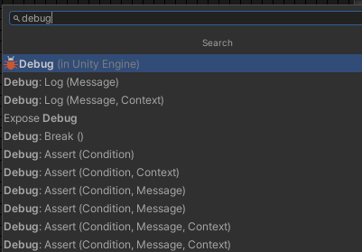
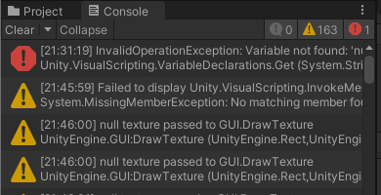
Debug
Debug class contains many methods
  Error log
  Warning log
  Assertion log
All Output messages, warnings and exceptions can be seen in Console log, under corresponding tab.

Slide 24
Exception Handling
Exception handling features help you deal with any unexpected or exceptional situations that occur when a program is running
It prevents your game from crashing in case you suspect some code might fail.
Anything that gets executed in the Try branch is considered "safe": the script continues from the Catch branch instead if it fails.
The Finally branch is optional. It is always called after Try or Catch, regardless of whether the operation succeeded or no.
(1)

Slide 25
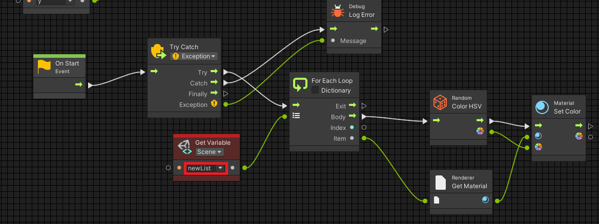
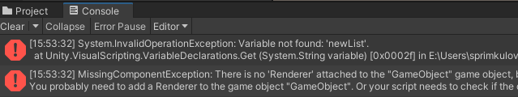
Example: Exception Handling
Use same example as one above. Each item of the game object list should be given color in the beginning of the game.
We deliberately changed variable name to non-existing one, to see if error will be caught.
Here is Console Log.
Endeed, newList variable is not found

Slide 26
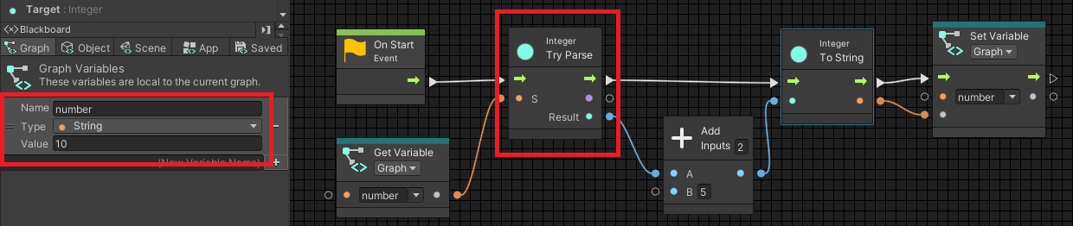
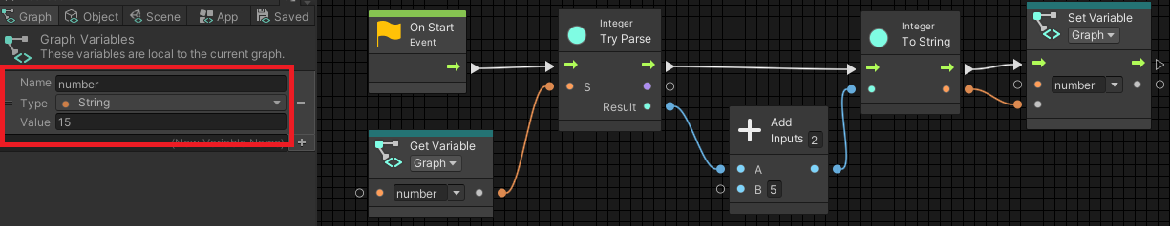
Another Try
There are several other Try methods. E.g when we try to convert from one data type to another – this process is called Parse.
Example: we take a variable of String data type, try to Parse it to Integer, increase the value by 10 and return to variables value again.
After running the code. Variable is equal to 15. It means parsing was successful

Slide 27
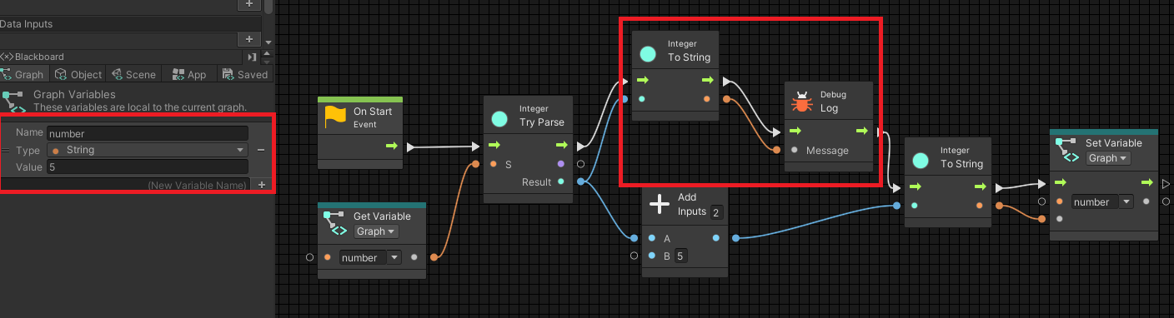

Trying to Parse
If String variable has value that cannot be converted into number, then it is treated as zero.

Slide 28
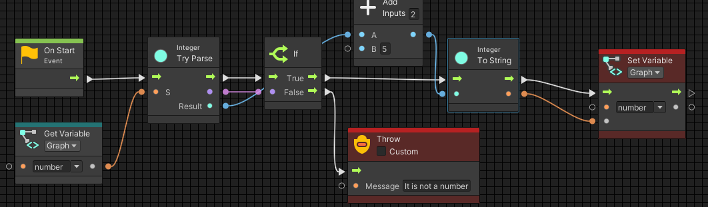
Throw
The Throw unit allows you to raise your own exceptions that stop the flow. These are caught with Try Catch.
It is good to predict where your code may fail and handle it before incorrect results will be produced.
Example: we try parse String variable. If parsing is successful – we continue with calculations. If parsing is not successful, i.e. String variable’s value cannot be correctly converted into number – let’s throw an exception.

Slide 29
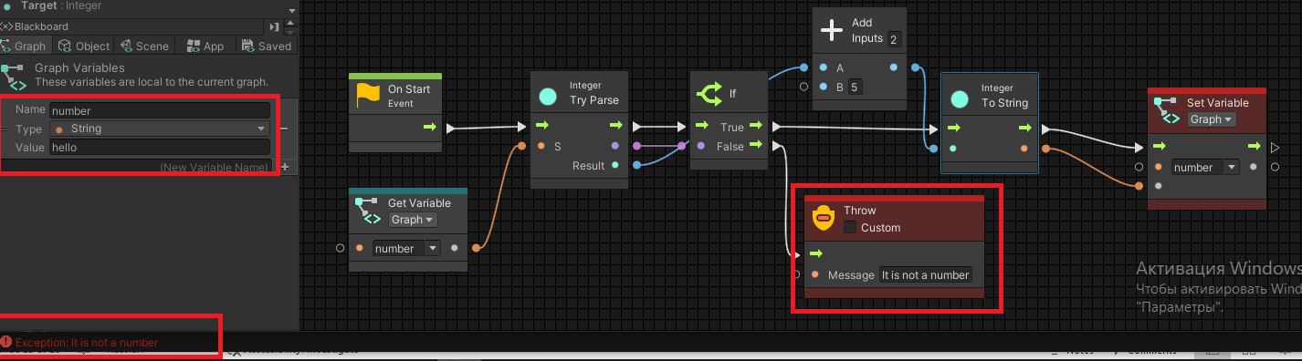
Throw an exception
Parsing is not successful. String variable’s value cannot be correctly converted into number. Exception is thrown and caught.

Slide 30
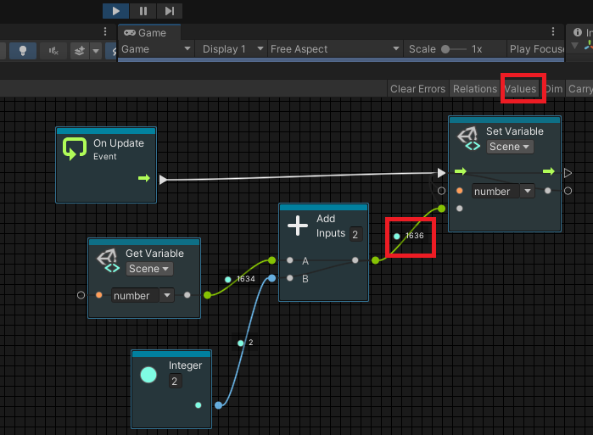
Live editing
You can see the values of the variables and check if flows and nodes are visited in live editing mode.
In play mode, turn on Values in the toolbar of graph window.

Slide 31
References
https://docs.unity3d.com/Packages/com.unity.visualscripting@1.5/manual/vs-formula.html
https://docs.unity3d.com/Packages/com.unity.visualscripting@1.6/manual/vs-control.html

