Slide 1
Visual Programming
Lecture 5
UI elements

Slide 2
Agenda
UI elements
Button
Input Field
Text Mesh Pro
Slider
Toggle
Colliders
Scenes
Build of the game

Slide 3

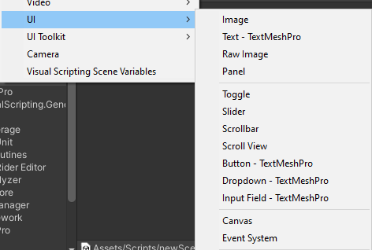
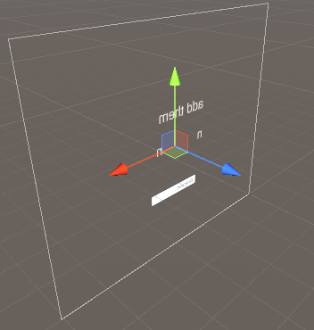
UI
User Interface or UI elements are not placed directly onto the scene. They are always placed as children of a special GameObject called the Canvas.
The Canvas is like a “drawing sheet” for UI on the scene, where all UI elements will render. Creating a UI element from the Create context menu without an existing Canvas will automatically generate one.

Slide 4
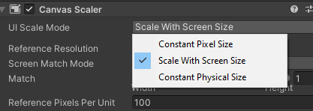
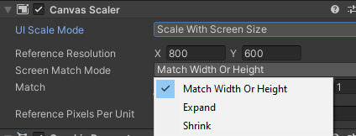
Main Canvas properties
UI scale mode
Screen match mode

Slide 5

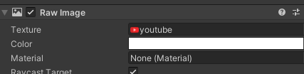

Raw Image
Static Image which can serve as decoration or icon/logo.
Add desired image to Assets, and then drag to Texture in Inspector

Slide 6
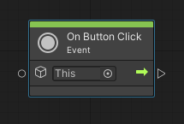

Button
One of the most common UI control element.
Button click normally used as triggers for some other actions
Often used to initiate or confirm an action

Slide 7
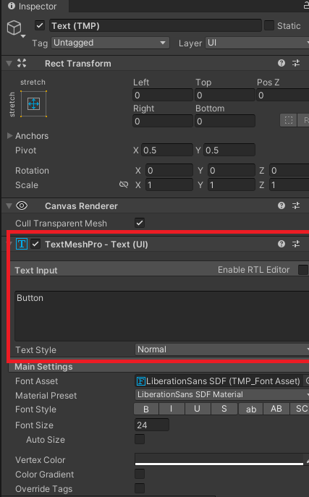
Button
You can change Button’s sign, by selecting TMP subcomponent, and do so in Inspector.

Slide 8
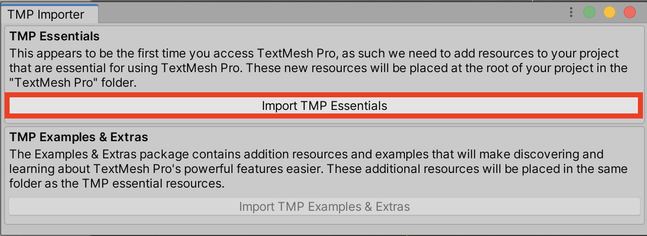
TextMeshPro
A text field.
When using first time, it will as you want to import its components (press yes)
There is also legacy component – Text (which much easier to use, but also has less features)
https://connect-prd-cdn.unity.com/20201014/learn/images/af943af9-163f-422d-81a4-352a98a2cba8_image7.png

Slide 9
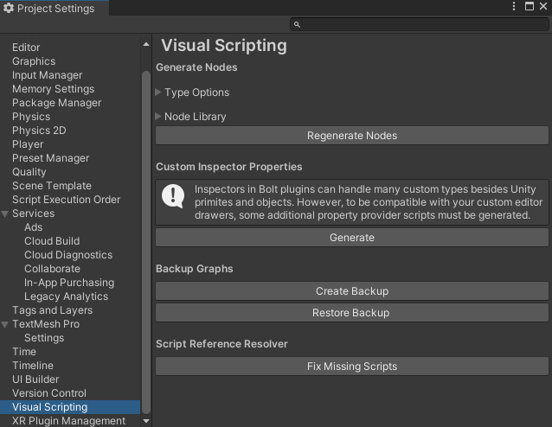
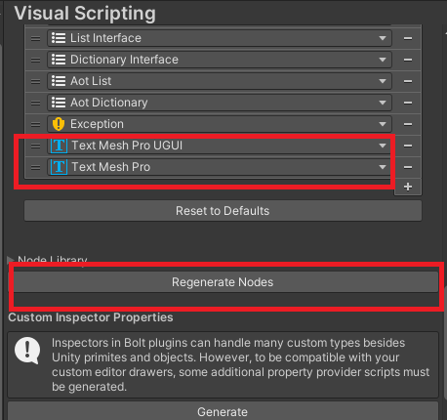
Example: TMP
Task: Show countdown time in the game.
Steps: 1. Add TextMeshPro to Types. Go to Edit->Project Settings->Visual Scripting
Type Options -> add TextMeshProUGUI and TextMeshPro to Node Library.
Click on Generate Nodes.

Slide 10
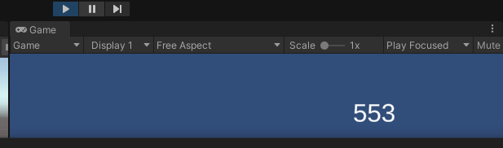
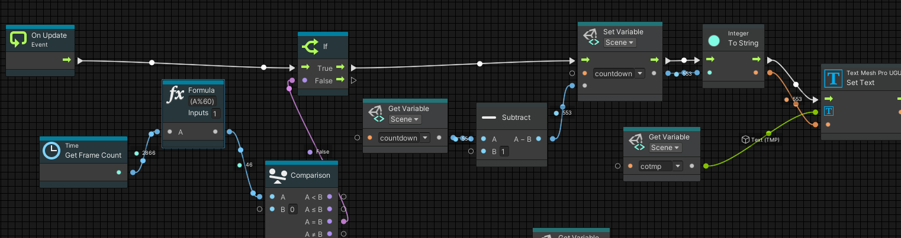
Example: TMP
2. Add TextMeshPro to Scene. In Graph Script editor of TextMeshPro element create the following graph.

Slide 11
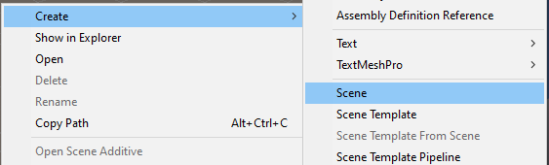
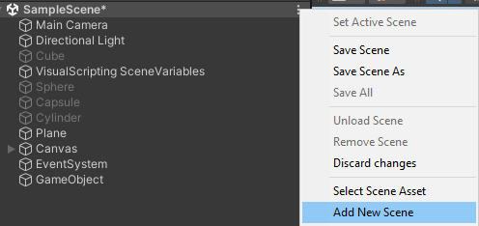
Scene
It is an asset, that contains all or part of the application.
Place where you work with objects and content
Level of the game
Default scene is called Sample Scene (you can always rename it)
You can save a scene as a template and use for the creating of new scenes
Create a new scene: in Assets and in Hierarchy

Slide 12
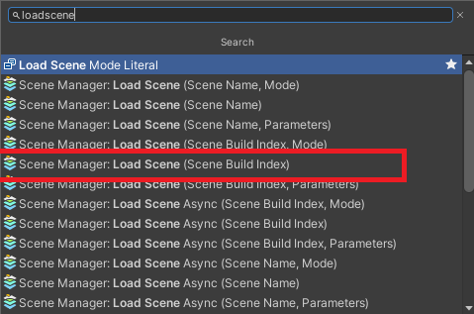
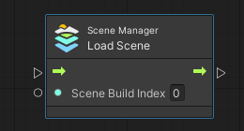
Scene Jump
To have a transition from one scene to another, use LoadScene method.
It is overloaded with different parameters. It is recommended to use index argument.

Slide 13
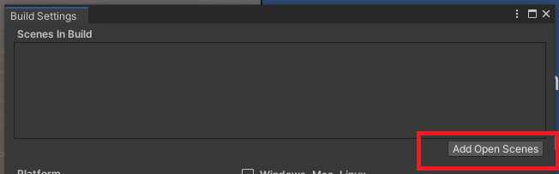
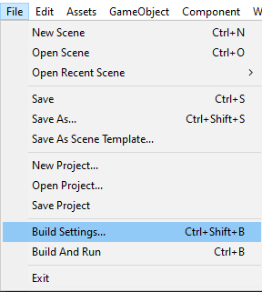
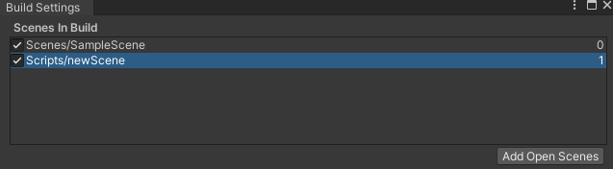
Build settings
If you have several scenes, how to know which one has which index?
Build settings will help us. Go File - > Build Settings
You will see the window where you can set settings for Build of the game
Very often Scenes in Build window does not show any scenes. Click Add Open Scenes or drag scenes from Assets.
Scenes can be reordered, just drag them.

Slide 14
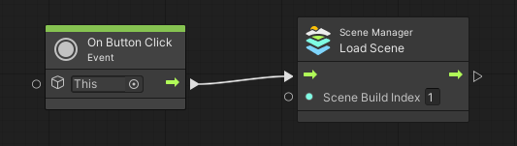
Example: Button
Create two scenes. Put one button on each and make them refer to each other, in other words, clicking on one game will move to Scene 2, clicking on second, will move to Scene 1.

Slide 15
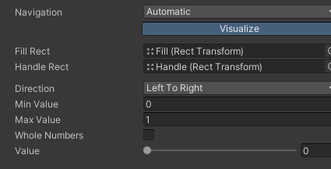

Slider
Allows the user to select a numeric value from a predetermined range by dragging the mouse
Familiar examples include difficulty settings in games, audio volume and brightness settings in image editors. (3)
Main properties:
  Direction
  Min value
  Max value
  Whole numbers

Slide 16
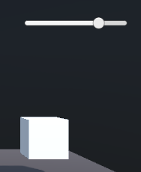
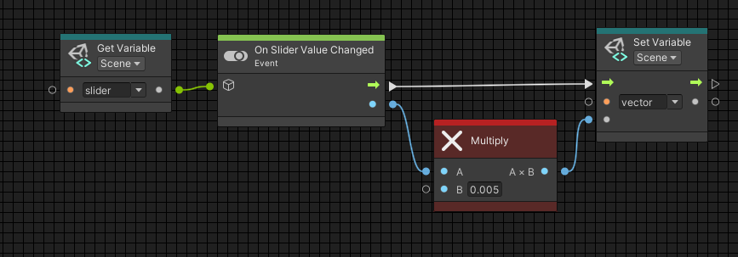
Example: Slider
Task: change the difficulty of the game help of slider
Steps:
  1. Main character moves with certain - default speed
  2. Changing slider we can decrease or increase movement speed

Slide 17
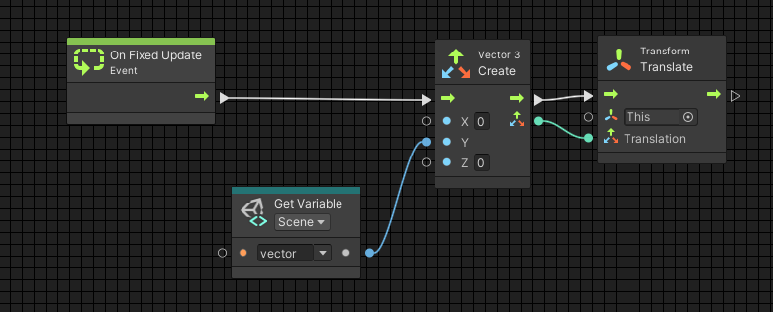
Example: Slider
Changing slider we can decrease or increase movement speed

Slide 18

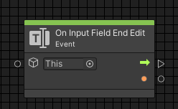
Input Field
Expects user input
Comes with two subcomponents: Placeholder and Text.
Main method to work with is On Input Field End Edit

Slide 19
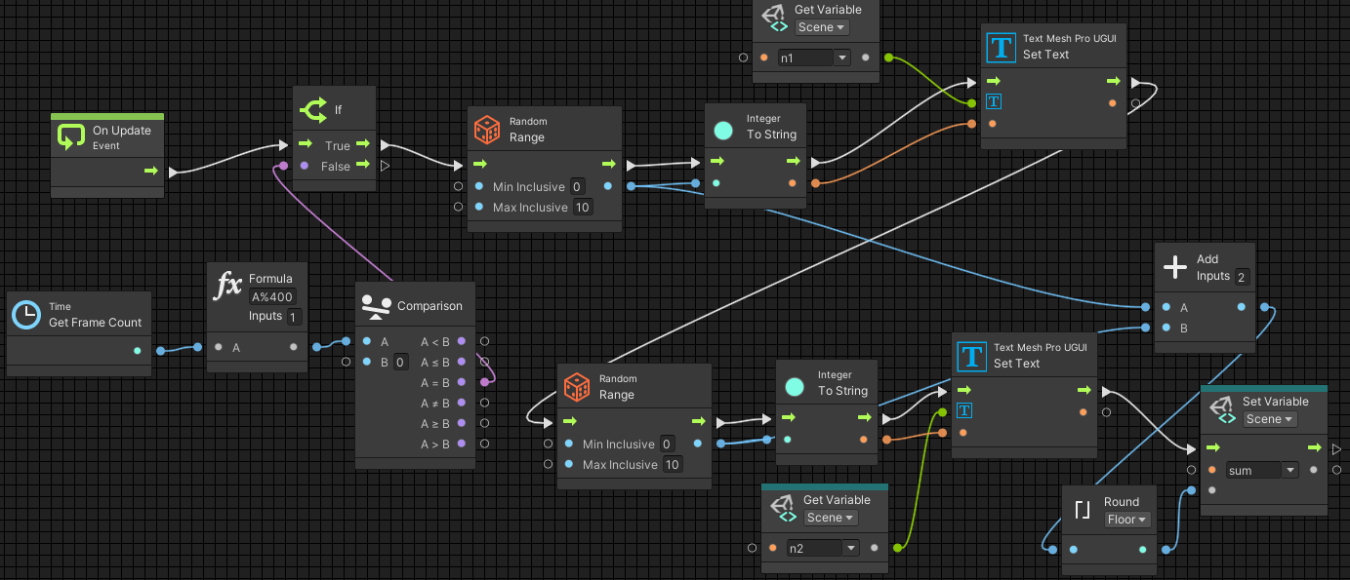
Example: Input Field
Task: create an educational training game, which will generate 2 random numbers every 8 seconds and will wait for user entering sum of these two numbers.
Steps:
  1. Generate 2 random numbers and display them through TextMeshPro element
  2. Read user input and compare with calculated sum
  3. If sum is correct update feedback TextMeshPro sign with Right, otherwise Wrong sign.

Slide 20
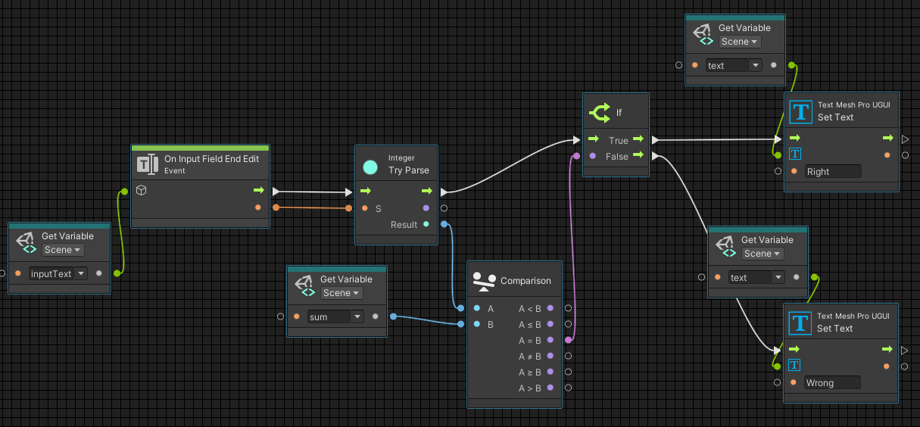
Example: Input Field
  2. Read user input and compare with calculated sum
  3. If sum is correct update feedback TextMeshPro sign with Right, otherwise Wrong sign

Slide 21
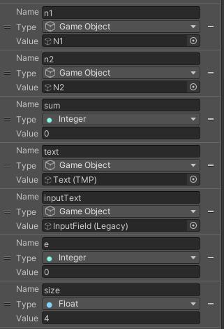
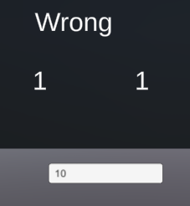
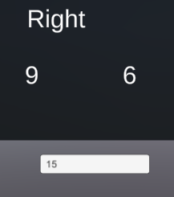
Variables used and results

Slide 22


Toggle
The Toggle control is a checkbox that allows the user to switch an option on or off. (4)

Slide 23
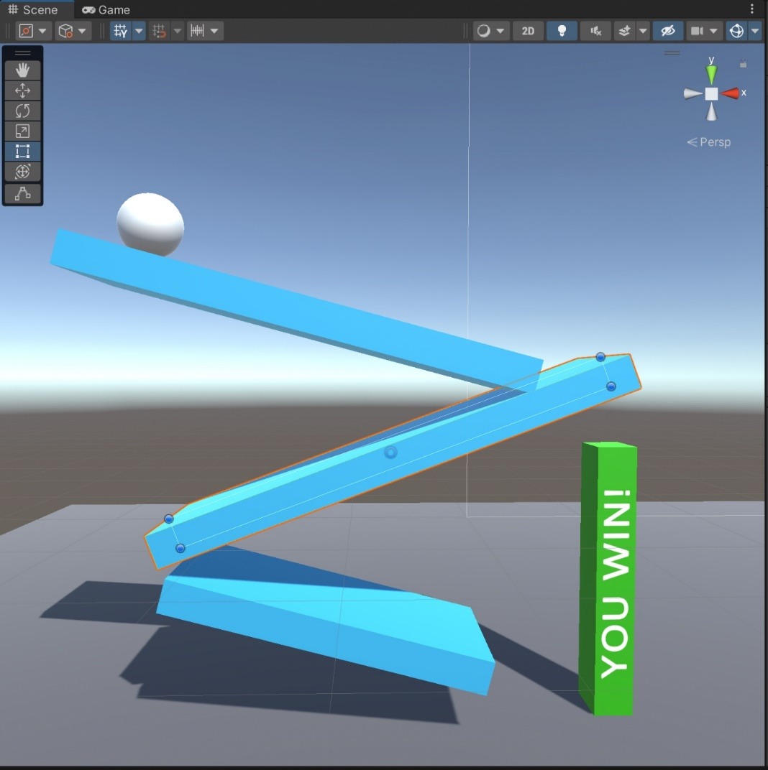
Example: Toggle
Task: suppose we have a level which is impossible to pass. What to do?
Solution can be set inactive Collider component, to make it possible to go though bars at some moment
And make Collider component active again at another moment to be able to hit YouWin bar

Slide 24
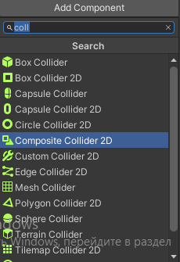
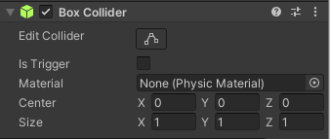
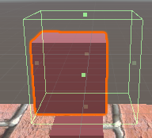

Collider Component
Collider components define the shape of an object for the purposes of physical collisions.
Clicking on Edit Collider, you can change the borders of collider, making it larger or smaller than actual size of an object.

Slide 25
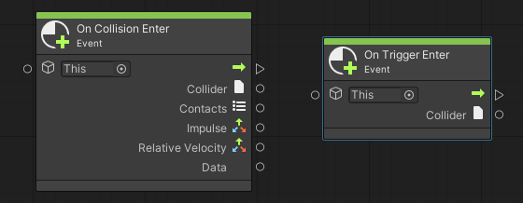
Collider properties
If one Rigidbody collides with another, the physics engine
only calculates a collision if both GameObjects have a Collider attached.
If one GameObject has a Rigidbody but no Collider, it passes through other GameObjects, and Unity does not include it in collision calculations. (6)
The scripting system can detect when collisions occur and initiate actions using the OnCollisionEnter function.
If you use physics engine simply to detect when one collider enters the space of another without creating a collision – configure collider as a Trigger method OnTriggerEnter can be used. (5)

Slide 26


Collision methods
When collisions occur, the physics engine calls functions with specific names on any scripts attached to the objects involved.
On the first physics update where the collision is detected, the OnCollisionEnter function is called.
During updates where contact is maintained, OnCollisionStay is called and finally,
OnCollisionExit indicates that contact has been broken.
Trigger colliders call the analogous OnTriggerEnter, OnTriggerStay and OnTriggerExit functions. (5)

Slide 27
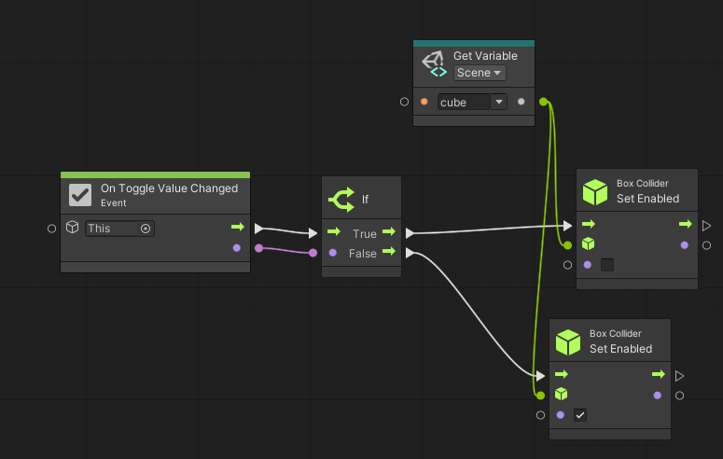

Solution
Create Script machine and Script graph for Toggle
Main event of Toggle control element is onToggleValueChanged – which has Boolean output, saying if it is checked or not.

Slide 28
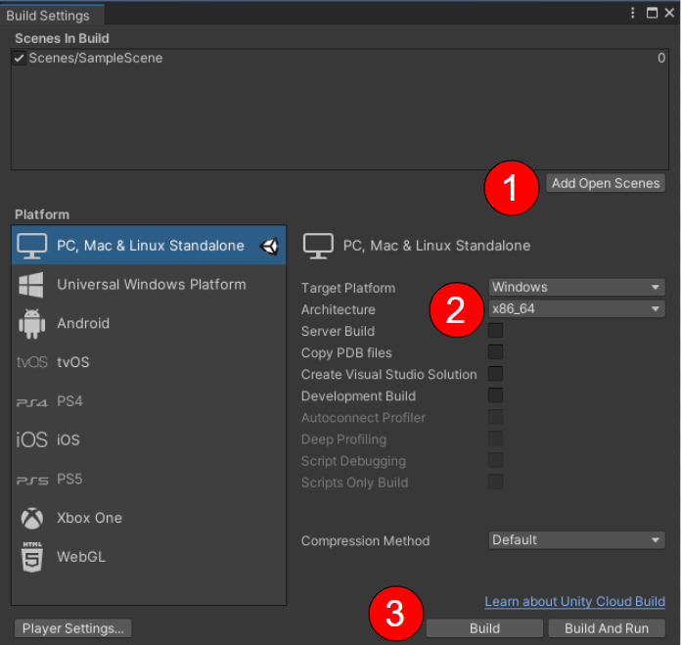
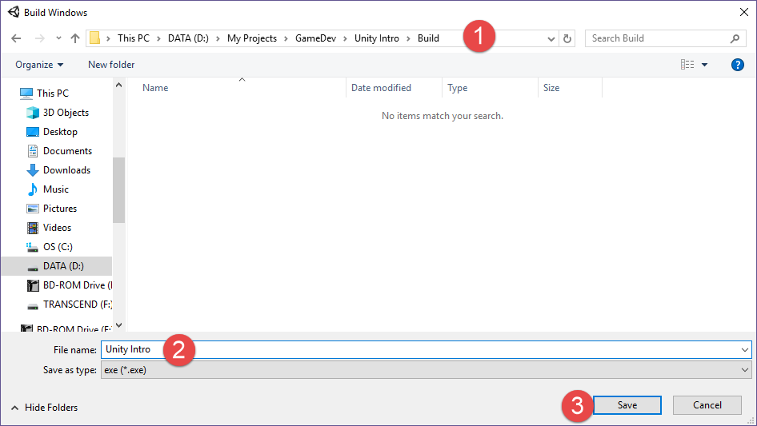
Build your game
Go to File -> Build settings. Choose Windows or\Mac desktop* platform
*building to mobile platforms require additional setup

Slide 29
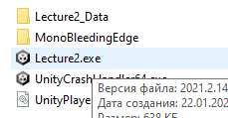

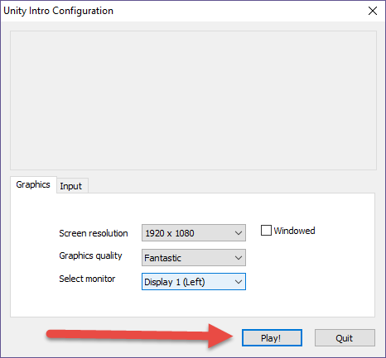
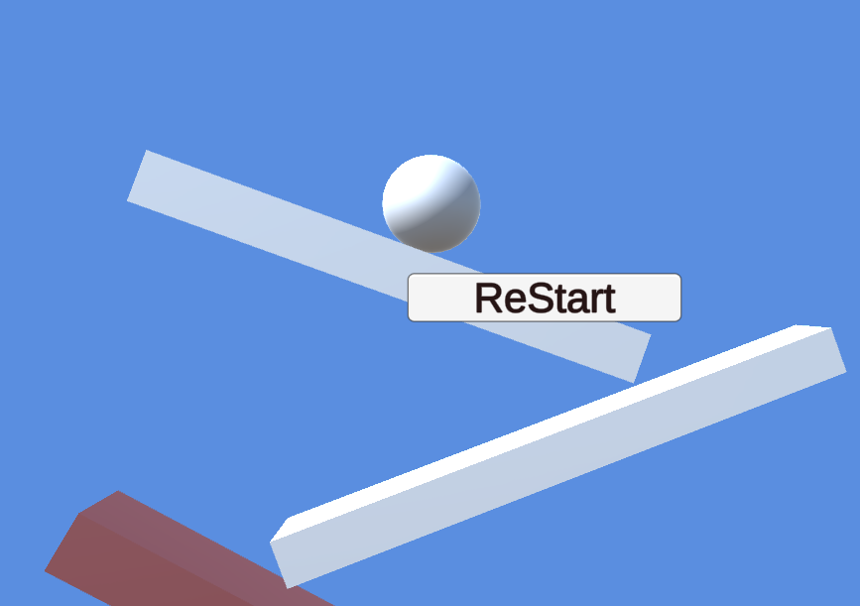
Build your game
Locate your build and run it. Unity build will prompt standard quality settings in the beginning
Find .exe file in your project folder and run it.

Slide 30
References
https://www.tutorialspoint.com/unity/unity_starting_with_ui.htm
https://docs.unity3d.com/Manual/CreatingScenes.html
https://docs.unity.cn/560/Documentation/Manual/script-Slider.html
https://docs.unity.cn/530/Documentation/Manual/script-Toggle.html
https://docs.unity3d.com/560/Documentation/Manual/CollidersOverview.html
https://docs.unity3d.com/Manual/rigidbody-configure-colliders.html
https://docs.unity3d.com/Manual/collision-section.html

