Slide 1
Visual Programming
Lecture 6
Instantiating objects

Slide 2
Agenda
Prefabs
Instantiating
Coroutine
Destroy
Events
Rigidbody Component
Shooting Game example

Slide 3
Prefabs
Unity’s Prefab system allows you to create, configure, and store a GameObject
complete with all its components, property values, and child GameObjects as a reusable Asset. The Prefab Asset acts as a template from which you can create new Prefab instances in the Scene
Any edits that you make to a Prefab Asset are automatically reflected in the instances of that Prefab, allowing you to easily make broad changes across your whole Project without having to repeatedly make the same edit to every copy of the Asset.
When? - when you want to instantiate GameObjects at runtime that did not exist in your Scene at the start - for example, to make powerups, special effects, projectiles, or NPCs appear at the right moments during gameplay.
Instance overrides
(1)

Slide 4
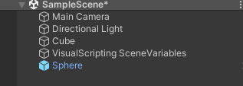
How?
To create a prefab, simply drag the object from the Hierarchy into Assets.
The object’s icon in Heirarchy should turn blue.

Slide 5
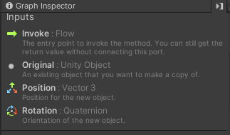
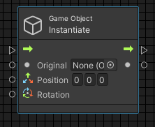
Instantiate
When we want to instantiate any object (spawn out of nowhere), we use GameObject.Instantiate method.
It comes with the following input data ports
For Original: only prefab Unity Object can be selected

Slide 6
Frame rate
Frame rate in Unity refers to how many images are displayed on the screen per second
Factors:
  The complexity of the game
  Graphic Settings
  The performance of your computer
DeltaTime is a term used in Unity to refer to the amount of time (in seconds) that has passed since the last frame was rendered
  1/60 = 0.0167
  make the game frame-independent

Slide 7
Updates
Update method - is not called at a fixed time interval, which can lead to some variability in performance.
  Good for user input, animations, and other fast updates
  after the FixedUpdate and Before the LateUpdate
FixedUpdate is a Frame Independent Update Function
  Edit > Project Settings > Time > Fixed Timestep
  it runs consistently and deterministically, regardless of how fast or slow your game is running.
  position or velocity of rigidbodies, which are affected by the physics engine
LateUpdate
  called once per frame after all other updates have been processed
  camera or lighting system
  post-processing effects

Slide 8
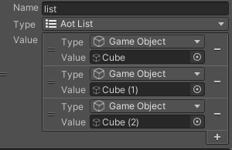
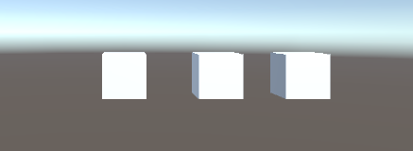
Example: Updates
Test: create 3 similar objects and put them to same vertical position
Use same scenario for 3 of them, changing only event: onUpdate, onLateUpdate, onFixedUpdate.

Slide 9
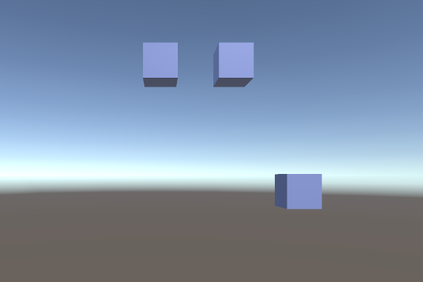
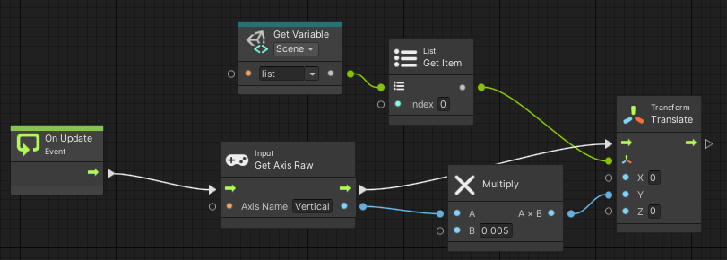
Example: Updates
1 – Update;
2 – LateUpdate;
3 – FixedUpdate

Slide 10
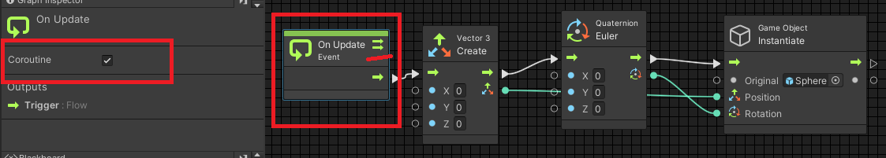
Coroutine
If you use Instantiate together with OnUpdate event, it means that new object will be created every timeframe, i.e. 60 objects per second. PC’s memory will be overloaded very soon. Solutions:
  manage time of Instantiating
  destroy objects after some time
  use Coroutines
A coroutine allows you to spread tasks across several frames. In Unity, a coroutine is a method that can pause execution and return control to Unity but then continue where it left off on the following frame. (2)

Slide 11
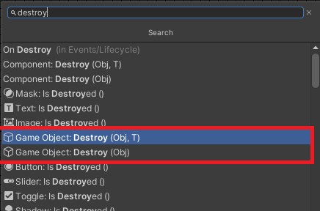
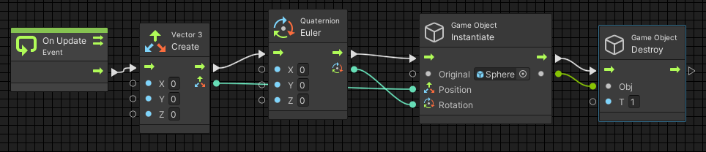
Destroy
You can destroy objects once you don’t need them in your gameplay.
In this example, Instantiated Object is destroyed after 1 second.

Slide 12
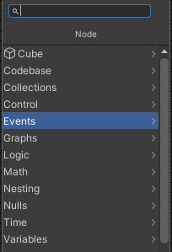
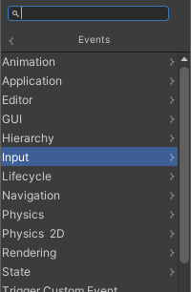
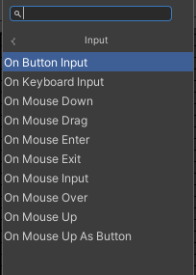
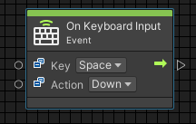
Events
Events – triggers, occasions that enable execution of certain flow or function/script.
Events – everything what can happen with your program: user input, moving, colliding, beginning, ending, etc.
They do not have Input flow, as they are themselves the beginning of the flow.

Slide 13
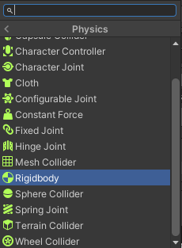
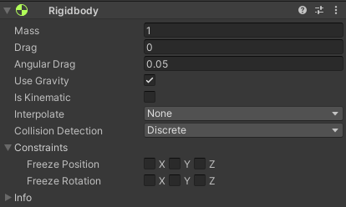
Rigidbody component
Control of an object's position through physics simulation
Adding a Rigidbody component to an object will put its motion under the control of Unity's physics engine. Even without adding any code, a Rigidbody object will be pulled downward by gravity and will react to collisions with incoming objects if the right Collider component is also present.
Recommended to use FixedUpdate
(3)
To add - in Inspector click Add Component – Physics - Rigidbody

Slide 14
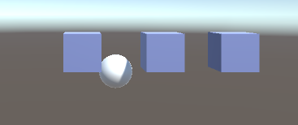
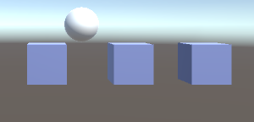
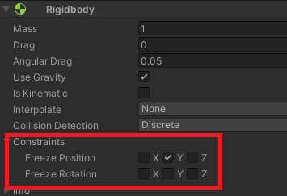
Example: Rigidbody
Adding Rigidbody, will add gravity to the object.
Sphere is falling
But you can also freeze Position or Rotation constraints, and still use features of this properties

Slide 15
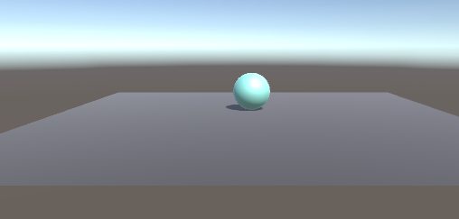
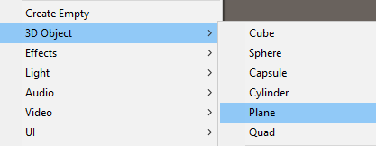
Example: Events
Task: Enable rolling depending on user input from the keyboard.
Steps: 1. Add Rigidbody component to ball
2. Add platform under the ball, so it will not be falling
3. Manage User input and write corresponding script graph

Slide 16
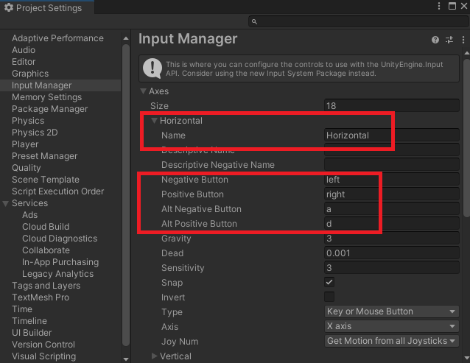
User Input
To check or edit settings go to Edit -> Project Settings -> Input Manager -> Axes
Here we may see how this property is called, what keys are responsible for this property.
They are left and right buttons, and “a” and “d” – as alternatives
Similar can be done for Vertical input

Slide 17
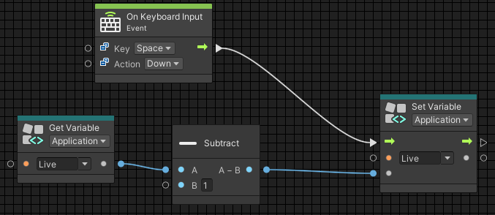
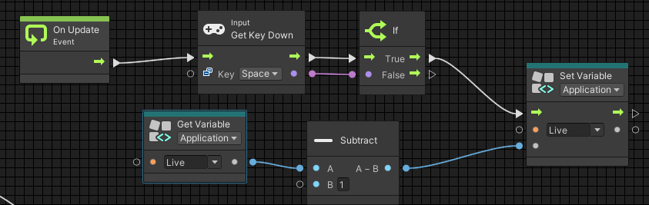
User Input
You can use event to write the flow
You can use method for the same purpose

Slide 18
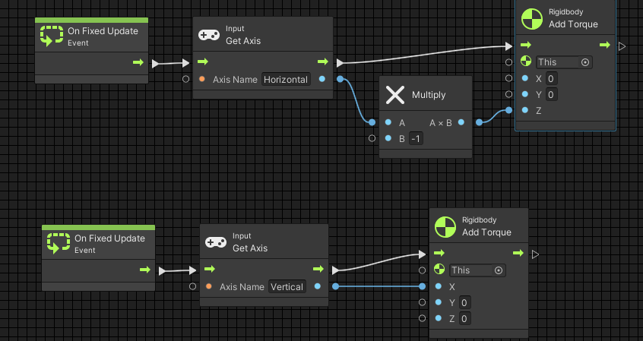
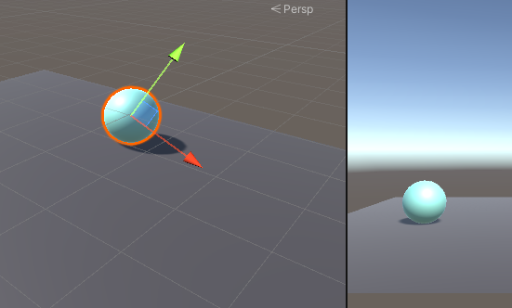
Add torque

Slide 19
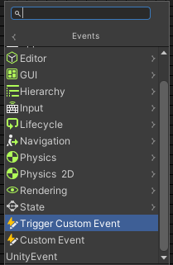
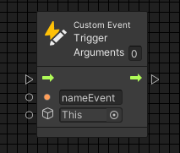
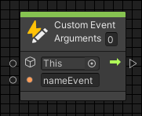
Custom events
Besides default system and program events that Unity already has, you can create your own Custom events and trigger them whenever needed in your program.
First you need to Trigger an Event. Second you need to describe what will be done. Both Trigger and Custom Events should have same name. You may add as many parameters as you need.

Slide 20
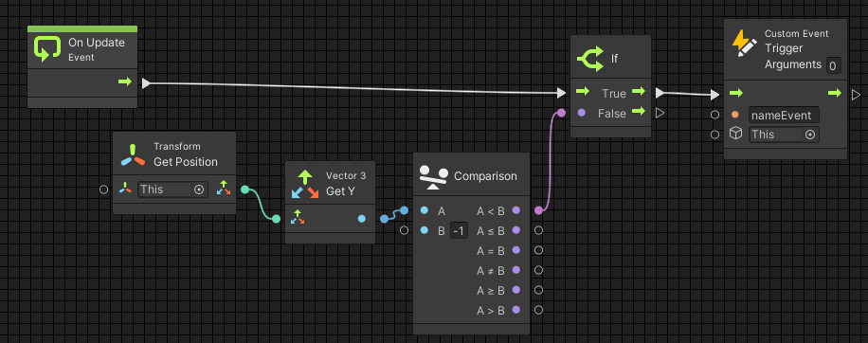
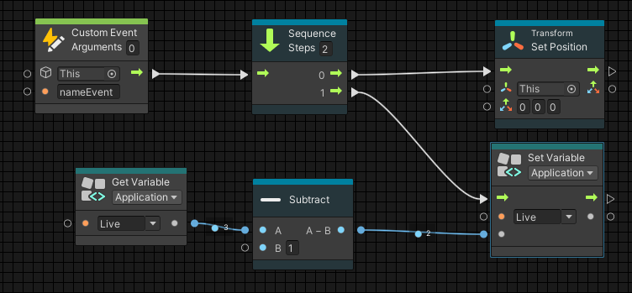
Example: Custom Event
Task: When ball will fall down from the platform trigger an event, which will decrease variable Live by one, and put the ball on to the platform again.

Slide 21
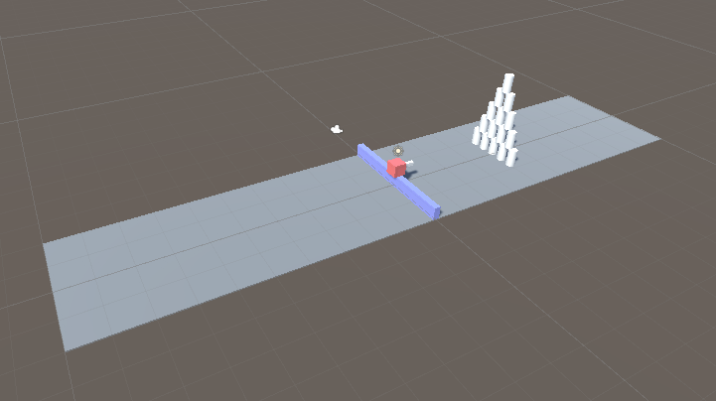
Shooting Game Example
Build a simple level

Slide 22
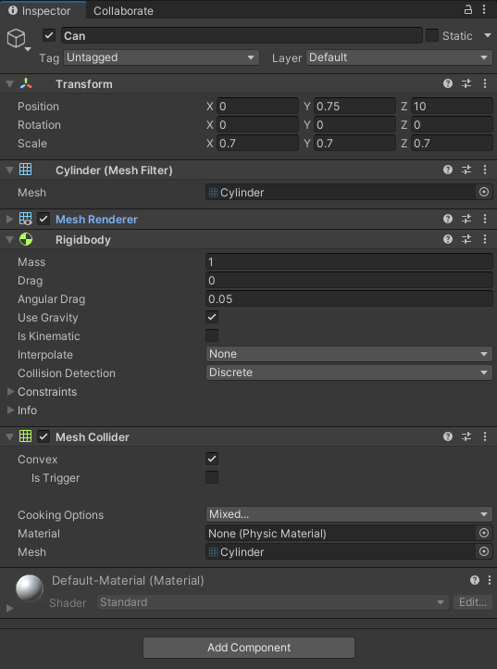
Inspector components
Add Rigidbody component and Mesh Collider component to Cans
Also, don’t forget to mark the “Convex” checkbox in the Mesh Collider component. It will simplify mesh and let the rigidbody component work without crashes and fatal errors.

Slide 23
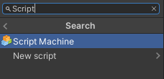
Adding Script Machine
To move our player left and right we want using user input, we should add Script Machine component to our player object:
After that create Script graph and attach to created Script Machine.

Slide 24
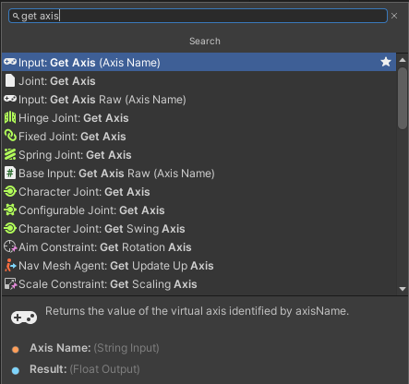
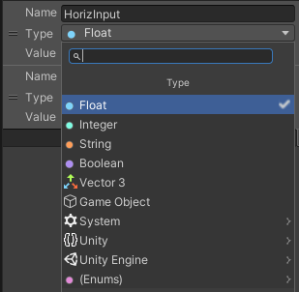
User Input
To get input from the player to move left and right, we need only horizontal axis input. Create graph variable: name it “horizontal” and choose type “float”:
Hover over graph area and right click in empty place, type “Get Axis” and add it

Slide 25
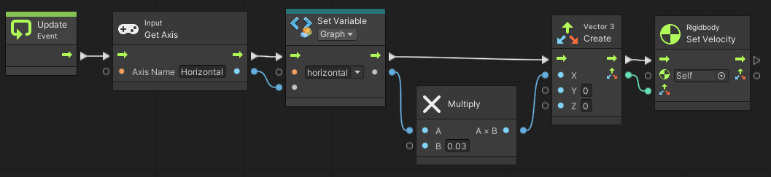
Scripting
Enter “Horizontal” in “Axis name” field and make connection from Update to Get Axis:
Add “Set variable” node in the same way, as we added “Get Axis” node and connect “Get Axis” node with “Set variable” node as shown below:
We are multiplying by 0,03 because the speed of the object is too slow for the scene in example.

Slide 26
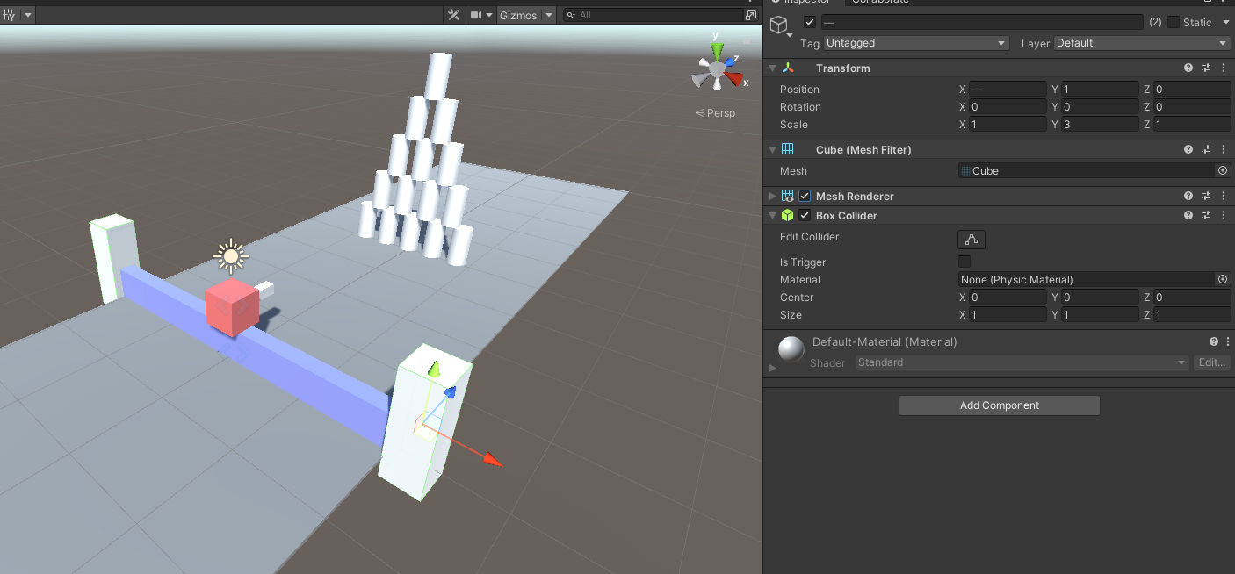
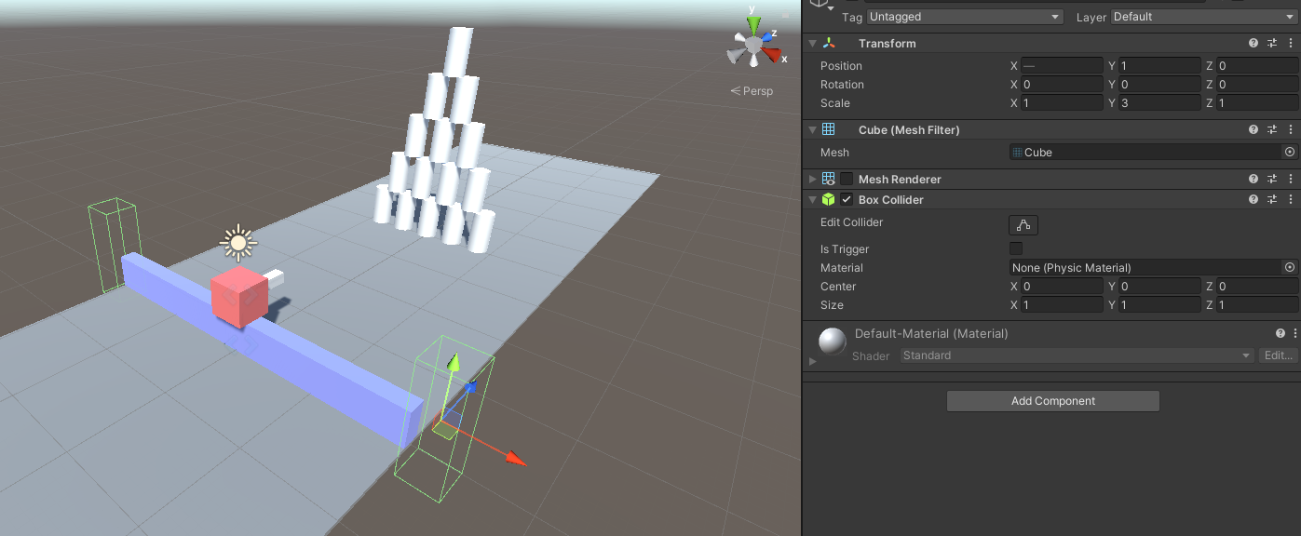
Mesh Renderer
As we test our script, we can see how our player cube can move left and right without no limits. Let’s add these limits. Our player cube stays on 0 by X and it’s in the middle of our playground. So we can count the distance to one of the sides (left or right) and use it for the opposite side too, because the player stays in the middle of the movement ground.
To fix it we will put 2 walls on the edges of our road cube for the player’s cube. Also, don’t forget to turn of Mesh Renderer component of walls to hide them from player’s perspective:
With mesh renderer
Without mesh renderer

Slide 27
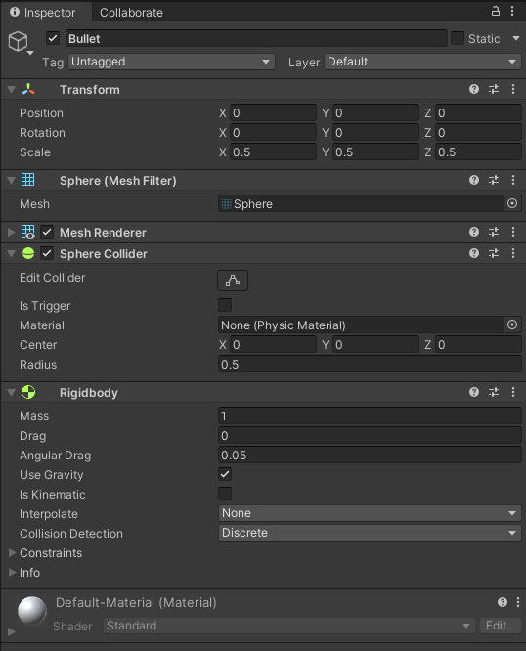
Bullet
If we test our game now, we will see that everything works properly and as planned.
The last task is now to let our player to shoot. First we need to create a bullet prefab. It would be a sphere with parameters as shown:

Slide 28
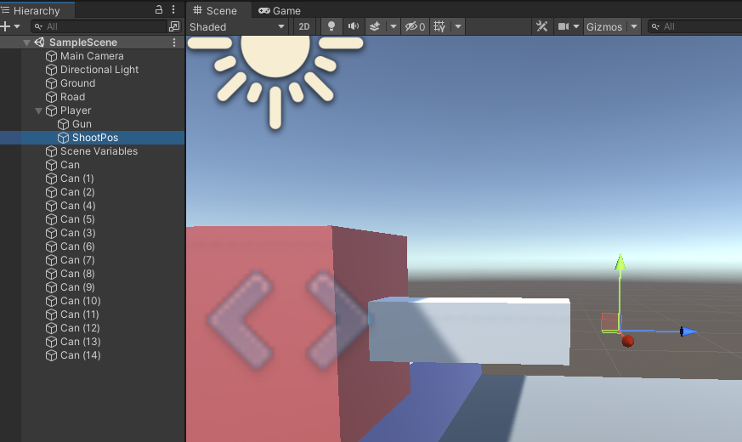
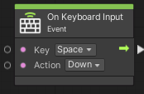
Placing bullet
In Player object create an empty gameobject and name it “ShootingPos” and place it in front of our gun gameobject
Go to the ShootPos object and add a new Script Machine. Create a new visual graph, name it “PlayerShooting” and go to the “visual scripting graph” window.
We need to create a sphere and give it an impulse everytime “Space” button is pressed down. To catch this event there is a node named “OnKeyboardInput”:
Field “Key” describes which key on the keyboard should be pressed.
Field “Action” has 3 states:
Down - when key is pressed;
Hold - when key is hold;
Up - when key is released;

Slide 29
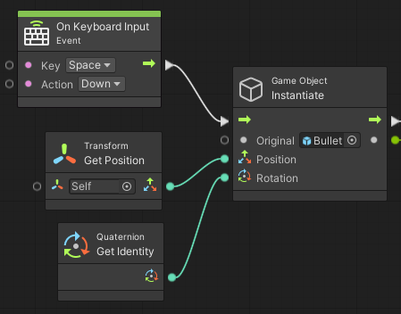
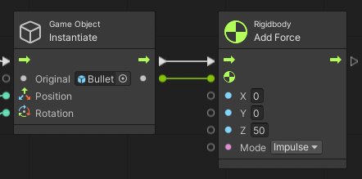
Shooting bullet
Next step is creating a bullet. Drag and drop Bullet prefab to variable’s value or choose it by clicking on the circle icon and choosing bullet prefab. On the Script Graph window create a node “Instantiate (Original, Position, Rotation)” and connect it with “OnKeyboardInput” node.
But the bullet is just spawned and not shooting. For that we add “Add Force(X, Y, Z)” node as shown below:

Slide 30
References
https://docs.unity3d.com/Manual/Prefabs.html
https://docs.unity3d.com/Manual/Coroutines.html
https://docs.unity3d.com/ScriptReference/Rigidbody.html

