Slide 1
Visual Programming
Lecture 8
State Machines and State Graphs

Slide 2
Agenda
SubGraphs
State machines
State Graphs
Transitions
SuperScript
AnyState
Visual Effects
Assets store

Slide 3
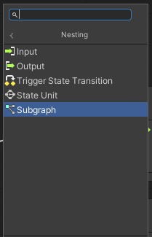

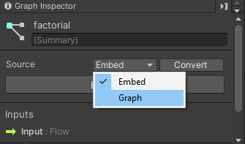
Subgraph
In a Script Graph, you can add a node that links directly to another Script Graph. A nested Script Graph is called a Subgraph.
A Subgraph can be embedded in the node that adds it to a graph, or it can be a link to an external graph file.
Inputs, Outputs

Slide 4
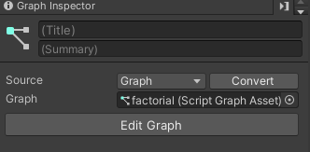

Example: Subgraph
Task: create Subgraph to calculate factorial, which can be reused in the program.
  Step1. Add Subgraph
  Step2. Give it a title and change type from Embed to Graph
  Step3. Assign input and output parameters
  Step4. Call Subgraph from the main ScriptGraph
Step 1.
Step 2.

Slide 5
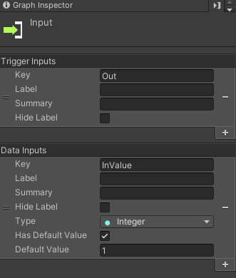
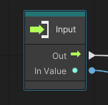
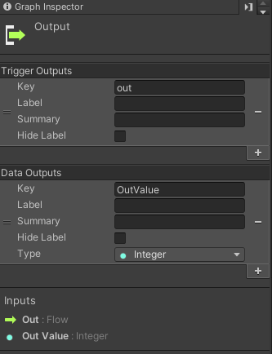
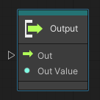
Subgraph: Inputs and Outputs
Step 3. Input
Step 3. Output

Slide 6
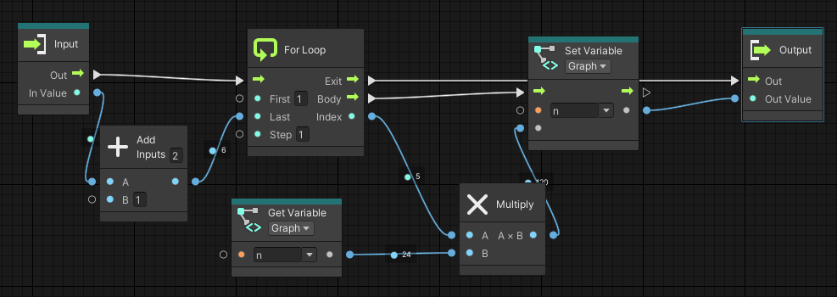

Subgraph: Factorial
Step 4. Program the loop to calculate Factorial of given number

Slide 7
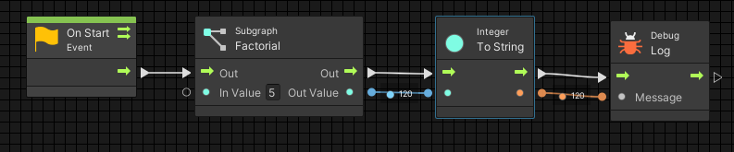

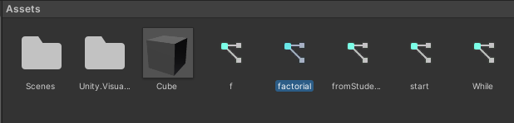
Subgraph: Call
To demonstrate the work of SubGraph, we pass value 5 to calculate factorial and print the result into Console.
Created SubGraph can be used just like any other ScriptGraph from Assets.

Slide 8

State machine
State machines consist of States, Transitions and Events
Used when there are definite numbers of states
Each state can lead to one or several other states
There is a certain condition which will be used as transition between states
Should be added to object’s components
Example: weather, seasons, daytime, states of objects, i.e. door- door is open, closed, locked.

Slide 9
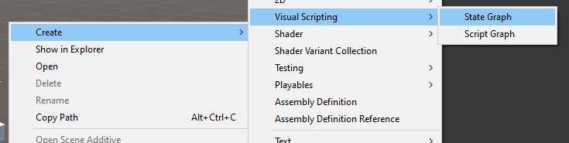
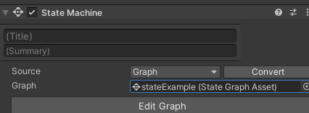
StateGraph
State Graphs can be created through context menu in Assets or directly through State Machine

Slide 10
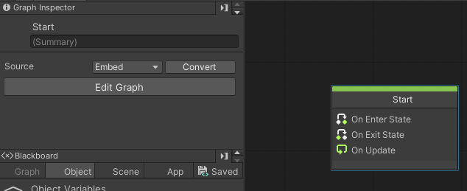
StateGraph
When open StateGraph first time, you may see the following node.
You can remove it or substitute with another one
You can convert from Embed to Graph and back.
Graph is a separate asset, which can be reused

Slide 11
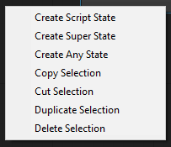
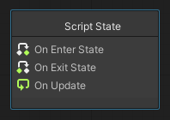


Creating States
Pressing context menu, you will see these options:
ScriptState
SuperState
AnyState

Slide 12
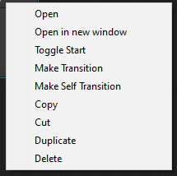
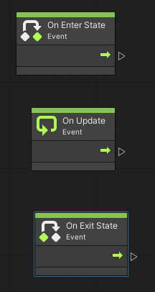
Script State
When new Script State is created it is dimmed.
Context menu suggests that we can make any Script State – Start, which means it will be executed first.
Any Script State has On Enter State, On Exit State and On Update.
Double clicking on Script State, will show that it is not different from ScriptgGraph. It uses same events, methods, etc.
You can remove or add events and manage the logic of your program in any way

Slide 13
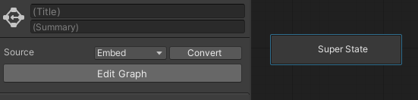
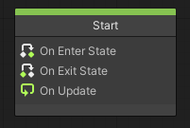
SuperState
Super States contain another, nested State Graph.
A Super State can help you better organize a State Graph, and reuse states and transitions across multiple graphs.
State Graph can be marked as Start Graph from context menu.
When opening SuperState – it is not different from State Graph interface.
You can give it a title, and you can program scripts in it.

Slide 14
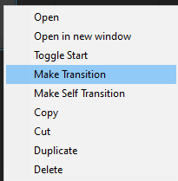
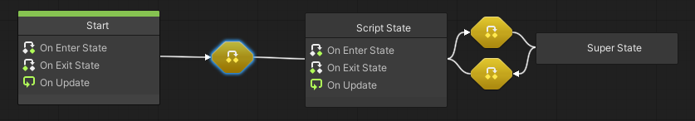
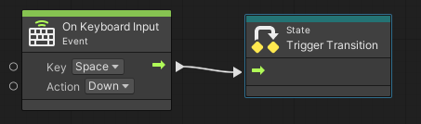
Transitions
One of the most important function in managing States
Transitions – are events or conditions, that trigger path from one state to another
Press any SuperState or Script State, open context menu, you will see options for Transitions: Make Transition, Make Self Transition
Clicking on Transition itself you will se graph interface, where you need to add what will be a trigger for this transition

Slide 15
Example: StateGraph
Task: Simulate Sun behaviour. Difference of moving curve of the object depending on time of the day.
  State 1: Sun rising
  State 2: Daytime
  State 3: Sunset
  Transitions between states
  Step 1. We shall take a sphere to simulate sun’s behaviour
  Step 2. Add State Machine and State Graph to sphere

Slide 16
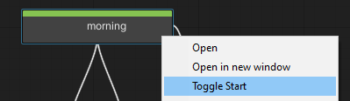
Example: Sun’s states
Step 3. programming Morning
State 1. Add Super state, call it Morning and set as a start point.
It the morning, the Sun shall have certain color, as well as always move on one trajectory
For giving color, we shall create a Subgraph, since we shall reuse this script several times.

Slide 17
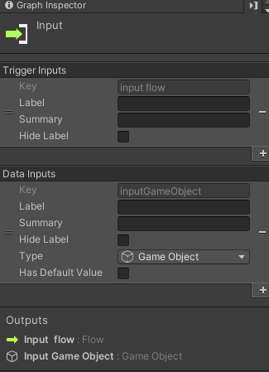
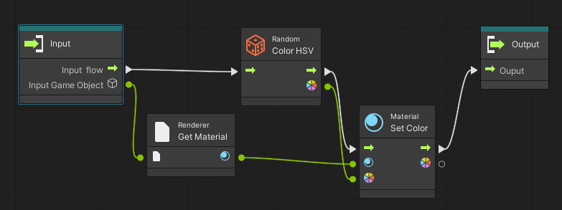
Subgraph: Change color
This subgraph shall have one input parameter – Object, which it has to color, no output parameters.
We can assign specific color or random color

Slide 18
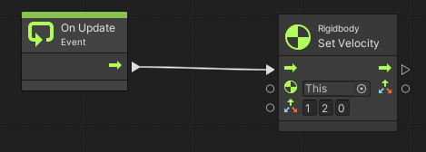
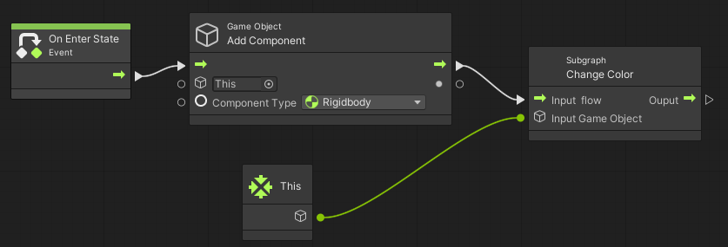
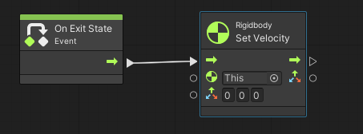
SuperState: Morning
In this SuperState we shall add Component – rigidbody on the fly, change it color.
On Update – we unable it to move under set trajectory with help of SetVelocity
On Exit – movement should stop.

Slide 19
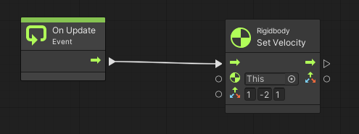
SuperState: Daytime
Very similar scripts we shall apply to Daytime SuperScript.
The difference is in trajectory

Slide 20
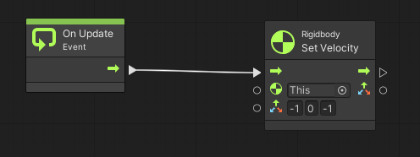
SuperState: Sunset
Very similar scripts we shall apply to Sunset SuperScript.
The difference is in trajectory

Slide 21
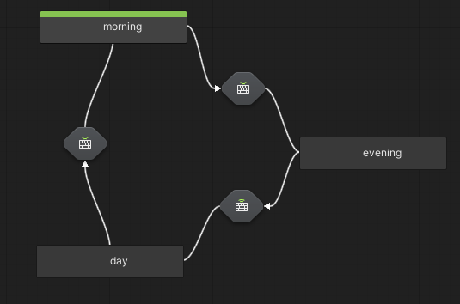
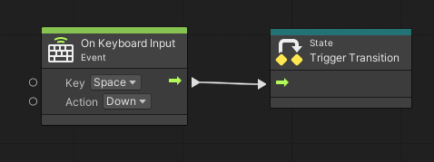
Sun: transitions
Add transitions between states and let it be same trigger in all three cases

Slide 22
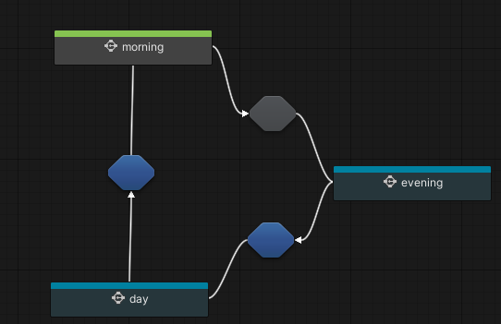
Sun: debug
When running the game, keep graph editor open
You will be able to see on which state your object currently is, as well as transition was triggered

Slide 23
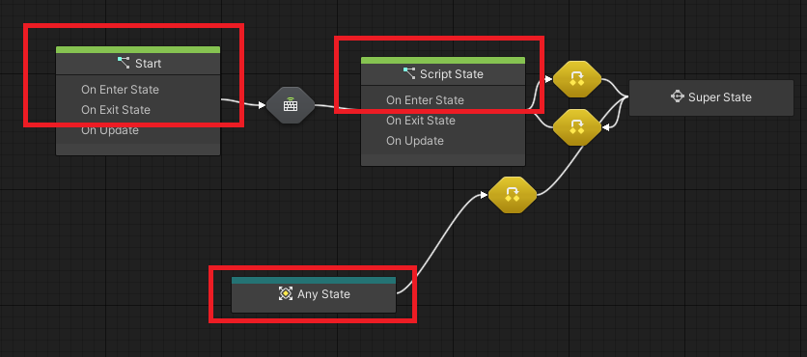
AnyState
Any States serve as a placeholder for any other state in a State Graph.
You can use an Any State node and create a single transition to a new state, rather than create multiple transitions from other states. (1)
You can also have multiple Start States in a single graph.

Slide 24
Example: Door
Task: Simulate states of door lock.
  State 1. Door is closed
  State 2. Door is open
  State 3. Door is locked
  Transitions: Close can transit to open and lock. Lock can transit to close only. Open can transit to close only.
  N.b. When we talk about transitions, it is not only about changing properties of one game object. In most cases multiple objects are involved.

Slide 25
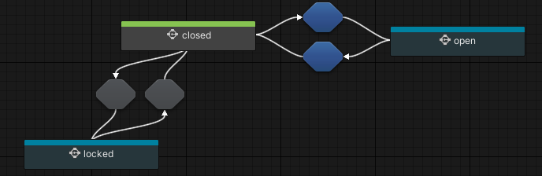
Door states
To trigger transition between Closed and Open will be Space key press
To trigger transition between Closed and Locked we shall use Mouse Down and Mouse Down

Slide 26
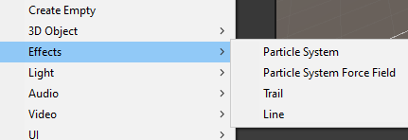
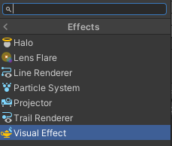
Visual Effects
Effects can be object, which are visual aids that can be added to objects in Hierarchy.
Or can be added as a Component -> Effects to any object
They are:
  Particle System
  Particle System Force Field
  Trail
  Line
  Halo
  Lens Flare

Slide 27
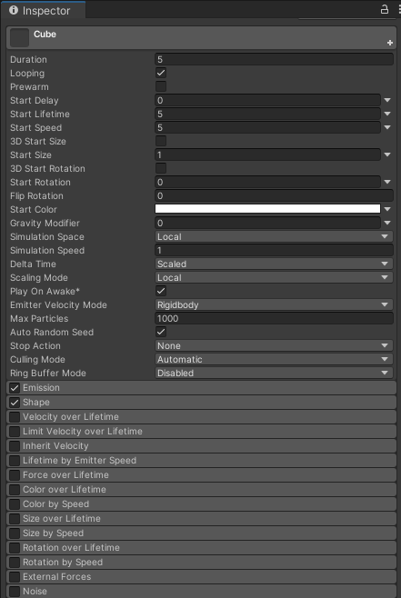
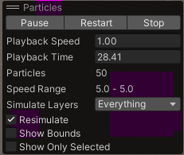
Particle System
A particle system simulates and renders many small images or Meshes, called particles, to produce a visual effect.
Each particle in a system represents an individual graphical element in the effect. The system simulates every particle collectively to create the impression of the complete effect. (2)
In Inspector you can find many properties which you can change to get desired effect

Slide 28
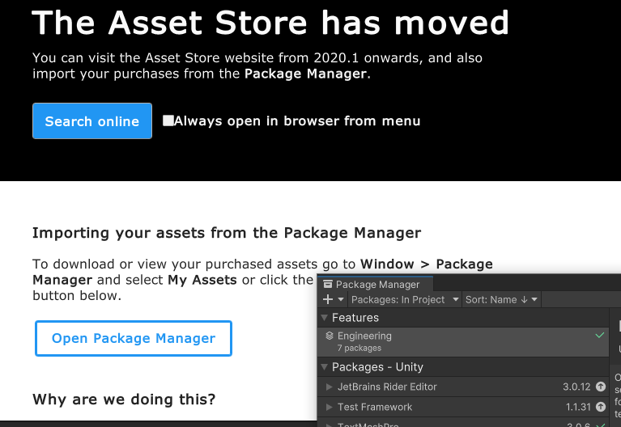
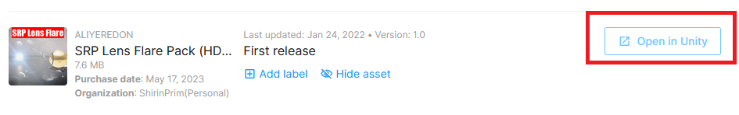
Lens flares and halos
Lens flares and halos are lighting effects that can add atmosphere to your scene. (3)
Download any Flares from Assets store and use it in Lens Flares component
To open Assets Store, go Window - > Asset Store. You will have two options: Search Online and Open Package Manager. Go for online option and find any Flares in Asset store. Download it and open in Unity

Slide 29
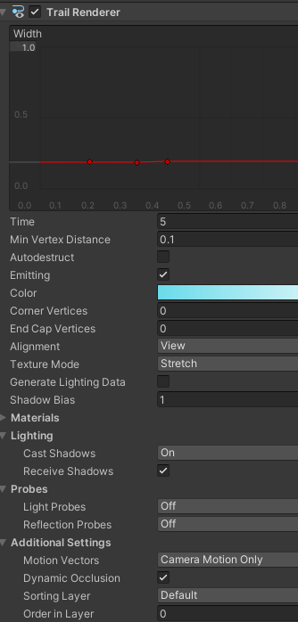


Trail
The Trail Renderer component renders a trail of polygons behind a moving GameObject , over time
Should be attached to some Game Object, as it will simulate trail behavior and will follow the object.
In Inspector, you can change properties of this trail
Example: we have sphere moving and attached trail to it.

Slide 30
References
https://docs.unity.cn/Packages/com.unity.visualscripting@1.7/manual/vs-graph-types.html
https://docs.unity3d.com/Manual/ParticleSystems.html
https://docs.unity3d.com/Manual/visual-effects-lens-flares.html

