Slide 1
Visual Programming
Lecture 9
Intro MIT app inventor.
UI elements. Layout

Slide 2
Agenda
Installation
Interface
Layout
Control elements

Slide 3
Installation
MIT app Inventor (1) – is programming environment which was initially developed by Google Labs, but now is under control of Massachusetts Institute of Technology (MIT)
Can create mobile applications (for Android)
There is no desktop version of MIT app Inventor
Development environment can be found in http://ai2.appinventor.mit.edu/

Slide 4
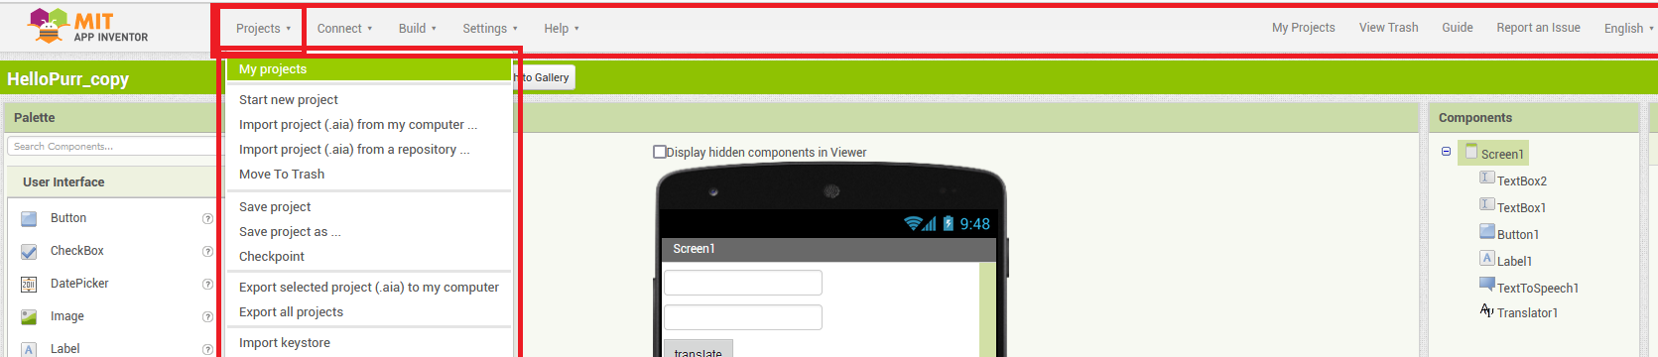
Interface
Top panel has different menus: Project, Connect, Build, Settings, Help and major references: My Projects, View Trash, Guide and Language (it supports multiple languages)
Project menu allows you to play with projects: create, delete, save, export and import

Slide 5
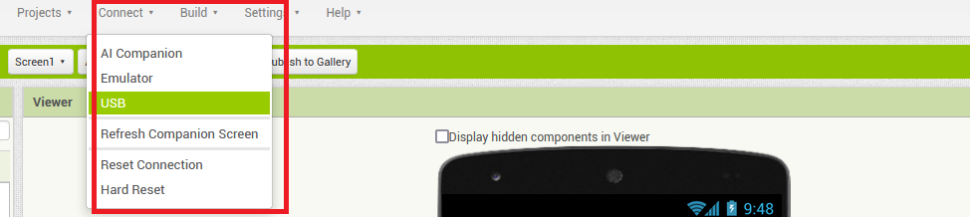
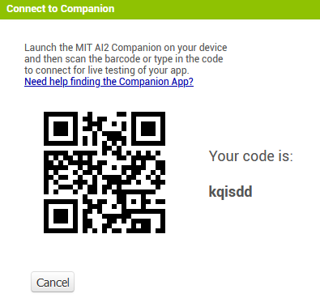
Connect
There is no build in emulator, so in order to try your code out you need to choose one of the options:
AI companion -
Download the Emulator
Connect your device through USB
Install AI companion onto your handheld device and launch it
Also, you see Refresh Companion Screen – press it whenever you introduce changes to your code

Slide 6
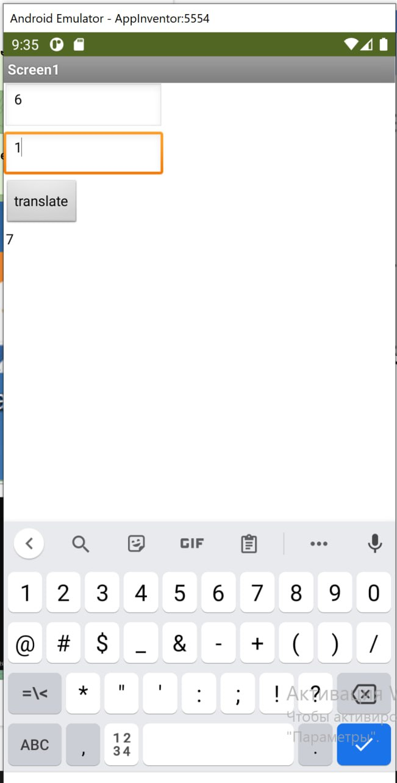
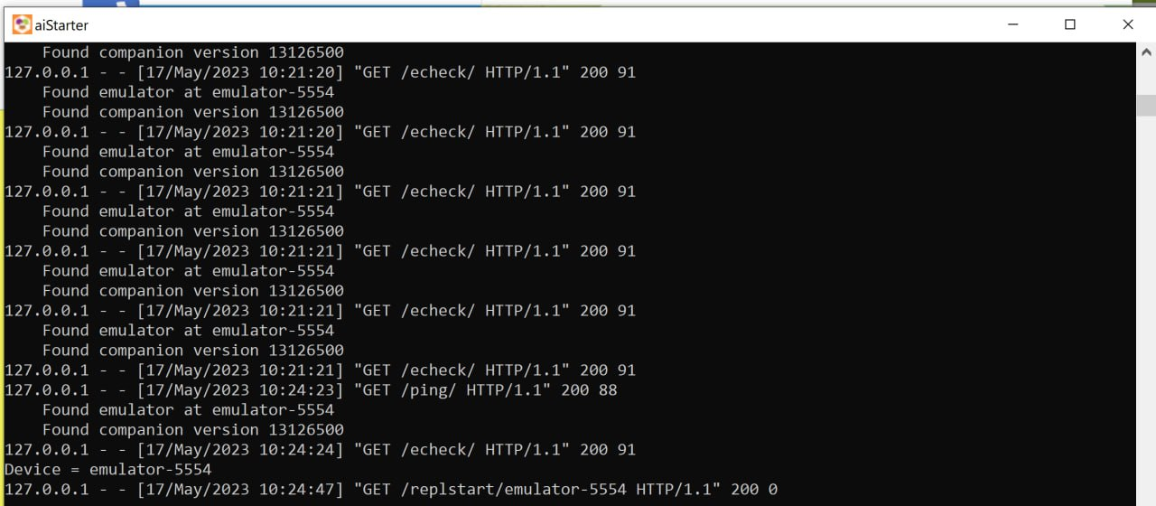
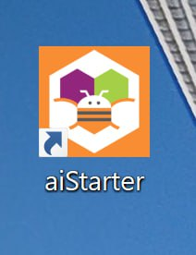
Emulator
Follow the instruction of emulator installation on this page
After installation, you need to launch emulator
Emulator will look like phone on very same desktop you are working in, you don’t need to switch to another device.

Slide 7
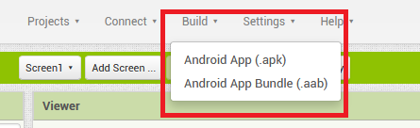
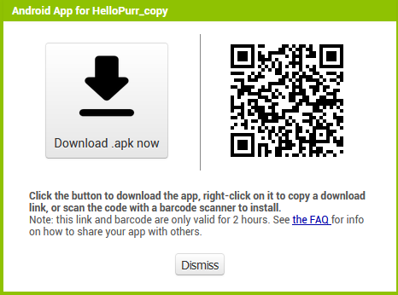
Build
For building the application you have 2 options: .apk and .aab
After building it will provide QR code, through which you can download your application to handheld device and istall
Make sure you allow installations from unknown sources

Slide 8
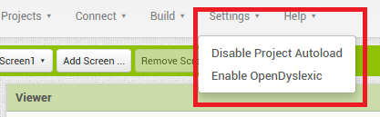
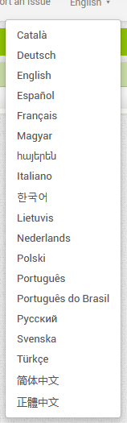
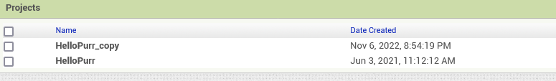
Top menu settings
You can enable OpenDyslexic or disable Project AutoLoad
Clicking on projects you will see the list of project you saved
AppInventor’s interface supports multiple languages

Slide 9


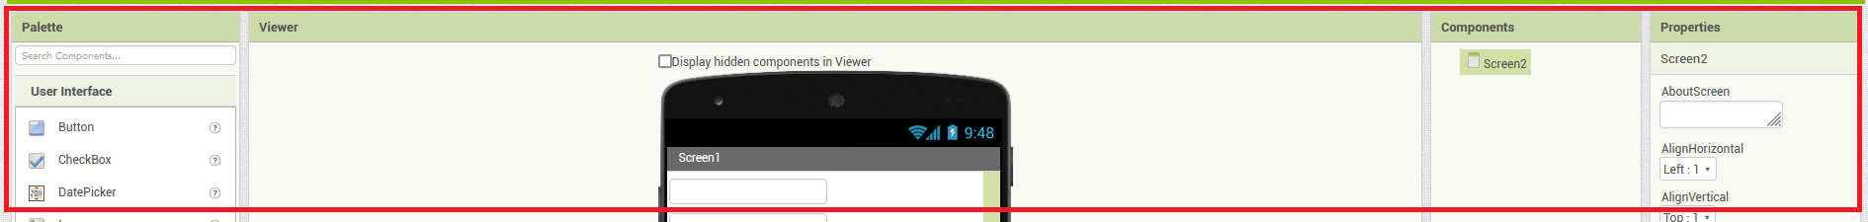
Project’s toolbar
Project’s toolbar allows you to add/remove screen, switch between the screens, publish to gallery as well as switch between Designer and Code mode
Other panels include: Pallete – Which includes categorized subpanels of components
Viewer – where you design application’s interface
Components – list of items which were used in the application
Properties of Components
Media used

Slide 10
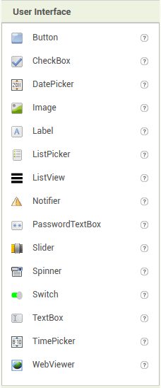
Palette
User Interface category contains one of the most important components of any mobile applications.
These components which we put into interface, and which interact with user.
Apart from common components, such as Button, Image, Label, DatePicker, CheckBox, TextBox, Switch, there are also some specific ones, such as PasswordTextBox, Notifier, Spinner
To add the component to the screen, just drag and drop the needed one

Slide 11
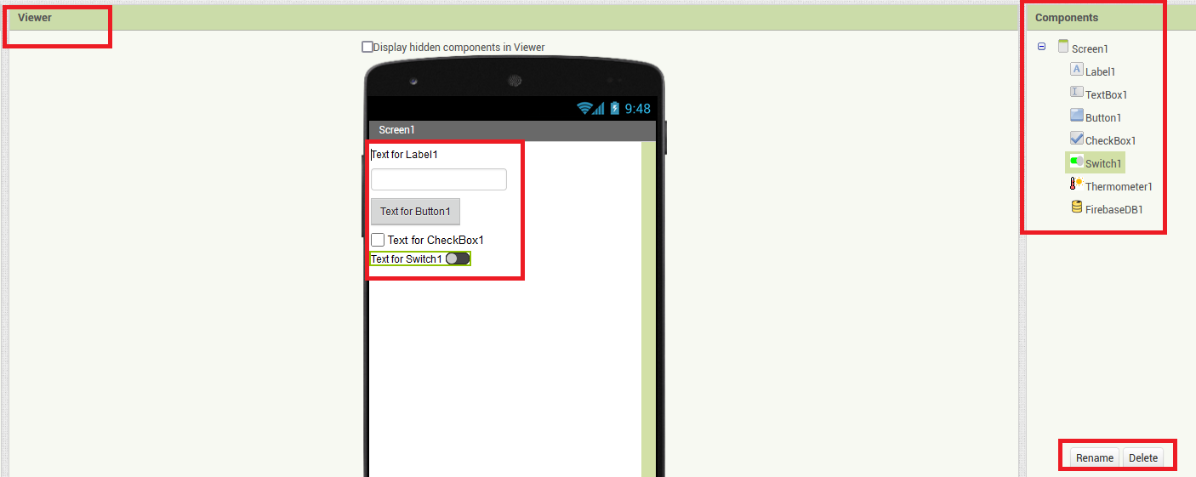
Viewer and Components
When you add the components, they appear in both Designer Viewer and Components Panel
To remove the components press Delete button on Components panel

Slide 12
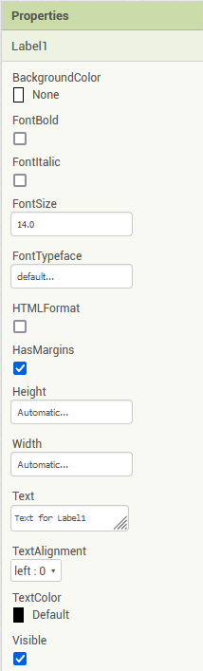
Properties
In Properties panel you can change visual properties of the component.
They include size, background color, font, make it visible or not etc.

Slide 13
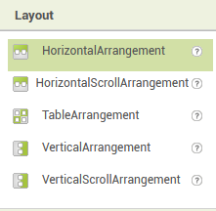
Layout
Elements on the screen can be arranged in a specific order: Horizontal, Vertical (and their scrollable options) or Table.
You should use HorizontalArrangement layout if need to place components that should be displayed from left to right.
You should use VerticalArrangement layout if need to place components that should be displayed from top to bottom. The first child component is stored on top, the second beneath it, etc.
Table Arrangement - A formatting element in which to place components that should be displayed in tabular form.

Slide 14
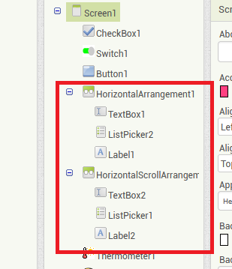
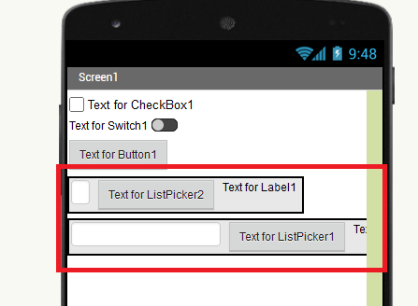
HorizontalArrangement
Three UI elements inside of one HorizontalArrangement container

Slide 15
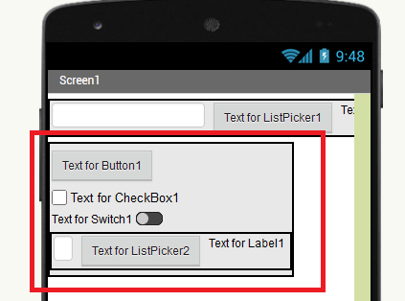
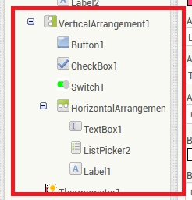
VerticalArrangement
Arrangements can be nested. In this example we have Horizontal Arrangment inside of Vertical Arrangement

Slide 16
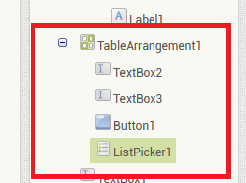
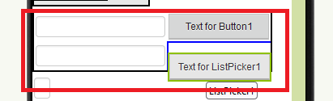
Table Arrangement
Elements can be arranged in tabular form
Elements can be nested

Slide 17
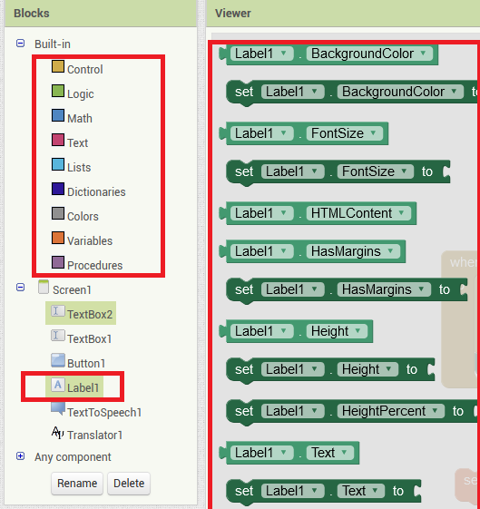
Code
When you switch from Designer view to Block, you will be able to code your application.
The code system is based on visual Blocky concept. All blocks can be dragged and dropped from Blocks panel.
All types of blocks divided into categories
There are also blocks for every component you added to your application in Designer view.

Slide 18
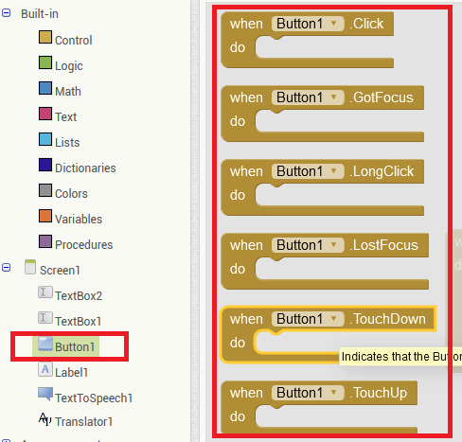
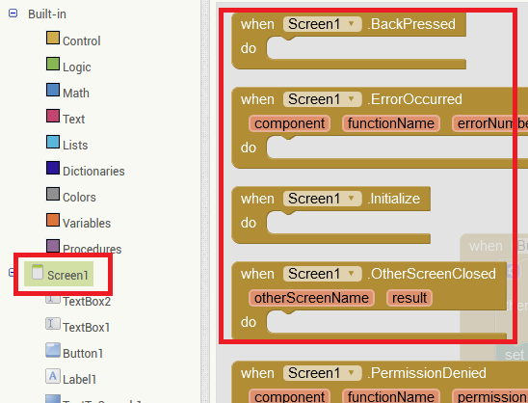
Events
Like in Unity, events are triggers for any kind of code execution.
Examples: click on button, load the screen, scroll the screen, change the value, etc.
Most events are related to UI elements, that is why you need to click on the element to find corresponding one.

Slide 19
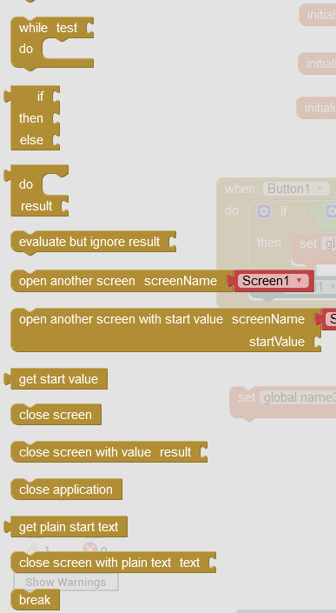
Control elements
Control elements help us to form the logic of the program and direct the flow of the execution
In addition to standard control elements: loops (for each, while, do), conditions (if-else statements)
there are also those related to transitions between scenes and application.

Slide 20
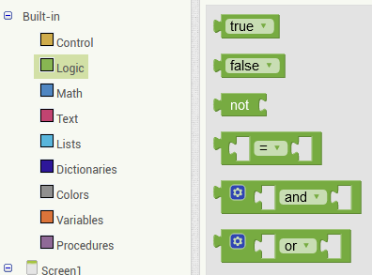
Logic elements
Logic elements are normally used in Conditionals (If-Else statements)
Standard:
  Negation
  True,
  False,
  comparison,
  logical multiplication
  logical addition

Slide 21
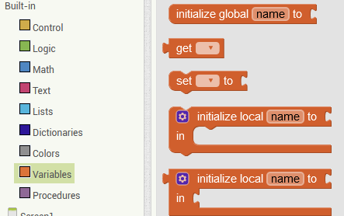
Variables
Variables are named space in memory.
We can assigned some value to the variable and use it later in our program.
The value of the variable can change.
There are blocks to assign the value – Set
Blocks to read the value of the variable – Get
Scope of the variable is important.
Global variables can be access from any place of the program
Local variables can be access only within the scope where it was declared.

Slide 22
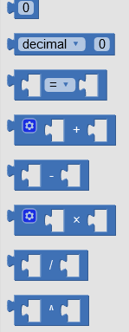
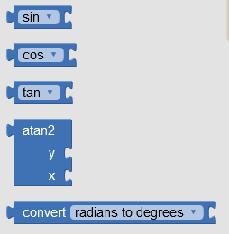
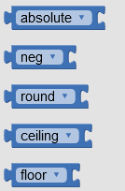
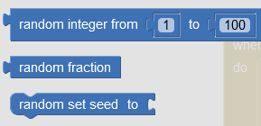
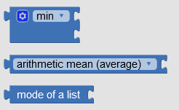
Mathematical functions
Arithmetic
Trigonometric
Precision
Randomizers
Aggregate

Slide 23
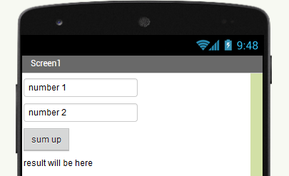
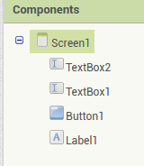
Example: Try out buttons
Task: Add the button which will sum up entered numbers
  Step 1: Design user interface: add textbox fields, buttons and label
  Step 2: Code basic mathematical function
User Interface will look the following

Slide 24


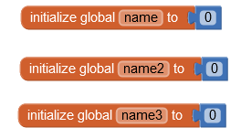


Try out buttons: Step 2
Initialize 3 variables (for 2 textboxes and 1 label) and assign 0 value to them.
Whenever we click on the button, values entered through textboxes should be assigned to first two variables
We cannot sum up text, only numbers, thus will have to check if entered text is number.
Since we have two textboxes, we can have two different conditions or combine them in one with logical multiplication

Slide 25
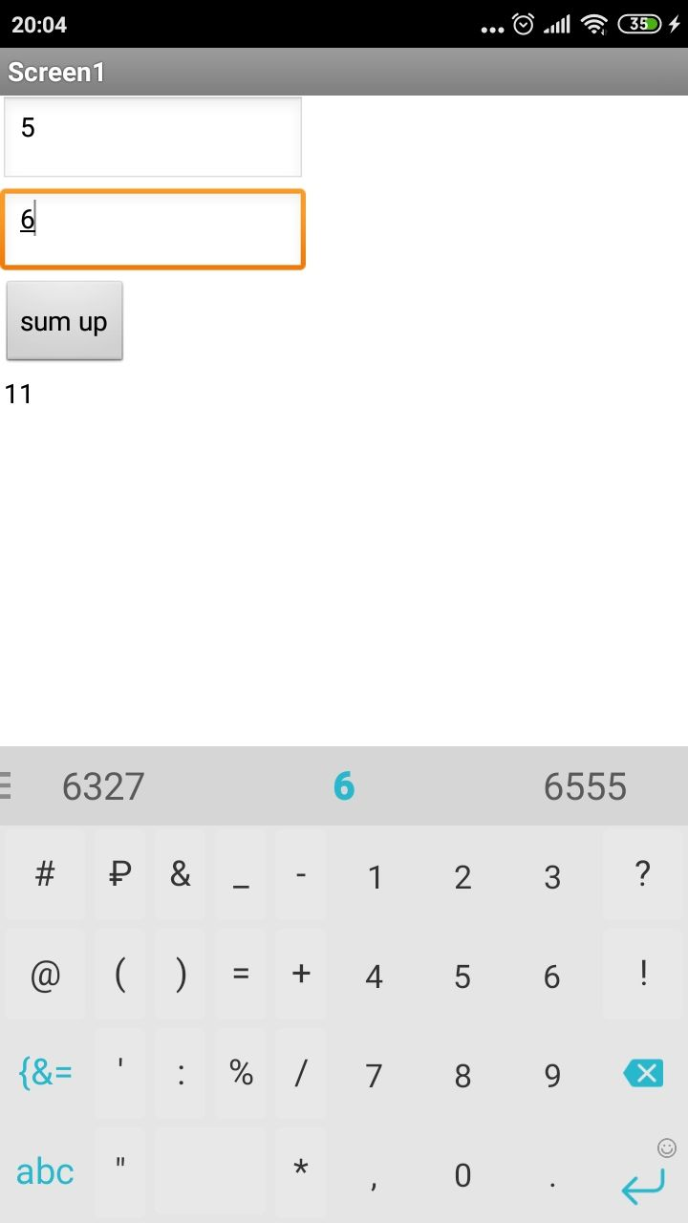
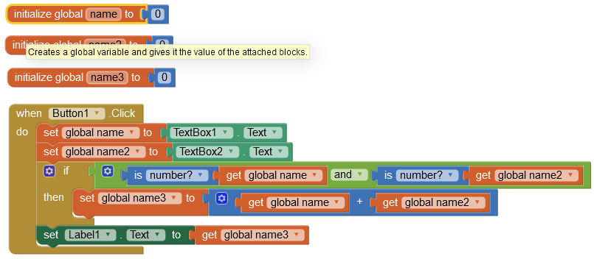
Try out buttons
Overall whole code will look the following
Result

Slide 26
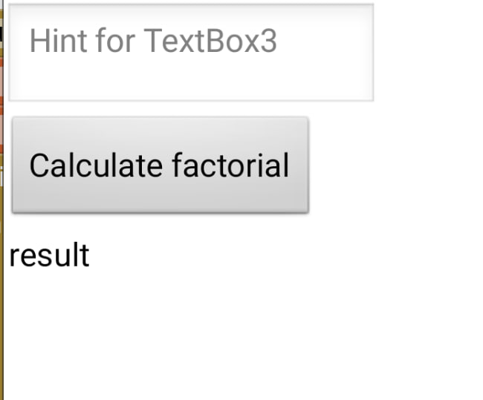
Example: Factorial
Task: Calculate factorial of the given number
  Step 1: Create user interface with one textbox, one button and one label
  Step 2: Check if entered text is a number. If not, give a corresponding warning message.
  Step 3: Calculate factorial with help of For Each control element

Slide 27
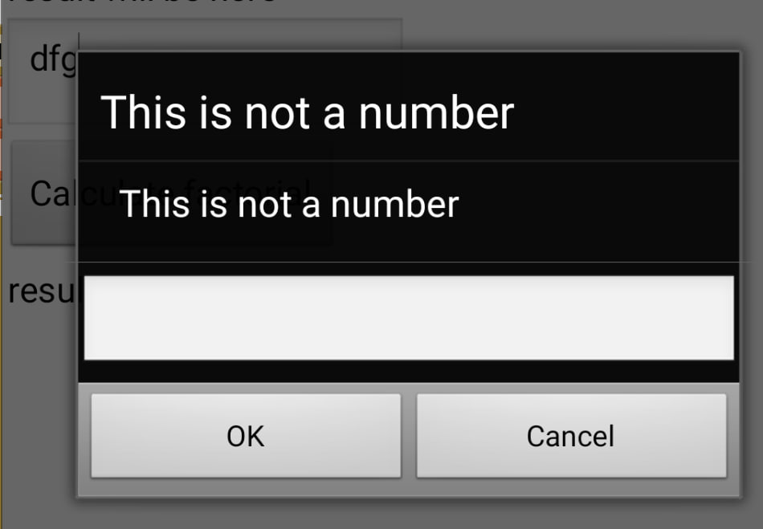
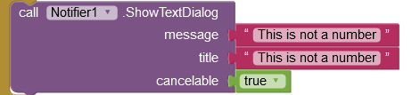
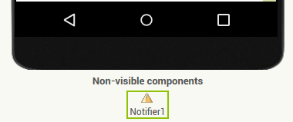
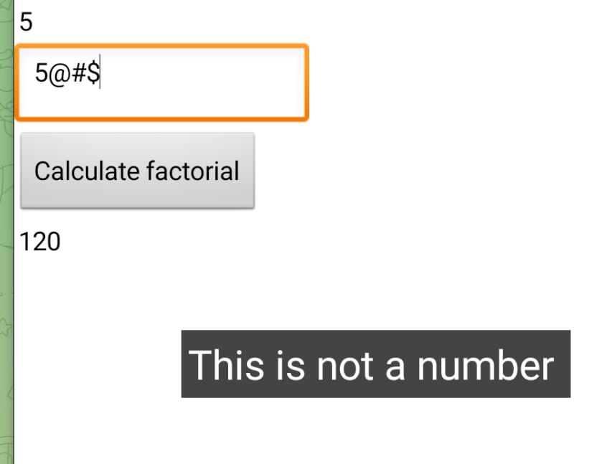

Warning message
1. There are UI elements, that can be added to the screen, but they will stay invisible. E.g. Notifier
2. Notifier has its own events and methods.

Slide 28

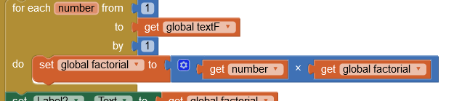
Loop
Calculate factorial of given number:
  Declare two variables
  For Each loop to multiply values from 1 up to given number

Slide 29
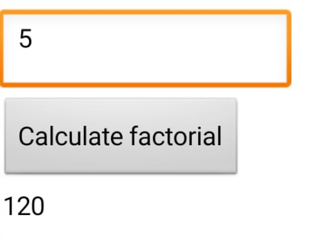
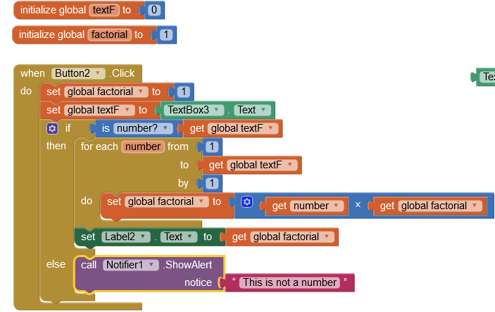
Result
Overall code looks the following
Result will look the following

Slide 30
References
https://appinventor.mit.edu/
http://ai2.appinventor.mit.edu/
https://appinventor.mit.edu/explore/ai2/setup-emulator.html

