Slide 1
Python programming language
Week 4. Python operators
Alisher Ismailov
Lecturer
Department of Information technology
Andijan Branch of Tashkent Financial Institute
Email: alisherismailov534@gmail.com

Slide 2
Python dasturlash tili
4-Mavzu. Python operatorlari
Ma’ruzachi: Alisher Ismoilov
Axborot texnologiyalari kafedrasi
Toshkent moliya instituti Andijon filiali
Elektron pochta: alisherismailov534@gmail.com

Slide 3

4-Mavzu. Python operatorlari
Reja:
Python arifmetik operatorlari
Belgilash (tayinlash) operatorlari
Taqqoslash operatorlari
Mantiqiy operatorlar
A’zolik operatorlari

Slide 4
Python dasturlash tilida
operatorlar
Arifmetik operatorlar umumiy matematik amallarni bajarish uchun raqamli qiymatlar bilan ishlatiladi

Slide 5
Python dasturlash tilida arifmetik operatorlar
Quyida asosiy python dasturlash tili arifmetik amallari keltirilgan
Operator Nomi Misol
+ Qo‘shuv x + y
- Ayirma x - y
* Ko‘paytiruv x * y
/ Bo‘luv x / y
% Modul x % y
** Koʻrsatkichga koʻtarish x ** y

Slide 6
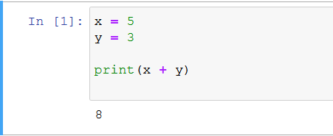
  Python dasturlash tilida arifmetik operatorlar
+ (qo‘shuv) operatoriga misol.

Slide 7
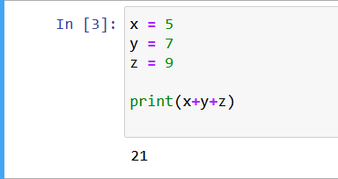
  Python dasturlash tilida arifmetik operatorlar
+ (qo‘shuv) operatoriga misol.

Slide 8
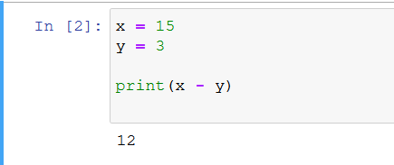
  Python dasturlash tilida arifmetik operatorlar
‘-’ (ayirma) operatoriga misol

Slide 9
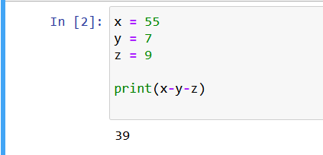
  Python dasturlash tilida arifmetik operatorlar
‘-’ (ayirma) operatoriga misol

Slide 10
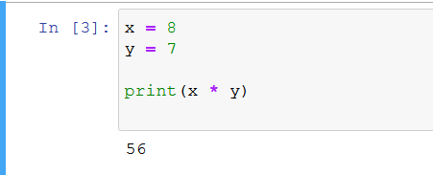
  Python dasturlash tilida arifmetik operatorlar
‘*‘ (ko‘paytiruv) operatoriga misol

Slide 11
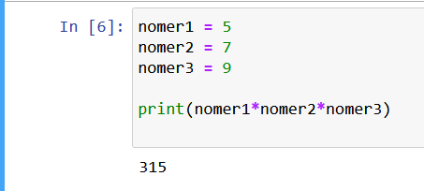
  Python dasturlash tilida arifmetik operatorlar
‘*‘ (ko‘paytiruv) operatoriga misol

Slide 12
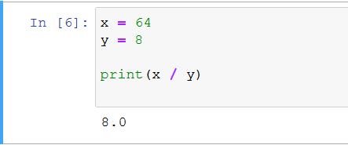
  Python dasturlash tilida arifmetik operatorlar
‘/’ (bo‘luv) operatoriga misol

Slide 13
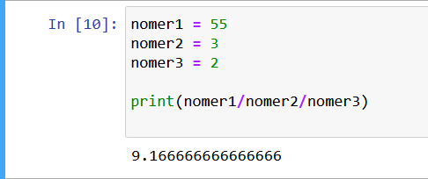
  Python dasturlash tilida arifmetik operatorlar
‘/’ (bo‘luv) operatoriga misol

Slide 14
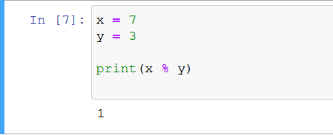
  Python dasturlash tilida arifmetik operatorlar
‘%’ (modul) operatoriga misol

Slide 15
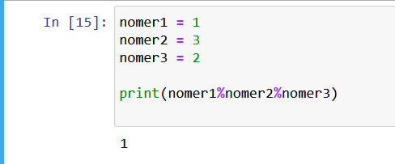
  Python dasturlash tilida arifmetik operatorlar
‘%’ (modul) operatoriga misol

Slide 16
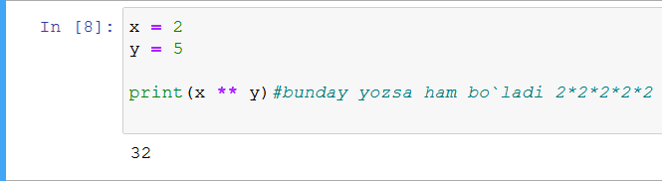
  Python dasturlash tilida arifmetik operatorlar
‘**’ (ko‘rsatkichga ko‘tarish) operatori misol

Slide 17
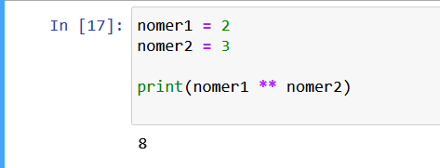
  Python dasturlash tilida arifmetik operatorlar
‘**’ (ko‘rsatkichga ko‘tarish) operatori misol

Slide 18
Python dasturlash tilida tayinlash operatorlar
O‘zgaruvchilarga qiymatlarni belgilash uchun tayinlash operatorlari ishlatiladi:
Operator misol bir xil (bu usulda yozilsa ham bir xil natija beradi)
= x = 5 x = 5
+= x += 3 x = x + 3
-= x -= 3 x = x - 3
*= x *= 3 x = x * 3
/= x /= 3 x = x / 3
%= x %= 3 x = x % 3
//= x //= 3 x = x // 3
**= x **= 3 x = x ** 3
&= x &= 3 x = x & 3
|= x |= 3 x = x | 3
^= x ^= 3 x = x ^ 3
>>= x >>= 3 x = x >> 3
<<= x <<= 3 x = x << 3

Slide 19
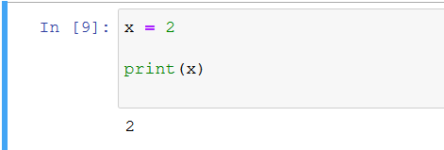
  Python dasturlash tilida tayinlash operatorlar
‘=’ operatoriga misol

Slide 20
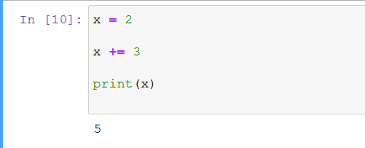
  Python dasturlash tilida tayinlash operatorlar
‘+=’ operatoriga misol

Slide 21
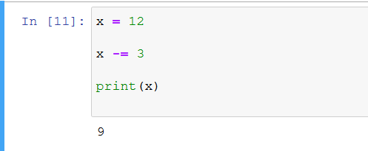
  Python dasturlash tilida tayinlash operatorlar
‘-=’ operatoriga misol

Slide 22
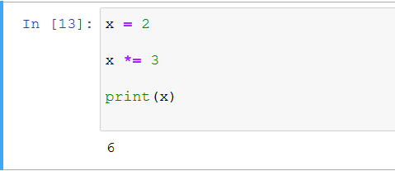
  Python dasturlash tilida tayinlash operatorlar
‘*=’ operatoriga misol

Slide 23
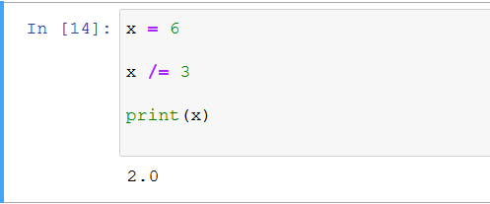
  Python dasturlash tilida tayinlash operatorlar
‘/=’ operatoriga misol

Slide 24
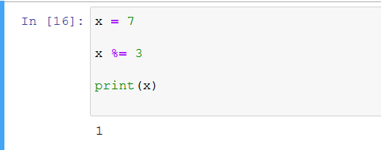
  Python dasturlash tilida tayinlash operatorlar
‘%=’ operatoriga misol

Slide 25
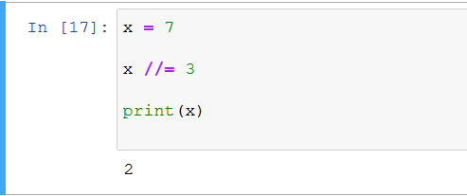
  Python dasturlash tilida tayinlash operatorlar
‘//=’ operatoriga misol

Slide 26
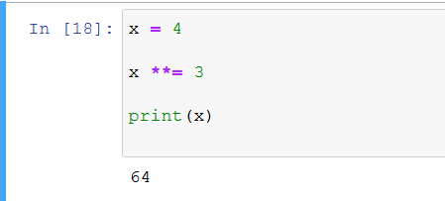
  Python dasturlash tilida tayinlash operatorlar
‘**=’ operatoriga misol

Slide 27
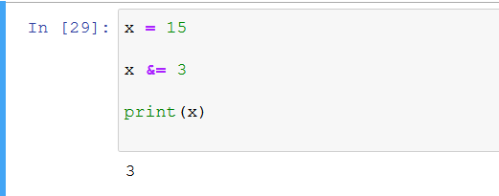
  Python dasturlash tilida tayinlash operatorlar
‘&=’ operatoriga misol

Slide 28
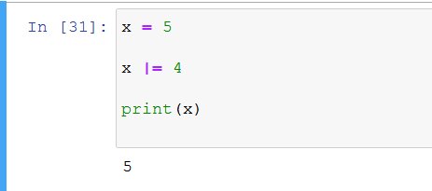
  Python dasturlash tilida tayinlash operatorlar
‘|=’ operatoriga misol

Slide 29

  Python dasturlash tilida tayinlash operatorlar
‘^=’ operatoriga misol

Slide 30
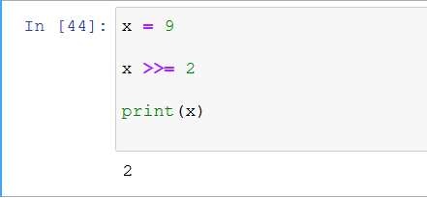
  Python dasturlash tilida tayinlash operatorlar
‘>>=’ operatoriga misol

Slide 31
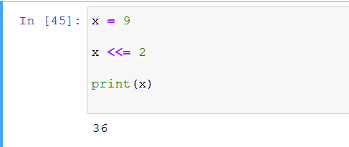
  Python dasturlash tilida tayinlash operatorlar
‘<<=’ operatoriga misol

Slide 32
Python dasturlash tilida taqqoslash operatorlar
O‘zgaruvchilarga qiymatlarni belgilash uchun tayinlash operatorlari ishlatiladi:
Operator Nomi Misol
== teng x == y
!= teng emas x != y
> katta x > y
< kichik x < y
>= katta yoki teng x >= y
<= kichik yoki teng x <= y

Slide 33
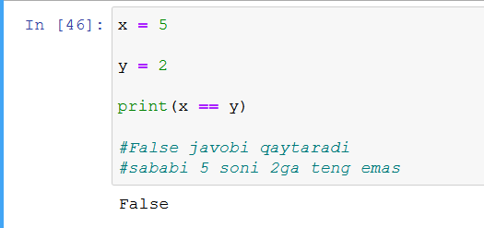
  Python dasturlash tilida taqqoslash operatorlar
‘==’ (teng) operatoriga misol

Slide 34
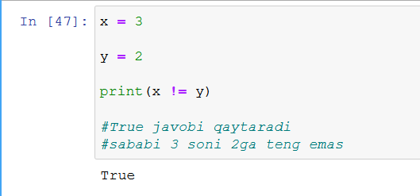
  Python dasturlash tilida taqqoslash operatorlar
‘!=’ (teng emas) operatori misol

Slide 35
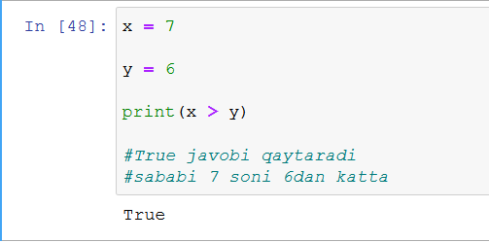
  Python dasturlash tilida taqqoslash operatorlar
‘>’ (katta) operatoriga misol

Slide 36
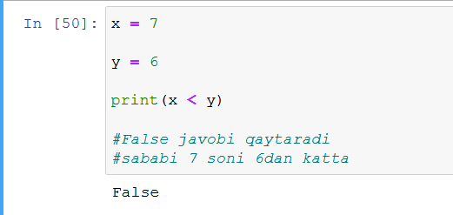
  Python dasturlash tilida taqqoslash operatorlar
‘<’ (kichik) operatoriga misol

Slide 37
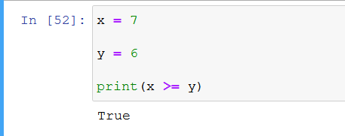
  Python dasturlash tilida taqqoslash operatorlar
‘>=’ (katta yoki teng) operatoriga misol

Slide 38
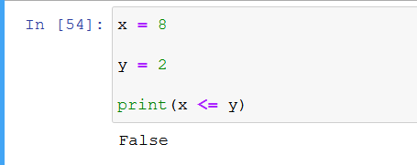
  Python dasturlash tilida taqqoslash operatorlar
‘<=’ (kichik yoki teng) operatoriga misol

Slide 39
Python dasturlash tilida mantiqiy operatorlar
Mantiqiy operatorlar shartli gaplarni birlashtirish uchun ishlatiladi:
Operator Ta’rifi Misol
and Ikkala holat ham to‘g‘ri bo‘lsa,True qiymatini qaytaradi x < 5 and x < 10
or Agar holatlardan biri to‘g‘ri bo‘lsa, True qiymatini qaytaradi x < 5 or x < 4
not Natijani teskari o‘zgartiring, agar natija to‘g‘ri bo‘lsa, False qiymatini qaytaradi not(x < 5 and x < 10)

Slide 40
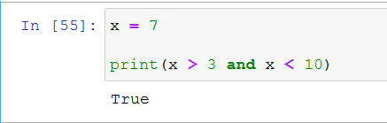
  Python dasturlash tilida mantiqiy operatorlar
‘and’ operatoriga misol

Slide 41
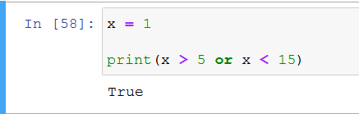
  Python dasturlash tilida mantiqiy operatorlar
‘or’ operatoriga misol

Slide 42
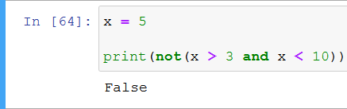
  Python dasturlash tilida mantiqiy operatorlar
‘not’ operatoriga misol

Slide 43
Python dasturlash tilida Identifikatsiya operatorlar
Identifikatsiya operatorlari o‘zgaruvchilarni solishtirish uchun ishlatiladi, taqqoslash operatidan farqi identifikatsiya operatorlari, o‘zgaruvchilarni xotira joylashuvi bilan solishtiradi:
Operator Ta’rifi Misol
is Ikkala o‘zgaruvchi ham bir xil obyekt bo‘lsa, True qiymatini qaytaradi x is y
is not Ikkala o‘zgaruvchi ham bir xil obyekt bo‘lmasa, True qiymatini qaytaradi x is not y

Slide 44
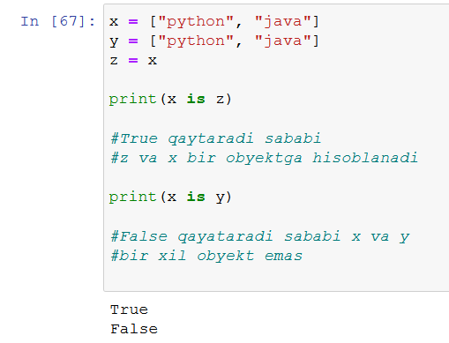
  Python dasturlash tilida Identifikatsiya operatorlar
‘is’ operatoriga misol

Slide 45
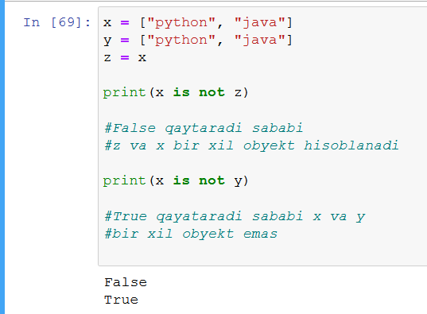
  Python dasturlash tilida Identifikatsiya operatorlar
‘is not’ operatoriga misol

Slide 46
Python dasturlash tilida A’zolik operatorlar
O‘zgaruvchida ketma-ketlik mavjudligini tekshirish uchun a’zolik operatorlari ishlatiladi:
Operator Ta’rifi Misol
in Obyektda ko‘rsatilgan qiymatga ega ma’lumot mavjud bo‘lsa, True qiymatini qaytaradi x in y
not in Belgilangan qiymatga ega ma’lumot obyektda mavjud bo‘lmasa, True qiymatini qaytaradi x not in y

Slide 47
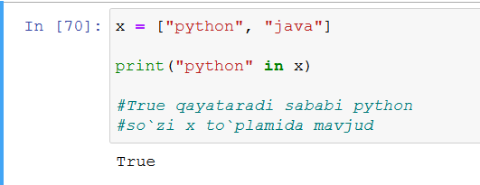
  Python dasturlash tilida A’zolik operatorlar
‘in’ operatoriga misol

Slide 48
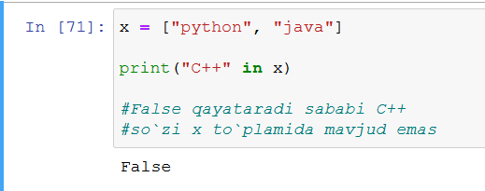
  Python dasturlash tilida A’zolik operatorlar
‘not in’ operatoriga misol

Slide 49
Foydalanilgan adabiyotlar
1. Mastering Object-Oriented Python: Build powerful applications with reusable code using OOP design patterns and Python 3.7, 2nd Edition, Steven F. Lott, Packt Publishing (June 14, 2019)
2. Learning Python, 5th Edition Fifth Edition, Mark Lutz , O'Reilly Media, June 12, 2013
3. Python Programming for Beginners: The Ultimate Guide for Beginners to Learn Python Programming: Crash Course on Python Programming for Beginners, AMZ Publishing, Independently published (July 13, 2021)
4. https://www.python.org/
5. https://www.w3schools.com/
6. https://www.codecademy.com/catalog/language/python
7. https://realpython.com/
8. https://www.anaconda.com/

Slide 50
E’tiboringiz
uchun rahmat!

