Slide 1
Python programming language
Week 7. Python If ... Else
Alisher Ismailov
Lecturer
Department of Information technology
Andijan Branch of Tashkent Financial Institute
Email: alisherismailov534@gmail.com

Slide 2
Python dasturlash tili
7-Mavzu. Istisno holatlari bilan ishlash
Ma’ruzachi: Alisher Ismoilov
Axborot texnologiyalari kafedrasi
Toshkent moliya instituti Andijon filiali
Elektron pochta: alisherismailov534@gmail.com

Slide 3
7-Mavzu. Python istisno holatlari bilan ishlash
Reja:
Python dasturlash tilida mantiqiy shartlar
Indentation (bo‘sh joy)
Elif kalit so‘zi
Else kalit so‘zi
If holatini yozishning qisqa usuli
If..else holatini yozishning qisqa usuli
And kalit so‘zi
Or kalit so‘zi
If holati ichida if holatini qo‘llash
Pass kalit so‘zi
Break
Continue

Slide 4
Python dasturlash tilida mantiqiy shart
Python dasturlash tili matematikadan mantiqiy shartlarni qo‘llab-quvvatlaydi:
Teng: a == b
Teng emas: a != b
Kichik: a < b
Kichik yoki teng: a <= b
Katta: a > b
Katta yoki teng: a >= b

Slide 5
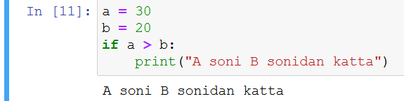
Python dasturlash tilida mantiqiy shart
Bu shartlar bir necha usulda qo‘llanilishi mumkin, ko‘pincha "if" holatlari va sikllarda foydalaniladi.
Shartlar if kalit so‘zi yordamida yoziladi.

Slide 6
Python dasturlash tilida mantiqiy shart
  Indentation (bo‘sh joy)
Python dasturlash tilida koddagi qamrovni aniqlash uchun qator boshida bo‘sh joy tashlanadi. Boshqa dasturlash tillari ko‘pincha bu maqsadda figuralik qavslardan {} foydalaniladi.

Slide 7
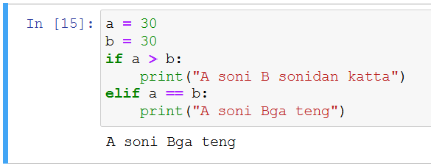
Python dasturlash tilida mantiqiy shart
  Elif kalit so‘zi
Elif kalit so‘zi "agar oldingi shartlar to‘g‘ri bo‘lmasa, bu shartni sinab ko‘ring" deyishning python dasturlash tilidagi usulidir.

Slide 8
Python dasturlash tilida mantiqiy shart
  Elif kalit so‘zi
Elif kalit so‘zi "agar oldingi shartlar to‘g‘ri bo‘lmasa, bu shartni sinab ko‘ring" deyishning python dasturlash tilidagi usulidir.
Bu misolda a o‘zgaruvchi b o‘zgaruvchiga teng, shuning uchun birinchi shart to‘g‘ri emas, lekin elif sharti to‘g‘ri, shuning uchun biz ekranga "A soni Bga teng" deb yozuv chop etdik.

Slide 9
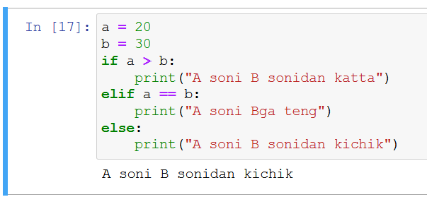
Python dasturlash tilida mantiqiy shart
  Else kalit so‘zi
else kalit so‘zi oldingi shartlar hammasi noto‘g‘ri bo‘lsa ishlaydi.
Bu misolda a o‘zgaruvchisi b o‘zgaruvchisidan kichik, shuning uchun birinchi shart to‘g‘ri emas, elif sharti ham to‘g‘ri emas sababi a o‘zgaruvchisi b o‘zgaruvchisiga teng emas, shuning uchun biz else shartiga o‘tamiz va "A soni B sonidan kichik" deb ekranga chop etamiz.

Slide 10
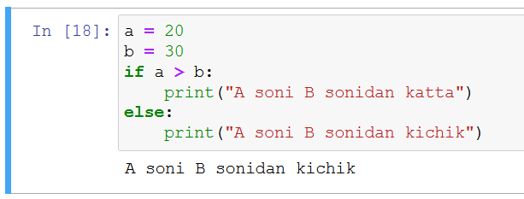
Python dasturlash tilida mantiqiy shart
  Else kalit so‘zi
Elif kalit so‘zisiz ham else holatini ishlatishingiz mumkin:

Slide 11
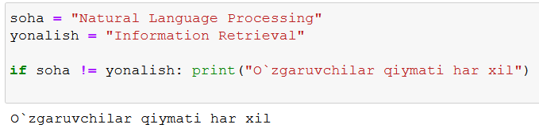
Python dasturlash tilida mantiqiy shart
  If holatini yozishning qisqa usuli
Agar sizda faqat bitta buyruqni bajarish kerak bo‘lsa, uni if operatori bilan bir qatorga qo‘yishingiz mumkin.

Slide 12
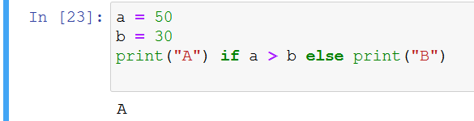
Python dasturlash tilida mantiqiy shart
  If..else holatini yozishning qisqa usuli
Agar bajarish kerak bo‘lgan bitta buyruq mavjud bo‘lsa, bittasi if uchun va biri else uchun bo‘lsa, barchasini bir qatorga qo‘yishingiz mumkin:

Slide 13
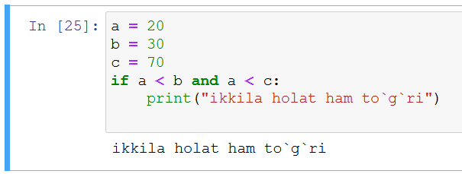
Python dasturlash tilida mantiqiy shart
  And kalit so‘zi
and kalit so‘zi mantiqiy operator bo‘lib, shartli gaplarni birlashtirish uchun ishlatiladi:
and kalit so‘zi ishlatilganda ikkila shart ham to‘g‘ri bo‘lishi kerak.

Slide 14
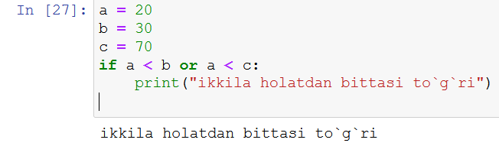
Python dasturlash tilida mantiqiy shart
  Or kalit so‘zi
or (yoki) kalit so‘zi mantiqiy operator bo‘lib, shartli gaplarni birlashtirish uchun ishlatiladi:
kalit so‘zi ishlatilganda ikkita shartdan biri to‘g‘ri bo‘lishi kerak.

Slide 15
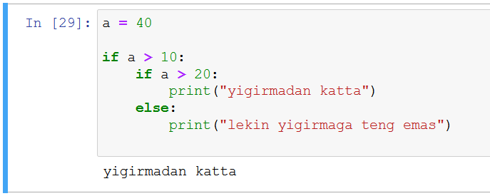
Python dasturlash tilida mantiqiy shart
  If holati ichida if holatini qo‘llash
If holati ichida if holati qo‘llanilishi mumkin, bu nested if operatori deb ataladi.

Slide 16
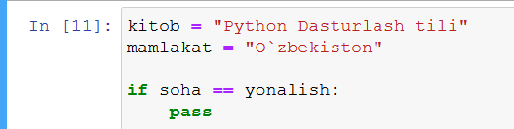
Python dasturlash tilida mantiqiy shart
  Pass kalit so‘zi
If holati bo‘sh bo‘lsa hech qanday natija bermaydigan bo‘lsa python dasturlash tili xato ko‘rsatadi, xatoni oldini olish uchun pass kalit so‘zidan foydalanish mumkin.

Slide 17
Python dasturlash tilida mantiqiy shart
  Break kalit so‘zi
break kalit so'zi for yoki while siklini buzish uchun ishlatiladi.
  for i in range(9):
  if i > 3:
  break
  print(i)

Slide 18
Python dasturlash tilida mantiqiy shart
  Break kalit so‘zi
break kalit so'zi for yoki while siklini buzish uchun ishlatiladi.
  i = 1
  while i < 9:
  print(i)
  if i == 3:
  break
  i += 1

Slide 19
Python dasturlash tilida mantiqiy shart
  Continue kalit so‘zi
Joriy iteratsiyani tsiklda tugatish uchun continue kalit so'zidan foydalaning, lekin keyingisini davom eting.
  for i in range(9):
  if i == 3:
  continue
  print(i)

Slide 20
Python dasturlash tilida mantiqiy shart
  Continue kalit so‘zi
Joriy iteratsiyani tsiklda tugatish uchun continue kalit so'zidan foydalaning, lekin keyingisini davom eting.
  i = 0
  while i < 9:
  i += 1
  if i == 3:
  continue
  print(i)

Slide 21
Python dasturlash tilida mantiqiy shart
  hafta kunlarini topish
  kun = 1
  if kun == 1:
  print(“Dushanba”)
  elif kun == 2:
  print(“Seshanba”)
  elif kun == 3:
  print(“Chorshanba”)
  elif kun == 4:
  print(“Payshanba”)
  elif kun == 5:
  print(“Juma”)
  elif kun == 6:
  print(“Shanba”)
  elif kun == 7:
  print(“Yakshanba”)
  else:
  print(“Noto`g`ri raqam kiritilgan”)

Slide 22
Python dasturlash tilida mantiqiy shart
  oy nomlarini topish
  oy = 1
  if oy == 1:
  print(“Yanvar”)
  elif oy == 2:
  print(“Fevral”)
  elif oy == 3:
  print(“Mart”)
  elif oy == 4:
  print(“Aprel”)
  elif oy == 5:
  print(“May”)
  elif oy == 6:
  print(“Iyun”)

Slide 23
Python dasturlash tilida mantiqiy shart
  elif oy == 7:
  print(“Iyul”)
  elif oy == 8:
  print(“Avgust”)
  elif oy == 9:
  print(“Sentabr”)
  elif oy == 10:
  print(“Oktabr”)
  elif oy == 11:
  print(“Noyabr”)
  elif oy == 12:
  print(“Dekabr”)
  else:
  print(“Noto`g`ri raqam kiritilgan”)

Slide 24
Python dasturlash tilida mantiqiy shart
  Bahoni aniqlash
  baho = 90
  if baho > 90:
  print(“A’lo”)
  elif baho > 80:
  print(“yaxshi”)
  elif baho > 70:
  print(“Qoniqarli”)
  elif baho > 60:
  print(“O`tish bali to`plagan”)
  elif baho < 60:
  print(“qoniqarsiz”)
  else:
  print(“Noto`g`ri raqam kiritilgan”)

Slide 25
Python dasturlash tilida mantiqiy shart
  Kun vaqtlarini aniqlash
  soat = 9
  if baho == 9:
  print(“Ertalab”)
  elif baho == 12:
  print(“Obed”)
  elif baho == 17:
  print(“Kechki Payt”)
  elif baho == 22:
  print(“Kechqurun”)
  elif baho == 23:
  print(“Tun”)
  else:
  print(“Noto`g`ri raqam kiritilgan”)

Slide 26
Python dasturlash tilida mantiqiy shart
  Mashina = (“Damas”, “Nexia”, “Lacetti”, “Matiz”, “Spark”)
  For i in Mashina:
  if i == “Matiz”
  print(i)
  break

Slide 27
Python dasturlash tilida mantiqiy shart
  Mashina = (“Damas”, “Nexia”, “Lacetti”, “Matiz”, “Spark”)
  for i in Mashina:
  if i == “Matiz”
  break
  print(i)

Slide 28
Python dasturlash tilida mantiqiy shart
  Son = (“1”, “2”, “3”, “4”, “5”, “6”, “7”, “8”, “9”, “10”)
  For i in Son:
  if i == 5:
  break
  print(i)

Slide 29
Python dasturlash tilida mantiqiy shart
  Son = (“1”, “2”, “3”, “4”, “5”, “6”, “7”, “8”, “9”, “10”)
  For i in Son:
  if i == 5:
  continue
  print(i)

Slide 30
Foydalanilgan adabiyotlar
1. Mastering Object-Oriented Python: Build powerful applications with reusable code using OOP design patterns and Python 3.7, 2nd Edition, Steven F. Lott, Packt Publishing (June 14, 2019)
2. Learning Python, 5th Edition Fifth Edition, Mark Lutz , O'Reilly Media, June 12, 2013
3. Python Programming for Beginners: The Ultimate Guide for Beginners to Learn Python Programming: Crash Course on Python Programming for Beginners, AMZ Publishing, Independently published (July 13, 2021)
4. https://www.python.org/
5. https://www.w3schools.com/
6. https://www.codecademy.com/catalog/language/python
7. https://realpython.com/
8. https://www.anaconda.com/

Slide 31
E’tiboringiz
uchun rahmat!

