Slide 1
Python programming language
Week 8. Python loops
Alisher Ismailov
Lecturer
Department of Information technology
Andijan Branch of Tashkent Financial Institute
Email: alisherismailov534@gmail.com

Slide 2
Python dasturlash tili
8-Mavzu. Python loops
Ma’ruzachi: Alisher Ismoilov
Axborot texnologiyalari kafedrasi
Toshkent moliya instituti Andijon filiali
Elektron pochta: alisherismailov534@gmail.com

Slide 3
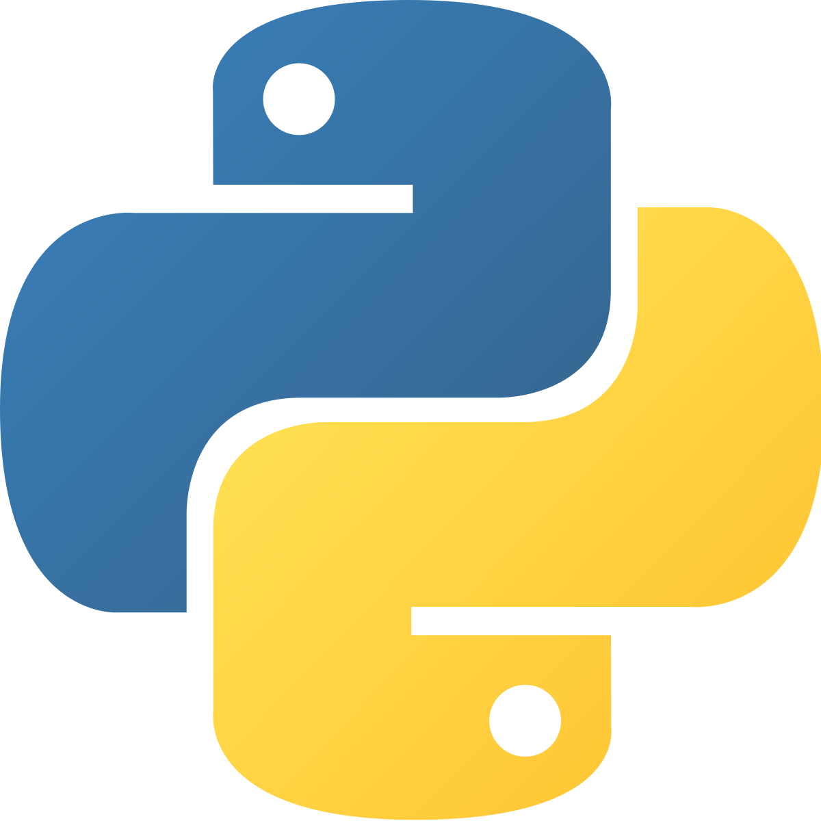
8-Mavzu. Python loops
Reja:
while sikli
For sikli
Sikl ichida sikl ishlatish
Python iteratorlari (takrorlanuvchilari)
Iterator va iterator bo‘ladigan obyektlar
Loop orqali Iteratordan foydalanish
Iterator yaratish
Iteratsiyani to‘xtatish

Slide 4
Python dasturlash tilida Loops (sikllar)
Python dasturlash tilida ikkita sikl buyrug‘i mavjud:
while sikl
for sikl

Slide 5
Python dasturlash tilida loops (sikllar)
while sikli bilan biz shart to‘g‘ri bo‘lsa, bir qator holatlarni bajarishimiz mumkin.
  a = 1
  while a < 5:
  print(a)
  a = a + 1

Slide 6
Python dasturlash tilida loops (sikllar)
break kalit so‘zi
break kalit so‘zi yordamida while sharti to‘g‘ri bo‘lsa ham siklni to‘xtata olish mumkin:
  a = 1
  while a < 5:
  print(a)
  if a == 2:
  break
  a = a + 1

Slide 7
Python dasturlash tilida loops (sikllar)
  continue kalit so‘zi
continue kalit so‘zi bilan sikldagi bitta elementni tashlab keyingi elementdan siklni davom ettirish mumkin:
  a = 1
  while a < 5:
  print(a)
  if a == 2:
  continue
  a = a + 1

Slide 8
Python dasturlash tilida loops (sikllar)
  else holati
Agar shart to‘g‘ri bo‘lmasa, else kalit so‘zi bilan biz kod blokini bir marta ishga tushirishimiz mumkin:
  a = 0
  while a < 5:
  print(a)
  a = a + 1
  else:
  print(“a qiymati 5 dan katta”)

Slide 9
Python dasturlash tilida loops (sikllar)
  For sikli
For sikli ketma-ketlikni takrorlash uchun ishlatiladi. For sikli yordamida ro‘yxatdagi har bir element uchun bir martadan bajarish mumkin.
  avtomobil = [“lacetti”, “matiz”, “spark”]
  for x in avtombil:
  print(x)

Slide 10
Python dasturlash tilida loops (sikllar)
  String o‘zgaruvchini sikl orqali chop etish
String o‘zgaruvchilar takrorlanadigan obyektlardan biri bo‘lib, ular belgilar ketma-ketligini o‘z ichiga oladi.
  kitob = “Python”
  for x in kitob:
  print(x)

Slide 11
Python dasturlash tilida loops (sikllar)
  break kalit so‘zi
Break kalit so‘zi yordamida siklni to‘xtatish mumkin:
  avtomobil = [“lacetti”, “matiz”, “spark”]
  for x in avtombil:
  print(x)
  if x == “matiz”:
  break

Slide 12
Python dasturlash tilida loops (sikllar)
  continue kalit so‘zi
continue kalit so‘zi bilan siklning joriy iteratsiyasini to‘xtatib, keying iteratsiyadan davom ettirish mumkin:
  avtomobil = [“lacetti”, “matiz”, “spark”]
  for x in avtombil:
  if x == “matiz”:
  continue
  print(x)

Slide 13
Python dasturlash tilida loops (sikllar)
  range() funksiyasi
Kodlar to‘plamini ma’lum bir necha marta aylantirish uchun range() funksiyasidan foydalanish mumkin, range() funksiyasi 0 dan boshlanadigan raqamlar ketma-ketligini qaytaradi va 1 ga orttiradi va belgilangan raqamda tugaydi.
  for x in range(5):
  print(x)

Slide 14
Python dasturlash tilida loops (sikllar)
  range() funksiyasi
range() funksiyasi boshlangʻich qiymat sifatida 0 ga teng, lekin parametr qoʻshish orqali boshlangʻich qiymatni belgilash mumkin: range(5, 10), bu 5 dan 10 gacha boʻlgan qiymatlarni bildiradi (10 dan tashqari):
  for x in range(5, 10):
  print(x)

Slide 15
Python dasturlash tilida loops (sikllar)
  range() funksiyasi
range() funksiyasi ketma-ketlikni 1 ga oshiradi, biroq uchinchi parametrni qoʻshish orqali oʻsish qiymatini belgilash mumkin: range(2, 30, 3):
  for x in range(0, 10, 2):
  print(x)

Slide 16
Python dasturlash tilida loops (sikllar)
  Else holati For sikli Ichida
For siklidagi else kalit so‘zi sikl tugagandan so‘ng bajarilishi kerak bo‘lgan kod blokini belgilaydi:
  for x in range(5):
  print(x)
  else:
  print(“Yakuniga yetdi”)

Slide 17
Python dasturlash tilida loops (sikllar)
  Else holati For sikli Ichida
Keyingi misolda x o‘zgaruvchisi 4ga teng bo‘lganda siklni to‘xtating va else bloki bilan nima sodir bo‘lishini ko‘ring:
  for x in range(5):
  if x == 4: break
  print(x)
  else:
  print(“Yakuniga yetdi”)

Slide 18
Python dasturlash tilida loops (sikllar)
  haftaKunlari = [“Dushanba”, “Seshanba”, “Chorshanba”, “Payshanba”, “Juma”, “Shanba”, “Yakshanba”]
  for x in range(7):
  print(haftakunlari[x])

Slide 19
Python dasturlash tilida loops (sikllar)
  oynomlari = [“Yanvar”, “Fevral”, “Mart”, “Aprel”, “Iyun”, “Iyul”, “Avgust”, “Sentabr”, “Oktabr”, “Noyabr”, “Dekabr”]
  for x in range(12):
  print(oynamlari[x])

Slide 20
Python dasturlash tilida loops (sikllar)
  Dasturlashtillari = [“Java”, “C++”, “Python”, “Javascript”]
  for x in range(4):
  print(Dasturlashtillari[x])

Slide 21
Python dasturlash tilida loops (sikllar)
  Dasturlashtillari = [“Java”, “C++”, “Python”, “Javascript”]
  for x in range(4):
  if x == 2: break
  print(Dasturlashtillari[x])

Slide 22
Python dasturlash tilida loops (sikllar)
  Sikl ichida sikl ishlatish
"Ichki sikl" "tashqi sikl" ning har bir iteratsiyasi uchun bir marta bajariladi:
  Dasturlashtillari = [“Java”, “Python”, “C++”]
  Sohalar = [“Machine learning”, “NLP”, “Information retrieval”]
  for x in dasturlashtillari:
  for y in sohalar:
  print(x, y)

Slide 23
Python dasturlash tilida Loops (sikllar)
Python iteratorlari (takrorlanuvchilari)
Iterator - bu sanash mumkin bo‘lgan qiymatlarni o‘z ichiga olgan obyekt hisoblanadi. Iterator takrorlanadigan obyekt, ya’ni siz barcha qiymatlarni birma bir chop etishingiz mumkin.
Python dasturlash tilida iterator __iter__() va __next__() funksiyalaridan tashkil topgan funksiyalar orqali amalga oshiriladigan obyekt hisoblanadi.

Slide 24
Python dasturlash tilida Loops (sikllar)
Iterator va iterator bo‘ladigan obyektlar
Ro‘yxatlar, kortejlar, lug‘atlar va to‘plamlar takrorlanadigan obyekt hisoblanadi. Bu obyektlarning barchasi iteratorni olish uchun ishlatiladigan iter() funksiyasiga ega. Misol uchun kortejdan iteratorni funksiyasi orqali har bir qiymatni chop etish jarayoni quyidagicha bo‘lishi mumkin:

Slide 25
Python dasturlash tilida loops (sikllar)
Iterator
  fanlar = (“fizika”, “matematika”, “dasturlash”)
  iterator = iter(fanlar)
  print(next(itertator))
  print(next(itertator))
  print(next(itertator))

Slide 26
Python dasturlash tilida loops (sikllar)
String (satr)lar ham takrorlanadigan obyektlar hisoblanadi va iteratordan foydalanish mumkin. Quyidagi misolda text string (satr) o‘zgauvchisini har bir qiymatini iterator orqali chop etamiz.
  text = ‘lingvistika’
  text_iterator = iter(text)
  print(next(text_iterator))
  print(next(text_iterator))
  print(next(text_iterator))
  print(next(text_iterator))
  print(next(text_iterator))
  print(next(text_iterator))
  print(next(text_iterator))
  print(next(text_iterator))
  print(next(text_iterator))
  print(next(text_iterator))
  print(next(text_iterator))

Slide 27
Python dasturlash tilida loops (sikllar)
Loop orqali iteratordan foydalanish
  Yuqoridagi misollarda iterator qiymatini alohida print() funksiyasi orqali amalga oshirdik. Bu ko‘p vaqt va kod yozishni talab qiladigan usul. Bu muammoni loop(sikl) orqali yechish mumkin.

Slide 28
Python dasturlash tilida loops (sikllar)
Loop orqali iteratordan foydalanish
  Yuqoridagi misollarda iterator qiymatini alohida print() funksiyasi orqali amalga oshirdik. Bu ko‘p vaqt va kod yozishni talab qiladigan usul. Bu muammoni loop(sikl) orqali yechish mumkin.
  kortej = (“kitob”, “daftar”, “qalam”)
  for x in kortej:
  print(x)

Slide 29
Python dasturlash tilida loops (sikllar)
Loop orqali iteratordan foydalanish
  Yuqoridagi misollarda iterator qiymatini alohida print() funksiyasi orqali amalga oshirdik. Bu ko‘p vaqt va kod yozishni talab qiladigan usul. Bu muammoni loop(sikl) orqali yechish mumkin.
    satr = ‘kitob’
    for y in satr:
    print(y)

Slide 30
Foydalanilgan adabiyotlar
1. Mastering Object-Oriented Python: Build powerful applications with reusable code using OOP design patterns and Python 3.7, 2nd Edition, Steven F. Lott, Packt Publishing (June 14, 2019)
2. Learning Python, 5th Edition Fifth Edition, Mark Lutz , O'Reilly Media, June 12, 2013
3. Python Programming for Beginners: The Ultimate Guide for Beginners to Learn Python Programming: Crash Course on Python Programming for Beginners, AMZ Publishing, Independently published (July 13, 2021)
4. https://www.python.org/
5. https://www.w3schools.com/
6. https://www.codecademy.com/catalog/language/python
7. https://realpython.com/
8. https://www.anaconda.com/

Slide 31
E’tiboringiz
uchun rahmat!

