Slide 1
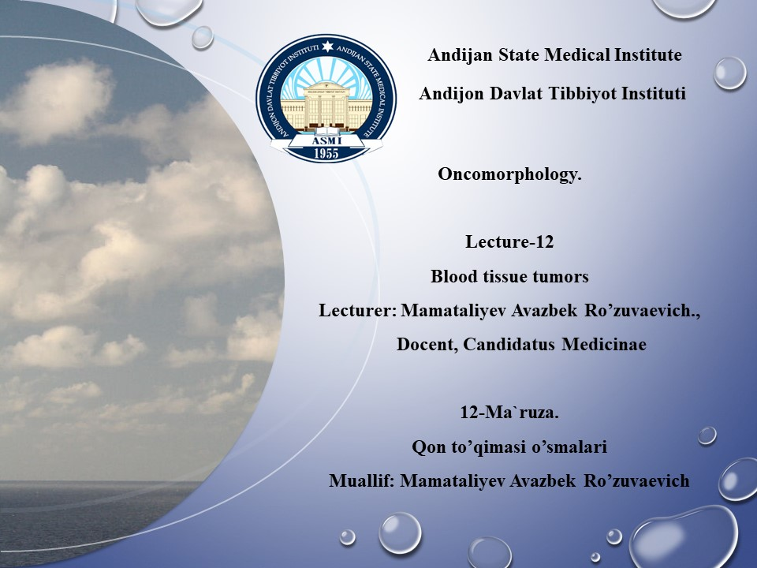

Slide 2
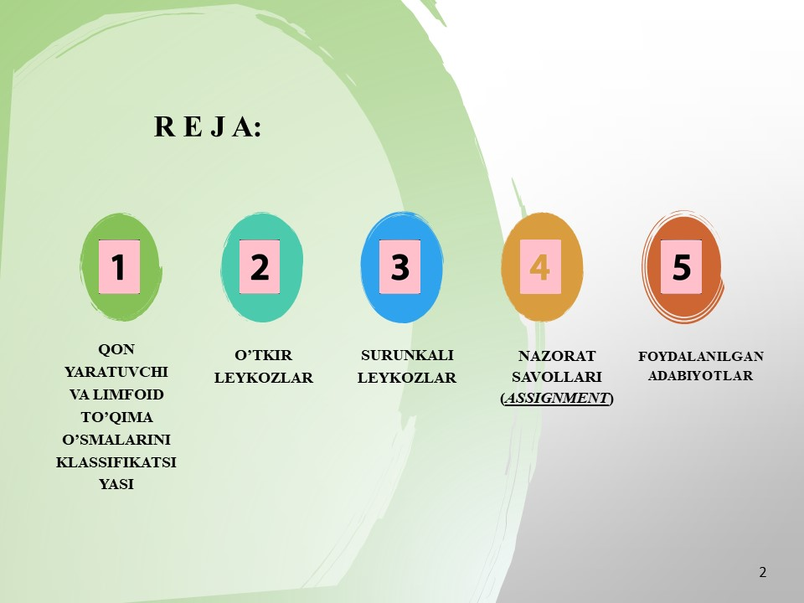

Slide 3
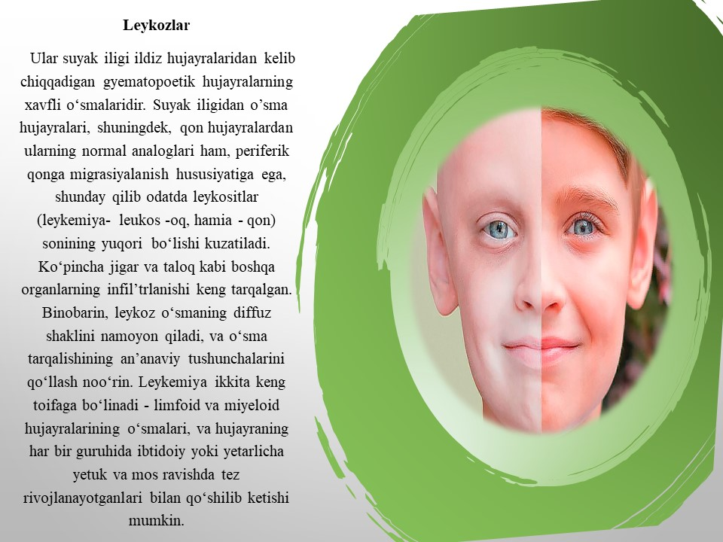
Image 1: https://fainaidea.com/jeto-interesno-znat/rak-podzheludochnoj-zhelezy-izlechim-87786.html

Slide 4
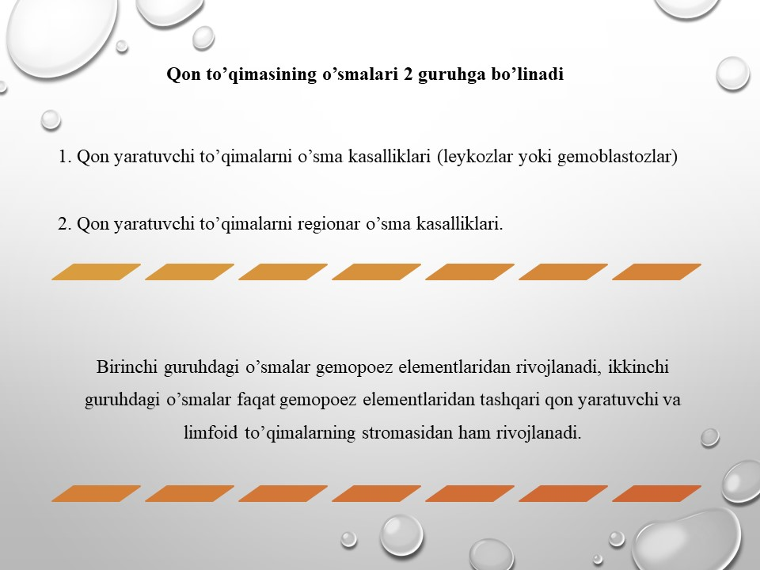

Slide 5
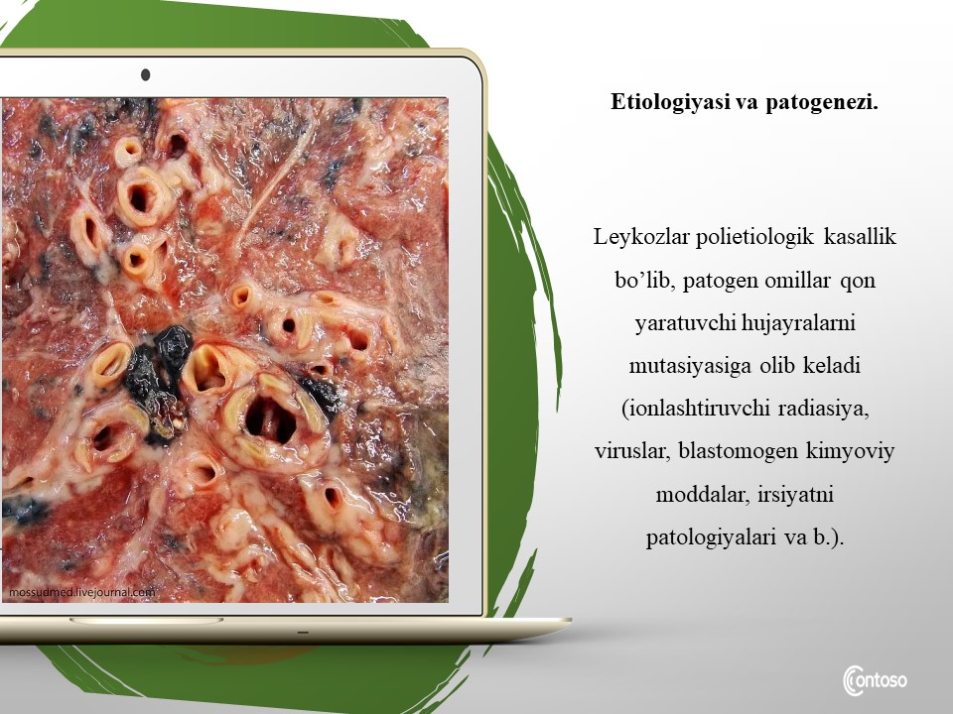
Image 2: https://fainaidea.com/jeto-interesno-znat/rak-podzheludochnoj-zhelezy-izlechim-87786.html

Slide 6
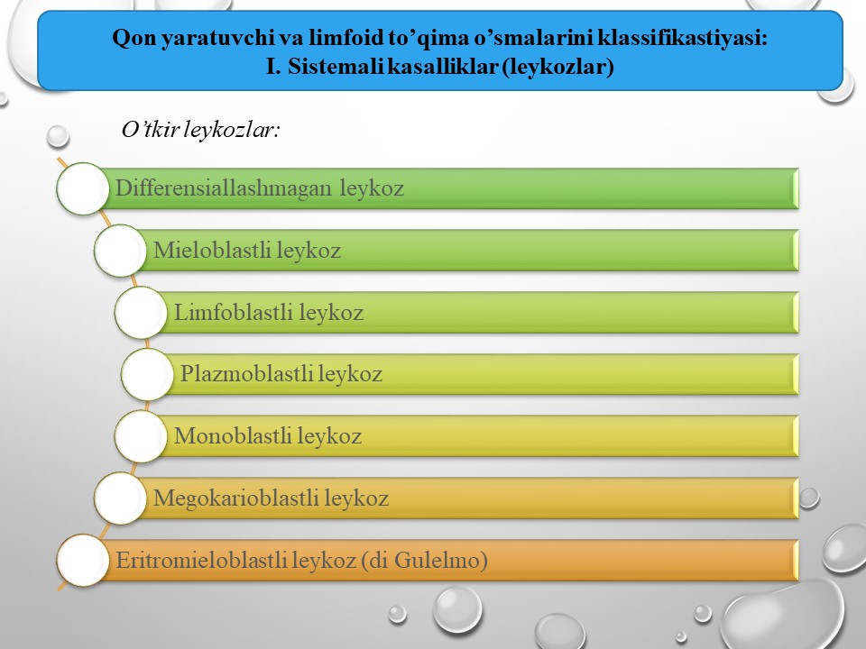

Slide 7
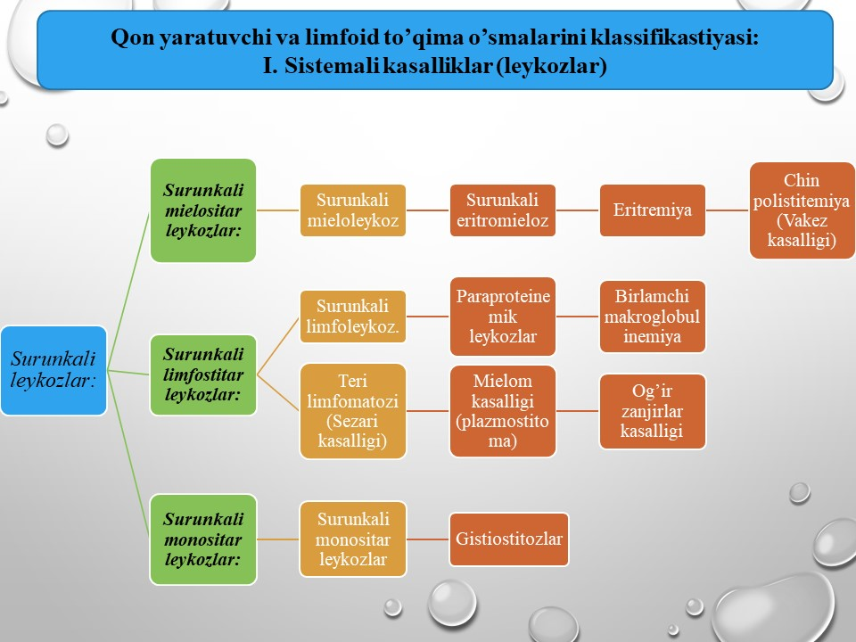

Slide 8
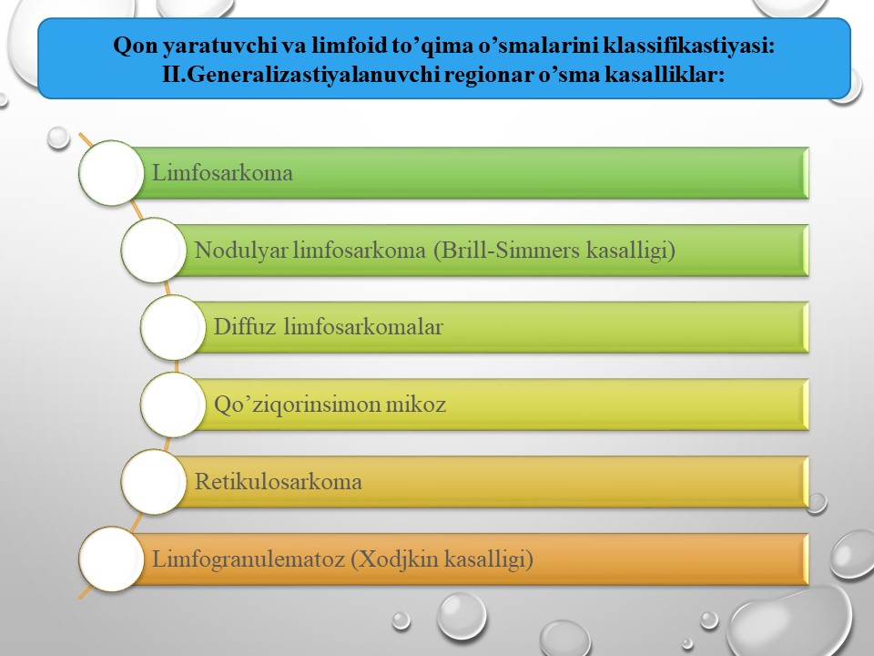

Slide 9
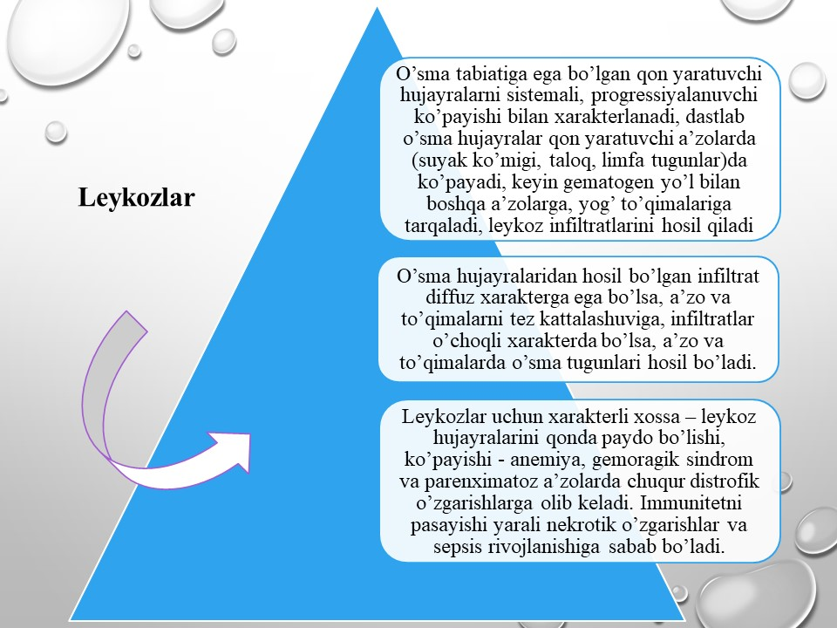

Slide 10
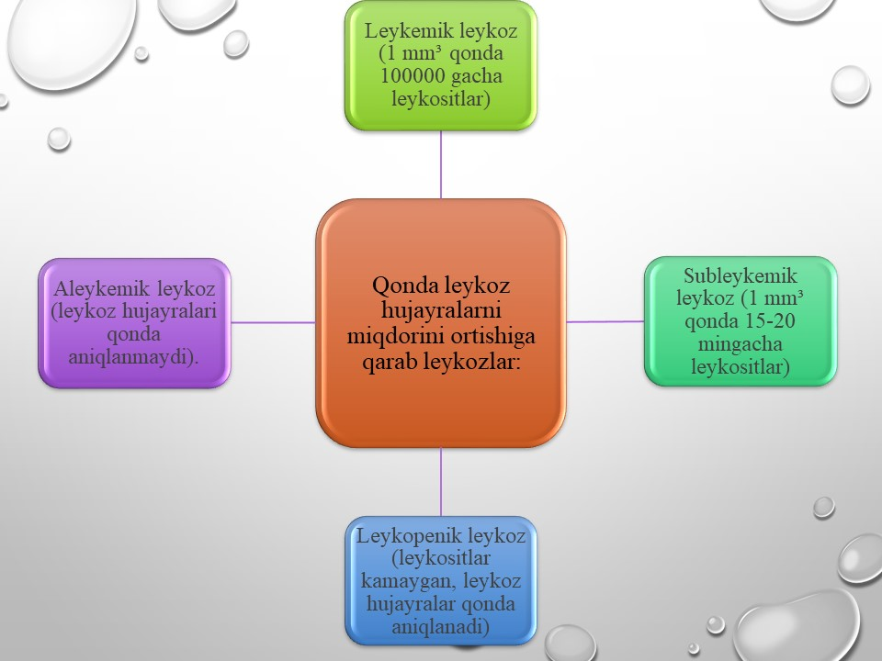

Slide 11
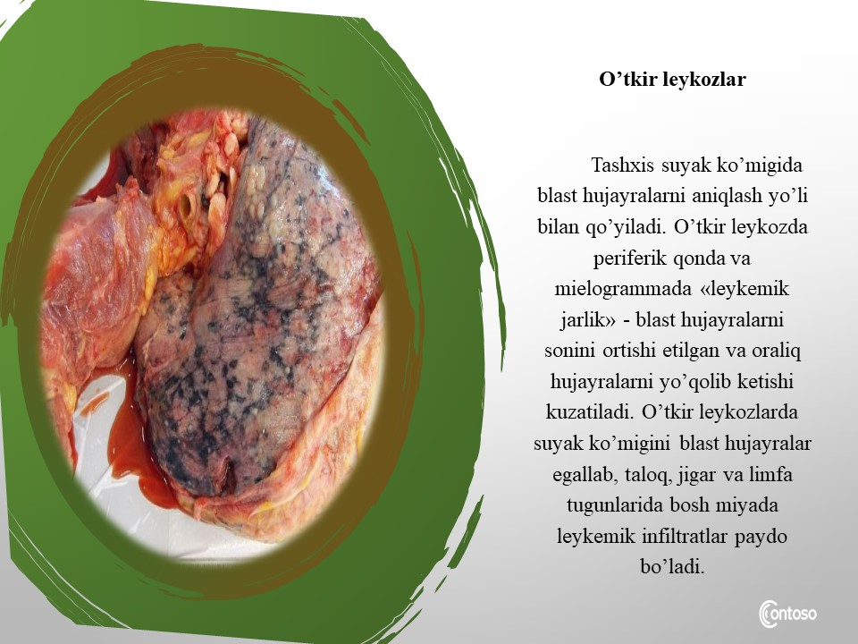
Image 3: https://fainaidea.com/jeto-interesno-znat/rak-podzheludochnoj-zhelezy-izlechim-87786.html

Slide 12
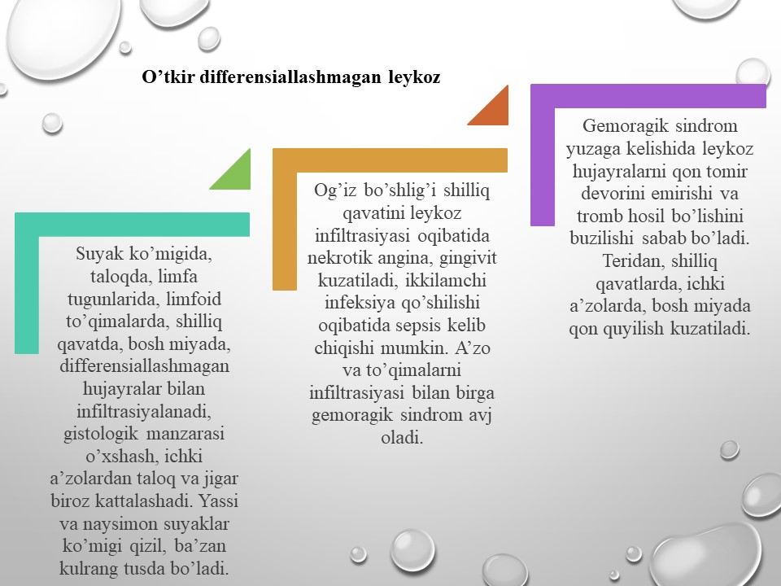

Slide 13
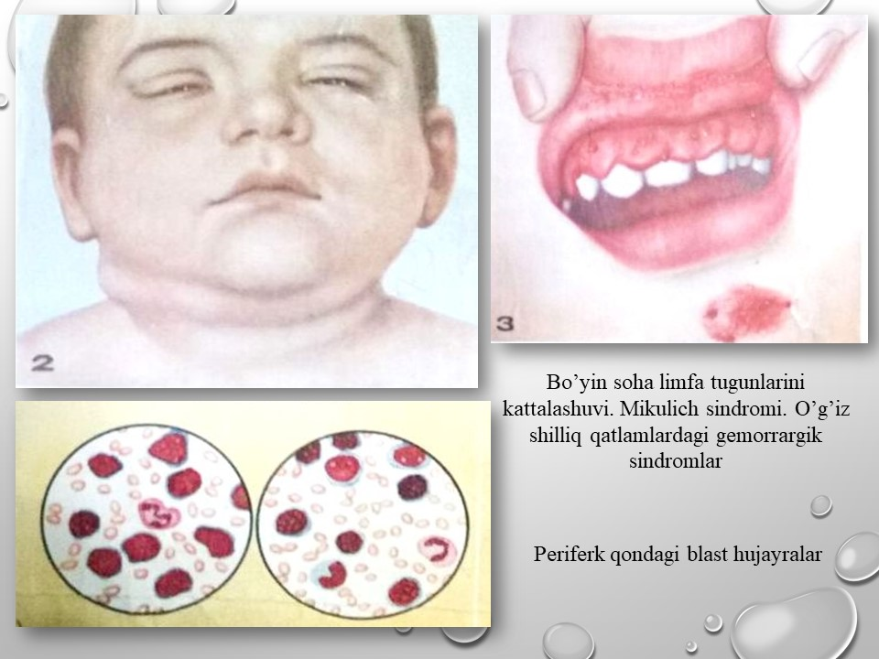
Rasm 4:Mamataliev A.R., Magrupov B.А., Don A.N. / ONKOMORFOLOGIYA O’quv qo’llanma Toshkent -2022y.

Slide 14
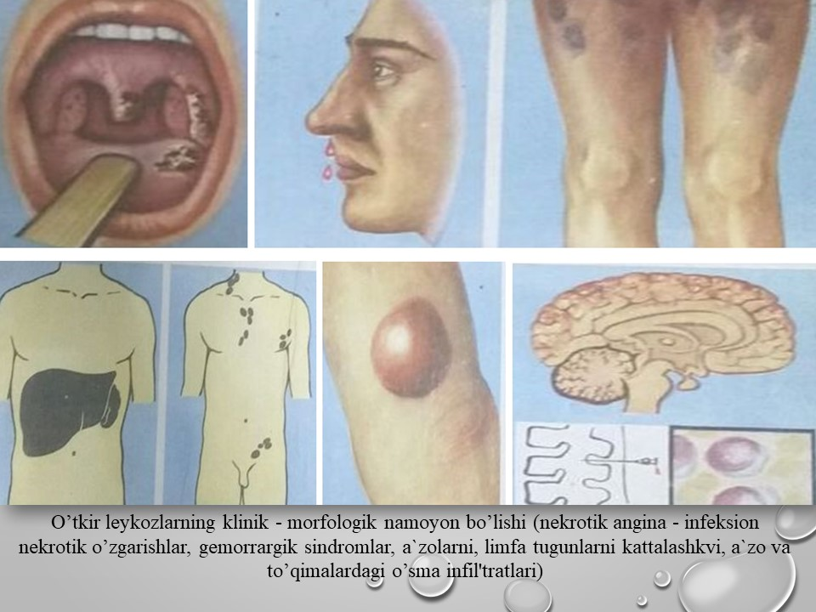
Rasm 5:Mamataliev A.R., Magrupov B.А., Don A.N. / ONKOMORFOLOGIYA O’quv qo’llanma Toshkent -2022y.

Slide 15
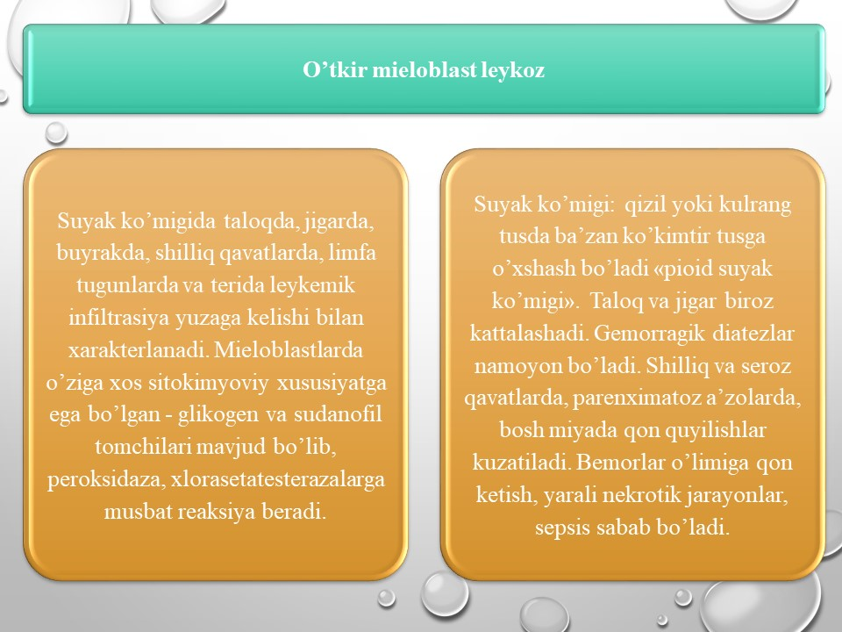

Slide 16
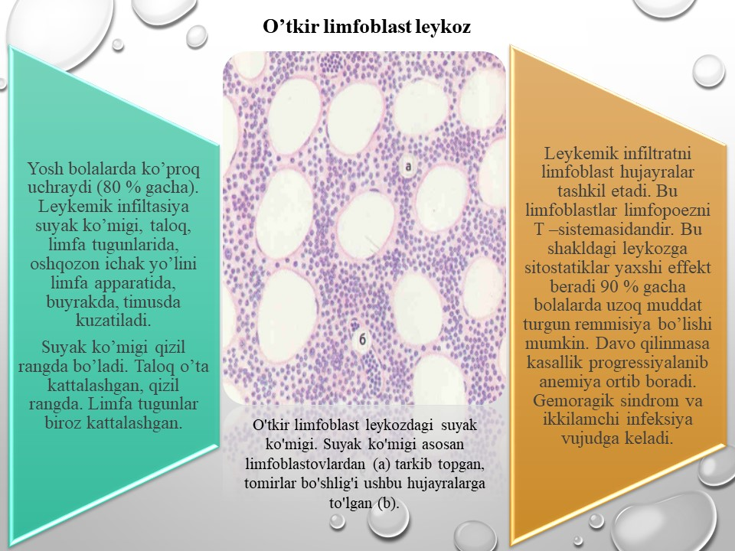
Rasm 6:Mamataliev A.R., Magrupov B.А., Don A.N. / ONKOMORFOLOGIYA O’quv qo’llanma Toshkent -2022y.

Slide 17
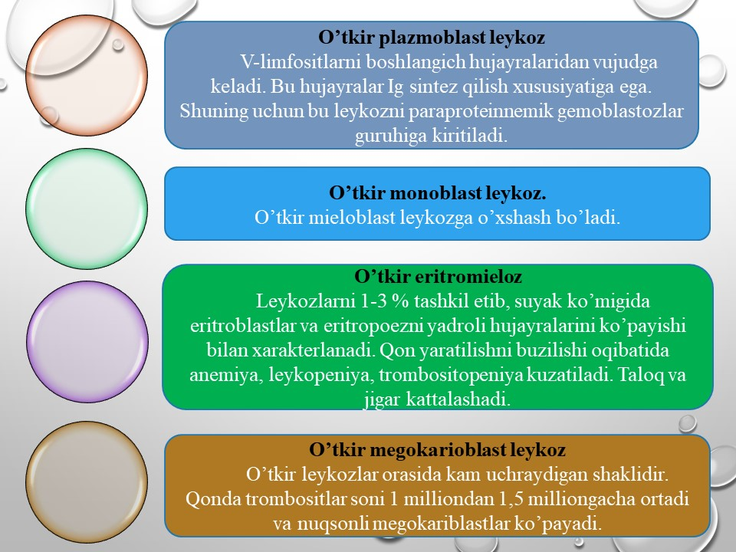

Slide 18
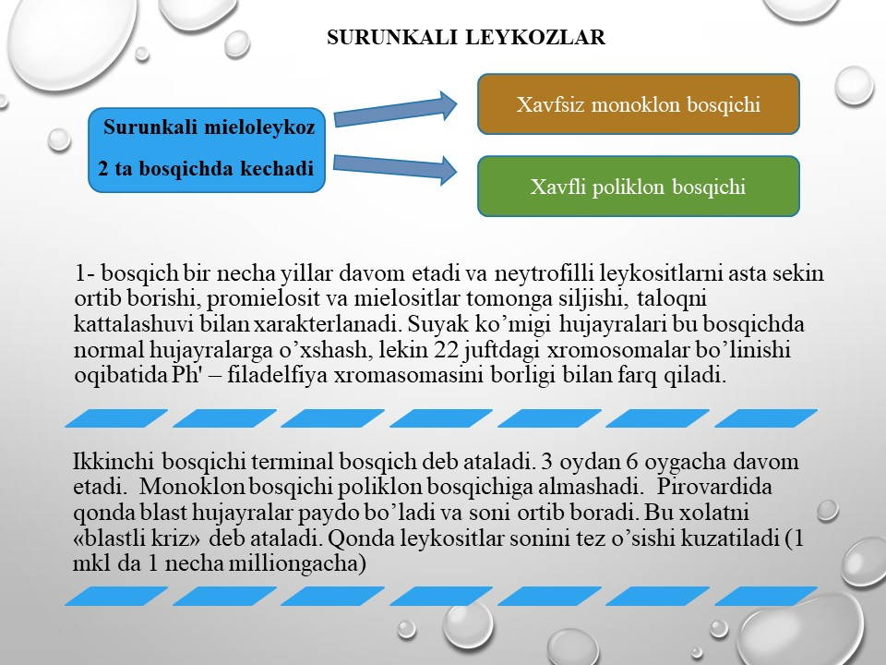

Slide 19
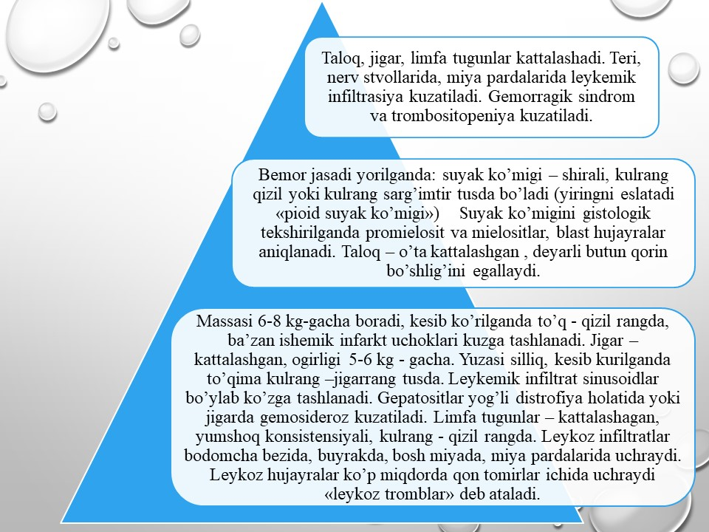

Slide 20
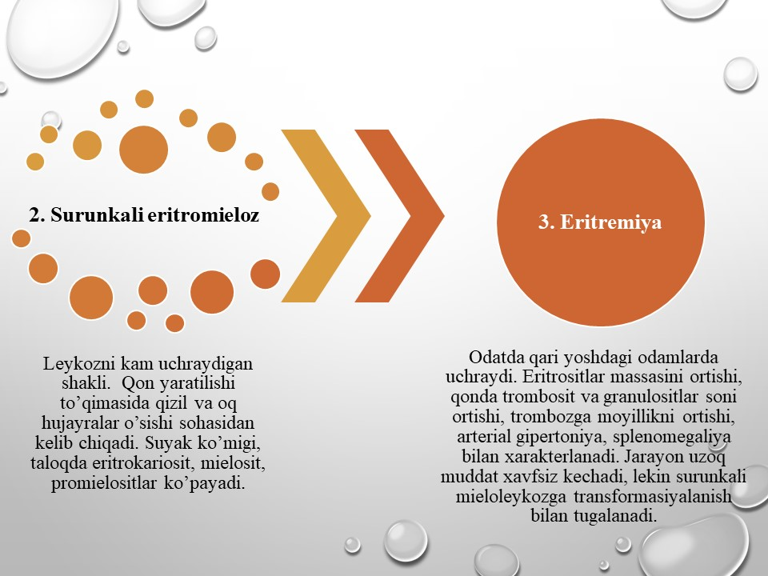

Slide 21
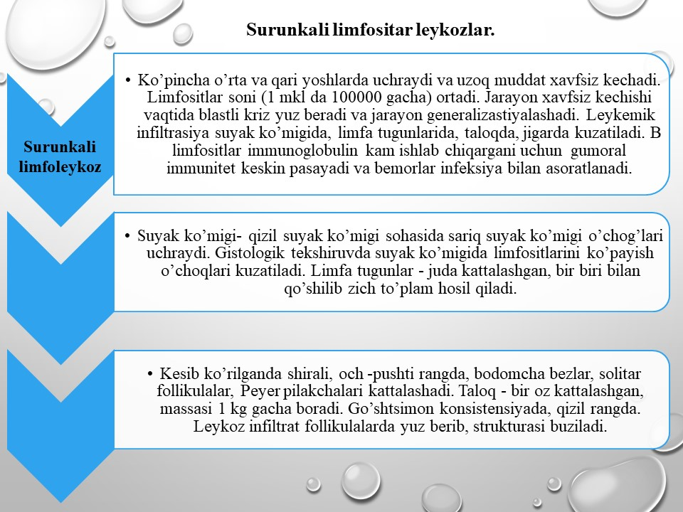

Slide 22
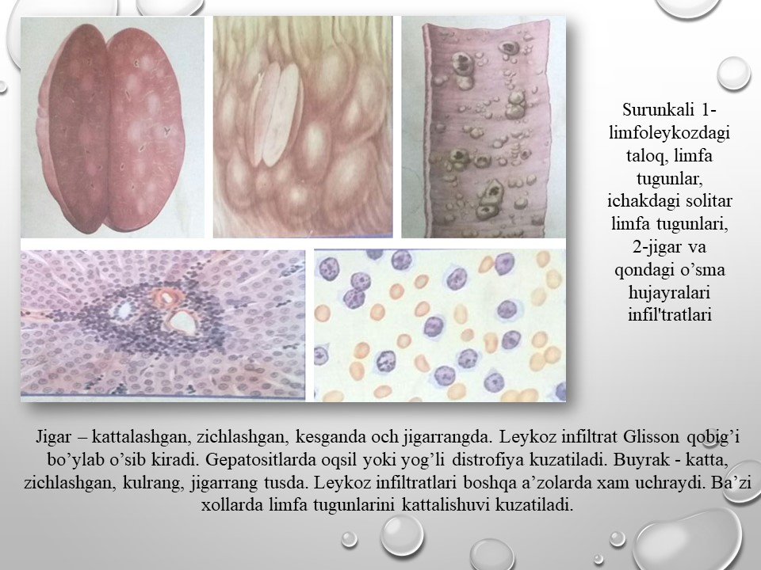
Rasm 7:Mamataliev A.R., Magrupov B.А., Don A.N. / ONKOMORFOLOGIYA O’quv qo’llanma Toshkent -2022y.

Slide 23
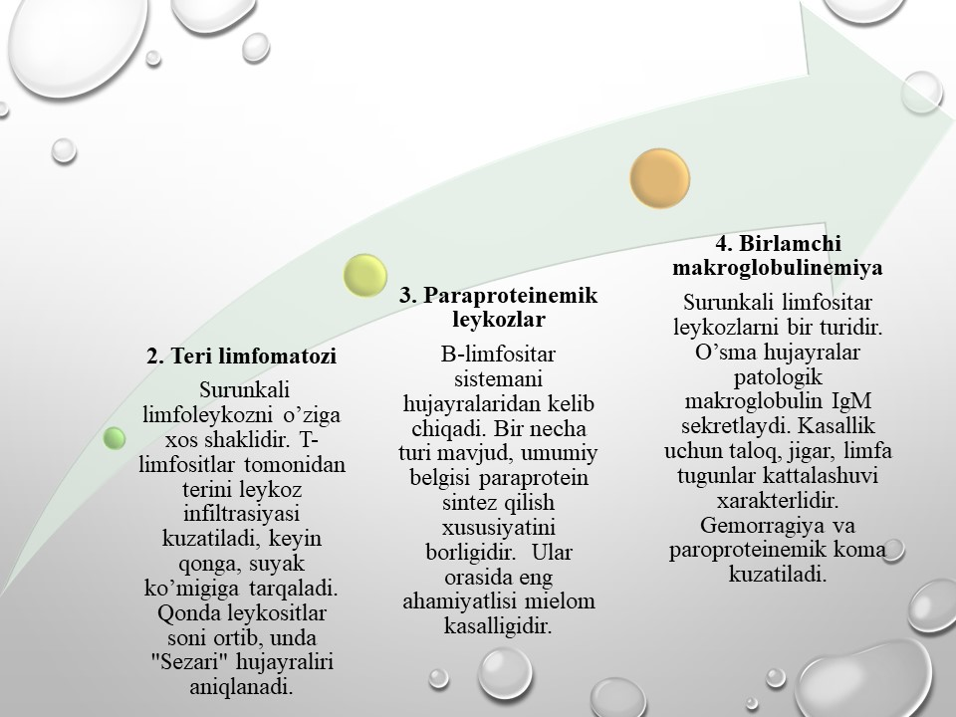

Slide 24
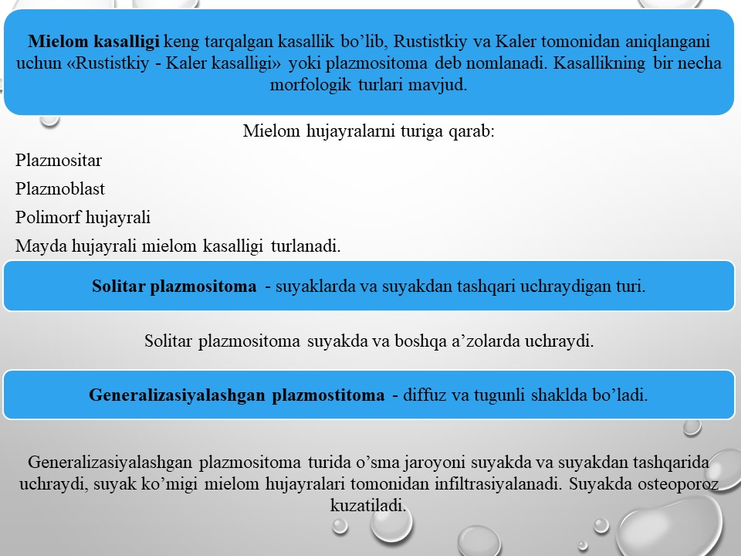

Slide 25
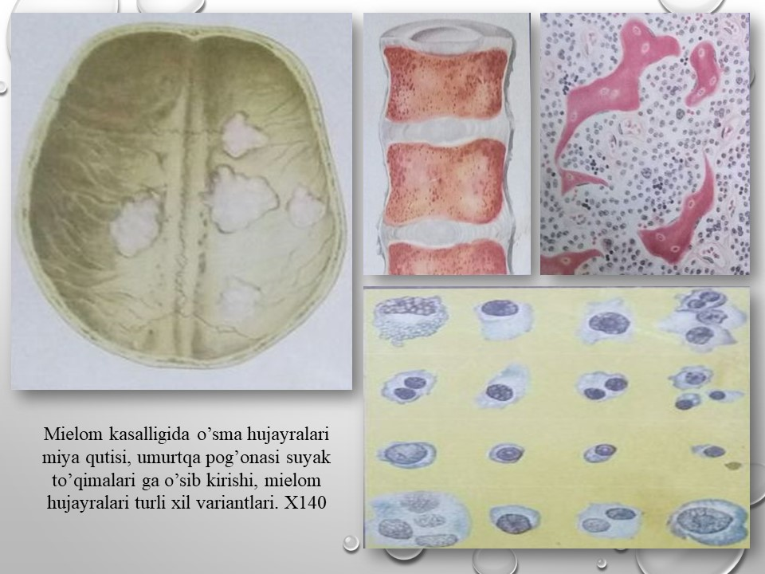
Rasm 8:Mamataliev A.R., Magrupov B.А., Don A.N. / ONKOMORFOLOGIYA O’quv qo’llanma Toshkent -2022y.

Slide 26
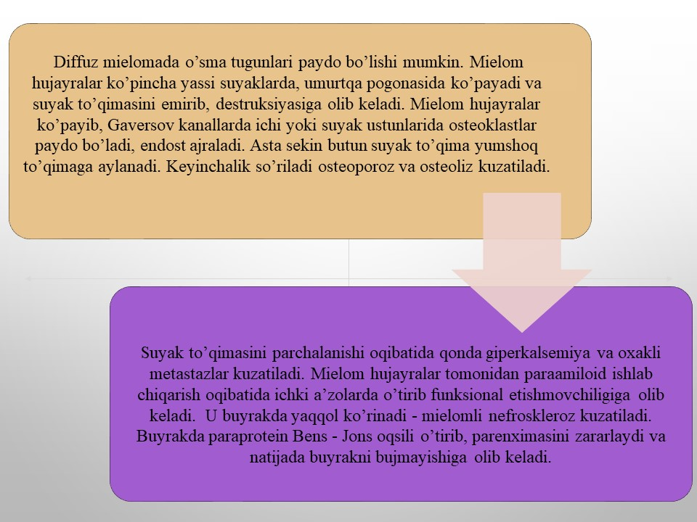

Slide 27
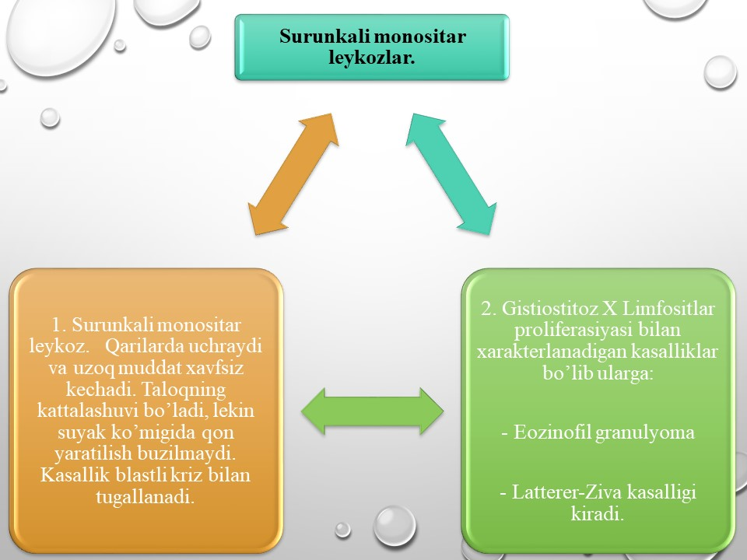

Slide 28
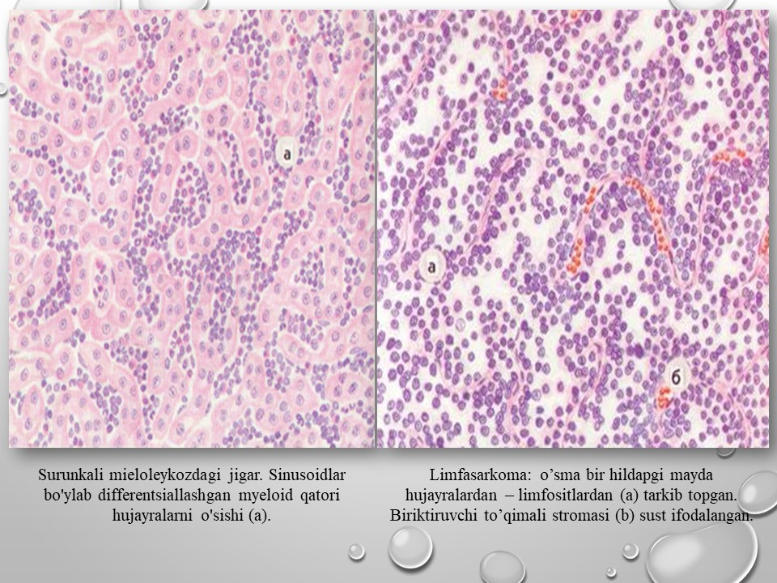
Rasm 9:Mamataliev A.R., Magrupov B.А., Don A.N. / ONKOMORFOLOGIYA O’quv qo’llanma Toshkent -2022y.

Slide 29
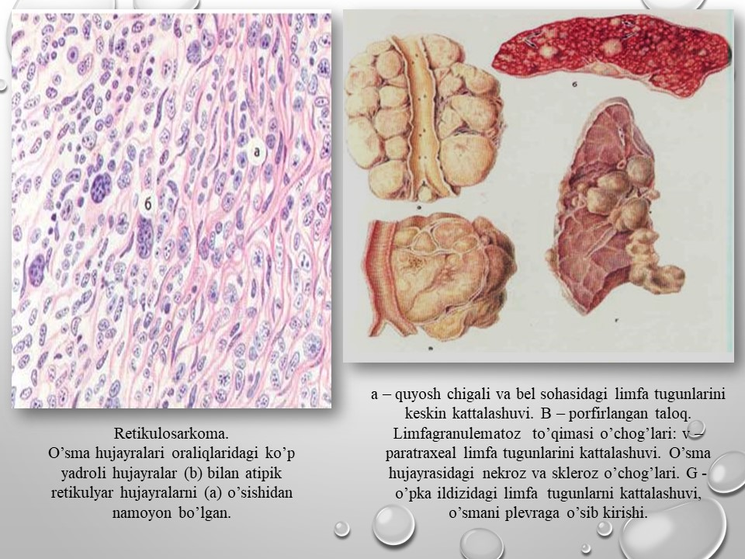
Rasm 10:Mamataliev A.R., Magrupov B.А., Don A.N. / ONKOMORFOLOGIYA O’quv qo’llanma Toshkent -2022y.

Slide 30
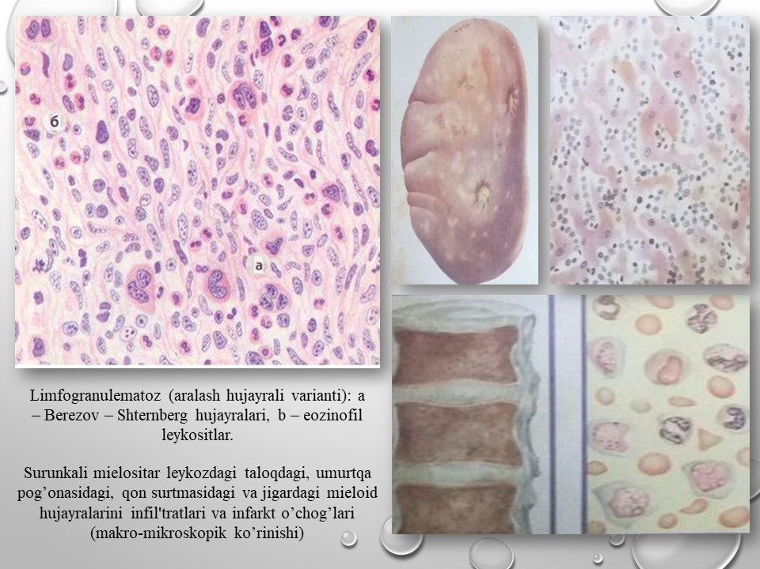
Rasm 11:Mamataliev A.R., Magrupov B.А., Don A.N. / ONKOMORFOLOGIYA O’quv qo’llanma Toshkent -2022y.

Slide 31
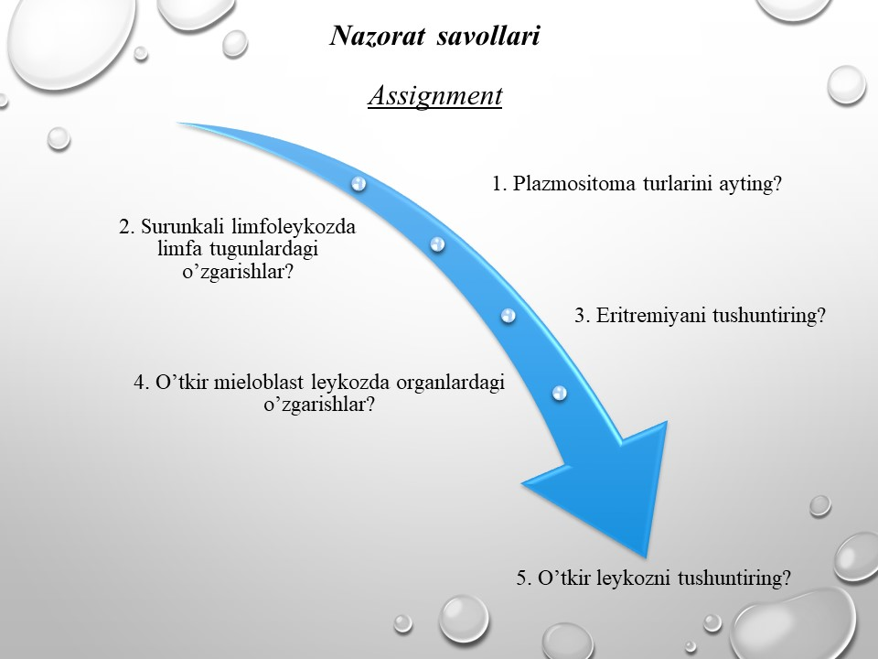

Slide 32
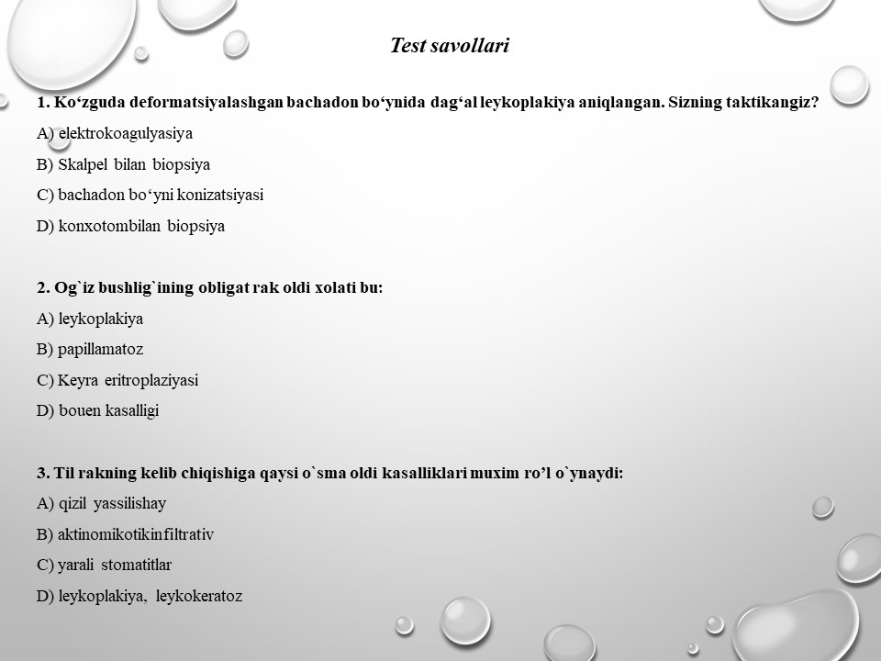

Slide 33
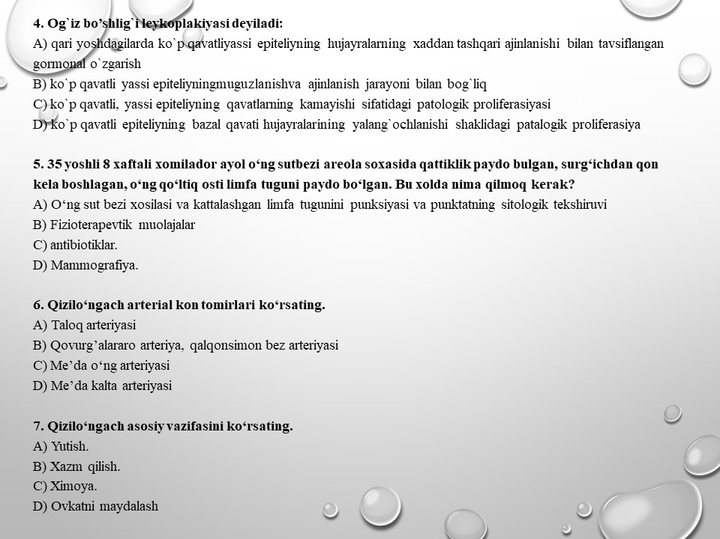

Slide 34
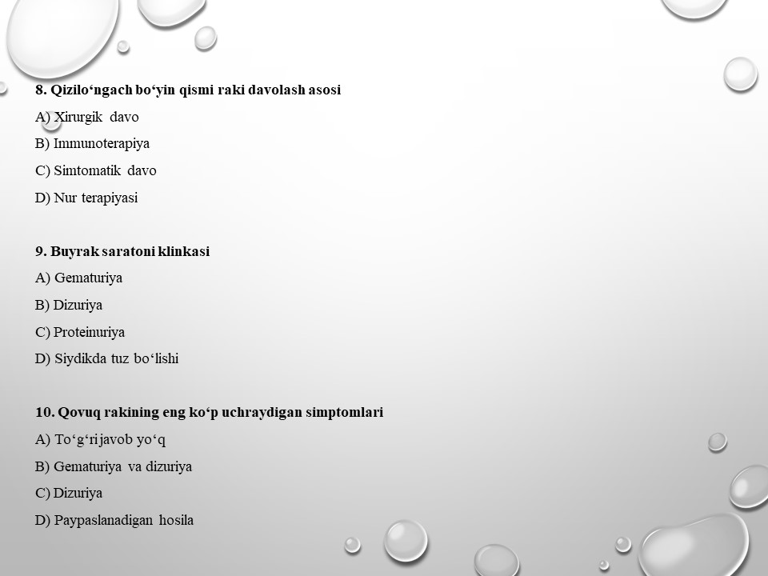

Slide 35
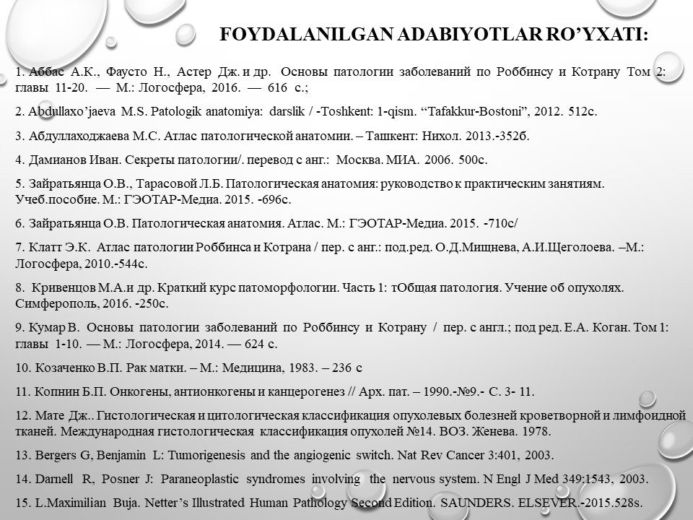

Slide 36


