Slide 1
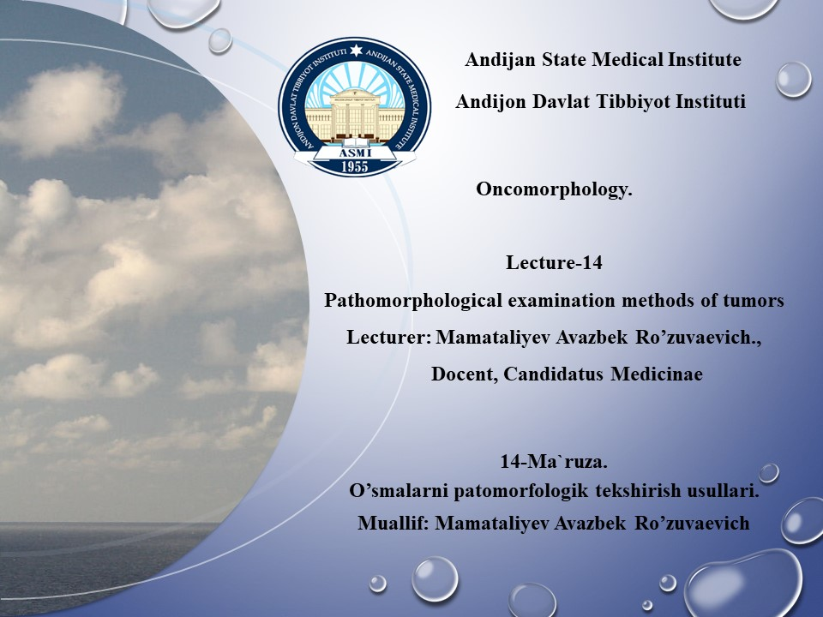

Slide 2
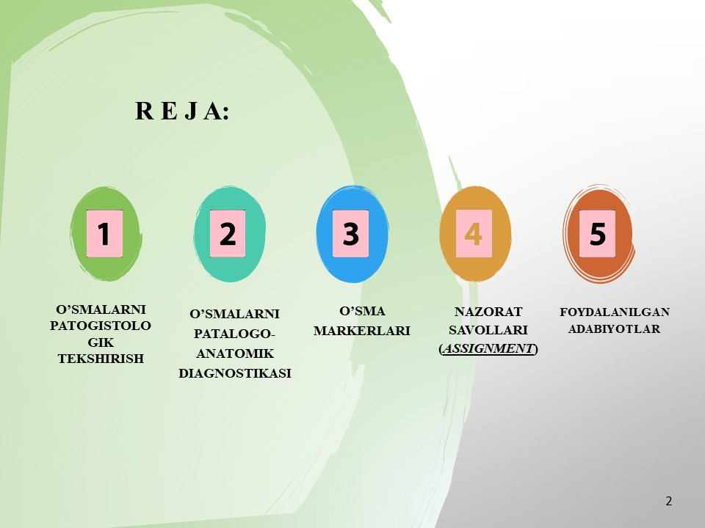

Slide 3
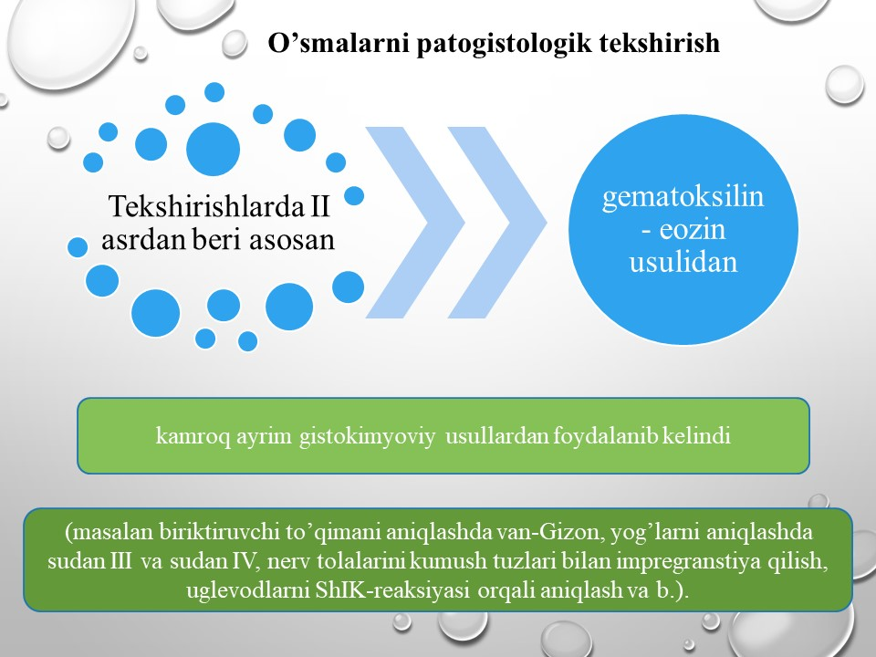

Slide 4
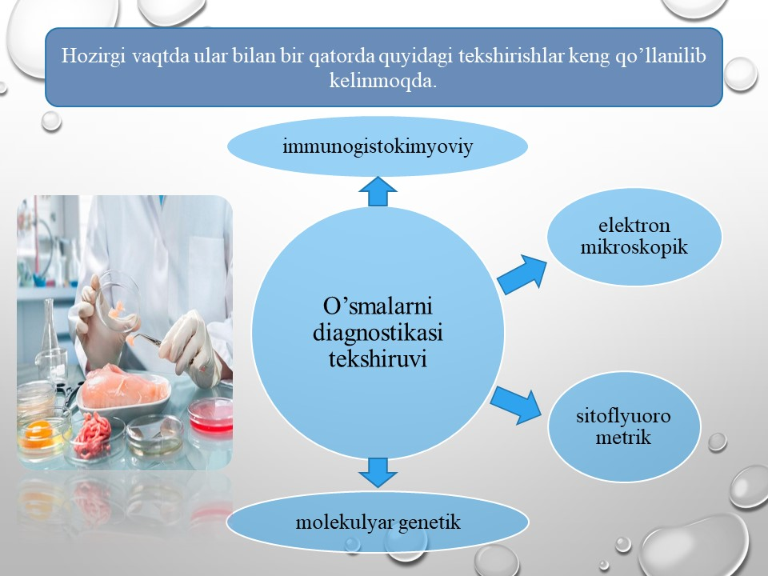
Image 1: https://eldala.kz/novosti/kazahstan/5741-v-rk-otkroyut-laboratorii-dlya-analiza-pishchevyh-produktov-i-kormov

Slide 5
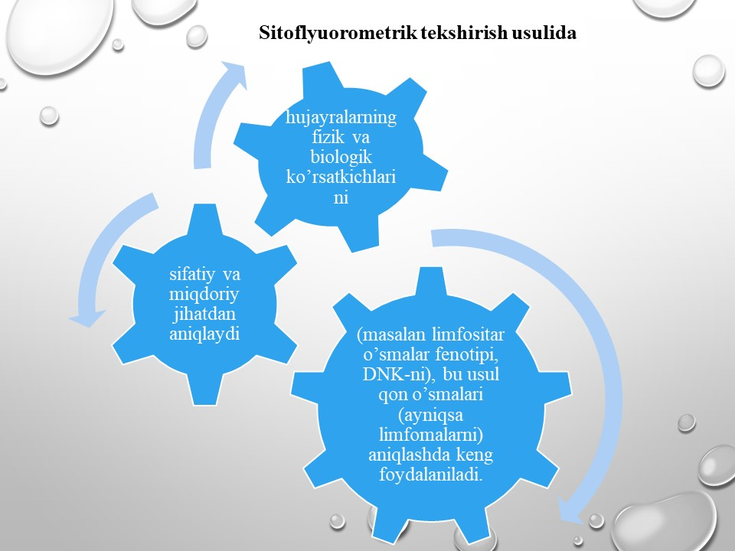

Slide 6
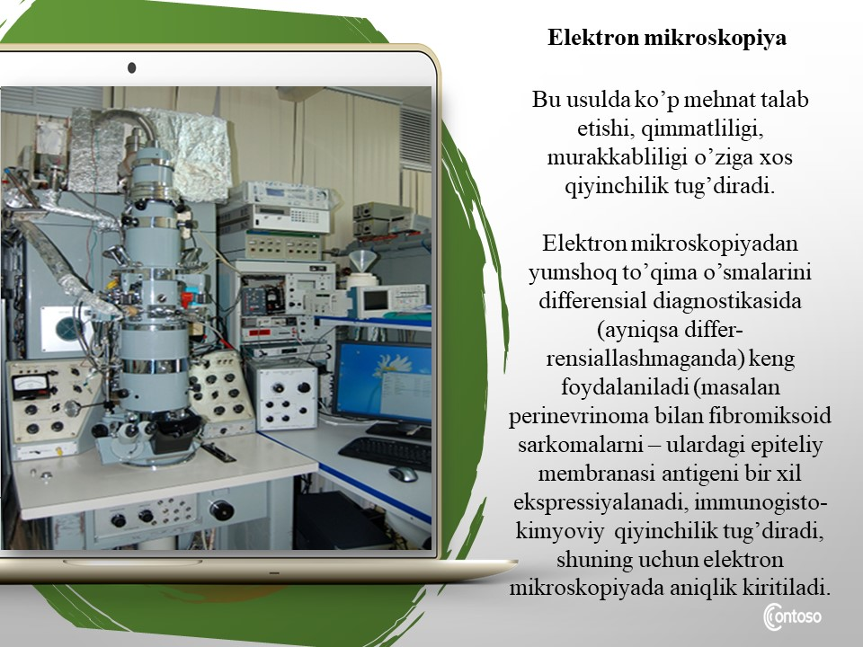
Image 2: https://www.isp.nsc.ru/ckp/pribornyj-park/kompleks-sverkhvysokovakuumnoj-otrazhatelnoj-elektronnoj-mikroskopii

Slide 7
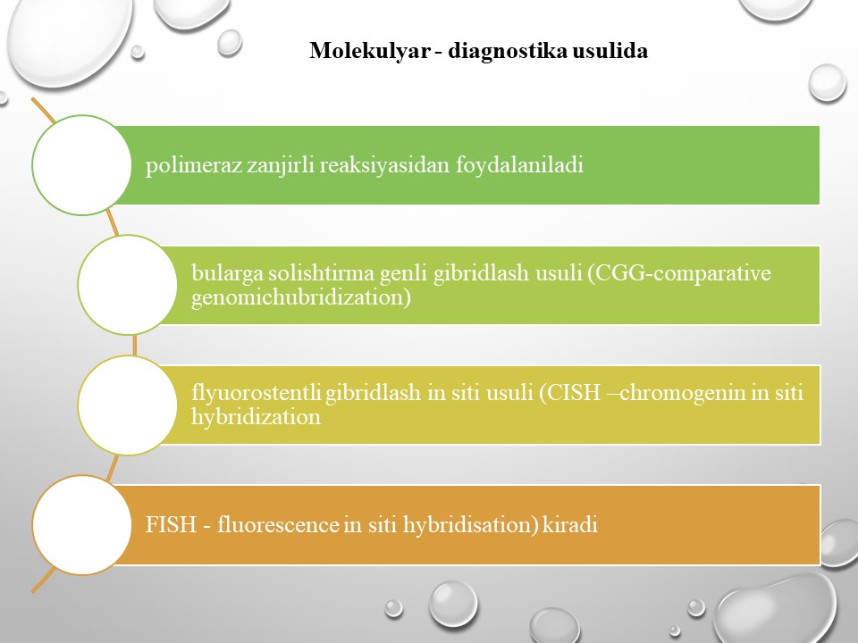

Slide 8
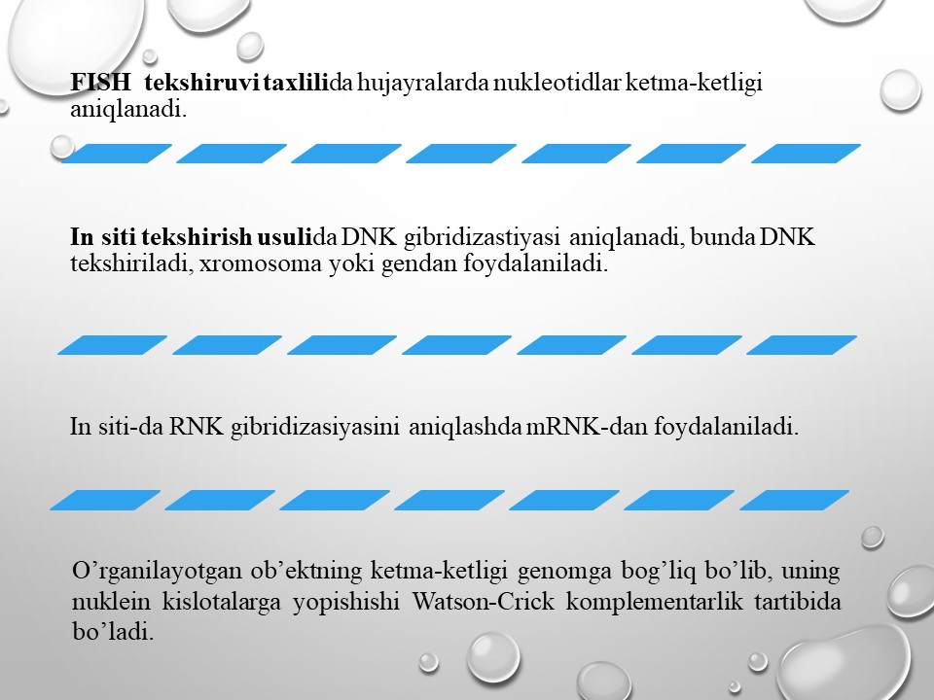

Slide 9
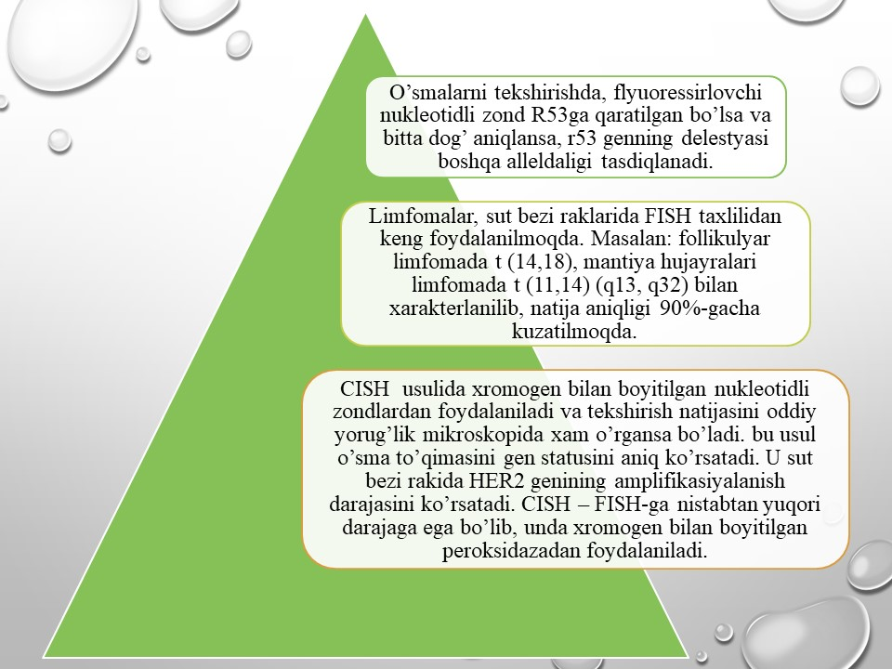

Slide 10
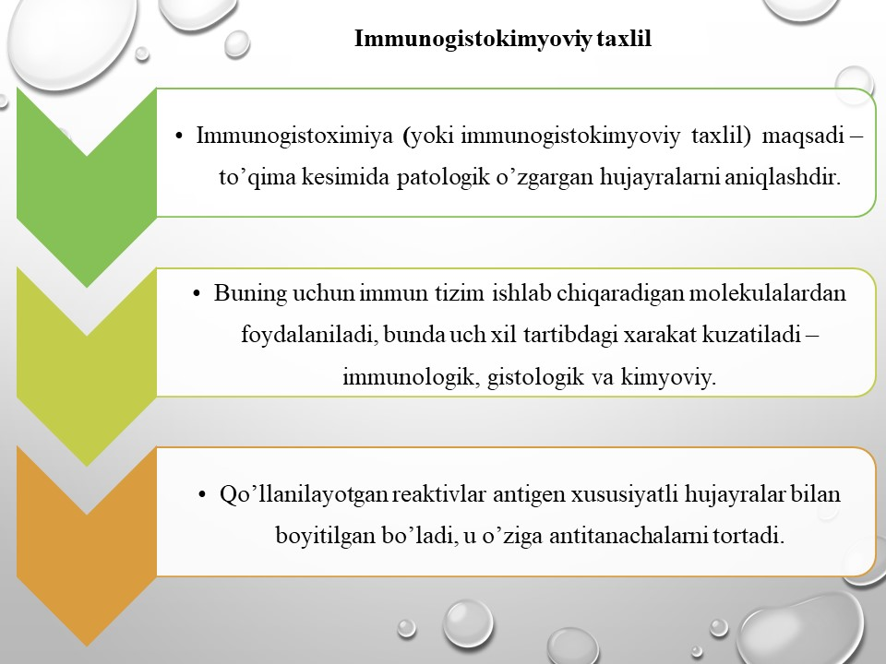

Slide 11
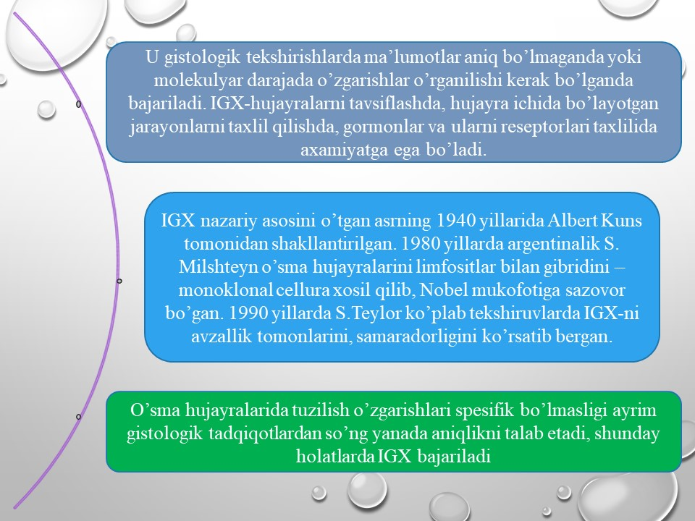

Slide 12
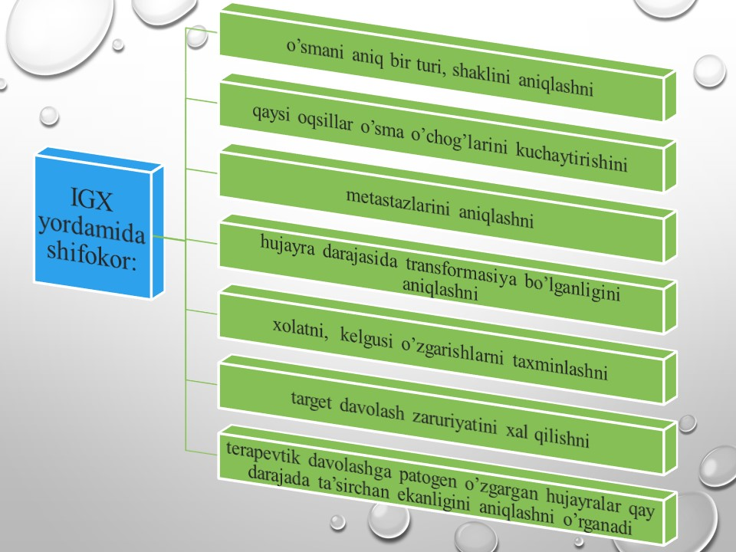

Slide 13
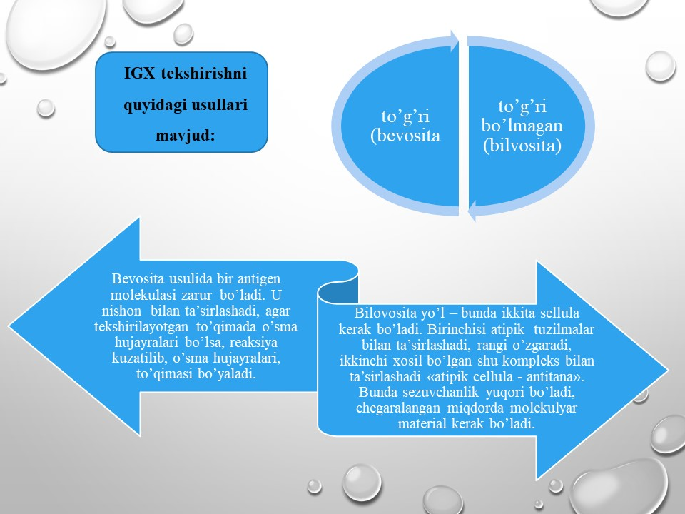

Slide 14
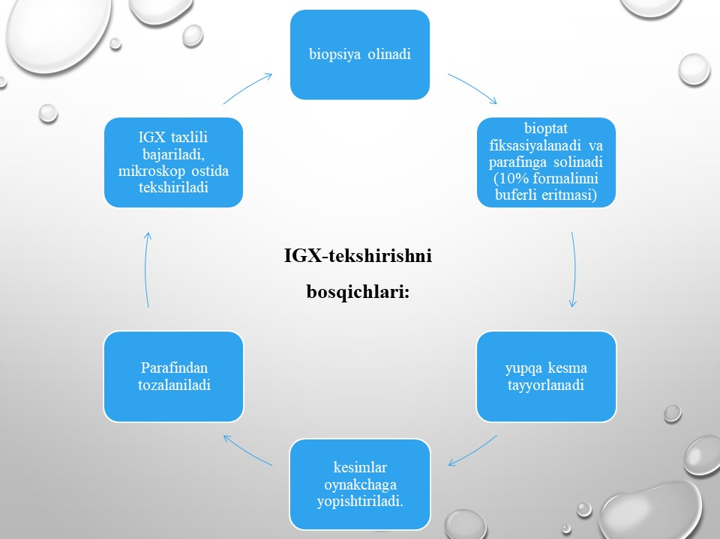

Slide 15
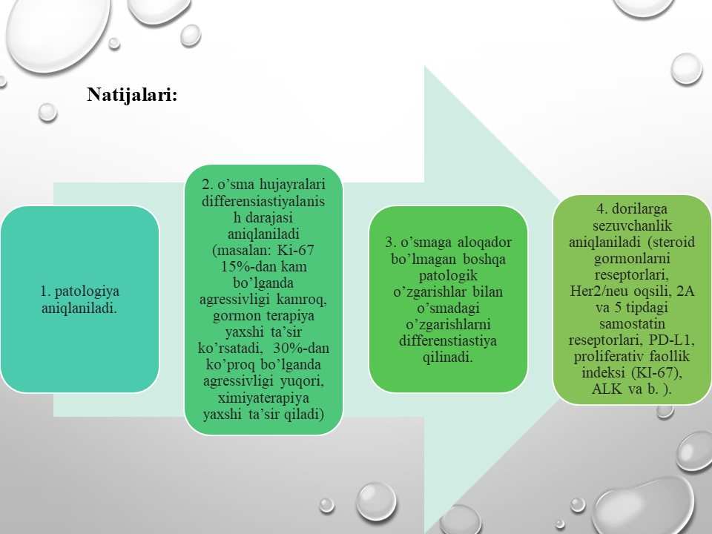

Slide 16
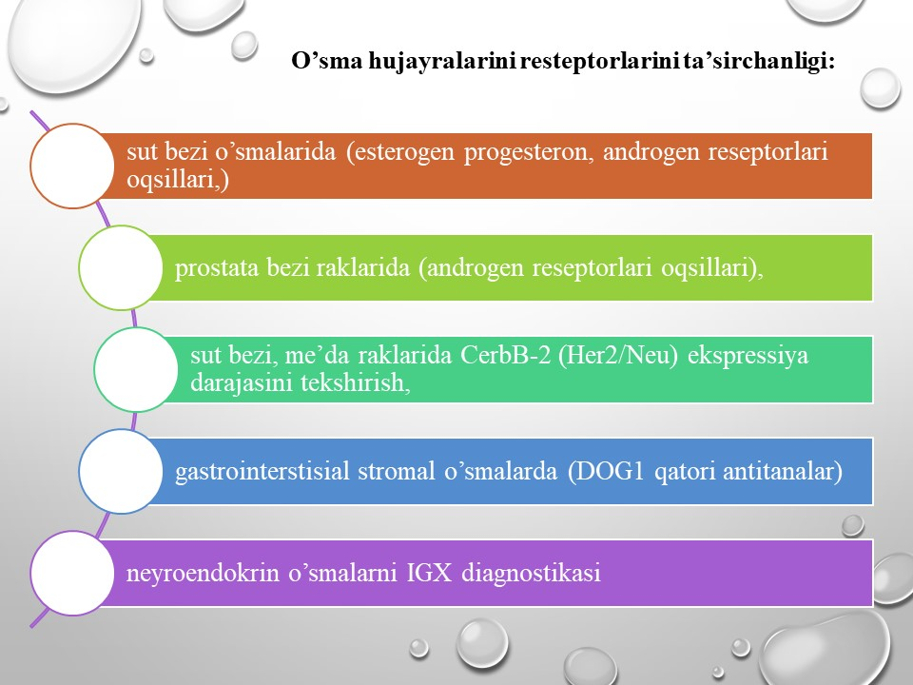

Slide 17
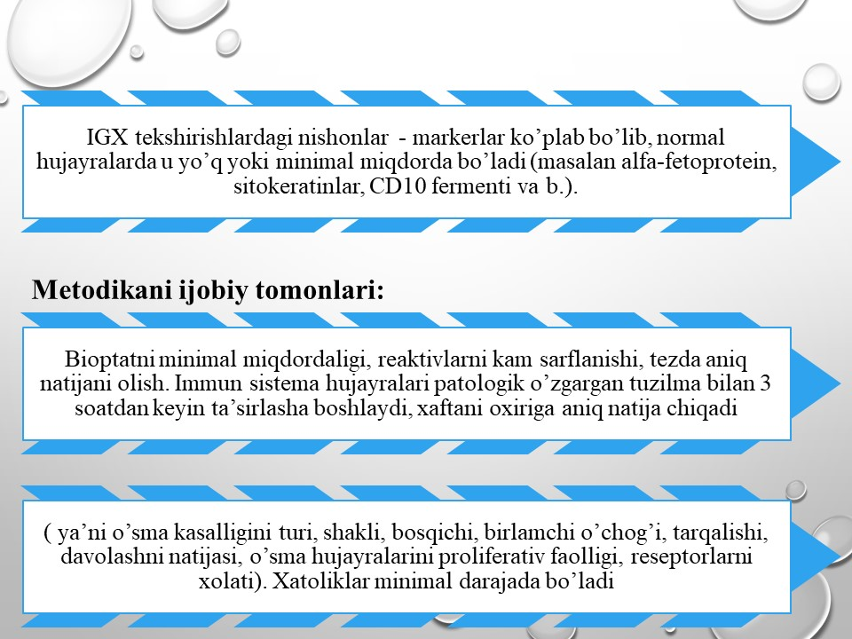

Slide 18
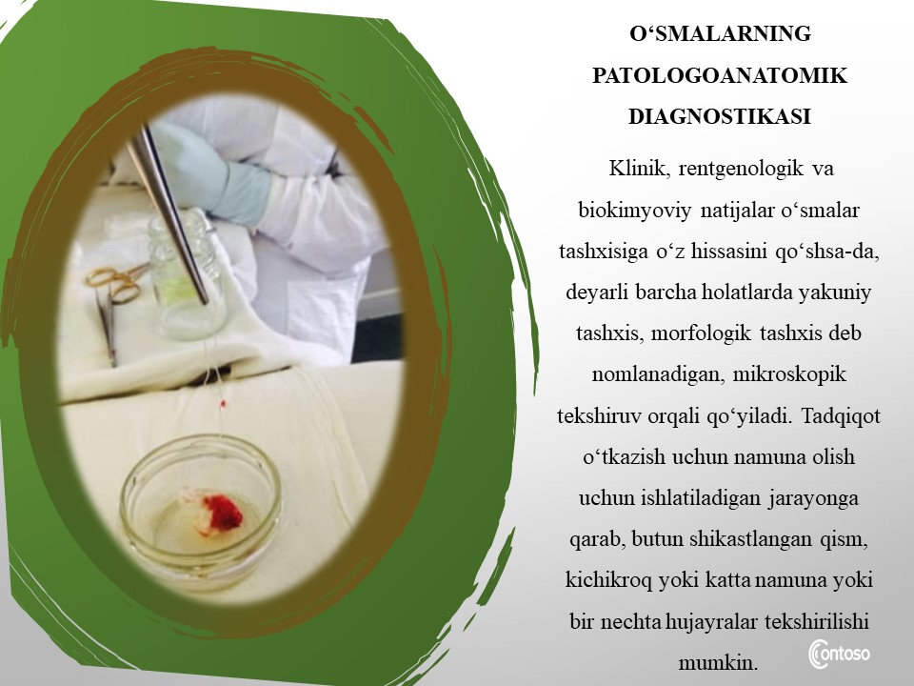
Image 3: http://9sargb.ru/news/filyarioz-sluchay-iz-praktiki/

Slide 19
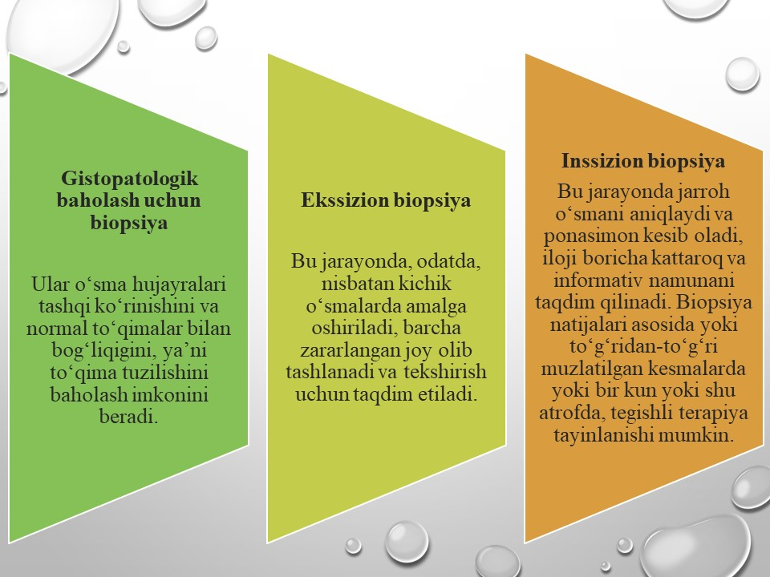

Slide 20
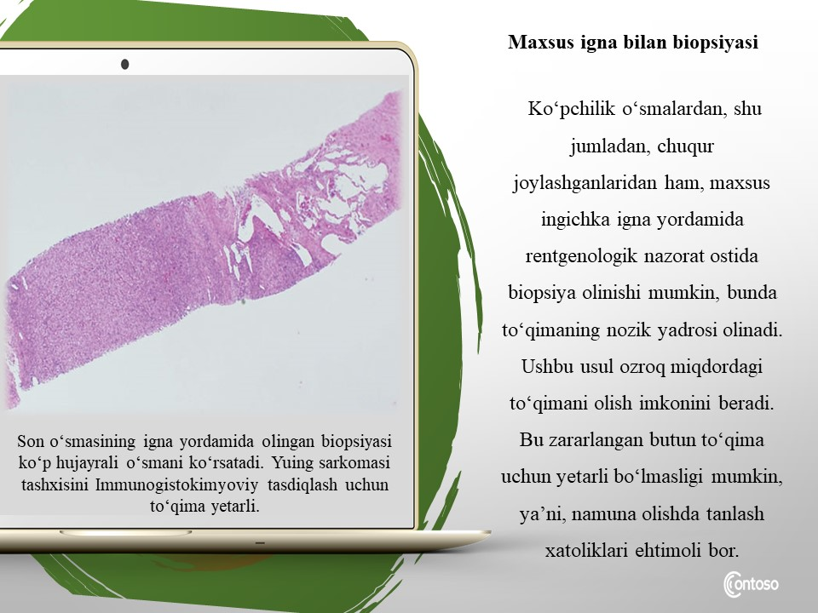
Rasm 4:Mamataliev A.R., Magrupov B.А., Don A.N. / ONKOMORFOLOGIYA O’quv qo’llanma Toshkent -2022y.

Slide 21
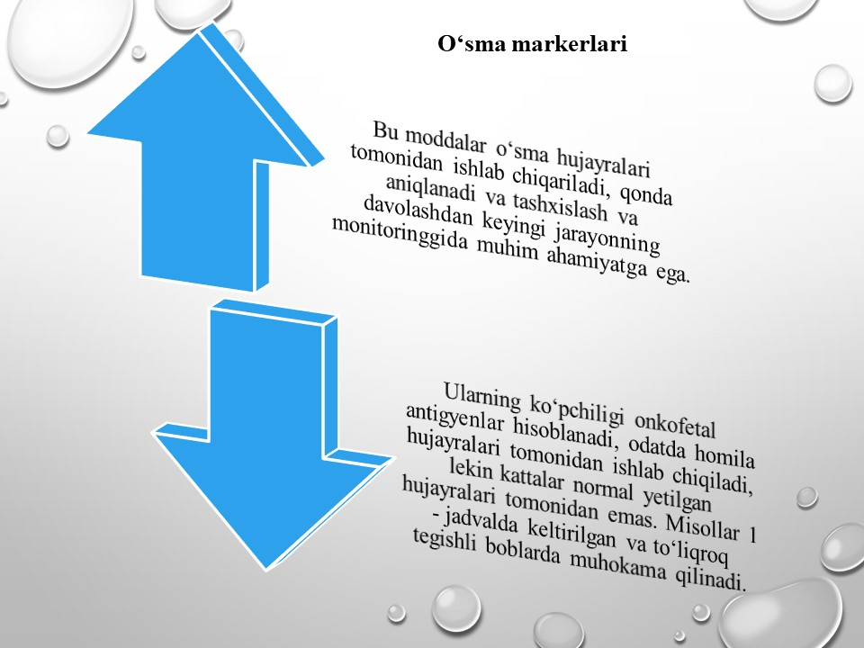

Slide 22
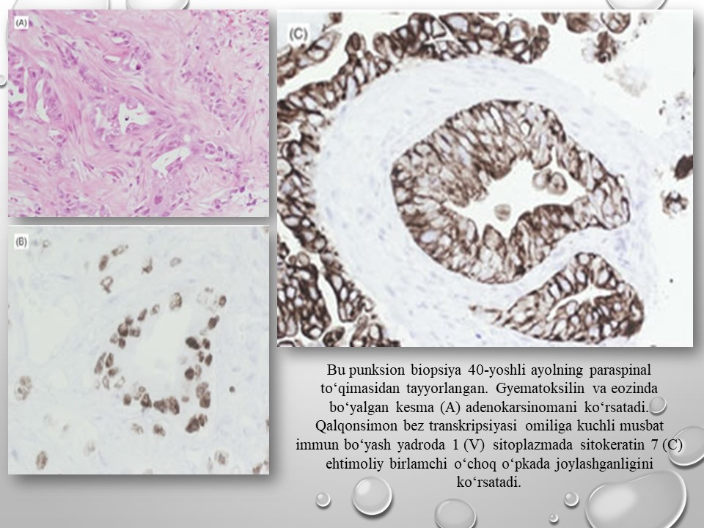
Rasm 5:Mamataliev A.R., Magrupov B.А., Don A.N. / ONKOMORFOLOGIYA O’quv qo’llanma Toshkent -2022y.

Slide 23
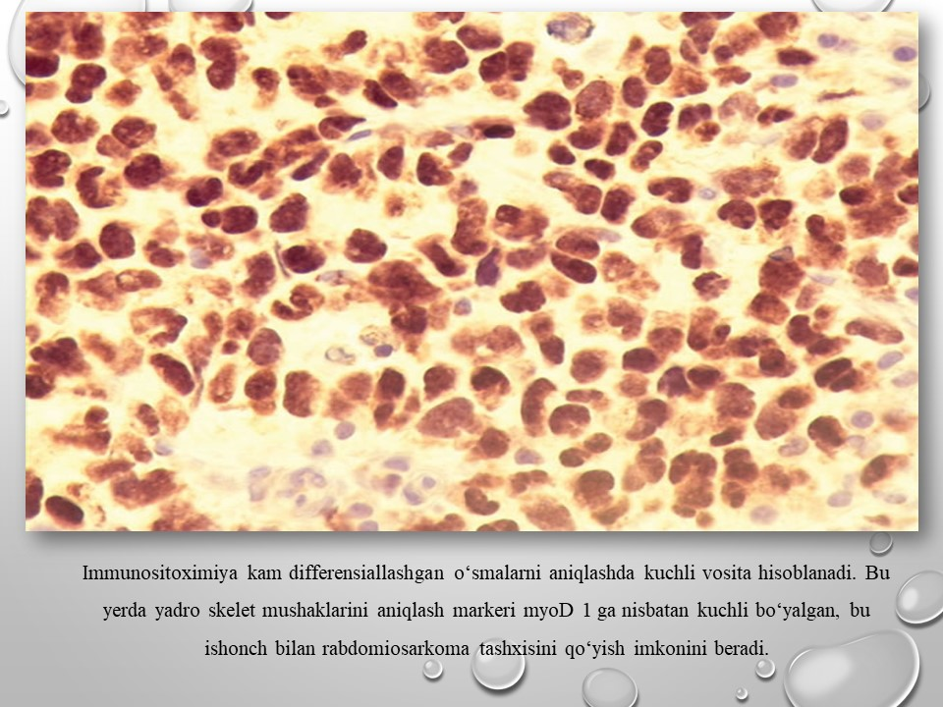
Rasm 6:Mamataliev A.R., Magrupov B.А., Don A.N. / ONKOMORFOLOGIYA O’quv qo’llanma Toshkent -2022y.

Slide 24
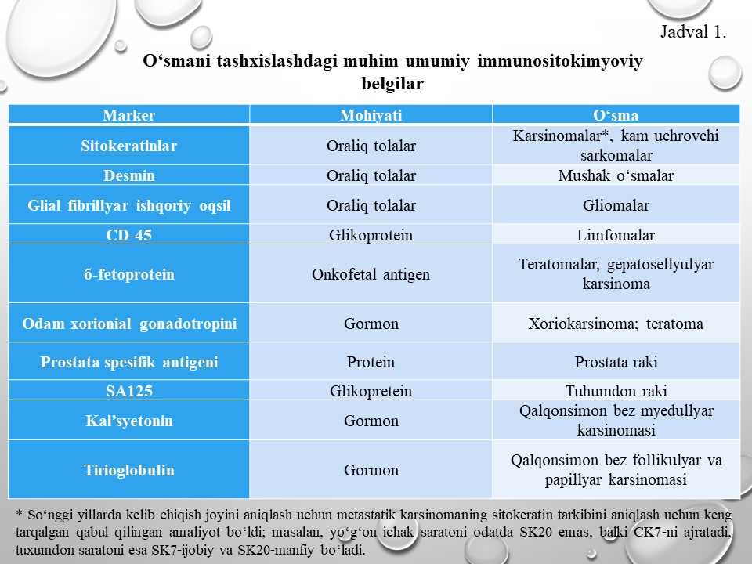

Slide 25
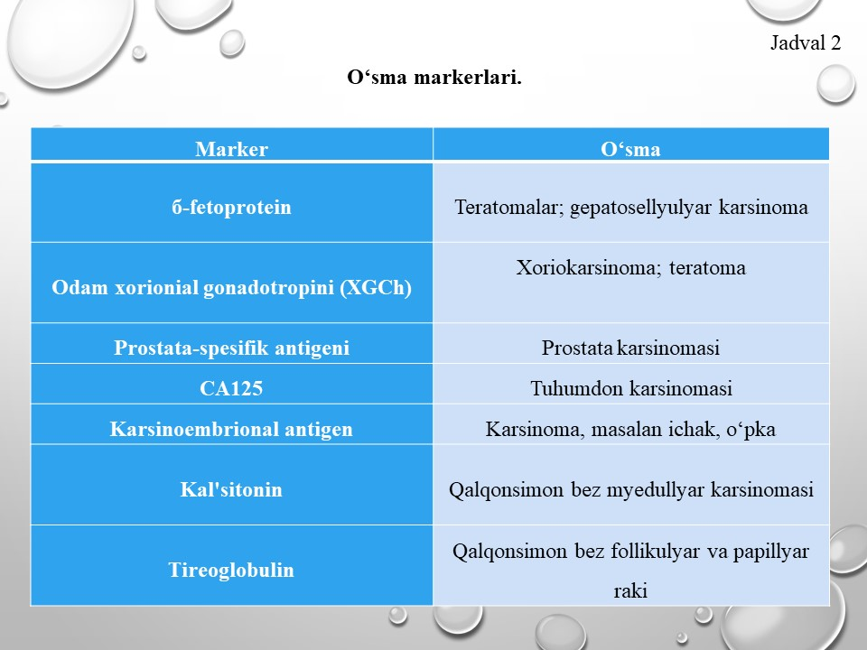

Slide 26
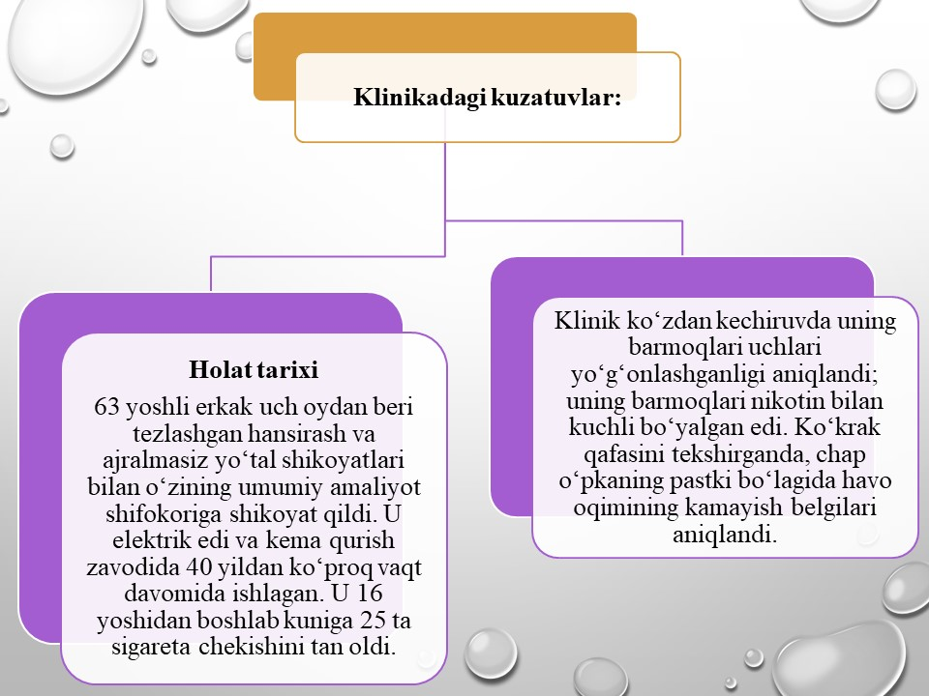

Slide 27
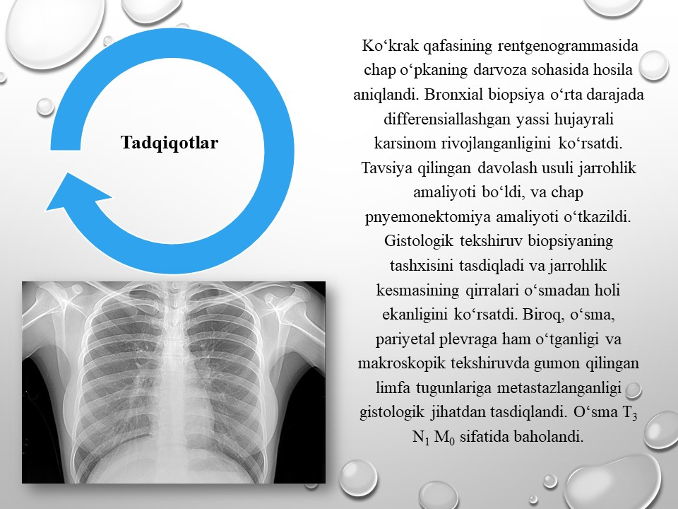
Image 7: https://www.ipn.md/ru/rastet-chislo-sluchaev-zabolevaniya-tyazhelymi-formami-tuberkuleza-7967_1004056.html

Slide 28
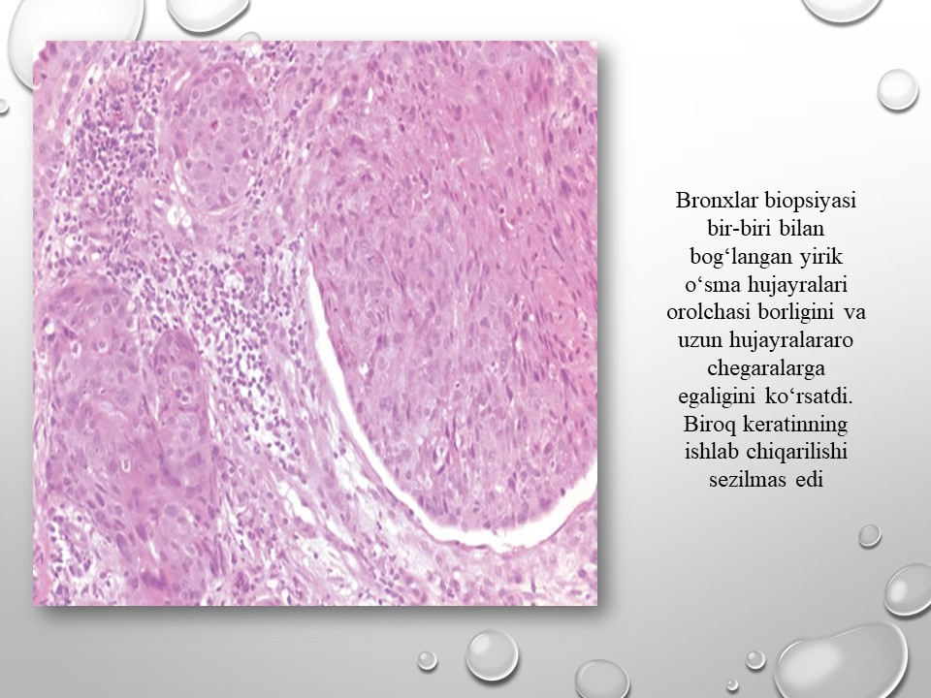
Rasm 8:Mamataliev A.R., Magrupov B.А., Don A.N. / ONKOMORFOLOGIYA O’quv qo’llanma Toshkent -2022y.

Slide 29
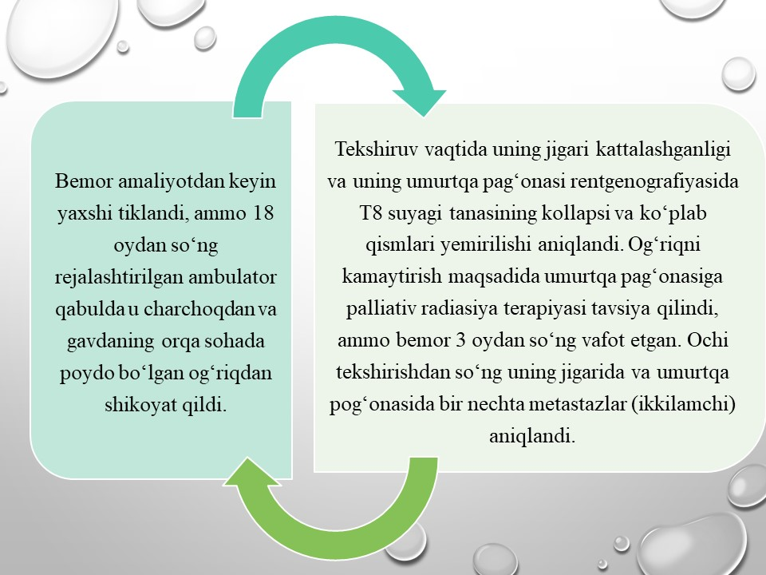

Slide 30
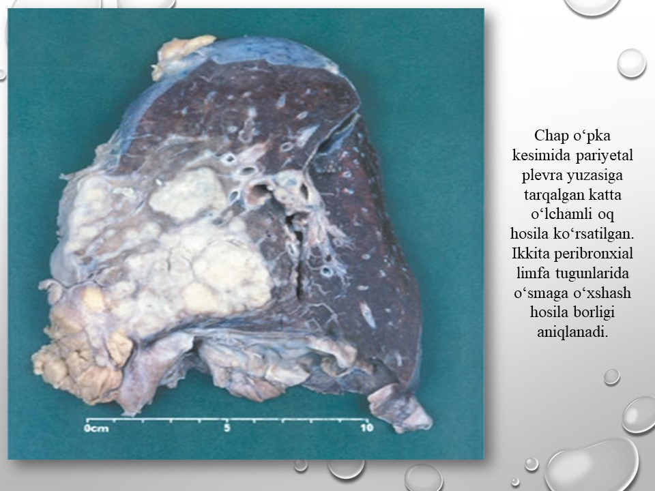
Rasm 9:Mamataliev A.R., Magrupov B.А., Don A.N. / ONKOMORFOLOGIYA O’quv qo’llanma Toshkent -2022y.

Slide 31
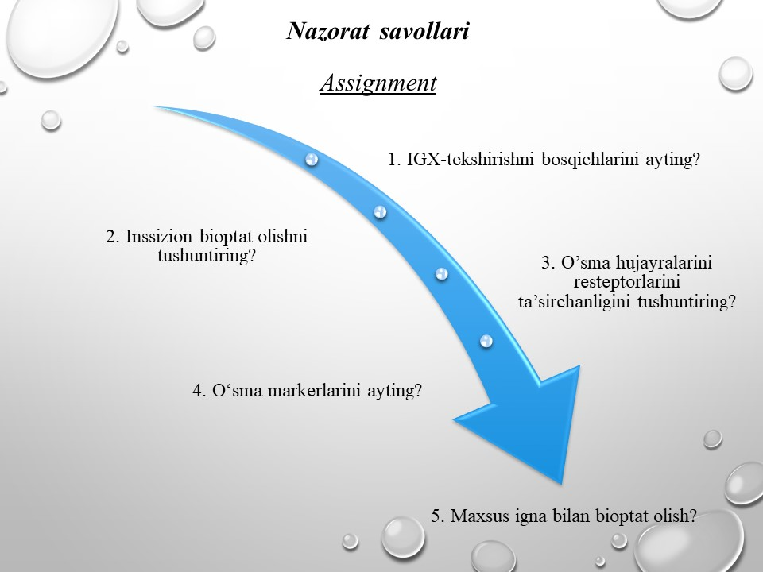

Slide 32
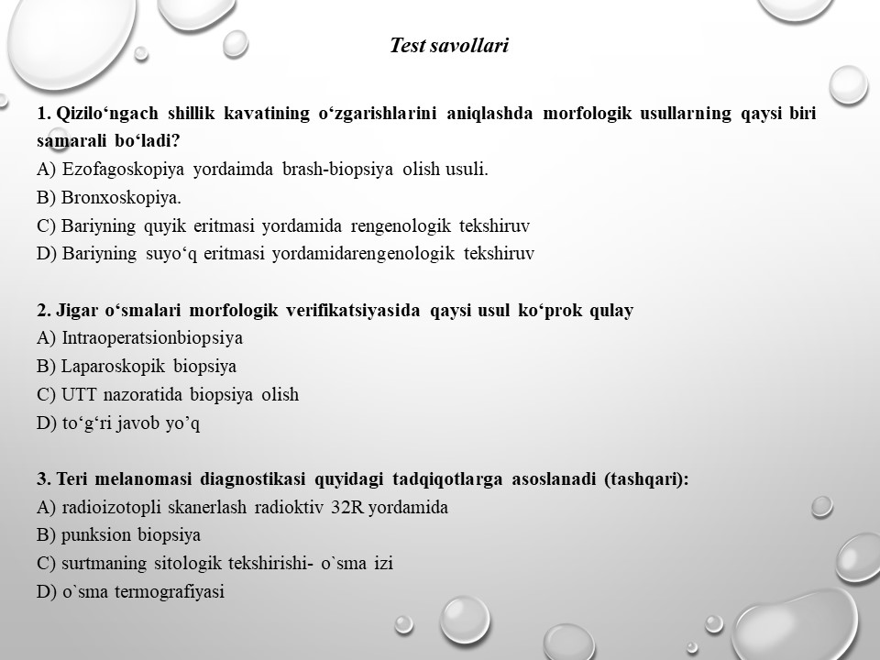

Slide 33
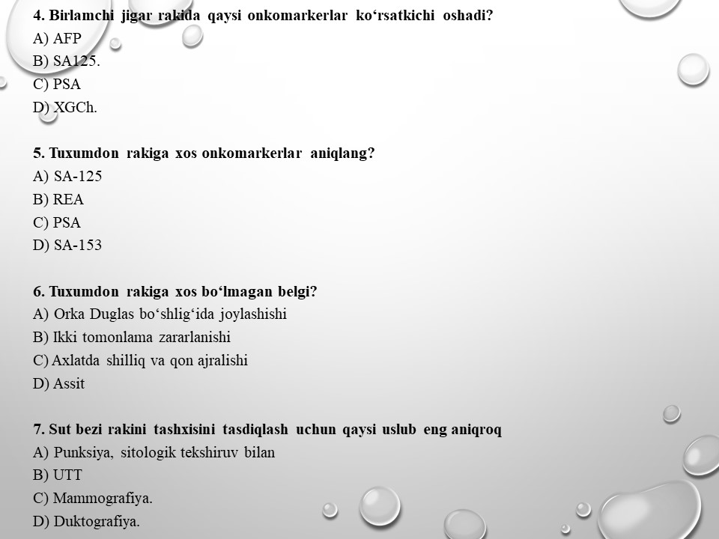

Slide 34
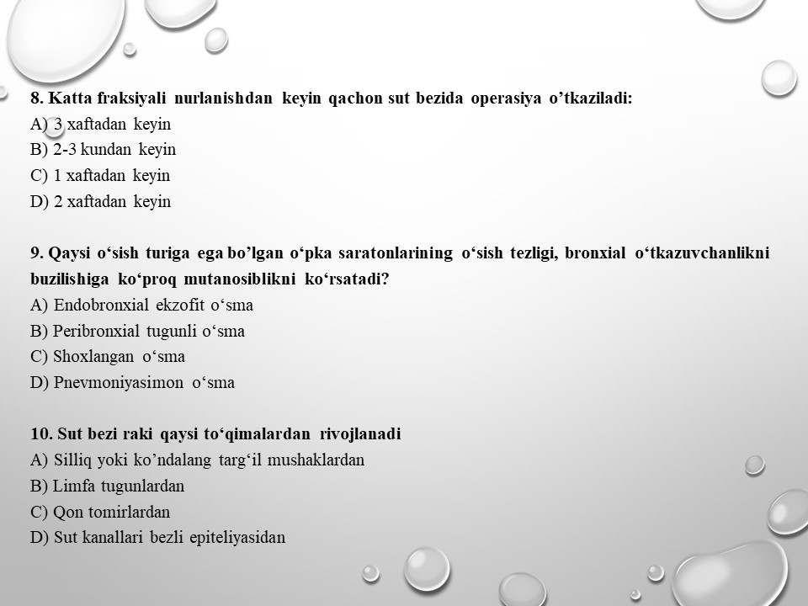

Slide 35
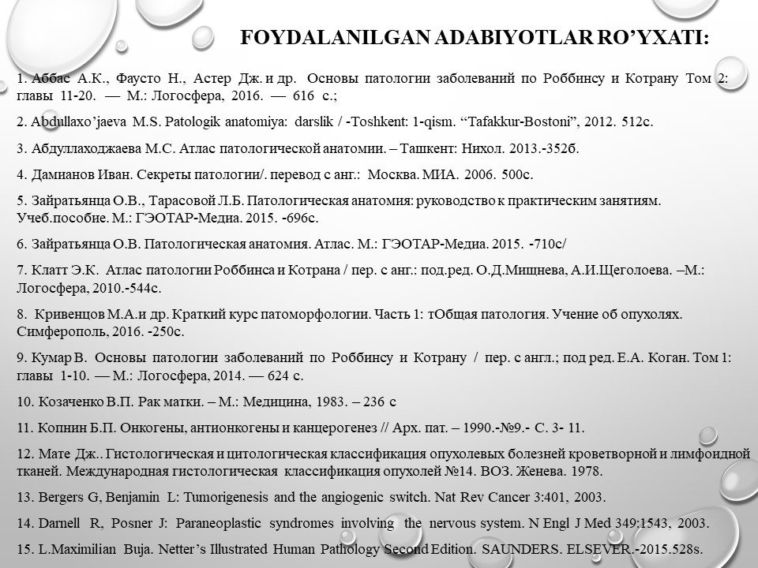

Slide 36


