Slide 1
Trauma and Trauma Therapy
Lecture 2
Stress and Crisis Counseling
Lecturer: Susan Gitau (PhD)

Slide 2
Introduction
Stress can be defined as any type of change that causes physical, emotional, or psychological strain. Stress is your body's response to anything that requires attention or action. Everyone experiences stress to some degree. The way you respond to stress, however, makes a big difference to your overall well-being.

Slide 3
Lecture Learning Outcomes
At the end of this lecture, you will be able to:
Define stress and related terms.
Identify types of stress
Explain the signs, causes and impact of stress.
Examine the treatments for stress and how to cope with stress

Slide 4
Types of Stress
Acute stress: Acute stress is a very short-term type of stress that can either be positive or more distressing; this is the type of stress we most often encounter in day-to-day life.
Chronic stress: Chronic stress is stress that seems never-ending and inescapable, like the stress of a bad marriage or an extremely taxing job; chronic stress can also stem from traumatic experiences and childhood trauma.

Slide 5
Types of Stress
Episodic acute stress: Episodic acute stress is acute stress that seems to run rampant and be a way of life, creating a life of ongoing distress.
Eustress: Eustress is fun and exciting. It's known as a positive type of stress that can keep you energized. It's associated with surges of adrenaline, such as when you are skiing or racing to meet a deadline.

Slide 6
Signs of Stress
Changes in mood
Clammy or sweaty palms
Decreased sex drive
Diarrhea
Difficulty sleeping
Digestive problems
Dizziness
Feeling anxious
Frequent sickness
Grinding teeth
Headaches
Low energy
Muscle tension, especially in the neck and shoulders
Physical aches and pains
Racing heartbeat
Trembling

Slide 7
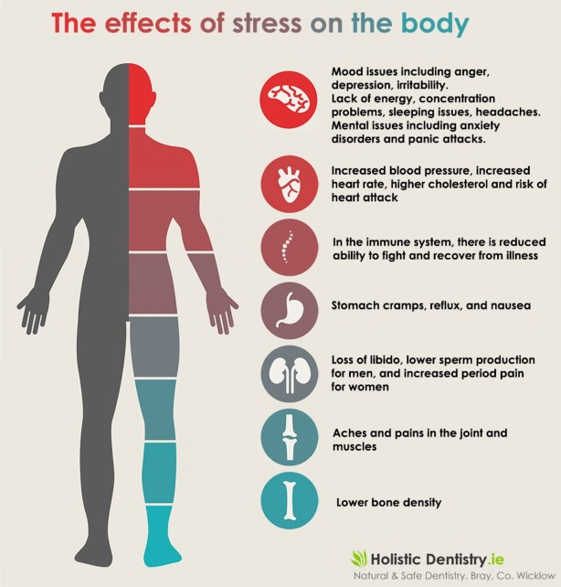
Impact of Stress
Physical
Emotional
Cognitive
Social
Spiritual
Behavioral

Slide 8
Causes of Stress
Some of the main sources of stress include:
work,
finances,
relationships,
parenting,
and day-to-day inconveniences.

Slide 9
Impact of Stress
Stress can trigger the body’s response to a perceived threat or danger, known as the fight-or-flight response. During this reaction, certain hormones like adrenaline and cortisol are released.

Slide 10
UNHEALTHY HABITS
Stress can also lead to some unhealthy habits that have a negative impact on your health. For example, many people cope with stress by eating too much or by smoking.
These unhealthy habits damage the body and create bigger problems in the long-term.

Slide 11
Impact of Stress
Stress can have several effects on your health and well-being. It can make it more challenging to deal with life's daily hassles, affect your interpersonal relationships, and have detrimental effects on your health.
The connection between your mind and body is apparent when you examine stress's impact on your life.

Slide 12
Impact of Stress
Feeling stressed over a relationship, money, or living situation can create physical health issues. The inverse is also true.
Health problems, whether you're dealing with high blood pressure or diabetes, will also affect your stress level and mental health.
When your brain experiences high degrees of stress, your body reacts accordingly.
Serious acute stress, like being involved in a natural disaster or getting into a verbal altercation, can trigger heart attacks, arrhythmias, and even sudden death.

Slide 13
Stress-Influenced Conditions
Diabetes
Hair loss
Heart disease
Hyperthyroidism
Obesity
Sexual dysfunction
Tooth and gum disease
Ulcers

Slide 14
Treatments for Stress
Psychotherapy
Some forms of therapy that may be particularly helpful in addressing symptoms of stress including
cognitive behavioral therapy (CBT)
mindfulness-based stress reduction (MBSR).
CBT focuses on helping people identify and change negative thinking patterns, while MBSR utilizes meditation and mindfulness to help reduce stress levels.

Slide 15
Treatment for Stress
Medication
Medication may sometimes be prescribed to address some specific symptoms that are related to stress. Such medications may include sleep aids, antacids, antidepressants, and anti-anxiety medications.
Complementary and Alternative Medicine
Some complementary approaches that may also be helpful for reducing stress include acupuncture, aromatherapy, massage, yoga, and meditation.

Slide 16
Burn out
Burnout happens to everyone at some point or another.
Our lives get busy going everywhere and doing everything from working, helping others, or taking care of our families.
Sometimes, we get too busy and forget to take a step back and rest. That is when burnout can occurs.

Slide 17
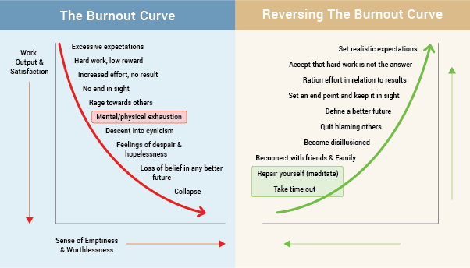
BURNOUT CURVE

Slide 18
Characteristic of Burnout
Burnout is characterized by exhaustion caused by constantly feeling swamped.
It’s a result of excessive and prolonged emotional, physical, and mental stress.
In many cases, burnout is related to one’s job than personal issues.

Slide 19
Characteristic of Burnout
The condition isn’t medically diagnosed though in 2019, WHO defined it as a serious mental and medical health concern because it affects one’s physical and mental health if not addressed.
Burnout keeps an individual from being productive. It reduces your energy, making one feel hopeless, cynical, and resentful.
The effects of burnout can hurt your family, work, and social life. Long- term burnout can make you more vulnerable to colds and flu

Slide 20
Coping With Stress
Learn to recognize the signs and symptoms of stress.
Beware of how stress affects you and impacts your life
Try to get regular exercise.
Take care of yourself.
Practice mindfulness in your life.
Be compassionate to yourself

Slide 21
Main Causes of Burnout
High expectations at workplace
Unmanageable workloads
Unfair treatment at work
Confusing work responsibilities
Lack of communication or support from managers
Immense deadline pressure
Incompetence

Slide 22
Types of Burnout
Three types of burnout have been identified, each with their own cause:
Overload Burnout
This happens when you work harder and harder, becoming frantic in your pursuit of success. If you experience this, you may be willing to risk your health and personal life to feel successful in your job.

Slide 23
Types of Burnout
Under-Challenged Burnout
This happens when you feel underappreciated and bored in your job. Maybe your job doesn’t provide learning opportunities or have room for professional growth. If you feel under-challenged, you may distance yourself from your job, become cynical, and avoid responsibilities.

Slide 24
Types of Burnout
Neglect Burnout
This happens when a worker feel helpless at work. If things aren’t going right, they may believe they are incompetent or unable to keep up with responsibilities. Such burnout can be closely connected to imposter syndrome, a psychological pattern in which you doubt your skills, talents, or accomplishments (Salvagioni et al; 2017).

Slide 25
A crisis is a perception of an event or situation as an intolerable difficulty situation that exceeds a person’s resources and coping mechanisms.
Usually, it is a disruptive experience with the affected person feeling frustrated, fearful, shocked, and distressed about the crisis. It is a situation that calls for urgent external assistance or support to enable the person move on.
Most disasters, sudden illness, dismissal from work are crisis situations.

Slide 26
Stress and Crisis
Stress can get a person into a state of crisis and crisis can lead to stress. For example, when an individual is in a financial crisis, family crisis, relationship crisis, workplace crisis, they are likely to become stressed.
Equally, when an individual is stressed, they may not perform their duties as before and they may not make right decisions as opposed to when they had no stress.
Consequently, they find themselves in state of crisis marked with diminished personal coping resources.

Slide 27
Crisis Intervention
For personal crisis, an individual can seek counseling and life coaching services.
For group and community crisis, programs that include emergency response personnel (counselors, medical experts,fire fighters, emergency response workers) and strategies like psychological first aid (PFA) and general first aid training might be helpful for you as counselor in trauma work.
Practising mindfulness and mindful self compassion is also helpful in crisis intervention and self care.

Slide 28
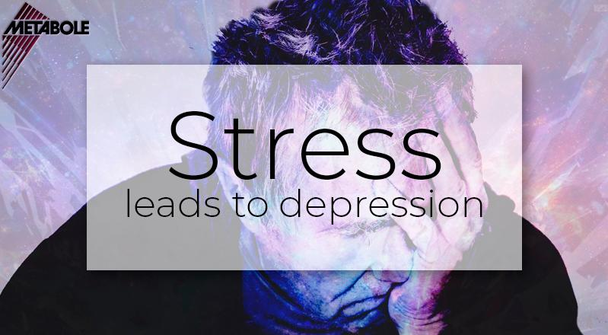
STRESS AND DEPRESSION
Stress, crisis and burnout if left unmanaged can lead to depression

Slide 29
Conclusion
Stress is a normal part of life for everyone. Some stress is positive because it energizes an individual to rise and do something about the stressors.
However, some stress maybe harmful because if prolonged and not worked through can lead to serious mental , physical and psychological health issues.
This lecture has defined stress and related terms, identify types of stress, explained the signs, causes and impact of Stress as well as examined various treatments for stress and how to cope with stress. In lecture three, we shall look into the counselor’s personal trauma story and see the effect of the same in trauma care practice

Slide 30
References
Bianchi , R., Schonfeld, I., & Laurent , E. (2015). Burnout-depression overlap: a review. Clin Psychol Rev., 36(1), 28-41.
Bitonte, R., & DeSanto , D. (2014). Mandatory physical exercise for the prevention of mental illness in medical students. . Ment Illn., 6(2), 5549.
Demerouti, E. (2015). Strategies used by individuals to prevent burnout. Eur J Clin Invest., 45(10), 11-12.
Gladding, S. T., & Newsome, W. D. (2018). Clinical mental health counseling in community and agency settings. New York: Pearson
Goldstein, D. (2010). Adrenal responses to stress. Cell Mol Neurobiol., 30(8), 1433–1440.
Salvagioni DAJ, Melanda FN, Mesas AE, González AD, Gabani FL, & Andrade SM. (2017). Physical, psychological and occupational consequences of job burnout: A systematic review of prospective studies. PLoS One. 12(10):e0185781. Published 2017 Oct 4. doi:10.1371/journal.pone.0185781
Stahl JE, Dossett ML, & LaJoie AS, et al. (2017). Relaxation response and resiliency training and its effect on healthcare resource utilization [published correction appears in PLoS One. 12 (2):e0172874]. PLoS One. 2015;10(10):e0140212. doi:10.1371/journal.pone.0140212
https://www.youtube.com/watch?v=d6dZXU-pJYw&t=178s
https://www.youtube.com/watch?v=TljiLETXZSM

