Slide 1

Discrete Mathematics
Lecture 12
Introduction to Mathematical Proofs
Lecturer: Kahenya, N.P

Slide 2

Introduction to Lecture 12
The lecture will introduce methods of direct and indirect mathematical proof. Mathematical proofs are important in developing your logical and analytical skills relevant to programming.
This lecture builds on concepts learnt in the lectures on logic and validity, propositional and predicate logic.

Slide 3

References and Further readings
The lecture notes have derived from relevant topics from (Kahenya, 2017; Murray & Robert, 2009; Rosen, 2012; Stewart, 2012) and lecture 13 from mathematics for science (Kahenya, 2022).

Slide 4
Intended Learning Outcomes
Be
At the end of this lecture, you will be able to;
Explain
Explain the direct and indirect methods of mathematical proofs.
Apply
Apply the methods of direct and indirect proofs to prove theorems.

Slide 5

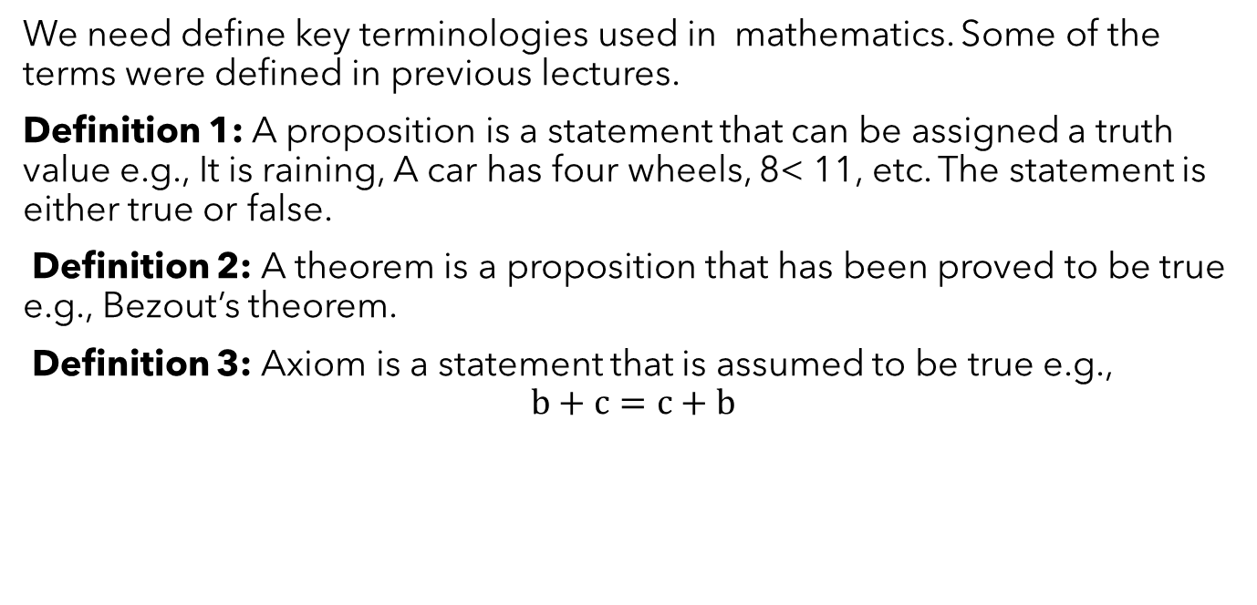
Definition of Terms
We need define key terminologies used in mathematics. Some of the terms were defined in previous lectures.
Definition 1: A proposition is a statement that can be assigned a truth value e.g., It is raining, A car has four wheels, 8< 11, etc. The statement is either true or false.
Definition 2: A theorem is a proposition that has been proved to be true e.g., Bezout’s theorem.
Definition 3: Axiom is a statement that is assumed to be true e.g.,
$$b+c=c+b$$

Slide 6

Types of Reasoning
Reasoning can be viewed as drawing of inferences or conclusions from known or assumed facts.
Deductive reasoning is the type of logic (science of correct reasoning that is fundamental to critical thinking and problem solving) that involves the application of a general statement to a specific case i.e., from general to specific.
On the other hand, inductive reason is drawing conclusions from a specific case i.e., from specific to general (Kahenya, 2022).

Slide 7

Examples
An example of deductive reasoning (from GENERAL to SPECIFIC) is the use of a formula to solve a particular problem e.g.,
We use the general quadratic formula to solve specific problems involving quadratic equations (Kahenya, 2022).
An example of inductive reasoning (from Specific to General) is where we use a blood sample to make a conclusion or generalization of the entire blood.

Slide 8
An argument is a structure that consists of premises or assumptions and a conclusion.
Proof is an argument that is used to establish the truth of a theorem .
We have different methods of mathematical proofs for establishing the truth of statements or theorems or claims.
There exist direct and indirect methods of proof used depending on the nature of the statement, theorem, or claim.

Slide 9

Method of Direct Proof
In methods of direct proof, one starts with the hypothesis of an implication and then shows that the conclusion is true.
One assumes the hypothesis is true and then presents a logical chain of reasoning to directly establish the truth of the conclusion.

Slide 10

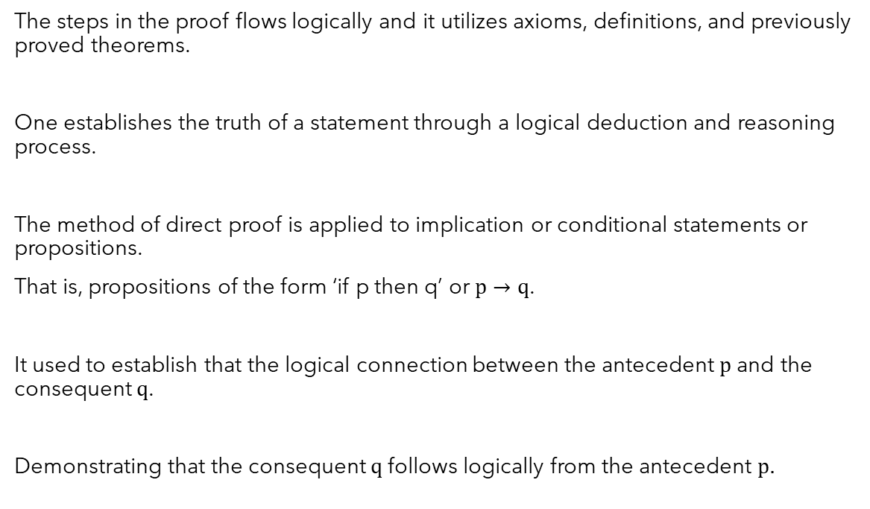
Method of Direct Proof…contd…
The steps in the proof flows logically and it utilizes axioms, definitions, and previously proved theorems.
One establishes the truth of a statement through a logical deduction and reasoning process.
The method of direct proof is applied to implication or conditional statements or propositions.
That is, propositions of the form ‘if p then q’ or $p→q$.
It used to establish that the logical connection between the antecedent $p$ and the consequent $q$.
Demonstrating that the consequent $q$ follows logically from the antecedent $p.$

Slide 11
Methods of direct
There exist different methods of direct proof among them.
Constructive proof
Method of exhaustion
Method of counterexample
Method of proof by cases

Slide 12

Constructive Proof
The method seeks to establish the truth of a statement and goes further by providing explicit evidence (constructive procedure) to demonstrate the validity of the conclusion.
This method provides practical insights and methods.
One can use this method of proof in areas such as number theory, optimization etc. where explicit solutions are important.

Slide 13

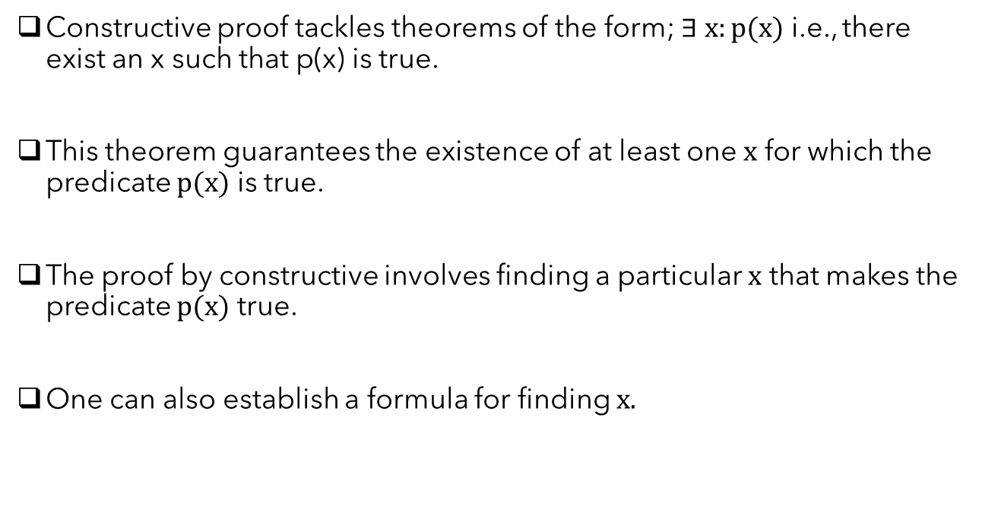
Constructive proof…contd…
Constructive proof tackles theorems of the form; $∃ x:p(x)$ i.e., there exist an x such that p(x) is true.
This theorem guarantees the existence of at least one $x$ for which the predicate $p(x)$ is true.
The proof by constructive involves finding a particular $x$ that makes the predicate $p(x)$ true.
One can also establish a formula for finding $x.$

Slide 14

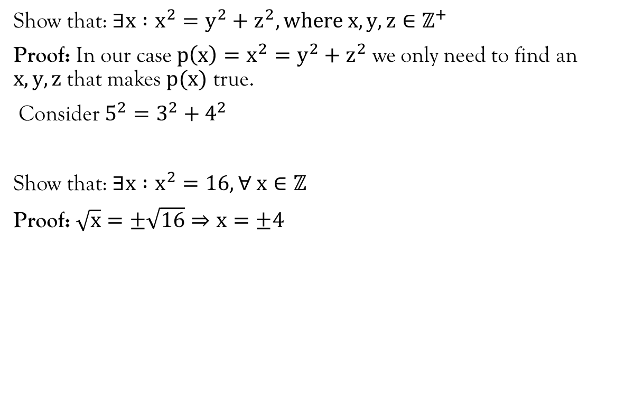
Examples
Show that: $∃x :x^{2}=y^{2}+z^{2}, where x,y,z∈ℤ^{+}$
Proof: In our case $p\left(x\right)=x^{2}=y^{2}+z^{2}$ we only need to find an $x,y,z$ that makes $p(x)$ true.
Consider $5^{2}=3^{2}+4^{2}$
Show that: $∃x :x^{2}=16, ∀ x∈ℤ$
Proof: $\sqrt{x}=±\sqrt{16}⇒x=±4$

Slide 15
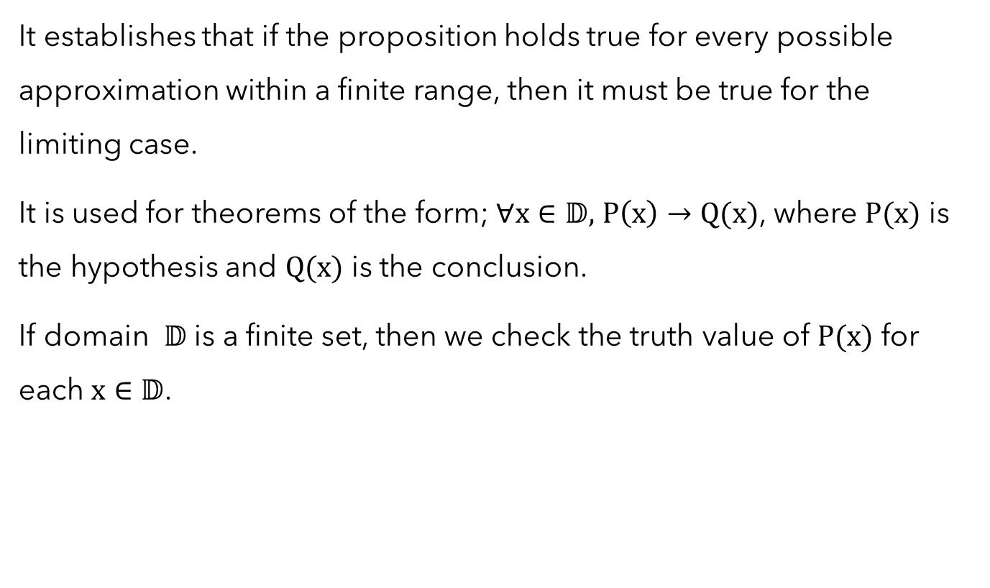
Method of Exhaustion
It establishes that if the proposition holds true for every possible approximation within a finite range, then it must be true for the limiting case.
It is used for theorems of the form; $∀x∈𝔻,$ $P\left(x\right)→Q(x)$, where $P(x)$ is the hypothesis and $Q(x)$ is the conclusion.
If domain $𝔻$ is a finite set, then we check the truth value of $P(x)$ for each $x∈𝔻$.

Slide 16
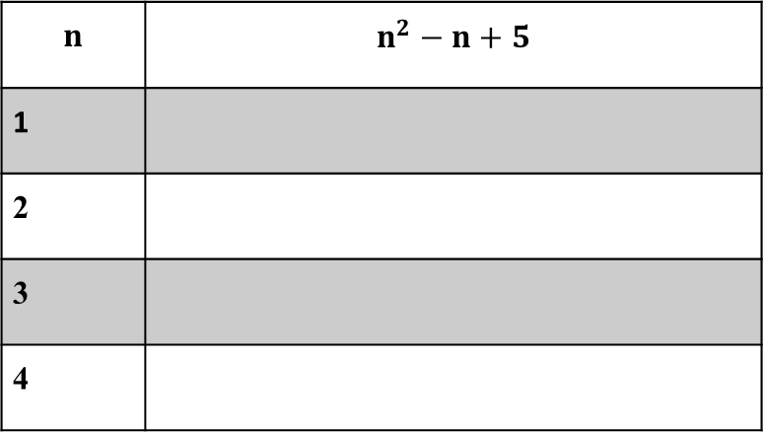
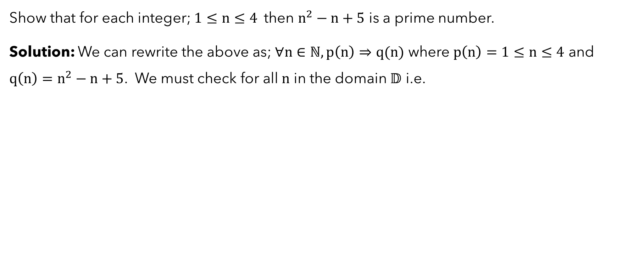
Example 1
Show that for each integer; $1≤n≤4$then $n^{2}−n+5$ is a prime number.
Solution: We can rewrite the above as; $∀n∈ℕ, p\left(n\right)⇒q(n)$ where $p\left(n\right)=1≤n≤4$ and $q\left(n\right)=n^{2}−n+5$. We must check for all $n$ in the domain $𝔻$ i.e.
$$n$$ | $$n^{2}−n+5$$
1
2
3
4

Slide 17

Method of Counterexample
It involves using logical reasoning to disprove a claim by providing a specific example or scenario where the claim fails to hold true.
You only need to provide a single instance that contradicts the given proposition.
This instance must demonstrate the invalidity of the given proposition.

Slide 18
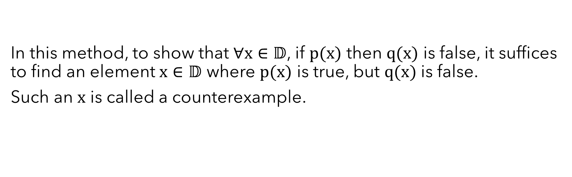
Method of counterexample…contd…
In this method, to show that $∀x∈𝔻$, if $p(x)$ then $q(x)$ is false, it suffices to find an element $x∈𝔻$ where $p(x)$ is true, but $q(x)$ is false.
Such an $x$ is called a counterexample.

Slide 19
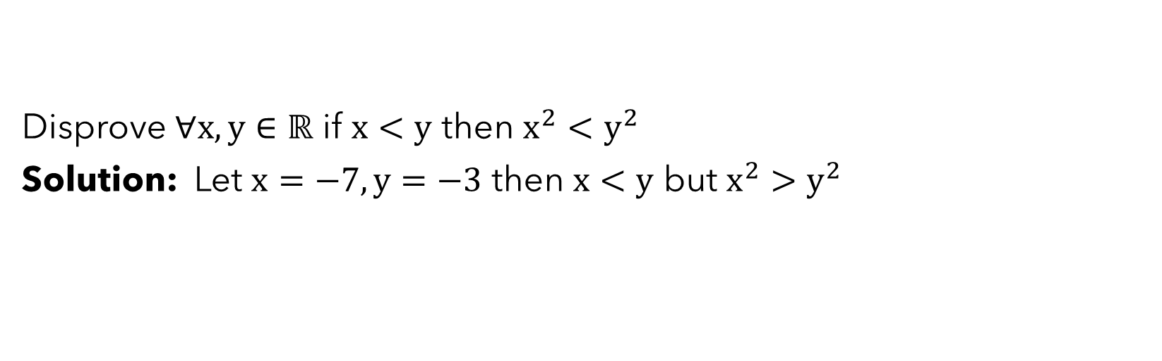
Example 1
Disprove $∀x,y∈ℝ$ if $x<y$ then $x^{2}<y^{2}$
Solution: Let $x=−7, y=−3$ then $x<y$ but $x^{2}>y^{2}$

Slide 20

Example 2
Prove: Every computer science student owns a laptop.
Solution: It suffices to find at least one computer science student who owns no laptop.

Slide 21

Method of Proof by Cases
This method involves splitting the statement into distinct cases and proceeding by proving each case individually, demonstrating that the statement holds true under each case specific circumstance.
It is appropriate when one is interested in identifying key scenarios that encompass all possible situations and hence proving the claim separately for each case rather than considering all possibles cases exhaustively.

Slide 22

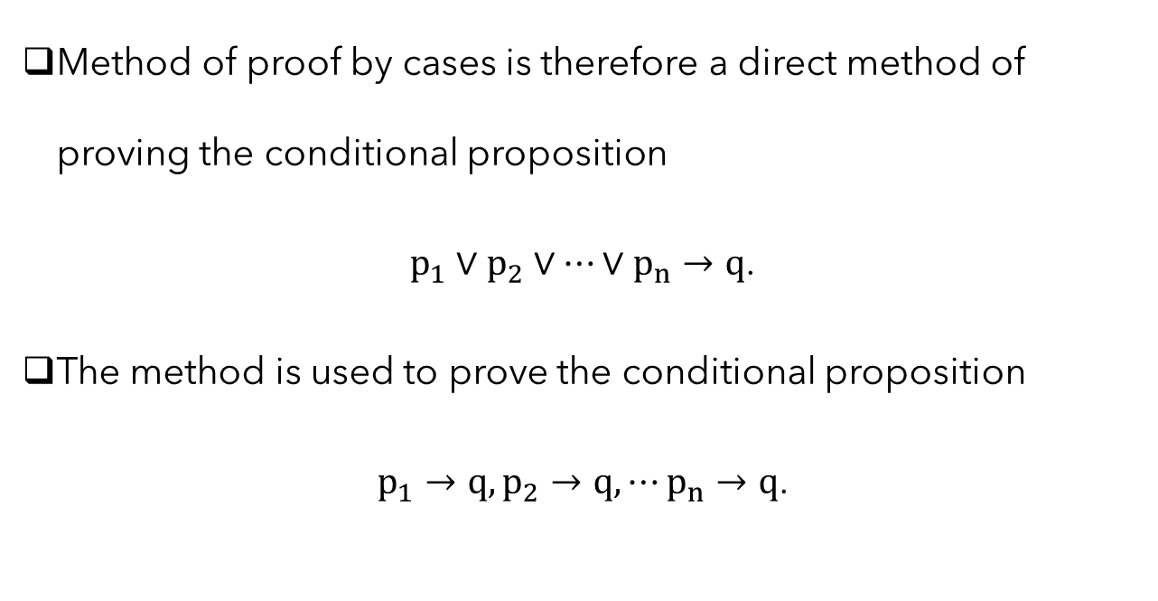
Method of Proof by Cases…contd…
Method of proof by cases is therefore a direct method of proving the conditional proposition
$p_{1}∨p_{2}∨⋯∨p_{n}→q$.
The method is used to prove the conditional proposition
$p_{1}→q, p_{2}→q, ⋯p_{n}→q$.

Slide 23
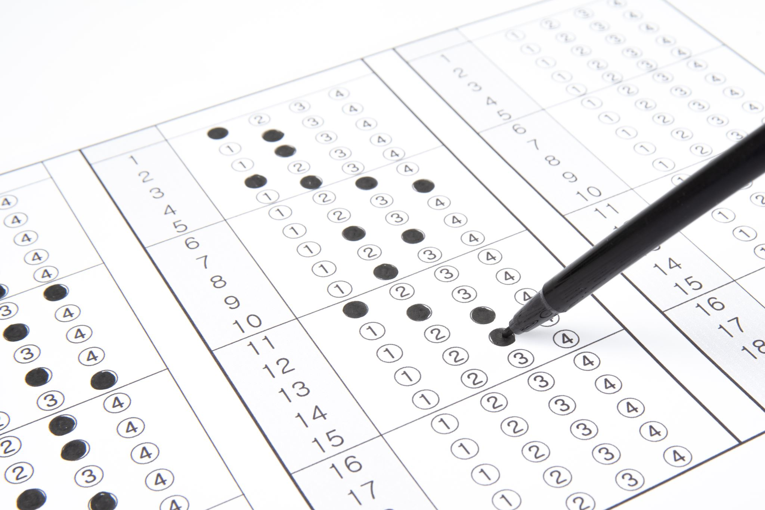
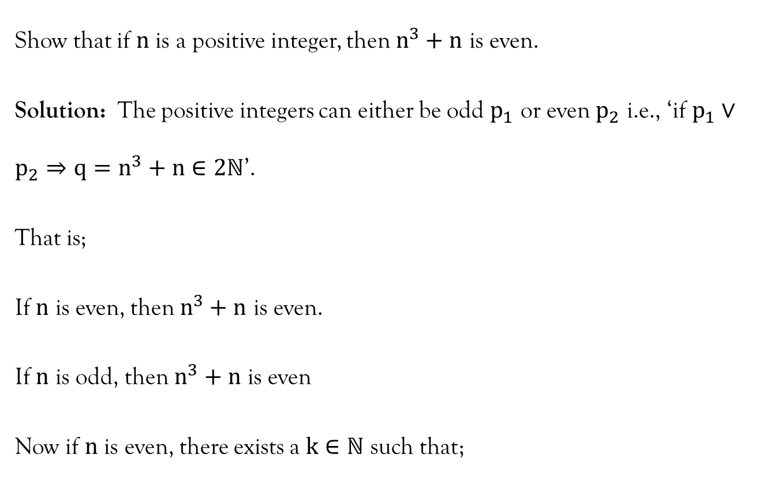
Example 1
Show that if $n$ is a positive integer, then $n^{3}+n$ is even.
Solution: The positive integers can either be odd $p_{1}$ or even $p_{2}$ i.e., ‘if $p_{1}∨p_{2}⇒{q=n}^{3}+n∈2ℕ$’.
That is;
If $n$ is even, then $n^{3}+n$ is even.
If $n$ is odd, then $n^{3}+n$ is even
Now if $n$ is even, there exists a $k∈ℕ$ such that;

Slide 24

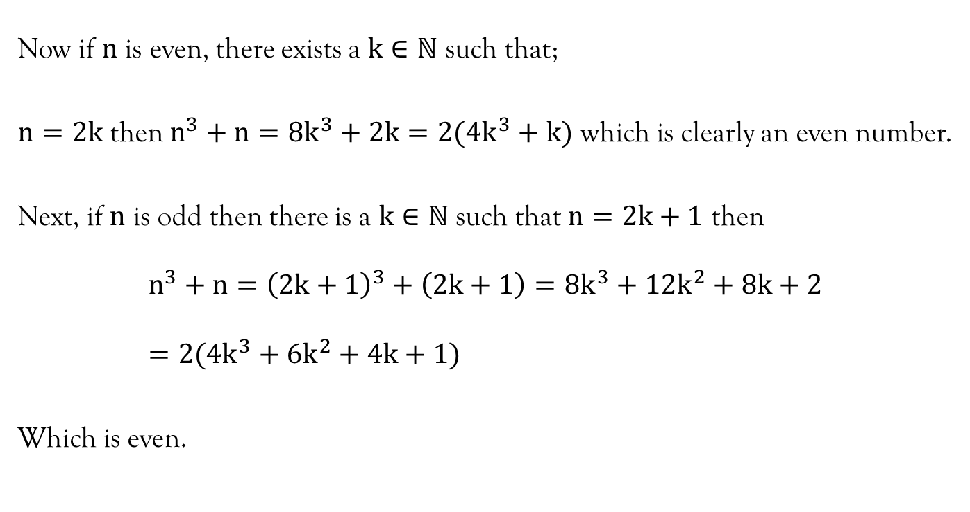
Example 1…contd…
Now if $n$ is even, there exists a $k∈ℕ$ such that;
$n=2k$ then $n^{3}+n=8k^{3}+2k=2(4k^{3}+k)$ which is clearly an even number.
Next, if $n$ is odd then there is a $k∈ℕ$ such that $n=2k+1$ then
$$n^{3}+n={\left(2k+1\right)}^{3}+\left(2k+1\right)=8k^{3}+12k^{2}+8k+2=2(4k^{3}+6k^{2}+4k+1)$$
Which is even.

Slide 25

Methods of Indirect Proof
Some statements or claims may be difficulty to prove directly and hence the importance of methods of indirect proof.
Some important methods of indirect proofs include proof by contradiction, proof by contrapositive, and proof by mathematical induction.

Slide 26
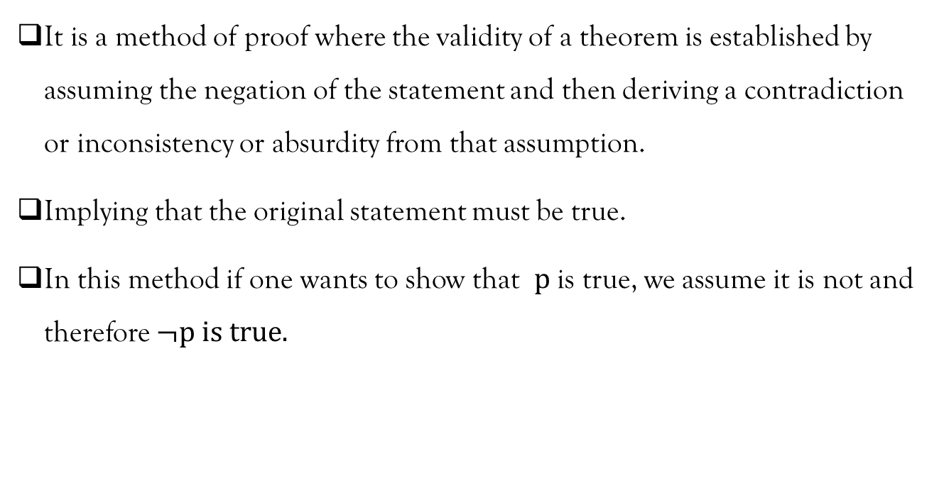
Proof by Contradiction
It is a method of proof where the validity of a theorem is established by assuming the negation of the statement and then deriving a contradiction or inconsistency or absurdity from that assumption.
Implying that the original statement must be true.
In this method if one wants to show that $p$ is true, we assume it is not and therefore $¬p is true.$

Slide 27

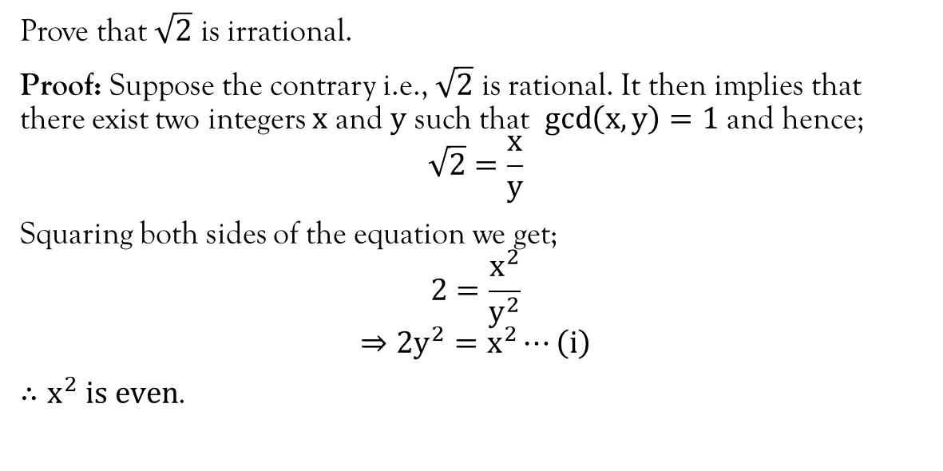
Example 1
Prove that $\sqrt{2}$ is irrational.
Proof: Suppose the contrary i.e., $\sqrt{2}$ is rational. It then implies that there exist two integers $x$ and $y$ such that $\gcd\left(x,y\right)=1$ and hence;
$$\sqrt{2}=\frac{x}{y}$$
Squaring both sides of the equation we get;
$$2=\frac{x^{2}}{y^{2}}$$
$$⇒2y^{2}=x^{2}⋯\left(i\right)$$
$∴x^{2} is even$.

Slide 28

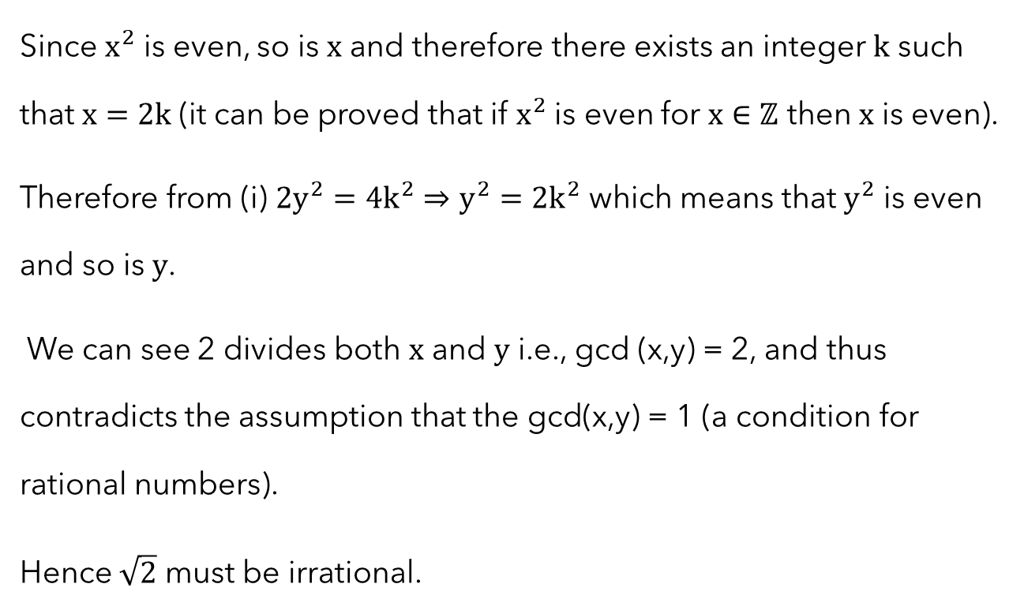
Example 1…contd…
Since $x^{2}$ is even, so is $x$ and therefore there exists an integer $k$ such that $x=2k$ (it can be proved that if $x^{2}$ is even for $x∈ℤ$ then $x$ is even).
Therefore from (i) $2y^{2}=4k^{2}⇒y^{2}=2k^{2}$ which means that $y^{2}$ is even and so is $y$.
We can see 2 divides both $x$ and $y$ i.e., gcd (x,y) = 2, and thus contradicts the assumption that the gcd(x,y) = 1 (a condition for rational numbers).
Hence $\sqrt{2}$ must be irrational.

Slide 29
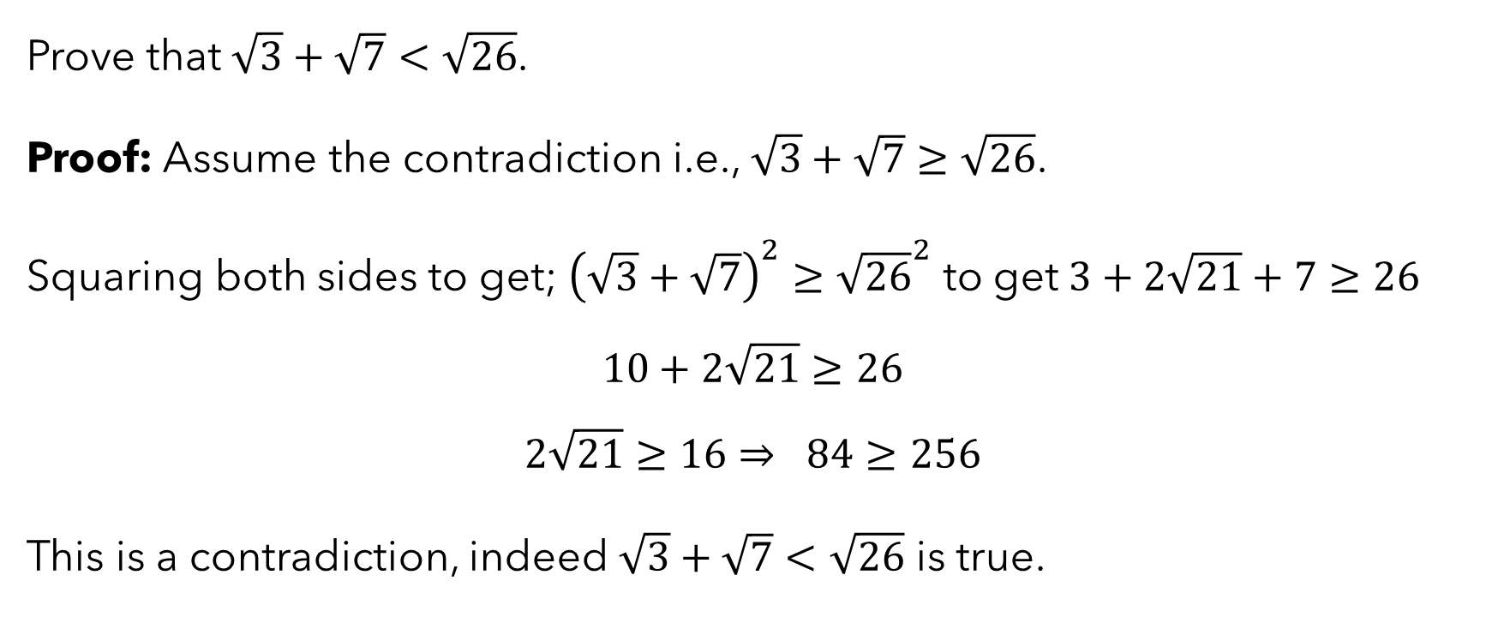
Example 2
Prove that $\sqrt{3}+\sqrt{7}<\sqrt{26}$.
Proof: Assume the contradiction i.e., $\sqrt{3}+\sqrt{7}≥\sqrt{26}$.
Squaring both sides to get; ${\left(\sqrt{3}+\sqrt{7}\right)}^{2}≥{\sqrt{26}}^{2}$ to get $3+2\sqrt{21}+7≥26$
$$10+2\sqrt{21}≥26$$
$$2\sqrt{21}≥16⇒ 84≥256$$
This is a contradiction, indeed $\sqrt{3}+\sqrt{7}<\sqrt{26}$ is true.

Slide 30

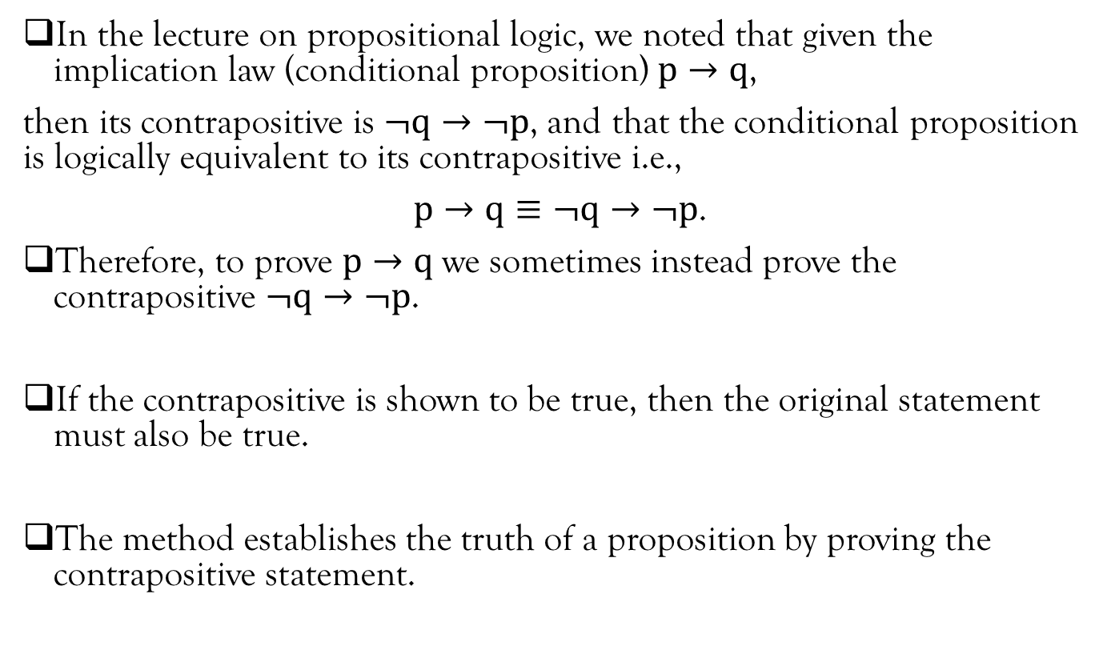
Proof by Contrapositive
In the lecture on propositional logic, we noted that given the implication law (conditional proposition) $p→q$,
then its contrapositive is $¬q→¬p$, and that the conditional proposition is logically equivalent to its contrapositive i.e.,
$p→q≡¬q→¬p$.
Therefore, to prove $p→q$ we sometimes instead prove the contrapositive $¬q→¬p$.
If the contrapositive is shown to be true, then the original statement must also be true.
The method establishes the truth of a proposition by proving the contrapositive statement.

Slide 31

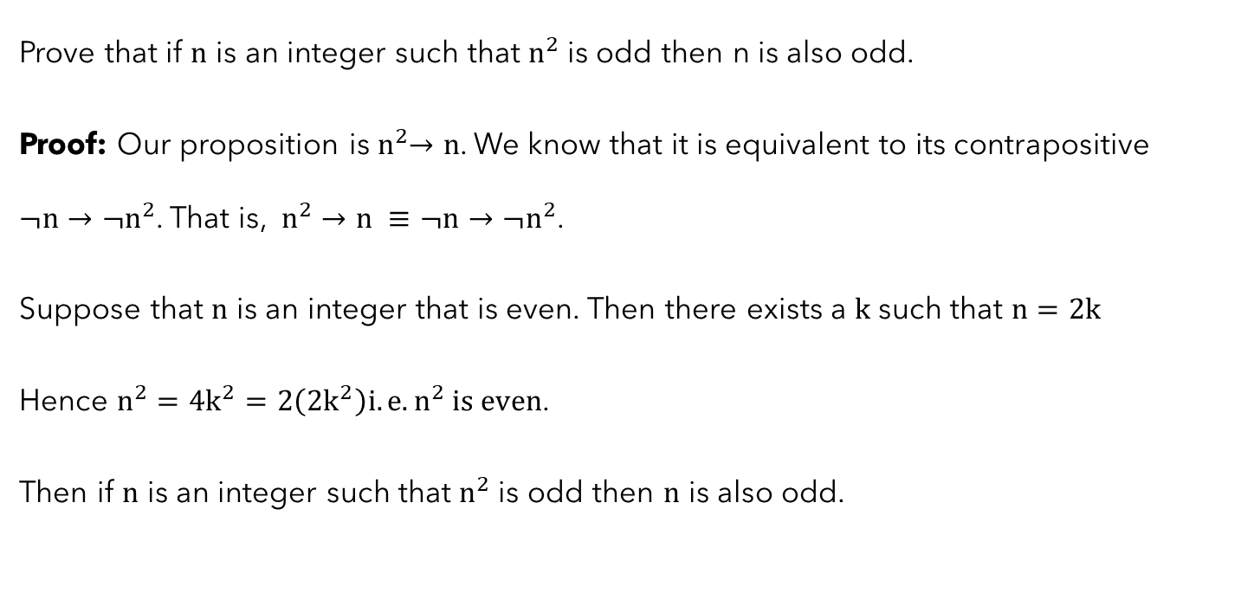
Example 1
Prove that if $n$ is an integer such that $n^{2}$ is odd then n is also odd.
Proof: Our proposition is${ n}^{2}→n$. We know that it is equivalent to its contrapositive $¬n→¬n^{2}$. That is, $n^{2}→n ≡¬n→¬n^{2}$.
Suppose that $n$ is an integer that is even. Then there exists a $k$ such that $n=2k$
Hence $n^{2}=4k^{2}=2\left(2k^{2}\right)i.e. n^{2} is even$.
Then if $n$ is an integer such that $n^{2}$ is odd then $n$ is also odd.

Slide 32
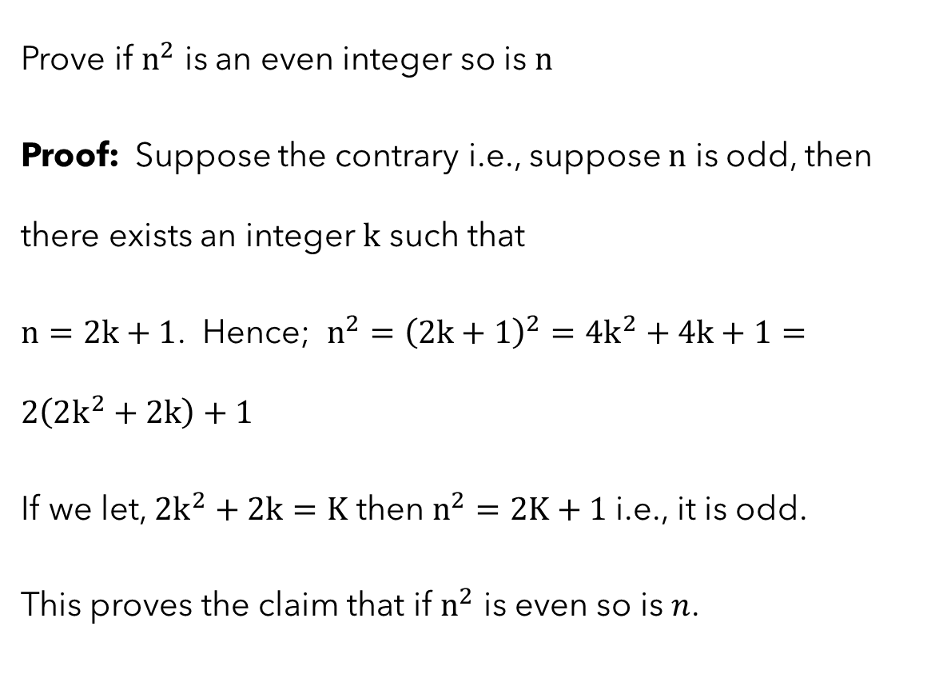
Example 2
Prove if $n^{2}$ is an even integer so is $n$
Proof: Suppose the contrary i.e., suppose $n$ is odd, then there exists an integer $k$ such that
$n=2k+1$. Hence; $n^{2}={\left(2k+1\right)}^{2}=4k^{2}+4k+1=2\left(2k^{2}+2k\right)+1$
If we let, $2k^{2}+2k=K$ then $n^{2}=2K+1$i.e., it is odd.
This proves the claim that if $n^{2}$ is even so is $n$.

Slide 33

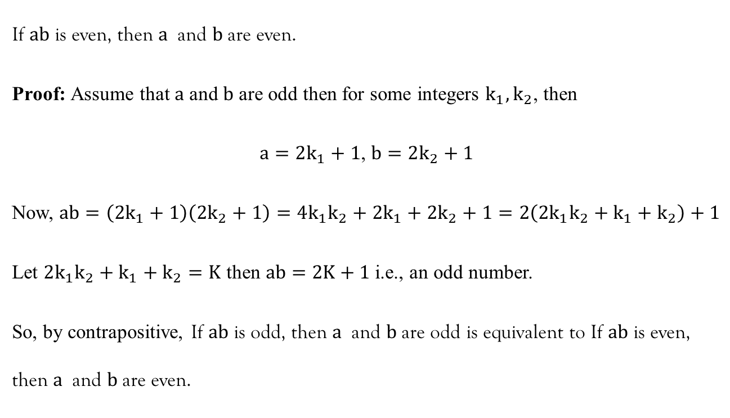
Example 3
If $ab$ is even, then $a$ and $b$are even.
Proof: Assume that $a$ and $b$ are odd then for some integers $k_{1}, k_{2}$, then
$a=2k_{1}+1$, $b=2k_{2}+1$
Now, $ab=\left(2k_{1}+1\right)\left(2k_{2}+1\right)=4k_{1}k_{2}+2k_{1}+2k_{2}+1=2\left(2k_{1}k_{2}+k_{1}+k_{2}\right)+1$
Let $2k_{1}k_{2}+k_{1}+k_{2}=K$ then $ab=2K+1$ i.e., an odd number.
So, by contrapositive, If $ab$ is odd, then $a$ and $b$are odd is equivalent to If $ab$ is even, then $a$ and $b$are even.

Slide 34

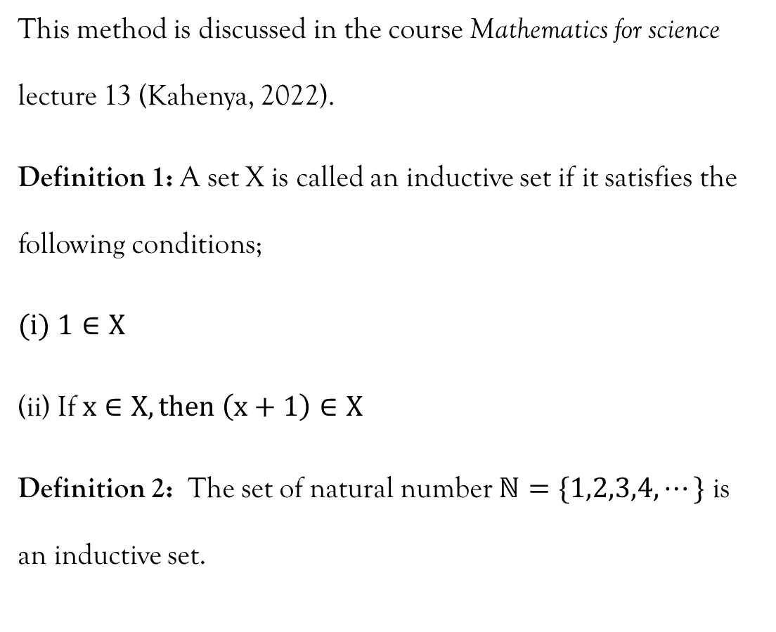
Mathematical Induction
This method is discussed in the course Mathematics for science lecture 13 (Kahenya, 2022).
Definition 1: A set X is called an inductive set if it satisfies the following conditions;
$1∈X$
If $x∈X, then \left(x+1\right)∈X$
Definition 2: The set of natural number $ℕ=\{1,2,3,4,⋯\}$ is an inductive set.

Slide 35

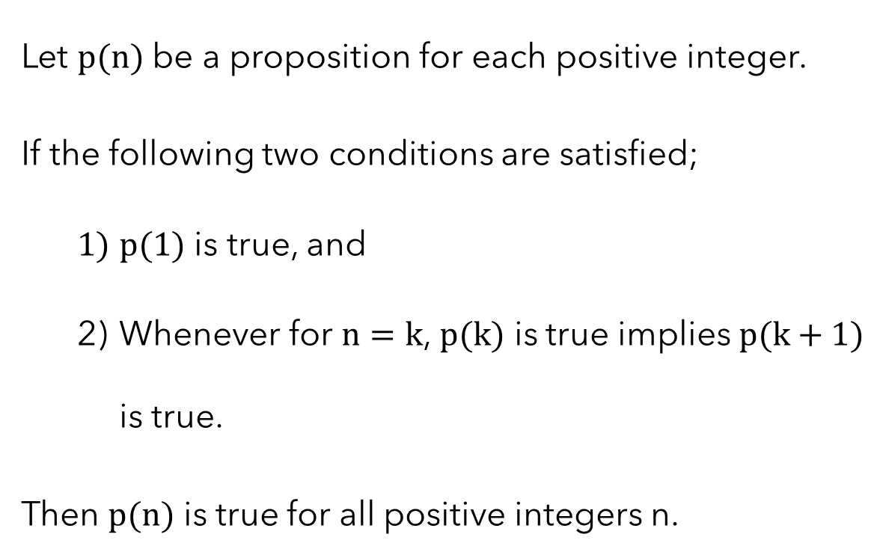
Principle of mathematical induction
Let $p(n)$ be a proposition for each positive integer.
If the following two conditions are satisfied;
  $p(1)$ is true, and
  Whenever for $n=k$, $p(k)$ is true implies $p(k+1)$ is true.
Then $p(n)$ is true for all positive integers n.

Slide 36

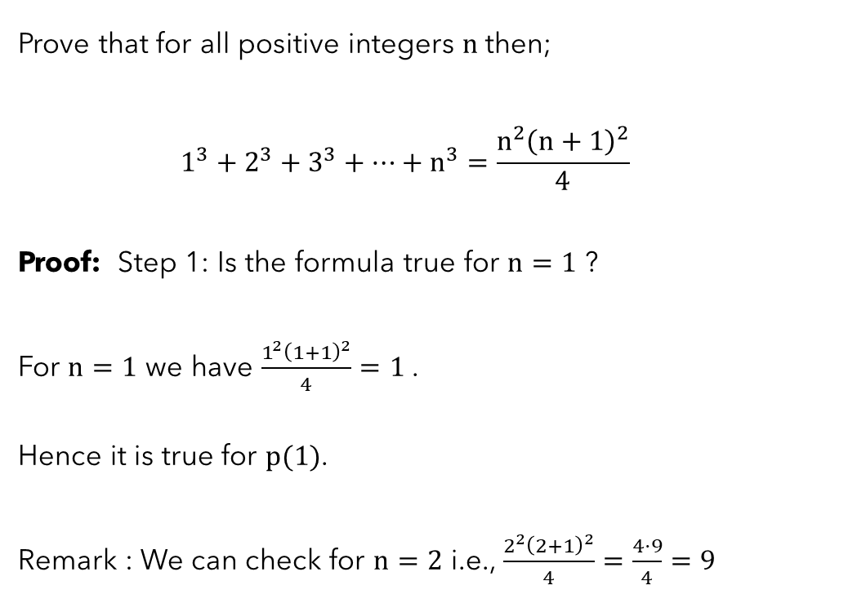
Example 1
Prove that for all positive integers $n$then;
$$1^{3}+2^{3}+3^{3}+⋯+n^{3}=\frac{n^{2}{\left(n+1\right)}^{2}}{4}$$
Proof: Step 1: Is the formula true for $n=1$ ?
For $n=1$ we have $\frac{1^{2}{\left(1+1\right)}^{2}}{4}=1$ .
Hence it is true for $p(1)$.
Remark : We can check for $n=2$ i.e., $\frac{2^{2}{\left(2+1\right)}^{2}}{4}=\frac{4⋅9}{4}=9$

Slide 37
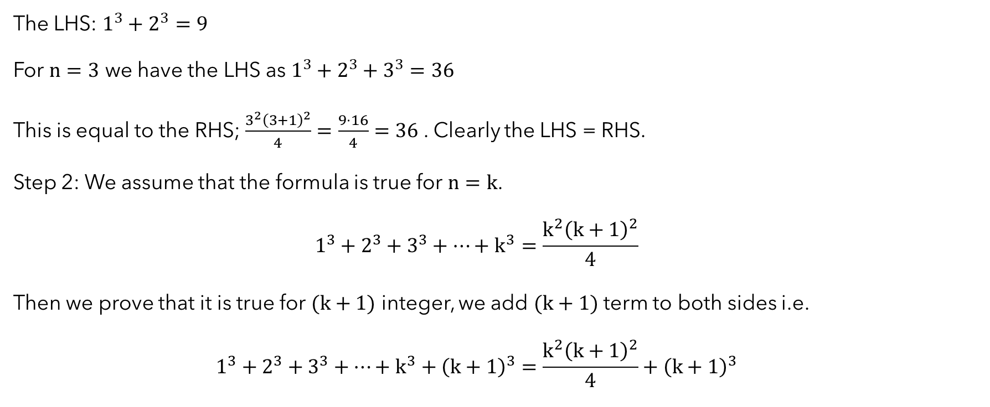
Example 1…contd…
The LHS: $1^{3}+2^{3}=9$
For $n=3$ we have the LHS as $1^{3}+2^{3}+3^{3}=36$
This is equal to the RHS; $\frac{3^{2}{\left(3+1\right)}^{2}}{4}=\frac{9⋅16}{4}=36$. Clearly the LHS = RHS.
Step 2: We assume that the formula is true for $n=k$.
$$1^{3}+2^{3}+3^{3}+⋯+k^{3}=\frac{k^{2}{\left(k+1\right)}^{2}}{4}$$
Then we prove that it is true for $(k+1)$ integer, we add $(k+1)$ term to both sides i.e.
$$1^{3}+2^{3}+3^{3}+⋯+k^{3}+{\left(k+1\right)}^{3}=\frac{k^{2}{\left(k+1\right)}^{2}}{4}+{\left(k+1\right)}^{3}$$

Slide 38

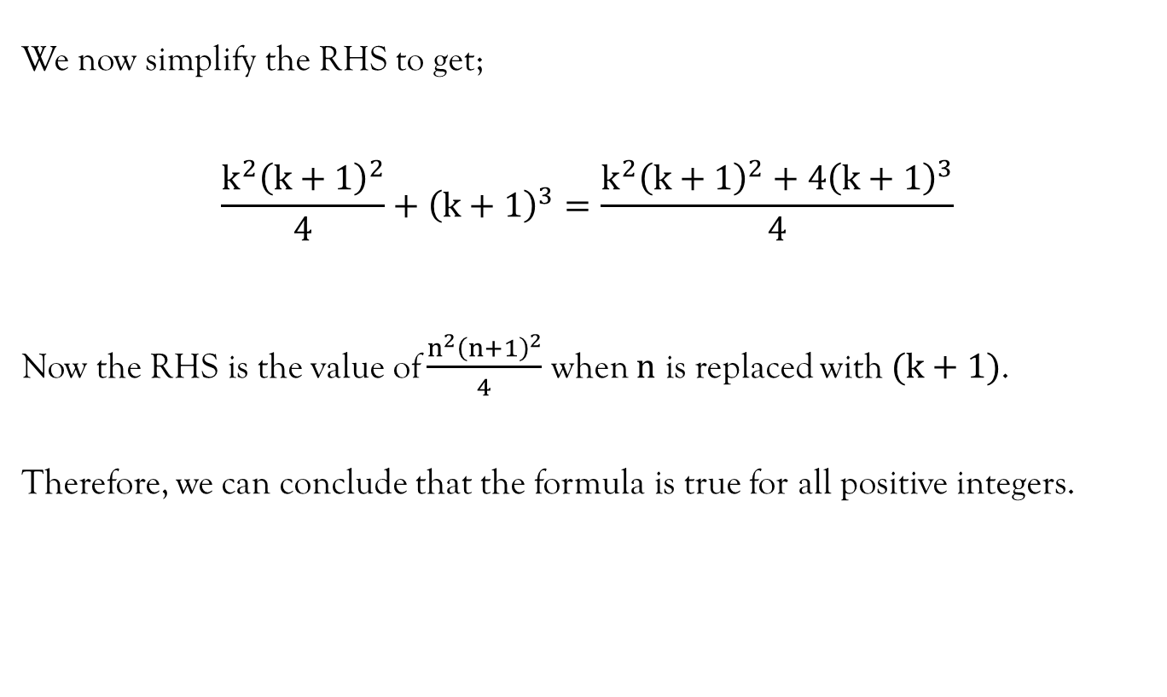
Example 1…contd…
We now simplify the RHS to get;
$$\frac{k^{2}{\left(k+1\right)}^{2}}{4}+{\left(k+1\right)}^{3}=\frac{k^{2}{\left(k+1\right)}^{2}+4{\left(k+1\right)}^{3}}{4}$$
Now the RHS is the value of $\frac{n^{2}{\left(n+1\right)}^{2}}{4}$ when $n$ is replaced with $(k+1)$.
Therefore, we can conclude that the formula is true for all positive integers.

Slide 39
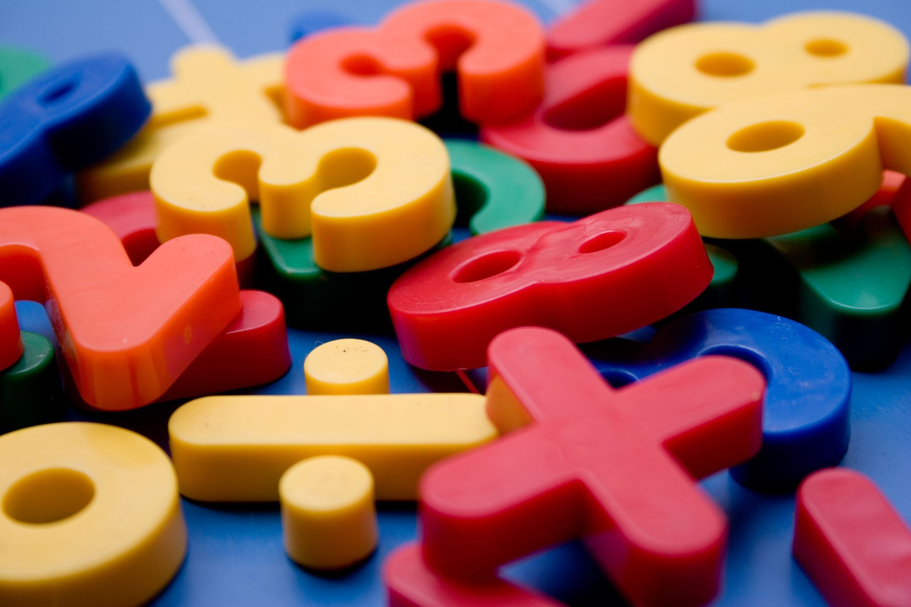
References
Kahenya, P. (2017). Foundation Maths. LAP Lambert Academic Publishers.
Kahenya, P. (2022). Mathematics for Science. https://www.hufocw.org/Course/932
Murray, S., & Robert, M. (2009). College Algebra. McGraw-Hill.
Rosen, K. (2012). Discrete mathematics and its application (7th ed.). McGraw-Hill.
Stewart, J. (2012). Calculus (7th ed.). Brooks/Cole Cengage Learning.
https://www.mathcentre.ac.uk/resources/uploaded/mathcentre-direct.pdf retrieved on 21/5/2023
Proof-and-Reasoning.pdf (birmingham.ac.uk) retrieved on 21/5/2023
math-299-lecture.pdf (scranton.edu) retrieved on 21/5/2023

