Slide 1
Communication Systems in Africa
LECTURE 3
WEEK THREE: Merits and demerits of Traditional Communication
BY DR. RAPHAEL OGUTU,
Mass Communication Department,
AFRICA NAZARENE UNIVERSITY

Slide 2
Objectives
Classify traditional communication
List the channels under each class of traditional communication
Outline the different types of communication in Africa
To discuss the merits and demerit of African Communication Systems
To discuss the uniqueness of oramedia

Slide 3
CLASSIFICATION OF TRADITIONAL COMMUNICATION
Traditional communication is a term that has become synonymous with African means of communication such as African traditional media, communal media, folk media, indigenous media and oramedia.
There are varying definitions of traditional communication, just as there are several schools of thought and scholars with idiosyncratic views.

Slide 4
CLASSIFICATION OF TRADITIONAL COMMUNICATION
Traditional media systems are considered to:
1. Have defied all efforts by Western media to cannibalize (used as second hand or preyed upon) them and perhaps supplant them
2. Trusted and believed by a majority of people who use the traditional media
3. Supplement information filtered through opinion leaders.
The word tradition comes from the Latin traditionem, acc. of traditio, which means "handing over, passing on"

Slide 5
CLASSIFICATION OF TRADITIONAL COMMUNICATION
Characteristics of traditional media systems
Traditional systems of communication is a continuous process of information dissemination, entertainment and education used in societies which have not been seriously dislocated by western culture or any external influences as the case in many parts of the World. The system further more operates in urban centres which have accepted to manipulate western media system for the purpose of enhancing the socio-economic development of these areas.
The traditional system refers to the mode of control (ownership) and model. Ownership of the means (media/channels) of communication lies with the society. Hence, for example, the village/ clan head only acts as a trustee and head of the gate keeping.
(Wilson, 1987).

Slide 6
CLASSIFICATION OF TRADITIONAL COMMUNICATION
Categories of traditional media systems Des Wilson
There are numerous traditional forms of communication Africa. They can be broadly divided into sixteen classes or more, namely:
(i) Idiophones: These are self-sounding instruments or technical wares which produce sound without the addition or use of an Intermediary medium. The sound or message emanates from the materials from which the Instruments are made and they could be shaken, scratched, struck, pricked (pulled) or pressed with the feet. In this group we have the gong, wood jock, wooden drum, bell and rattle.
(Des Wilson,1987)

Slide 7
CLASSIFICATION OF TRADITIONAL COMMUNICATION
Categories of traditional media systems
Membranophones: These are media on which sound is produced through the vibration of membranes. They include all varieties of skin or leather drum.
These drums are beaten or struck with well-carved sticks.
Among the various Nigerian groups, skin drums of various sizes and shapes abound.
Perhaps the most popular, because it is the most exposed and intricate In Its craftsmanship, is the Yoruba talking drum, locally called dundun.
(Des Wilson,1987)

Slide 8
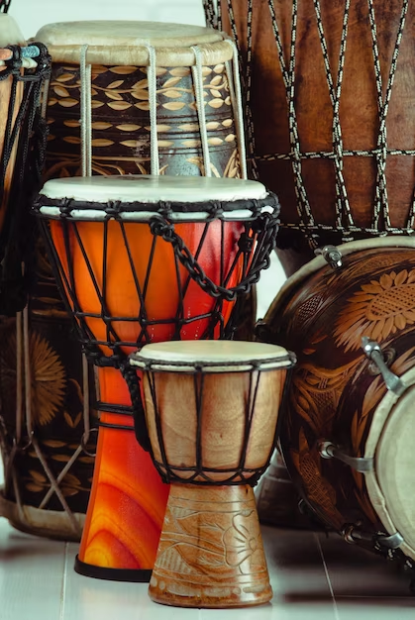
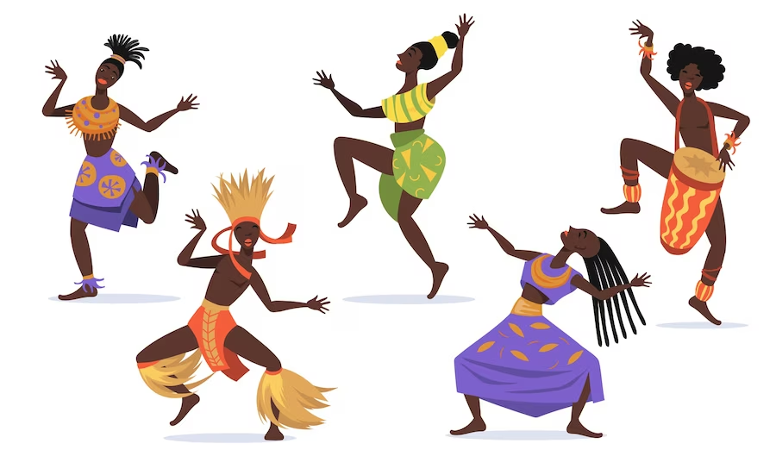
AFRICAN TRADITIONAL COMMUNICATION MEDIA
Source:
https://www.freepik.com/search?format=search&page=2&query=african+traditional+music

Slide 9
CLASSIFICATION OF TRADITIONAL COMMUNICATION
Categories of traditional media systems
Aerophones: These are media, which produce sound as a result of the vibration of a column of air.
They comprise media of the flute family; whistle reed pipes, horns and trumpets.
Symbolography: This simply means symbol writing or representation.
Communication takes place when an encoder uses graphic representations to convey a message which l understood within the context of a known social event and an accompanying verbal message. It is a descriptive representational device for conveying meaning.
(Des Wilson,1987)

Slide 10
CLASSIFICATION OF TRADITIONAL COMMUNICATION
Categories of traditional media systems
Signals: These are the physical embodiments of a message. Many ancient signals are still being used for modem communication today.
For example, in Nigeria, there is hardly a broadcasting station which does not utilize drum signals to draw the attention of its listeners to the fact that they are about to begin transmission for the day deliver their main news broadcast or announce time, close down or prepare for the broadcast of the local or national leader. Some of the signals include fire, gunshots, canon shots, drum (wooden or skin).
(Des Wilson,1987)

Slide 11
CLASSIFICATION OF TRADITIONAL COMMUNICATION
Categories of traditional media systems :
Signs: Marks, which are meaningful, or objects or symbols used to represent something are signs.
It is a construct by which organisms affect the behaviour or state of another in a communication context Sign language (i.e. a system of human• communication by gestures) has been developed for the deal while signs are more likely to be symbolic in certain contexts.
Symbols are not signs. Signs are associated with specific denotative meanings while symbols usually carry along with them connotative meanings as well.
(Des Wilson,1987)

Slide 12
CLASSIFICATION OF TRADITIONAL COMMUNICATION
Categories of traditional media systems :
Objectifies: Media presented in concrete forms which may have significance for a specific society only or may be universal through their traditional association with specific contextual meanings.
This Include: kola nut, the young unopened bud of the palm frond, charcoal, White Pigeon or fowl, white egg, feather, cowries, mimosa. Flowers, sculptures, pictures, drawing, the flag etc.
(Des Wilson,1987)

Slide 13
CLASSIFICATION OF TRADITIONAL COMMUNICATION
Categories of traditional media systems :
Colour schemes: This is the general conception and use of combination of colours in a design to convey some meanings.
Colour uses the advantages of pictorial communication by combining the speed of its impact and freedom from linguistic boundaries to achieve instant and effective communication.
Combinations of these colours produce certain significant meanings for the society. Since colours play an important role in modern advertising, greater attention will continue to be given to them in the fields of science, industries, advertising, public .relations and social communication.
(Des Wilson, 1987)

Slide 14
CLASSIFICATION OF TRADITIONAL COMMUNICATION
Categories of traditional media systems :
Music: Itinerant musical entertainment groups sing satirical songs.
Praise songs and generally criticize wrong doings of individuals in. society.
Names of those being satirized or praised may be mentioned or descriptions of their physical or personality attributes, where they live, or what they do may form part of such songs.
(Des Wilson,1987)

Slide 15
CLASSIFICATION OF TRADITIONAL COMMUNICATION
Categories of traditional media systems :
Extramundane communication: This is the mode of communication between the living and the dead, the supernatural or Supreme Being.
This is usually done through Incantation, spiritual chants, ritual, prayers, sacrifice, Invocation, séance, trance, hysterics or liberation.
Cultural ritual performance evokes intensity of emotion, which may lead to a temporary spiritual transmigration of the participants as in religious or spiritual ceremonies.
Modern forms of extra- mundane communication are found in obituary and in memorial notices published in newspapers, magazines or on radio and television.
(Des Wilson,1987)

Slide 16
CLASSIFICATION OF TRADITIONAL COMMUNICATION
Categories of traditional media systems :
Symbolic displays or non verbal communication:
These would be cultural-specific or may have universal significance and some of their characteristics are shared even with primates e.g. smiling, sticking out the tongue, expression of anger, disgust, happiness, and fear, the way we walk, or sit, gestures we use, voice qualities and other facial expressions.
(Des Wilson,1987)

Slide 17
CLASSIFICATION OF TRADITIONAL COMMUNICATION
Categories of traditional media systems :
Clubs or societies are also used for the purpose of disseminating-Information, passing on gossips, rumors and at times highly confidential information.
Operate in both urban and rural areas especially the following: cooperative societies, clan/town/village/family unions, ethnic unions, and voluntary organizations.
Drinking clubs, old students associations, market women’s associations, traders associations, religious groups, men only, and women only clubs, secret societies, cults, sports clubs, recreational clubs, age traders, choral groups, self-help group, occupational groups and many others
(Des Wilson,1987)

Slide 18
CLASSIFICATION OF TRADITIONAL COMMUNICATION
Categories of traditional media systems :
Traditional emissary whose function was a message carrier, messenger or newsman, is equivalent to today’s news reporters, correspondents, news agents, messengers, spokesmen/women, envoys (ambassador) etc.
Community drama or dramaturgical performance is referred by Goffman as way participants use to produce, sustain and safeguard their social roleplay. A reference which has to do with the way people maintain their behaviour in real life or stage actors (Goffman E. 1975).
In Africa closely connected to drama are songs and the dances used during the performance. Drama or plays (comedy, stage, satire, etc) in Africa is based on legends, myths, poetry, past or present events.
(Des Wilson,1987)

Slide 19
CLASSIFICATION OF TRADITIONAL COMMUNICATION
Categories of traditional media systems :
Story telling among the Africans. One thing to bear in mind is that in many old traditions storytelling is synonymous with song, chant, music, or epic poetry, especially in the bardic traditions.
Stories may be chanted or sung, along with musical accompaniment on a certain instrument.
Therefore some who would be called folk musicians by foreign music enthusiasts are just as accurately called storytellers - their true roles are more profound, as their names reflect: bards, ashiks, jyrau, griots amongst many more.
Their roles in fact are often as much spiritual teachers and exemplars, or healers, for which the stories and music are vehicles, as well as historians and tradition-bearers.
(Des Wilson,1987)

Slide 20
CLASSIFICATION OF TRADITIONAL COMMUNICATION
Categories of traditional media systems :
Myths among the Africans: Myths (sacred history narrative) and legends (verbal art or narrative explaining the origin of a people) developed over thousands of years in Africa south of the Sahara. Among the influences on their development were the mass migrations that took place from time to time.
About 7,000 years ago, the ancestors of the Hottentot and the Bushmen began moving from the Sahara toward southern Africa. Five thousand years later, people who spoke Bantu languages began spreading out from Cameroon, on Africa's west coast, until they eventually inhabited much of sub-Saharan Africa.
Such migrations caused myths and legends to spread from group to group and led to a mixing of myths and legends.
(Des Wilson,1987)

Slide 21
CLASSIFICATION OF TRADITIONAL COMMUNICATION
Categories of traditional media systems :
Proverbs, Sayings and Riddles:
What is Proverb?
Proverb can be defined as a short, generally known sentence of the folk, which contains wisdom, truths, morals, and traditional views in a metaphorical, fixed, and memorable form and which is handed down from generation to generation.
Among the Africans, proverbs are common ways of expressing religious ideas and feelings.
It is in proverbs they find the remains of the oldest forms of African religions and philosophical wisdom.
(Des Wilson,1987)

Slide 22
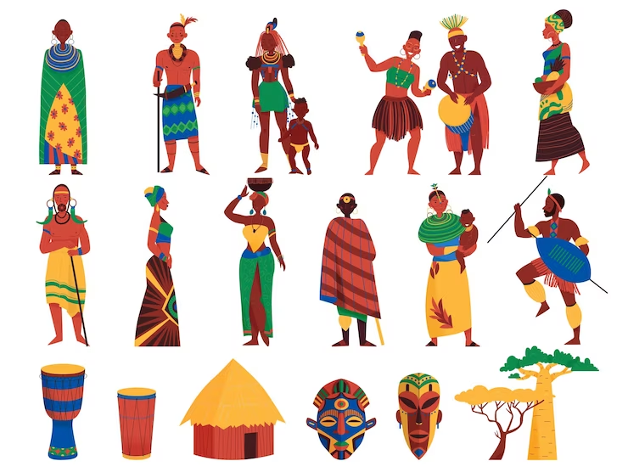
MERITS OF AFRICAN COMMUNICATION SYSTEMS
Source: https://www.freepik.com/search?format=search&query=african%20traditions

Slide 23
MERITS OF AFRICAN COMMUNICATION SYSTEMS
• It is understood by members of a community
• It readily appeals and connects with the people’s language, culture, belief, myth, legend and customs which enhances effectiveness of communication (relates to values, norms, ethos and culture of Africans)
• Uses symbols, values and indigenous institutions, which enhance messages’ effectiveness
• Projects African historical past (traditions)

Slide 24
MERITS OF AFRICAN COMMUNICATION SYSTEMS
• Derived from the culture, beliefs, and the way of life of Africans
• Rooted among the local people and respected by the people, especially the ruralites
• Embedded in the culture of the people, which is the driving force
• Relies on indigenous technology, employs values and symbols that the people identify with.

Slide 25
MERITS OF AFRICAN COMMUNICATION SYSTEMS
Uniqueness of Oramedia in Modern Age
Traditional: Oramedia are traditional means of communication in Africa as they are transmitted from one generation to the other. People grew up with them, and they get accustomed to them in their day-to-day interactions.
So, they are bound to be with the people till eternity. When you seek to separate a people from the oramedia, you are attempting to exterminate them from the faces of the earth.
Language: Oramedia are both verbal and non-verbal means of communication which make them more appealing, effective, and understandable.
(Osho, 2011).

Slide 26
MERITS OF AFRICAN COMMUNICATION SYSTEMS
Uniqueness of Oramedia in Modern Age
Alternative Media: The indigenous media in Africa serves as alternative media in the modern age because for messages to properly get to the grass root, the people must be linked up through the oramedia.
traditional rulers across Africa even in big cities like Lagos, Cairo, Cape Town, Nairobi, Abeokuta and others still use the Town Criers to announce festivals, restrictions, and traditional ceremonies.
It reinforces the information they get from the mass media e.g market women and others have the opportunity of asking questions directly from the representatives of the traditional ruler, the Town Crier who brought the message. Indeed, the ‘medium is the message’.
(McLuhan, 1964).

Slide 27
MERITS OF AFRICAN COMMUNICATION SYSTEMS
Uniqueness of Oramedia in Modern Age
Culture: The or media are derived from the culture and way of life of the people. Hence, it is enduring and effective.
Less Expensive: The traditional media is less expensive, as it costs less to send messages and to receive. It contradicts the new media and the mass media that takes toll on your lean purse every second.
The more you are on your laptop, hardtop, or handset communicating online or talking, the more you are paying for the service. It is not so with oramedia.
(Osho, 2011).

Slide 28
MERITS OF AFRICAN COMMUNICATION SYSTEMS
Uniqueness of Oramedia in Modern Age
6. Uses Indigenous technology: The folk media uses indigenous technology which can be improved upon by our Engineers and Traditional experts in the transmission and reception of information which are peculiar to the way of life of the people.
7. Communal: The oramedia are communal in nature because they are used within the confines and understanding of a particular people, tribe or ethnic.
8. Credible: The people believe in the messages of the traditional media more than the exogenous media or the new media.
(Osho, 2011).

Slide 29
MERITS OF AFRICAN COMMUNICATION SYSTEMS
Uniqueness of Oramedia in Modern Age
9. Easy Understanding: The messages that are being transmitted through the traditional media (language and culture) are easy to understood, and does not require the interpretation of anybody.
10. Simplicity: The oramedia are simple and less sophisticated to apply. A lot of elite still don’t know how to manipulate many things in their handsets and laptops after many years.
11. Opinion Leadership: The people of Africa believe strongly in their Opinion Leaders and whatever information they get from them. They include the traditional rulers, traditional Chiefs, market leaders, Aides of traditional rulers, and heads of families, and religious leaders. The people believe that these leaders cannot mislead them because they are in position to serve them.

Slide 30
DEMERITS OF AFRICAN COMMUNICATION SYSTEMS
i. Extinction of African Languages: A lot of African languages are going into extinction because of the adoption of the language of colonial masters as official language. Nigeria adopts English as the official language as part of the colonial heritage.
This threatens the over 250 languages being spoken in the 200 million population country. Once the language of a people is taken, the whole of its culture is eroded.
ii. The manifestation of the ‘Global Village’ theory of Marshall McLuhan is a challenge to oramedia. We now have the new communication culture of electronic age that perhaps enslaves man on the websites and internet.
(Osho, 2011).

Slide 31
DEMERITS OF AFRICAN COMMUNICATION SYSTEMS
iii. The erosion of the cultural technology in preference for new technologies constitutes threats to oramedia.
iv. The reliance of oramedia in the opinion leaders is a challenge as the new sets of opinion leaders in Africa are selfish, self-centred, and protégés of the West that continues to undermine African culture. The new opinion leaders are partisan, and distort information.
v. The social system in the African family set up, community and institutions are greatly affected by the dominant Western culture. The African children now lack the home training, and the understanding of languages to the understanding of the oramedia vi. The erosion of African value system in various homes in Africa also threatens the folk media. (Osho, 2011).

Slide 32
DEMERITS OF AFRICAN COMMUNICATION SYSTEMS
vii. The domineering nature and indeed the ubiquitous nature of the mass media and the new media threaten the indigenous communication system in Africa.
viii. The lack of understanding of African body language, paralanguage and other non-verbal codes by the new generation of African children, constitute threat to oramedia.
ix. Lack of pride in African tradition and values among the new generation of African children is a challenge the African communication system.
x. Urbanisation constitutes threat to oramedia through the expansion of African villages and towns into cities, as it destroys the communal way of living of the people that gives fillip to folk media.
xi. The problems of illiteracy, poverty, ill-health, lack of social amenities, and population explosion constitutes threat to oramedia in African countries. (Osho, 2011).

Slide 33
SUMMARY
Traditional systems of communication is a continuous process of information dissemination, entertainment and education used in societies which have not been seriously dislocated by western culture or any external influences as the case in many parts of the World. The system further more operates in urban centers which have accepted to manipulate western media system for the purpose of enhancing the socio-economic development of these areas. The village/ clan head only acts as a trustee and head of the gate keeping. From the notes discussion, it is obvious that no classification is right or wrong. However, this does not discount the fact that the classification attempt made by this author would enhance our understanding of the traditional modes of communication in Africa. The merits of African communication systems are like, it is understood by members of a community and so on. The African communication system is faced with some challenges in the contemporary world.

Slide 34
THANK YOU
LECTURE 3
BY DR. RAPHAEL OGUTU,
Mass Communication Department,
AFRICA NAZARENE UNIVERSITY.

