Slide 1
Communication Systems in Africa
LECTURE 6
WEEK SIX: Communication and change: Development and dependency communication system in Africa.
BY DR. RAPHAEL OGUTU,
Mass Communication Department,
AFRICA NAZARENE UNIVERSITY

Slide 2
Objectives
Understand development, change, and African communication systems
Explain the relationship between underdevelopment and dependency.
Analyze the Dependency theory
Discuss the effects of Bad Leadership and Governance in Africa.

Slide 3
LECTURE OVERVIEW
In this lecture, attempts have been made to connect dependency of Africa on foreign nations with development, underdevelopment, bad leadership and governance.
Dependency theory holds that “the condition of underdevelopment is precisely the result of the incorporation of the Third World economies into the capitalist world system which is dominated by the West and North America” (Randall and Theobald, 1998)
Hence in development studies, dependency implies a situation in which a particular country or region relies on another for support, “survival” and growth (Emeh, 2013).

Slide 4
Introduction of underdevelopment and dependency in Africa
According to Njoku (2013), dependency and underdevelopment draws our attention to the stagnation, deplorable and peripheral condition of Africa, Asia, Latin America, in the international system.
Africa, among other continents in the world, is seen as the poorest continent of the world. In the international system, the G8 (Group of eight) and other international organizations regard Africa states as “POOR” thereby seeing Africa as an incapable or handicapped continent

Slide 5
Introduction of underdevelopment and dependency in Africa
Factors necessitating the phenomenon of underdevelopment and dependency in Africa, such as;
i. The reckless and excess lust for foreign loan and aid: This has to do with a financial assistance granted to third world country in order to boost their economy and project them capable for international trade.
ii. The domination of import over export trade: This is one of the major problems in Africa, or third world countries economy, since they tend to patronize more of the foreign goods over indigenous goods thereby bringing the implication of exploitation from the foreigners at the detriment of indigenous traders.

Slide 6
Introduction of underdevelopment and dependency in Africa
Political Crisis and Corruption: Africa is conversant with the above, since it is married with different kind of political crisis ranging from military coups to party crisis and worst of all which is corruption since it is the end products of any political unstable nation.
iv. The failure of policies made by the government: Since policies made cannot be strictly adhered to, and in most cases these policies made are irrelevant to the countries or nations development agenda.
v. Lastly but not the least poor education: Here the level of education which is the key to every kind of success is too low and a times poor, in third world countries the education, sector is dominated with all manner of malpractices which includes bribery, strikes, indefinite closure of school, due to illegality in its operations, unaccredited academic structures and all other shortcomings etc. (Njoku , 2013)

Slide 7
Structural Imperialism and the World Systems Theories
focuses on structural inequality and explains how it is an historical development brought about by, among other, constructions, colonialism and capitalism (Galtung, 1971).
These factors are considered a major feature of the direction of flow, and contents of the international news.
Inequalities in news flow relate closely to even greater inequalities and imbalances in the distribution of financial resources, communication resources and technology around the world.
Attributed to historical factors such as colonialism and prevailing economic practices, including capitalism and its manifestations such as cheap labour (Nye, 2003).

Slide 8
Structural Imperialism and the World Systems Theories
Hierarchy and structural inequality, both important features of the world system theory, are universally recognised as major factors determining the direction of flow of news content in countries (Moisy, 1996).
In keeping with the assumptions of world system theory the hierarchical positions of component units – and nation states in particular – in the global system have given rise to inequalities between developed and developing countries in both the quantity and quality of news flow and news coverage.
Since World War II, imperialism has assumed new forms. The former colonies gained their independence. It was no longer so easy for the big powers to resort to military intervention to expand their hegemony.

Slide 9
Structural Imperialism and the World Systems Theories
Nowadays, nation states tend to use economic and cultural methods to extend their power and influence. Not surprisingly, Third World countries refer to current practices in the world economy as “neo-imperialism” (Hamelink, 1990).
In his structural theory of imperialism, Galtung (1971) explains reasons for existing inequalities between countries. Just like the dependency theorists, he draws a line of differences between centre and periphery.
Galtung (1971) explains the inequalities between centre and periphery as imperialism, which he defines as a relation of dominance between nations, especially between nation states.

Slide 10
Structural Imperialism and the World Systems Theories
Distinction between Centre and Periphery
The largest percentage of news content reported globally every day derives from the centre. In other words, news from the centre dominates news coverage worldwide.
In addition, there is a greater difference in the ratio of news exchanged between centre and periphery than in the ratio of news exchanged among nations at the centre. This means that there is a far more equal relationship in the exchange of news between countries at the centre than in the exchange of news content between centre and periphery (Alleyn, 1997).
News content from the centre makes up a larger percentage of the news content of countries on the periphery than in the news coverage given to countries on the periphery in media at the centre.

Slide 11
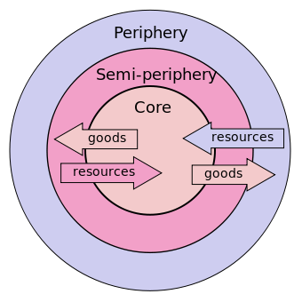
Distinction between Centre/ Core and Periphery
There is also very little or at times no exchange of news content between countries on the periphery.
More news is exchanged between center and semi-periphery than between center and periphery. The semi-periphery thus acts as an intermediate zone between the three strata.
Source: https://medium.com/@gabbyturner/inequity-of-development-in-the-core-and-periphery-d824cd04de71

Slide 12
Structural Imperialism and the World Systems Theories
Distinction between North and South
assumption that news flows vertically from northern to southern countries.
At the same time, there is also horizontal flow between the various countries in the North and those in the South. Although some news does flow from South to North, its volume is far smaller than that of the flow from North to South.
Global North include the United States, Western Europe, Canada, outer regions of the European Union, developed regions of Asia as well as Australia and New Zealand.
On the other hand Global South mostly comprises of nations from Africa, parts of developing Asia including Middle East and Latin America.

Slide 13
Structural Imperialism and the World Systems Theories
Centre and Periphery Communication Interactions
Galtung (1997) distinguishes these interactions through outlining five forms of imperialism, which include: economic imperialism, political imperialism, military imperialism, communication imperialism and cultural imperialism.
Communication imperialism requires in the first place that the centre should have the industrial capacity to develop and manufacture the latest information, communication and transport technology.
News flow between the centre and periphery to explain the power of news content in influencing foreign culture from the developed nations to developing nations. World’s largest news agencies are located at the centre and controlled by countries known to be powerful and wealthy.
most of the global news content transmission relies heavily on feudal communication networks dominated by the centre (Golan , 2010).

Slide 14
Structural Imperialism and the World Systems Theories
Communication imperialism
Another dimension of understanding communication imperialism has to do with division of labour in the field of communication. Just the same way nations in the periphery provide raw materials, which are used in manufacturing processes at the centre, they also produce news events, which are converted into news at the centre (Chang, 1998).
Primarily professional international journalists who view events through the eyes of the centre do this. The process is then completed via communication channels in which events are filtered by a series of gatekeepers who adapt the message to fit the general pattern of the agenda and perception of the centre.

Slide 15
Structural Imperialism and the World Systems Theories
According to Chang (1998) the hierarchical and structural position of a country in the world system is a key determinant of the direction of news flow.
But the world systems theory does not explain the fact that states on the periphery occasionally occupy a prominent place in media at the Centre.
Hence there are other factors that influence the global information flow, which Chang calls filters-affecting international news coverage.
The assumption in this group is that international news coverage is determined partly by the context-both national and international-within, which an event occurs.

Slide 16
Structural Imperialism and the World Systems Theories
Context-related or Extra-media Factors.
I. Structural and Hierarchic Status of a Country in the World System.
According to Chang (1998), what is done or said on the periphery or semi periphery usually caries little weight in international news media. An additional factor like that of event related factors –are usually required for events in these countries to make the front pages of global media.
For them, the best chance of attracting the world’s attention to what they say and do is when one or more countries at the Centre notice them, and so to speak, see to it that that global media focuses on them.

Slide 17
Structural Imperialism and the World Systems Theories
Context-related or Extra-media Factors
I. Structural and Hierarchic Status of a Country in the World System
Conflict with countries at the Centre can make the global media focus on periphery or semi-periphery states, this is not because the periphery or semi-periphery is considered important at that time but because of the news value of conflict between prevailing and emerging forces in the world system (Boyd-Barret, 1998).
Therefore for countries in the periphery of semi-periphery the way to get to the global media is via the countries at the Centre. The prevalence of countries like Iraq, Afghanistan and Iran in the international media is because of the involvement of a Centre country-the US-in the conflict.

Slide 18
Structural Imperialism and the World Systems Theories
II. Economic Variables
Rosengren (1974) indicated that economic variables have a greater influence on international news coverage as compared to most factors that have direct bearing to the event itself.
Economic variables greatly influence the quality, quantity, availability and dissemination of news in different ways.
For example the media in a given country is likely to give preference to news about the country’s trade partners, if a country has high oil production or high gross domestic products, the chances of this states being featured in the news(by countries at the Centre) are increased

Slide 19
Structural Imperialism and the World Systems Theories
II. Economic Variables
In addition, economic factors are also key in determining the availability of technological and other infrastructure of newsgathering and dissemination in a particular country.
In most developing countries limited technological infrastructure has made it a challenge for this countries to gather news and get it to international networks in time. Availability of infrastructure also influences the presence of foreign news correspondents-this explains why international journalists from the Centre will not stay long in a country with limited and primitive infrastructure.
A country economic strength also determines whether the country has the ability to maintain news media, which can compete with the rest of the world’s media in regard to quality, advertising and remuneration of journalists

Slide 20
Structural Imperialism and the World Systems Theories
III. Political and Ideological Factors
Political and ideological factors influence both the contents and international flow of news.
In any country the extent of media freedom also has a direct impact on censorship, control over foreign correspondents entering and leaving the nation, and the control over the import and marketing of news content.
In addition, official or unofficial perceptions of the value of certain news items and the function of the news in a given political system directly affect the news flow in a given system.
A higher value is evident to news from countries enjoying more media freedom, thus the politicians from these countries have a major impact on the flow of news.

Slide 21
Structural Imperialism and the World Systems Theories
III. Political and Ideological Factors
People’s Republic of China and the Kingdom of Saudi Arabia have developed measures to strictly control the international flow of news.
China for example, has developed ‘Great Firewall of China, which is used to filter news content and makes it difficult for citizens in the country to get news from outside their boarders.
In 2011, the government in China tried to block the information of the uprising in Egypt, trying to stem the flow of international news to China.
In Saudi Arabia the governments filters out what it refers to as ‘dangerous content’ from the Internet.

Slide 22
Structural Imperialism and the World Systems Theories
IV. Social and Cultural Proximity.
Cultural, religious and other differences greatly impede the flow of international news.
Language, problems of translation and ethnic attitudes and prejudice are the main factors that impede international news flow (Giffard, 1998).
Thus countries in Africa which use the English language are more likely to have news exchange among themselves than exchanging with Francophone African countries.
Other important social cultural factors are the extent of migration between the states and the historical relations between the states. Another factor could be religious diversity. According to Golan (2011), countries with a lower religious diversity than home nations would receive coverage.

Slide 23
Structural Imperialism and the World Systems Theories
V. Geographical Proximity.
When distances are quite small people often regards news from the neighborhood countries as local news and accord it great prominence when reporting it.
For instance people from the American content prefer being feed with news about other countries in their continent and region rather than news from a further field.
According to Kim and Barnet (1996), geographical distance plays a lesser function in international news flow (internet).
This implies the distance is no longer such an important factor that influences international flow of information.

Slide 24
Structural Imperialism and the World Systems Theories
VI. Attributes of the population.
Communication research studies have assumed that the larger a countries population, the more communication it is likely to have with other nations, the more it will have news production and the more it will import news.
According to Kim and Barnet (1996) most countries with large populations occupy a key position in the international flow of news.
Another factor considered to affect news flow is the literacy levels of a country’s population
Literacy levels does not only affect people awareness and perception of the world outside but also determine the news the media produce and also import to feed their citizens.

Slide 25
Structural Imperialism and the World Systems Theories
Content of International News.
Paterson (1998) regards the role-plays in global news-and global news agencies as the major force in shaping people’s perceptions of events happenings all over the world. His main reasons for these views were the following:
Global news agencies determine and set the agenda for international.
These global agencies decide what stories will get covered and how to disseminate them to their target clients. Also have the power to decide the nature and amount of audiovisual and the nature of content that will accompany a given story
The influence of global agencies on decision-making in this regard is even greater in the case of nations on the periphery and semi-periphery.
Research has indicated that ideological component is a factor considered by global agencies when choosing to disseminate information, whereby they analyze the world’s perception on given events.

Slide 26
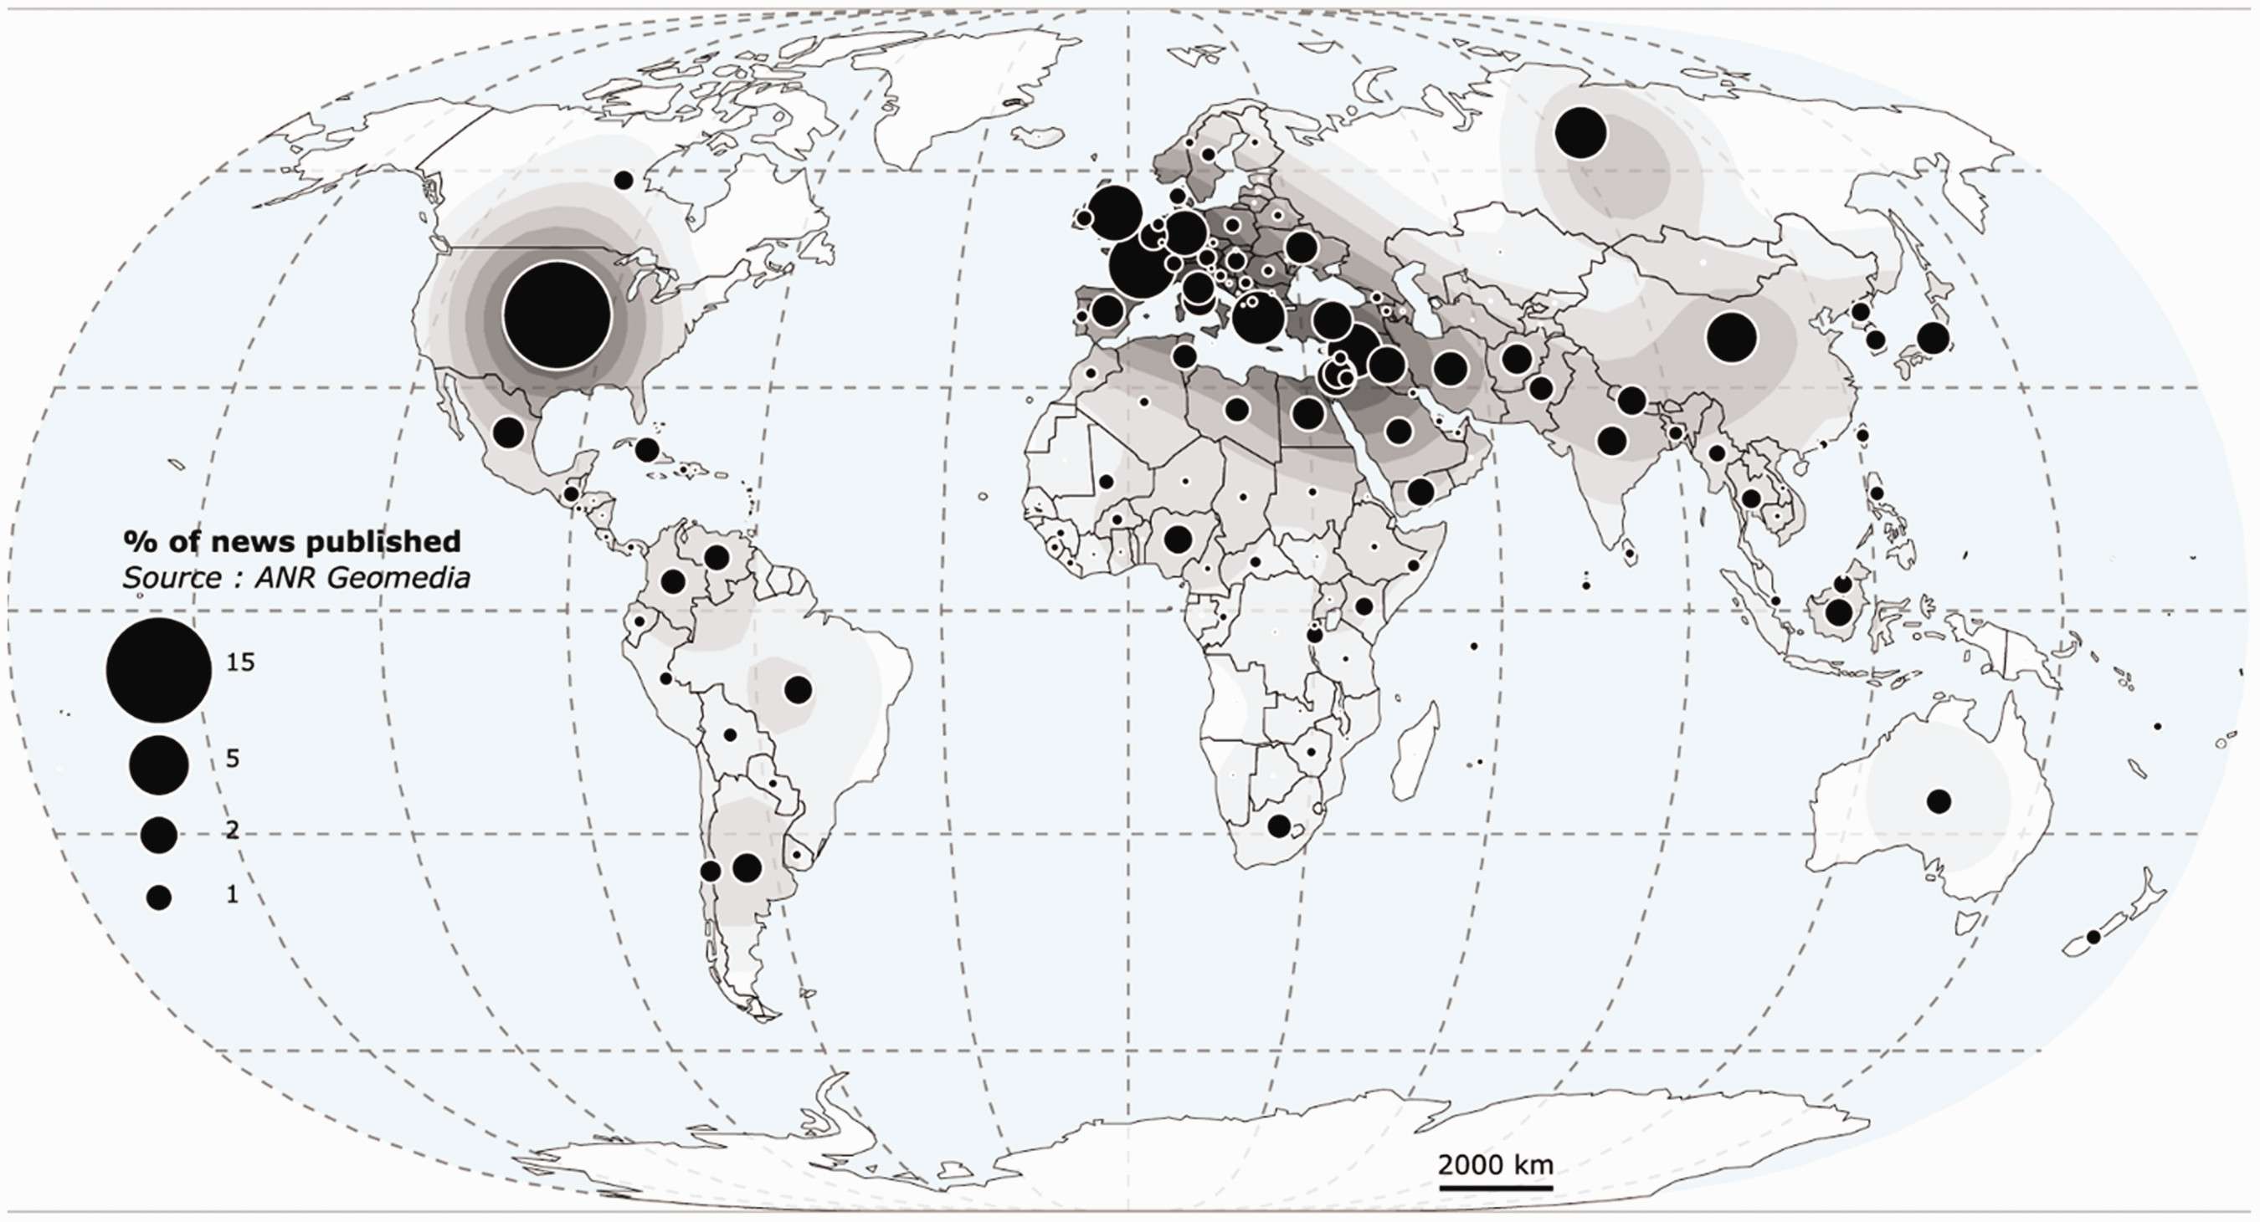
International news flow theory
Source:Grasland, C. (2020). International news flow theory revisited through a space–time interaction model: Application to a sample of 320,000 international news stories published through RSS flows by 31 daily newspapers in 2015. International Communication Gazette, 82(3), 231–259. https://doi.org/10.1177/1748048518825091

Slide 27
Hierarchy, Dependency and Imperialism in the International Flow of News.
Most of the world’s largest global news companies are all found in North America and Europe and are located in the world’s richest countries: Great Britain, France, the USA and Germany.
Hierarchy factor is evident in the fact that a handful of world’s global agencies supply news to client’s − including national news agencies from different countries all over the world.
This hierarchy in its turn leads to dependency.
The most visible form of dependency is quantitative, that is the extent to which nation states and national news agencies around the world are reliant on the large agencies to get volumes of events and happenings considered to be important and hot.
This form of dependency relates not only to news on international events but also to news about their own geopolitical region

Slide 28
Electronic colonialism theory
Similar to dependency theory, electronic colonialism theory also focuses on forms of dependence in the relationship between the periphery and the centre (McPhail 2010).
However, the focus falls on the dependent relationship between the periphery and the centre that results from the importation of communication hardware (technology) and foreign-produced software (such as, television programmes, films and internet content) that is also associated with the need to import skills associated with both hardware and software (engineers, technicians, and so forth).
They carry with them a set of foreign norms, a foreign language (mainly the English language) as well as a foreign culture (an American-Western culture) that alter local cultures, languages, norms, habits and socialisation processes, in indigenous cultures.

Slide 29
Theorizing the international flow of information and Africa
Although a theory such as dependency theory was formulated with the Latin American experience in mind, Africa’s disadvantaged position in the information economy of today’s structural theory of imperialism and electronic colonialism theory as well as the notion of hierarchy in world systems theory.
The problems that Africa experience are often ascribed to historical processes of imperialism and colonialism as proposed by the structural theory of imperialism and electronic colonialism theory.
During the colonial period and its aftermath Africa has also become the target of the development initiatives moulded by the modernisation paradigm of the West.

Slide 30
Theorizing the international flow of information and Africa
The woes of Africa are consequently also ascribed to the failure of these development initiatives and the fact that Africa has remained dependent on the West in numerous ways.
African leaders and elites in particular, contribute substantially to the problems that the continent and its people experience.
Major corruption by governmental officials is regarded as one of the main factors that lead to the underdevelopment of Africa (How African leaders … 2007). For example, money intended for development projects is often siphoned off by government officials.
Largest parts of Africa play a peripheral role in the global information economy and that many African countries are in a dependent position with regard to the centre and the semi-periphery (Bornman, 2017).

Slide 31
SUMMARY
Critique the flow of information globally as influenced by ‘core nation’ news agencies and communication industries to the receiving ‘periphery nations’ causes media and communication dependency to the center by the periphery
Industrially less developed countries export raw materials to highly industrialized countries for processing and then purchase back the more costly finished products. Notably lacking is the exchange of data, news, information, cultural programs and products, and persons among developing countries.
Communication technologies and international policies. There is a broadly shared perception of a growing overall gap between industrially developed and developing countries in the way they are able to create, process, and apply the information needed for economic, political, and cultural development.

Slide 32
SUMMARY
Research supports the observation that the growth of technology in developing countries is not necessarily increasing the access of all peoples to information, nationally or internationally. On the contrary, there is a great disparity between the poor and the rich.
Trends in national policies. The debate and writings on communication and information issues during the last ten years have stimulated governments in both industrialized and developing countries to adopt national policies, and in some cases comprehensive plans, to respond to problems brought about by advances in computer and telecommunications technologies and to protect vital national interests.
Developing countries, in particular, view their dependence on foreign firms and transnational actors as evidence that the important basis for national decision-making is now located outside their national boundaries.

Slide 33
SUMMARY
Electronic colonialism and cultural imperialism: focuses specifically on communication and media practises.
Imbalance in communication research. As research on the international flow of information has expanded during the last ten years, with its most dramatic growth taking place at the beginning of the 1980s, it has been accompanied by several new lines of inquiry. There is no doubt that the debate on new world information and communication order in various international fora, including UNESCO, has been primarily responsible for this growth.
The fact that "the vessel of sovereignty" is leaking, and in some instances may even be sinking, is now beyond doubt. Nations may act as though they are in control of their full national rights, the erosion of sovereignty through communication technology and new transnational actors is paralleled by the growing constraints on freedom of national action and the increasing responsibility of international organizations.

Slide 34
THANK YOU
LECTURE 6
BY DR. RAPHAEL OGUTU,
Mass Communication Department,
AFRICA NAZARENE UNIVERSITY.

