Slide 1
Visual Programming
Working with Audio Source, Clip, Listener

Slide 2
Agenda
Audio Listener
Audio Clip
Audio Source
Audio Mixer
Audio Filters
Audio Effects
Drag and drop in 2D
Controlling volume

Slide 3
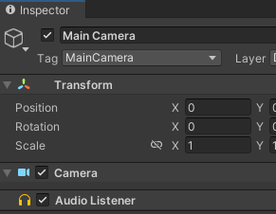
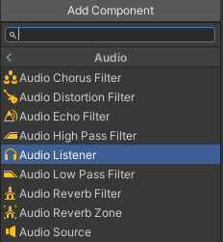
Audio Listener
Without it you will not be able to hear sounds playing.
Default Listener is Main Camera
You can change default listener
To change the Listener from Default object:
Remove Listener from Default object
Add Audio Listener Component to object you like
Make sure you have only ONE Listener on the Scene

Slide 4

Audio Clip
Clip is any audio file (for any purpose: background or sound effect), which you can add to Assets
Supported file formats: aif, .wav, .mp3, and .ogg.
Tracker modules: .xm, .mod, .it, and .s3m
Preview Window
Play
Autoplay
Loop on

Slide 5
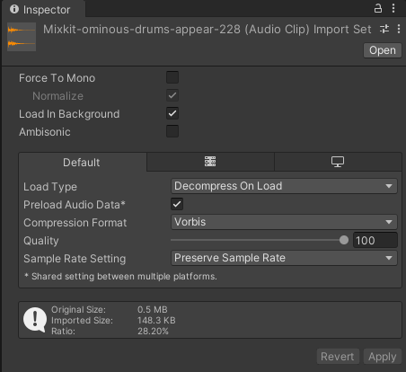
Audio Clip properties
Force to Mono - multi-channel audio will be mixed down to a mono track before packing
Normalize – normalize the audio
Load in Background - the loading of the clip will happen at a delayed time on a separate thread, without blocking the main thread
Ambisonic - store audio in a format which represents a soundfield that can be rotated based on the listener’s orientation
Load Type - Decompress On Load, Compressed In Memory, Streaming
Sample Rate Setting - Preserve Sample Rate, Optimize Sample Rate, Override Sample Rate
Source: (1)

Slide 6
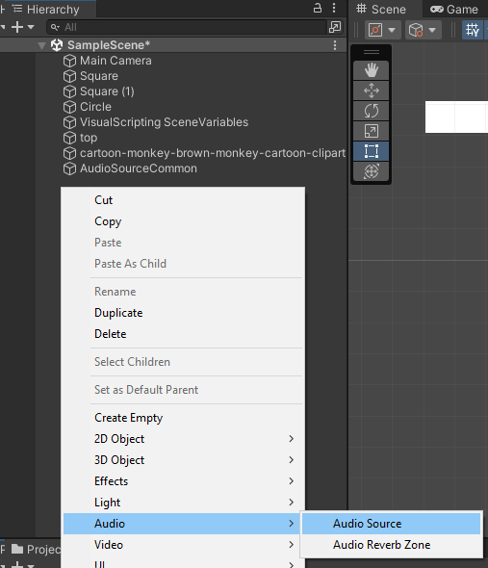
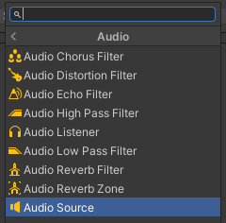
Audio Source
Can be a separate Object in Hierarchy, as well as Component of the object.
Hierarchy
Component

Slide 7
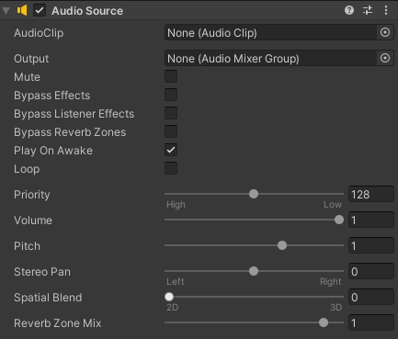
Audio Source properties
Plays the Audio Clip attached to Audio Source
You can assign Audio Clip to Audio Source through Inspector Properties or though code

Slide 8
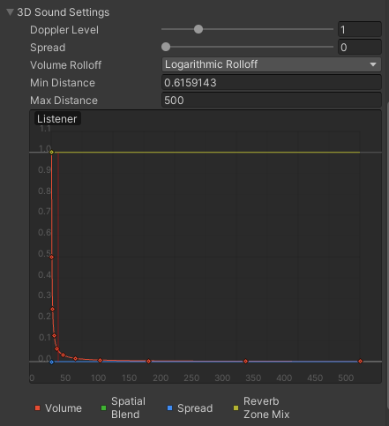
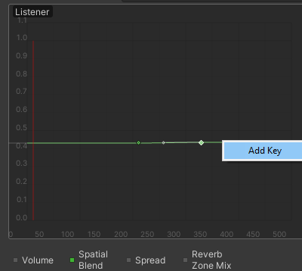
Audio Source properties
Apart from technical properties, such as Mute, Loop, Play on Load, Priority, Volume, you can also control Rolloff.
Try different Rolloffs available: Logarithmic, Linear and Custom (where you can set your own curves for every of parameter: Volume, Spacial Blend, Spread, Reverb Zone

Slide 9
Example: Audio Source
Task: Create a 2D sorter game
  Step 1: Create 2 color categories
  Step 2: Create several objects that can be categorized and sorted out
  Step 3: Implement object drag and drop functionality
  Step 4: When object is being correctly sorted out - give corresponding sound effect
  Step 5: Give warning sound effect if object was not correctly categorized.

Slide 10
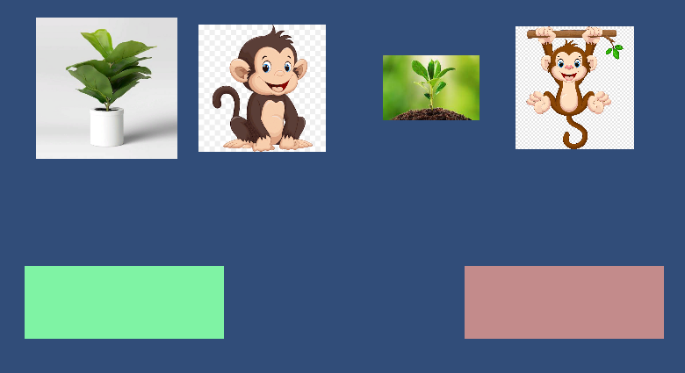
Sorter game
Create a 2D project
Add 2 rectangles – green to represent Plants and red to represent Animals.
Add several sprites with images of animals and plants.

Slide 11
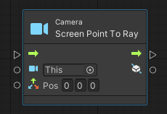
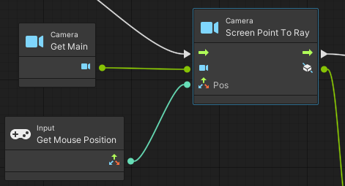
Sorter game: Select the object
Implementation of Drag and Drop effect. Create Empty Object
Here we use: Camera.ScreenPointTo Ray, which has 2 input parameters: Camera and Position.
For Camera – we shall use Main Camera
For Position – Mouse Pointer Position

Slide 12
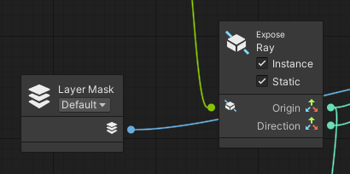
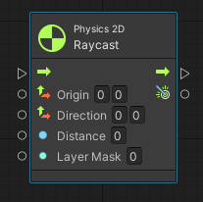
Sorter Game: Hit the object
Output parameter of ScreenPointToRay is Ray itself, which can be further be exposed into Origin point of the Ray and Direction of the Ray
Physics 2D Raycast has 4 input parameters:
  Origin (taken from ExposeRay)
  Direction (taken from ExposeRay)
  Distance
  Layer Mask
Physics 2D Raycast Output parameter is RaycastHit2D – which can be used to detect whether object was pressed on or not

Slide 13

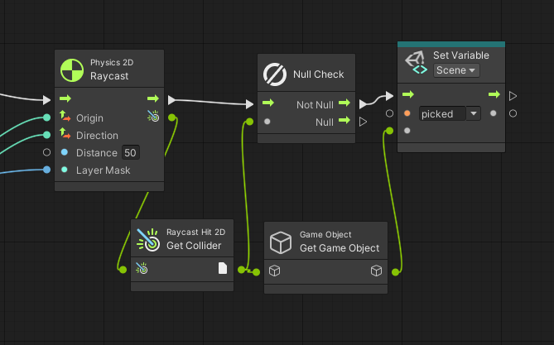
Sorter Game: Drag and Drop
To implement drag and drop effect, we need to assign clicked object to object variable (picked). When it is unclicked – variable should stay null.
After selection, the object should move together with mouse pointer until it is being desected

Slide 14
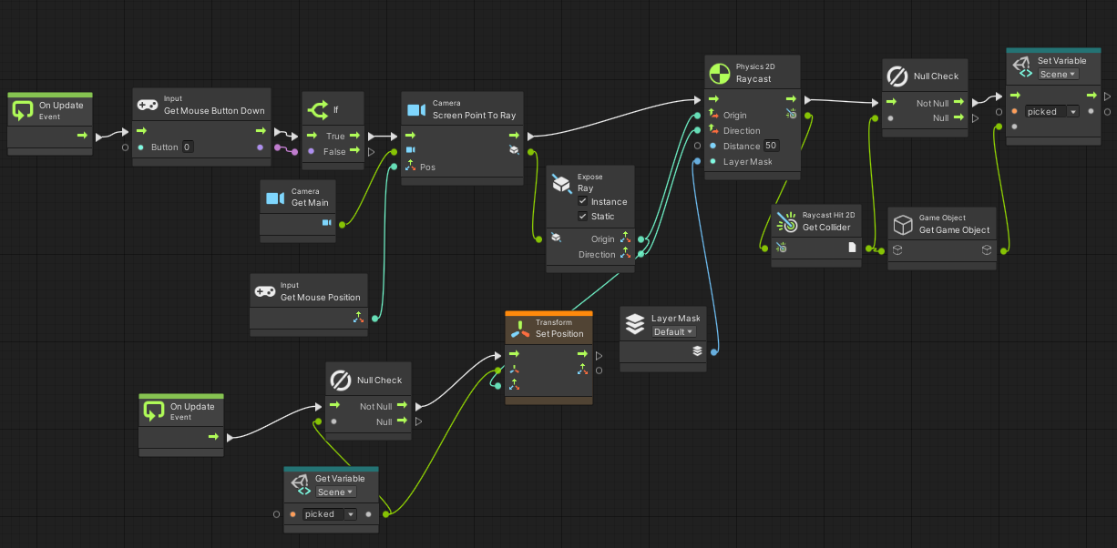
Sorter Game: Selection
Overall selection and movement process should look the following

Slide 15
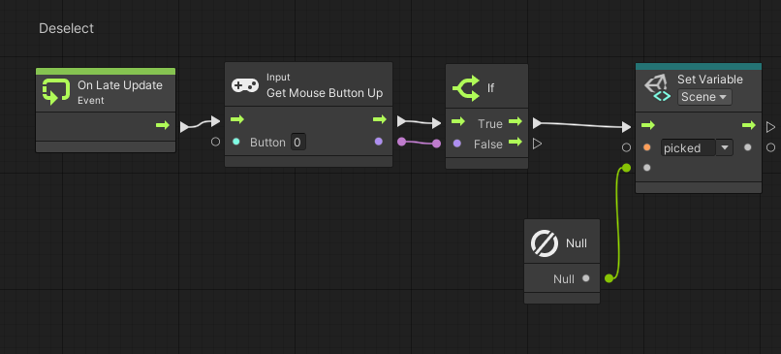
Sorter Game: Deselection
Deselection – is when mouse pointer is up, we need to change the value of the “picked” variable to null.
This flow shall be called on LateUpdate to give the opportunity to finish other flows called on Update

Slide 16
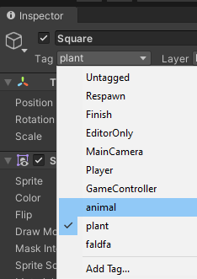
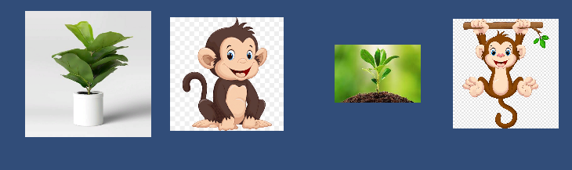
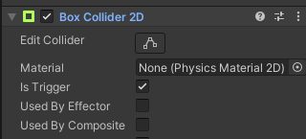
Sorter Game: Collision
Every object/sprite that should be sorted should be assigned a tag: plant or animal
For every colored rectangle we shall create Script machine and Separate script graph.
For both select Box collision as a Trigger

Slide 17
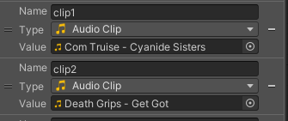
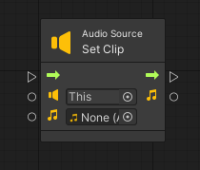
Sorter Game: Setting Audio
Add Audio Source components to both of rectangles and some Audio Clips to Assets – to simulate correct/not correct behaviour.
Both clips will be added as Object variables
To play the clip we use AudioSource – Set Clip
Input/Output parameters: Clip

Slide 18
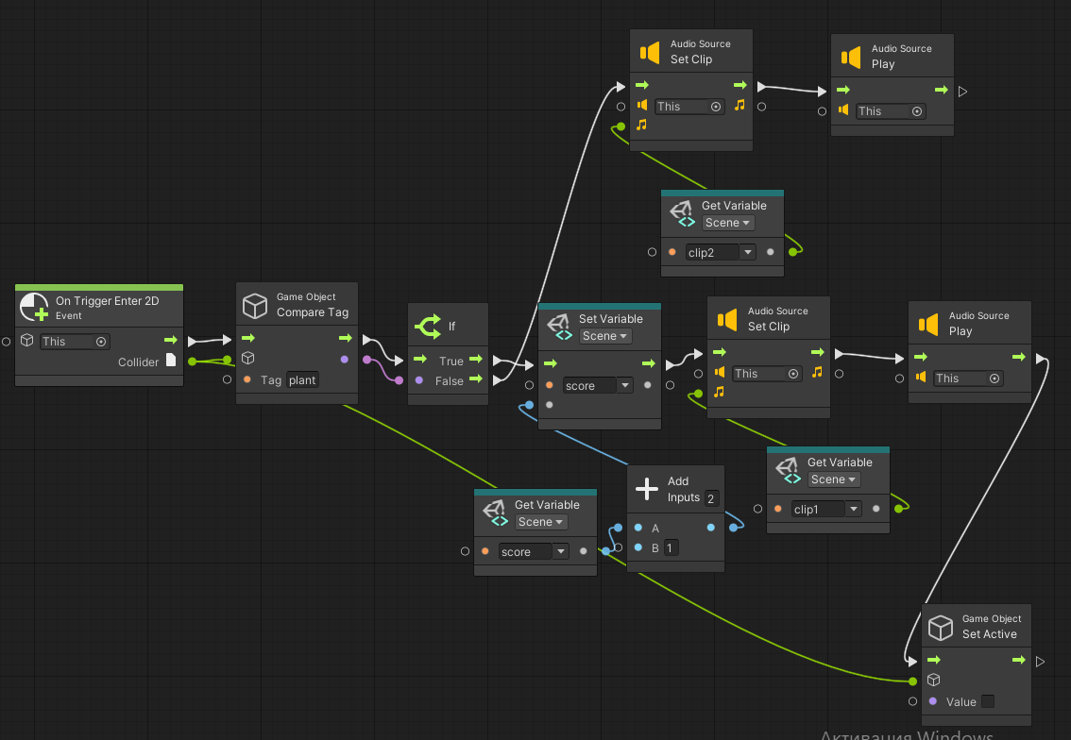
Sorter Game: Detection
Whenever there is trigger collision, we shall check whether the object with correct tag (Plant or Animal) collided with corresponding color.
If so, we play the clip and make this object not active – just to remove it from the screen as it was already correctly sorted out.

Slide 19
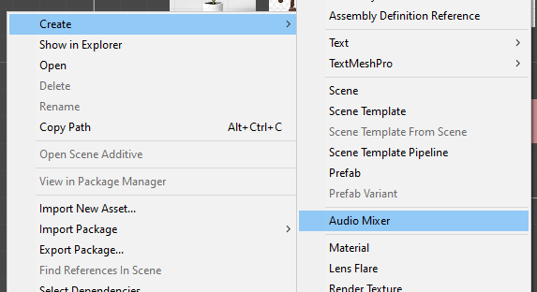
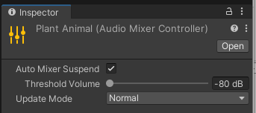
Audio Mixer
You can control the output of Audio Source with help of Audio Mixer (instead of Audio Listener)
To add one, context menu on Assets -> Create -> Audio Mixer
In Inspector, it has very few properties:
To be able to suspend
Threshold volume
Update Mode: normal and unscaled time
To open a Mixer -> click Open button in Inspector

Slide 20
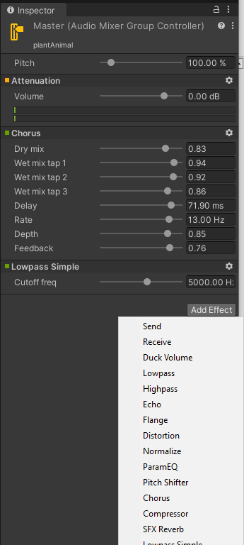
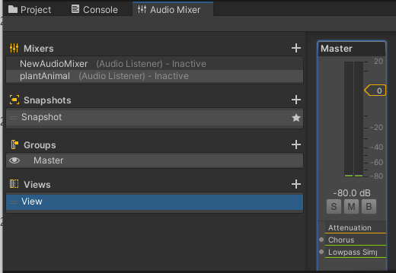
Audio Mixer panel
Audio Mixer panel will open in the bottom, next to Assets panel.
You can add as many Mixers as you like. Selecting one of them, you will see separate Inspector, where you will be able to add and mix different effects

Slide 21

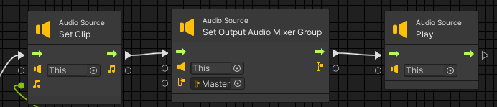
Using Audio Mixer
You can drag and drop created Mixer from Assets to Audio Source Output
Or you can use it in Code

Slide 22

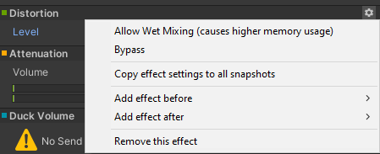
Audio Effects
The effects are applied by adding effect components to the relevant section of the Audio Mixer. (2)
Order of Effects is important, since they will be applied in corresponding order
To change the order, drag and move to right place the effect from Mixer or use Settings in Inspector
Though highly optimized, some filters are still CPU intensive. (2)

Slide 23
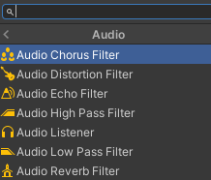
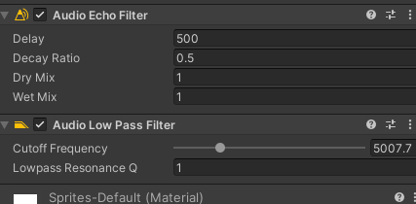
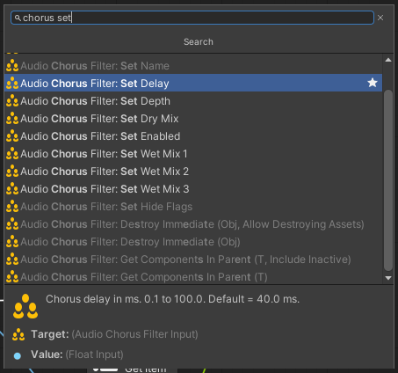
Audio Filters
You can modify the output of Audio Source and Listener components by applying Filters. (3)
These can filter the frequency ranges of the sound or apply reverb and other effects.
They can be added as Components to Objects
Order of components is important
Also, you can manage Filters though code in Script Graph

Slide 24
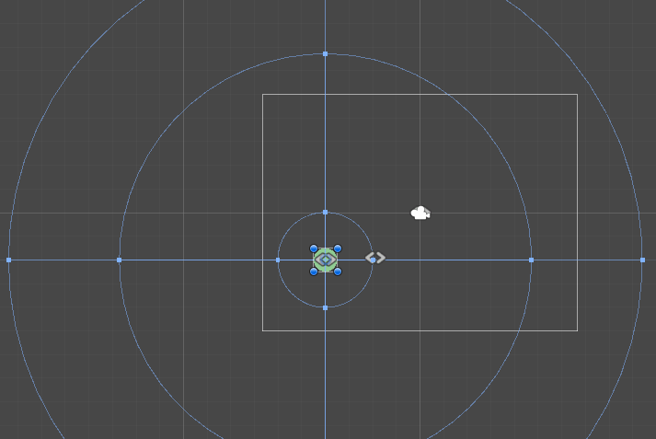
Reverb Zones
Reverb Zones take an Audio Clip and distorts it depending where the audio listener is located inside the reverb zone (4)
They are used when you want to gradually change from a point where there is no ambient effect to a place where there is one
After adding this component, you will be able to see Gizmos (helpers) for min, max distance and volume.

Slide 25
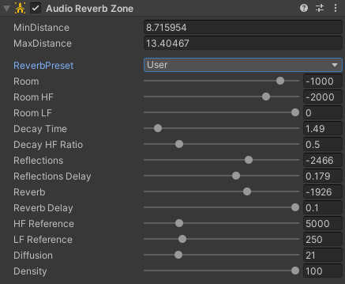
Reverb Zones settings
Min Distance | determines the zone where there is a gradually reverb effect and a full reverb zone.
Max Distance | determines the zone where there is no effect and where the reverb starts to get applied gradually.
Reverb Preset | determines the reverb effect that will be used by the reverb zone. There is a large list of Reverb Preset with predefined settings. If you want to customize them, use User Preset (4)

Slide 26
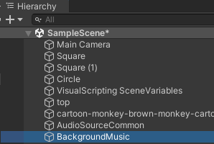
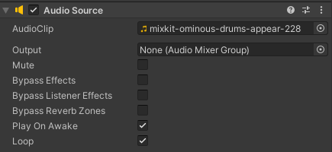
Example: Controlling volume
Task: Add a Slider to be able to control volume of background music.
  Step 1: Add Audio Source to Hierarchy, add Audio Clip, tick Play on Load and Loop properties
  Step 2: Add Slider to Hierarchy
  Step 3: Connect Slider’s number to Audio Source's volume
Step 1.

Slide 27
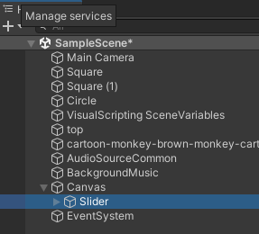
Example: Controlling volume
Step 2.
Step 3.
Create a Script machine and Script Graph.
Slider data change will be trigger for the flow.
We need to make a connection between Slider’s value and Volume level of Audio Source.

Slide 28
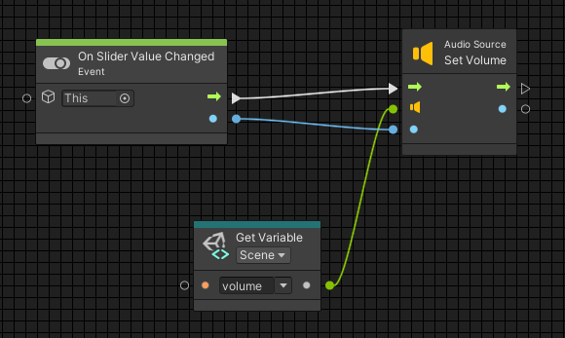
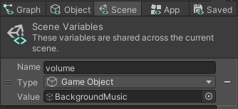
Example: Slider
Create Scene level variable to which we assign created Audio Source as value
Since we already assigned Audio Clip to Audio Source we don’t have to do it in code.

Slide 29

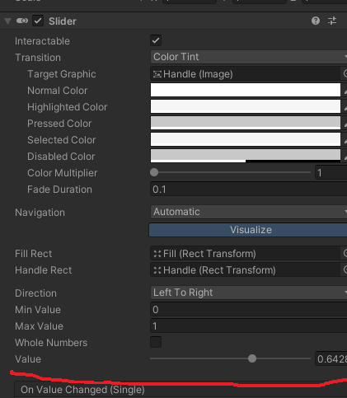
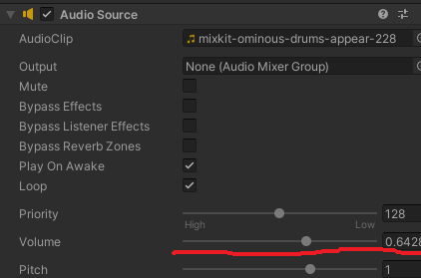
Result

Slide 30
References
https://docs.unity3d.com/Manual/class-AudioClip.html
https://docs.unity3d.com/Manual/class-AudioEffectMixer.html
https://docs.unity3d.com/Manual/class-AudioEffect.html
https://docs.unity3d.com/Manual/class-AudioReverbZone.html

