Slide 1
Visual Programming
Lecture 10
Media elements and charts

Slide 2
Agenda
Screens
Text
Media components
Lists
Charts

Slide 3

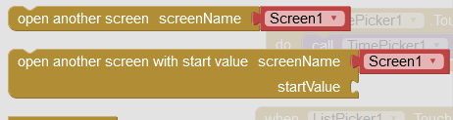
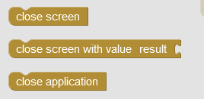
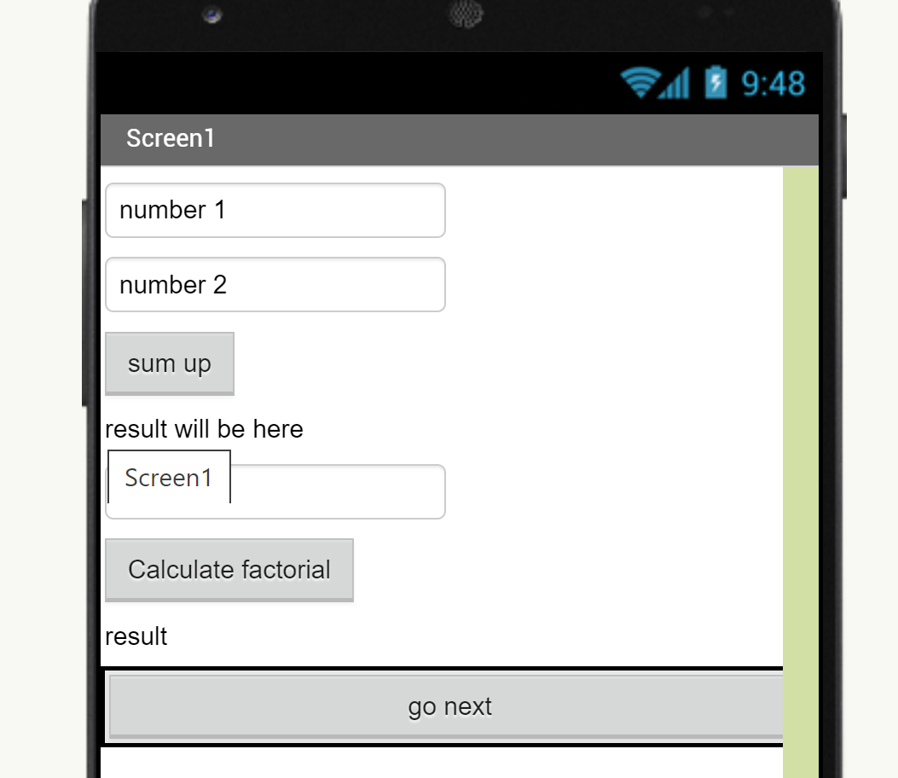
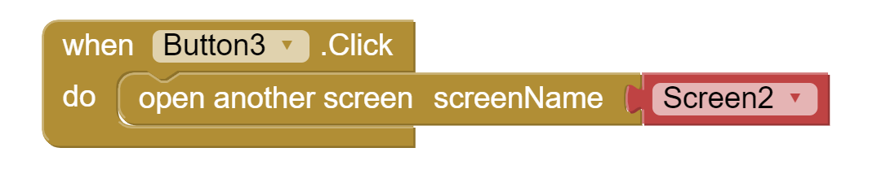
Screens
To add or remove screens use top bar
Controls that will help you to navigate between screens
Example: Create a button on first screen which will allow you to jump to second screen

Slide 4
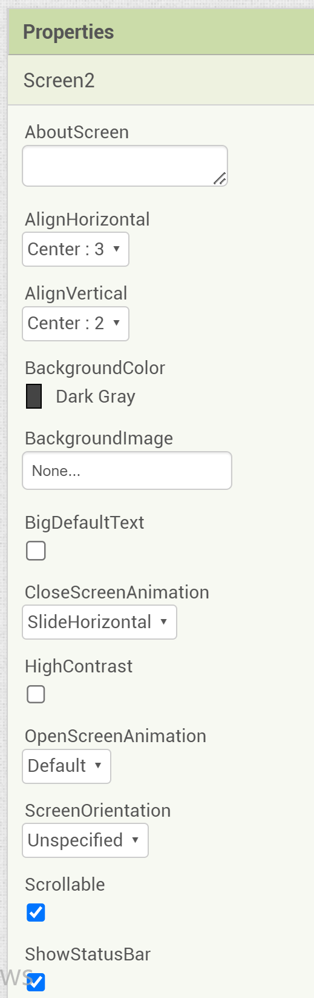
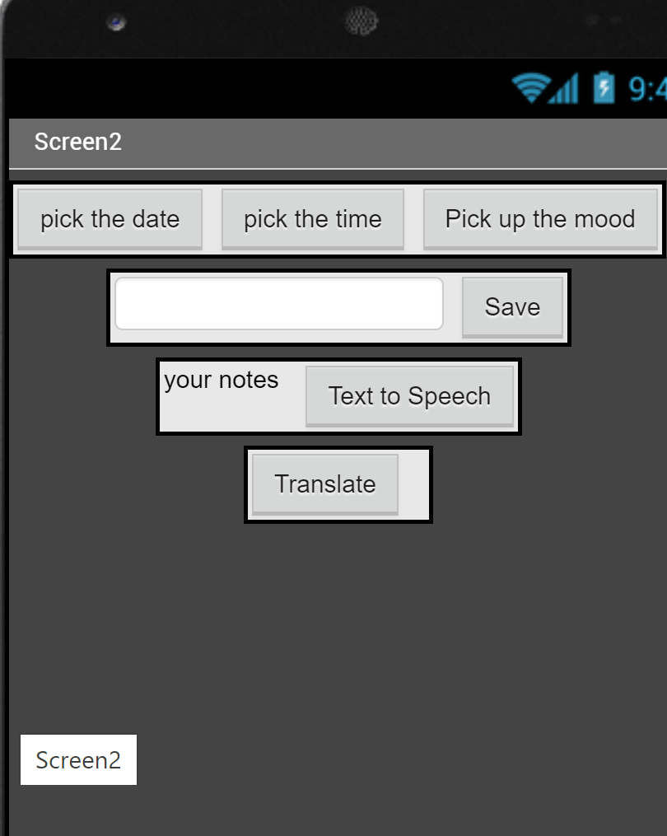
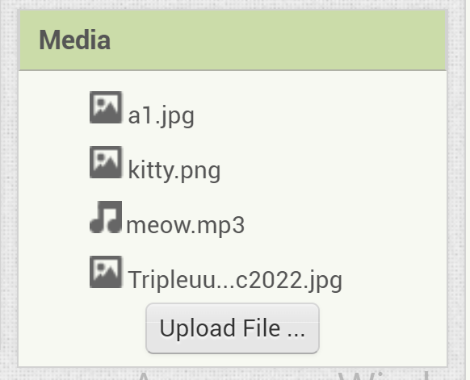
Screen settings
You can play with Screen settings:
  Change background color
  Set image to the background
  Change the alignment of the objects
  Choose screen animation – the way screen will appear
  To be able to put image to background, you need to add to Media files

Slide 5
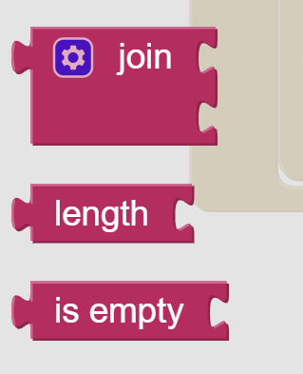
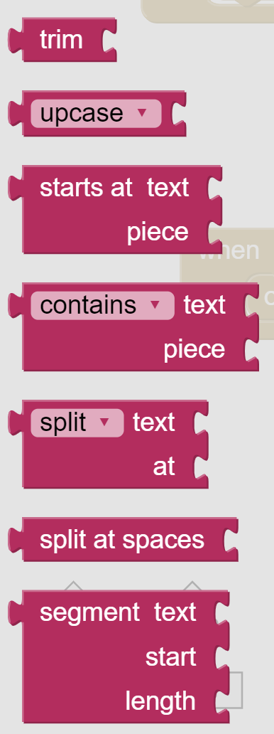

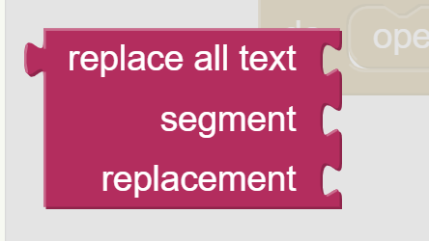

Text
With help of Text blocks you can work with text and strings:
  Join (concatenate) two strings
  Calculate the length of text
  Check if textbox is empty
  Trim the text
  Make text UPPERCASE or lowcase
  Check if text contains certain expression
  Split the text setting the splitter yourself
  Reverse the text
  Replace the segment of text with another one
  Lexicographically compare 2 texts

Slide 6
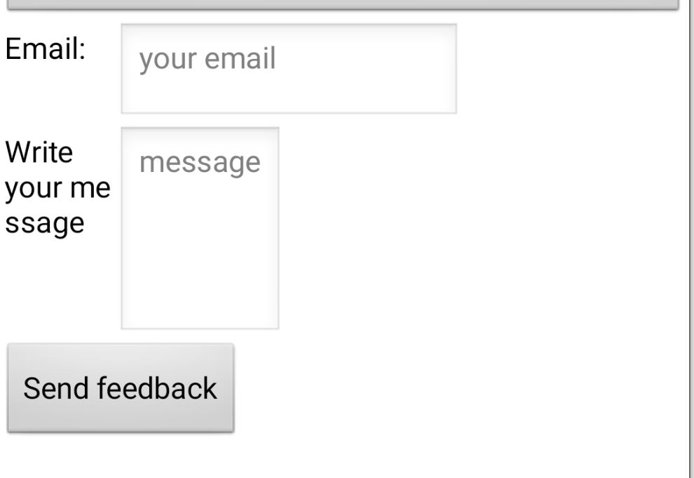
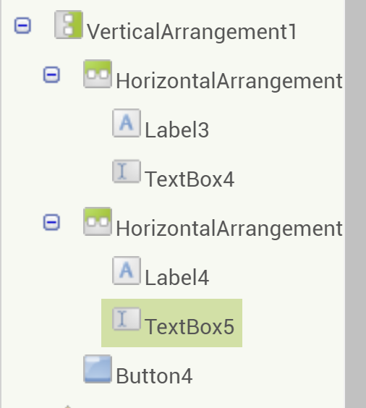
Text example
Task: create form fields validator
  Step 1: Design user interface: feedback form having 2 fields: email address and message itself, and a button to send the form.
  Step 2: Validate if email field contains @ sign
  Step 3: Validate if message field is not empty and text does not exceed 200 symbols.

Slide 7
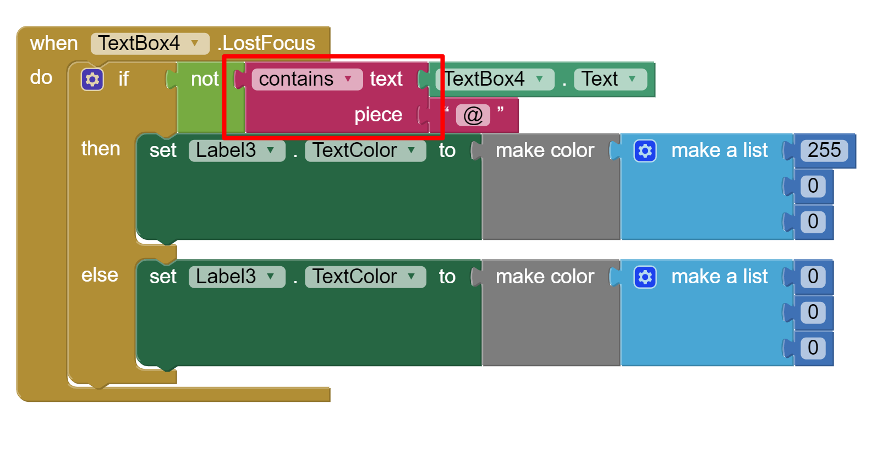
Checking email address
Here we have simple validation. We just check if the text contains “@” sign.
Main event we use is When Textbox loses focus, it is when textbox field was visited and no active anymore.
If the field does not contain correct sign, the text should be colored red. Otherwise it should stay black.
Here we use Contain block from Text category

Slide 8
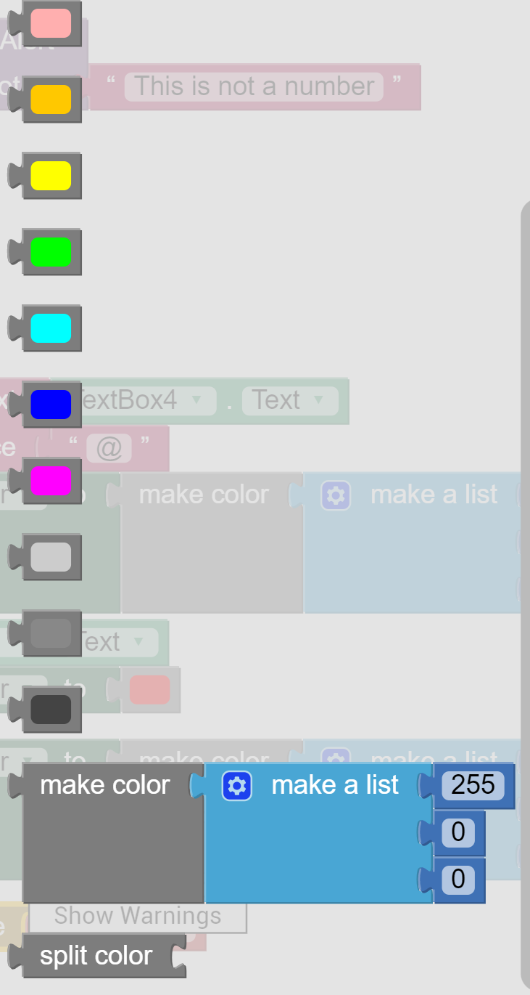
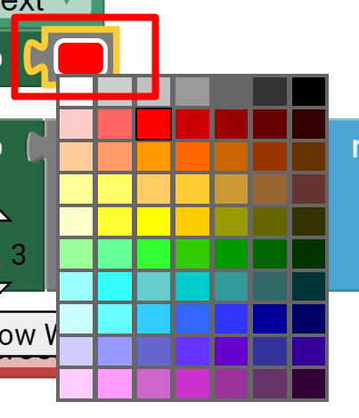
Playing with color
Color block category looks the following
You can simply pick any of predefined color or use MakeColor block, where you specify numbers according to RGB notation.
Having chosen first option, you still can change the color, just click on the color block itself in the Viewer, you will see the pallet.

Slide 9

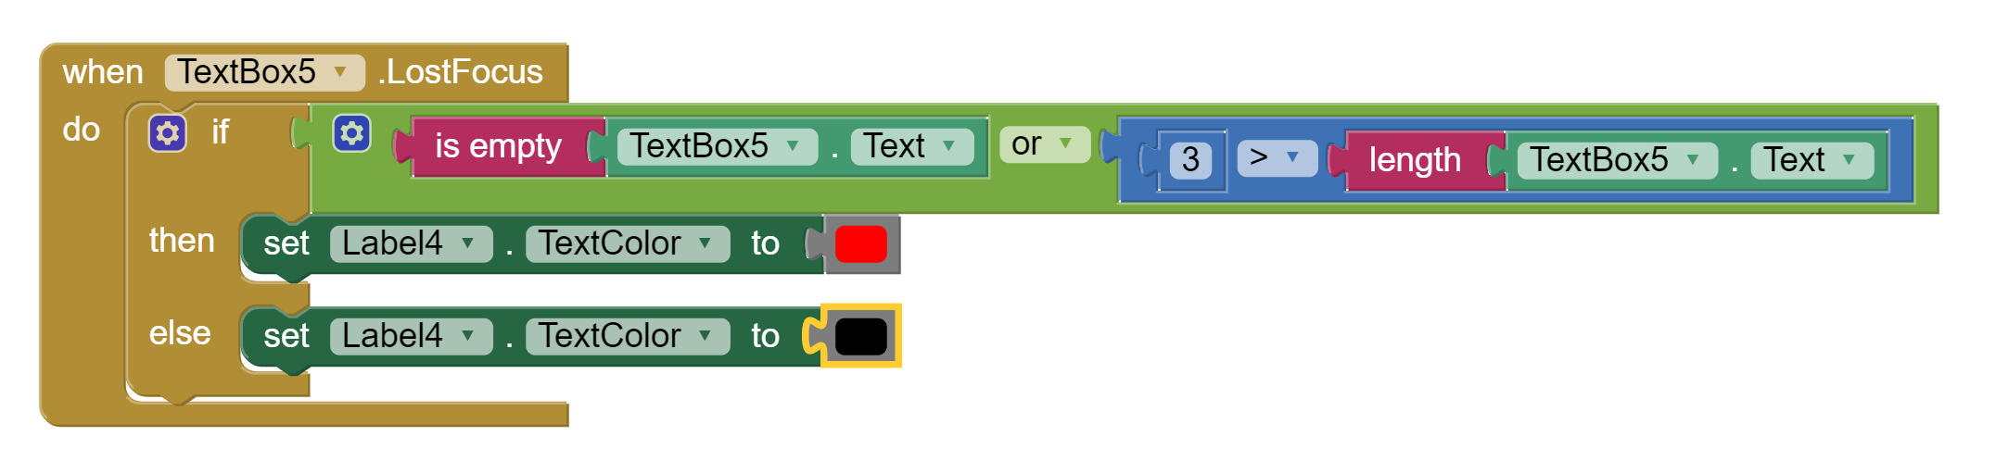
Validating message field
Validation of message field is simple – we check if the field is empty (we can also add checking number of symbols)

Slide 10
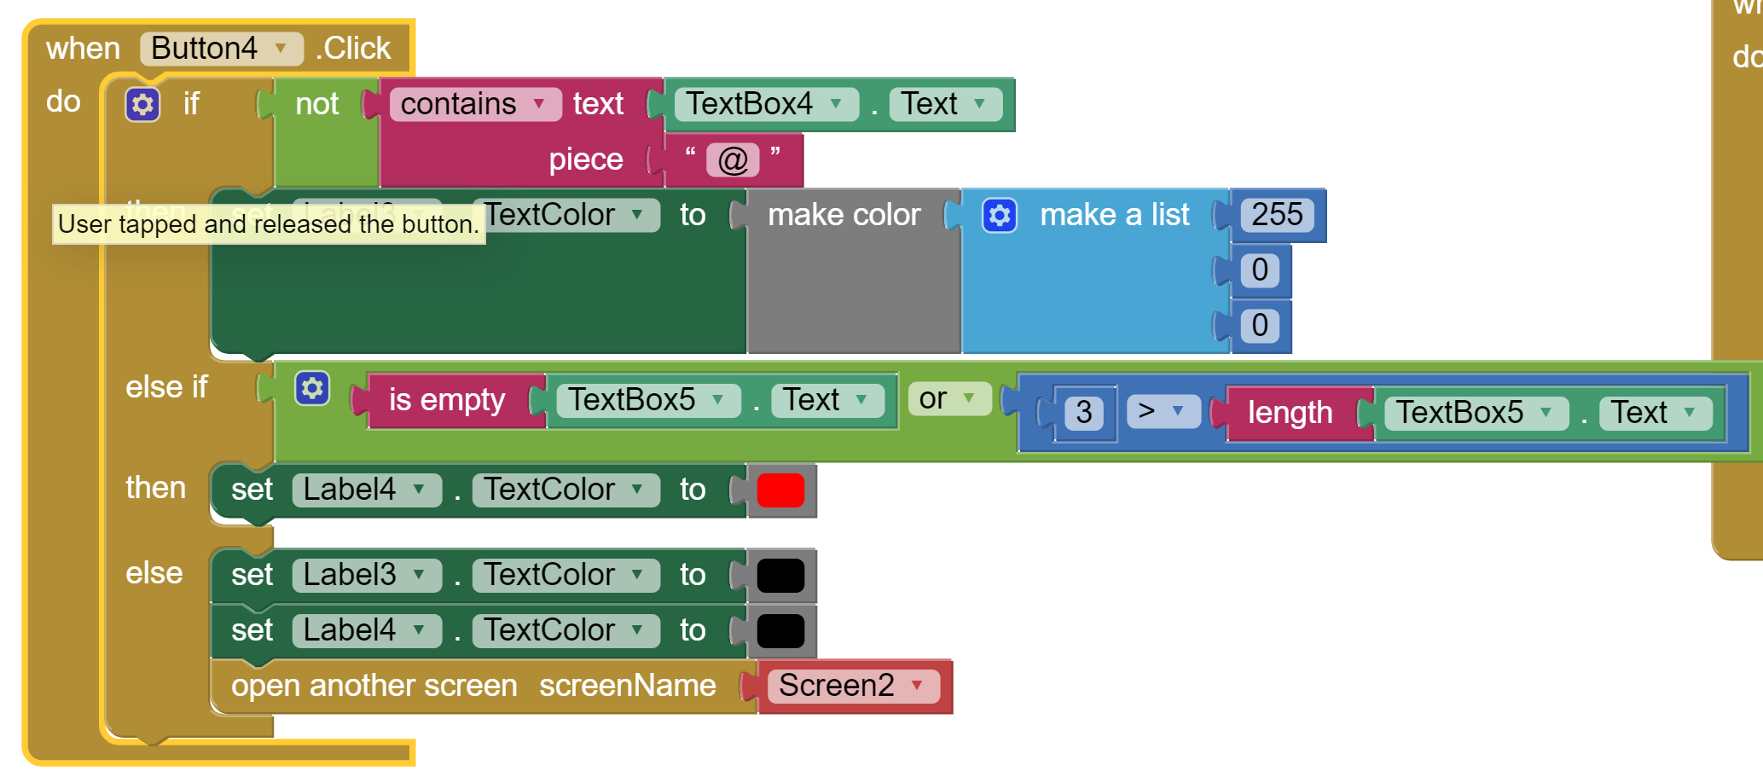
Coding button behavior
We need to add very similar conditions to button, before going to another screen, as there could be situations, when textbox fields were not visited at all – thus main event – LostFocus will not be called.

Slide 11
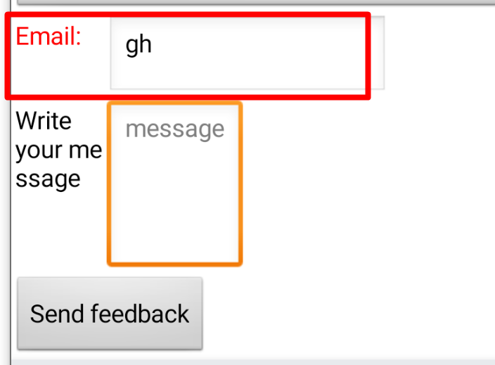
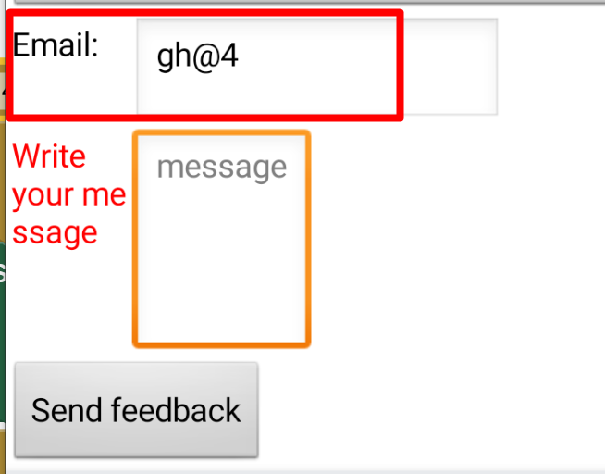
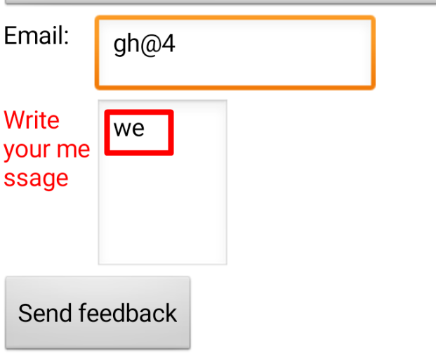
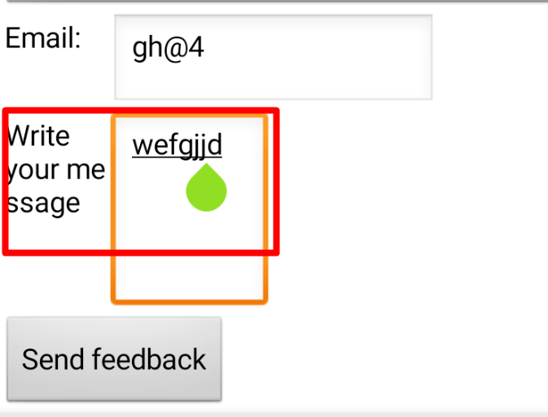
Results
@ sign validation
Not empty and has more than 3 symbols

Slide 12
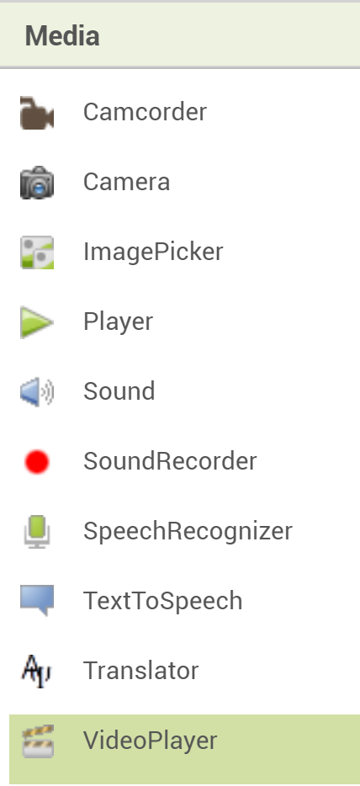
Media Components
Media Components are those which work with audio, video, images.
In MITappInventor they are:
  Camcoder – to record video using device’s camera
  Camera – to take a picture using device’s camera
  ImagePicker – choosing image from device’s image gallery
  Player - plays audio and controls phone vibration
  Sound - plays sound files, best for short sound files
  SoundRecorder – records audio
  SpeechRecogniser – converts speech to text
  TextToSpeech – converts text to speech (reads aloud)
  Translator - translate words and sentences between different languages. This component needs Internet access.
  Video Player – playing videos (1)

Slide 13
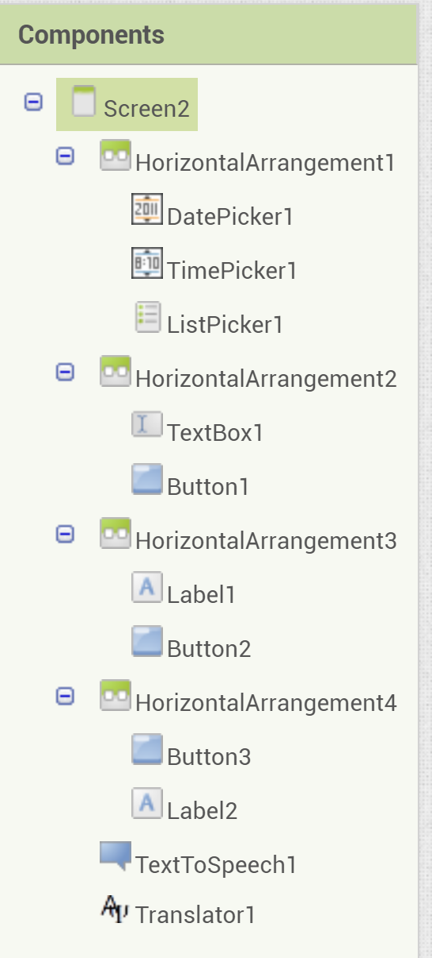
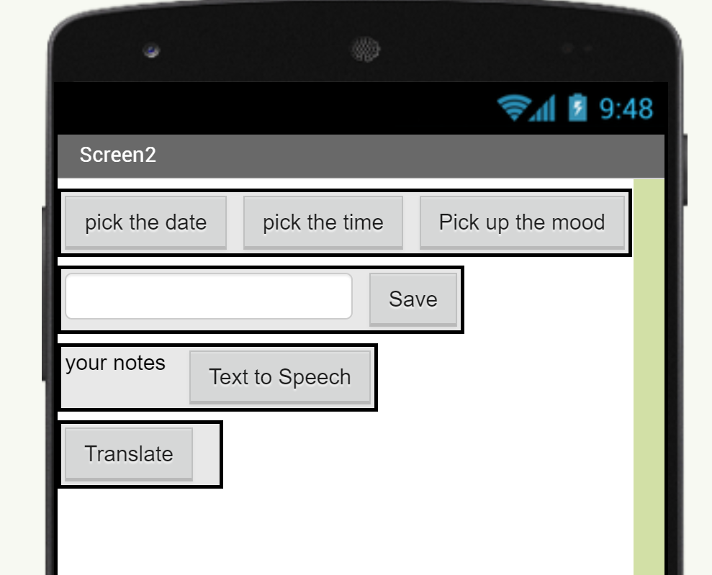
Example
Task: create and note taking application, where you can pick up the date, time and mood, add some notes, translate the text and listen it.
  Step 1: Create corresponding user interface
  Step 2: Program date, time and mood pickers
  Step 3: Save text
  Step 4: Enable translation of the text
  Step 5: Enable Text to Speech function

Slide 14
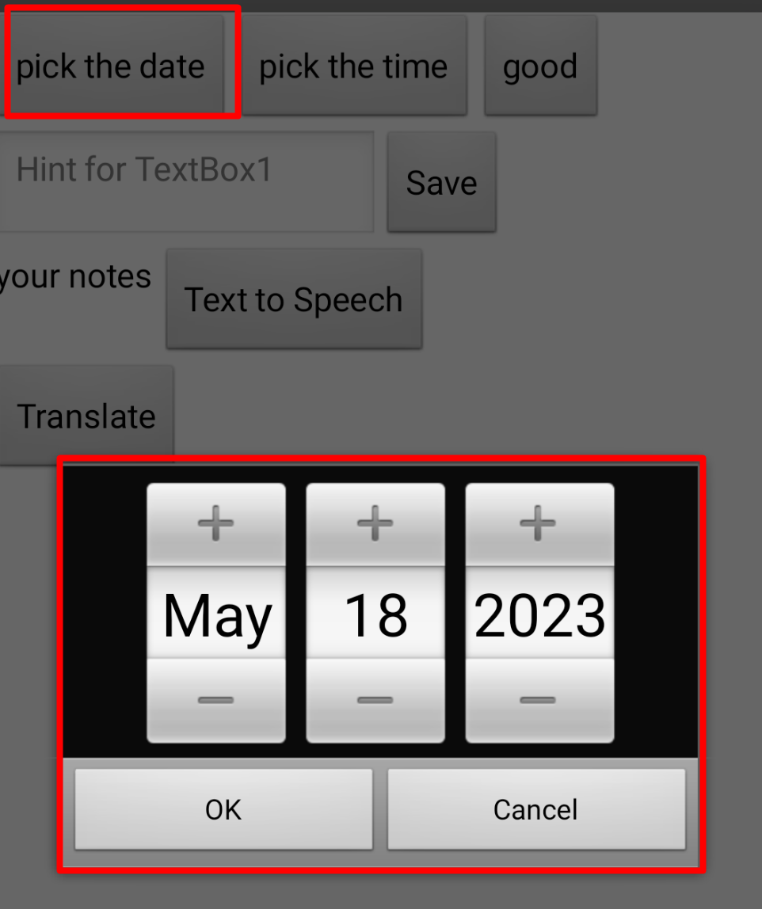
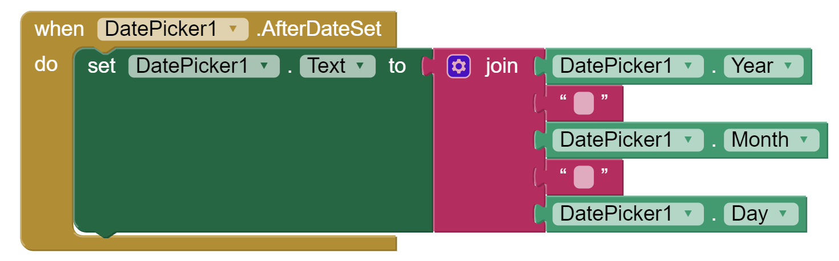
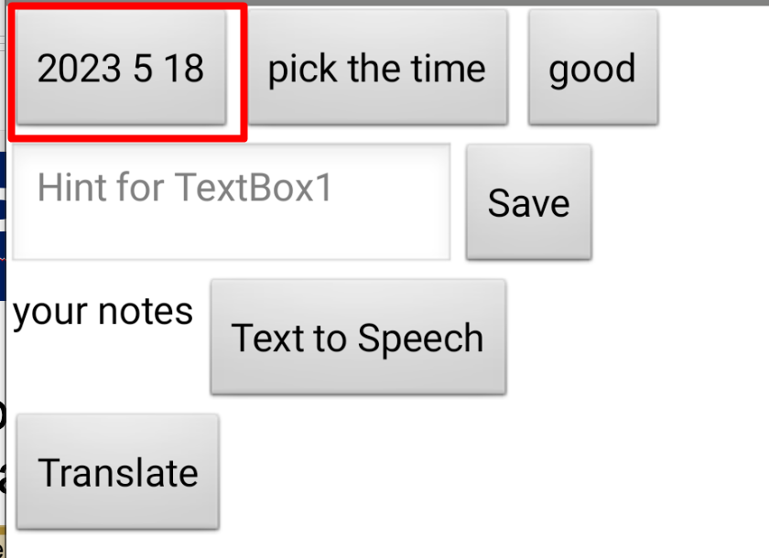
DatePicker
A button that, when clicked on, launches a popup dialog to allow the user to select a date. (1)

Slide 15
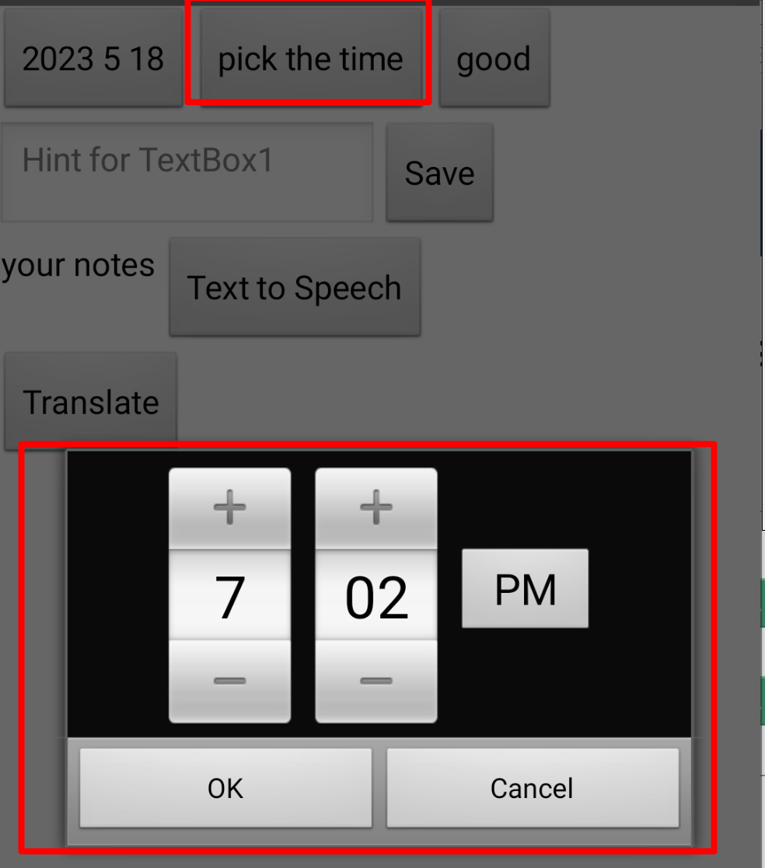
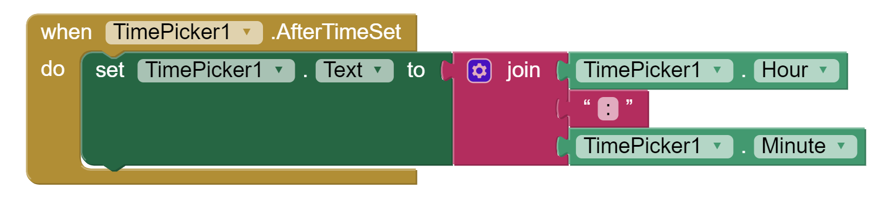
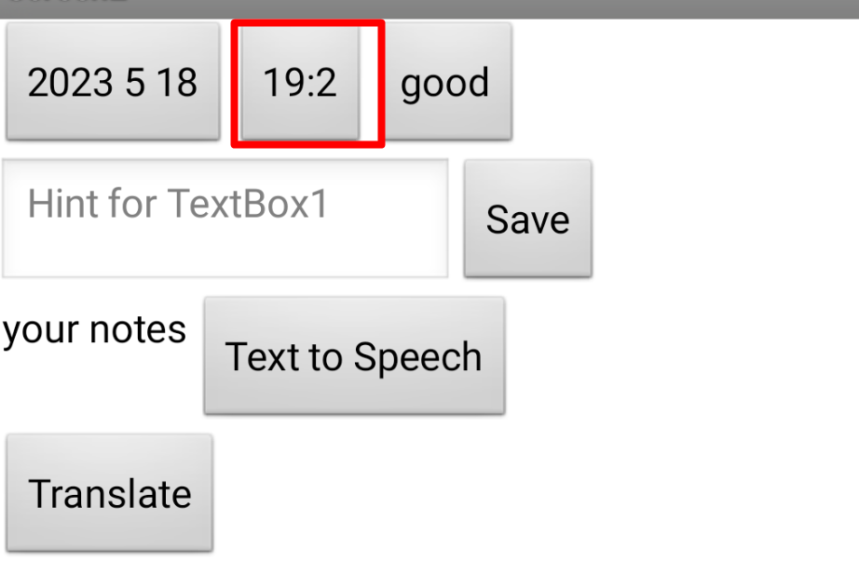
TimePicker
A button that, when clicked on, launches a popup dialog to allow the user to select a time. (1)

Slide 16
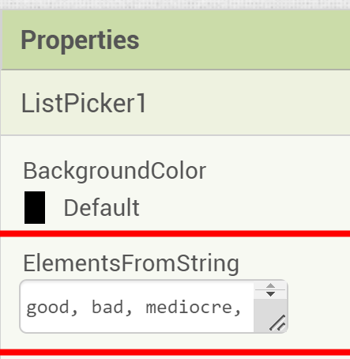
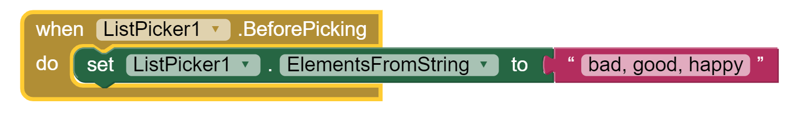
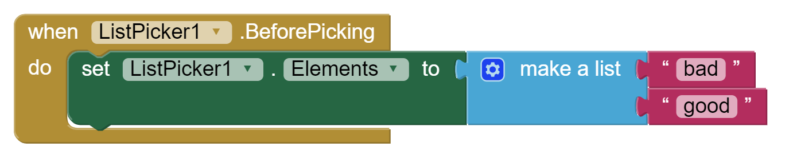
ListPicker
A button that, when clicked on, displays a list of texts for the user to choose among.
Items can be specified in Designer view in Property – ElementsFromString – values should be comma separated
They also can be specified in Blocks in two ways:

Slide 17
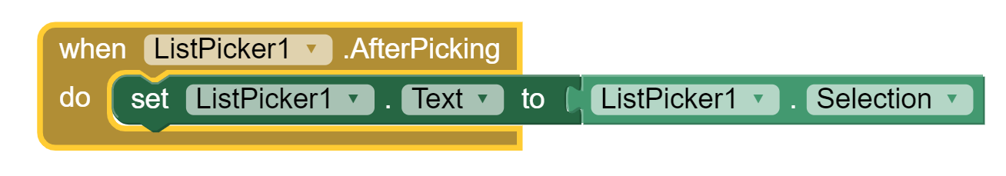
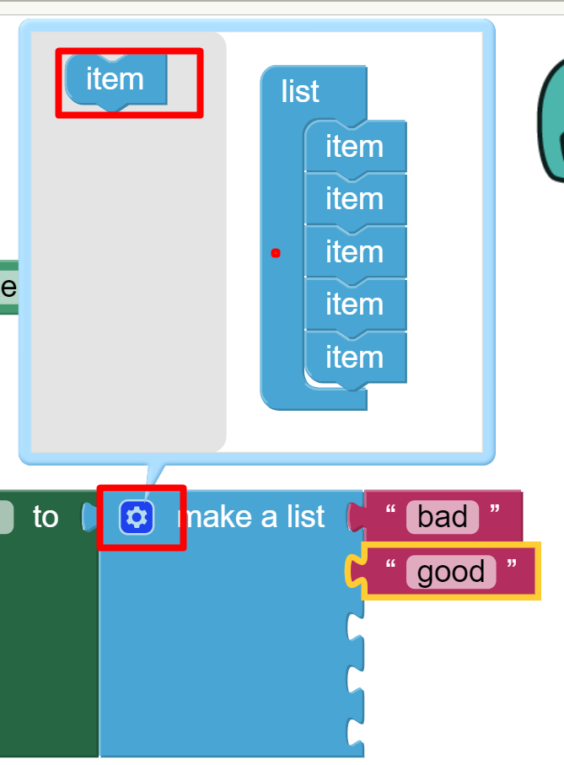
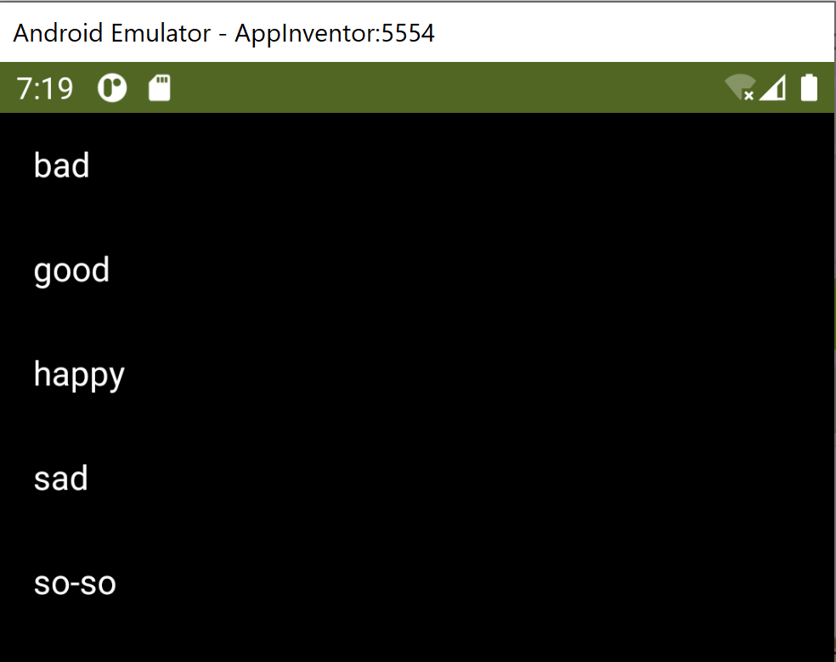
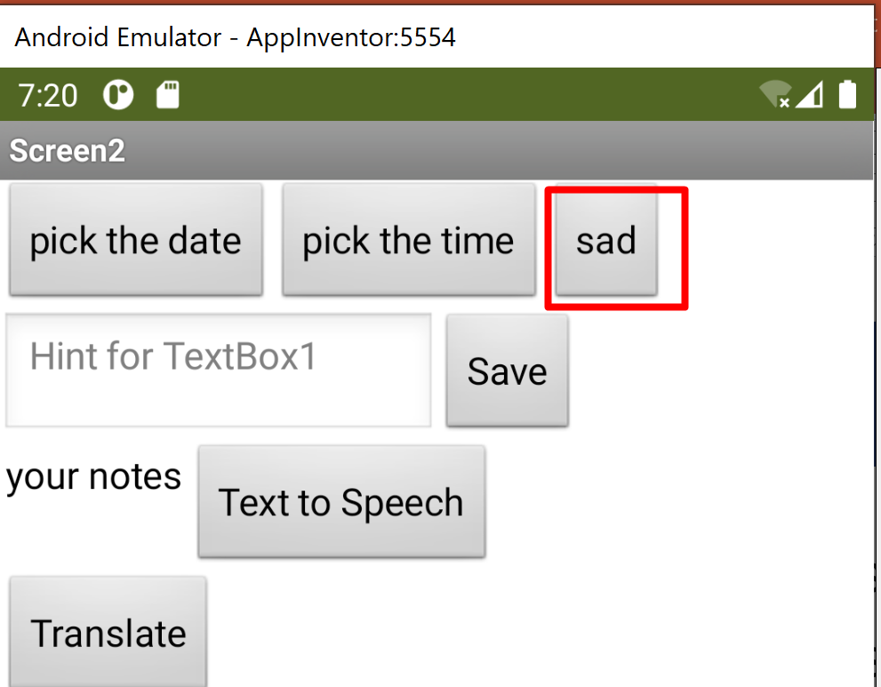
ListPicker
When the item is picked it should be assigned to ListPicker.Text
Many block come with Gear symbol. It is a special symbols for changing settings of the block, i.e. you can add/remove similar components.

Slide 18
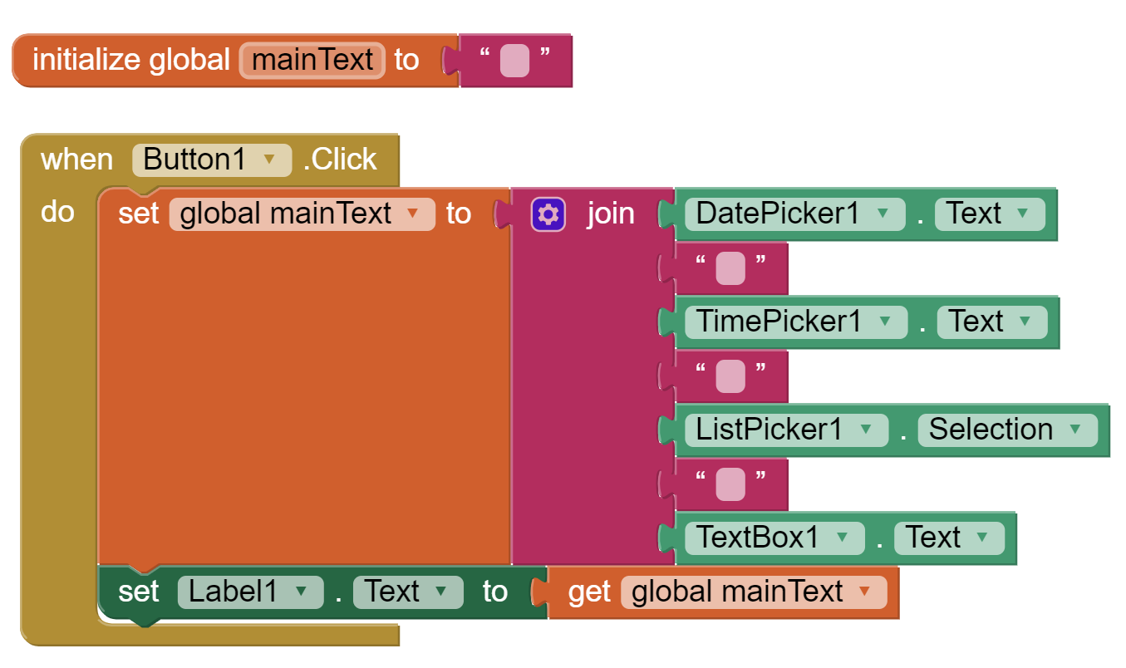
Creating a note Button
When Save button is clicked, we need to merge the date, time and mood picked to text user inserted and display it below.

Slide 19
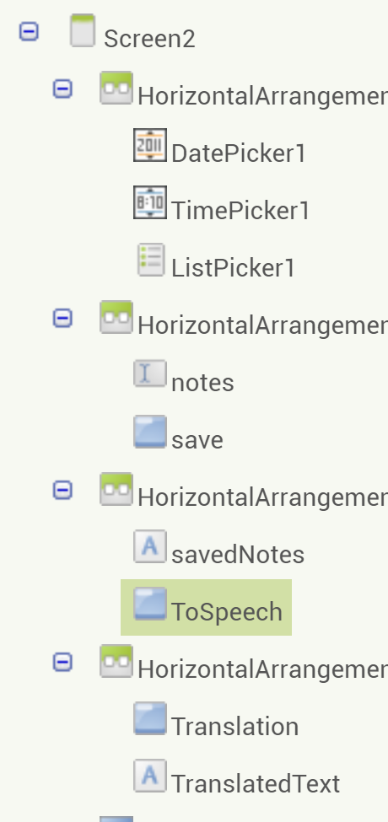
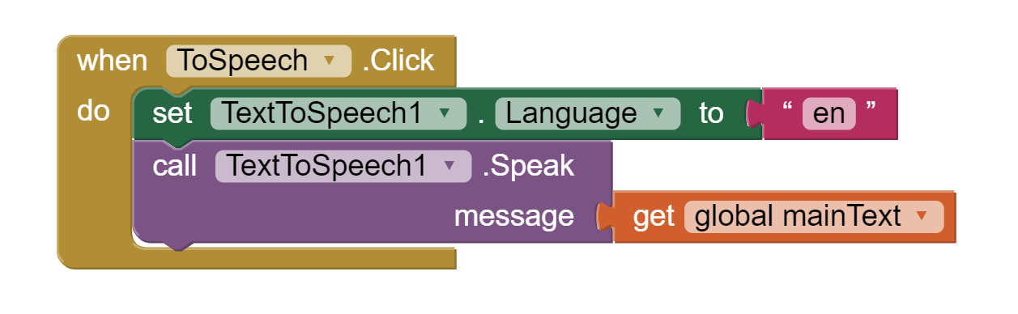
Text to Speech
Since we having more and more UI elements, it becomes difficult to remember all their names and numbers, thus we better change their names to more understandable and close to task or purpose they were created for.
You can select country, language, speech rate and pitch the voice

Slide 20
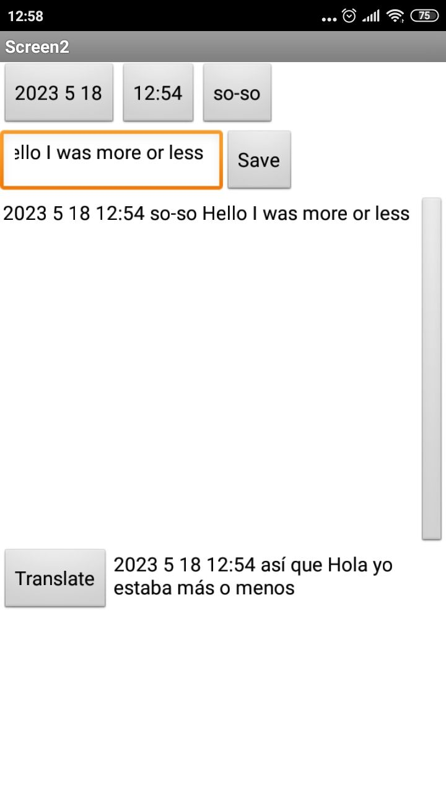
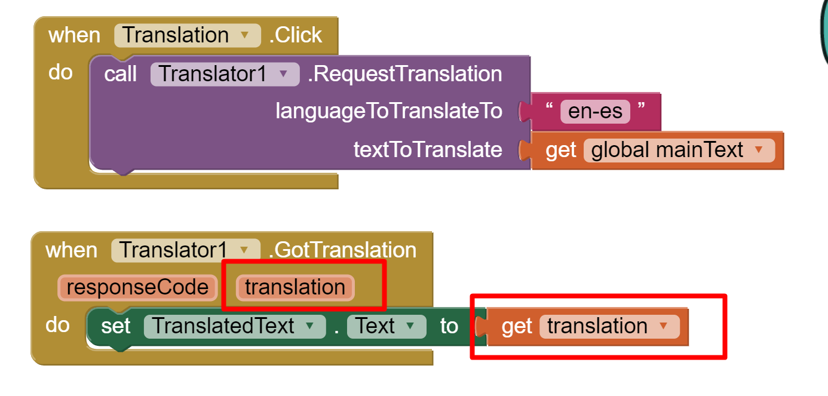
Translation
For proper translation, we need to know short names of languages
Translator component has only one method and one event

Slide 21
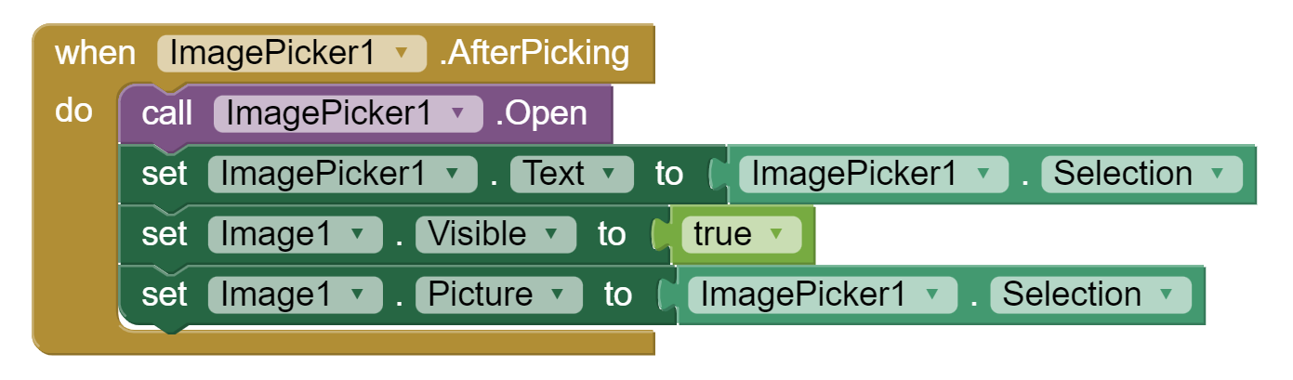
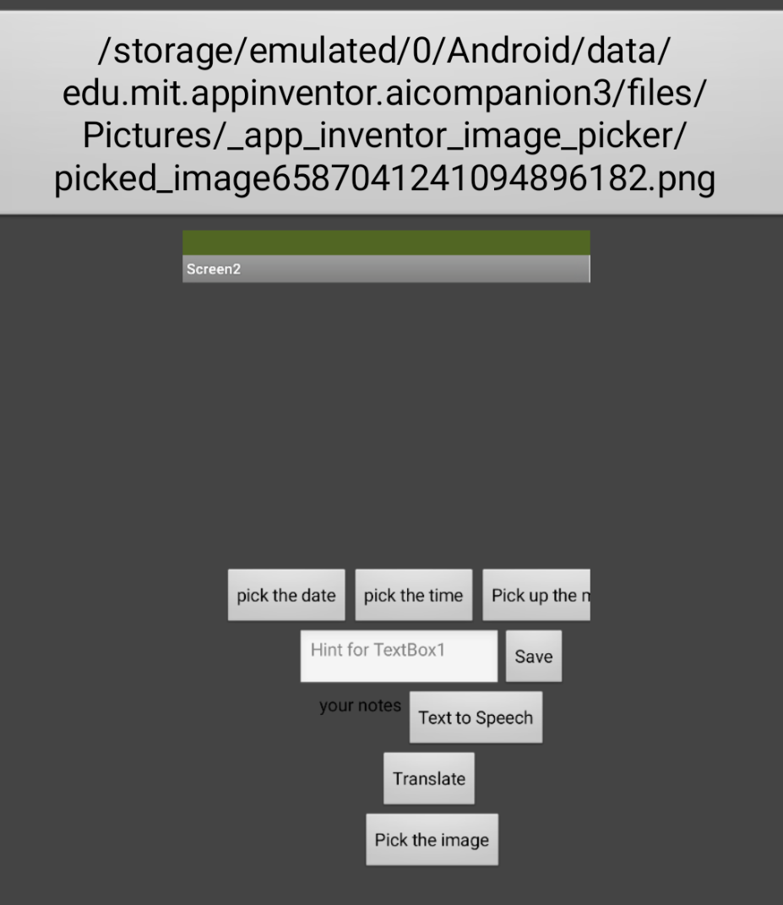
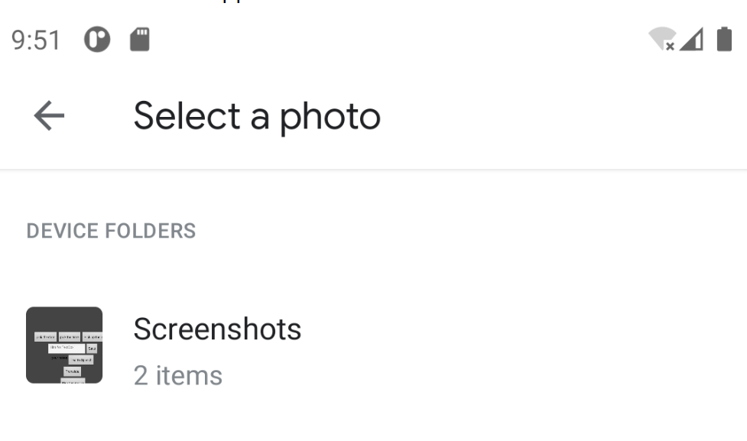
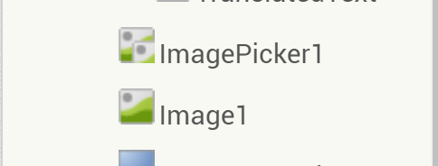
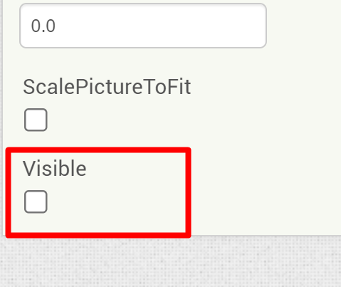

ImagePicker and Image
ImagePicker can help to pick up the image and we cad display selected image in Image component.
Let’s make Image component not visible, before image is selected.

Slide 22
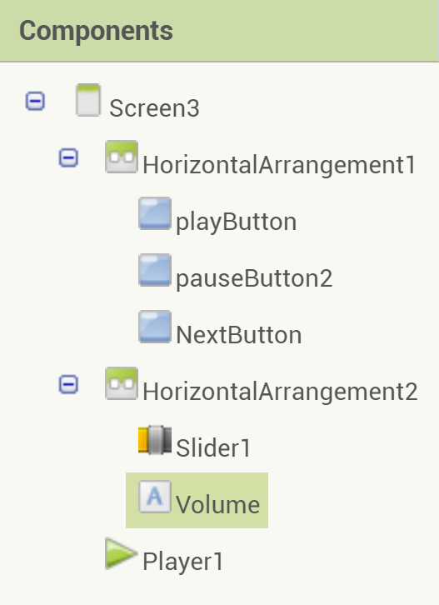
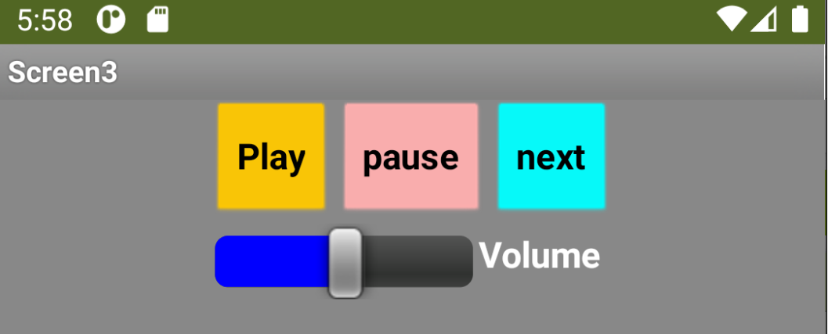
Player and sound
Task: add buttons to simulate audio player: play, pause, next, set the volume
  Step 1: UI interface
  Step 2: Add audio files to project and add them to form a playlist
  Step 3: Add slider and make a link between audio volume and value of the slider
Step 1. UI interface. Buttons: Player, Play, Pause, Next, Slider and a Label

Slide 23
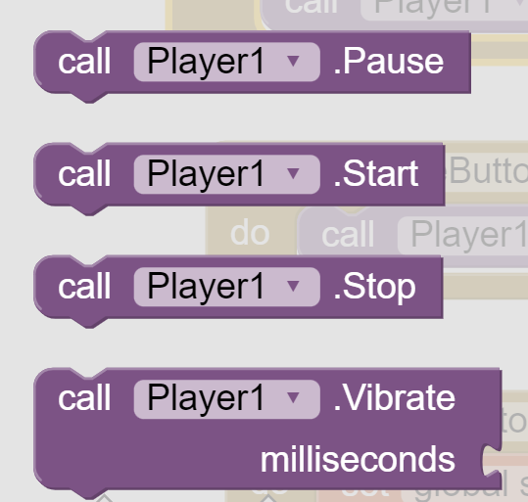



Player
Add several audio files to Media
Player component has build in methods, which can be directly used four our purposes
To program Next button, we need to form a list of all audio files.
For this we use Lists – special structure which allows to create with collections of elements

Slide 24



Create lists
Declare a variable List, which will consist of several audio files.
Whenever we click Next button, we check if we reached the end of the list, and if yes, we just restart, having set songNumber to 1 again.

Slide 25



Slider
Slider’s ThumbPosition property should be connected to Player’s volume

Slide 26





Camera
Task: record video and take a photo. Display the result on the screen
  Step 1: Components we need: 2 buttons, Image, VideoPlayer, Camcorder, Camera

Slide 27




Charts
Charts - Components that allow to visualize data
ChartData2D - A component that holds (x, y)-coordinate based data (1)
The main properties of the Chart is LabelsFrom String (comma separated) and the type of the chart

Slide 28

ChartData2D
Main properties of ChartData2D is ElementsFromPairs – you assume that data for your chart was taken from the table. In tabular format, every data entry has and address (starts from 0) and the value.
The values will look the following:
  0 – first element has value 3
  1 – second element has value 1
  2 – third element has value 5
  3 – fourth element has value 2
  4 – fifth element has value 6
  5 – sixth element has value 3
  6 – seventh element has value 3
Same should be done for all 3 ChartData2D (but of course with different values)

Slide 29



Legend
Enable the legend and set the label for every ChartData2D
Charts using extension
Download free extension from (2)
Import extension to your project
Add ChartMaker to your screen and open in Blocks

Slide 30
References
http://ai2.appinventor.mit.edu/
https://github.com/MillsCS215AppInventorProj/chartmaker

