Slide 1
Visual Programming
Lecture 12
Storages, connectivity.

Slide 2
Agenda
Permissions
Social
  Contact Picker
  Email Picker
  Phone Call
  Phone number Picker
  Sharing
  Texting
  Twitter
Storage
  TinyDB
  CloudDB
  Firebase
  Textfiles
  Datafiles
  Spreadsheets
Connectivity

Slide 3
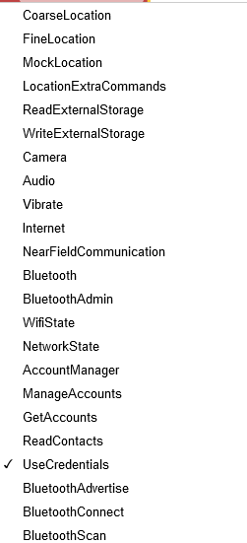
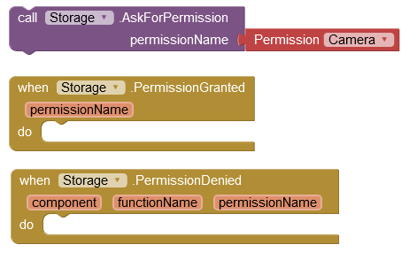
Permissions
Ask user to grant access to permissions.
Permission can be denied. In this case you need to write how to proceed

Slide 4
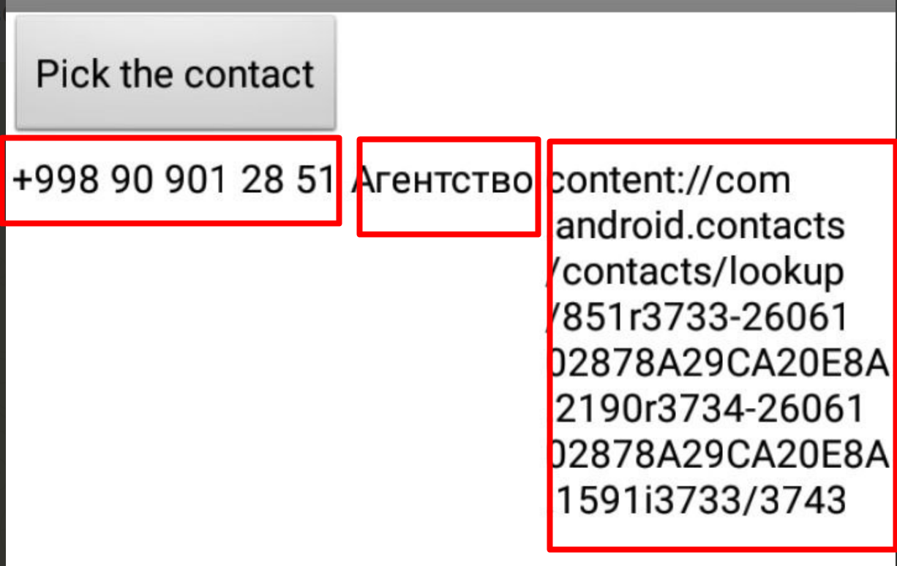
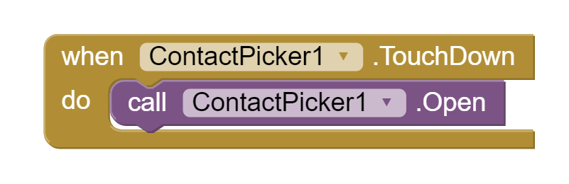
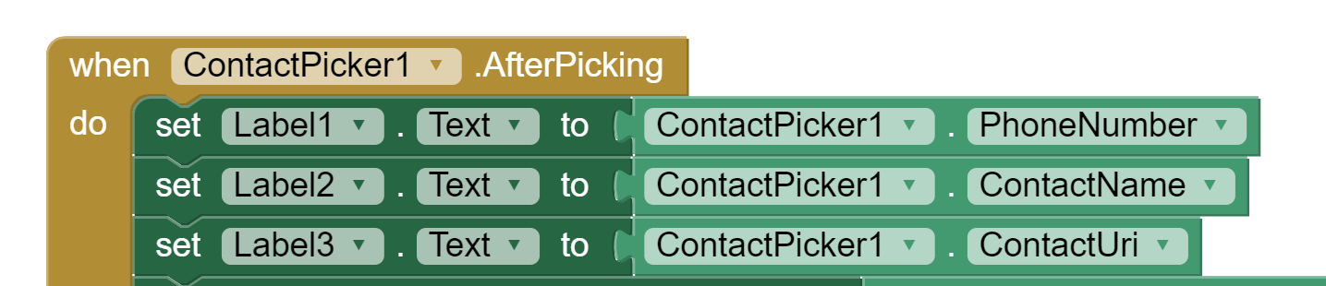
Contact Picker
Displays a list of the contacts to choose among. (1)
The following properties will be set to information about the chosen contact:
  ContactName: the contact's name
  EmailAddress: the contact's primary email address
  ContactUri: the contact's URI on the device
  EmailAddressList: a list of the contact's email addresses
  PhoneNumber: the contact's primary phone number
  PhoneNumberList: a list of the contact's phone numbers
  Picture: the name of the file containing the contact's image

Slide 5
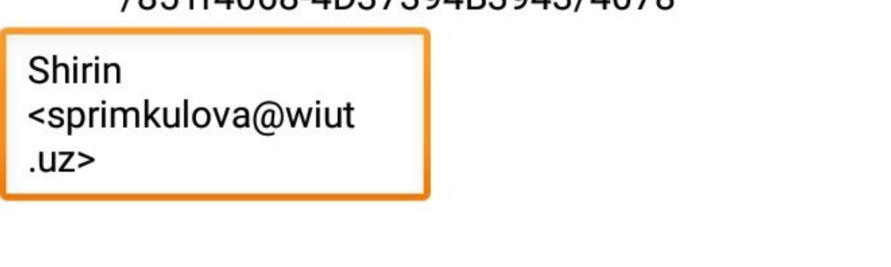
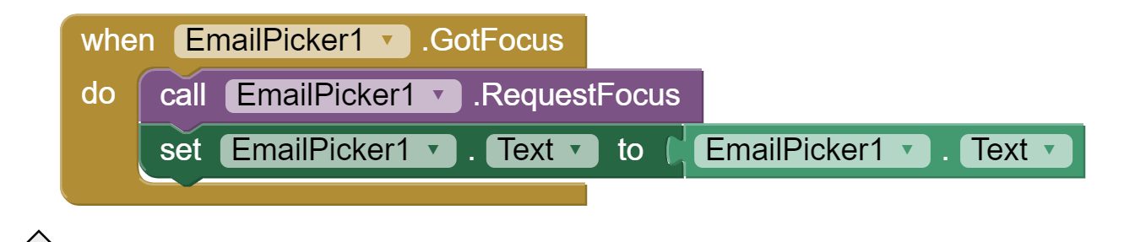
Email Picker
Text box.
If the user begins entering the name or email address of a contact, the phone will show a dropdown menu of choices that complete the entry.
The initial contents of the text box and the contents< after user entry is in the Text property. If the Text property is initially empty, the contents of the Hint property will be faintly shown in the text box as a hint to the user. (1)

Slide 6
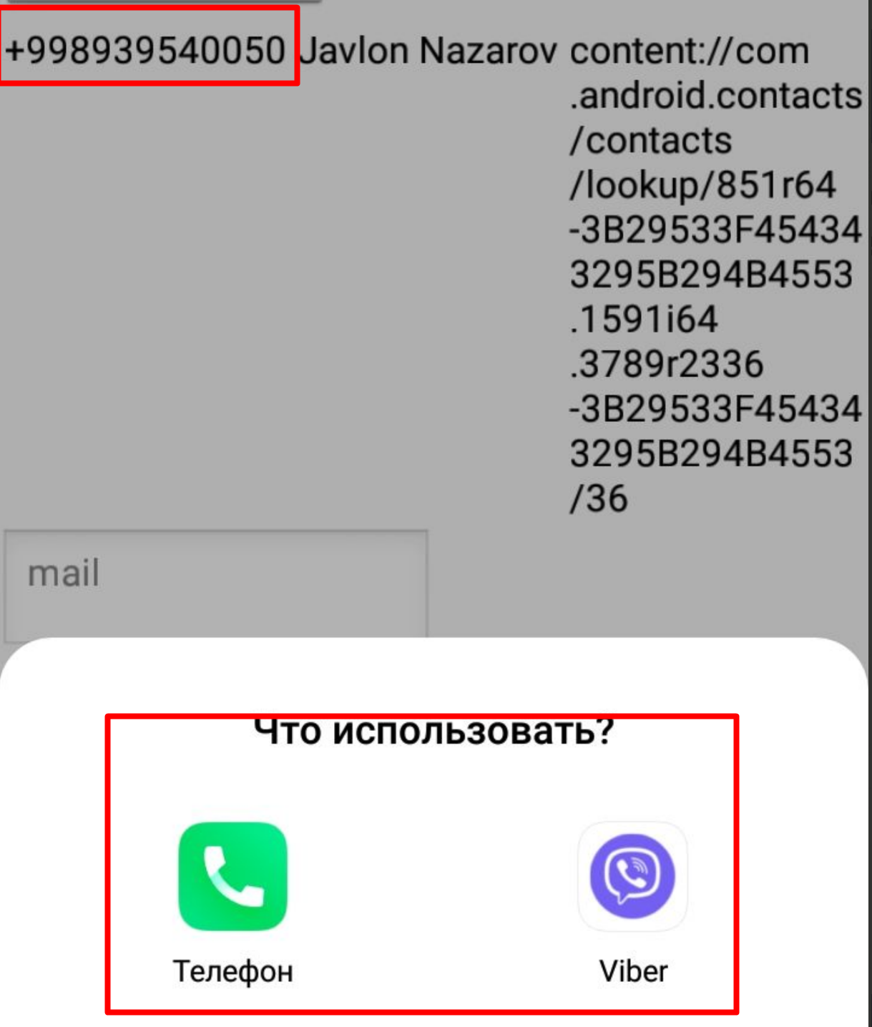
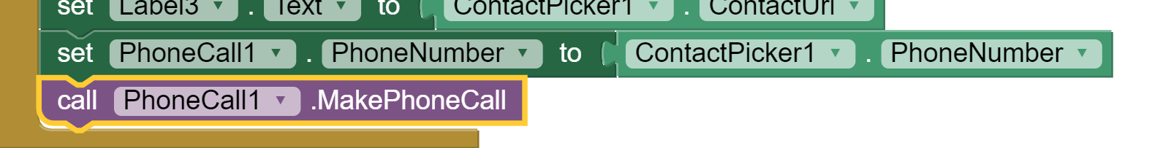
Phone Call
A non-visible component
Makes a phone call to the number specified in the PhoneNumber property
MakePhoneCall method, enabling the program to launch a phone call.
To directly specify the phone number (e.g., 650-555-1212), set the PhoneNumber property to a Text with the specified digits (e.g., "6505551212").
Dashes, dots, and parentheses may be included (e.g., "(650)-555-1212") but will be ignored; spaces may not be included. (1)

Slide 7
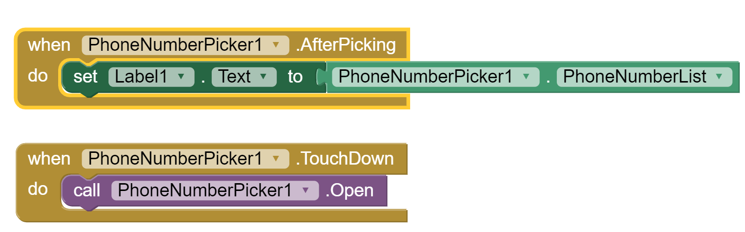
Phone number Picker
Displays a list of the contacts' phone numbers to choose among. After the user has made a selection, the following properties will be set to information about the chosen contact:
  ContactName: the contact's name
  PhoneNumber: the contact's phone number
  EmailAddress: the contact's email address
  Picture: the name of the file containing the contact's image, which can be used as a Picture property value for the Image or ImageSprite component. (1)

Slide 8
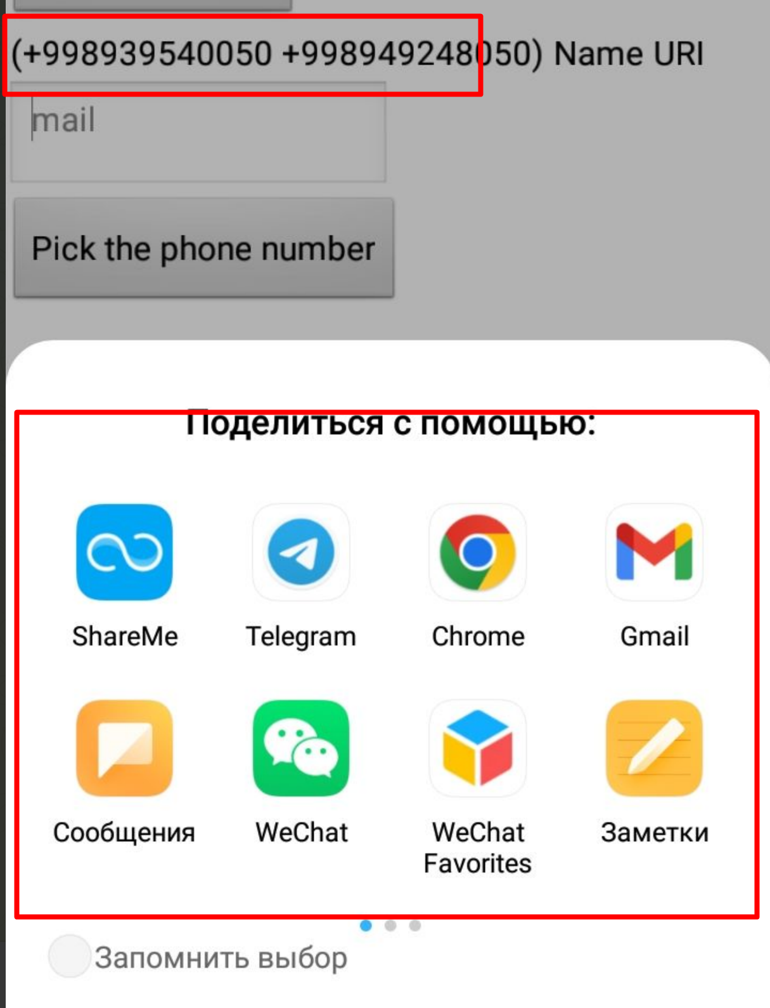
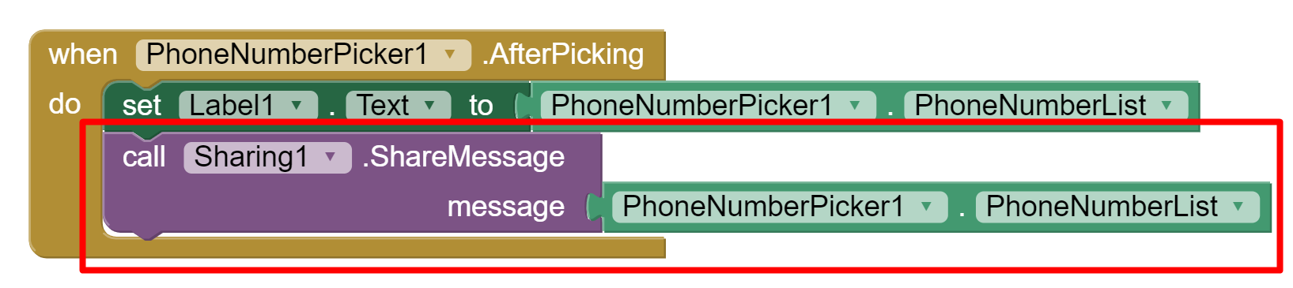
Sharing
Sharing is a non-visible component
Enables sharing files and/or messages between your app and other apps installed on a device
Display a list of the installed apps that can handle the information provided
The file path can be taken directly from other components such as the Camera or the ImagePicker, but can also be specified directly to read from storage (1)
Sharing Phone numbers

Slide 9
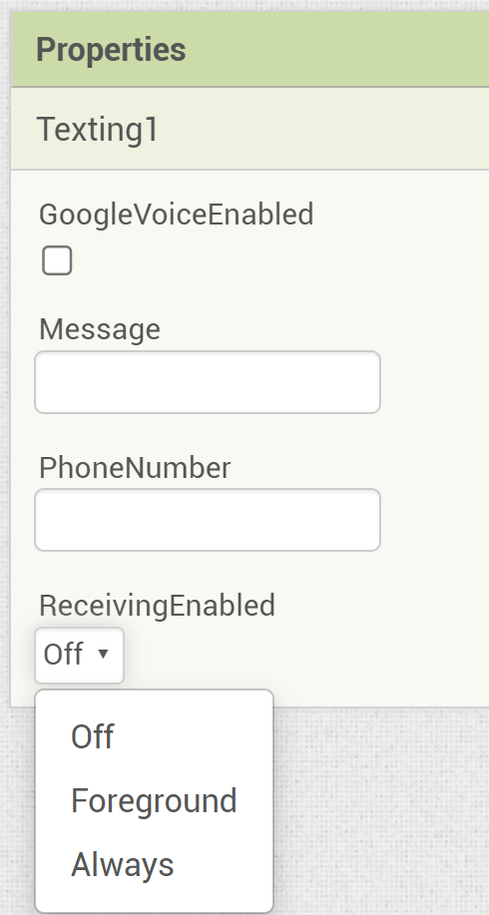
Texting
A component that will, when the SendMessage method is called, send the text message specified in the Message property to the phone number specified in the PhoneNumber property.
  If the ReceivingEnabled property is set to 1 messages will not be received.
  If ReceivingEnabled is set to 2 messages will be received only when the application is running.
  Finally if ReceivingEnabled is set to 3, messages will be received when the application is running and when the application is not running they will be queued and a notification displayed to the user.
When a message arrives, the MessageReceived event is raised and provides the sending number and message.
If the GoogleVoiceEnabled property is true, messages can be sent over Wifi using Google Voice. (1)

Slide 10
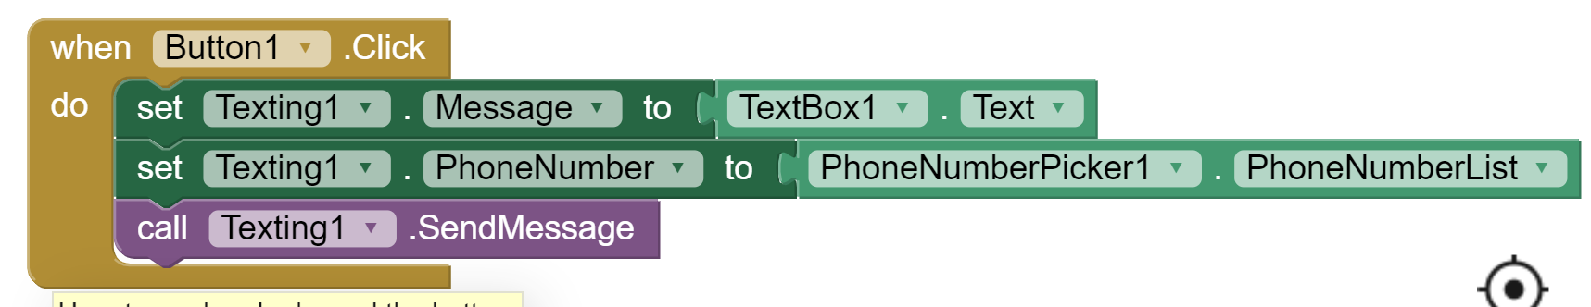
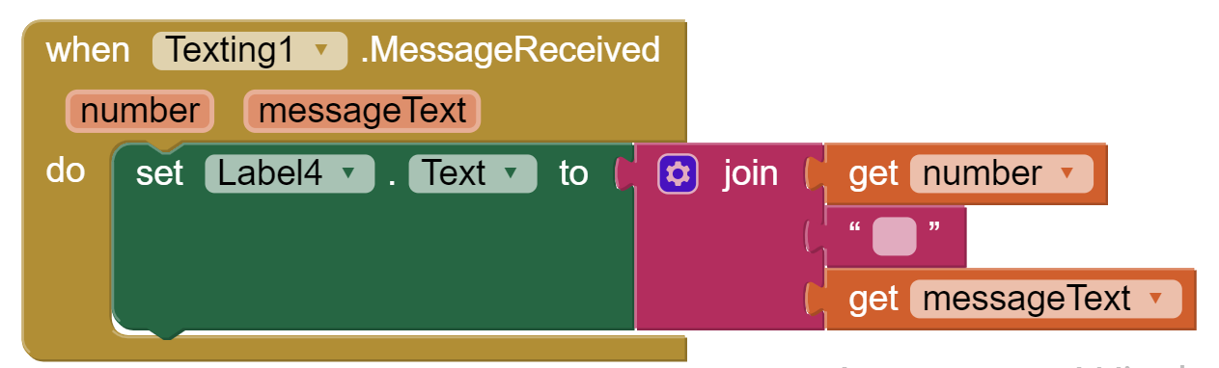
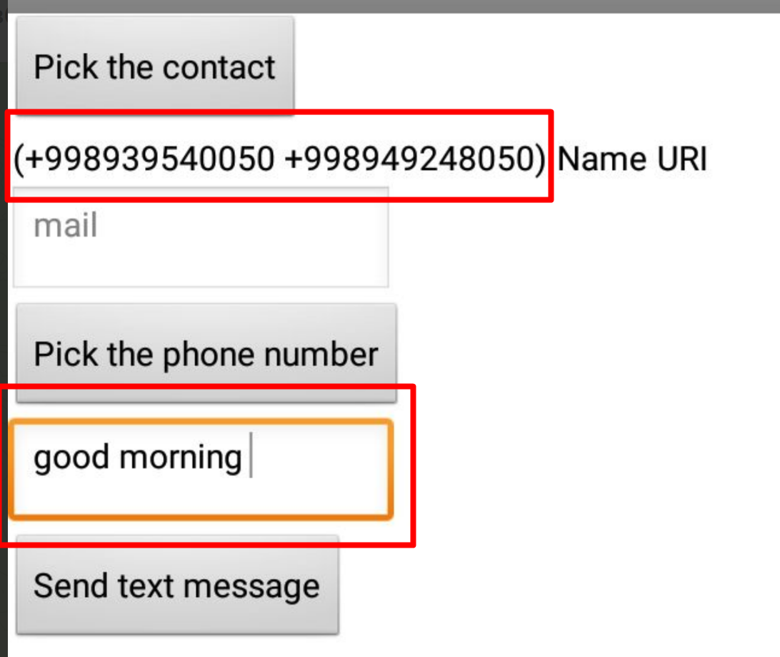
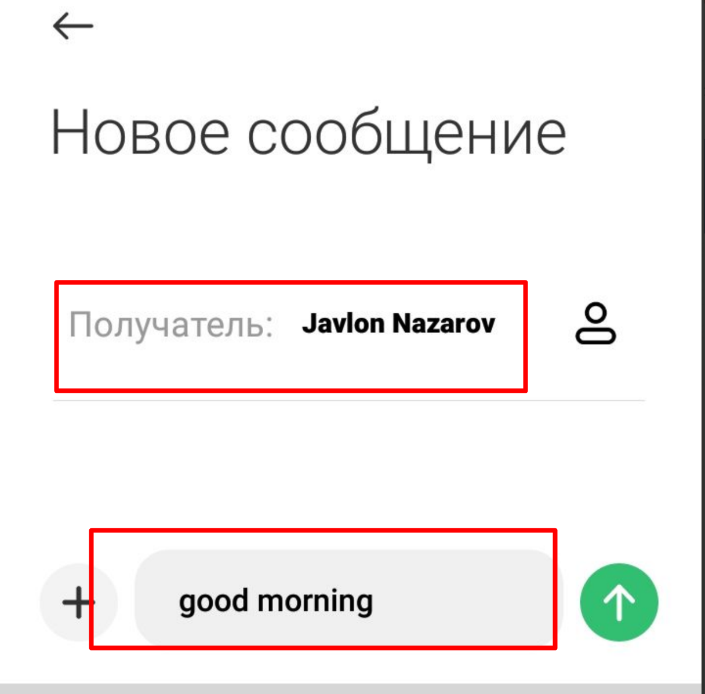
Texting
Sending message
Receiving message

Slide 11
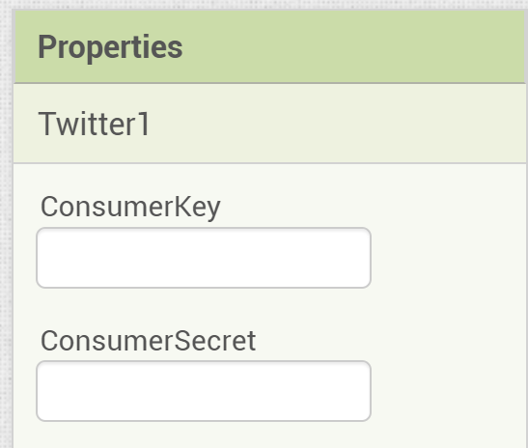
Twitter
Enables communication with Twitter.
Requires Twitter authorization:
  Searching Twitter for tweets or labels
  Sending a Tweet
  Sending a Tweet with an Image
  Directing a message to a specific user
  Receiving the most recent messages directed to the logged-in user
  Following a specific user
  Ceasing to follow a specific user
  Getting a list of users following the logged-in user
  Getting the most recent messages of users followed by the logged-in user
  Getting the most recent mentions of the logged-in user
You must obtain a Consumer Key and Consumer Secret for Twitter authorization specific to your app from http://twitter.com/oauth_clients/new (1)

Slide 12
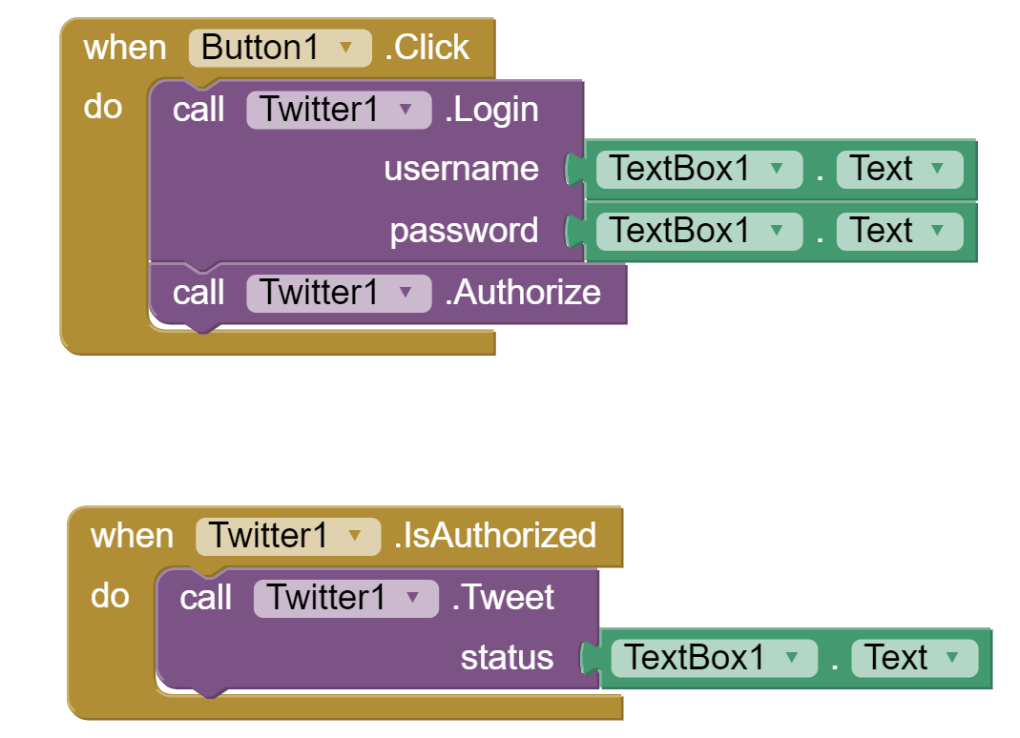
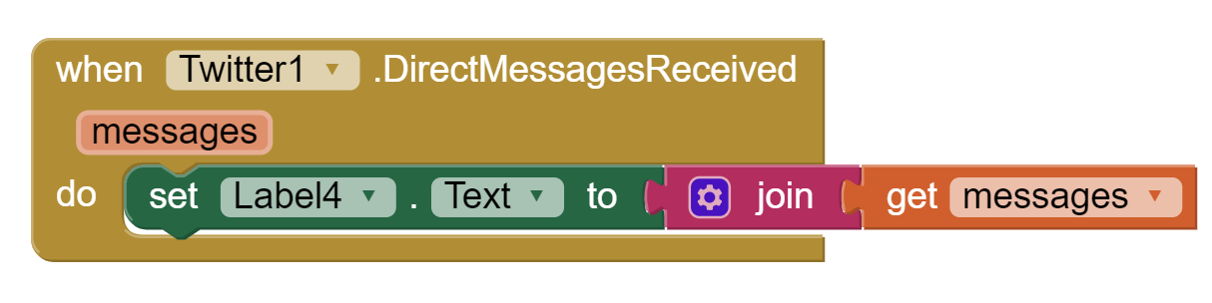
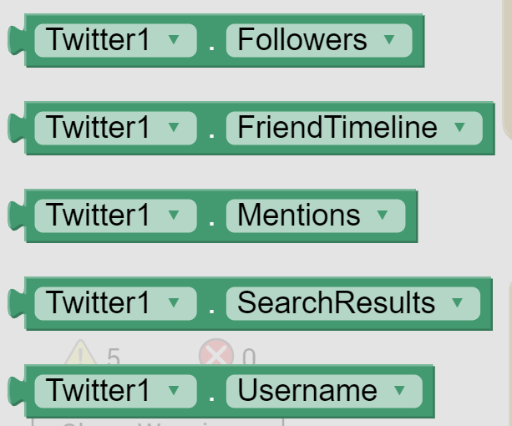
Twitter
Sending
Receiving
In addition to messages, you can see Followers, SearchResultls, Mentions, etc.

Slide 13
Storing data
Apps created with App Inventor are initialized each time they run: If an app sets the value of a variable and the user then quits the app, the value of that variable will not be remembered the next time the app is run. (1)
For storing data you have several options:
  Local files
  Local databases
  Spreadsheets
  Online databases

Slide 14
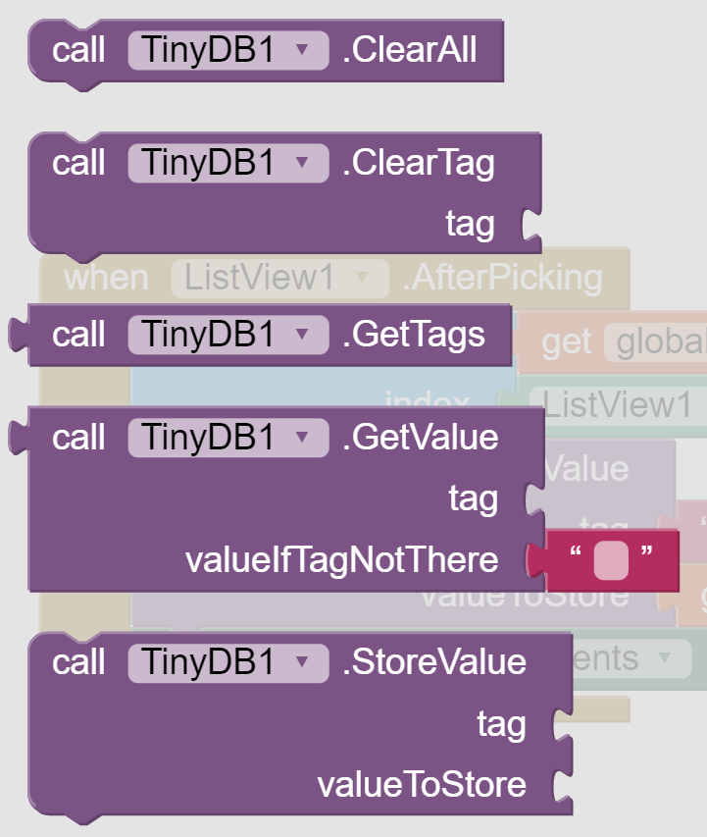
TinyDB
Stores data for an app.
persistent data store for the app, data stored there will be available each time the app is run.
Data items are strings stored under tags.
There is only one data store per app. Even if you have multiple TinyDB components, they will use the same data store.
TinyWebDB - Non-visible component that communicates with a Web service to store and retrieve information. (1)

Slide 15
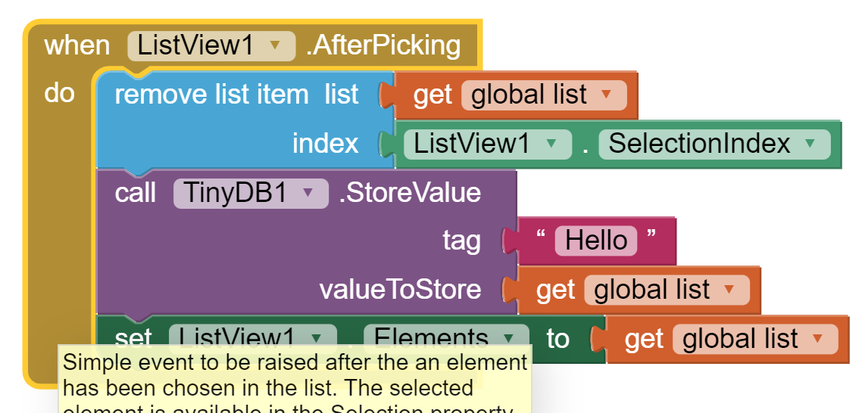
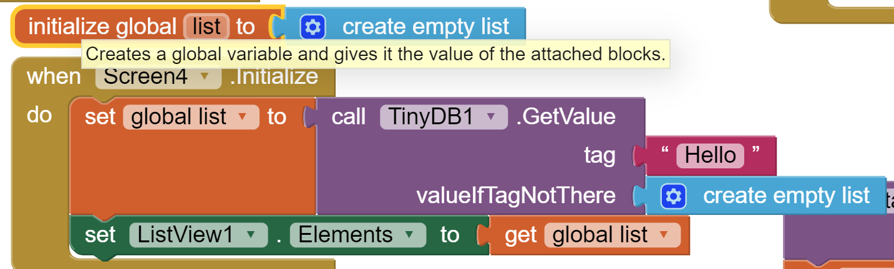
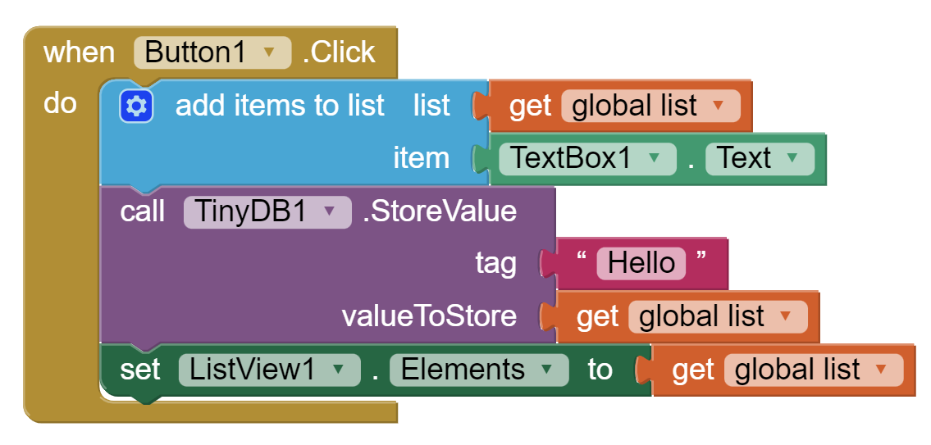
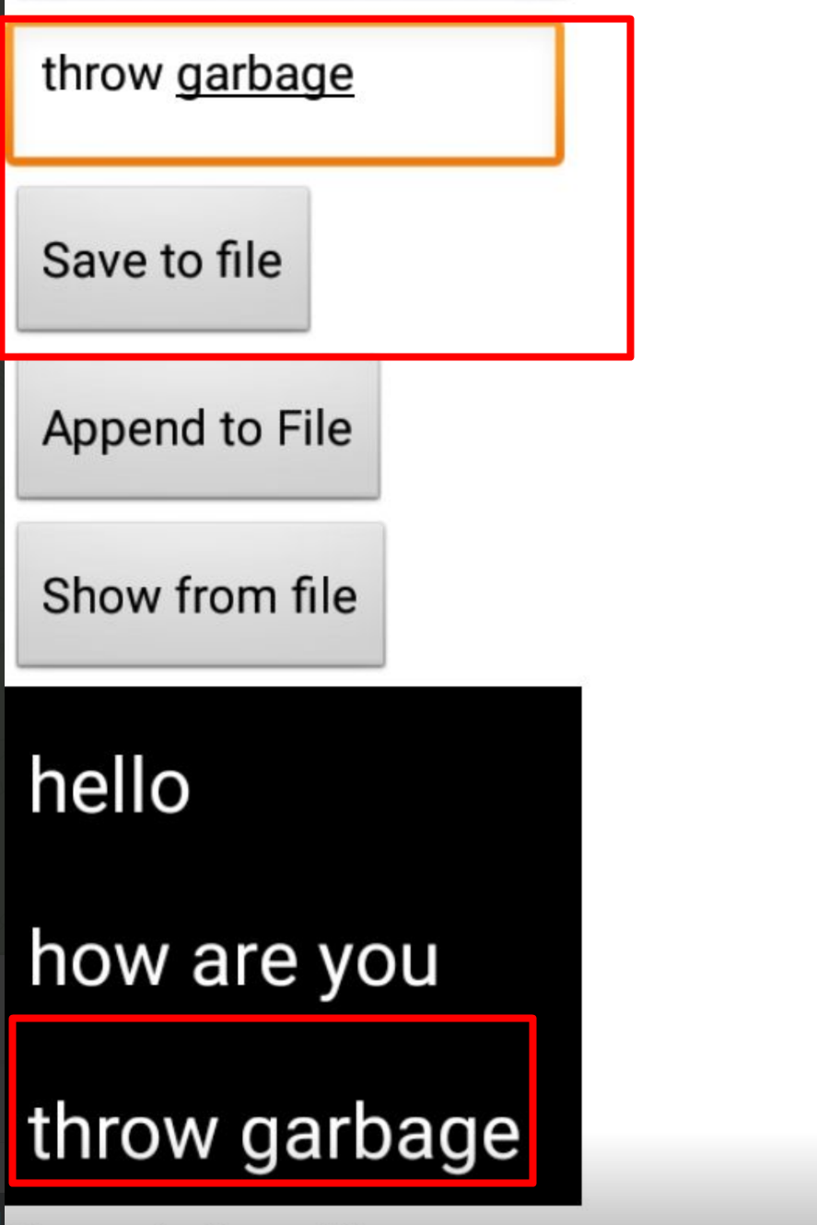
To do list
Task: create to do list with help of TinyDB.

Slide 16
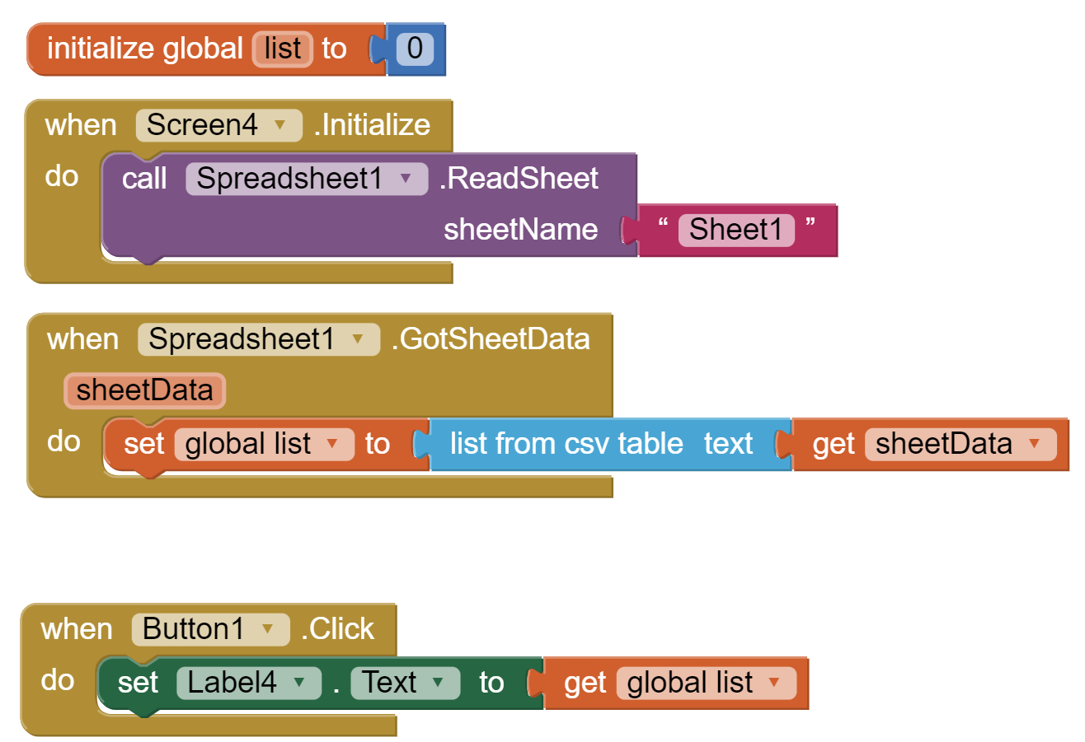
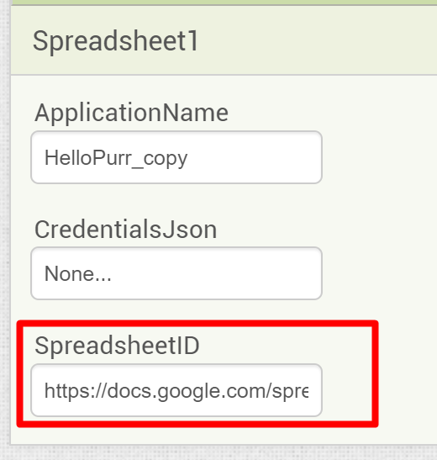
Spreadsheet
Reading from spreadsheet
Spreadsheet is a non-visible component for storing and receiving data from a Spreadsheet document using the Google Sheets API. (1)
Share spreadsheet, specify address in properties and substitute edit with export?format=csv

Slide 17
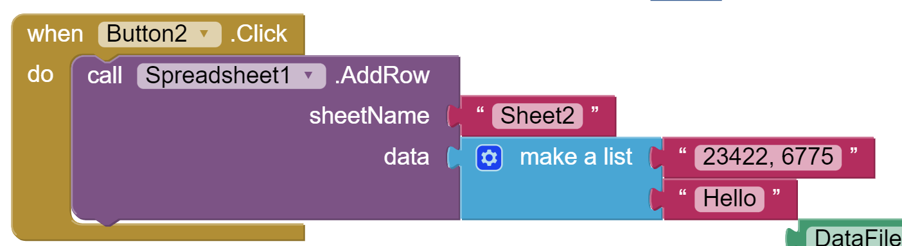
Spreadsheet
A Wide range of capabilities to play with Spreadsheet
Read column
read row
remove column
remove row
add column
add row
read data (column, row, range)
write data (column, row, range)
Adding row to Spreadsheet

Slide 18
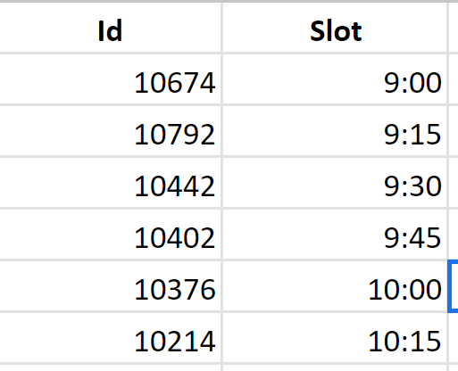
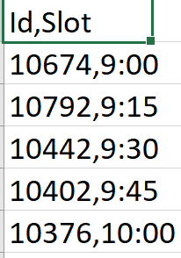
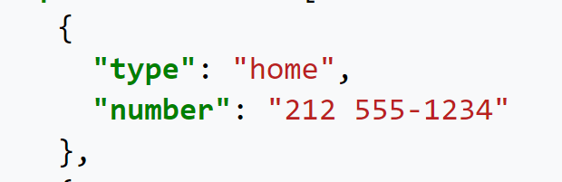
DataFile
Component that allows reading CSV and JSON data.
  A CSV (comma-separated values) file is a text file that has a specific format which allows data to be saved in a table structured format (3)
  JSON - (JavaScript Object Notation) is an open standard file format and data interchange format that uses human-readable text to store and transmit data objects consisting of attribute–value pairs and arrays (or other serializable values) (4)
Can be used together with the ChartData2D component to import data directly from a file to the Chart. (1)

Slide 19
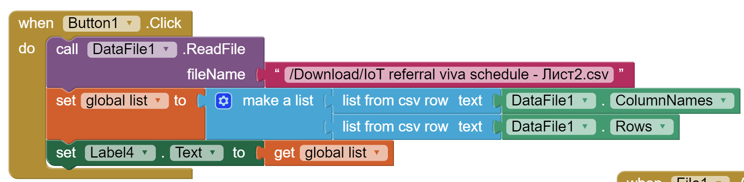
DataFile
Reading csv file and displaying results.

Slide 20
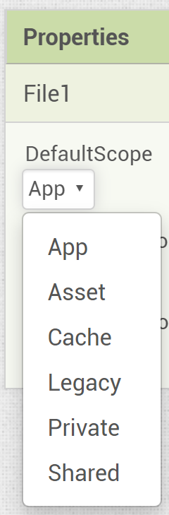
File
Non-visible component for storing and retrieving files.
Use this component to write or read files on your device. The default behaviour is to write files to the private data directory associated with your App. (1)
Scope
  App: Files will be read from and written to app-specific storage on Android 2.2 and higher.
  Asset: Files will be read from the app assets.
  Cache: Files will be read from and written to the app’s cache directory.
  Legacy: Files will be read from and written to the file system using the App Inventor rules prior to release nb187. That is, file names starting with a single / will be read from and written to the root of the external storage directory, e.g., /sdcard/. Legacy functionality will not work on Android 11 or later.
  Private: Files will be read from and written to the app’s private directory.
  Shared: Files will be read from and written to the device’s shared media directories, such as Pictures. (2)

Slide 21
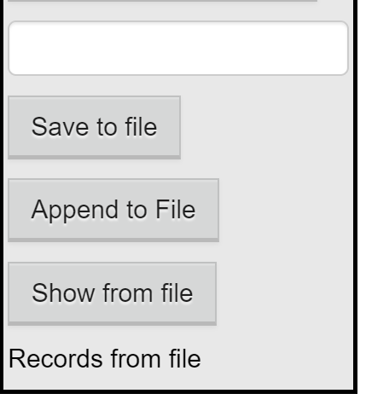
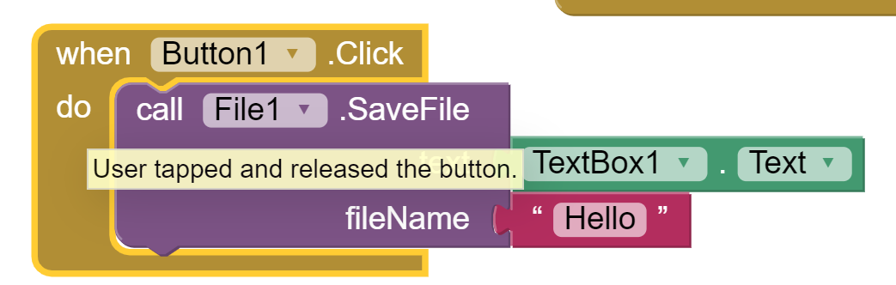
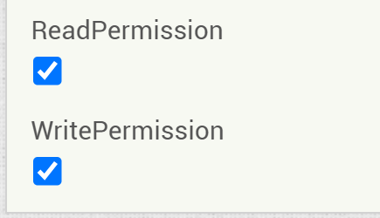
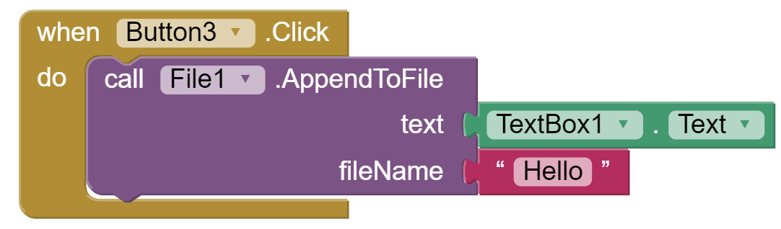
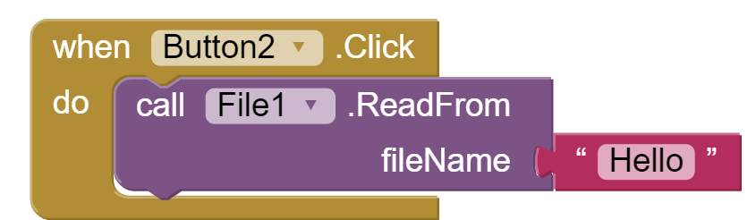
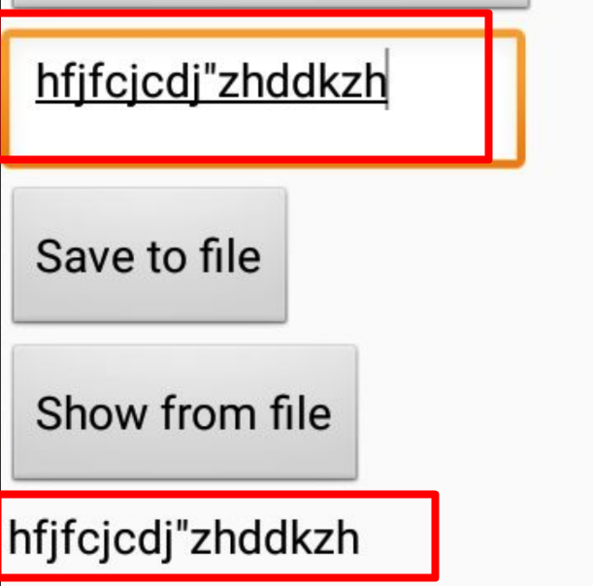
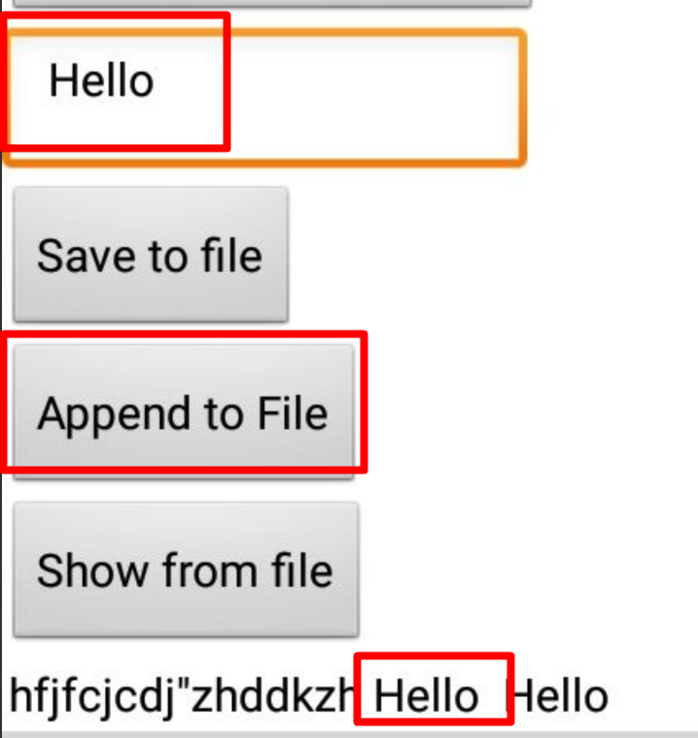
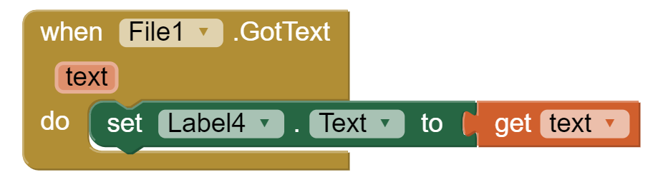
File
Select read and write permissions
Save, Show, Append

Slide 22
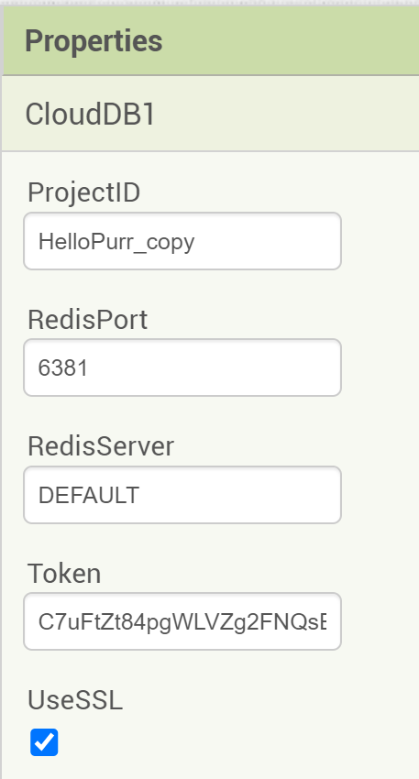
Cloud DB
Non-visible component allowing you to store data on a Internet connected database server (using Redis software – Remote Dictionary Server).
This allows the users of your App to share data with each other. (1)
Whereas TinyDB stores data only on the device running the app, a CloudDB is shared among users on multiple devices running the same app because it stores data online, in the cloud.
Access to the web data is asynchronous, which means storing and retrieving data may not happen immediately. (5)
RedisPort
  The Redis Server port to use. Defaults to 6381
RedisServer
  A setting of “DEFAULT” means that the MIT server will be used.
Token
  This field contains the authentication token used to login to the backed Redis server. For the “DEFAULT” server, do not edit this value, the system will fill it in for you. If using your own Redis server, set a password in the server’s config and enter it here.
UseSSL
  Set to true to use SSL to talk to CloudDB/Redis server. This should be set to True for the “DEFAULT” server.

Slide 23
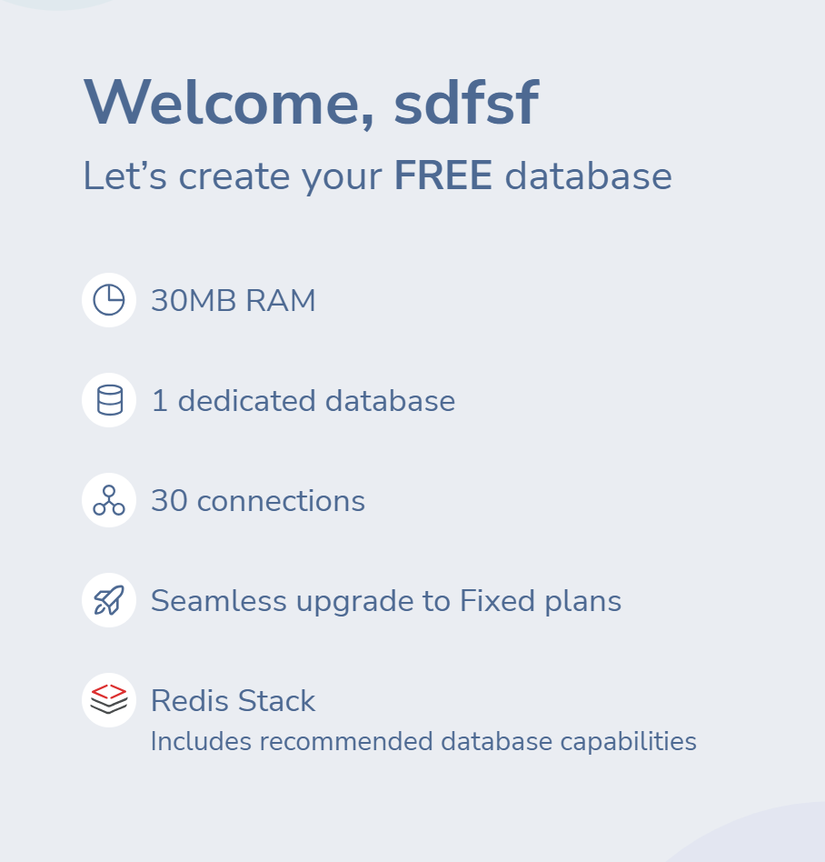
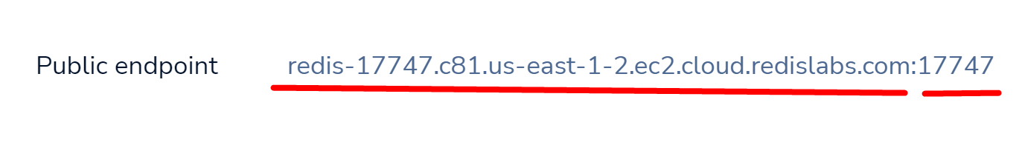
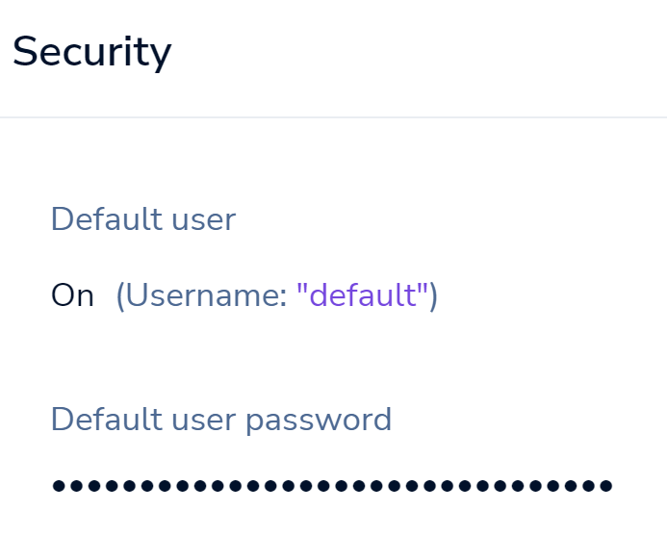
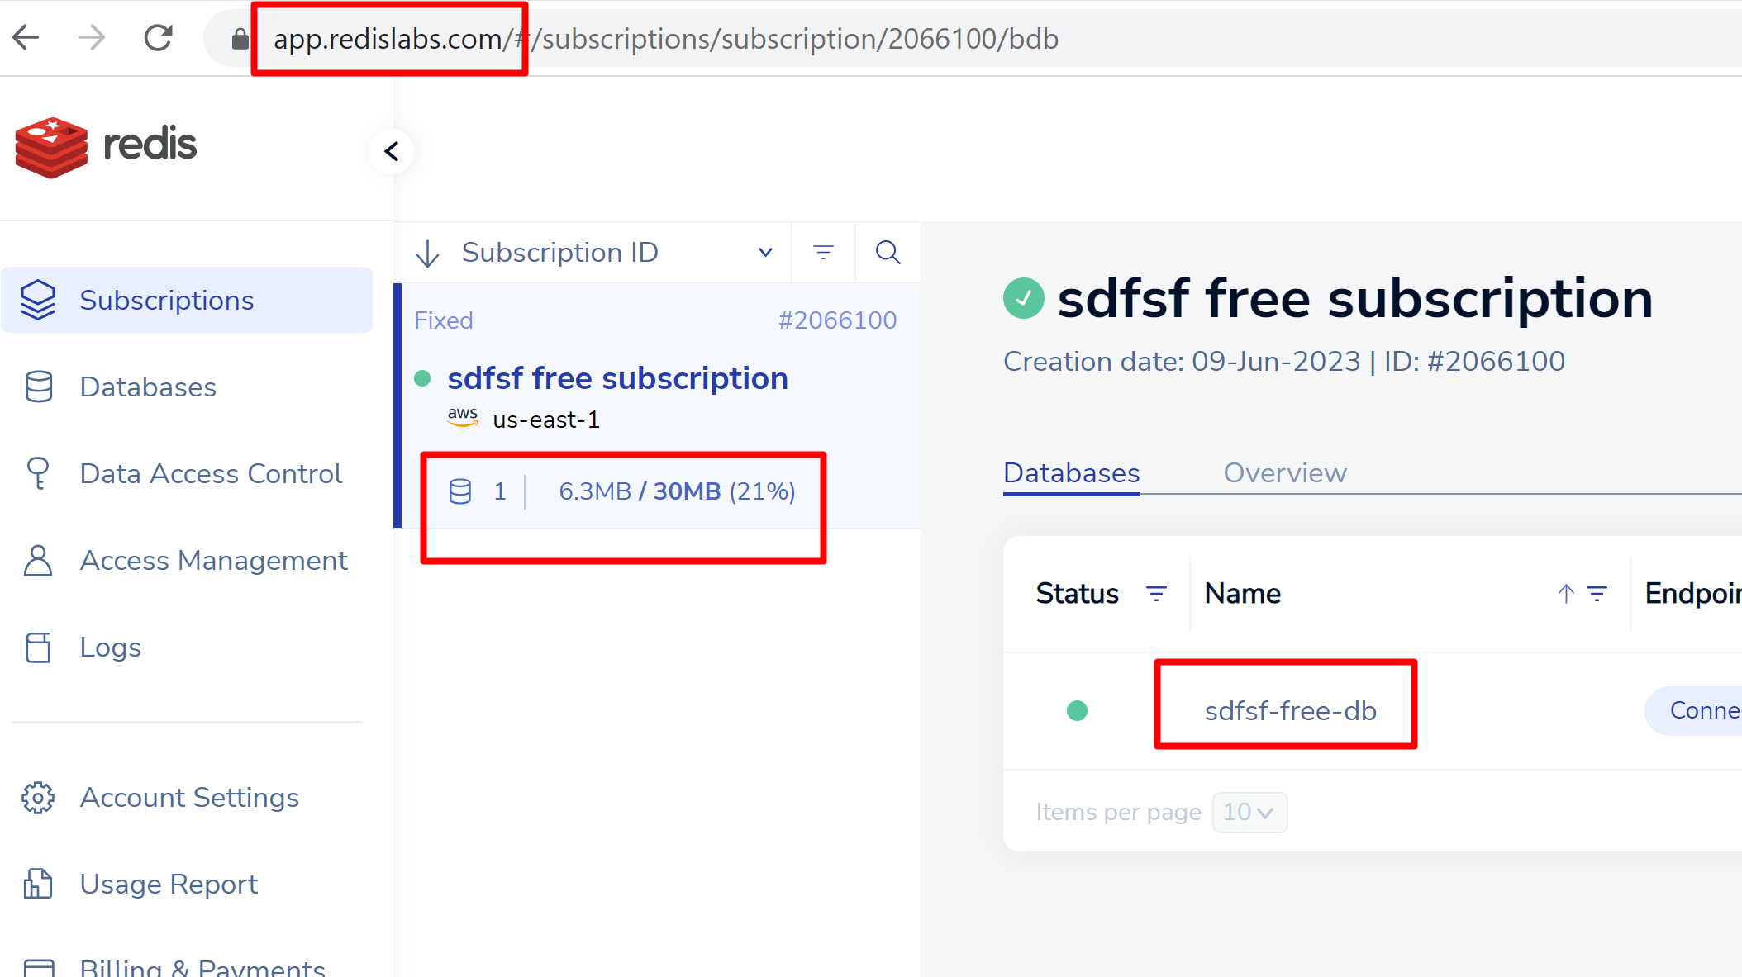
CloudDB
If Default is not working (most probably, server is overloaded, get registered on redis.com (6)
Up to 30 MB
Up to 30 connectons
You need to copy Public endpoint and Security Password

Slide 24
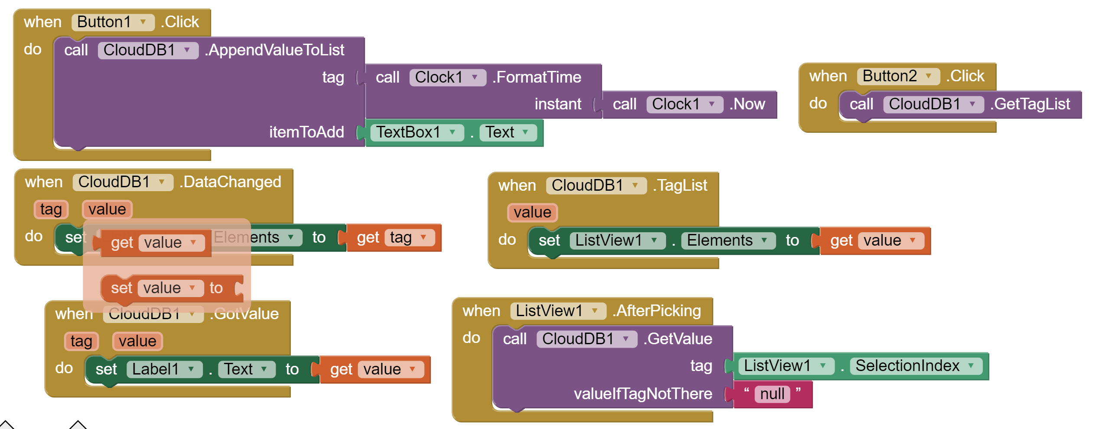
CloudDB

Slide 25
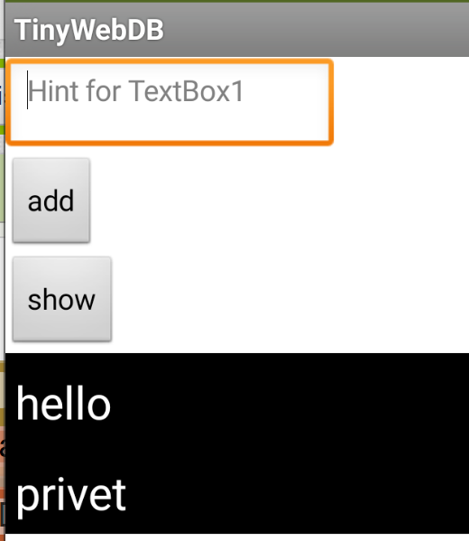
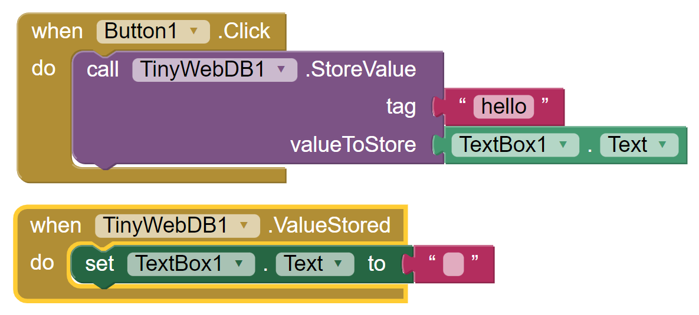

TinyWebDb
Several apps can share data
Stored on the Web (http://tinywebdb.appinventor.mit.edu/)
The database will store at most 2000 entries
Individual data values are limited to at most 500 characters
Save data
Retrieve data

Slide 26

Firebase
Non-visible component that communicates with Firebase to store and retrieve information.
Firebase is an app development platform that helps you build and grow apps and games (7).
Allows to store data and synchronize then across all users.
Some services, like Real-time Database is free, others may require payment.
Structure is NoSQL, storage system – Key - Value
Go to firebase.google.com
Get Registered
Create Realtime Database
Add several Key-Value pairs

Slide 27



Displaying data from Firebase
Task: Creating application for smart home. Temperature and Humidity should be displayed, LED status should be shown with possibility to Turn on/off.
Step 1. Add FirebaseDB component
Configure accordingly

Slide 28



Firebase
Call GetTagList when screen is Initialized and every Second to see realtime updates
Having known the tags, we can easily retrieve necessary information

Slide 29





Writing to Firebase
Let’s add switch, which will allow us control LED remotely.

Slide 30
References
http://ai2.appinventor.mit.edu
http://ai2.appinventor.mit.edu/reference/components/storage.html#File
https://support.google.com/google-ads/answer
https://en.wikipedia.org/wiki/JSON
https://runestone.academy/ns/books/published/mobilecsp/Unit7-Using-Analyzing-Data/Clicker-App-with-CloudDB-optional.html
https://redis.com
https://firebase.google.com/

