Slide 1
Visual Programming
Lecture 11
Programming sensors

Slide 2
Agenda
Sensors in general
Sensors in MITAppInventor
Maps

Slide 3
Definition
Sensors are devices that can detect changes in the environment. In other words, these devices “sense”.
Human beings also have “sensors”: eyes, ears, nose, skin and tongue, which can detect changes and react accordingly. In addition to those, human body also has balance sensor, body position sensors and others.
Typical examples of sensors can be:
    Temperature
    Humidity
    Proximity
    Gyroscope
    Accelerometer
    Pressure
    Light
    Ultrasonic, Infrared
    Smoke, gas

Slide 4
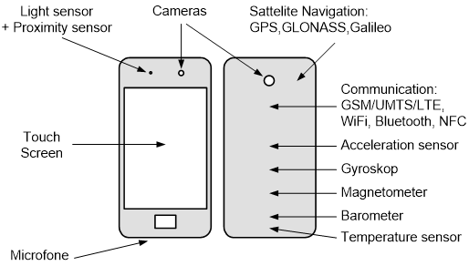
Sensors in mobile phones
Let’s see and understand the purpose of each sensor in mobile phones.
Image is from: (4)

Slide 5
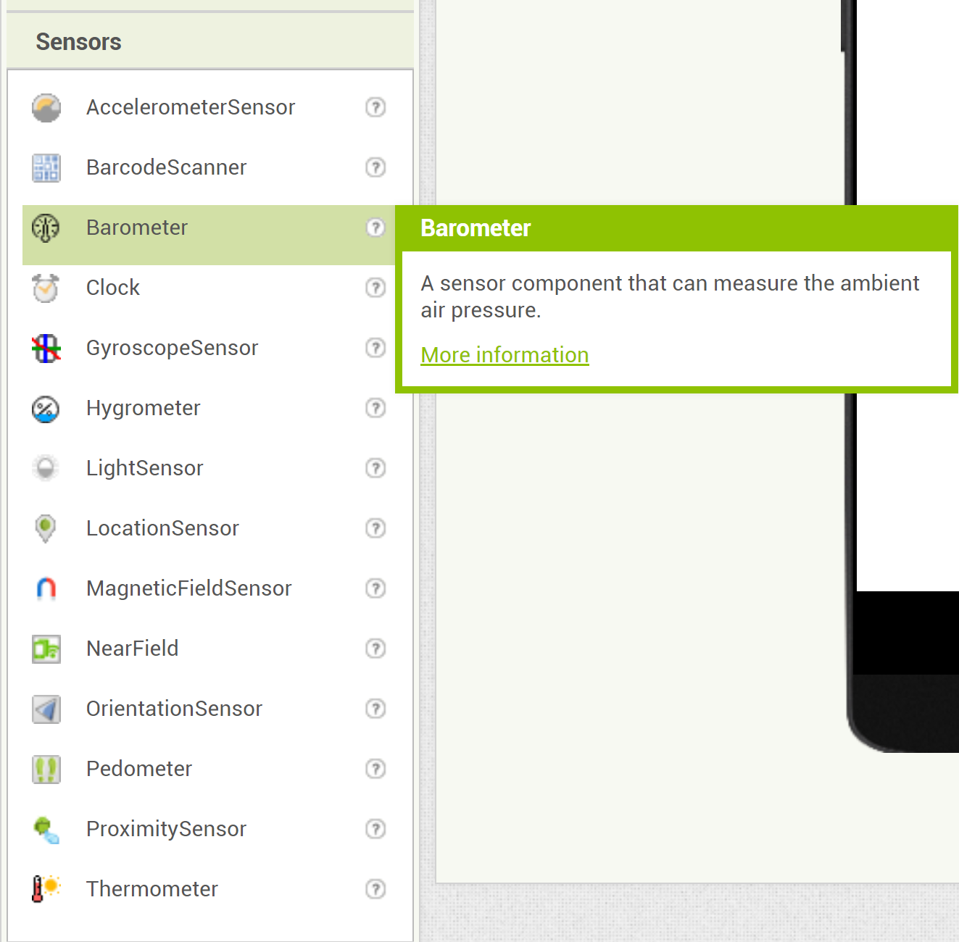
Sensors in MITAppInventor
In addition to standard ones, in MITAppInventors we also have
Barcode Scanner
Location Sensor (can be substituted with GPS or working based on GPS data)
Pedometer (which can work based on information provided by accelerometer)
NearField – to provide NFC capabilities

Slide 6
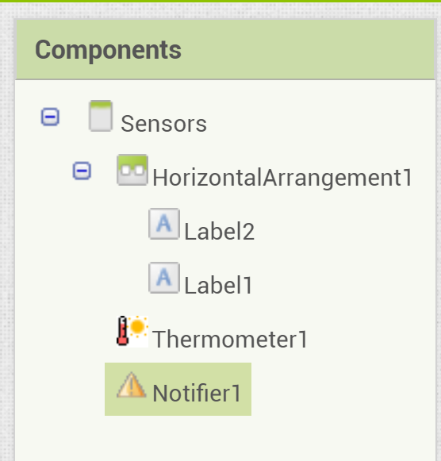
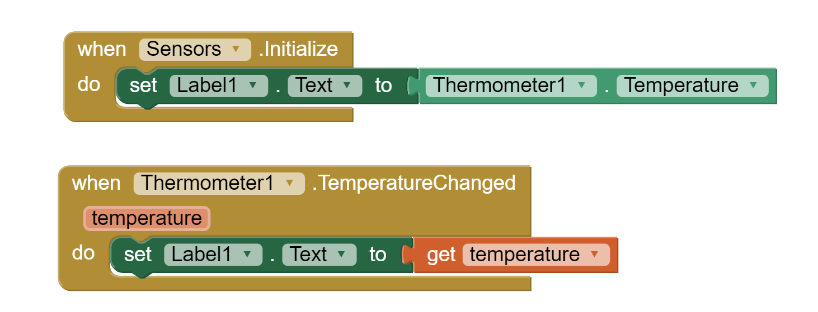
Temperature Sensor
Task: create user interface where current temperature will be displayed. If temperature goes dangerous, make a corresponding notification.
Step 1: Measure current temperature and display it on the screen
Step 2: Add condition for temperature above 35 degrees
Step 1: Add two Labels and one Notifier and one Temperature sensor
Whenever screen is loaded or temperature has changed, label sign should show corresponding temperature

Slide 7
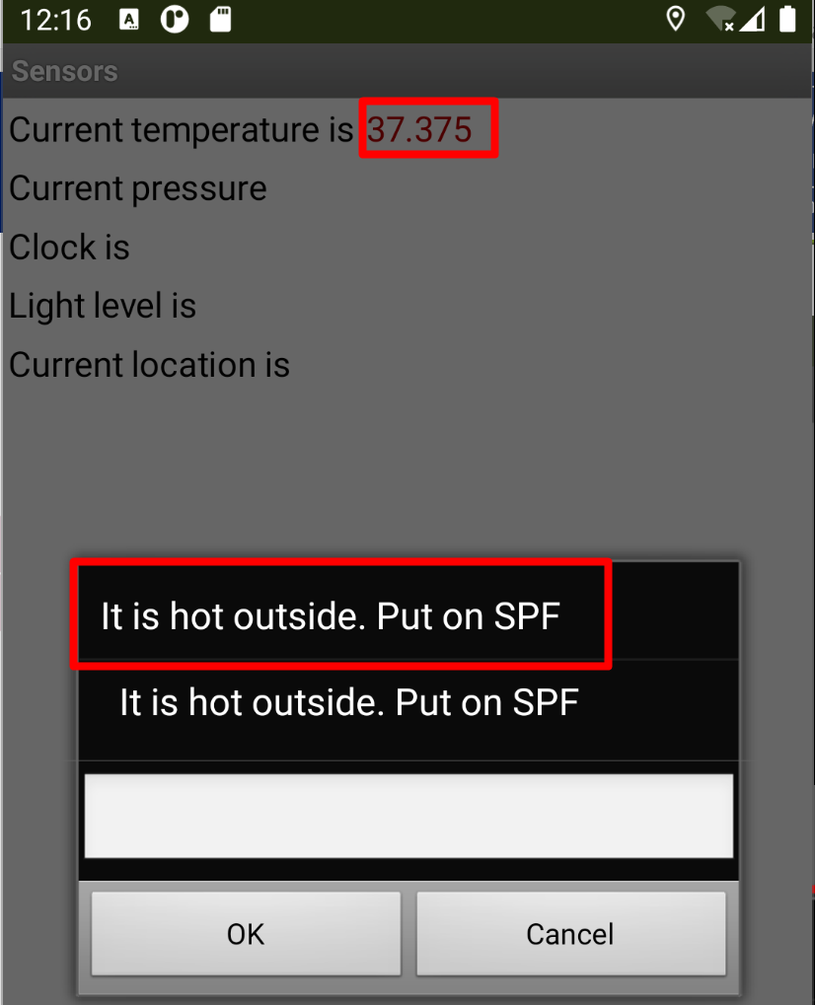
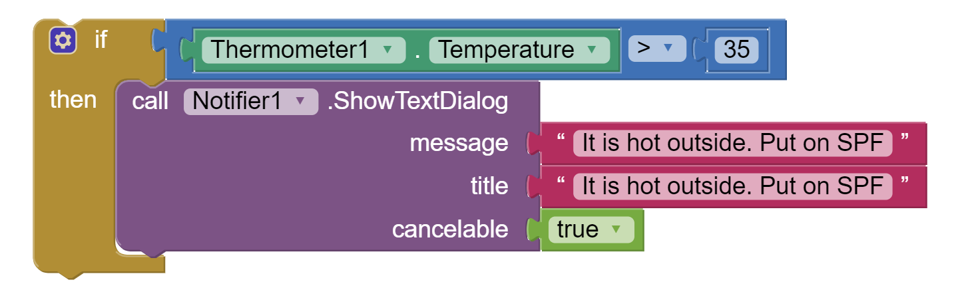
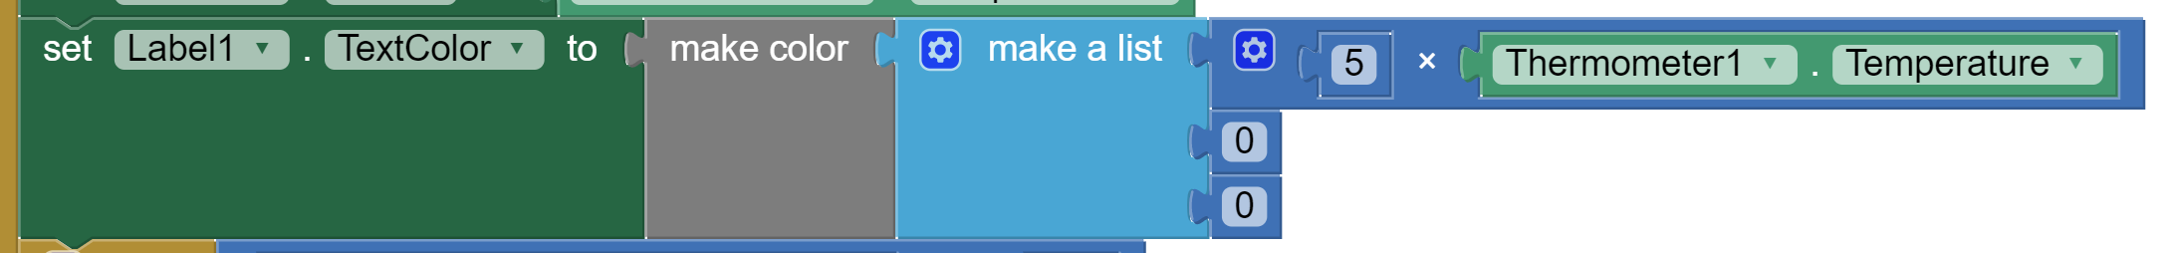
Example: temperature
Step 2: Adding condition and notifier
Step 3: You can adjust color to corresponding value

Slide 8
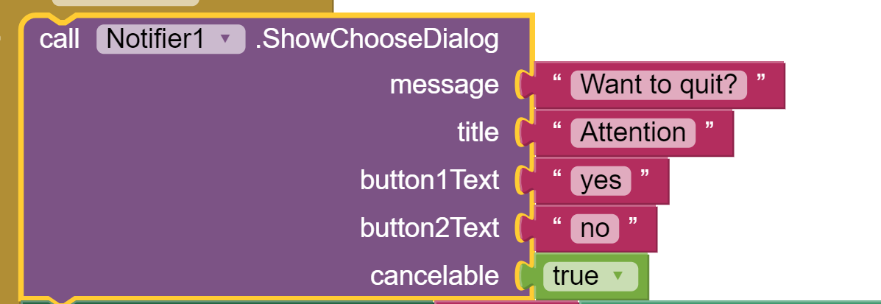
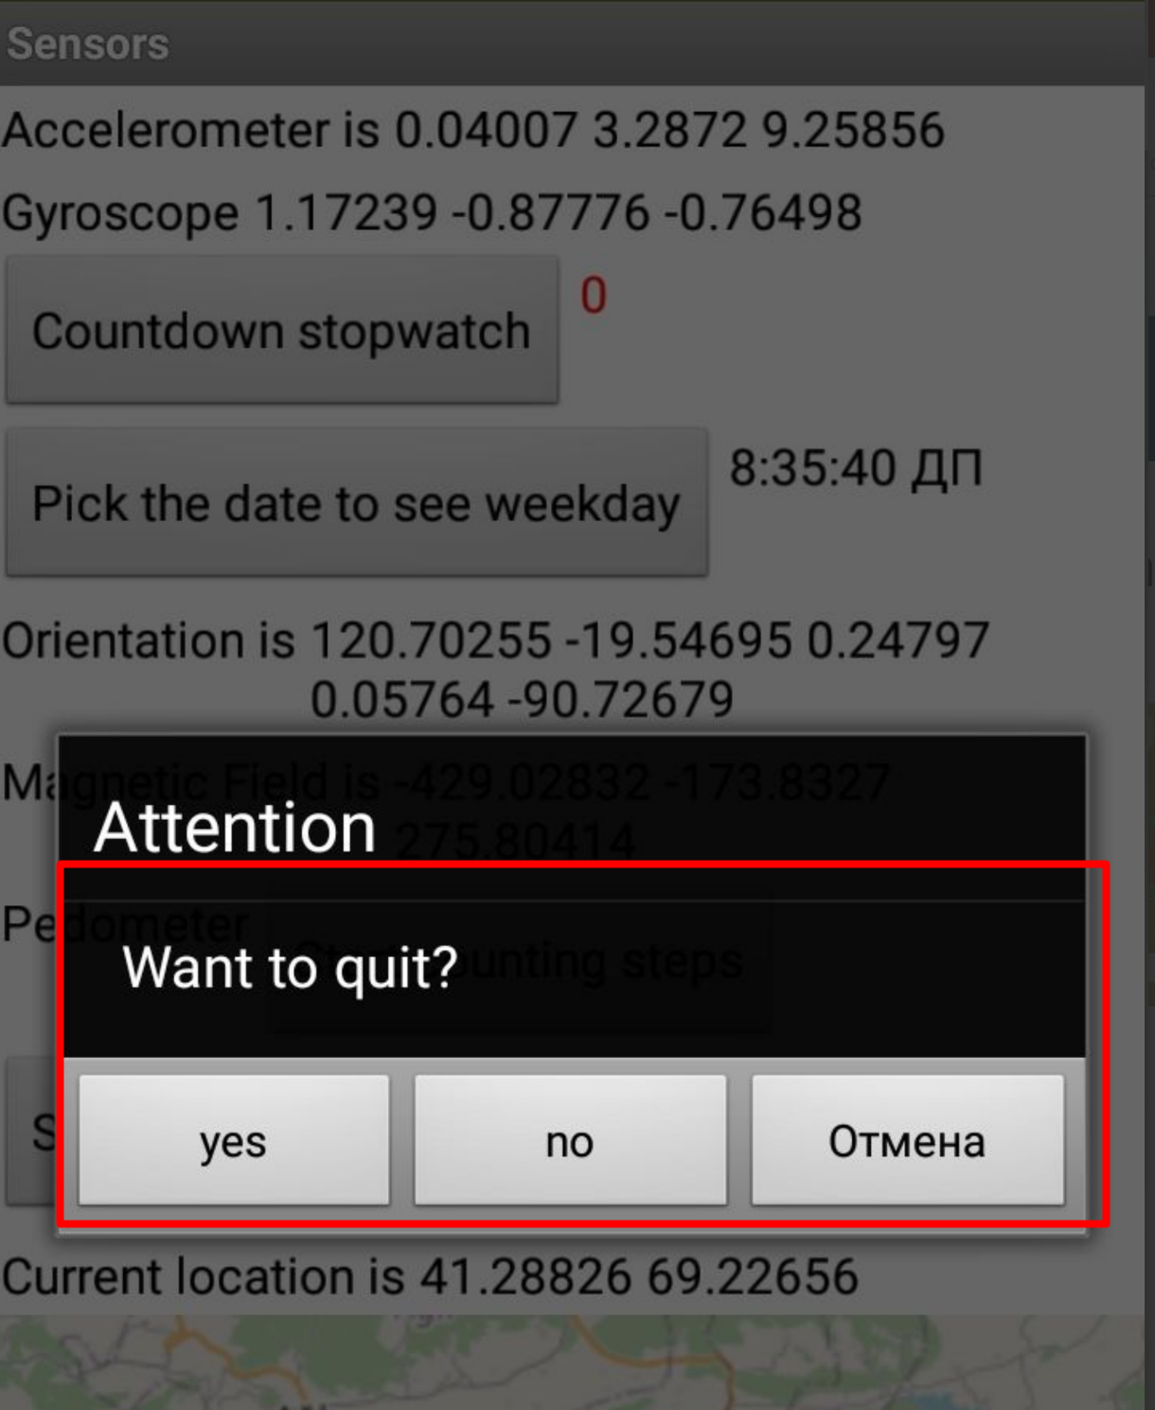
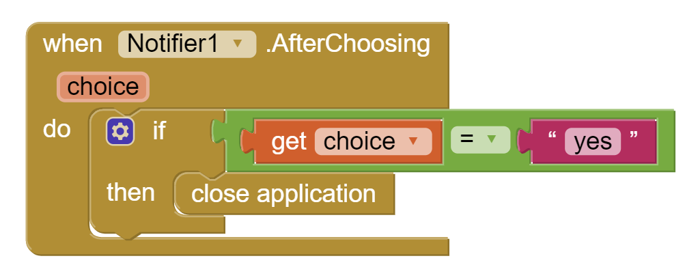
Closing application
You can close application with help of notifyer prompt

Slide 9
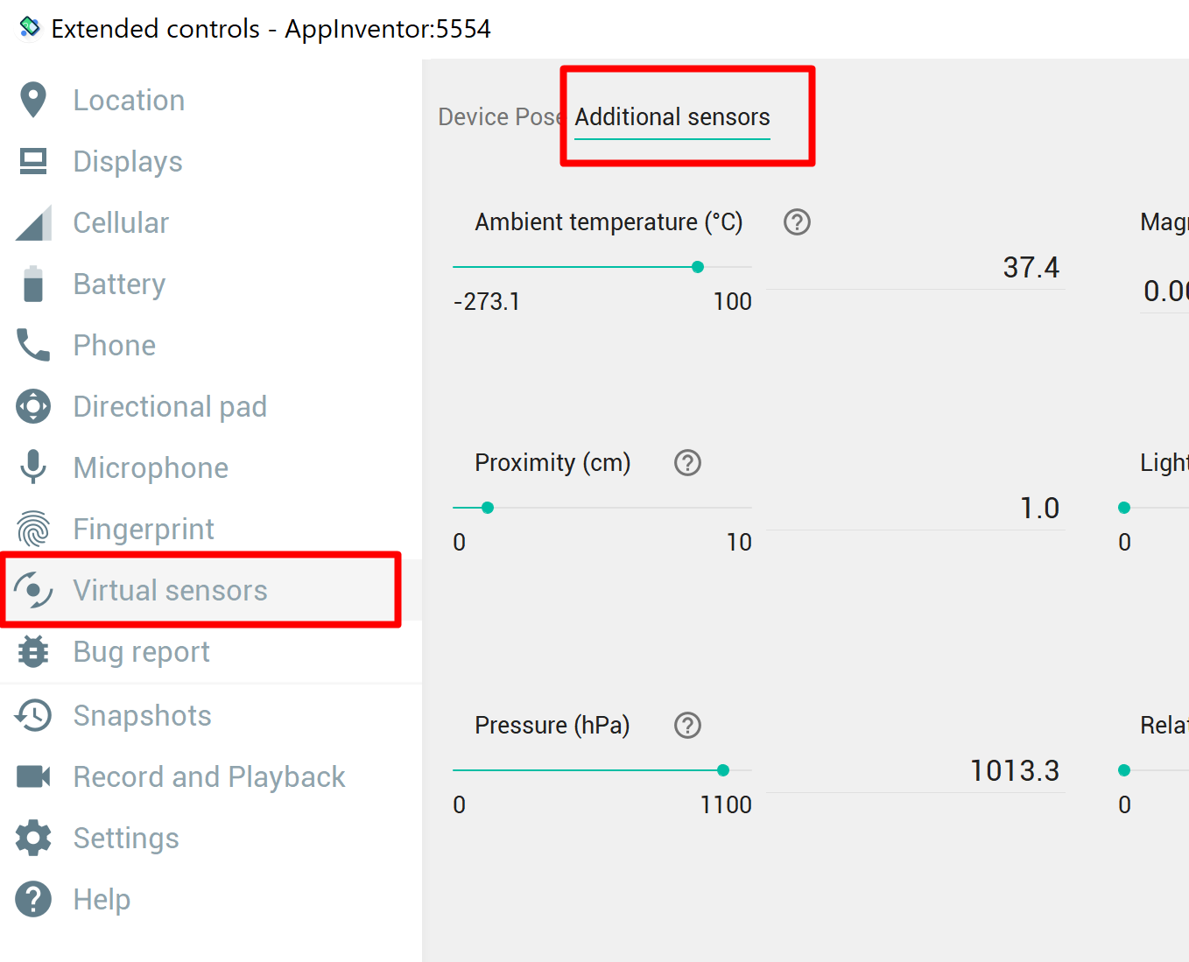
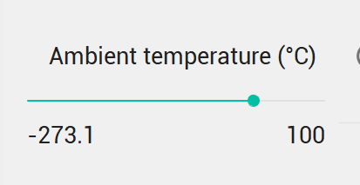
Changing environment
To learn that sensors work, you need to make changes in the environment. If you are using emulator, you can do clicking on settings->more->Virtual Sensors –> Additional sensors
Note: temperature varies from
-273 to +100

Slide 10
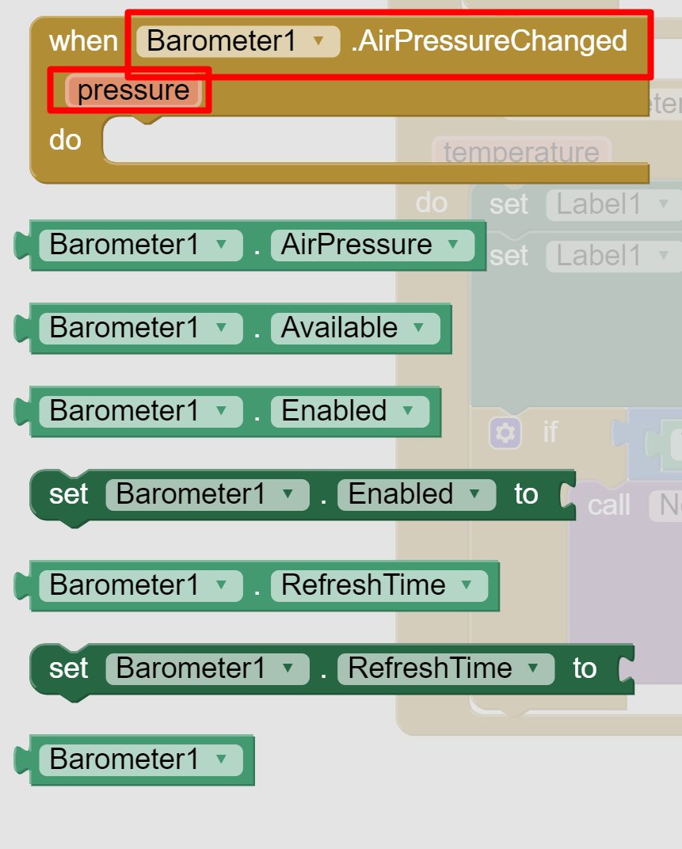
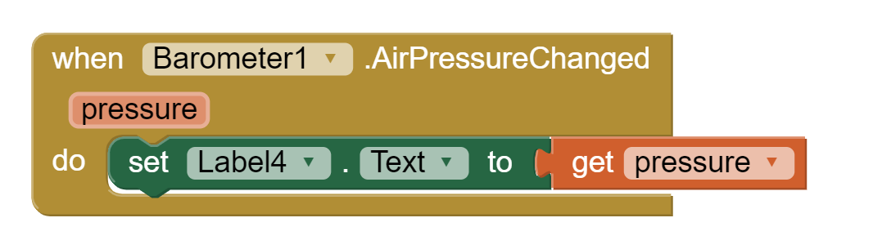
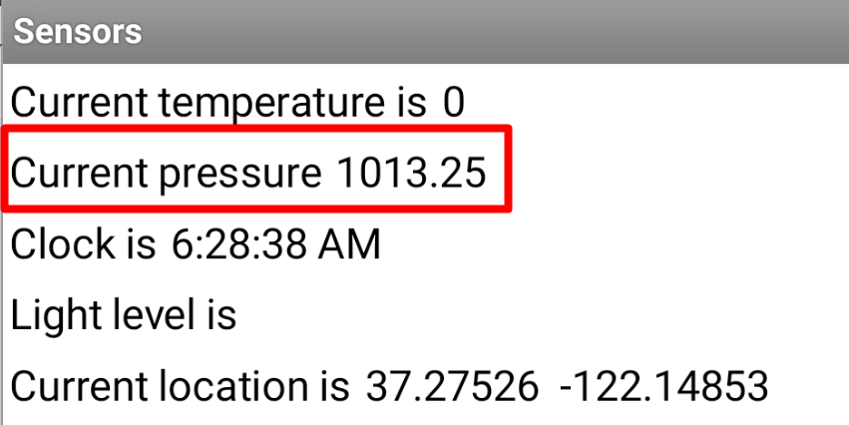
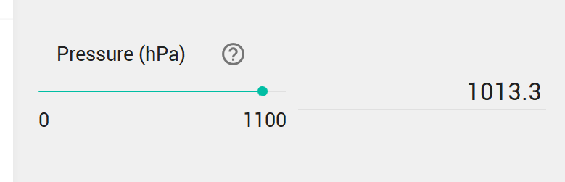
Barometer
Sensor that measures the ambient air pressure. (1)
Most sensors share similar properties and methods, i.e. When environment changes
Values of air pressure vary from 0 - 1100

Slide 11
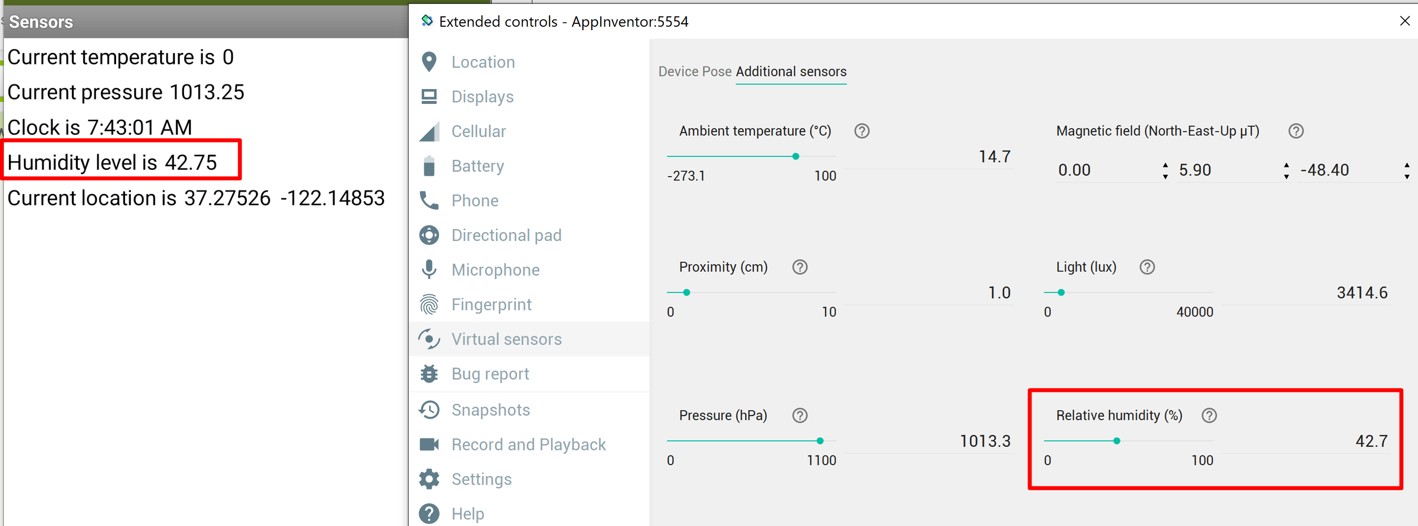
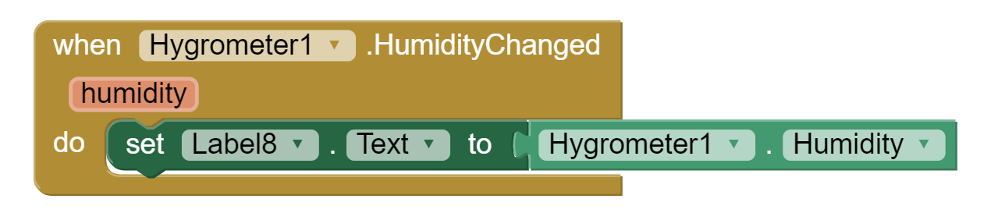
Hygrometer
A sensor component that can measure the relative ambient air humidity.
Most Android devices do not have this sensor. (1)

Slide 12
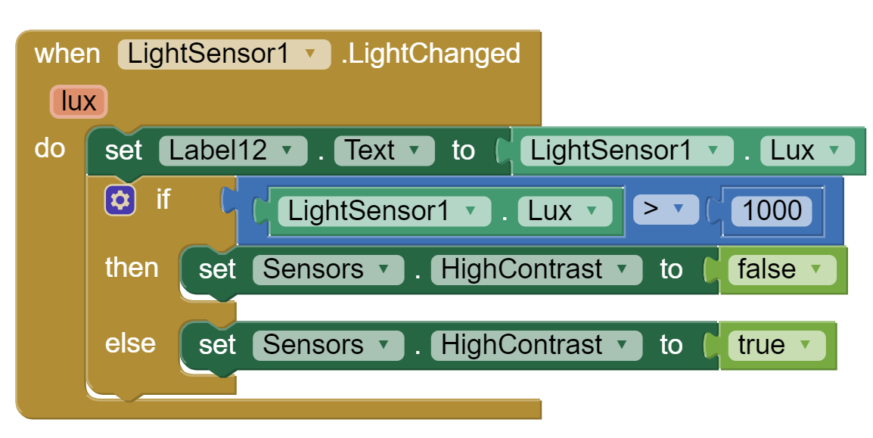
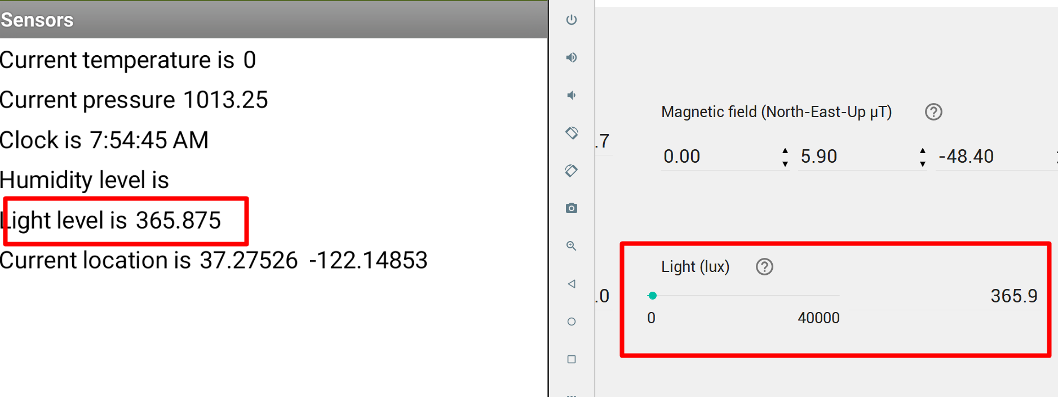
Light sensor
Can measure light level.
Usage: appropriately dims screen lightness to match ambient light level.
Measures in Lux – unit of illuminance per unit area. (3)
Illuminance (lux) | Surfaces illuminated by
0.0001 | Moonless, overcast night sky
0.002 | Moonless clear night sky with airglow
0.05–0.3 | Full moon on a clear night
3.4 | Dark limit of civil twilight under a clear sky
20–50 | Public areas with dark surroundings
50 | Family living room lights
80 | Office building hallway lighting
100 | Very dark overcast day
150 | Train station platforms
320–500 | Office lighting
400 | Sunrise or sunset on a clear day.
1000 | Overcast day; typical TV studio lighting
10,000–25,000 | Full daylight (not direct sun)
32,000–100,000 | Direct sunlight

Slide 13

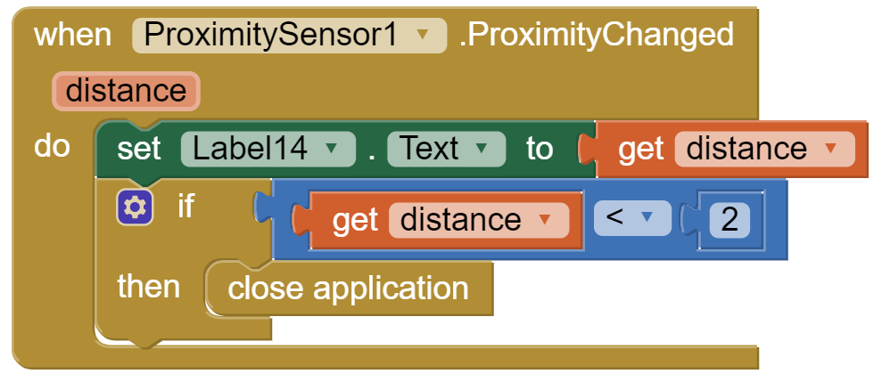
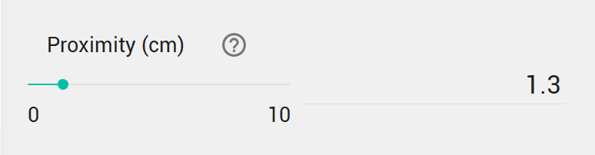
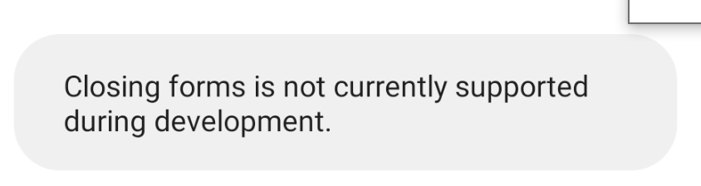
Proximity sensor
Measures the proximity of an object in cm relative to the view screen of a device: to determine how far away an object is from a device (1)
Application: some applications stop working at some level of proximity, while others on contrary resume work.
Example. Let’s quit application when proximity level is less than 2. It will mean that device is too close and not need to run the display.

Slide 14
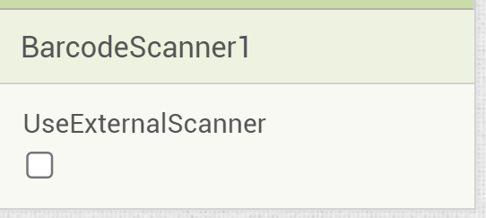
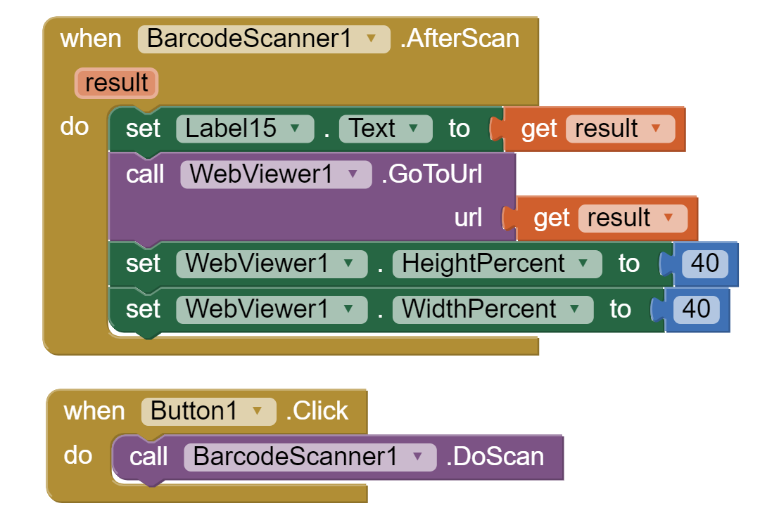
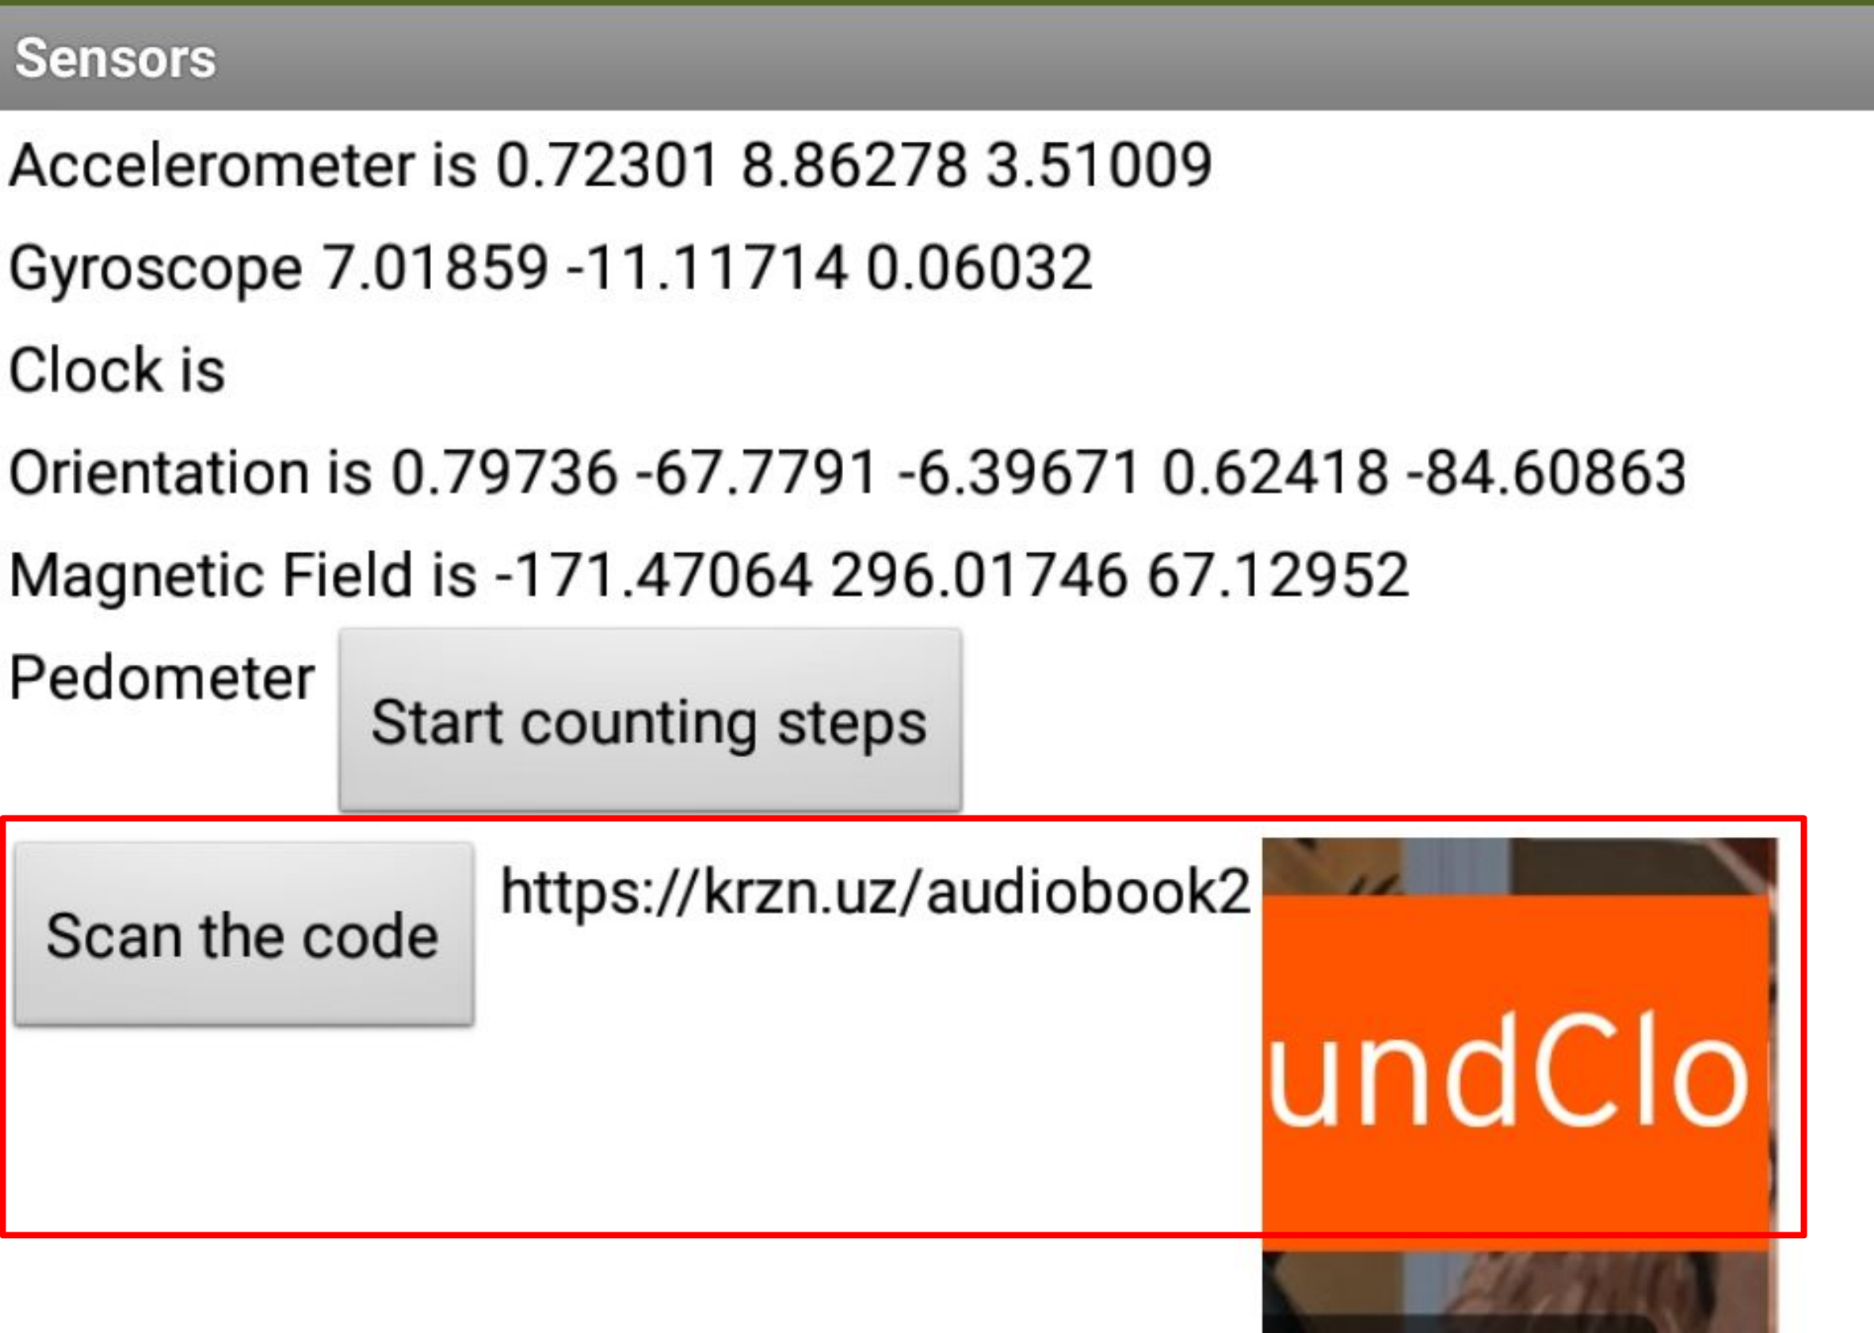
Barcode scanner
To read the barcode.
If your device does not have external barcode scanner, you should deselect UseExternalScanner

Slide 15
Accelerometer
can detect shaking and measure acceleration approximately in three dimensions
The components are:
  xAccel:
    0 when the phone is at rest on a flat surface,
    positive when the phone is tilted to the right (i.e., its left side is raised),
    negative when the phone is tilted to the left (i.e., its right size is raised).
  yAccel:
    0 when the phone is at rest on a flat surface,
    positive when its bottom is raised,
    negative when its top is raised.
  zAccel:
    Equal to -9.8 (earth's gravity in meters per second per second when the device is at rest parallel to the ground with the display facing up,
    0 when perpendicular to the ground,
    +9.8 when facing down. (1)

Slide 16
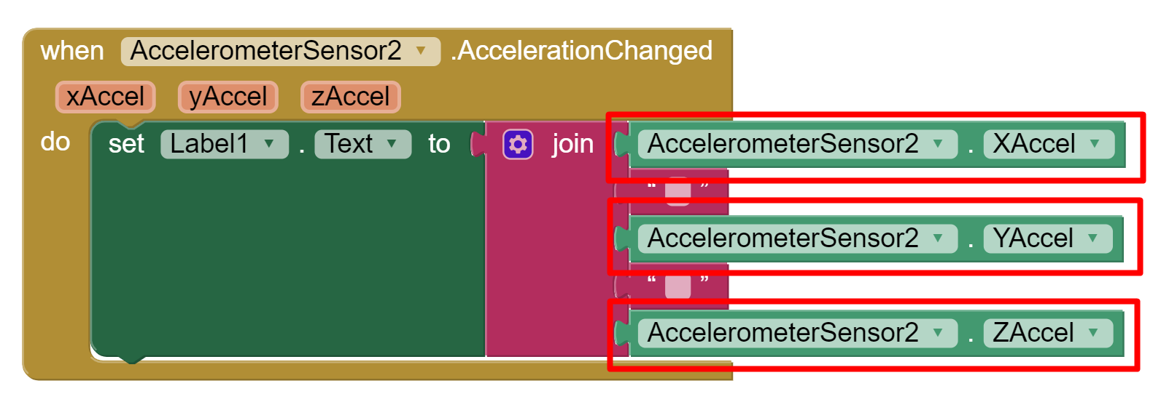
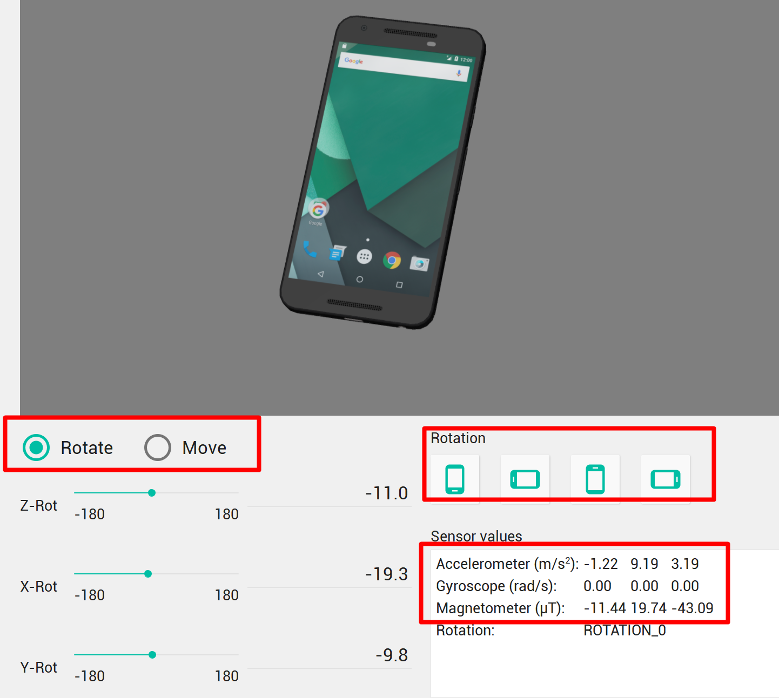
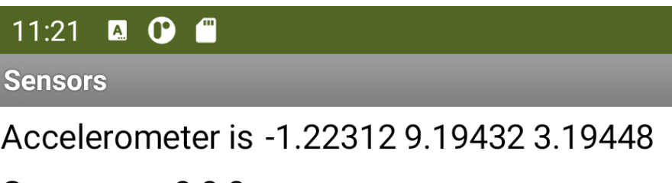
Accelerometer
Measure XAccel, YAccel, ZAccel when Acceleration Changed and screen is initiated
In Emulator you can switch from Moving to Rotation and vice versa.
You will see sensors values right below

Slide 17
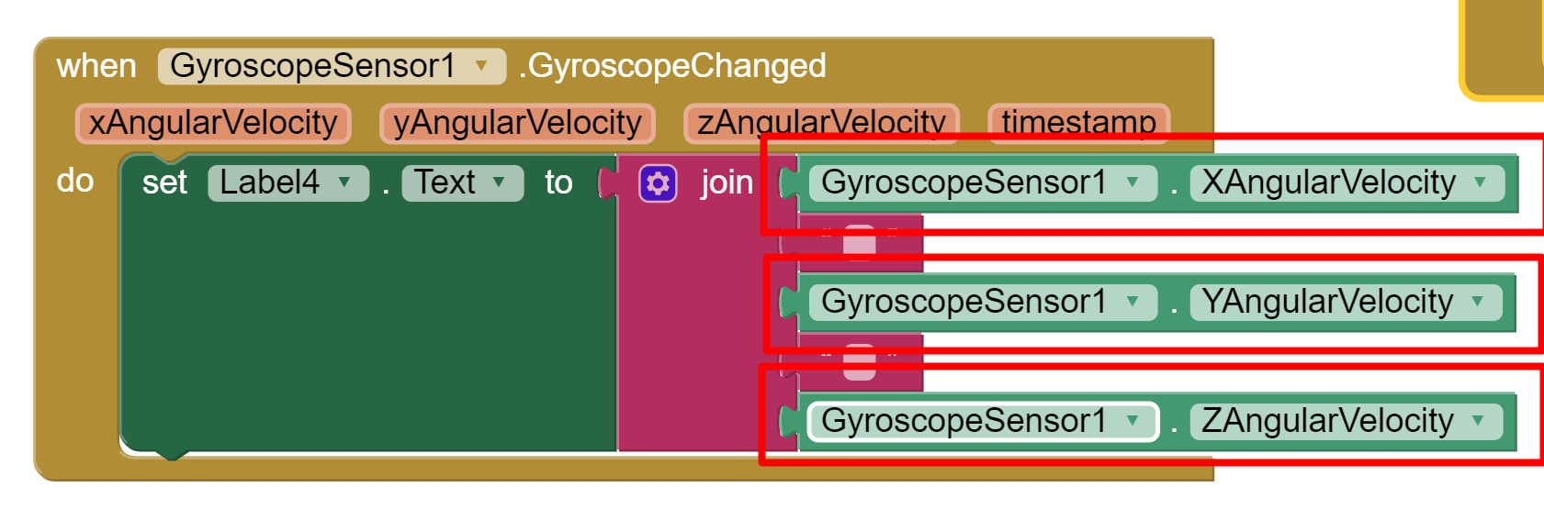
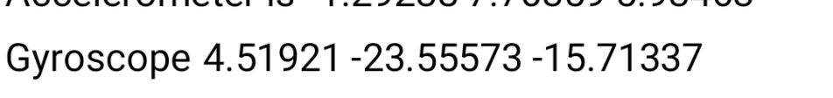
Gyroscope
Measures angular velocity in three dimensions in units of degrees per second.
The component must have its Enabled property set to True, and the device must have a gyroscope sensor. (1)

Slide 18
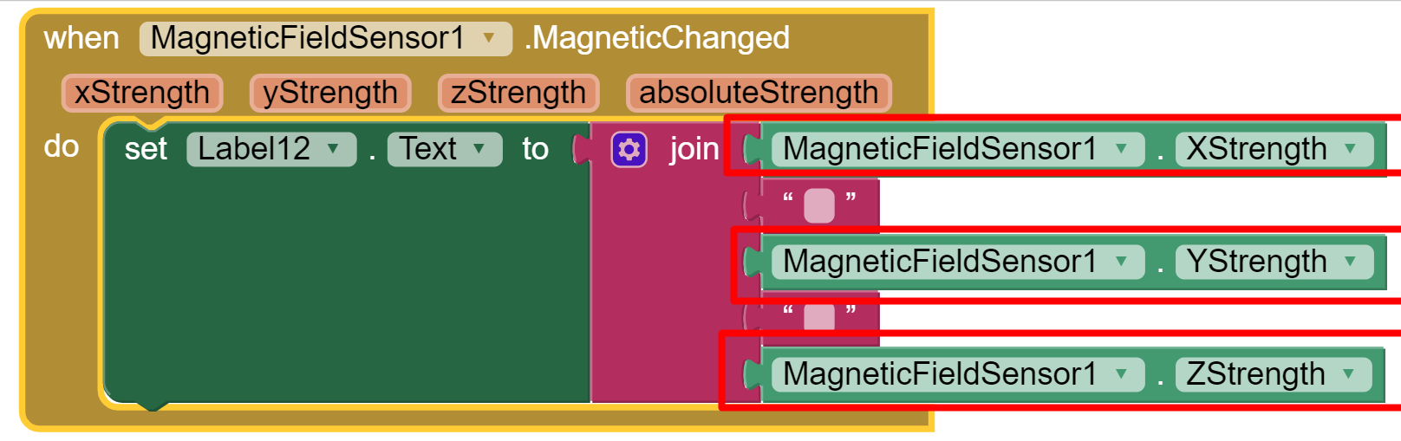

Magnetic Field Sensor
measures the ambient geomagnetic field for all three physical axes (x, y, z) in Tesla (compass sensor) (1)
Usage: determine the position of a device
Measure geomagnetic field when magnetic filed is changed or when screen is initiated

Slide 19
Orientation Sensor
Provides information about the device's physical orientation in three dimensions:
  Roll:
    0 degrees when the device is level,
    increases to 90 degrees as the device is tilted up on its left side,
    decreases to -90 degrees when the device is tilted up on its right side.
  Pitch:
    0 degrees when the device is level,
    up to 90 degrees as the device is tilted so its top is pointing down,
    up to 180 degrees as it gets turned over
    decreases to -90 degrees as the device is tilted so its bottom points down
    further decreases to -180 degrees as it gets turned all the way over.
  Azimuth:
    0 degrees when the top of the device is pointing north,
    90 degrees when it is pointing east,
    180 degrees when it is pointing south,
    270 degrees when it is pointing west, etc.
These measurements assume that the device itself is not moving. (1)

Slide 20
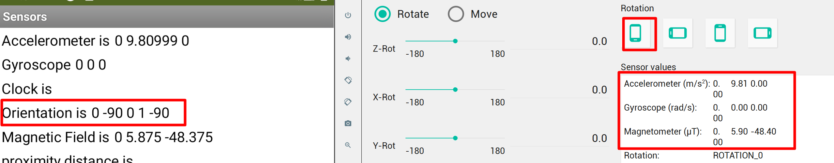
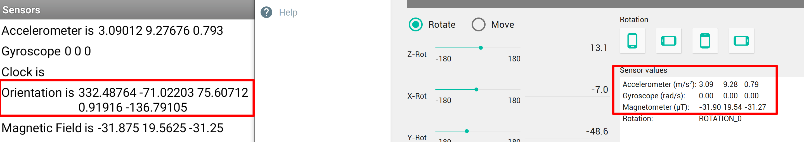
Orientation Sensor
In addition to Azimuth, Pitch and Roll you can also measure Magnitude and Angle
It is based on the values received from Accelerometer, Gyroscope and Magnetic Field Sensors

Slide 21
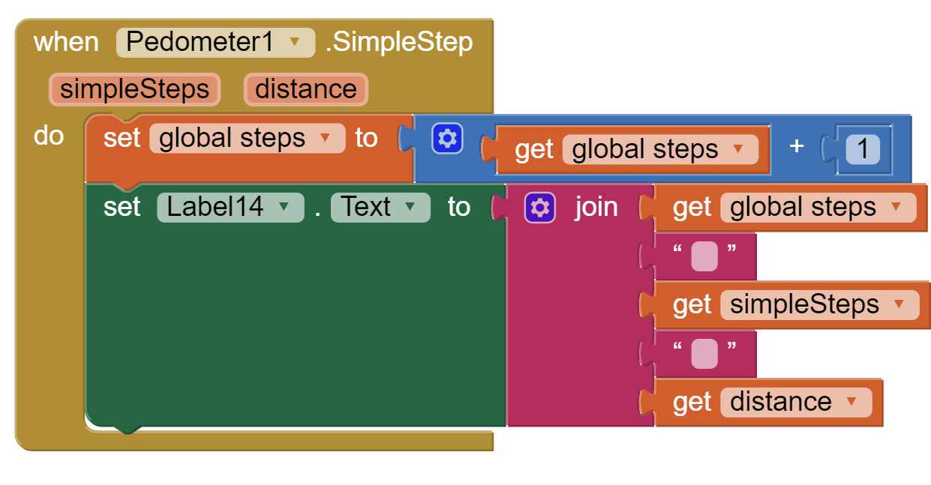
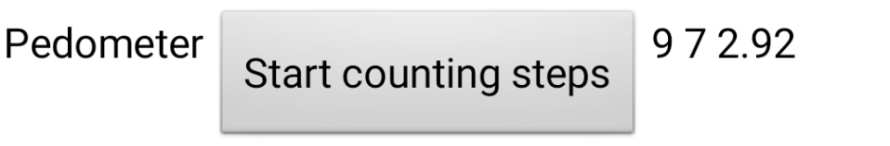
Pedometer
It senses motion via the Accelerometer and attempts to determine if a step has been taken. (1)
Using a configurable stride length, it can estimate the distance traveled as well.
It can detect Simple Step and Walk Step. The difference is in direction. Walk step is always forward.
Has 4 methods: Start, Stop, Save and Reset.
Can measure number of steps and distance.

Slide 22
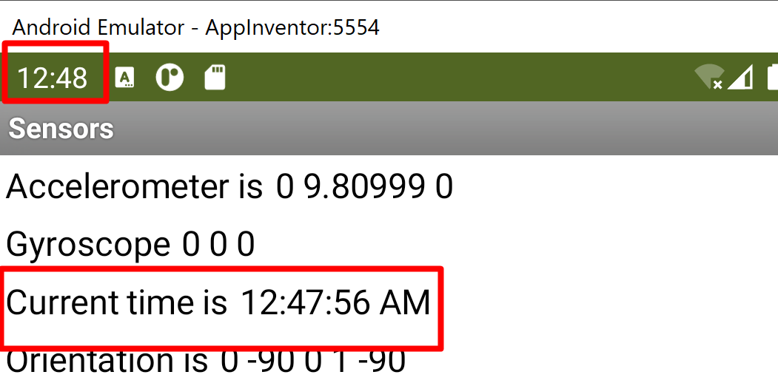
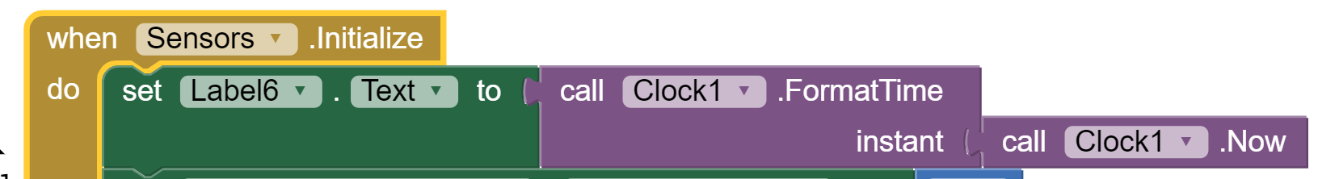
Clock
A component that provides the instant in time using the internal clock on the phone.
It can fire a timer at regularly set intervals and perform time calculations, manipulations, and conversions.
Methods to convert an instant to text are also available. (1)
Acceptable patterns are:
  empty string
  MM/DD/YYYY
  HH:mm:ss a
  MMM d, yyyyHH:mm
To show current time

Slide 23
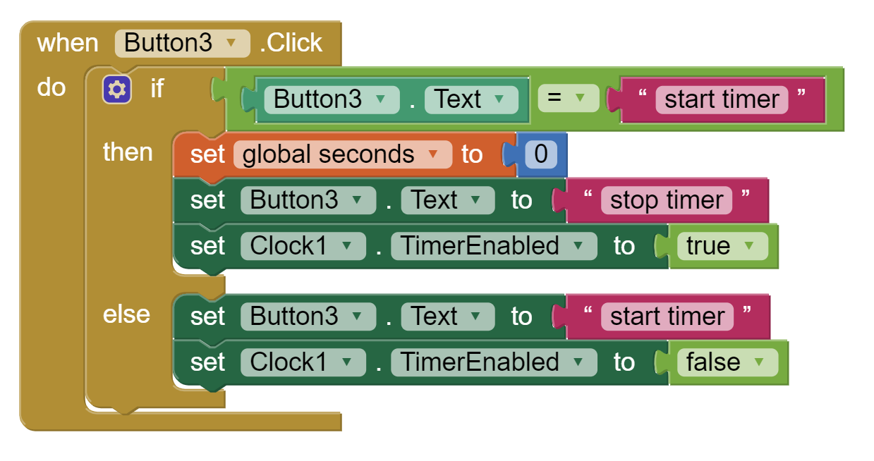
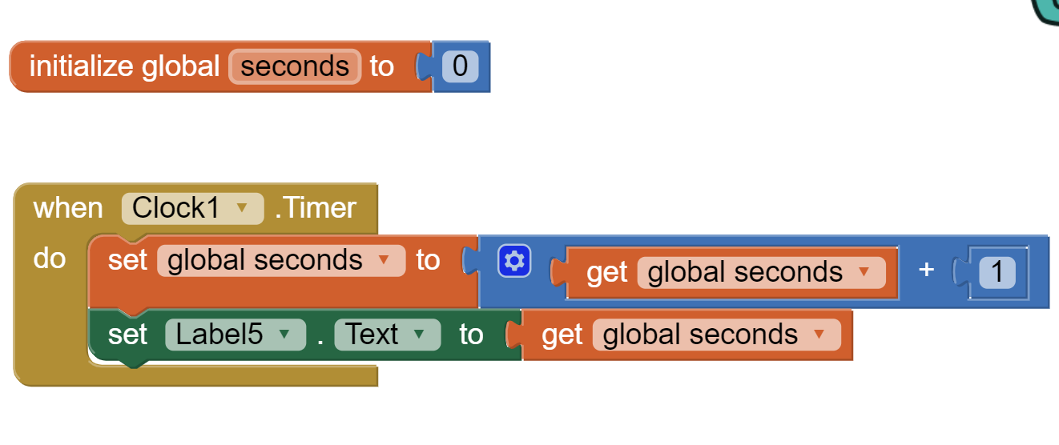
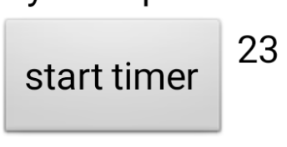
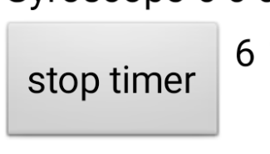
Timer
For Timer, Clock component has special event called – Timer.
We also need to enable and disable Timer when we click corresponding button.

Slide 24
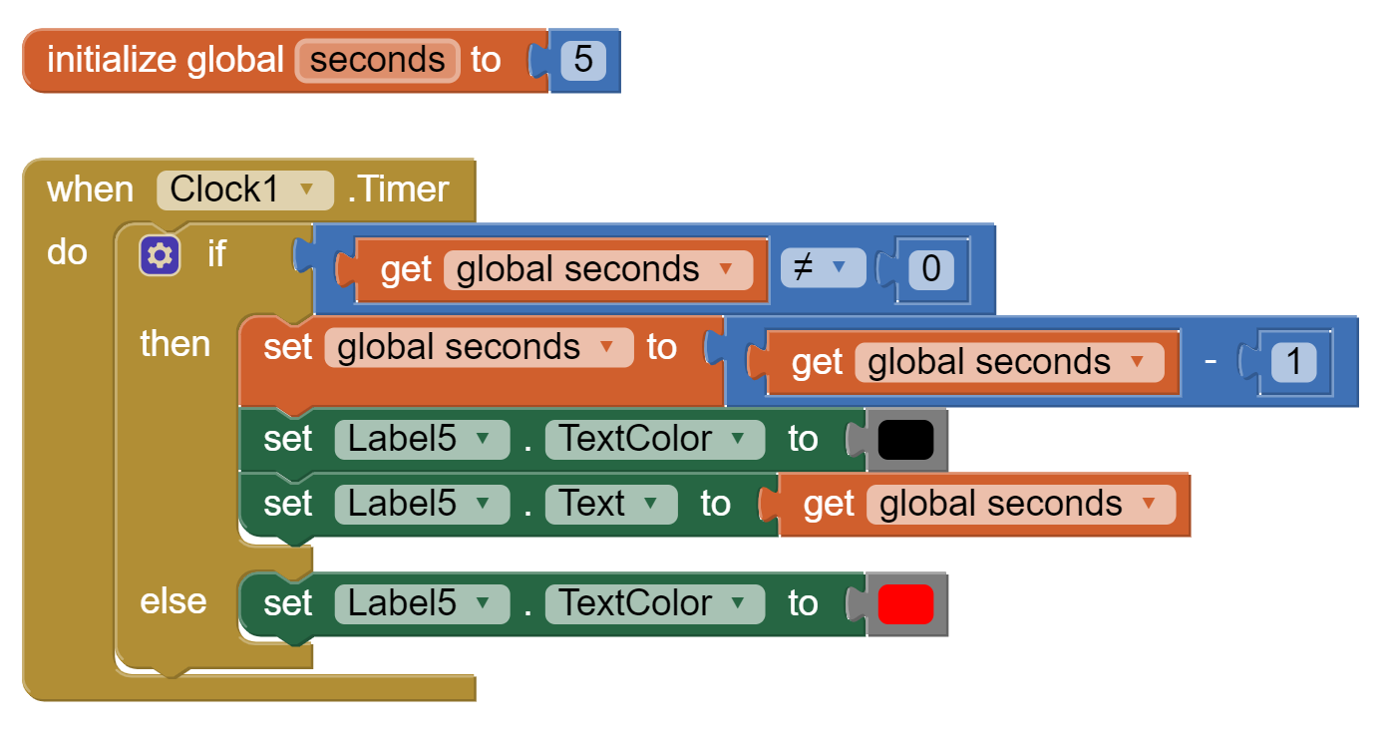
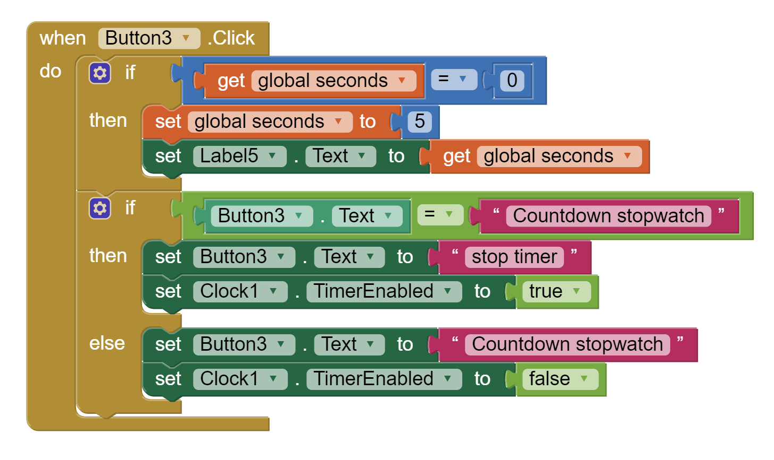
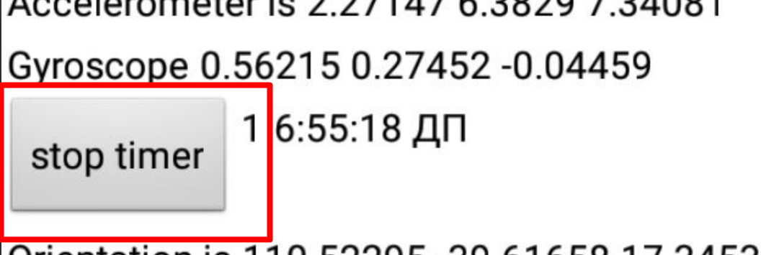
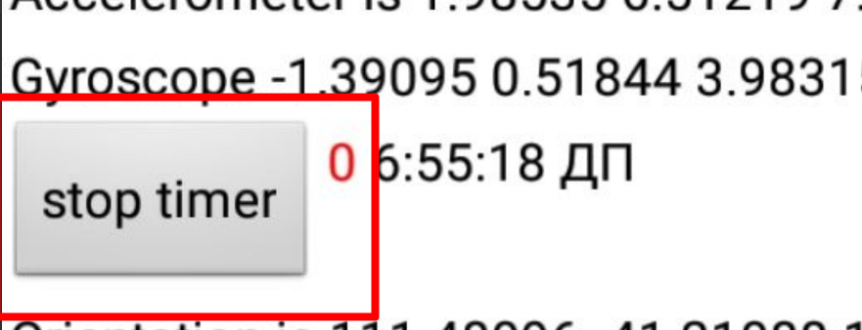
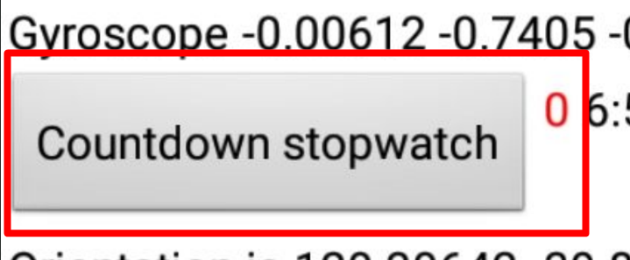
Countdown
Countdown is similar to Timer, but here we subtract from given value.

Slide 25
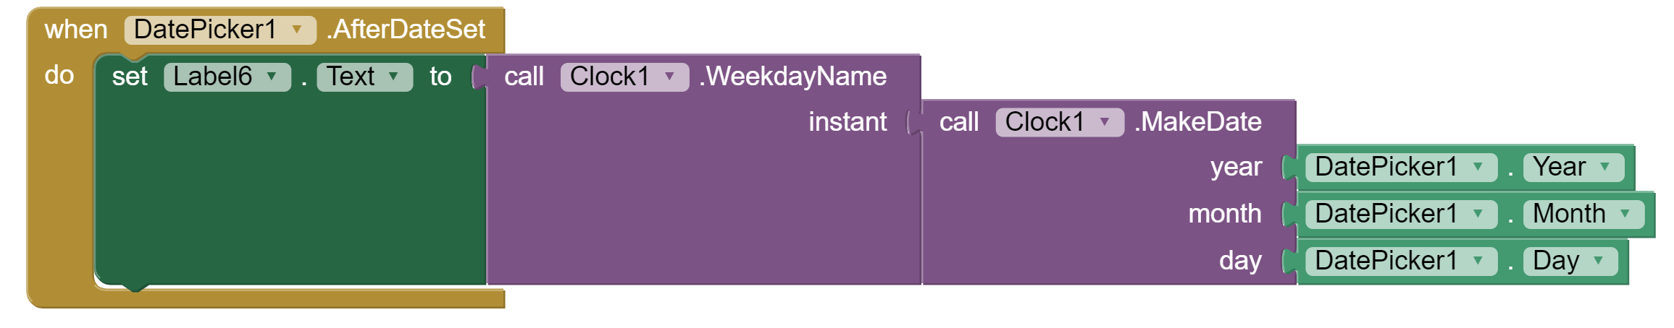
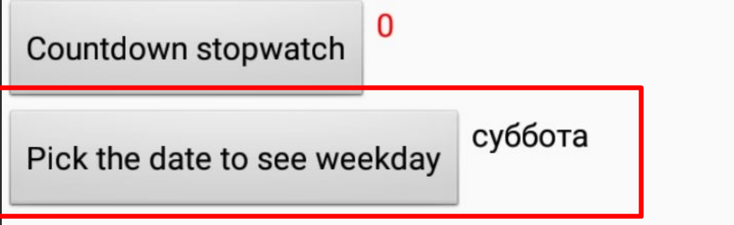
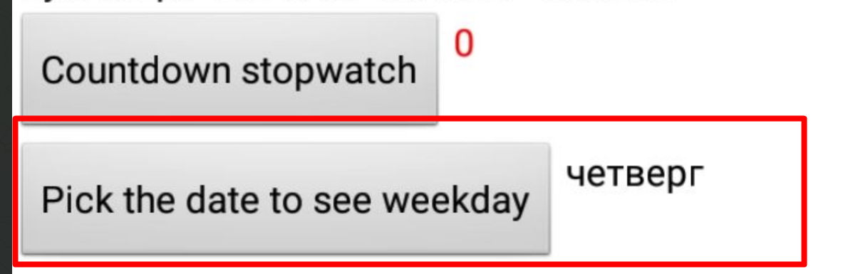
Display date
Clock has many methods to be called. They are selfexplanatory.
Example: identify a week day having picked the date. Here, we add DatePicker

Slide 26

Location Sensor
Non-visible component providing location information, including longitude, latitude, altitude (if supported by the device), speed (if supported by the device), and address.
device must have location sensing enabled through wireless networks or GPS satellites (1)

Slide 27




Location Sensor
In order to function, the component must have its Enabled property set to True
You can also set Time and Distance Interval via Blocks

Slide 28



Location Sensor
Checking latitude and longitude can be onLocationChanged or onScreenInitialize events.

Slide 29


Maps
A two-dimensional container that renders map tiles in the background and allows for multiple Marker elements to identify points on the map.
Working together with LocationSensor, current location can be easily marked on the map.

Slide 30
References
http://ai2.appinventor.mit.edu/
https://appinventor.mit.edu/explore
https://en.wikipedia.org/wiki/Lux
https://www.movisens.com/en/solutions/mobile-sensing/

