Slide 1

EXPORT MARKETING AND FINANCE
WEEK 10 LECTURE
E-COMMERCE IN EXPORT MARKETING
Dr. John Kamau

Slide 2

Welcome!
Welcome to week 10 lecture
It is my joy to have you in this lecture
In the last lecture we focused on trading blocks and export
To facilitate trade in these blocks, e-commerce has been embraced
We examine basics of ecommerce
Application of e-commerce in export business

Slide 3

Intended learning outcomes
At the end of this lecture, you will be able to
1. Describe e-commerce
2. Discuss various types of e-commerce
3. Evaluate benefits and challenges in e-commerce
4. Examine application of e-commerce in export business

Slide 4

Understanding e-commerce
Electronic commerce is sharing business information, maintaining business relationships and conducting business transactions by means of telecommunications networks (Zwass,1996) ’.
E-commerce encampuses situations where business transactions take place via telecommunications networks, especially the Internet – (E. Turban, et al 2002)
E-commerce is usually associated with buying and selling over the Internet, or conducting any transaction involving the transfer of ownership or rights to use goods or services through a computer-mediated network (Mesenbourg, 2000)
E-commerce is the use of electronic communications and digital information processing technology in business transactions to create, transform, and redefine relationships for value creation between or among organizations, and between organizations and individuals (Lallana et al 2002…..)

Slide 5

Definition of e-commerce
Involves purchasing and selling goods or services.
Transactions done via electronic means, such as the internet or cell phone applications.
Process of creating, marketing, servicing, and paying for services
Participants include businesses, governments, and the public in general.

Slide 6
Characteristics of e-commerce
Characteristic | Explanation
Ubiquity | It is always available just about everywhere and all times
Global reach | The potential market size is roughly equal to the size of the online population of the world.
Universal standards | The technical standards of the Internet are shared by all the nations in the world
Richness | Users can access and utilize text messages and visual and audio components to send and receive information.

Slide 7
Characteristics of e-commerce
Characteristic | Explanation
Interactivity | E-commerce technologies allow two-way communication between the merchant and the consumer.
Personalization | Technologies within e-Commerce allow for the personalization and customization of marketing messages that groups or individuals receive.
Information density | The use of e-Commerce reduces the cost to store, process and communicate information

Slide 8
Characteristics of e-commerce
Characteristic | Explanation
Social technology | E-Commerce technology has tie up the social media networking application to provide the best source of content sharing technology and e-Marketing systems.
User-Generated Content | Social networks use e-Commerce technologies to allow members, the general public, to share content with the worldwide community.

Slide 9

E-Commerce Facilitators
a) Internet: E-commerce has grown through huge penetration of the internet.
b) Payment Gateway: The payment transfer, is an ecommerce application service provider service.
c) Analytics: Analytics is the empirical way of transforming data into decision-making intelligence.
d) Social Media: Social media involves blogs and computer applications that allow the use of the computer or cell phone for connection and exchanging information through the internet.
e) 3D Printing: 3D printer belongs to an electronic device category that can build a digital 3-dimensional model.

Slide 10

Types of e-commerce
1. Business-to-Business (B2B): Electronic commerce B2B includes all electronic products or services transfers between firms
2. Business-to-Consumer (B2C): It is the e-commerce shopping section, where conventional retail business typically takes place.
3. Consumer-to-consumer (C2C): Type C2C electronic e-commerce encompasses all trade in goods or services electronically between customers.

Slide 11

Types of e-commerce
4. Consumer-to-business (C2B): In C2B is reversed the usual context of exchange in goods. This method of e-commerce is widely used in crowdsourcing-based companies.
5. Business-to-administration (B2A): This portion comprises all internet transactions between companies and the government.
6. Consumer-to-administration (C2A): The C2A model includes all electronic purchases between governments and individuals

Slide 12
E-commerce benefits to consumer
Lower trade rates for stock exchange members.
Enhanced flexibility
Save time - Consumers will at any time purchase or sell any product online.
Comfort in both purchases and transactions is made from the comfort that a buyer needs from a home or office.
Moving to other company customers is still easy if the company's operation is unsatisfactory.
A product that was not available at the local or national market that provides consumer’s access to a larger product than before could be available to customers.
A consumer will make feedback on a product to see what others buy or see other clients' review comments before making a final purchase.

Slide 13

E-commerce benefits to consumers.
It helps in revenue generation.
Reduces significantly costs related to operation as well as maintenance.
Reduces costs that are spent on purchase as well as procurement.
It helps to raise customer loyalty as well as retention.
Improve and develop the relationship between customer and the supplier.
It helps in speeding up the selling process.
Make internal as well as external communication better.
It promotes the image of any company and brand.

Slide 14

Challenges of e-commerce
The electronic commerce market is not rising along with private and public enterprises.
Security: There is no system protection, reliability, special requirements and some communication protocols
Poor support from financial institutions and intermediates
Bargaining culture
Internet prices
Trust in electronic settlements

Slide 15

Challenges of e-commerce
Diverse Culture and traditions
Poor framework related to online marketing.
Less marketing and promotion
Political issues
Less coverage of internet
Communication is disorganized across the country.
Less number of trustable business as well as enterprise and
Direct meetings with seller and buyer is missing.

Slide 16
Application of e-commerce in export business
E-commerce is transforming the way business is carried out by improving speed, accuracy and efficiency of business processes and fundamentally changing business relationships.
E-commerce is greatly facilitated by the dramatic rise of the Internet and World Wide Web as business tools.
Exporters new to e-commerce may be apprehensive of the criteria of best practice to adopt.
Customer satisfaction is still fundamental even with online business

Slide 17

Application of e-commerce in export business
Michael Porter (2001) notes that
“Basic Internet applications will become table stakes—companies will not be able to survive without them, but they will not gain any advantage from them.
The more robust competitive advantages will arise from traditional strengths such as unique products, proprietary content, distinctive physical activities, superior product knowledge, and strong service and relationships. . . .
Ultimately, strategies that integrate the Internet and traditional competitive advantages and ways of competing should win in many industries.”

Slide 18
Best practice in e-export
How to ensure an internal customer redress system to resolve customer complaints is in place and second what customers expect from a company’s internal redress system.
Code of practice to handle customer embraces the following:
Objective should be clear.
Credible and supportive to customers
Easily accessible
Free for customers, a quick and equitable treatment
Should not deprive customers would be rights.
Should be operated with adequate resources.

Slide 19
Handling customers complaints in export business
Customers’ complaints must be treated as an opportunity to resolve a problem and deepen the relationship with the customer, a marketing advantage.
Let dispute resolution mechanisms be done conclusively without company interference
A customer’s complaint should not be handled by the same staff about whom the complaint is raised.

Slide 20

Handling customers complaints in export business
Staff members processing should be provided with the necessary powers to take or review the decisions.
Any staff member handling a complaint should be well equipped with all information pertinent to the case involving obtaining the opinion of all parties concerned.
If the complaint reveals a serious grievance or risk that company may face considerable claims, a senior director must be informed promptly.

Slide 21
Website sales development
The exporter should endeavor to manage the website themselves, which the designer must be informed of.
A specification of the content and objectives is required for website to proceed and focus on the sales and delivery process.
The sales data should feature three parts:
a) Products: categories, categories, description, and availability
b) Customers: details that customers will provide when they register on the exporter’s website
c) Orders: with quantities, dates, and prices together with shipment details to ease buyer’ s quotation comparison.

Slide 22
Website sales development
Devise a sequential strategy so that one entry logically follows another, relative to securing the order.
The website design ideally must be simple and fast to enable customers to follow the process easily.
Website identification where easy access and identification is essential in promotion.
Website testing whereby potential customers visit the site and provide a critical analysis of all its aspects which goes a long way to improve the website marketing and customer empathy.

Slide 23

Export Software Systems Specification and Outsourcing
Effective export software system should contain the following:
a) Global breadth and depth with the ability to adhere to the changing rules and cross border regulations
b) Trade specific applications that replace manual process of documentation within the trading process
c) The system must be able to function around the world supporting different measurement systems, providing for currency conversions, and multiple languages for export form filling.

Slide 24

Bolero
Bolero is an internet-based open E-commerce system developed in 1998.
It facilitates trade through the exchange of all trade documents in an electronic format.
A key issue with Bolero is the framework in which it operates embracing four areas:
The legal framework
Digital signatures/certificates of authority
Standardized documents
Neutral ownership

Slide 25

Bolero
To the business involved in international trade, Bolero will allow its users to undertake the following:
Exchange standardized commercial, financial, and official documents in a legally binding and secure format
Issue standard documentation
Integrate back-office data system.
Improve supply chain efficiency.
Use the open nature of the system to trade in a multi-bank environment.

Slide 26
Bolero
The benefits of the Bolero system extend to all departments; legal, technical, marketing, production, and servicing.
The benefits include:
Improved time efficiency
Better administrative procedures
Improved security systems
Improved coordination across information systems
Improved customer services
Better inventory control
Consistent legal framework process
Document improvement and fraud reduction

Slide 27
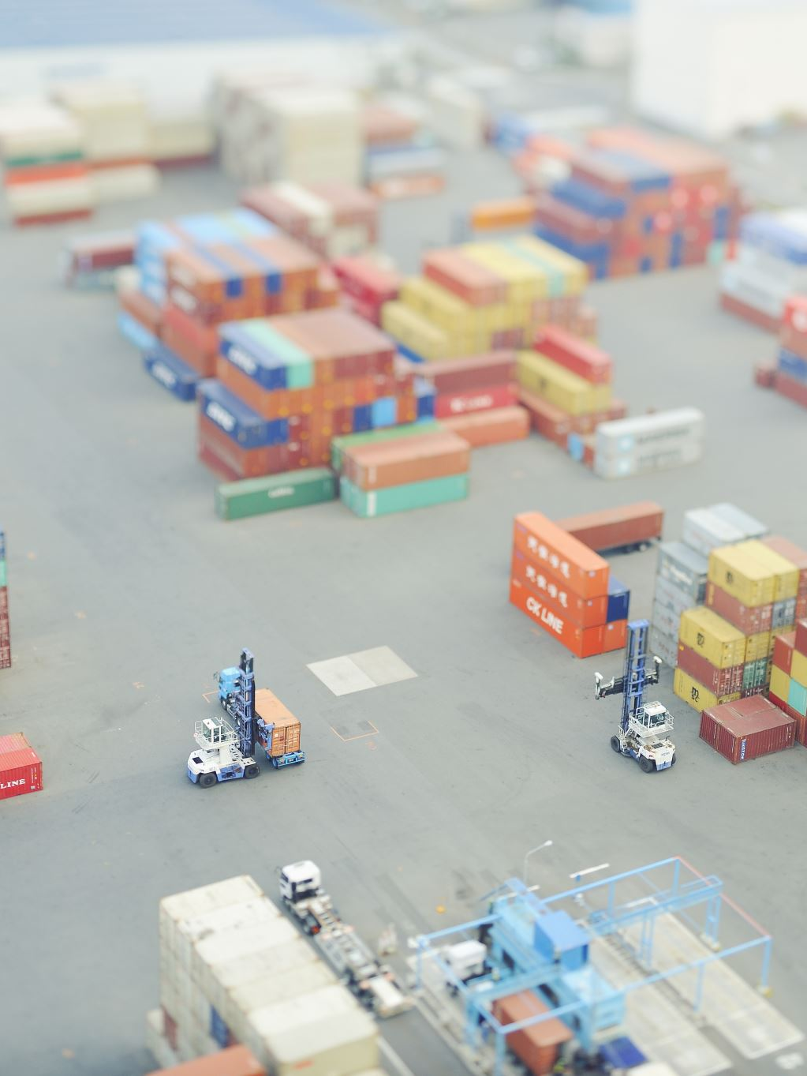
Summary of Benefits of Bolero
Exporters, suppliers, and sales personnel can increase customer service through faster and more reliable delivery of merchandise to the buyers in a cost-effective manner.
Importers/buyers/overseas procurement personnel can reduce their working capital through less delays and improved accuracy
Carriers: ship/air/road/rail/inland waterways implementing the Bolero.net service can better meet customer demands for speed and accuracy.

Slide 28
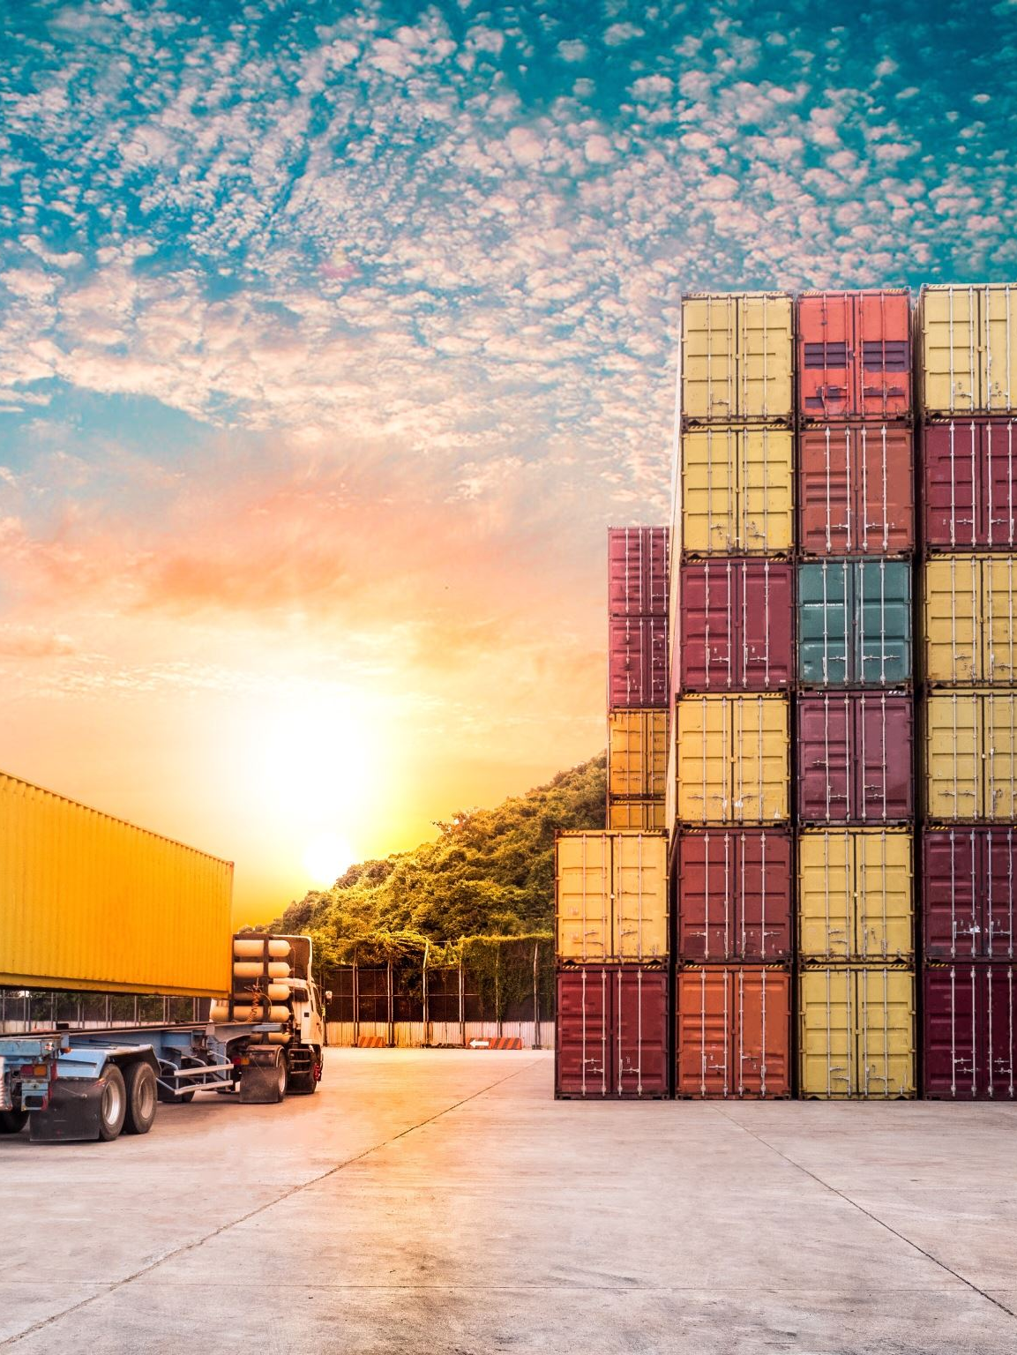
Summary of Benefits of Bolero
Freight forwards are logistic operators exploiting computer technology with Bolero where they offer integrated services with air freight, international road operators, container operators and multimodal.
Financial institutions. Trade financial transactions through Bolero have enabled financial transactions to be more efficient, transparent and with much improved customer satisfaction through value added.
Customs authorities have encouraged electronic transmission of customs documents/message.

Slide 29
Developing an e-export strategy
Item | Explanation
Product customization | Customize your product or service offerings based on the customer’s location by offering special links on your website for different markets
Customer support | Offer electronic customer support through a list of frequently asked questions on your website or through email assistance
Promotion | Highlight the features and benefits of your products or services using pictures, descriptions, technical details, pricing, shipping and return policies, as well as include customer testimonials and video demonstrations

Slide 30
Developing an e-export strategy
Item | Explanation
Branding | Promote your company and build your brand with potential customers by telling them more about your company's history, staff, location, partners and so on
Internal communication | Facilitate communication with international customers through email. Respond to questions instantly, notify your customers of their product shipment status and send them the latest news or information on special offerings

Slide 31
Practical principal steps in export
1. Evaluate your e-export potential.
2. Develop an e-export plan.
3. Modify your products for foreign markets.
4. Research the legal issues related to e-exporting.
5. Leverage your website to sell abroad.
6. Ship your products.
7. Receive payment.

Slide 32
References
Branch A. (2006) Export Practice and Management, Thomson Learning pg-182-224, 255-276
Khan A.G (2016), “Electronic Commerce: A Study on Benefits and Challenges in an Emerging Economy,” Type Double Blind Peer Rev. Int. Res. J. Publ. Glob. Journals Inc.
Lallana E, Quimbo R, Andam Z.R &, EPrimer (2002): An Introduction to E-commerce Philippines: DAI-AGILE,2.
Mesenbourg T.L,(2000) Measuring Electronic Business: Definitions, Underlying Concepts, and Measurement Plans
Rahayu R & Day J, (2017) “E-commerce adoption by SMEs in developing countries: evidence from Indonesia,” Eurasian Bus. Rev, doi: 10.1007/s40821-016-0044-6.
Turban, Efraim & King, David & Chung, H. Michael. (2002). Electronic Commerce A managerial Perspective Prentice Hall.
Vipin J. Malviya B and Arya S (2021) An Overview of Electronic Commerce (e-Commerce). Journal of Contemporary Issues in Business and Government Vol. 27, No. 3.
Zwass, V (1996) Electronic Commerce: Structures and Issues, International Journal of Electronic Commerce 10.1080/10864415.1996.11518273

Slide 33

End
End
Thank you
See you in week 11 lecture

