Slide 1

Export Marketing and Finance
Week 11 Lecture
Managing export operations
Dr John Kamau

Slide 2

Welcome!
Welcome to week 11 lecture
It is my joy to have you in this second last lecture in this series
We have already seen how export procedures affect export business
We are now ready to examine the export strategy development
We will also examine logistical issues in export
We will conclude by looking at problems encountered and solutions in physical distribution

Slide 3

Intended learning outcome
At the end of this lecture, you will be able to
Describe export market strategy development.
Discuss physical distribution strategy.
Discuss the logistics strategy.
Evaluate challenges encountered in physical distribution

Slide 4

Understanding export strategy
Developing an export strategy is one of the chief responsibilities of an export marketer.
The strategy guides all activities that will help service an export order.
An export strategy will constitute all activities and decisions regarding how the company will export to a foreign country, determination of pricing strategies, the products that will be sold, the markets it will sell to, as well as how the products will be exported.

Slide 5

Steps in developing export strategy
1. Analyzing export market opportunities: marketing opportunities in foreign markets are identified through market research.
2. Assess product potential: the exporter must determine the potential demand through market research.
The demand must be large enough to warrant further action from the marketer.
3. Establish market entry mode.
There are two major ways of entering into a foreign market: direct or indirect.

Slide 6
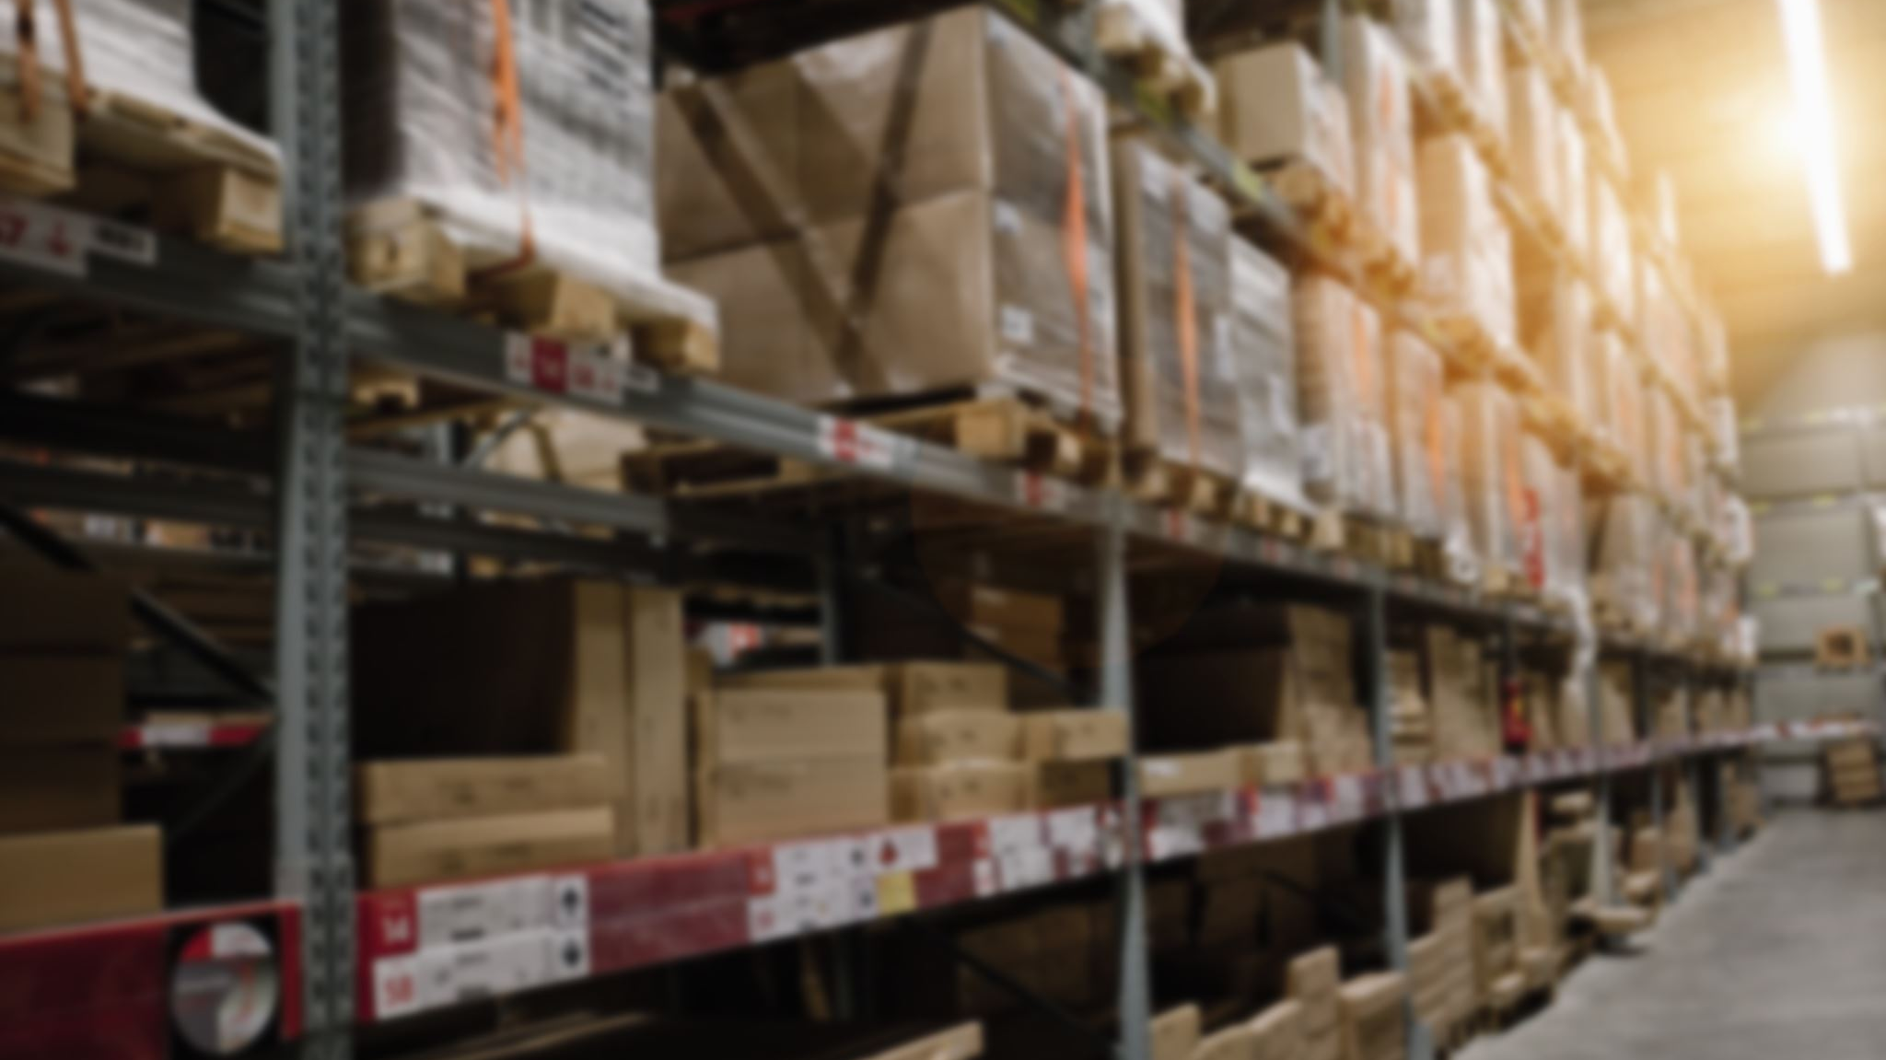
Steps in developing export strategy
4. Make a firm commitment.
Once the firm has established the mode to use, it must demonstrate firm commitment especially from top management for the strategy to work.
5. Allocate necessary resources:
The main costs include procurement of goods, licenses costs, shipping costs, taxes among others.
6. Identify technical issues:
These revolve around documentation process, financing, regulations, and all other technical challenges that may be encountered.

Slide 7

Steps in developing export strategy
7. Develop a strategic marketing plan:
All marketing activities must be guided by a marketing plan.
The plan is drawn from an overall company plan and will constitute marketing objectives, strategic activities, and evaluation methods.
8. Organize operation team:
Export operations require a team to be set to carry out the activities effectively
The manager must be conversant with export procedures and the international markets.

Slide 8
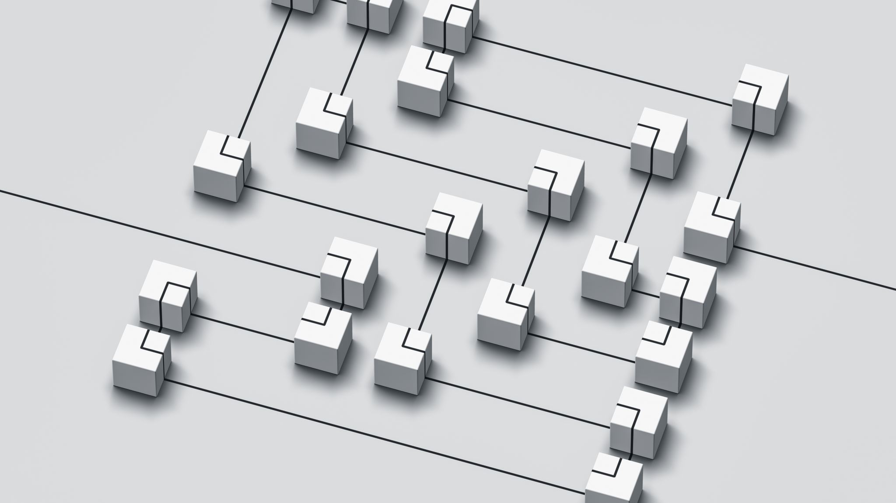
Steps in developing export strategy
9. Implement marketing strategy:
the export marketer will then implement the strategy.
This will require coordination of all processes, activities, and procedures.
10. Evaluate and control operations:
Evaluation will ensure that if the strategy is not working, that corrective actions are put in place.
This will be done all the time until the strategy produces expected results.

Slide 9
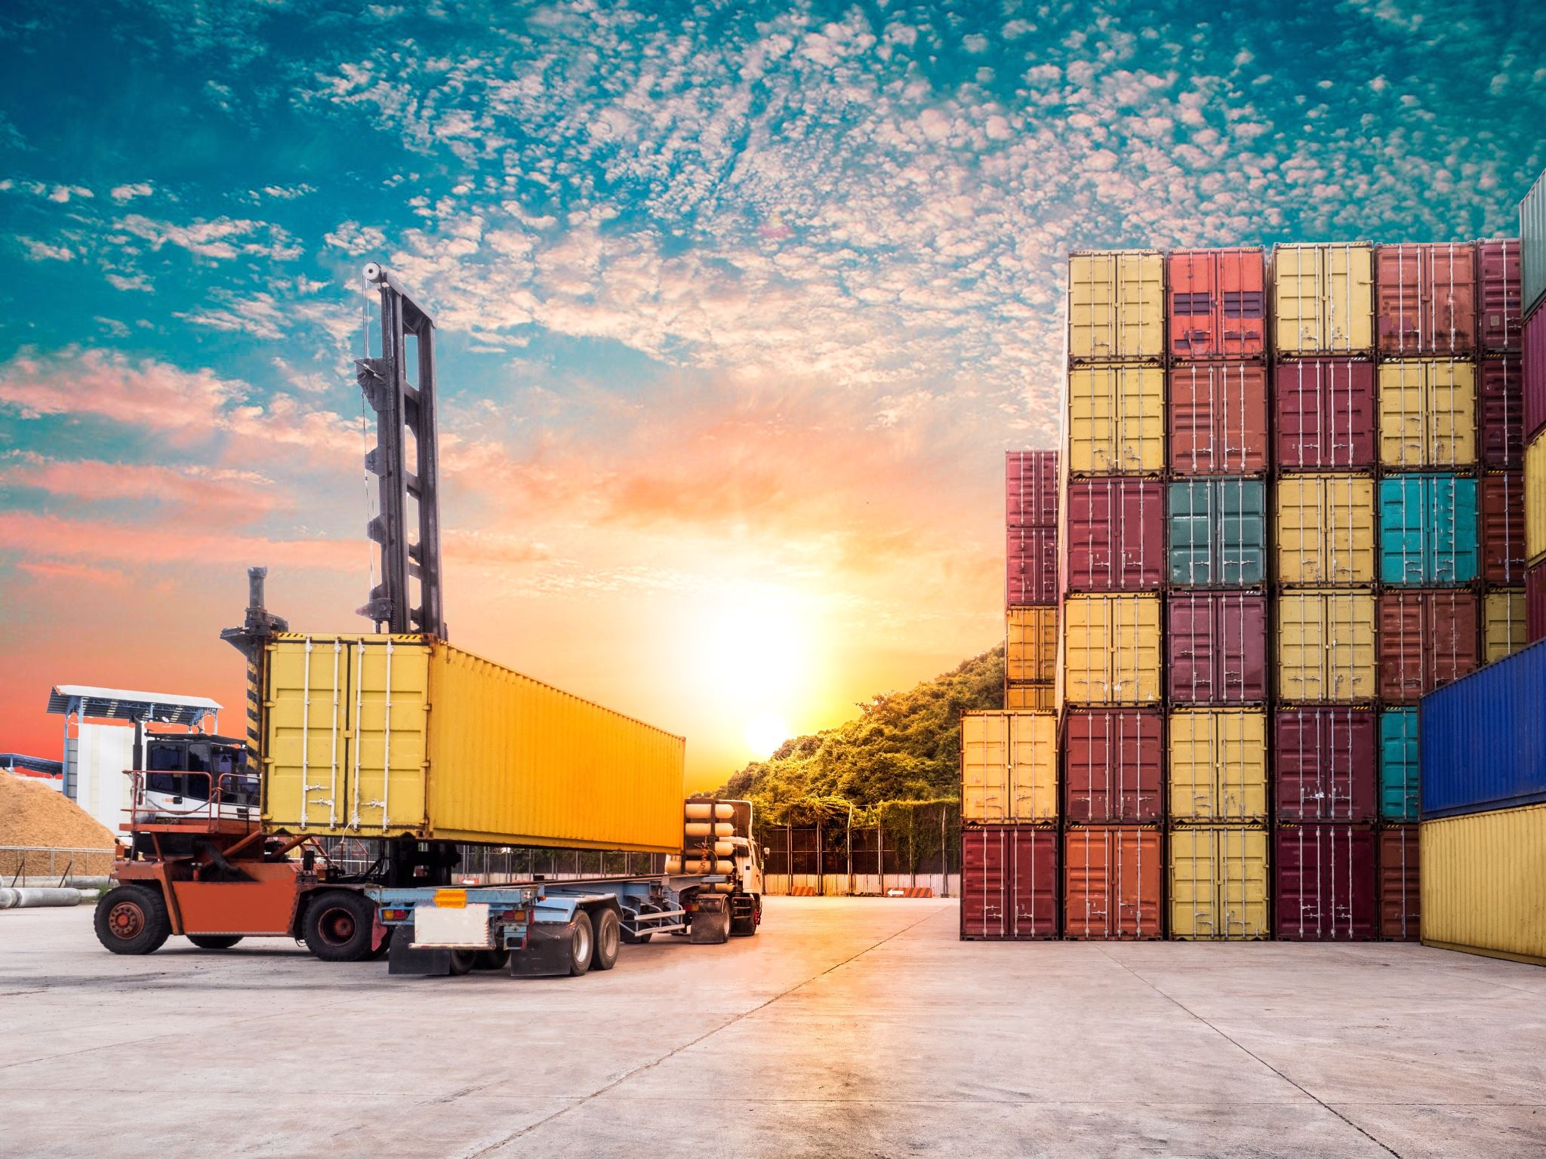
Factors that influence development of export strategy.
a) Company objectives:
The objectives are found in the company’s business plan which is reviewed regularly
b) Company resources:
The extent to a firm has specialist personnel engaged in shipping and warehouse distribution activities
c) The company’s position in the marketplace:
The higher the company’s profile, the more likely is the company to be market leader

Slide 10
Factors that influence development of export strategy.
d) Legal and political constraint:
several governments insist that imported goods are conveyed on their airlines or shipping services.
e) The sales focus and market stability:
company’s may be reluctant to set up an extensive and logistics department to cater for irregular shipments to unstable markets.
f) Level and nature of competition:
This raises the need for the exporter to choose the most advantageous and competitive distribution network to obtain and retain overseas business.

Slide 11

Factors that influence development of export strategy.
g) Cost:
constantly monitor these costs to ensure they remain competitive in the market in which they operate
h) Value added benefit:
Shippers are constantly looking for improved efficiency in the distribution network which they can transform into improved profitability and competitiveness derived from the imported product.
i) Flexibility of service:
flexibility arises from the range of facilities offered by the carrier and route options whose distribution network enables the shipper to exploit market opportunities.

Slide 12
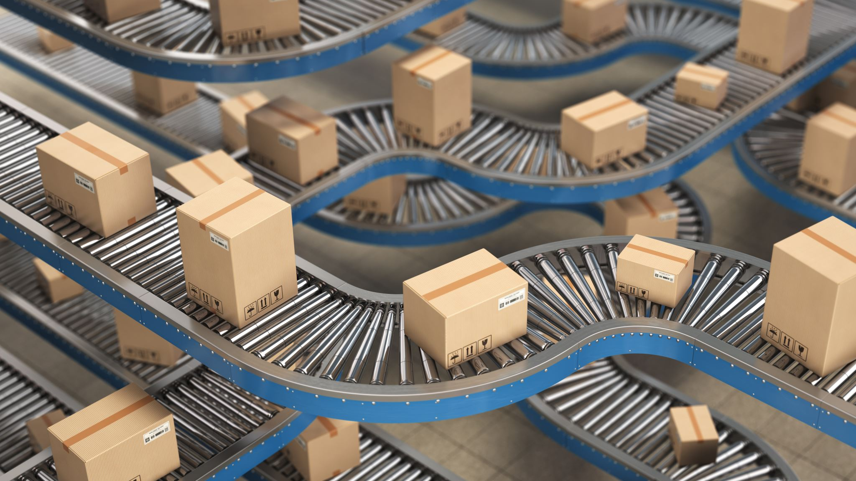
Factors that influence development of export strategy.
j) Frequency of service:
competitive transit times and frequent, reliable services at a competitive rate are the best ingredients to facilitate overseas market development.
k) Logistics: the need for inventory management which normally requires substantial resource investment.

Slide 13

Factors that influence development of export strategy.
l) Maximize:
The company business must strive to maximize business volume through flexible pricing strategies.
m) Culture:
The company must fully understand the market culture in which they are dealing and this embraces the importers’ company management culture, and in particular the management decision making process.

Slide 14
International Distribution Strategy options
1
International Distribution Strategy | Explanation
Near and distant markets | Near markets are easier to serve than distant markets, regular business and control systems are easy to set up, freight cost is lower and transit time quicker.
Destination seaports | The factors that influence choice of destination or feeder seaport include overall efficiency, infrastructure, level of tariffs, overall transit time, degree of technology, competitiveness, range of facilities, proximity to buyers address etc.
Sea-land bridge and sea-air bridge | This mode of transport opens new markets and offers good inventory management, especially for perishable goods with such competitively priced services offering quick transit times and numerous benefits to shippers.

Slide 15
International Distribution Strategy options
1
International Distribution Strategy | Explanation
Distriparks | They provide a new dimension to international physical distribution where suppliers, shippers or exporters can lease warehouse accommodation in the port environs and assemble, process, and label the products with substantial cost savings.
Free trade zones/industrial zones | Cost, local taxes and rate reduction are realized as well as providing a means to enter markets which are restrictive by using local labor int the manufacturing and assembling process.
Customs planning | It involves a wide variety of customs activities including tariff costing outwards, duty preference and origin, freight procurement, VAT etc

Slide 16
International Distribution Strategy options
1
International Distribution Strategy | Explanation
Districentre | It is virtually a warehouse. The system provides a total transportation service package geared to individual manufacturers and their customs needs.
Serving a single market | It offers a high volume of business, potentially good profitability, good infrastructure, trade within very low risk, single product specification, good logistically and computer focused distribution , ease market entry, free circulation within the market, single currency, labor mobility within the market and free capital movement
Routing | Routing of consignment requires examination where ultimate choice influence transit time, transshipment resources, handling and any constraints on weight, length etc.

Slide 17
International Distribution Strategy options
1
International Distribution Strategy | Explanation
Economic blocks | Companies situated in economic blocks and customs unions should strive to export within the block or union which offers the potential to develop volume business and to take advantage of the liberalization of trade within the block or union.
Consolidation | Consolidation of stock is a growth market by air, truck and container which is economical where a network of services exists worldwide.
Packaging | It is a form of protection and an aid to handling, identity, and stowage. Excessive packing increases the volumetric size of the goods that can increase freight cost on high volume products.

Slide 18
International Distribution Strategy options
1
International Distribution Strategy | Explanation
Loadability and stowage | The optimum size packing that maximizes loadability will lower the distribution cost of product and result in more competitive pricing.
Distribution centres | The concept exists whereby the exporter will centralize all his products on one distribution centre which will feed into the neighboring market.
Piggyback and trade associations | Several exporters selling in common overseas territories have joined forces and operate common distribution channels apportioning the cost. Such a system is called “piggyback “where the inexperienced exporter works on the backs of the established overseas exporter.

Slide 19
International Distribution Strategy options
1
International Distribution Strategy | Explanation
Third countries | An increasing volume of business is now conducted on a third-country basis and may involve a different distribution network.
Buyer’s or importer’s portfolio empathy | Good relationships and lasting business development emerge form the strategy of empathy whereby exporter and importer share each other’s views and objectives in the conduct of international trade. Special attention being the infrastructure obtaining in the buyer’s country and the most acceptable and efficient distribution method.
Currency | The freight rate may involve the exporters or currency or a third currency, but the currency used requires careful evaluation.

Slide 20
International Distribution Strategy options
1
International Distribution Strategy | Explanation
Audit of carrier or freight forwarder | The selection of the most suitable freight forwarder and carrier requires careful evaluation with the feasibility test of both undertaken and a system devised to monitor transits.
Direct or indirect marketing | Choosing direct marketing, the exporter has complete influence over the distribution in consultation with the importer
Shippers’ council | It exists in many countries, and it provides a useful contact point to advise on local distribution resources; infrastructure; problem areas and possible solutions; and availability of freight forwards /logistic operators/customs regulations.

Slide 21

Physical distribution
This is a critical step in export business and right decisions must be made.
Physical distribution encompasses the movement and handling of products outward to points of consumption or use.
In export business the processes, procedures, and documents required in export shipments are relatively more complex because of the following (Albaum et al, 2016):
a) The passage of goods across national boundaries, with attendant legal requirements.
b) Shipment by ocean-going vessels or international airlines, with attendant security needs and specific documentary requirements.
c) The time and distance required to complete the transaction, with attendant needs for ensuring payment.

Slide 22

Significance of physical distribution
The price that the ultimate user in foreign markets must pay is strongly influenced by the way in which the product is physically moved from the manufacturer/exporter.
Through export market strategy, the marketer can increase profits directly – through either reduced costs or increased sales.
Physical distribution can have a positive effect on a company’s sales volume through
Company structures: The physical distribution system can determine whether the firm succeeds or even survives in foreign markets.

Slide 23

Decision areas in physical distribution
a) Nature of the shipment: the minimum size of the unit pack, the quantities to be shipped, the type and method of packing to be used
b) Transportation: the route that the shipment is to follow, selecting the mode(s) of transportation, and providing adequate insurance coverage.
c) Warehousing: this encompasses storage, assembling, breaking bulk shipments into smaller sizes to meet customer needs and preparing products for reshipment.

Slide 24
Decision areas in physical distribution
d) Materials handling: Provision must be made for the internal movement of products within plant and warehouse facilities.
e) Carrying inventory: This involves determining the proper level of inventory to hold so that a balance is maintained between customer service and inventory cost.
f) Order processing and documentation: Correct documentation is essential to the successful physical movement of a shipment.

Slide 25
Decision areas in physical distribution
Davies (1984, has summarized the so-called ‘problem of documentation’ as consisting of five main components.
These are as follows:
Complexity: numbers of documents and correspondents.
Culture: language, currency, law.
Change: changes in requirements.
Cost: costs of preparation.
Error: consequential costs of error and cost of correction.

Slide 26
Distribution Network Problem areas and Possible Solutions
a) Industrial disputes: Industrial disputes or a build-up of traffic at a seaport can seriously disrupt a service and result in a delay in goods’ arrival.
Alternative routes should be explored at the earliest possible time to include transferring to air freight.
b) Trucks and container types: The range of truck and container types tends to increase but it generates an imbalance of their use
It can result in a shortage of specific container types at peak time.

Slide 27
Distribution Network Problem areas and Possible Solutions
c) Dangerous goods: Dangerous goods and individual loads require special arrangements where the following become relevant in the international movement of individual loads:
Checking of the ports of departure, destination, and any transshipment areas
Have plan and specification of shipment to evaluate stowage, handling arrangement and identify weight distribution.
Pre-planning of transportation of an indivisible load especially regarding route and time scale.
Consider that the rates for transporting indivisible loads are assessed on a cost-plus profit basis.

Slide 28
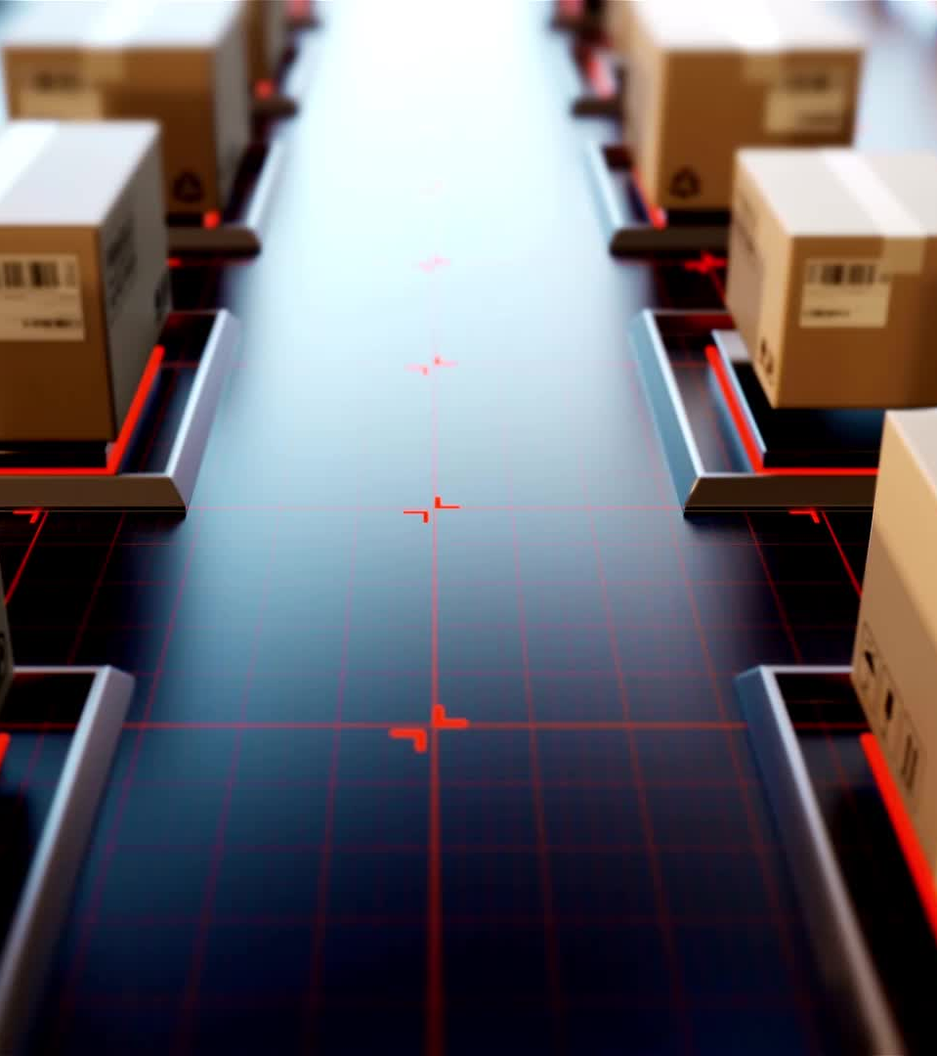
Distribution Network Problem areas and Possible Solutions
d) Cargo monitoring: The need for companies to monitor closely all transits and any irregularities to initiate early remedial measures with the parties concerned.
Computerization of the shipment logistics enables quicker and more accurate routine work.
e) Management team: Some companies have a low profile in the management structure.
Have a professionally qualified management team for the company’s international physical distribution.

Slide 29
Distribution Network Problem areas and Possible Solutions
f) Exchange risks: Exchange risk remains evident in many markets.
The need to seek advice from professional sources, especially the national bank of the importer’s country.
g) Cargo insurance: Exporters should check that the importer has insured the goods and take contingent measures when in doubt.
h) Documentary credits: Documentary credits should be checked thoroughly on arrival to ensure they represent the terms already agreed.

Slide 30

Distribution Network Problem areas and Possible Solutions
i) Faulty documents: Faulty documents are a frequent cause of late payment and delivery of goods.
Qualified personnel handling such documents can reduce the risk,
Attendance at training courses and seminars enables staff to keep up to date.
Full use should be made of EDI resources and techniques.
A logistic distribution plan should be devised and monitored using EDI resources.

Slide 31
References
Albaum G, Duerr E, & Josiassen A (2016). International Marketing and Export Management Pearson.
Branch A. (2006) Export Practice and Management, Thomson Learning pg-182-224, 255-276
Darling, J.R. and Seristö, H.T. (2004), "Key steps for success in export markets: A new paradigm for strategic decision making", European Business Review, Vol. 16 No. 1, pp. 28-43.
Davies, G. (1984). Managing Export Distribution. London: William Heinemann.

Slide 32

End
End
Thank you
See you in lecture twelve

