Slide 1

Export Marketing And Finance
Week 12
Ethical Issues In Export Marketing
Dr John Kamau

Slide 2

Welcome
Welcome to week 12 lecture
Its my great joy to have you in our last lecture on this series
I want to expresses my heartfelt gratitude for walking with me throughout the course
Once again congratulations for making it so far
It is my sincere hope that we have met the course objectives and that you can confidently participate in export marketing

Slide 3

Intended learning outcomes
1. Describe ethics in the context of export marketing.
2. Discuss ethics effect on exporter importer relationship.
3. Examine basis for ethical behavior in export marketing.
4. Evaluate ethical dilemma in export marketing.
5. Discuss contemporary issues on export marketing ethics.

Slide 4

Why ethics?
Export business has been on rise globally.
This is accelerated by forces of globalization, intensifying competition, and advancing transportation, communication, and information technologies, among others.
The greatest impediment to this trend is ethics between exporter and import which may affect their business relations

Slide 5

Definitions of ethics
Ethics are the embodiment of the values and belief one holds with regard to the standard which are used to determine what is right and what is wrong (Wisler,2016).
Marketing ethics as the extent to which the firm’s marketing policies and practices are transparent, trustworthy, and responsible, thus creating a feeling of fairness and rightness by other stakeholder parties (Armstrong 1996).

Slide 6

Definitions of ethics
marketing ethics refers to the systematic study of how moral standards are applied to marketing decisions, behaviors and intuitions‟ and embraces a wide variety of topics (Schlegelmilch and Oberseder, 2010).
Marketing ethics means acknowledgement of transparency, trustworthy and responsibility of the individuals and also organizational marketing policies focus on integrity and fairness toward customers and stakeholders as well (Yuan et al,2015).

Slide 7
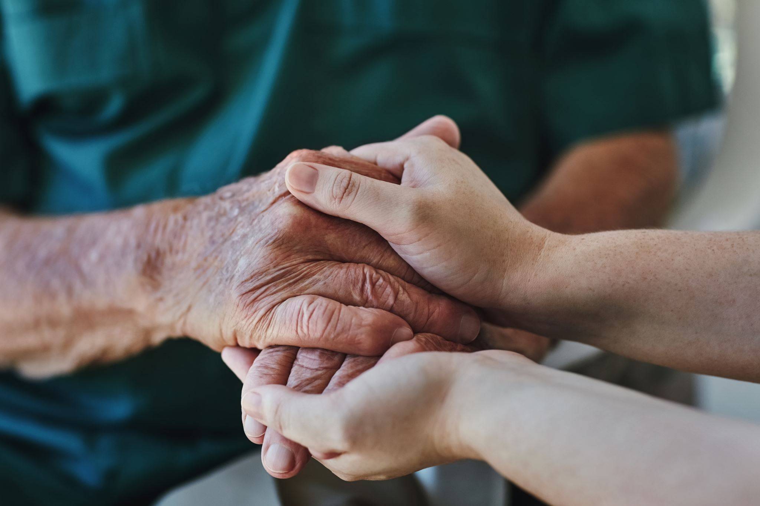
Definitions of ethics
Ferrell (2005) who viewed marketing, ethics in the workplace as rules (standards, principles) governing the conduct of organizational members and the consequences of marketing decisions
Tsalikis and Fritzsch (1980) defined ethics as an inquiry into the nature and grounds of morality where morality means moral judgments, standards, and rules of conduct.

Slide 8
Definition of ethics
Its all about what is right and wrong.
It’s about values and standards in a firm.
It’s about how we treat others.
What is right and wrong may vary depending on context
It’s about transparency, trustworthiness, and fairness.

Slide 9

12.4 Importance of ethical marketing to a business
The exporter will benefit in the following ways from ethical marketing
Better satisfy the needs of their import customers
Secure the continuation of purchases from them.
Minimize the possibility of foreign customer loss.
Use customers as a source of new product ideas and foreign market information.

Slide 10

12.4 Importance of ethical marketing to a business
The importer will benefit in the following ways from ethical marketing
Ensure the long-term supply of products from foreign suppliers,
Suggest ways of improving the efficiency of the production/ delivery process,
Use the suppliers’ expertise to protect their cost structure and achieve better prices.
Exploit ideas relating to the technical development of products.

Slide 11

12.5 Dangers of unethical behavior in export marketing
Creating suspicion and reducing openness between the interacting parties.
Giving rise to moral dilemmas and eroding honesty in the exchange process.
Undermining respect and increasing uncertainty and instability in the working relationship.
Stirring up friction, frustration, and conflict between sellers and buyers.

Slide 12

12.5 Dangers of unethical behavior in export marketing
Cultivating short-term thinking and creating opportunistic behavior.
Reducing the robustness of business decisions.
Increasing uncertainty about the relationship.
Jeopardizing business smooth progress.

Slide 13
Philosophical approaches to ethics
According to Schermerhorn and Bachrach (2015). there are several approaches to what is generally considered ethical or unethical.
1. Utilitarian view
this holds the view that a behavior is considered ethical if it delivers the greatest good to the greatest number of people.
This view ignores individual feelings, beliefs, values, and thoughts and only looks at what is accepted by the majority.
.

Slide 14
Philosophical approaches to ethics cont.
2. The moral right view:
This view considers the fundamental rights of all human beings irrespective of their location.
These rights have to do with respecting individual privacy, due process, free speech, free consent, health and safety, freedom of conscience, among others.
This school of thought will approve any behavior that considers the fundamental rights of all individuals in the society.
.

Slide 15
Philosophical approaches to ethics cont.
3. Individual view:
This school of thought consider behavior that promote one’s long-term self-interest as ethical.
The school prohibits consideration of short-term interests and requires any individual to think about the long-term effect of their behaviors and actions.
.

Slide 16
Philosophical approaches to ethics cont.
4. The justice view:
According to the advocates of this view, a behavior is considered ethical if it shows fairness and impartiality.
This will depend on ethical code or other guiding principle in a particular situation.
.

Slide 17
Philosophical approaches to ethics cont.
5. Universal approach:
This school of thought hold the view that employees of any institution should choose a course of action that they believe would apply to all people under all situations.
Borrowing from the Holy Book (The Bible), it has the implication that one should do unto others as they would have them done unto them’.
.

Slide 18
Philosophical approaches to ethics cont.
6 Compensatory justice:
This view holds that if distributive and procedural justice approaches fail, those hurt by the inequitable distribution of rewards are compensated.
This compensation often takes the form of money or takes any other form.
.

Slide 19
Factors influencing ethical behavior among individual marketers
A) The person
General make-up of a person’s character
The family influence
Religion values
Personal standards and principles of life.
An individual who has well established value system will be predictable in different situations and positions as far as his conduct is concerned.
.

Slide 20
Factors influencing ethical behavior among individual marketers.
B) The organization
The organization’s policies
Code of conduct of the organization
The behavior of supervisor and colleagues
The culture of the organization.
.

Slide 21
Factors influencing ethical behavior among individual marketers .
C) The environment:
Governmental regulations,
Norms and values of society
The ethical climate of industry.
.

Slide 22
Ethical challenges and dilemmas in export marketing
The export marketer is faced with many ethical challenges
In the international business environment, there are specific ethic problems that rise due to factors such as (Soproni,2009).
a) The diversity of political and law regulation systems
b) The diversity of economical organizing forms and levels of economic development

Slide 23

Ethical challenges and dilemmas in export marketing
The export marketer is faced with many ethical challenges
In the international business environment there are specific ethic problems that rise due to factors such as (Soproni,2009).
c) Insufficient regulations, especially in less developed countries
d) Existing conflicts between national and regional economic interests
e) The influenced area and power of the multinational corporations, as well as their ability to elude law regulations.
f) Corruption in some areas of the world.

Slide 24
Ethical challenges and dilemmas in export marketing
Key area | Main ethical challenges
Product | Unsafe products, product adulteration and misbranding, product quality
Packaging | Package size, misleading information, and package imitations
Advertising | Ads to children, deceptive/misleading advertising,
Pricing | Unfair pricing, excessive pricing, misleading price reduction, price advertisements, price fixing, predatory pricing, discriminatory pricing

Slide 25
Ethical challenges and dilemmas in export marketing
Key area | Main ethical challenges
Environmental consumerism | Green marketing, green products, and green consumers who may not hold to the views despite claims
Customer care | Customer dissatisfaction addressed through, polite and courteous service, offering, confidentiality, open door policy, proactive problem solving.
Distribution | Increase in counterfeit products distribution,

Slide 26
Ethical decision-making process in marketing
Ethical decision-making refers to the process of evaluating and choosing among alternatives in a manner consistent with the ethical principles
The steps include Nurreti Et al (2015):
1. Determine the facts of the situation: the decision maker should make an honest effort to understand the problem.
2. Identifying the ethical issues involved: requires the marketer to recognize a decision as an ethical one.

Slide 27
Ethical decision-making process in marketing
The steps include Nurreti Et al (2015):
3. identify relevant factors: these are factors like stakeholders or laws or professional codes and consider the situation from their point of view who will affected by a decision, policy or operation of a firm.
4. Evaluate alternatives: Once the facts have been examined, it is needed to consider the available alternatives which is also called the moral imagination.
Obvious and unobvious options should be considered.

Slide 28
Ethical decision-making process in marketing
The steps include Nurreti Et al (2015):
5. Rational decision: after considering all options a rational decision has to be made.
This requires one to pick a course of action among the supported ethical alternatives.
6. Evaluate implications: evaluate the implications of the selected course of action to monitor and learn from the outcomes and to modify the actions according to face similar challenges in the future.

Slide 29
Towards an international ethical code in business
There is no one code of conduct of business globally.
1. The Principles of Business drafted by the Caux Round Table:. Advocated for respect and protection of human dignity and responsible stewardship.
It failed to reduce social and economic inequities that threaten the planet’s peace and stability.
The main principles of this code include Recognize stakeholder constituencies; Create wealth for development of the world; Act with sincerity, candor and truthfulness; Respect the law; The World is one economic community; Sustain the environment; Avoid corruption and illicit dealings

Slide 30
Towards an international ethical code in business
2. Global Sullivan Principles: developed by Leon Sullivan, in 1999 and requires companies to adhere to principles such as:
Express support for universal human rights,
Promote equal opportunity for our employees at all levels of the company,
Respect our employees' voluntary freedom of association,
Compensate employees to enable them meet their basic needs,

Slide 31
Towards an international ethical code in business
2. Global Sullivan Principles: developed by Leon Sullivan, in 1999 and requires companies to adhere to principles such as:
Provide a safe and healthy workplace;
Promote fair competition,
Work with government and communities in which we do business to improve the quality of life in those communities
Promote the application of these principles by those with whom we do business.

Slide 32
Towards an international ethical code in business
3. Business ethic rules for Rotary International: requires members to respond to four questions in assessing ethical situation:
Is it just for all those involved? Will it lead to good understanding and consolidation of friendship? Will all those involved benefit from this?
The code requires the members to adhere to these principles:
Consider my vocation to be another opportunity to serve;
Be faithful to the letter and to the spirit of the ethical codes of my vocation, to the laws of my country, and to the moral standards of my community;
Do all in my power to dignify my vocation and to promote the highest ethical standards in my chosen vocation;

Slide 33
Towards an international ethical code in business
3. Business ethic rules for Rotary International: requires members to respond to four questions in assessing ethical situation:
Be fair to my employer, employees, associates, competitors, customers, the public, and all those with whom I have a business or professional relationship;
Recognize the honor and respect due to all occupations which are useful to society;
Offer my vocational talents: to provide opportunities for young people, to work for the relief of the special needs of others, and to improve the quality of life in my community;
Adhere to honesty in my advertising and in all representations to the public concerning my business or profession;
Neither seek from nor grant to a fellow Rotarian a privilege or advantage not normally accorded others in a business or professional relationship

Slide 34
References
Armstrong, R.W. (1996). The relationship between culture and perception of ethical problems of international marketing. Journal of Business Ethics, 15: 1199-1208
Business Schools and Corporate Leaders”. R.A. Peterson and O.C. Ferrell, (eds.) Armonk, New York: M.E. Sharpe, pp. 3-17.
Caux Round Table (2009) , ―Principles for Business‖, Caux Round Table website, http://www.cauxroundtable.org/index.cfm?&menuid=8
De George, R.T. (1993). Competing with integrity in international business. New York: Oxford
Donaldson, T. (1989). The ethics of international business, New York: Oxford University Press.
Elfstrom, G. (1991). Moral issues and multinational corporations. New York: St. Martin’s Press.
Ferrell O.C (2005), “A Framework for Understanding Organizational Ethics: New Challenges for
Global Sullivan Principles of Social Responsibility, http://www.globalsullivanprinciples.org

Slide 35
References
Nurettin P, Banu K & Bülent O (2015) Ethical issues in marketing: an application for understanding ethical decision making. ResearchGate.
Schermerhorn. J. & Bachrach, D. (2015). Management, (13th ed.). New York: Wiley & Sons.
Schlegelmilch, B.B., & Öberseder, M. (2010), Half a century of marketing ethics: Shifting perspectives and emerging trends. Journal of Business Ethics, 93(1): 1-19.
Singhapakdi A. & Vitell S.J (1990), “Marketing Ethics: Factors Influencing Perceptions of Ethical Problems and Alternatives.” Journal of Macro Marketing 10, pp. 4-18.
Soproni, L. (2009). Ethics in international business. Annals of the University of Oradea - International Relations and European Studies, 1, 126-138. https://nbn-resolving.org/urn:nbn:de:0168-ssoar-348177
Tsalikis J. & Fritzsch D (1980) , “Business Ethics: A Literature Review with a Focus on Marketing Ethics” Journal of Business Ethics, 8(2), 1989, pp. 695-743.
University Press.
Wisler,J,C.(2016). U.S. CEOs of SBUs in Luxury Goods Organizations: A Mixed Methods Comparison of Ethical Decision-Making Profiles. Journal of Business Ethics.PP 1-76
Yuan,R.Liu,M,J.Liu,J.(2015).Ethical marketing: China, Taiwan, Japan and South Korea. Ethical and Social Marketing in Asia.pp 35-53.

Slide 36
End
End
Thank you
Blessings

