Slide 1

Export marketing and finance
Dr. John Kamau

Slide 2

Welcome note
Welcome to export marketing and finance course
It is my joy to take you through the course
Thanks for choosing to be tutored by me
This is a third-year course and I hope you will enjoy
I will begin by doing self introduction
I will then give an overview of the entire course
I will finally introduce today’s lesson

Slide 3

Self-introduction
Name: Dr john N Kamau
Profession: lecturer
University: Africa Nazarene University
Faith: Christian
Family : married with children

Slide 4

Overview of export marketing
Introduction to export marketing
Export marketing research
Developing export marketing strategy
Processing export order and Incoterms
Export documentation

Slide 5

Overview cont.
Packaging shipping and insurance
Export contract and financing
Export regulation
Trading blocks and exports

Slide 6
Overview cont.
Electronic commerce in export marketing
Managing export marketing operations
Ethical issues in export marketing

Slide 7

Introduction to export marketing
Definition of export marketing
Features of export marketing
Functions of export marketing
Importance of export marketing
Special problems in export marketing
Characteristics of export marketing executives

Slide 8
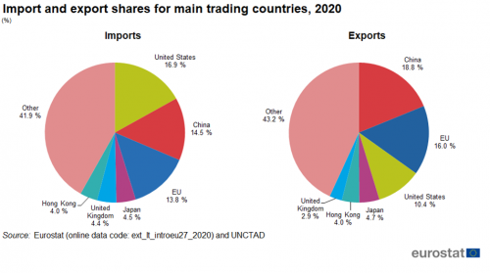
World statistics
Source: Eurostat (ext_lt_introeu27_2020) and UNCTAD

Slide 9
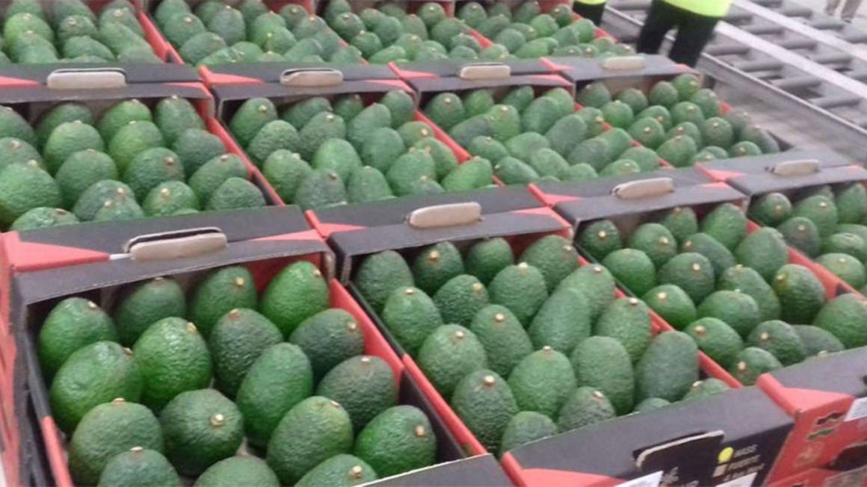

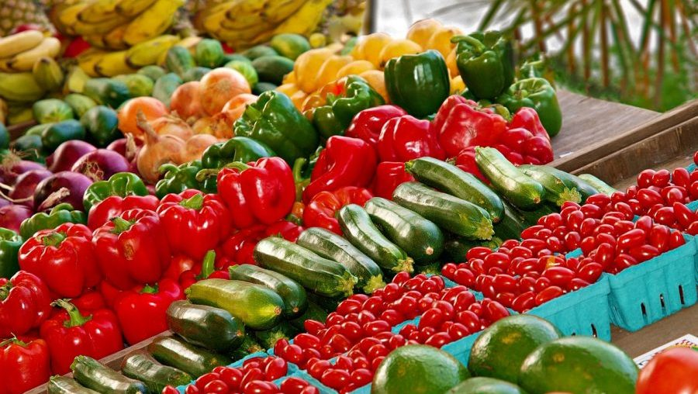

Kenya main exports
source: Nation media group ((2023) kenyan farmer picking tea, Retrieved from https://www.theeastafrican.co.ke / on 18/9/2023
source: Nation Media group (2022) Avocados for export from Kenya retried from https://www.invest.go.ke 18/9/2023
source: Farmers review (2020), Display of kenya horticultural product: retrieved from https://furtherafrica.com/ 18/9/2023
source: Food Business Africa (2022) Display of kenyan coffee : retrieved from https://www.foodbusinessafrica.com 18/9/2022

Slide 10
What is export marketing
Export marketing is a branch of international marketing that focuses on the movement of goods and services from one country to another
Export marketing is the process of exchanging goods and services between the residents of one country to the residents of another country.
a) Marketing of goods and services
b) Goods and services are exchanged between countries/nations.
c) Process well organized and managed
d) Export may be carried out by companies and even governments.

Slide 11

Features of export marketing
Lengthy procedures
Large-scale operations
Dominances of MNCS and TNCS from developed countries
Trade barriers
Trade blocs

Slide 12

Features cont.
Importance of advanced technology
Foreign exchange regulations
Three-faced competition
Involvement of international organizations

Slide 13

Benefits of export marketing
Balance of payment
Foreign exchange reserves
Financing Development Plans
Employment opportunities
Optimum Utilization of Resources

Slide 14

Benefits cont.
Increase in National and Per-capita Income
International peace
Research and development
Profit Advantage
Goodwill and Reputation

Slide 15
Benefits cont.
Spreading risk
Improves Organizational Efficiency
Financial benefits and incentives
Government Policies and Regulations

Slide 16

Functions of Export Marketing
Export Marketing Research
Research and Development
Export Financing
Export Production
Export Packaging

Slide 17

Functions cont.
Export Pricing
Export Procedure
Export Incentives and Assistance
Foreign Trade Policy

Slide 18

Special Problems of Export Marketing
Long Distance
High Risks and Uncertainties
Customs Formalities
Trade Barriers

Slide 19

Special Problems cont.
Three-faced Competition
Payment Difficulties
Documentation Formalities
Diverse Languages, Customs and Traditions

Slide 20

Essential Qualities for Export Manager
Educational Qualification
Professional Qualifications
Specialized Knowledge
Managerial Abilities

Slide 21
Essential Qualities for Export Manager
Essential personal qualities
Orderliness
Courtesy
Adaptability
Sound judgment
Self-confidence
Leadership

Slide 22

Successful exporting strategies
The development of ideas should be equalized to physical products
Growing world competition informs companies growth strategies
Recognize importance of technology
Developing long-term strategies on a growth market basis
Looking for new markets and opening new sales opportunities.

Slide 23

Successful export marketing strategies
Continuous improvement inside the marketing
Developing strong service philosophy
Logistically focused firms
Undertaking export marketing research continuously

Slide 24

Export marketing risks
Long period before payment are made
Problems arising from fluctuation interest rates, exchange rates, economic & trade cycles.
Manipulation of trade barriers to favor some companies
Increase in corruption, crime, expropriation and fraud and terrorism and diseases

Slide 25

Export marketing risks continued
New skills required in handling cash and funds management procedures
High cost of launching a product in a foreign market.
Changing global nations alignments
Climate change and its impact

Slide 26

Key personnel and functions
1. Export director
Develops overall policy strategy
Supervises other export managers

Slide 27

Key personnel and functions cont.
2. Export marketing manager
Receives inquiry ascertains its feasibility and whether it complies with set standards.
Ascertains dispatch date and mode
Receives order from customers and ascertains its in line with the quotation
Ensure the quotation is sent to production on time
Follows to ensure order is delivered as expected

Slide 28

Key personnel and functions cont.
Liaison with trade associations
Develops marketing and sales plan
Agency appointment
Budget formulation
Export marketing research

Slide 29

Key personnel and functions
3. Export shipping manager
Links with export sales, ensuring the order complies with import /export controls
Issues instructions on packaging and marking
Chartering or booking shipping space

Slide 30
Key personnel and functions
3. Export shipping manager
Drawing up all necessary documents and later collating and cross-checking all documents after shipment
Passing documents to accounts department for collection of payments.

Slide 31
References
Rathor B.S (2015) Export marketing, Himalayan publishers pg1-15
Branch A (2006) Export practice and management , Thomson learning pg-36-51
Cateora P.R, John Hess J.M & Irwin R. D, (1975)International Marketing pg 1
Acharya, W.K (2009) Export Marketing , Global Media, 2009) pg 1-12
Nation Media group (2022) Avocados for export from Kenya retried from https://www.invest.go.ke 18/9/2023
Farmers Review Africa (2020), Display of kenya horticultural product: retrieved from https://furtherafrica.com/ 18/9/2023
Food Business Africa (2022) Display of kenyan coffee : retrieved from https://www.foodbusinessafrica.com 18/9/2023
Nation media group ((2023) kenyan farmer picking tea, Retrieved from https://www.theeastafrican.co.ke/ on 18/9/2023

