Slide 1

EXPORT MARKETING AND FINANCE
LECTURE 2
EXPORT MARKETING RESEARCH
DR KAMAU JOHN NJAU (PhD)

Slide 2

Welcome
Welcome to lecture 2 in export marketing and finance
Recap of the last lecture
“Whoever understands the customer best, wins.” - Mike Gospe
“When the customer comes first, the customer will last.” - Robert Half
“Listening is hearing the needs of the customer, understanding those needs and making sure the company recognizes the opportunity they present.” - Frank Eliason
“Everything starts with the customer.” - June Martin

Slide 3

Intended learning outcomes
Define export marketing research.
Discuss significance of export marketing research
Evaluate aims and structure of export marketing research
Examine procedures of conducting export marketing research
Discuss special problems in export marketing research.
Evaluate firm’s readiness to venture into export marketing

Slide 4

Definition of export marketing research
Export marketing research is a part of international marketing research
International marketing research implies:
Research for true international products (international research)
Foreign research
Multinational research
Cross-cultural research.

Slide 5

Definition of export marketing research cont.
Export marketing research as the formal, systematic application of scientific methods to the acquisition of more objective and purposeful export marketing information (Koksal, 2008) .
From these definitions we deduce the following about export marketing research
Research is the same irrespective of markets geographical locations.
Research is useful in providing information for decision making
Export research is conducted in many countries
Export research is systematic and scientific
Improves firm’s performance

Slide 6

Significance of export marketing research
Understanding different culture
Complying with law/regulation
Determining customer tastes and preferences
Mitigating risks

Slide 7

Significance of export marketing research cont.
Assessing Logistic problems
Determining the level of Competition
Assessing resources availability
Determining Marketing channels available

Slide 8
Aims of export marketing research
Determining export markets to venture into:
Determine the levels of Product modification required
Assessing distribution channels available

Slide 9

Aims of export marketing research
Pricing: price sensitivity and demand for products
Assess sales volume potential : the export marketer would further want to dig out the potential sales volumes and
Identify Business performance criteria for different markets

Slide 10
Structure for conducting export marketing research.
a) Own staff: firm staff sent to foreign market.
Advantage: gives more reliable information
Disadvantage: expensive and language problems
b) Importing agents: firms doing business with the exporter.
Advantage: ease of access to study participant
Disadvantage: lack objectivity due to conflict of interest

Slide 11
Structure for conducting export marketing research.
c) Research agency: research firms in importing countries
Advantage: familiarity with the market, specialized personnel available.
Disadvantage : costly and problems of identifying reliable firms
d) Domestic marketing research agency: these are research firms hosted in the exporting country with the services of consulting firm in the importing country.
Advantage : The exporter is familiar with the research firm and this may produce better results.
Disadvantage : may be expensive

Slide 12
Structure for conducting export marketing research.
e) Consortium of research agencies: conglomeration of firms with different expertise
Advantage: high quality results
Disadvantage : expensive, and the quality of the research may vary among firms

Slide 13
Consideration for effective export marketing research
Marketing program: Has the management developed an export marketing program with accompanying market research tasks?
Continuity: Does management understand that foreign market research is an ongoing activity?
Monitoring and evaluation: Have procedures been developed to monitor, evaluate, and correct export marketing performance?

Slide 14
Consideration for effective export marketing research cont.
Tracking changes: Has the firm provided the means for timely warning of pertinent changes in foreign markets?
Specificity: Does the export market research seek the most specific information concerning the firm’s products?
Discretion: Is mature judgement being applied to the facts developed by the export market research efforts?

Slide 15
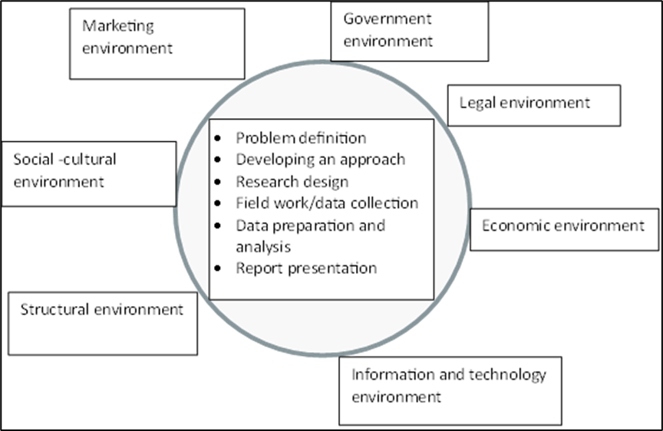
Export marketing research procedure

Slide 16

Environmental factors impact on research
a) Marketing environmental factors:
Variety and assortment of products available
Pricing policies
Government control of media
Public’s attitude towards advertising
Efficiency of the distribution system
Marketing effort undertaken
Unsatisfied needs
Behavior of consumers

Slide 17
Environmental factors impact on research cont.
b) Government environmental factor:
Public policy
Regulatory agencies
Government incentives and penalties
Investment in government enterprises

Slide 18

Environmental factors impact on research cont.
c) Legal environmental factors:
Common law
Foreign law
International law
Transaction law
Antitrust
Bribery
Taxes

Slide 19

Environmental factors impact on research cont.
d) Economic environmental factors
Economic size (gross domestic product)level
Source, and distribution of income
Growth trends
Sectoral trends

Slide 20

Environmental factors impact on research cont.
e) Informational and technological environmental factors
Information and communication systems
Computerization
Use of electronic equipment
Energy
Production technology
Science and invention

Slide 21

Environmental factors impact on research cont.
f) Structure environment
Transportation
Communication
Utilities
Infrastructure.

Slide 22
Environmental factors impact on research cont.
g) Social cultural environmental factors:
Values
Literacy
Language
Religion
Communication patterns
Family and social institutions

Slide 23

Steps in the research process
a) Definition of the problem:
Specify the problem
Set objectives
Research questions
Hypothesis
Export logistical issues to be investigated.

Slide 24

Steps in the research process cont.
b) Determine research approach:
Appropriate research design
Quantitative approach
Qualitative approach
Mixed method approach

Slide 25
Steps in the research process cont.
c) Research methodology
Sampling design
Develop data collection instruments
Test of instruments

Slide 26

Steps in the research process cont.
d) Field work:
Actual collection of information
Secondary sources considered first
Primary sources
Challenges of primary sources

Slide 27
Steps in the research process cont.
e) Analysis and interpretation of information.
Data clean up
Descriptive analysis
Inferential analysis
Make recommendation.

Slide 28
Steps in the research process cont.
f) Preparation of the report.
Executive summary
Findings
Recommendation
Decision points

Slide 29
Special problems in export marketing research
Variety of markets
Reliability of secondary data
Difficulties in collecting primary data
Comparability of data
Availability of data
Religious and cultural beliefs

Slide 30
Export marketing readiness
Analyzing Your Company Ability To Export
Competitive capability in the domestic market.
Motivation for going international.
Commitment of top management to the export cause.
Organizational readiness
Product readiness
Company resources

Slide 31
b) Motivation For Going International
Expanding into key markets.
Enhancing competitiveness by acquiring market knowledge
Extending the life cycle of existing products by launching them into new markets
Diversifying risk by selling in foreign markets.
Exploiting proprietary knowledge and technology
Improving long-term return for the company by tapping profitable markets
Long-term sales land operations expansion

Slide 32
Commitment of Top Management to Export Cause
Company’s willingness to risk current profits and returns in the short term to medium term.
Willingness to be more of an insider in foreign market than selling through middlemen.
Willingness to engage law firms in the foreign market.
Top management view of exporting as a regular, aggressive and targeted activity
Placing strategic emphasis on developing strong market shares
Availing funds particularly in market research and market development
Provision of human resource both at senior management level and operations personnel

Slide 33
Organizational Readiness
Human resource
Export experiences
Financial resources
Manufacturing capacity
Marketing expertise, marketing intelligence, technical knowledge
Planning and systems for going international

Slide 34

Product Readiness
Adaptations of products
Redesigning the product
Adding or eliminating features
Refining attributes
Changing specifications or components
Repositioning the product

Slide 35
References
Koksal M.H (2008) How export marketing research affects company export performance Evidence from Turkish companies, Marketing Intelligence & Planning Vo. 26 No. 4, pg 418
Shaw J (2023) 8 Reasons Why Companies Need to Research Their International Markets: Retrieved from https://kadence.com/ 2023
Zou S., Kim D. & Cavusgil S.T (2009) Export marketing strategy, tactics and skills that work, Business expert press ltd pg 31-36
Cavusgil, S.T., Knight, G.A., & Riesenberger, J.R. (2008) International business: strategy, management, and new realities. Upper Saddle River, NJ: Prentice Hall
Burton, E.N., & Schlegelmilch, B.B. (1987) Profile analysis of non-exporters verses exporters grouped by export involvement, 1978-1988. Management International Review, 27(1), 38-49
Zou, S., & Stan, S. (1998). The determinants of export performance: A review of the empirical literature between 1987-1997. International Marketing Review, 15(5), 333-356
Aksoy, S., & Kaynak, E. (1994). Export behavior of produce marketers. International Marketing Review, 11(2), 16-32
Cavusgil, S.T. (1993) preparing for expoort marketing. International Trade Forum, 34(6), 92-100

Slide 36

End
End
Thank you

