Slide 1
Export Marketing and Finance
Week 3 Lecture
Developing export marketing strategy
Dr John N Kamau

Slide 2

Welcome note
Welcome to week 3 lecture
It is my joy to have you in this class
We have now covered export marketing research
Successful export research allows us to explore export strategy

Slide 3
Saying of the wise
"In real life, strategy is actually very straightforward. You pick a general direction and implement like hell." — Jack Welch
"However beautiful the strategy, you should occasionally look at the results." — Sir Winston Churchill
"The real challenge in crafting strategy lies in detecting subtle discontinuities that may undermine a business in the future. And for that there is no technique, no program, just a sharp mind in touch with the situation." — Henry Mintzberg

Slide 4

Intended learning outcomes
1. Describe export marketing strategy.
2. Explain the export marketing planning process
3. Discuss export marketing strategy development process
4. Evaluate entry modes in export marketing
5. Examine obstacles to export marketing

Slide 5

Description of strategy
An export marketing strategy constitute a series of plans and activities used by a marketer in exporting his goods to other countries.
Export marketing strategy constitute goals, programs, and organizations the firms wish to engage in export business (Albaum, 2016).

Slide 6

Components of strategy
Goal. These are objectives which the firm wishes to achieve
Program. This involves developing the marketing mix at both strategic and tactical levels.
Organization: combining plan and resources required to make the plan work.

Slide 7
Importance of strategy
Overcoming trade barriers and
Enabling the firm to pursue expansion
Forms basis for determining firm performance
Significant in allocation of resources and in
Giving the firm overall
Strategy helps the firm to identify its strengths and weaknesses

Slide 8
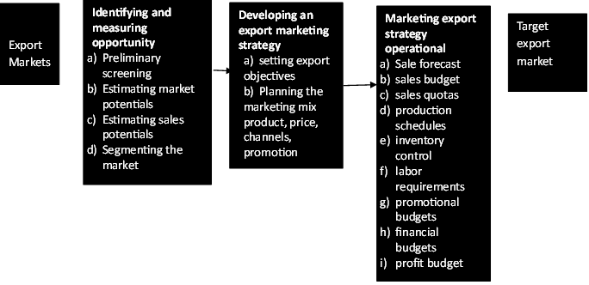
Export marketing planning process

Slide 9

Export marketing planning process
1. Identifying and measuring opportunity
Conduct marketing research
Determine the most viable segments
Sending salespeople to the markets
Research to estimate market potential
Estimate sales potential
Focus on viable segments .

Slide 10
Export marketing planning process cont.
2. Developing an export marketing strategy
Focuses on two issues in strategy development.
a) Sets export marketing objectives.
Objectives aligned with the firm’s overall marketing strategy.
Objectives could focus on market development, market growth, market concentration.
Give a specific estimate of what the firm expects to achieve within a given period.

Slide 11
Export marketing planning process cont.
2. Developing an export marketing strategy
b) Changes to be made in the marketing mix variable to suit the identifying market segment.
Product decisions
Promotion decisions
Pricing decisions
Distribution decision
Marketing mix for different segments

Slide 12
Export marketing planning process cont.
3. Marketing export strategy operational
Accurate sale forecast and accompanying sales budget.
Recruit the appropriate number of salespeople
Set sales quotas.
Work with the production department
Meet labor requirements
Set promotional budgets
Financial budgets

Slide 13

Export marketing expansion strategy
1. Set up expansion program:
Export team
Appoint team leader to guide the project.
Assigned the appropriate tasks
Allocate resources
Set goals.

Slide 14

Export marketing expansion strategy cont.
2. identify firms’ products with highest export potential:
Identify preferred products in different markets
customize products
Selections of export promotion organizations

Slide 15

Export marketing expansion strategy cont
3. Determine entry modes into selected markets:
Directly entry modes
Indirectly entry mode
Combination of the modes
Identify competitor offerings

Slide 16
Export marketing expansion strategy cont
4. Set an export organization:
Organizational structure
Compare different structures
Hire the right people and train them
Develop appropriate policies to support export business.
Secure necessary approvals
Develop communication strategies

Slide 17

Export marketing expansion strategy cont
5. Develop a distribution network:
Find appropriate middlemen
Determine criteria for selecting distributors
Determine distributors resource capabilities, agree terms, and sign distribution contracts.

Slide 18

Export marketing expansion strategy cont
6. Commence exporting:
Prepares and send first consignment of goods to foreign markets.
Export documentation process must be followed
Customs duties paid.
Inspections of goods carried out.

Slide 19

Export marketing expansion strategy cont
7. Monitoring and evaluation:
Monitor market reaction quickly
Take any corrective measures soonest.

Slide 20

Entry modes in export business
Two major categories
i) Indirect entry: occurs when the exporting manufacturer uses independent organizations located in the producer’s country.
Alternatives indirect entry modes:
a) International marketing organizations
b) Cooperative organization.
ii) Direct entry mode:

Slide 21
Indirect entry mode
a) Export merchants:
Domestic based export merchant company buys and sells on its own account.
Marketing job for the manufacturer is reduced to essentially domestic marketing.
All international marketing task are handled by this merchant
The merchant’s activities: selecting the channel ,marketing, merchandising, advertising, delivery and services.

Slide 22
Indirect entry mode cont.
b) Export commission house (ECH)
Representative of foreign buyers who resides in exporter’s home country.
Overseas customer’s hired purchasing agent in exporter’s domestic market,
Operating on the basis of orders
Buyer it is the buyer who pays commission.
Researches the market

Slide 23

Indirect entry mode cont.
c) Resident buyer
Represents all types of overseas buyers home domiciled (located’) in the exporter’s home market.
Sent to the market or are local people appointed as representatives.
Permanently employed representatives of foreign buyers

Slide 24
Indirect entry mode cont.
d) Broker
Export-import broker.
Bring a buyer and seller together.
Paid commission by the principal.
Specializes in particular products or classes of products
Export brokers act as agents of buyers or sellers.

Slide 25
Indirect entry mode cont.
e) Export Management Company
functions as an exclusive export department for several allied but not competing manufacturers
EMC conducts business in the name of each manufacturer its presents.
All correspondence with the buyers and contracts are negotiated in the name of manufacturer.

Slide 26
Indirect entry mode cont.
f)Piggyback marketing:
Cooperative organization
It occurs when one manufacturer (the carriers) uses its foreign distribution facilities to sell another company’s (the “supplier”) products alongside its own.
Used for products from unrelated companies that are non-competitive (but related) complementary

Slide 27
Indirect entry mode cont.
g) Exporting combinations:
formal association of independent and competitive business firms with membership being voluntary organized for purposes of selling to foreign markets.
i. Marketing cooperative: association of producers that engage in exporting members’ products
ii. Export cartels: two or more independent business in the same or affiliated fields of economic activity join together for the purpose of exerting control over the market.

Slide 28
Direct entry mode
a) Home based export department:
Establishment of export department or division in the home country.
Three different types of home country based export organizations:
Built-in export department
Separate or self contained export department
Export sales subsidiary

Slide 29
Direct entry mode cont.
b) Foreign sales branch:
handles all of the sales distribution and promotional work throughout a designated market area
initial link in the marketing channel within a foreign market.
offers storage and warehousing facilities

Slide 30
Direct entry mode cont.
c) Storage or warehousing facilities:
Part of a sales branch
Afford the buyer greater convenience.
Used as central distribution points to serve a wide area.

Slide 31

Indirect entry mode cont.
d) Foreign sales subsidiary:
Similar to a foreign sales branch office.
Greater autonomy enjoyed by foreign based subsidiary
Has broader responsibilities of a foreign sales office.
Purchases the products to be sold from the parent firm
All foreign orders channeled through the subsidiary

Slide 32

Indirect entry mode cont.
e) Traveling salesperson:
Resides in one country, often the home country of the employer, and travels abroad to perform the sales duties.
Does order making to order taking.
Order making requires competent and well trained salesperson

Slide 33
Obstacles to strategy development
a) Internal controllable barrier to strategy implementation
Communication with foreign unit
Lack of export training (experiences and language skills)
Lack of market information
Controlling international activities
Documentation requirements

Slide 34

Obstacles to strategy development
b) Foreign non-controllable barriers
Foreign government attitudes
Foreign public attitudes
Trade barriers (tariffs, quotas)

Slide 35
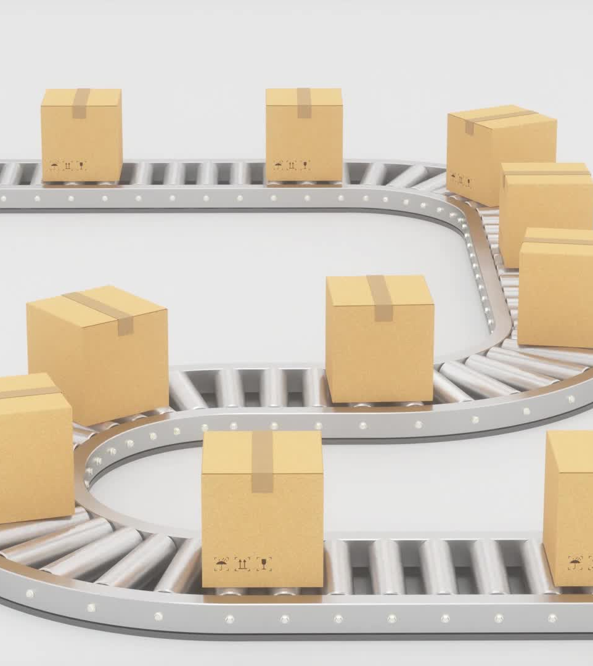
Obstacles to strategy development
c) Internal controllable barriers
Arranging transportation, packaging, etc.
Providing services
Higher than domestic risk

Slide 36

Obstacles to strategy development
d) local non controllable dimensions
Financing sales
No assistance from home government

Slide 37
References
Albaum G., Duerr E. & Josiassen A (2016), International Marketing and Export Management Pearson education limited pg 28-35, 271-406
Shoham, A. and Albaum, G. (1995). Reducing the impact of barriers to exporting: a managerial perspective.Journal of International Marketing, 3(4), 85–105.

