Slide 1

Export Marketing and Finance week 4 Lecture
Processing Export Order and Incoterms
Dr. John N. Kamau

Slide 2

Welcome note
Welcome to week four lecture
It gives me great joy to have you in this lecture
This is our fourth lecture in a series of 12 lectures on export marketing and finance
We begin exploring export procedure by examining how to process an export order.

Slide 3

Intended learning outcomes
At the end of this lecture, you will be able to:
1. Describe an export order.
2. Discuss process of securing an export order
3. Evaluate the requirement for pre-shipment.
4. Examine shipment requirement.
5. Discuss post-shipment requirements.
6. Evaluate Incoterms

Slide 4

Description of an export order
An export order implies an agreement in the form of a document, between the exporter and importer.
It is the contract between exporter and importer where the importer specifies the type of goods required and how much he is willing to pay for the same and how (Gopal, 2006).

Slide 5

Critical issues in export order processing
Cashflow
Administration
Payment
Insurance
Risk areas
Total cost.

Slide 6

Export order processing stages
1. Getting an export order
2. Pre-shipment
3. Shipment
4. Post-shipment

Slide 7

Getting an export order
Obtaining export licensing
Not all goods for export require license
Prohibited items: not allowed under any circumstances
Restricted items: exported /imported only with a license
Canalized Items: Goods which are canalized can be imported or exported through the canalizing agency.

Slide 8
Getting an export order cont.
2. Inquiry and offer
An inquiry is a request from the prospective buyer to keep him informed of the terms and conditions of sale (Gopal,2006).
Treated with promptness and meticulous
Trade reference.
Send an offer a proposal (proforma invoice)

Slide 9

Getting an export order cont.
3. Examination of terms of export
Product description: specifications, style, color, packing conditions etc.
Marking and Labelling requirements.
Price, terms of payment (FOB, CIF etc.)
Terms of shipment: choice of the carrier, mode of carriage, place of delivery,

Slide 10
Getting an export order cont.
3. Examination of terms of export cont
Inspection requirement: type of inspection, place of inspection and inspection agency.
Insurance requirements: nature of risks to be covered and insurable value.
Documents for realizing payment include nature and number of invoices, certificate of origin, certificate of inspection, insurance policy, document of title etc.
Last date for negotiation of documents with bank.
Frustration clause indicating circumstances under which both the parties would be discharged from liability.
Customs documentation and country of origin.

Slide 11
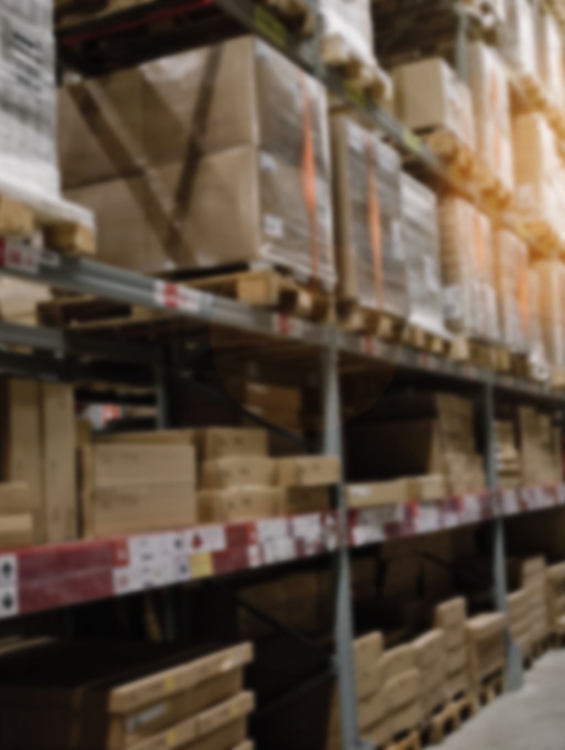
Getting an export order cont.
4. Export contract and confirmation of acceptance
May take either of the following forms
a) Proforma invoice: sent, in triplicate, to the importer who signs and sends back to the exporter
b)Purchase order: importer place a purchase order, duly signed, on the exporter, which is accepted by the exporter
c) Contract: both parties sign a contract that incorporate all the terms and conditions

Slide 12
Pre-shipment
1. Pre-shipment finance
Seek credit facilities from banks and other financial institutions
Negotiate terms of payment and interest rates.
Credit useful in procuring raw material, processing, and packing of goods for export.
Bank will obtain the necessary document to facilitate the exporter to receive payment from the importer

Slide 13
Pre-shipment
2. Production and procurement of goods
Manufactured or sought
Priority is given to goods for export
Sticking to production schedule
Planning for marking and labelling should be done in advance.

Slide 14

Pre-shipment
3. Booking of shaping space
Reserve shipping space depending on the mode of transport
Details of shipping goods from various carriers obtained.
Shipping agents booking the space.
Shipping order or shipping advice documents are used in the process.

Slide 15

Pre-shipment
4. Packing and marking
Properly packed and marked according to importers’ specific instructions
Packaging rules should be followed
Special care taken on hazardous products.
Marking should include markings of the consignee, port of shipment, port of destination, measurements, the country of origin, gross and net weight

Slide 16
Pre-shipment
5. Quality control and pre-shipment inspection
Export products meet the set quality standards
Low quality standards affects even reputation
Regulatory bodies
Inspection of goods may be conducted under, consignment-wise inspection, in-process quality control and self-certification.
Certificate of inspection is issued to facilitate shipment process.

Slide 17

Pre-shipment
6. Customs clearance
Pay any export taxes required
Familiarize himself with customs and taxes to be paid
Tax exemptions
Incentives given to exporter

Slide 18
Pre-shipment
7. Appointment of C & F agent
Exporting requires lot of documentation
Compliance of procedures.
Arrange shipment of goods,
Provide specialized services in movement of goods,
Secure customs clearance,
Procure relevant shipping documents
Give advice on the selection of shipping agent, route for shipment

Slide 19

Pre-shipment
8. Obtaining insurance cover
Take appropriate insurance cover for full risk coverage.
Cover commercial and credit risk.
Marine insurance cover sea perils.

Slide 20

Shipment
1. Documents examination at clearance house
2. Obtaining ‘carting order’ and customs physical examination
3. Loading cargo
4. Exchange control formalities

Slide 21

Shipment
Documents examination at clearance house
Obtain clearance through clearing and forwarding agent
The main document required is shipping bill.
Other documents: Commercial Invoice (one for each of the shipping bill
Packing List or Packing Note
Certificate of Origin
Export License (wherever required) etc
Physical examination of goods and assigns an official for the conduct of examination.

Slide 22
Shipment cont.
2. Obtaining ‘carting order’ and customs physical examination
Obtaining authority to move goods to the vessel (carting order)
Port trust authority issues carting order
Physical inspection report
Let export order.

Slide 23
Shipment
3. Loading cargo
Discretion to determine whether to inspect goods again
Issues “let ship order”,
Goods are loaded ready for the journey to begin.

Slide 24
Shipment
4. Exchange Control Formalities
Proceeds from export are expected to be sent to exporters country
Make a declaration to the customs authorities representing the full value of goods
Negotiate all the shipping documents
Receive payment through the authorized dealer
Compliance of exchange control formalities is made through customs.

Slide 25
post-shipment
Present documents for negotiation to the bank and
Realize any export incentives from the government.
“Negotiation of documents”. And the
Negotiable set of documents include bill of exchange, sight draft or usance draft. Full set of bill of lading or airway bill among others

Slide 26

Incoterms
International Commercial Terms (Incoterms) Created by international chamber of Commerce
Incoterms selling terms that the buyer and seller of goods both agree to during international transactions.
Accepted by governments and legal authorities around the world.
Rules of interpretation for most common commercial terms used in contracts for the sale of goods’
Incoterms states when the seller’s costs and risks are transferred onto the buyer.

Slide 27
Incoterms cont.
1. EXW – Ex-Works or Ex-Warehouse: Ex works is when the seller places the goods at the disposal of the buyer at the seller’s premises or at another named place (i.e., works, factory, warehouse, etc.).
2.FCA – Free Carrier: The seller delivers the goods to the carrier or another person nominated by the buyer at the seller’s premises or another named place.
3. FAS – Free Alongside Ship: The seller delivers when the goods are placed alongside the vessel (e.g., on a quay or a barge) nominated by the buyer at the named port of shipment.

Slide 28

Incoterms cont.
4. FOB – Free On Board: The seller delivers the goods on board the vessel nominated by the buyer at the named port of shipment or procures the goods already so delivered.
5. CFR – Cost and Freight: The seller delivers the goods on board the vessel or procures the goods already so delivered. The risk of loss of or damage to the goods passes when the products are on board the vessel.
6. CIF – Cost, Insurance and Freight: The seller delivers the goods on board the vessel or procures the goods already so delivered. The risk of loss of or damage to the goods passes when the products are on the ship. The seller must contract for and pay the costs and freight necessary to bring the goods to the named port of destination.

Slide 29

Incoterms cont.
7. CPT – Carriage Paid To: The seller delivers the goods to the carrier or another person nominated by the seller at an agreed place (if any such site is agreed between parties). The seller must contract for and pay the costs of carriage necessary to bring the goods to the named place of destination.
8. CIP – Carriage And Insurance Paid To: The seller has the same responsibilities as CPT, but they also contract for insurance cover against the buyer’s risk of loss of or damage to the goods during the carriage..
9. DAP – Delivered At Place: The seller delivers when the goods are placed at the disposal of the buyer on the arriving means of transport ready for unloading at the named place of destination.

Slide 30
Incoterms cont.
10. DPU – Delivered At Place Unloaded (replaces Incoterm® 2010 DAT) DPU replaces the former Incoterm DAT (Delivered At Terminal). The seller delivers when the goods, once unloaded, are placed at the disposal of the buyer at a named place of destination.
11. DDP – Delivered Duty Paid: The seller delivers the goods when the goods are placed at the disposal of the buyer, cleared for import on the arriving means of transport ready for unloading at the named place of destination.

Slide 31
References
1. Branch A (2006) Export practice and management, Thomson learning (2006) pg-395-445
2. Gopal C.R (2006) Import, Export Procedures, Documentation and Logistics, New international publishers pg. 163-174
3. Incoterms® 2020 Explained - The Complete Guide | IncoDocs. (2023, August 17). IncoDocs. https://incodocs.com/blog/incoterms-2020-explained-the-complete-guide

Slide 32

End
End
Thank you
See you in lecture five

