Slide 1

Export marketing and finance week 5 lecture export market documentation
Dr John N Kamau

Slide 2

Welcome!
Welcome to week five lecture!
Every time we begin a lecture am excited by your presence and choice to walk with me
In the last week lecture we started exploring export procedures by examining how export orders are processed
We continue with the process by examining documents that accompany the process

Slide 3

Intended learning outcomes
At the end of this lecture, you will be able to:
1. Describe the aligned document systems
2. Discuss principal export documents
3. Examine commercial export documents
4. Evaluate use of technology in export documentation

Slide 4
Need for export documentation
There are over 40 export documents
Ensuring your consignment arrive on time
All employees work to meet schedule
Make everything organized
Affects productivity and efficiency
Keeps a track of progress
Identifies areas of risk
Harmony

Slide 5

Aligned document system
Process of documentation is very cumbersome
Need for harmonized system
Various system exist
Aligned Document Systems (ADS)
Trade Facilitation Working Party of the UN/ECE (WP.4)
United Kingdom Board of Trade’s Simpler Export Documents (Gopal, 2006),
The Harmonized System (World Customs Organization, 2018) among other.

Slide 6

Benefits of harmonized system
Fewer documents and forms to complete.
Reduced time, money and human resources required
lower trade transaction costs.
Easier documents transmission between countries
Removal of language barriers.
Improved administrative controls –fewer errors.
Precondition for transition to automation
Golden rule “First simplify the process and documentary requirements, then automate”
Creates better image for the firm and the country

Slide 7

Dangers of poor documentation
Suffer financially in terms of higher interest costs/penalties/fines and discrepancy charges.
Must spend extra money on phone/fax/courier services.
Suffer heavily due to loss of credit cover from insurance companies.
Forced to pay heavy demurrage charges in his own country/
Affects the buyer’s ability to claim goods at the foreign ports.
Forced to airfreight goods at his own expense if the shipment is delayed
Suffer loss of goodwill with the buyer
Loss of further business.

Slide 8
Classification of documents
Classification by alignment
1. Commercial Documents
Principal export documents
Ancillary export documents
2. Regulatory Documents

Slide 9
Classification of export documents
Classification of Commercial and Regulatory Documents
Documents related to goods
Documents related to shipment
Documents related to payment
Documents related to inspection
Documents related to excisable goods
Documents related to foreign exchange regulations.

Slide 10

Principal export documents
Commercial invoice
The seller’s bill for merchandise or goods sold by him.
Contains all the particulars and details in respect of
Name and address of seller (exporter),
Name and address of buyer (importer),
Date,
Exporter’s reference number,
Importer’s reference number,
Country of origin of goods,
Signature of the exporter etc.

Slide 11
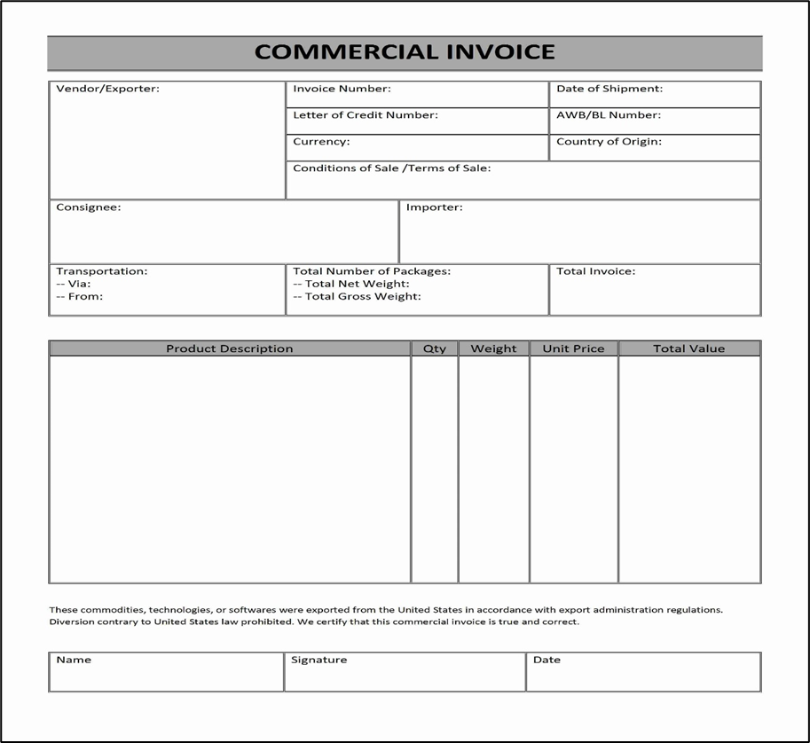
Principal export documents
Commercial invoice
Source: “Commercial Invoice Image .” What Is a Commercial Invoice in Shipping &amp; Exports, www.dripcapital.com/resources/blog/commercial-invoice-meaning-format. Accessed 28 Sept. 2023

Slide 12

Principal export documents
Commercial invoice (Significance )
It is prima facie evidence of the contract of sale and purchase of goods.
Invoice constitutes the main document for various export formalities such a pre-shipment, inspection, quality, excise and customs procedures.
It is useful for accounting purposes, both by the exporter and importer.
This document is required in collection/negotiation of documents through the bank.
For claiming incentives, this document is essential.

Slide 13

Principal export documents cont.
2. Packing list/note
Packing note refers to the particulars of contents of an individual pack
packing list is a consolidated statement of the contents of the total number of cases or packs.
A packing note contains the following details:
(a) Date of packing
(b) Number of packing note
(c) Number of case to which it relates to
(d) Contents of case in terms of quantity and weight
(e) Marking numbers

Slide 14
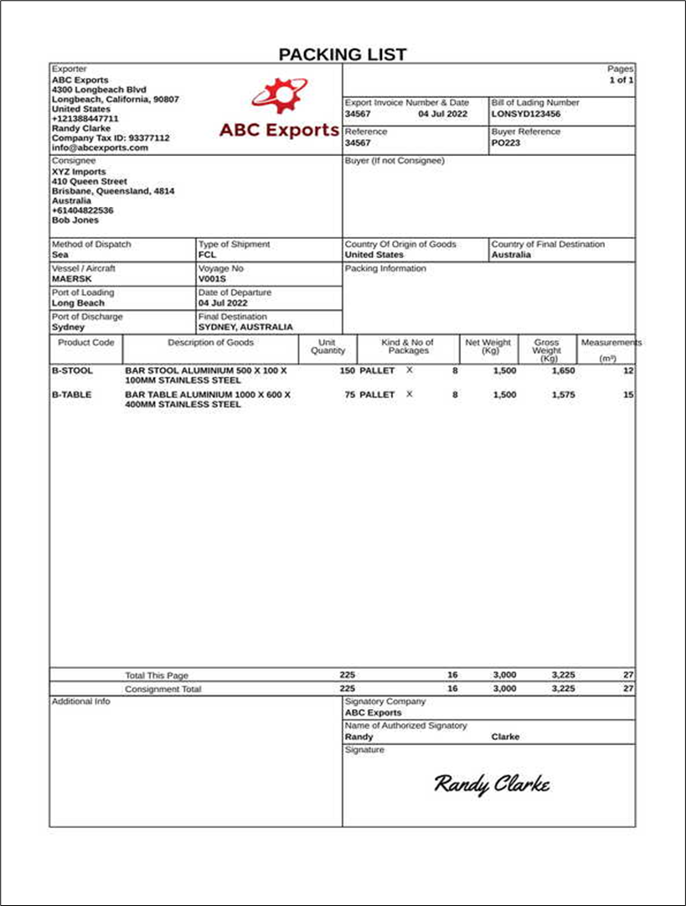
Principal export documents
2. Packing list/note
Source: IncoDocs. (2023). image of packing list Create a Packing List [Free Template] IncoDocs. https://incodocs.com/template/packing_list

Slide 15

Principal export documents
2. Packing list (significance)
Packing list concentrates on the physical and material part of consignment.
Exporter: serves as a cross-check of goods
Port personnel: planning the loading and offloading of cargo
Customs authorities: physical examination of cargo against the declarations made by the exporter in the packing list

Slide 16
Principal export documents
3. Bill of lading/Combined Transportation Documentation: a document issued by the shipping company or his agent acknowledging the receipt of cargo on board.
Purpose:
(A) As a document of title to the goods
(B) As a receipt from the shipping company
(C) As a contract of affreightment (transportation) of goods.

Slide 17
Principal export documents
3. Bill of lading/Combined Transportation Documentation
Types of bill of landing
(1) Received for Shipment B/L:
(2) On Board Shipped B/L:
(3) Clean B/L:
(4) Claused or Dirty B/L
(5)) Transshipment or Through B/L
(6) Stale B/L
(7) To Order B/L:
(8) Charter Party B/L:
(9) Freight paid B/L:
(10) Freight Collect B/L:

Slide 18
Principal export documents
3. Bill of lading/Combined Transportation Documentation
Information contained:
Name and address of the shipper
Name and address of the vessel
Name of port of loading
Date of loading of goods
Name of port of discharge and place of delivery
Number of packages.
Freight paid or payable

Slide 19
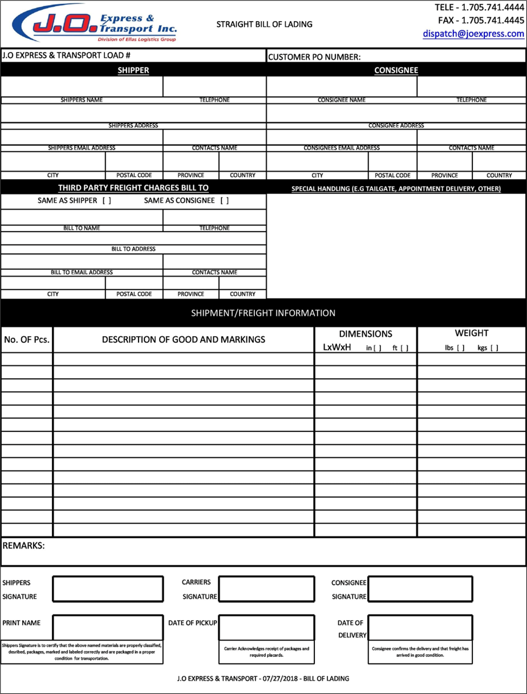
Principal export documents
3. Bill of lading/Combined Transportation Documentation
Source: Alexey. (2021, March 31). 30 Blank Bill Of Lading Templates (100% FREE) - TemplateArchive. TemplateArchive. https://templatearchive.com/bill-of-lading/

Slide 20

Principal export documents
3. Bill of landing (significance)
Importance to the Exporter
It is an acknowledgment from the shipping company that the goods have been
Received for the purpose of shipment.
Helps exporter send the shipping advice to the importer.
Can hold the shipping company for damage
To claim incentives
It is a contract of carriage between the exporter (shipper) and the shipping company.

Slide 21
Principal export documents
3. Bill of landing (significance)
Importance to the Importer
It is a document of title to the goods, which enables him to transfer the tittle by endorsement and delivery.
The exporter can send a non-negotiable copy of B/L as advance intimation of shipment to the importer.
It enables him to pay the freight amount as the B/L contains freight details.

Slide 22
Principal export documents
3. Bill of landing (significance)
Importance to the Shipping Company
1. It helps the shipping company to collect the freight amount from the exporter (CIF contract) or importer (FOB contract).
2. Shipping company can protect itself from the wrongful claims of exporter/importer by incorporating condition of goods/packaging, at the time of receipt.

Slide 23
Other principal export documents
Document | Purpose
Certification of inspection | issued by the Export Inspection Agency certifying that the consignment has been inspected and found that the requirements relating to quality control and inspection have been complied with, as applicable, and the goods are export worthy..
Certificate of origin | it is a certificate that specifies the name of the country where goods are produced, the nature, quantity, and the value of the goods.
Insurance Certificate | Issued against insurance declaration and covers all terms and conditions of cargo. The document is negotiable
Bill of Exchange. | It an instrument in writing containing an unconditional undertaking, signed by the maker, directing a certain person to pay a certain sum of money only to, or to the order of, a certain person or to the bearer of the instrument.

Slide 24

Ancillary export documents
These documents are required to prepare/procure the principal commercial documents and include
They include
1. Proforma invoice
2. Insurance declaration
3. Intimation for inspection
4. Shipping order
5. Mate’s receipt
6. Application for certificate of origin
7. Letter to bank for negotiation/collection of documents.

Slide 25
Ancillary documents
i) Proforma Invoice:
It is the starting point of an export contract
forms basis of all trade transactions and further negotiation,
It contains information on
A) name and address of the exporter
B) name and address of the intending importer,
C) nature of goods
D) mode of transportation,
E) unit price in terms of internationally accepted quotation
F) name of the country of origin of goods
G) signature of the exporter.

Slide 26
Ancillary documents cont.
ii) Mate’s Receipt:
issued by the mate (assistant to the captain of the ship) after the cargo is loaded into the ship.
Contains information on:
1. Name of the vessel
2. Date of shipment
3. Berth
4. Marks
5. Numbers, Description, and condition of goods at the time they are shipped,
6. port of loading
7. Name and address of the shipper,
8. Name and address of the importer(consignee)

Slide 27
Ancillary documents
Mate receipt cont.
two types of mate receipts: Clean Mate’s Receipt and Qualified Mate’s Receipt.
The document is significant in that:
It is an acknowledgment of goods,
Enable the exporter or his agent to secure bill of lading from the shipping company,
Forms the basis for preparing bill of landing
Port trust authorities are enabled to collect their dues as it is routed through them.

Slide 28
Other ancillary documents
Document | Purpose
Intimation for Inspection | This is the prescribed format for intimating the Export Inspection Agency (EIA) inviting them to come to inspect the shipment
Shipping Instructions | A standardized form prepared by the shipper and submitted to the airline. It provides all the relevant data which the carrier need to complete the bill of lading and specifies who is responsible for freight charges.
Insurance Declaration | The export sales contract with the buyer must clearly state who is responsible for arranging the insurance at all stage from the time the merchandise leaves the exporters premises until the buyer takes possession.
Shipping Orders | Ship’s delivery order is a written authority to deliver goods to a named party in exchange for the bill of lading, usually at the port of destination.
Letter to the Bank for Collection | It is a certificate issued by the negotiating bank to the exporter that the bill covering the shipment has been negotiated through it and export proceeds have been received from the importer..

Slide 29
Regulatory documents
These are prescribed by various government departments/bodies for compliance of formalities under relevant laws governing export transactions.
These include:
1. Exchange Control Declaration Form-GR Form
2. Freight Payment Certificate
3. Insurance Premium Payment Certificate
4. ARE I/ARE II Forms,
5. Shipping Bill/Bill of Export
6. Port Trust Copy of Shipping Bill/Export Application/Dock Challan,
7. Receipt of Payment of Port Charges
8. Vehicle Ticket

Slide 30
Regulatory documents
Shipping Bill
The shipping bill is the main document based on which the customs permission is given.
It contains information on
(A) Nature of goods exported
(B) Name of vessel, master or agents,
(C) Flag,
(D) Country of destination, the port at which the goods are to be discharged,
(E) Exporter’s address
(F) Importer’s address
(G) Details of the packages, such as numbers and marks,
(H) Quantity details of each case, total number of cases and aggregate weight,
(I) F.O.B. prices

Slide 31
Regulatory docs
Shipping bill cont.
This document is significant to an exporter:
Customs authorities refer to it for clearance of goods
Enables exporter to load goods on the ship
Facilitates the exporter to claim incentives such as excise duty refund and duty drawback.
Different types of shipping bill include,
Free shipping bill,
Dutiable shipping bill,
Drawback shipping bill,
Shipping bill for shipment ex-bond
Coastal shipping bill.

Slide 32
Other regulatory documents
Export Application/Dock Challan: | Dock receipt is issued by a Port Authority to confirm receipt of cargo on the quay or warehouse pending shipment. When all the formalities of the customs are completed, the importer pays the dock charges.
Receipt for Payment of Port Charges | After payment of dock charges, the importer is given back one copy of the application as a receipt. This receipt is is known as 'port trust dues receipt'
Exchange Control Declaration Forms | An export declaration is a form that is submitted by an exporter at the port of export. It provides information about the goods being shipped, including type, number, and value. This information is used by customs to control exports, in addition to compiling statistical information about a country's foreign trade.
Freight Payment Certificate | This certificate is an evidence of freight payment. It certifies that. due freight has been paid by the exporter. It is an equivalent of freight receipt.
Insurance Premium Payment Certificate | This document certifies the payment of insurance. premium.

Slide 33
Paperless trading in export marketing
Paperless trade refers to the digitization of these information flows, including making available and enabling the exchange of trade-related data and documents electronically (world Economic forum, 2017).
This has a possibility of transforming the entire industry and easing doing of business across national borders.
It may take form of data-trader interface (DTI) or electronic data interchange (EDI).

Slide 34
Benefits of paperless trading to business
Paperless trade systems streamline the flow of information in global supply chains
Generate savings for traders through faster movement of goods
Greater efficiency at border agencies where the exchange involves trade administration documents.
Particularly helpful for small and medium-sized enterprises (smes) using e-commerce platforms to access international markets
Driven major innovations in international supply chains, such as “just-in-time” delivery.
Paperless trade systems have facilitated the emergence of “third-party logistics” (3pl) players that offer elements of distribution and fulfilment for clients.

Slide 35
Benefits of paperless trading to government
Paperless trade can improve transparency and traceability.
Paperless trade can help to tackle illegal and counterfeit trade.
Help governments to address growing security concerns and the need to ensure there are no potential threats hidden in commercial packages.
Paperless trade can also play a key role in cross-border regulatory cooperation.

Slide 36
Challenges of paperless trading
The set-up and operation of paperless trade measures, supporting regulation and electronic single windows, is not yet a given across all countries.
Reliant on domestic rules on the legal validity of electronic documents, electronic signatures, where these are applied, and other data-regulation requirements.
Governments must accept data at customs and within regulatory agencies without also requiring original paper documentation.
Capacity building may be needed to boost paperless trade use.
High costs for implementing ict solution, automating and moving to paperless

Slide 37
References
Alexey. (2021, March 31). 30 Blank Bill Of Lading Templates (100% FREE) - TemplateArchive. TemplateArchive. https://templatearchive.com/bill-of-lading
Branch A (2006) Export practice and management, Thomson learning (2006) pg-395-445
Commercial Invoice Image .” What Is a Commercial Invoice in Shipping &amp; Exports, www.dripcapital.com/resources/blog/commercial-invoice-meaning-format. Accessed 28 Sept. 2023.
Gopal C.R (2006) Import, Export Procedures, Documentation and Logistics, New international publishers pg. 11-31
IncoDocs. (2023). image of packing list Create a Packing List [Free Template] - IncoDocs. https://incodocs.com/template/packing_list
Kumar A & Singh R. (2013) International Trade Procedures And Documentation Excel Books Private Limited India
Misovicova M. (2007) The Role of Aligned Trade Documents in Trade Facilitation, UNECE/UNESCAP Workshop on United Nations electronic Documents for Single Window Facilities in Asia and the Pacific
World Customs Organization. (2018.). The harmonized system retirved from http://www.wcoomd.org/ 2023
World Economic Forum (2017) Paperless Trading: How Does It Impact the Trade System? UNECE.

Slide 38
End
End
Thank you
Let's meet in week six

