Slide 1

EXPORT MARKETING AND FINANCE
WEEK SIX
PACKAGING SHIPPING AND INSURANCE
Dr John N Kamau

Slide 2

Welcome!
Welcome to week six lecture!
Am so excited to have you again in this class
We have now covered the half of the course and congratulations are in order!
In the last two weeks we have been exploring export procedures by going through the process of processing an export order as well as examining necessary documents
This week we continue by examining packaging of cargo, shipping and insurance

Slide 3

Intended learning outcome
At the end of this lecture, you will be able to:
Describe packaging procedures
Examine various shipping procedures
Discuss cargo insurance.

Slide 4

Packaging -introduction
Packaging entails all activities related to determining the kind of packaging materials and ensuring that they would help in transporting goods to other countries.
Packaging is the enclosing of a physical object, typically a product that will be offered for sale. It is the process of preparing items of equipment for transportation and storage and which embraces preservation, identification and packaging of products (Dileep, 2006) .

Slide 5

Functions of package
A package serves several basic functions-:
It contains, protects and dispenses a product
Provides points of purchase advertising
Serves as an attention getting device
Provides a reminder to current users
Source of information about direction, ingredient and potential cautions
Provides a vehicle for announcing promotions and deals
Promises physical and emotional end benefits
Encourages purchase etc.

Slide 6

Standard package
A standard package should be:
Simple
Quickly communicates what the product is
Makes use of focal points (exploits key benefits of a product)
Stands out from competition
Makes selection within product line easy
Carry the right quality impression
Reflects the image of the product.

Slide 7
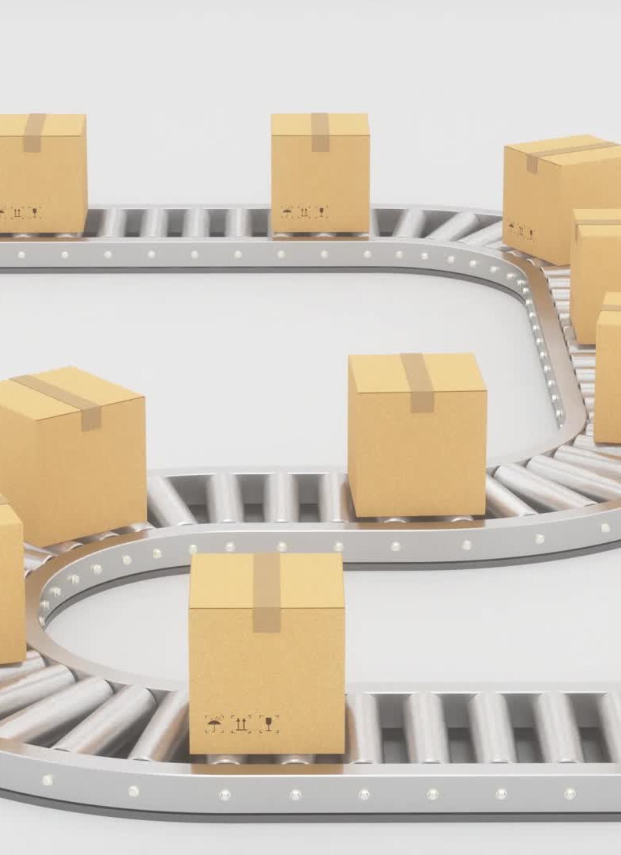
Areas of Packaging Improvement
Improved standards to reduce the risk of damage and pilferage.
Better utilization of transport capacity to lower distribution cost
Improved cargo handling
Engaging specialists packaging company for competitive packaging costs
Innovative cost-effective distribution solutions

Slide 8

Factors Influencing Type of Packaging
Value of the goods
Nature of the transit
Nature of the cargo
Compliance with customs or statutory requirements
Resale value

Slide 9

Factors Influencing Type of Packaging cont.
General fragility of cargo
The international consignment delivery terms of sale
Variation in temperature during transit
Ease of handling and stowage
Insurance acceptance conditions

Slide 10

Factors Influencing Type of Packaging cont.
The size of the cargo and its weight
Marketing considerations
Facilities at the terminal
Type and size of container
Marking of cargo packaging
Cost of packaging

Slide 11

Types of Packaging
Baling most suitable for paper, wool, hay, peat, cotton, carpets and rope.
Bags made of jute, cotton, plastic or paper: suitable for cement, fertilizer, flour, animal feed products,
Barrels, hogsheads and drums are used for the conveyance of liquid or greasy cargos
Boxes, cases, metal-lined cases are expensive packaging but with some resale value and are used extensively in break-bulk and LCL cargos.

Slide 12
Types of Packaging
Carboys or glass containers for carriages of acid and other dangerous liquids
Cartoons for consumer goods.
Crates or skeleton case Light weight goods of large cubic capacity machinery, domestic appliances
Aluminum transport and storage container are used globally due to their lightweight and are easily stacked and inter-stacked.

Slide 13
New Packaging Techniques
The bulk liquid bag or container =store various kinds of liquid
Shrink –wrapping popular with air freight consignments
Flat wrapping allows wooden components units to be laid on top of one another to be assembled at the destination.
European Packaging Waste Legislation (green packaging) -innovative and cost-effective solutions

Slide 14
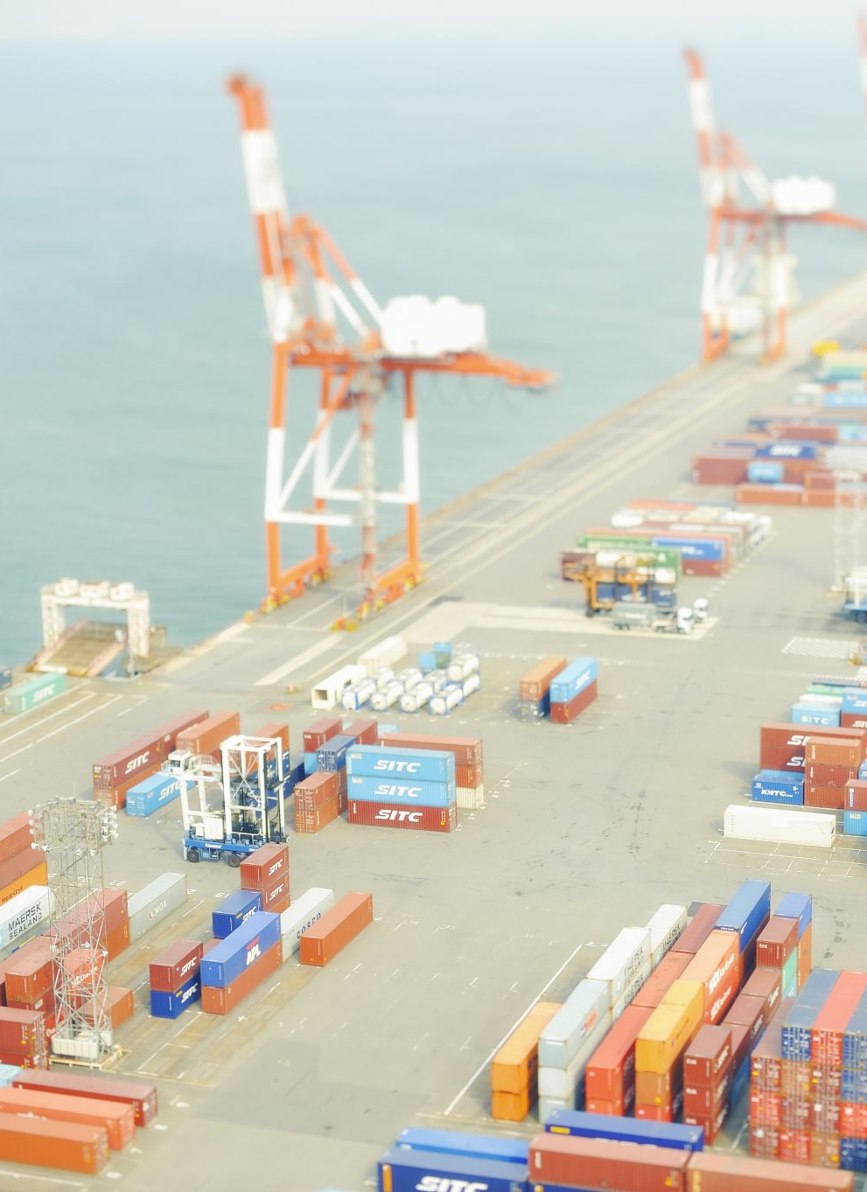
Dangerous Cargo.
Classified and declared by the shipper to the Master.
Packaged in a manner to withstand the ordinary risk of handling and transport by sea, having regard to their properties.
Marked with proper shipping name and indication of the danger.
Properly stowed and effectively segregated from others which may dangerously interact.
Listed in manifest or stowage plan giving stowage details.

Slide 15
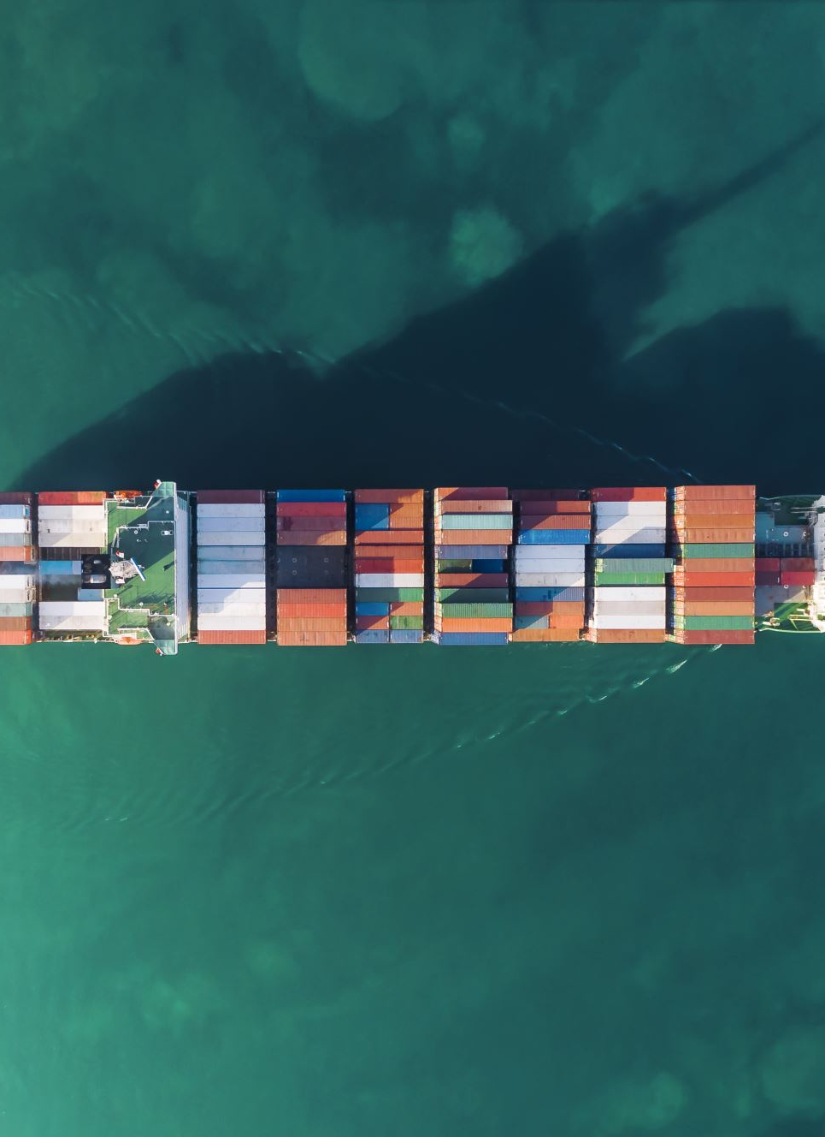
Shipping
“shipping” refers to any mode of transport that moves goods between two geographical points.
It is the process of moving goods from one country to another
Several modes of transportation may be used
Clearing and forwarding agents are critical in this role

Slide 16
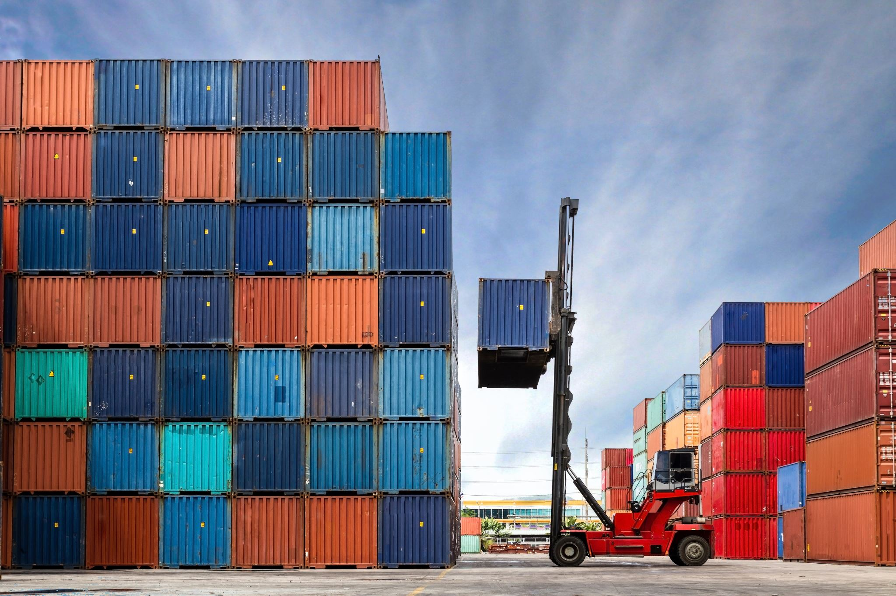
Roles of clearing and forwarding agents
Warehousing before Transportation
Local Transportation
Container Arrangement
Reservation of Shipping Space
Selection of mode of transport

Slide 17
Roles of clearing and forwarding agents
Packing, Marking and labelling
Completing Customs and Port formalities
Cargo Insurance
Advising Exporters on Trade Laws
Educating Exporters
Coordination with other Agencies
Procuring Documents

Slide 18
Other roles of C & F agents
Warehousing facilities abroad
Bringing back Goods
Locating Stranded Goods
Assessment of Damage

Slide 19
Nature of export cargo
Rush Cargo: required to reach destination very first. Usually transported through air
Bulk Cargo: be carried and stored in large quantities.
General cargo: General Cargo comprises manufactured, semi-manufactured, processed, semi-processed goods and materials

Slide 20

Modes of transport
Sea transport
Air transport
Multimodal transport
Road transport

Slide 21
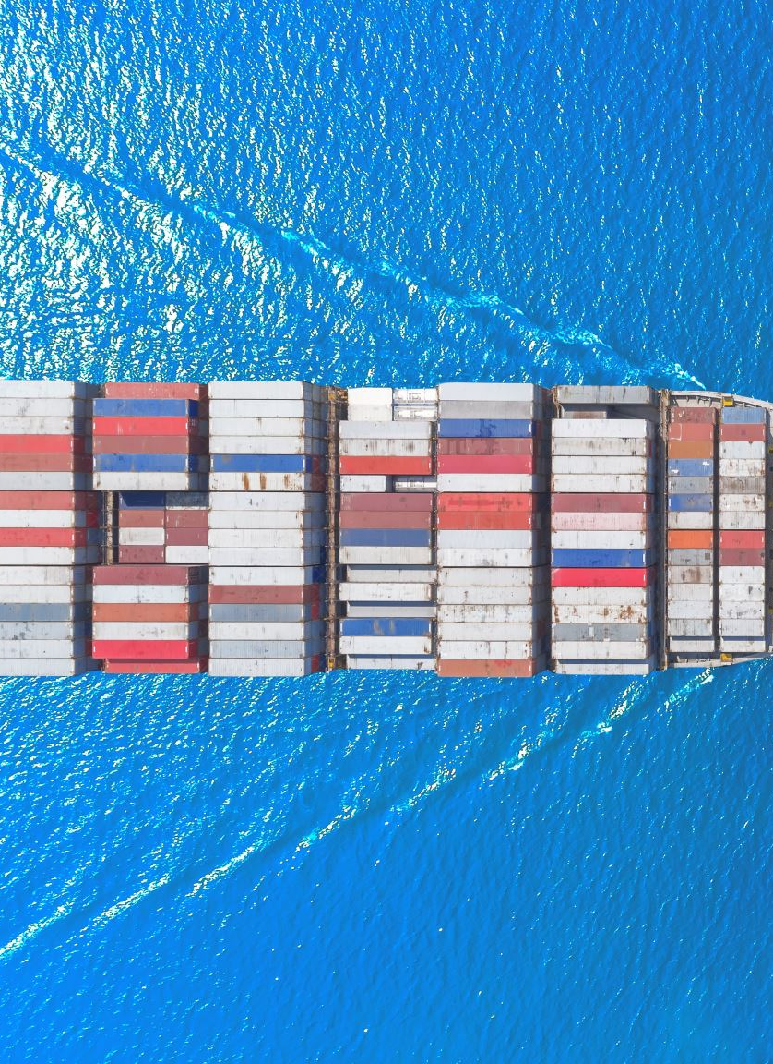
Sea transportation
Sea transport involves carriage of goods by the ship from the point of shipment to the port of discharge
The contract of carriage of cargo by sea refers to the contract between the shipper and shipping company (carrier) for transportation of goods against payment of remuneration, known as freight, to the carrier.
The shipper may be exporter or consignor.
Consignor becomes the shipper when he is acting on behalf of the exporter.

Slide 22
Forms of shipping
There are generally three forms of shipping
Liner shipping
Tramp shipping
Conference of shipping

Slide 23
Liner shipping
Characteristics of liner shipping
Regularity
Fixed Tariff
Designed to Carry Variety of Cargo
Sophisticated Equipment

Slide 24
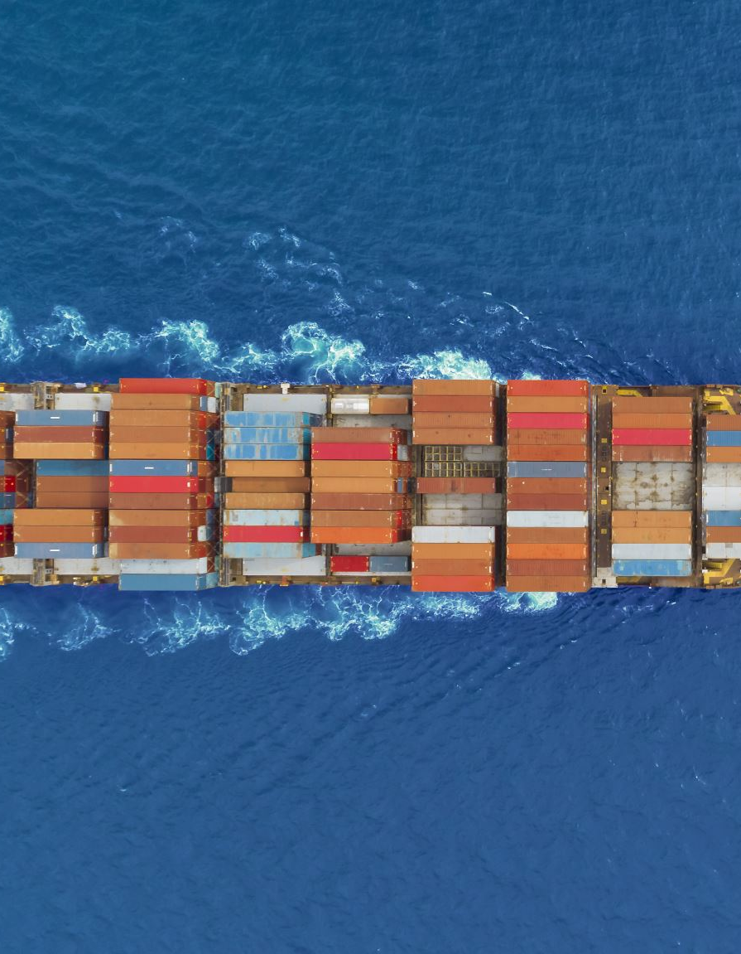
Tramp Shipping
Characteristics
Homogeneous transportation
No fixed route and tariff
Less expensive and less operating costs
Terms and conditions negotiable
Charter market and chartering

Slide 25

Chartering Practices
When a tramp carrier is engaged, it is said to be under charter.
The charterer (person who engages or hires the tramp) can hire the tramp either whole or bulk of the space.
The agreement between the ship owner and charterer for hiring the ship is called charter party.

Slide 26
Forms of chartering
A tramp may be chartered in one of the most important forms:
(a) Voyage Charter
(b) Time Charter
(c) Bare Boat Charter or Charter by Demise:

Slide 27
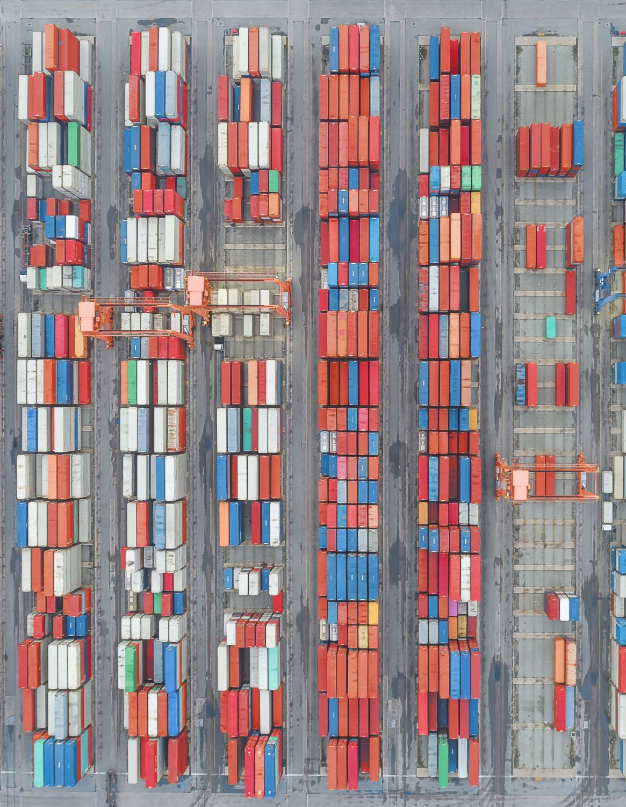
Forms of shipping
3. Conference Shipping
A conference is an association of two or more liner shipping companies.
The characteristics of conference shipping are:
(i) Restrict/Eliminate Competition:
(ii) Particular trade or geographical area

Slide 28
Cargo insurance
Cargo insurance is an insurance cover for marine goods, air cargo and post parcels.
The purpose of cargo insurance is to protect goods against physical loss or damage, during transit.
Cargo insurance is a contract of indemnity whereby the insurance company (Insurer) undertakes to indemnify the owner (Insured) of a ship or goods, against risks that are incidental to Marine insurance
Insured: one who procures the policy or becomes the beneficiary through the insurance contract.
Insurer: underwriter who assumes the liability as and when loss occurs.

Slide 29

Principles of insurance
Principle of Utmost Good Faith: The insured must disclose all the facts known to him or ought to be known to him, in the ordinary course of business.
Principle of Insurable Interest: Any person who has ‘insurable interest’ in the cargo only can insure
Principle of Indemnity: The underwriter indemnifies the loss arising from the risks covered under a policy.
Causa Proxima: The insurer indemnifies if the loss arises only from the nearest cause.

Slide 30

Types of Insurance Documents
Insurance Policy: The insurance policy sets out all the terms and conditions of the contract between the insurer and insured.
Certificate of Insurance: It is an evidence of insurance but does not set out the terms and conditions of insurance.
Insurance Broker’s Note: It indicates insurance has been made pending issuance of policy or certificate.

Slide 31
Scope of cargo insurance policy
1. Maritime Perils: These are the events which are created by God or man made.
2. Extraneous Perils: perils are caused due to faults in loading, carrying and unloading.
3. War Perils: These perils relate to losses due to war including civil war, revolution, rebellion and detainment of the ship
4. Strike Perils: damage or loss due to lockouts, strikes, labour disturbances, and riots.

Slide 32
Risks not covered by marine insurance
1. Under Normal Conditions Damage to fragility,
2. Insurance Contract Specifically Excluded
3. Delayed Arrival:
4. Ordinary and Unavoidable Trade Losses:
5. Violence
6. Dangerous Drugs Clause

Slide 33

Effecting Cargo Insurance
Party responsible for arranging insurance as per contract agreement
Insurance, cover for the goods should embrace the following:
Transportation of merchandise to the seaport or airport of departure.
Period during which the goods are stored awaiting shipment or loading.
The time while on board the ship, aircraft or other conveyance such as the international road haulage operation.
The ’offloading’ and storage on arrival at destination airport, seaport or other specified place.
Transport to the buyer’s premises or address.

Slide 34
Cargo Insurance Claims
Procedure for making claims
Documents required
The export invoice
The original bill of lading, charterparty, air waybill consignment note.
The original policy or certificate of insurance.
The survey report or other documentary evidence

Slide 35
Cargo Insurance Claims cont.
Extended protest or extract from ship logs for salvage loss, particular average in good, or total loss or average on goods.
Letters of subrogation for total loss of goods for maritime consignments
Any exchange of correspondence with carriers and other parties regarding their liability for the loss or damage.
Any landing account or weight notes at destination.
Account sale(salvage) or invoice for reconditioning charges.

Slide 36

References
Branch A. (2006) Export Practice and Management, Thomson Learning pg-182-224, 255-276
Dileep K M.(2006) Role of Packaging in Marketing Product and Organization, ResearchGate pg 1
Gopal R.C (2006) Export Import Procedures New Age International Publishers Ltd pg 83-92, 175-184

Slide 37

End
Thank you
Let's meet in week 7 lecture
Blessings

