Slide 1

Export Marketing And Finance
Week 9 Lecture
Trading Blocks And Exports
Dr. John Kamau

Slide 2

Welcome!
Welcome to week 9 lecture!
It is my joy and privilege to take you through lecture nine
We have now covered most of export procedure
We have examined order processing , documentation, financing among others
We now examine one of key macro-environmental factors influencing export business-trade blocs

Slide 3

Intended Learning Outcomes
At the end of this lecture, you will be able to:
Describe a trading bloc and its purpose.
Examine formation of trading blocs
Evaluate objectives and advantages of trading bloc.
Examine impact of trade bloc on export business
Discuss examples of trading bloc

Slide 4

Understanding trading blocs
A trading bloc is a preferential economic arrangement between a group of countries which might take a variety of textbook forms (Brand, 1992).
Regionalism, which is also associated with trading blocs, refers to the appearance and consolidation of various arrangements among groups of geographically proximate countries(Heywood, 2003).
(Maity, n.d) defines a regional trading bloc as a group of countries within a geographical region that protect themselves from imports from non-members.
Regional trade blocs are associations of nations at a governmental level to promote trade within the bloc and defend its members against global competition.

Slide 5

Definition of trade blocs cont.
a) Trading blocs: Regional trade agreements, regional integration agreements.
b) Formed by groups of countries that are close to each other geographically.
c) Formed to promote trade and economic cooperation within the region.
d) They are formed with a both economic and political agenda.

Slide 6

Types of trading blocs
a) Preferential Trade Area − Preferential Trade Areas (PTAs),
the first step towards making a full-fledged RTB,
occurs when countries of a particular geographical region agree to decrease or eliminate tariffs on selected goods and services imported from other members of the area.
Examples of such include Generalized System of Preferences – Armenia, African Growth and Opportunity Act and Caribbean Basin Economic Recovery Act.

Slide 7
Types of trading blocs
a) Preferential Trade Area − characterized by
This is the lowest level of integration.
PTAs aims to facilitate trade between countries,
Its usually unilateral
Offers benefits related to price reduction on customs
Non price related benefits such as reduction in formalities.

Slide 8
Types of trading blocs
b) Free Trade Area − Free Trade Areas (FTAs) are like PTAs but in FTAs, the participating countries agree to remove or reduce barriers to trade on all goods coming from the participating members.
Movement towards zero or near-zero tariff levels amongst them on substantially all trade
Examples of EFTA (European Free Trade Association), NAFTA (North American Free Trade Agreement) and New Zealand-China Free Trade Agreement

Slide 9

Types of trading blocs
b) Free Trade Area − Free Trade Areas (FTAs) characterized by.
Intellectual property protection
Product standards set
Selling to governments and
Fair treatment for investors among other agreements.

Slide 10

Types of trading blocs
c) Customs Union −
No tariff barriers between members
Agree to a common (unified) external tariff against non-members.
The members are allowed to negotiate as a single bloc with third parties, including other trading blocs, or with the WTO.
Examples of custom unions include: Andean Community (Can), Caribbean Community (Caricom), Central American Common Market (CACM), East African Community (EAC)

Slide 11

Types of trading blocs
d) Common Market −
A ‘common market’ is an exclusive economic integration.
The member countries trade freely all types of economic resources – not just tangible goods.
All barriers to trade in goods, services, capital, and labor are removed in common markets.
In addition to tariffs, non-tariff barriers are also diminished or removed in common markets.
Examples include the European Union, COMESA, and The Southern Common Market (MERCOSUR).

Slide 12
Motivation for formation of trading blocs
The motivation varies from region to region, and even from country to country.
a) Economic benefits:
Achieved by developing a more efficient production structure (including by exploiting economies of scale through spreading fixed costs over larger regional markets)
Enhanced economic growth from foreign direct investment
Learning by doing
Research and development.

Slide 13
Motivation for formation of trading blocs
b) Non-economic benefits:
Members may value noneconomic objectives, such as:
Strengthening political ties
Managing migration flows.
c) Safe heavens:
Smaller countries may seek increased security of market access by forming trading blocs with larger countries.

Slide 14

Motivation for formation of trading blocs
d) Locking in unilateral domestic policy reforms.
Improve their bargaining power in multilateral trade negotiations or
Express frustration with the slow pace of these negotiations (as happened during the Uruguay round).
e) Regional infant industries:
Promote industries that are not viable without a protected regional market.
Become internationally competitive if given sufficient time to develop.

Slide 15

Motivation for formation of trading blocs
f) Domino effect: As countries form new RTAs, or deepen existing ones,
Trade is diverted from third countries. This may
Tip the political balance in third countries in favor of joining the RTA,
Excluded countries suffer additional trade diversion
Incentives to join outweigh interests of import-competing firms—the domino effect.

Slide 16
9.6 Objectives of trading blocs
Reduction of trade barriers among the member countries
Maintaining better relations
Imposing barriers on nonmember countries
Promoting free transfer of labor, capital, and other factors of production
Creating currency and central bank

Slide 17

9.6 Objectives of trading blocs
Collective bargaining
Assisting member countries
Enhancing welfare of consumers
Generating competition
Prompting higher employment

Slide 18
9.6 Objectives of trading blocs
Other aims of trading bloc include (World Bank, 2000):
Encourage rias to achieve trade creation and avoid trade diversion,
Minimize harm to excluded countries
Permit deep integration, including nation building, between members.
Preserve the effects of previous liberalization
Provide credibility for any liberalization that forms part of the RIA.
Support a liberalizing dynamic within member countries and in the world trading system.

Slide 19
Advantages of a trading bloc
A) Foreign direct investment
Foreign direct investment (fdi) surges in trbs and it benefits the economies of participating nations.
B) Economies of scale
The larger markets created results in lower costs due to mass manufacturing of products locally.
C) Competition
Trade blocs bring manufacturers from various economies, resulting in greater competition. The
Competition promotes efficiency within firms.

Slide 20
Advantages of a trading bloc
d) Trade Effects
As tariffs are removed, the cost of imports goes down.
Demand changes and consumers become the king.
e) Market Efficiency
The increased consumption, the changes in demand, and a greater amount of products result in an efficient market.

Slide 21
Disadvantages of trading bloc
a) Regionalism
Bias in favor of their member countries.
Protect intra-regional trade from outside forces.
Regional trade bloc countries participate in regionalism.
b) Loss of Sovereignty −
A trading bloc, particularly when it becomes a political union, leads to partial loss of sovereignty of the member nations.

Slide 22
Disadvantages of trading bloc
c) Concessions −
The RTB countries want to let non-member firms gain domestic market access only after levying taxes.
Countries that join a trading bloc need to make some concessions.
d) Interdependence −
The countries of a bloc become interdependent on each other.
A natural disaster, conflict, or revolution in one country may have an adverse effect on the economies of all participants.

Slide 23

Principles for designing regional trade agreements.
a) WTO compatibility
b) Low Most Favored Nations tariffs
c) Liberal accession clauses.
d) Liberal rules of origin.
e) Deep integration.
f) Limiting antidumping actions.

Slide 24

Characteristics and growth of trade blocs
There are three common characteristics of trading blocs (Brand, 1992).
First, they are born of political fear. Fear of domination and threat of being colonized trade wise by other countries.
Second, blocs espouse trade liberalization internally, but achieve trade protection externally.
Third, Agriculture is treated in one of two ways. It is institutionalized as the central policy of the bloc or it is neglected purposefully

Slide 25
Characteristics and growth of trade blocs
Foxley (2010) notes the following about growth of trade blocs.
Regional trade agreements reach their full potential when the political and ideological differences among participating countries are minimal.
Trade deals work best when member states coordinate monetary and fiscal policies.
Bottom-up approaches, in which companies develop supply chains across borders, are more effective in facilitating regional integration than are top-down approaches imposed by governments.

Slide 26
Characteristics and growth of trade blocs
Foxley (2010) notes the following about growth of trade blocs.
Agreements on trade and investment norms—including reducing transportation costs through coordinated efforts to improve the quality of infrastructure can significantly improve trade.
Countries must achieve better balance between fiscal stimulus and financial solvency to reinvigorate regional trade agreements.
Ambitious goals for trade deals are easier to achieve when negotiations proceed among countries that embrace the benefits of globalization.

Slide 27
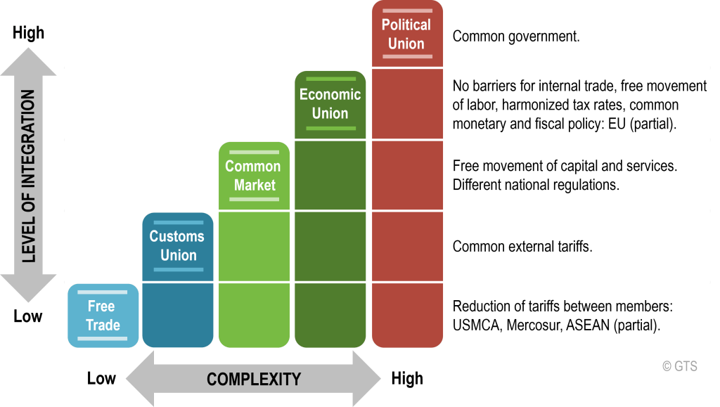
Development stages of trade block
Source: The Geography of Transport Systems FIFTH EDITION Jean-Paul Rodrigue (2020), New York: Routledge, 456 pages. ISBN 978-0-367-36463-2 doi.org/10.4324/9780429346323
No attribution required

Slide 28
Governing principles of a trading bloc
We take the example of South Asian Association for Regional Cooperation (SAARC) as demonstrated by Maity (n.d).
Respect for sovereignty, territorial integrity, political equality and independence of all members' state.
Non-interference of internal matters is one of its objectives.
Cooperation for mutual benefits.
All decisions to be taken unanimously and need a quorum of all the eight members.
All bilateral issues to be kept aside and only multilateral issues to be discussed without being prejudiced by bilateral issues.

Slide 29

Barriers to development of trade blocs
Geographical and political fragmentation,
Varying levels of development between member states
Political and economic variety,
Diversity of strategic views among member states
Irregular sharing of gains among the member states

Slide 30
Barriers to development of trade blocs
Unwillingness of member states to surrender their independence to supra-national organization.
Poor transport and communication system
Macro-economic challenges such as unfair trading systems, debts
Protective importation that hinders trade
Weak institutions to implement trade agreements.
Lack of inclusion of all players in developing of trade agreements especially the businesspeople

Slide 31
References
Brand, J L (1992). "The New World Order of Regional Trading Blocs." American University International Law Review 8, no. 1: 155-181.
Constantia A. & Nicolette S. (2006). The Role of Regional Trading Blocs in the Development and Management of Tourism: an Analysis of the European Union and the Association of Southeast Asian Nations, International Journal of Tourism Research Int. J. Tourism Res. 8, 317–332 (2006 Wiley Inter-Science (www.interscience.wiley.com) DOI: 10.1002/jtr.579
Foxley A. (2010) Regional Trade Blocs the Way to the Future? Carnegie Endowment for International Peace.
Heywood A. (2003). Politics. Palgrave: Basingstoke, England.
Maity S. K (n.d) Regional blocs in international trade: SAARC, OPEC, EU
Shiel C. (1995) Regional Trade Blocs: Trade Creating or Diverting? International Monetary Fund pg 30-32
The World Bank (2000). Trade blocs, Oxford University Press USA pg 106
Wanjugu T.B (2019), The effect of East African Community trade block on economic growth in Kenya, unpublished university of Nairobi master thesis

Slide 32

End
End
Thank you
We will meet in week 10 lecture

