Slide 1
COURSE: REWARD MANAGEMENT
LECTURE 3: RECOGNITION SCHEMES
LECTURER: DR LUCY KARIMI KIRIMA
Lecture learning outcomes:
At the end of the lecture, you will be able to:
Understand what recognition schemes are
Discuss various types of recognition schemes
Examine the principles of recognition

Slide 2
RECOGNITION SCHEMES
Recognition schemes enable appreciation to be shown to individuals for their achievements either informally on a day-to day basis or through formal recognition arrangements. They can take place quietly between managers and individuals in their teams or be visible celebrations of success

Slide 3

RECOGNITION SCHEMES
Recognition schemes acknowledge success
ttps://www.pexels.com/photo/a-billboard-award-trophy-7005694/

Slide 4
RECOGNITION SCHEMES
A recognition scheme can be formal and organization-wide, providing scope to recognize achievements by gifts or treats or by public applause
They complement direct financial rewards and can therefore enhance the reward system
Recognition schemes are based on the belief that taking steps to ensure that people’s achievements and contribution are recognized is an effective way of motivating them.

Slide 5
Benefits of recognition schemes
Complement and reinforce financial rewards as part of a total reward process
Increase engagement by demonstrating that the organization values its employees

Slide 6

RECOGNITION SCHEMES
Enable people’s achievements and contributions to be publicly acknowledged and provide an effective way of motivating them
https://www.pexels.com/photo/people-clapping-for-an-award-winning-actor-7005756/

Slide 7
Benefits of recognition schemes
Provide rewards for the average performers who are the core contributors in a business and may not benefit much if at all from performance pay
Provide ways of rewarding teams as well as individual effort and contribution

Slide 8

RECOGNITION SCHEMES
Gives line managers the means to provide their people with instant rewards for achievement or contribution
https://www.pexels.com/photo/men-in-office-doing-secret-santa-6285175/

Slide 9
Principles of recognition
should be given for valued behaviours and exceptional effort as well as for special achievements;
is about valuing people; it should be personalized so that people appreciate that it applies to them

Slide 10
Principles of recognition
needs to be applied equitably, fairly and consistently throughout the organization
should take place frequently
should be personal and face to face but can be supported by a handwritten thankyou note

Slide 11

Principles of recognition
should be provided in a way that makes everyone feel they have the opportunity to be recognized
https://www.pexels.com/photo/a-woman-giving-a-gift-to-a-man-6518869/

Slide 12
Principles of recognition
can be provided simply through being nominated for an award
must be genuine, not used as a mechanistic motivating device

Slide 13
Principles of recognition
should not be given formally as part of a scheme if the achievement has been rewarded under another arrangement, for example a bonus scheme
needs to be given as soon as possible after the achievement

Slide 14

Principles of recognition
should be available for teams as well as individuals to reward collective effort and avoid creating isolated winners
https://www.pexels.com/photo/photo-of-people-doing-handshakes-3183197/

Slide 15
Principles of recognition
should be available to all – there should be no limits on the numbers who can be recognized
Should not be predicated on the belief that they are just about rewarding winners

Slide 16

Principles of recognition
Recognition can indeed be reinforced by awards, but simply saying ‘thank you’, privately and publicly (applause), can be very effective
https://www.pexels.com/photo/a-group-of-people-celebrating-together-at-work-7550294/

Slide 17
Principles of recognition
should not be based on an over-elaborate scheme that the organization cannot manage

Slide 18

Types of recognition
Day-to-day recognition
The most effective form of recognition is that provided by managers to their staff on a day-today basis
https://www.pexels.com/photo/a-man-opening-a-gift-in-an-office-14524108/

Slide 19

Public recognition
Recognition for particular achievements or continuing effective contributions can be provided by public ‘applause’ through an ‘employee of the month scheme’ or some other announcement using an intranet, the house journal or notice boards.
https://www.pexels.com/photo/intelligent-businesswoman-explaining-documents-in-office-3757369/

Slide 20

Formal recognition
Formal recognition schemes provide individuals with tangible forms of recognition such as gifts, vouchers, holidays or trips
https://www.pexels.com/photo/man-in-black-long-sleeve-shirt-holding-red-plastic-cup-7580985

Slide 21
Designing a recognition scheme
when designing and implementing a recognition scheme. Line managers and employees should be consulted, guidelines prepared and explained to managers, and the details of the scheme publicized
The implementation of the scheme should be monitored and steps taken to maintain the impetus

Slide 22

Key points
Whatever scheme you choose, make sure you can apply it fairly and consistently
https://www.pexels.com/photo/crop-colleagues-shaking-hands-in-office-5673488/

Slide 23

Key points
For recognition to have any real value it must be genuine. Ensure that it is real, spontaneous and appropriate to what someone has done.
https://www.pexels.com/photo/a-smiling-woman-holding-a-trophy-7005564/

Slide 24
Key points
Involve everyone in recognition; empower the whole management team to recognize people formally, and encourage all colleagues to recognize each other.
https://www.pexels.com/photo/people-clapping-for-an-award-winning-actor-7005756/

Slide 25

Key points
Recognizing great behaviour as soon as it happens is the most powerful approach. Shout about great achievements and great behaviours
https://www.pexels.com/photo/athletes-wearing-medals-7005491/

Slide 26
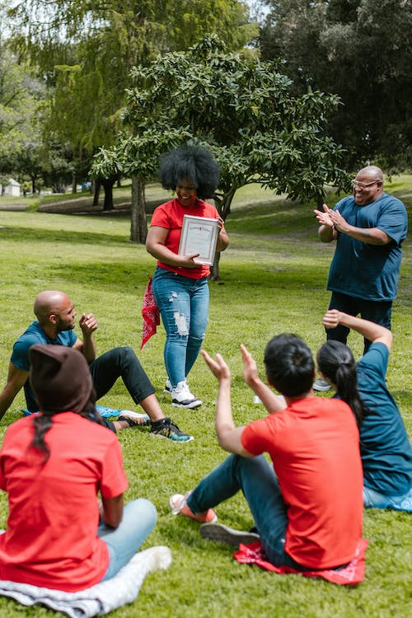
Key points
Public recognition can let others in the business know what has been done, and make a colleague feel proud
https://www.pexels.com/photo/woman-holding-an-award-7551451/

Slide 27
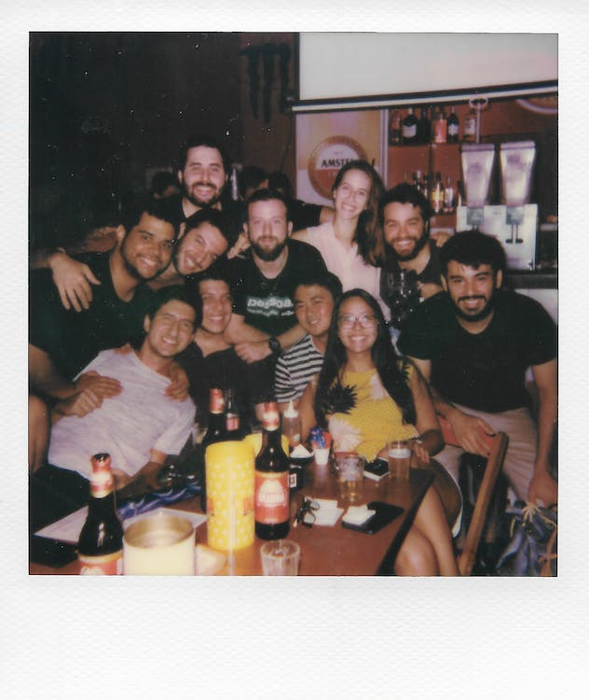
Key points
A lot of genuine recognition is simple and costs nothing, such as a thank you, a letter, or a photo on the wall. But sometimes spending wisely to treat the team to a meal or a day out can go a long way
https://www.pexels.com/photo/photo-of-people-gathering-together-3414186/

Slide 28
Reward Team
The reward team oversees all recognition initiatives to ensure branding, consistency and the achievement of principles without seeking to control and push responsibility to line managers

Slide 29
Recognition should drive the individual needs/success criteria of the business area.

Slide 30
References
Armstrong,M (2010).Handbook of reward management practice(Improving Performance through reward).Kogan Page Limited
Rose, M (2001) Recognising Performance: Non-cash rewards, Chartered Institute of Personnel and Development, London
Kohn, A (1993) Why incentive plans cannot work, Harvard Business Review, September/October, pp 54–63
RDNE Stock Project (2021). https://www.pexels.com/photo/a-billboard-award-trophy-7005694/
RDNE Stock Project (2021). https://www.pexels.com/photo/people-clapping-for-an-award-winning-actor-7005756/
Gustavo Firing (2020).https://www.pexels.com/photo/men-in-office-doing-secret-santa-6285175/
RDNE Stock Project (2021). https://www.pexels.com/photo/a-woman-giving-a-gift-to-a-man-6518869/
Fauxels (2019).https://www.pexels.com/photo/photo-of-people-doing-handshakes-3183197/
Mart Production (2021). https://www.pexels.com/photo/a-group-of-people-celebrating-together-at-work-7550294/

Slide 31
References
Utopix Pictures (2022). https://www.pexels.com/photo/a-man-opening-a-gift-in-an-office-14524108/
RDNE (2021). https://www.pexels.com/photo/man-in-black-long-sleeve-shirt-holding-red-plastic-cup-7580985/
Andrea Prequadio (2020). https://www.pexels.com/photo/intelligent-businesswoman-explaining-documents-in-office-3757369/
Sora Shimazaki (2020). https://www.pexels.com/photo/crop-colleagues-shaking-hands-in-office-5673488/
RDNE (2021). https://www.pexels.com/photo/a-smiling-woman-holding-a-trophy-7005564/
RDNE (2021). https://www.pexels.com/photo/athletes-wearing-medals-7005491/
RDNE (2021). https://www.pexels.com/photo/woman-holding-an-award-7551451/
Luis,A,D (2019). https://www.pexels.com/photo/photo-of-people-gathering-together-3414186/

