Slide 1
COURSE: REWARD MANAGEMENT
LECTURE 4: NON-FINANCIAL REWARDS
LECTURER: DR LUCY KARIMI KIRIMA
Lecture learning outcomes:
At the end of the lecture, you will be able to:
Understand the concept of non-financial rewards
Discuss the purpose and benefits of non-financial rewards
Examine various types of non-financial rewards

Slide 2
NON-FINANCIAL REWARDS
Non-financial rewards are those that focus on the needs people have to varying degrees for recognition, achievement, responsibility, autonomy, influence and personal growth.

Slide 3

Non-financial rewards
Consists of several material objects, such as automobiles, jewelry, precious metals. Companies offer non-financial reward in the form of providing several services like free car repairing and family vacations
https://www.pexels.com/photo/christmas-gifts-and-ornaments-3309878/

Slide 4

Non-financial
Can be extrinsic, such as praise or recognition, or intrinsic, arising from the work itself associated with job challenge and interest and feelings that the work is worthwhile.
https://www.pexels.com/photo/a-woman-holding-a-recognition-award-7005619/

Slide 5

Non-financial
They incorporate the notion of relational rewards, which are the intangible rewards concerned with the work environment (quality of working life, the work itself, work–life balance), recognition, performance management, and learning and development
https://www.pexels.com/photo/businessmen-exchanging-christmas-gifts-6285172/

Slide 6
Non-financial rewards
. It is important to be aware that the concept of non-financial reward does not mean that the reward provided should not have financial value, It simply means that whatever is given should not be just money.

Slide 7

Non-financial
The key thing is that this method of conveying appreciation is likely to be more memorable than cash award which is in the employees salary.
Non-financial rewards can offer a gift, an experience or means to purchase material goods of their choice. It provides the employees with something tangible that they can remember.
https://www.pexels.com/photo/crop-cheerful-multiethnic-colleagues-celebrating-victory-in-office-6774450/

Slide 8
The significance of non-financial rewards
Money is the primary incentive’ but ‘money alone is not enough to motivate high performance
Money may be an important factor in attracting and retaining people (the sorting effect). It can produce satisfaction, but this may be short-lived
Money will motivate some of the people all of the time and, perhaps, all of the people some of the time. But it cannot be relied on to motivate all of the people all of the time
Money has to be reinforced by nonfinancial rewards, especially those that provide intrinsic motivation

Slide 9
Types of non-financial rewards
Intangible non-financial rewards are referred as the relational rewards for example,work life balance, quality of work life
Tangible non-financial rewards are referred as the non cash rewards

Slide 10
Examples
Non-financial rewards can be classified as follows:
The manager saying ‘thank you’
The manager writing formally to record ‘thanks’
Public appreciation of the effort in a team meeting or organization newsletter or special dinner
Declaring the individual ‘employee of the month or year’
Retail or travel vouchers
Meals for the individual and partner
Theater or cinema tickets
Reserved parking space
Use of recreational facilities

Slide 11
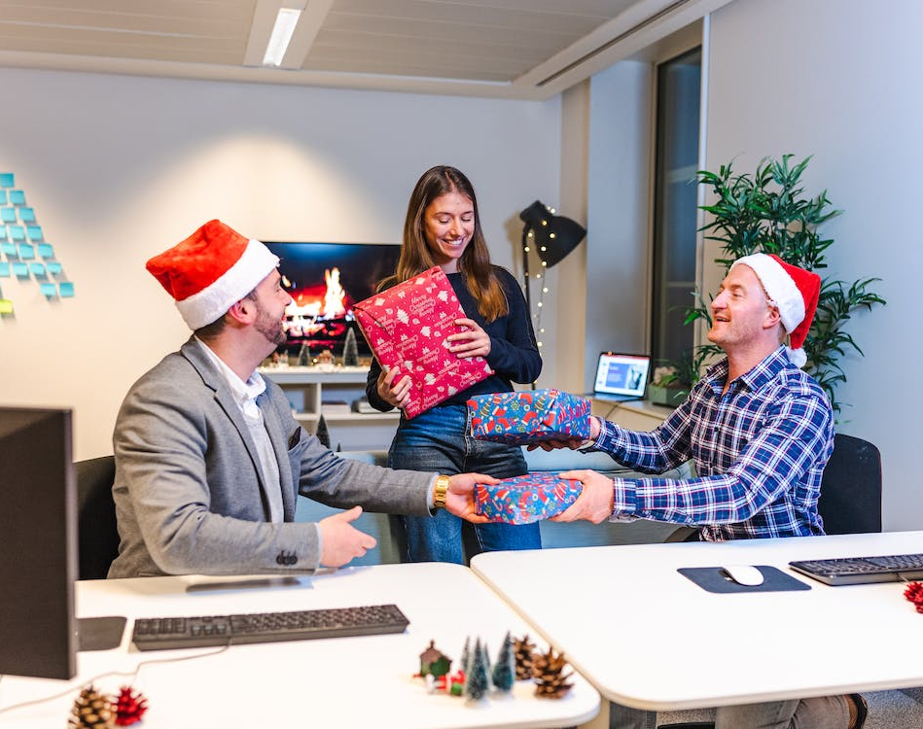
Individual extrinsic rewards
Non-financial recognition
Recognition is one of the most powerful methods of rewarding people.
They need to know not only how well they have achieved their objectives or carried out their work but also that their achievements are appreciated.
Recognition is a form of feedback that lets people know that they have done well and therefore provides positive reinforcement
https://www.pexels.com/photo/colleagues-exchanging-gifts-in-an-office-14524120/

Slide 12
Individual extrinsic rewards
Praise
Praise is, a form of recognition. It can be given privately during the course of work or in a performance review meeting. Public praise can be even more rewarding.
But the praise must be genuine and saved for real achievements. It should not be fulsome
Feedback
Feedback is another form of recognition. If done properly it can increase self-belief and provide the basis for self-directed learning.

Slide 13
Individual extrinsic rewards
Vouchers
Vouchers give employees a certain element of choice, A voucher can be a double reward because employee receives the voucher and then also spends it.
Nomination-based schemes
Organizations that do not wish to offer something that has a monetary value can offer a memento, trophy or certificate to denote the employees contribution.

Slide 14
Individual intrinsic rewards
Fulfilling work
Work can be fulfilling and therefore motivating when individuals feel that what they do is worthwhile and adds value
Use of abilities
Fulfilling work enables people to use and develop their abilities.

Slide 15
Individual intrinsic rewards
Achievement
People feel rewarded and motivated if they have the scope to achieve as well as being recognized for the achievement
Responsibility
Individuals can be motivated by being given more responsibility for their work.

Slide 16
Individual intrinsic rewards
Autonomy
Autonomy exists when an individual has freedom to make decisions and act independently without reference to higher authority.
It enhances self-belief, gives people more opportunity to achieve and provides an opportunity to develop skills
Influence
Jobs are more fulfilling if people can influence what they do or exert wider influence on policy and operational decisions.

Slide 17
Individual intrinsic rewards
Opportunity to grow
Providing people with opportunities for personal growth as a means of rewarding and therefore motivating them
Learning and development opportunities take place in the course of everyday work, and the organization can encourage this through coaching, mentoring and support in the implementation of personal development plans created as part of the performance management process.

Slide 18

Autonomy
Freedom to make decisions and act independently without reference to higher authority. It enhances self-belief, gives people more opportunity to achieve and provides an opportunity to develop skills
https://www.pexels.com/photo/woman-working-at-the-desk-in-office-8111853/

Slide 19
Collective extrinsic rewards
Collective extrinsic rewards are provided by the organization in the shape of policies, procedures, services and programs,for example:
Work–life balance policies reward people by recognizing their needs outside work by, for example, adopting family-friendly policies, including the provision of more flexible working arrangements.
Employee well-being services can be provided for individuals to help them deal with their problems. This may involve counselling or personal casework where the aim is as far as possible to get individuals to help themselves.

Slide 20
Collective extrinsic rewards
Concierge services provide employees with help by undertaking mundane personal tasks such as getting their car serviced, home repairs or waiting at home for deliveries.
Learning and development programs give employees the chance to develop their skills and careers
Voluntary benefit schemes provide opportunities for employees to buy goods or services at discounted prices. The employer negotiates deals with the suppliers.

Slide 21
Collective intrinsic rewards
Collective intrinsic rewards are provided mainly through the work environment. They relate to the quality of working life provided and the organization’s core values.
Quality of working life -The quality of working life refers to the feelings of satisfaction and well-being arising from the work itself and the way people are treated
Core values -The significance of the core values of an organization as a basis for creating a rewarding work environment

Slide 22
Benefits of non-financial rewards
Acknowledge performance above and beyond the norm
Enhance customer service
Recognizes achievements
Support line managers
Cost efficiency-these rewards do not need to be expensive.
Encouraging strategic behaviors and desired actions. The thinking is that by recognizing outstanding achievement and certain behaviours, other employees will aim to imitate such ways of performing.

Slide 23
Benefits of non-financial rewards
Immediate of impact-they have immediacy of their application.
The traditional performance appraisal and reward is done on annual basis and takes procedures while non-financial rewards have specific action that merit a reward.
Employer branding-it enhances employer branding and employer marketing.

Slide 24
Benefits of non-financial rewards
Retention-it helps to retain key talents, building affective relationship between employer and employee binds the two more closely together.
High street credibility-Non-financial recognition schemes can offer a more in-depth and longer lasting impact on motivation than motivation than more transient financial rewards.

Slide 25

Retention
Retention-it helps to retain key talents, building affective relationship between employer and employee binds the two more closely together.
https://www.pexels.com/photo/cheerful-multiethnic-colleagues-having-deal-in-office-5673487/

Slide 26
Problems and potentials pitfalls of non -financial rewards
This reward should be fair because it appeals to the emotional, affective side of people.
Credible assessment process-Aspect of fairness is procedural. It is important to ensure that whichever method of recognition is used, the process by which receivers of vouchers, certificates or awards are chosen should be credible, transparent and robust.

Slide 27
Ptfalls of non -financial rewards
Cultural fit-It is better for employees to use non-financial recognition approaches to align with the culture of the organization than to challenge Incentive schemes can counter cultural fit if not well administered.
Economic situation-External economic environment can impact on the effectiveness of non-financial rewards especially when organizations are effecting by the economic changes

Slide 28
Pitfalls of non -financial rewards
Fraudulent nominations-Some employees may conspire to fraudulently win awards. It is important to have a due process for nominations.
Maintaining momentum-There is need for organizations to review the non-financial recognition schemes regularly and update them where appropriate to ensure that they are still effective.

Slide 29

Emotional
Can impact positively or negatively if not carried out well
https://www.pexels.com/photo/upset-faceless-black-businessman-on-street-7925807/

Slide 30

Involvement
Involve employees as stakeholders in drawing up a set of core values associated with the employment relationship and in planning and implementing the steps required to ensure that everyone concerned ‘lives the values’.
https://www.pexels.com/photo/senior-gray-haired-bearded-male-coach-presenting-ideas-at-diverse-group-meeting-in-modern-office-3861933/

Slide 31
References
Alderfer, C (1972) Existence, Relatedness and Growth, New York, The Free Press
Armstrong, M., 2010. Armstrong’s Handbook of Reward Management Practice: Improving performance through Reward. London: Kogan Page.
Brun, J., and Dugas, N., 2008. An analysis of employee recognition, perspectives on Human Resource Practices. International Journal of Human Resource Management, 19(4), pp. 716-73
DeNisi, A S and Kluger, A N (2000) Feedback effectiveness: can 360-degree appraisals be improved? Academy of Management Executive, 14 (1) pp 129–39
Latham, G and Locke, R (1979) Goal setting: a motivational technique that works, Organizational Dynamics, Autumn, pp 68–80
Lewis, P., 2006. Reward Management, in T. Redman and A. Wilkinson, Contemporary Human Resource Management: text and cases, 2nd ed. Essex: Pearson.
Jill Wellington (2019). https://www.pexels.com/photo/christmas-gifts-and-ornaments-3309878/

Slide 32
References Cont…
REDNE (2020). https://www.pexels.com/photo/a-woman-holding-a-recognition-award-7005619/
Gustavo Firing (2020).https://www.pexels.com/photo/businessmen-exchanging-christmas-gifts-6285172/
Kindel Media (2021).https://www.pexels.com/photo/crop-cheerful-multiethnic-colleagues-celebrating-victory-in-office-6774450/
Utopix Pictures (2022). https://www.pexels.com/photo/colleagues-exchanging-gifts-in-an-office-14524120/
Pavel Danilyuk (2021). https://www.pexels.com/photo/woman-working-at-the-desk-in-office-8111853/
Sora Shimazaki (2020). https://www.pexels.com/photo/cheerful-multiethnic-colleagues-having-deal-in-office-5673487/
Nicola Barts(2021). https://www.pexels.com/photo/upset-faceless-black-businessman-on-street-7925807/
Andrea Pracquadio (2020). https://www.pexels.com/photo/senior-gray-haired-bearded-male-coach-presenting-ideas-at-diverse-group-meeting-in-modern-office-3861933/

