Slide 1
COURSE: REWARD MANAGEMENT
LECTURE 5: FINANACIAL REWARDS
LECTURER: DR LUCY KARIMI KIRIMA
Lecture learning outcomes:
At the end of the lecture, you will be able to:
Understand the concept of financial rewards
Discuss the role of money
Examine factors affecting financial rewards
Discuss the criteria for financial rewards

Slide 2

Financial rewards
All rewards that have a monetary value
https://www.pexels.com/photo/happy-woman-in-blue-long-sleeve-blouse-holding-money-7680637/

Slide 3
FINANCIAL REWARDS
Financial rewards comprise all rewards that have a monetary value and add up to total remuneration – base pay, pay contingent on performance, contribution, competency or skill, pay related to service, financial recognition schemes, and benefits such as pensions, sick pay and health insurance.

Slide 4
Financial rewards
Financial rewards consist of job-based pay, which provides base pay related to the value of the job, and person-based pay, which provides rewards that recognize the individual’s contribution, competence, or skill
The management of a reward system requires decisions on levels of pay, how jobs should be valued, the design and operation of grade and pay structures and the choice of benefits.

Slide 5

Financial reward
Total remuneration – base pay, pay contingent on performance, contribution, competency or skill, pay related to service, financial recognition schemes, and benefits such as pensions, sick pay and health insurance.
https://www.pexels.com/photo/people-exchanging-money-4968383/

Slide 6
Money and motivation
It can act as a goal that people generally strive for, although to different degrees.
It can act as an instrument that provides valued outcomes.
It can be a symbol that indicates the recipient’s value to the organization.
It can act as a general reinforcer because it is associated with valued rewards and therefore takes on reward value itself.

Slide 7

Money
Money can motivate because it is linked directly or indirectly with the satisfaction of many needs.
It satisfies the basic need for survival and security, if income is regular.
https://www.pexels.com/photo/woman-sitting-in-front-of-her-laptop-and-holding-a-lot-of-cash-5899197/

Slide 8
Money
It can also satisfy the need for self-esteem (it is a visible mark of appreciation) and status – money can set you in a grade apart from your fellows and can buy you things they cannot afford.
Money satisfies the less desirable but nevertheless prevalent drives of acquisitiveness and cupidity.

Slide 9

Money
Money acquires motivating power because it comes to symbolize so many intangible goals.
https://www.pexels.com/photo/man-and-woman-buying-pastries-8526400/

Slide 10
Factors affecting satisfaction with pay
People’s feelings about the adequacy of their pay are based upon comparisons they make between their own and others’
External market comparisons are the most critical because they are the ones that strongly influence whether individuals want to stay with the organization

Slide 11
Factors affecting satisfaction with pay
Employees compare their pay with external and internal
The key thing that the organization needs to focus on is whether its employees are more dissatisfied with their pay than are employees in other organizations

Slide 12
Factors affecting satisfaction with pay
Rewards are commensurate with the perceptions of individuals about their ability, contribution and value to the organization founded on information or beliefs about what other people, inside and outside the organization, are paid
individuals feel their rate of pay or increase has been determined fairly (the principle of procedural justice)

Slide 13

Factors affecting satisfaction with pay
Individuals are satisfied with other aspects of their employment – for example, the quality of working life, work–life balance, their status, promotion prospects, opportunity to use and develop skills, and relations with their managers and colleague
https://www.pexels.com/photo/woman-with-hand-s-on-face-looking-afar-8057325/

Slide 14
Job satisfaction and performance
People are motivated to achieve certain goals and will be satisfied if they achieve these goals through improved performance.
They may be even more satisfied if they are then rewarded by extrinsic recognition or an intrinsic sense of achievement.
It can also be argued that some people may be complacently satisfied with their job and will not be inspired to work harder or better

Slide 15
Arguments for financial rewards
Financial rewards is that those who contribute more should be paid more.
It is right and proper to recognize achievement with a financial and therefore tangible reward.

Slide 16
Arguments against
The extent to which contingent pay schemes motivate is questionable – the amounts available for distribution are usually so small that they cannot act as an incentive.
Money by itself will not result in sustained motivation; intrinsic motivation provided by the work itself goes deeper and lasts longer.

Slide 17
Arguments against
People react in widely different ways to any form of motivation – it cannot be assumed that money will motivate all people equally, yet that is the premise on which contingent pay schemes are based.
Financial rewards may possibly motivate those who receive them but they can demotivate those that don’t, and the numbers who are demotivated could be much higher than those who are motivated.

Slide 18
Arguments against
Contingent pay schemes can create more dissatisfaction than satisfaction if they are perceived to be unfair, inadequate or badly managed.
Employees can be suspicious of schemes because they fear that performance bars will be continuously raised; a scheme may therefore only operate successfully for a limited period.

Slide 19
Arguments against
Schemes depend on the existence of accurate and reliable methods of measuring performance, contribution, competence or skill, which might not exist.
Contingent pay decisions depend on the judgement of managers, which in the absence of reliable criteria can be partial, prejudiced, inconsistent or ill-informed.

Slide 20
Criteria for effectiveness
• There must be accurate, consistent and fair assessment of performance or contribution.
The principles of procedural and distributive justice are upheld.

Slide 21
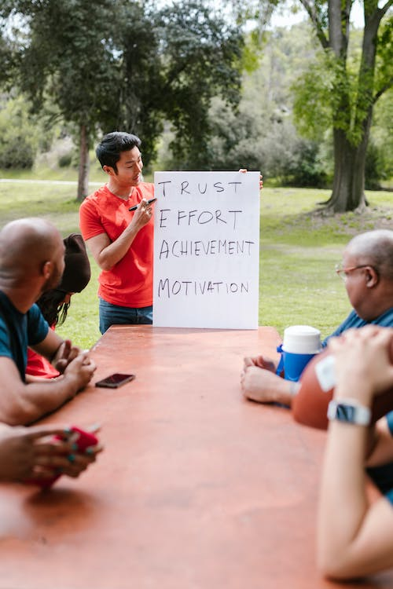
There is a climate of trust in the organization
Where there is trust, involvement and a commitment to fairness,
https://www.pexels.com/photo/man-speaking-to-a-group-on-team-building-7551454/

Slide 22
Criteria for effectiveness
The scheme is appropriate to the context and culture of the organization.
There is a clear line of sight between effort and reward

Slide 23
Criteria for effective
Performance management systems function well.
Line managers have the necessary skills and commitment.

Slide 24

Criteria for effectiveness
Stakeholders, including line managers, employees and employee representatives, have been involved in the design of the scheme.
https://www.pexels.com/photo/a-group-of-people-having-a-meeting-7691722/

Slide 25
The dos of financial incentives
Do tie financial incentives to valued behaviours.
Do have good measurement systems.
Do have good communications.
Do make the system complete, ie cover all relevant and valued aspects of performance

Slide 26
The Do’s
Do use financial incentives to supplement other rewards.
Do make meaningful differentiations.
Do set realistic goals.
Do provide relevant skills and resources.

Slide 27
The Do’s
Do emphasize long-term as well as short-term success.
Do accept reality – use incentives that do work rather than those that should work.

Slide 28
Don’t’s
Don’t rely on invalid behaviour measurement tools.
Don’t keep things secret.
Don’t violate employee expectations

Slide 29
Key points
Provide for the accurate, consistent and fair assessment of performance or contribution.
Fit the scheme to the context and culture of the organization

Slide 30
Key points
Keep it simple
Communicate the purpose, methodology and effect of the scheme.
Ensure that there is a clear line of sight between effort and reward and that the rewards provided by the scheme are attainable and worth attaining.
Involve stakeholders, including line managers, employees and employee representatives, in the design of the scheme.

Slide 31

Don’t’s
Don’t equate rewards and punishments.
https://www.pexels.com/photo/couple-quarreling-in-kitchen-8560740/

Slide 32
References
Abowd, J M (1990) Does performance-based managerial compensation affect corporate performance? Industrial and Labor Relations Review, 43 (3), pp 52–73
Adams, J S (1965) Injustice in social exchange, in Advances in Experimental Psychology, ed L Berkowitz, Academic Press, New York
Armstrong, M and Baron, A (2004) Performance Management: Action and impact, CIPD London
Blackburn, R M and Mann, R (1979) The Working Class in the Labour Market, Macmillan, London
Booth, A L and Frank, J (1999) Earnings, productivity and performance related pay, Journal of Labor Economics, 17 (3), pp 447–63

Slide 33
References
Bowey, A and Thorpe, R (1982) The Effects of Incentive Pay Systems, Department of Employment, London
Brayfield, A H and Crockett, W H (1955) Employee attitudes and employee performance, Psychological Bulletin, 52, pp 346–424
Brown, D and Armstrong, M (1999) Paying for Contribution, Kogan Page, London
Brumbach, G B (1988) Some ideas, issues and predictions about performance management, Public Personnel Management, Winter, pp 387–402
Bullock, R J and Tubbs, M E (1990) A case meta-analysis of gainsharing plans as organizational development interventions, Journal of Applied Behavioural Science, 26 (3), pp 383–406

Slide 34
References cont….
Karolina Grabolwska (2021). https://www.pexels.com/photo/happy-woman-in-blue-long-sleeve-blouse-holding-money-7680637/
Karolina Grabolwska (2020). https://www.pexels.com/photo/people-exchanging-money-4968383/
Karolina Grabolwska (2020). https://www.pexels.com/photo/woman-sitting-in-front-of-her-laptop-and-holding-a-lot-of-cash-5899197/
Pavel Danilyuk (2021). https://www.pexels.com/photo/man-and-woman-buying-pastries-8526400/
Pavel Danilyuk (2021). https://www.pexels.com/photo/woman-with-hand-s-on-face-looking-afar-8057325/
REDNE Stock Project (2021). https://www.pexels.com/photo/man-speaking-to-a-group-on-team-building-7551454/
Yan Krukau(2021). https://www.pexels.com/photo/a-group-of-people-having-a-meeting-7691722/
Timur Webner (2021). https://www.pexels.com/photo/couple-quarreling-in-kitchen-8560740/

