Slide 1
COURSE: REWARD MANAGEMENT
LECTURE 7: COMPONENTS OF COMPENSATION
LECTURER: DR LUCY KARIMI KIRIMA
Lecture learning outcomes:
At the end of the lecture, you will be able to:
Discuss the components of compensation

Slide 2

Compensation
Compensation is the remuneration an employee receives for his or her contribution to the organization.
https://www.pexels.com/photo/rolled-20-u-s-dollar-bill-164527/

Slide 3

Compensation
It occupies an important place in the life of employee. His or her standard of living, status in the society, motivation, loyalty and productivity depend upon the remuneration he or she receives
https://www.pexels.com/photo/smiling-woman-in-fur-coat-posing-5922465/

Slide 4
Compensation management
Compensation Management allow to control bottom-line expenditures and offer competitive and motivating remuneration, be it fixed pay, variable pay, stock options, merit increases, or promotion – in other words, total compensation.

Slide 5

Compensation
Compensation dissatisfaction can lead to absenteeism, turnover, job dissatisfaction, low performance, strikes and grievances. Majority of labor-management disputes relate to compensation.
Compensation is a key factor in attracting and keeping the best employees and ensuring that the organization has the competitive edge in an increasingly competitive world
https://www.pexels.com/photo/man-in-blue-and-brown-plaid-dress-shirt-touching-his-hair-897817/

Slide 6
Components of compensation
1. Basic Wages/Salaries
Basic wages / salaries refer to the cash component of the wage structure based on which other elements of compensation may be structured.
It is normally a fixed amount which is subject to changes based on annual increments or subject to periodical pay hikes

Slide 7

2. Dearness Allowance
The payment of dearness allowance facilitates employees and workers to face the price increase or inflation of prices of goods and services consumed by him.
https://www.pexels.com/photo/a-woman-shopping-in-the-supermarket-9016541/

Slide 8

Incentives
Incentives are paid in addition to wages and salaries
There are: (a) Individual incentive schemes, and (b) Group incentive programmes.
Individual incentives are applicable to specific employee performance.
https://www.pexels.com/photo/a-man-giving-a-gift-to-a-woman-6030167/

Slide 9

Bonus
The bonus can be paid in different ways.
It can be fixed percentage on the basic wage paid annually or in proportion to the profitability
https://www.pexels.com/photo/a-woman-receiving-money-from-the-customer-4921256/

Slide 10

Non-Monetary Benefits
These benefits give psychological satisfaction to employees even when financial benefit is not available. Such benefits are:
  Recognition of merit through certificate, gifts among others
  Offering challenging job responsibilities
  Promoting growth prospects
https://www.pexels.com/photo/people-clapping-for-an-award-winning-actor-7005756/

Slide 11

Commissions
Commission may be based on the sales revenue or profits of the company
It is always a fixed percentage on the target achieved
https://www.pexels.com/photo/crop-man-with-various-banknotes-in-pocket-4386407/

Slide 12
Mixed Plan
Apart from the salaries paid, the employees may be eligible for a fixed percentage of commission upon achievement of fixed target of sales or profits or Performance objectives.

Slide 13
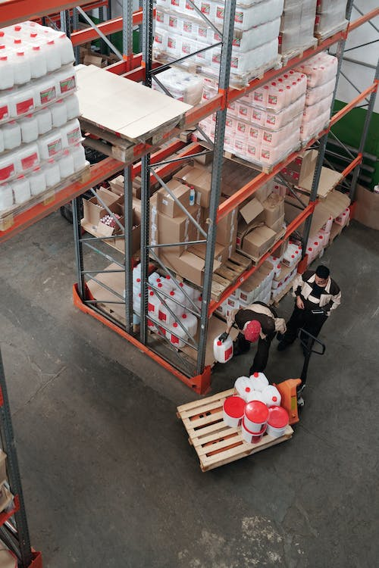
Piece Rate Wages
The laborers are paid wages for each of the Quantity produced by them.
The gross earnings of the labour would be equivalent to number of goods produced by them. Piece rate wages improves productivity and is an absolute measurement of productivity to wage structure.
https://www.pexels.com/photo/men-working-in-a-warehouse-4481532/

Slide 14
Fringe Benefits
. Fringe benefits are supplements to regular wages received by the workers at a cost of employers. They include benefits such as paid vacation, pension, health and insurance plans, etc
The purpose of fringe benefits is to retain efficient and capable people in the organization over a long period.

Slide 15
Profit Sharing
Profit-sharing is an agreement by which employees receive a share, fixed in advance of the profits.
Profit sharing usually involves the determination of an organization’s profit at the end of the fiscal year and the distribution of a percentage of the profits to the workers qualified to share in the earnings.

Slide 16
Job Descriptions
job descriptions define in writing the responsibilities, requirements, functions, duties, location, environment, conditions, and other aspects of jobs.

Slide 17
Job Analysis
Job Analysis is the procedure through which you determine the duties of the positions to be staffed and the characteristics of people who should be hired for them

Slide 18
Job Evaluation
A system for comparing jobs for the purpose of determining appropriate compensation levels for individual jobs or job elements

Slide 19
Pay Structures
Most pay structures include several grades with each grade containing a minimum salary/wage and either step increments or grade range

Slide 20
Salary Surveys
Companies may purchase results of surveys conducted by survey vendors or may conduct their own salary surveys.
When purchasing the results of salary surveys conducted by other vendors, note that surveys may be conducted within a specific industry or across industries as well as within one geographical region or across different geographical regions.

Slide 21
Policies and Regulations
Compensation is supposed to be as fair if it is contained the system of components to develop and maintain internal and external equity in organization.

Slide 22
Methods of Compensation
Wages and Salaries
Wages refers to the earnings of employees whose pay is calculated on an hourly basis. Salary refers to the earnings of employees whose pay is calculated on a weekly, bi-weekly, semi-monthly, or monthly basis.

Slide 23
Draws
Draws are often given to salespeople who work only for commission.
A draw is an advance given to a salesperson that will be collected when future sales transactions are closed

Slide 24

Sick Pay
Sick pay is any amount paid to an employee because of illness or injury under a plan providing for such benefits.
https://www.pexels.com/photo/professional-massage-therapist-treating-patient-in-clinic-5473177/

Slide 25

Tips
A tip is an additional amount from a customer for services rendered.
https://www.pexels.com/photo/delighted-black-female-barista-serving-coffee-in-cup-in-cafe-3796810/

Slide 26

Supplemental Wages
Supplemental wages differ from regular wages only in that they may be based on a different payroll period, computed on a different compensation plan or rate, or paid at a different time than regular wages.
https://www.pexels.com/photo/hands-holding-dollars-4968639/

Slide 27
Exempt Payments
Compensation not considered wages includes sickness and injury payments under a workers’ compensation law, and other payments that are likely to be tax deductible such as qualified moving expense reimbursements.

Slide 28
References
Aswathappa, K, Human Resource Management, New Delhi, Tata McGraw Hill, 2014, Pp. 390.
Bruno S. Frey, Margit Ostzerloh (2002) "Successful management by motivation : balancing intrinsic and extrinoic incentives, springer-verlag Berlin, Heidelberg, New York, 2002, Pg. 53-54
Biswanath Ghosh, Compensation and Reward Management, New Delhi, Sterling, 2012, Pp. 2 – 3. Biswanath Ghosh, Ibid, Pp. 43-46.
Aswathappa, K, Human Resource Management, New Delhi, Tata McGraw Hill, 2014, Pp. 393.
Tangthong, Sorasak, A causal model of compensation and benefits and reward management on organizational effectiveness of MNCs, Asian Journal of Management Research, Vol. 5, No. 1, January 2014, Pp. 44-65.

Slide 29
References
Aswathappa, K, (2014). Human Resource Management, New Delhi, Tata McGraw Hill
Bruno S. Frey, Margit Ostzerloh (2002) "Successful management by motivation : balancing intrinsic and extrinoic incentives, springer-verlag Berlin, Heidelberg, New York, 2002, Pg. 53-54
Biswanath Ghosh, Compensation and Reward Management, New Delhi, Sterling, 2012, Pp. 2 – 3.
Biswanath Ghosh, Ibid, Pp. 43-46.

Slide 30
References
Tangthong, Sorasak, A causal model of compensation and benefits and reward management on organizational effectiveness of MNCs, Asian Journal of Management Research, Vol. 5, No. 1, January 2014, Pp. 44-65.
Bhattacharyya, Dipak Kumar, Compensation Management, New Delhi, Oxford University Press, 2013, Pp. 11-12.
Biswanath Ghosh, Compensation and Reward Management, New Delhi, Sterling, 2012, Pp. 95.
Singh, BD, Compensation Reward Management, 2nd ed, New Delhi, Excel Books, 2012, Pp.232-236.
H.L. Kumar (2015), Practical Guide to Employee’s Compensation -Act & Rule. Universal Law Publishing Co. Pvt. Ltd. New Delhi – India..

Slide 31
References
Pixabay (2016).https://www.pexels.com/photo/rolled-20-u-s-dollar-bill-164527/
Cottonbro studio (2020). https://www.pexels.com/photo/smiling-woman-in-fur-coat-posing-5922465/
Nathan Cowley(2018).https://www.pexels.com/photo/man-in-blue-and-brown-plaid-dress-shirt-touching-his-hair-897817/
Polina Tanklevitch (2020). https://www.pexels.com/photo/a-man-giving-a-gift-to-a-woman-6030167/
Redne stock project (2020).https://www.pexels.com/photo/a-woman-receiving-money-from-the-customer-4921256/
Redne stock project (2021).https://www.pexels.com/photo/people-clapping-for-an-award-winning-actor-7005756/

Slide 32
References
Karolina Grabowska(2020). https://www.pexels.com/photo/crop-man-with-various-banknotes-in-pocket-4386407/
Tiger Lily (2020).https://www.pexels.com/photo/men-working-in-a-warehouse-4481532/
Ryutaro Tsukala(2020). https://www.pexels.com/photo/professional-massage-therapist-treating-patient-in-clinic-5473177/
Andrea Pracquadio (2020).https://www.pexels.com/photo/delighted-black-female-barista-serving-coffee-in-cup-in-cafe-3796810/
Karolina Grabowska (2020).https://www.pexels.com/photo/hands-holding-dollars-4968639/

