Slide 1
COURSE: REWARD MANAGEMENT
LECTURE 8: TYPES OF COMPENSATION
LECTURER: DR LUCY KARIMI KIRIMA
Lecture learning outcomes:
At the end of the lecture, you will be able to:
Discuss the types of compensation
Examine concepts of wages
Explore theories of wage determination

Slide 2

Compensation
Reward of any work or service offered by an individual to any organization or institution
https://www.pexels.com/photo/a-person-holding-a-recognition-award-7005751/

Slide 3
Direct /Base Compensation
Direct compensation refers to the monetary benefits offered and provided to employees in return of the services they provide to the organization.

Slide 4
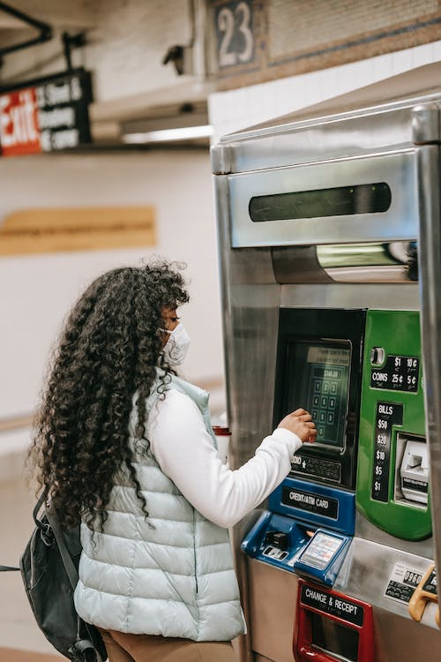
Basic Salary
Basic salary is the amount received by the employee in lieu of the work done by him/her for a certain period say a day, a week, a month
https://www.pexels.com/photo/black-woman-in-respirator-using-ticket-machine-in-underground-6280640/

Slide 5
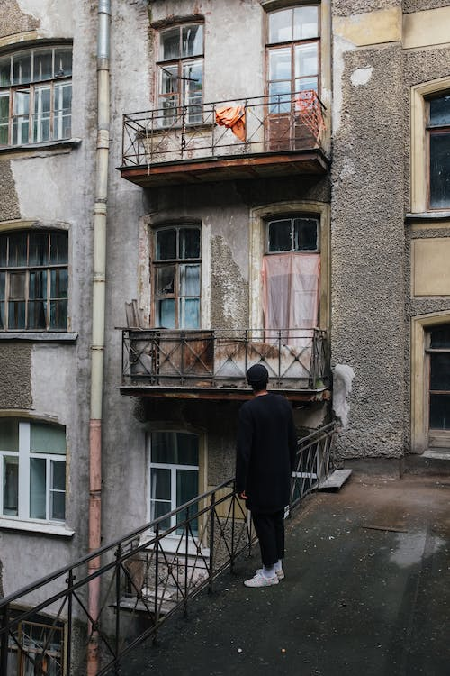
House Rent
Allowance Organizations either provide accommodations to its employees
https://www.pexels.com/photo/man-in-black-coat-walking-on-sidewalk-4727511/

Slide 6

Conveyance
Organizations provide for cab facilities to their employees
https://www.pexels.com/photo/photo-of-parked-yellow-suv-2085403/

Slide 7

Medical Reimbursement
The employees are provided with medi-claims for them and their family members.
https://www.pexels.com/photo/man-holding-another-man-s-head-3279196/

Slide 8

Bonus
Bonus is paid to the employees during festive seasons to motivate them and provide them the social security
https://www.pexels.com/photo/photo-of-people-gathering-together-3414186/

Slide 9

Special Allowance
Special allowance such as overtime, mobile allowances, meals, commissions, travel expenses, reduced interest loans; insurance, club memberships, etc are provided to employees to provide them social security and motivate them which improve the organizational productivity.
https://www.pexels.com/photo/cheerful-young-ethnic-man-with-photo-camera-resting-on-airfield-before-flight-4424288/

Slide 10

Dearness allowance
The payment of dearness allowance facilitates employees and workers to face the price increase or inflation of prices of goods and services consumed by him.
https://www.pexels.com/photo/couple-buying-fresh-fruits-during-pandemic-5910691/

Slide 11
City Compensation Allowance
City compensation allowance is paid to the employees in certain cities to compensate the cost of living. It varies from city to city & it is highest in metropolitan cities.

Slide 12

Incentives
An incentive is something that motivates an individual for good perform.
https://www.pexels.com/photo/women-giving-presents-to-an-expecting-mom-7802463/

Slide 13
Indirect /Supplementary Compensation
Indirect compensation refers to non-monetary compensation provided to employees in return of their services to the organization

Slide 14
Leave Policy
It is the right of employee to get adequate number of leave while working with the organization.
The organizations provide for paid leave such as, casual leaves, medical leaves (sick leave), and maternity leaves, statutory pay, etc

Slide 15

Overtime Policy
Employees should be provided with the adequate allowances and facilities during their overtime
https://www.pexels.com/photo/man-in-black-suit-standing-near-brown-wooden-chair-4820684/

Slide 16

Hospitalization
Medical allowances for medical treatment
https://www.pexels.com/photo/covid-19-vaccine-ampoules-and-syringe-5863374/

Slide 17

Insurance
Accidental insurance and life insurance for employees.
This gives them the emotional security and they feel themselves valued in the organization
https://www.pexels.com/photo/car-crash-on-dirt-road-11985980/

Slide 18

Leave Travel
The employees are provided with leaves and travel allowances to go for holiday with their families.
https://www.pexels.com/photo/cheerful-female-manager-checking-time-on-wristwatch-standing-with-bags-near-bus-station-3885597/

Slide 19
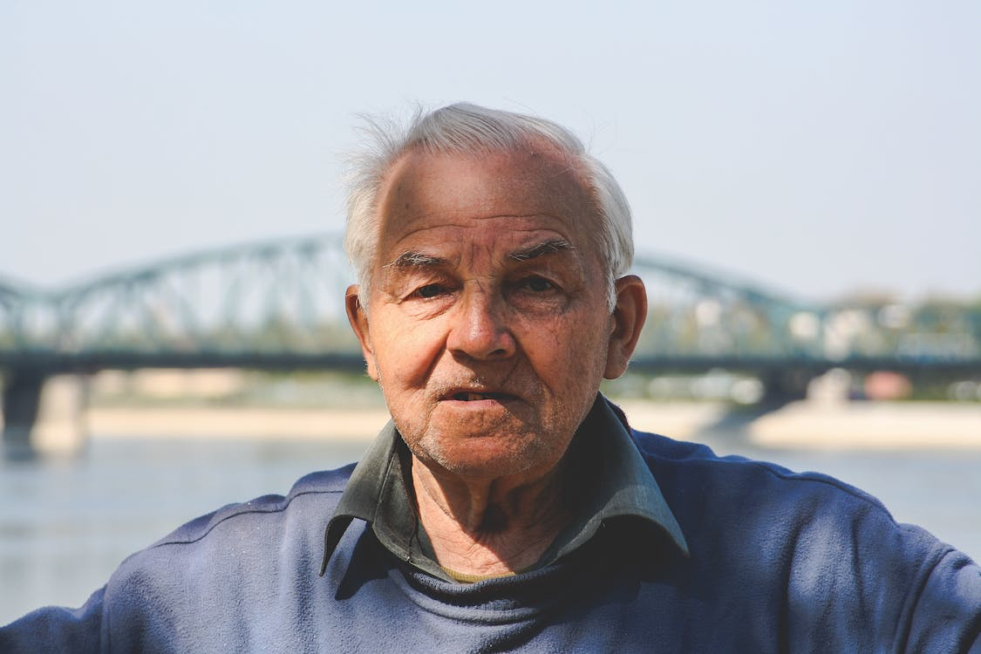
Retirement Benefits
Organizations provide for pension plans and other benefits for their employees which benefits them after they retire from the organization at the prescribed age
https://www.pexels.com/photo/old-man-6110/

Slide 20
Flexible Timings
Organizations provide for flexible timings to the employees who cannot come to work during normal shifts due to their personal problems and valid reasons.

Slide 21

Holiday Home
Organizations provide for holiday homes and guest house for their employees at different locations
https://images.pexels.com/photos/4261798/pexels-photo-4261798.jpeg?auto=compress&cs=tinysrgb&w=1260&h=750&dpr=1

Slide 22
Profit Sharing Payments
An employer may elect to pay cash to employees, give them stock in the business, or set up a deferred compensation fund for retirement

Slide 23
Other Taxable Forms of Compensation
Fringe benefits
Fringe benefits are a type of compensation provided to an employee outside of his normal wage or salary. Many years ago, employers began to understand that potential employees give great consideration to the wage or salary offered.

Slide 24
Non-Taxable Fringe Benefits
There are many types of non-taxable fringe benefits that may be offered to employees without increasing their tax burden
Insurance Coverage -include employer-paid life insurance, health insurance, and short or long-term disability insurance. When an insurance coverage fringe benefit is offered, the employer most commonly shares the cost of premiums at a certain percentage, thus reducing the amount for which the employee is responsible.

Slide 25

Childcare Assistance
large employers are offering on-site childcare, either free of charge, or at a discounted price.
This allows parents to concentrate on their work,
https://www.pexels.com/photo/photo-of-woman-feeding-her-child-3820131/

Slide 26
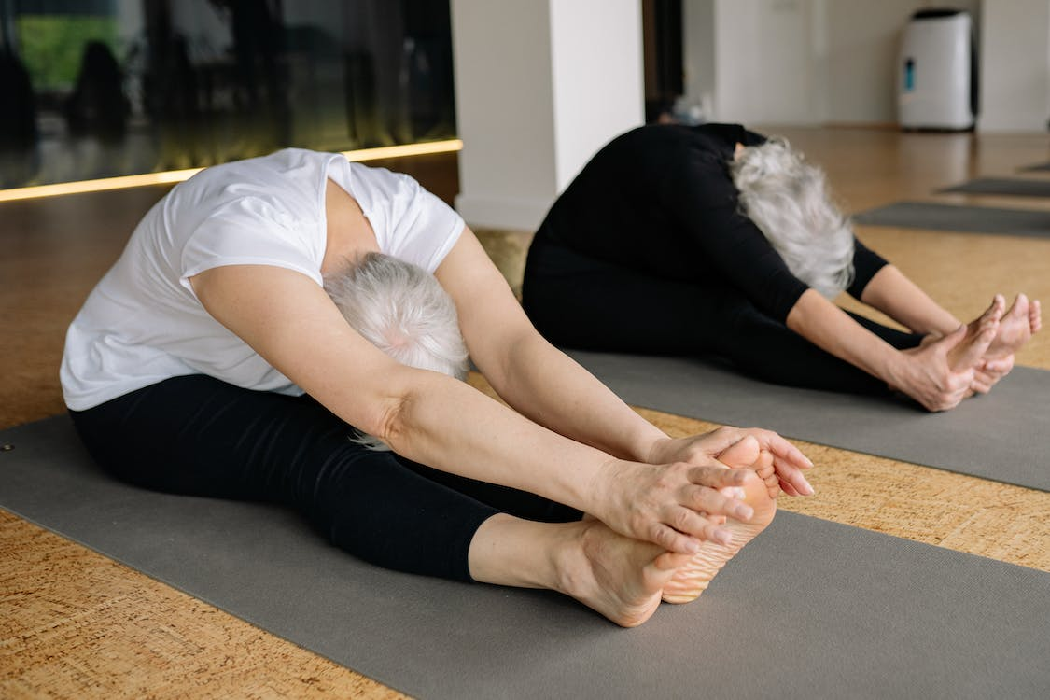
Physical Fitness
Employers make it a priority to ensure their employees have access to gyms or fitness centers in order to promote a healthy lifestyle, which in turn increases attendance and productivity
https://www.pexels.com/photo/elderly-people-doing-yoga-8436479/

Slide 27
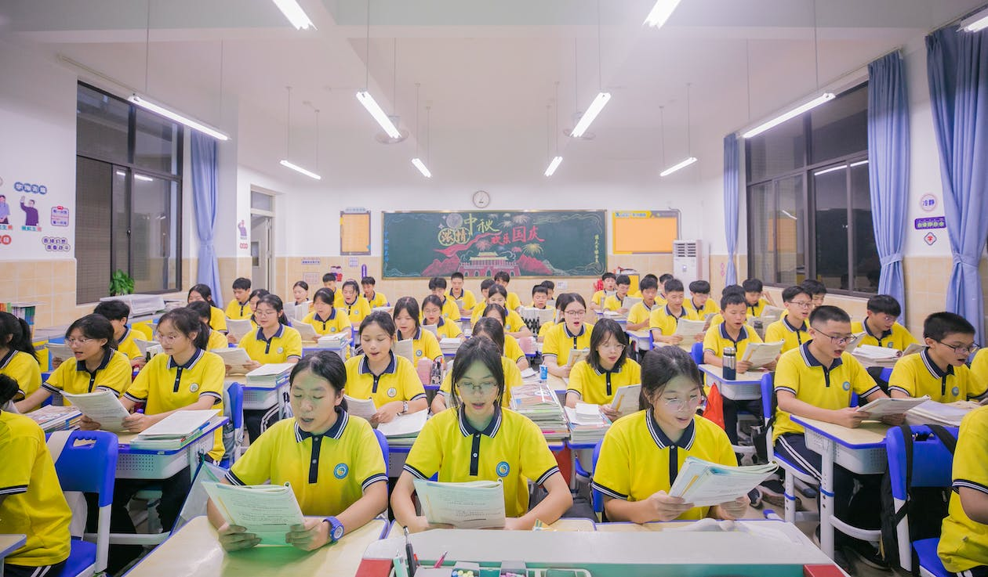
Education Assistance
Helping an employee gain new job-related skills or knowledge helps the company, as the employee is then able to work at a different level in his current position, or may become able to advance into new areas of the business
https://www.pexels.com/photo/teenagers-in-yellow-polo-shirts-studying-at-desks-in-a-class-room-18506745/

Slide 28
Determinants of the wage structure
Economic Determinants- In the labor market there commonly exists, known as Occupational Wage Differentials.
Job worth -These two concepts of worth and the concept of internal labor markets combine to explain important differences among employers in wage structure decisions.

Slide 29
Determinants of the wage structure
Training- Training requirements of jobs in terms of length, difficulty, and whether the training is provided by society, employers, or individuals constitute a primary factor in human-capital analysis and thus job worth.
Employee Tastes -People differ in the occupations they like and dislike

Slide 30
References
Aswathappa, K, Human Resource Management, New Delhi, Tata McGraw Hill, 2014, Pp. 390.
Biswanath Ghosh, Compensation and Reward Management, New Delhi, Sterling, 2012, Pp. 2 – 3.
Biswanath Ghosh, Ibid, Pp. 43-46.
Tangthong, Sorasak, A causal model of compensation and benefits and reward management on organizational effectiveness of MNCs, Asian Journal of Management Research, Vol. 5, No. 1, January 2014, Pp. 44-65.

Slide 31
Tangthong, Sorasak, A causal model of compensation and benefits and reward management on organizational effectiveness of MNCs, Asian Journal of Management Research, Vol. 5, No. 1, January 2014, Pp. 44-65.
Bhattacharyya, Dipak Kumar, Compensation Management, New Delhi, Oxford University Press, 2013, Pp. 11-12.
Biswanath Ghosh, Compensation and Reward Management, New Delhi, Sterling, 2012, Pp. 95.
Singh, BD, Compensation Reward Management, 2nd ed, New Delhi, Excel Books, 2012, Pp.232-236.
H.L. Kumar (2015), Practical Guide to Employee’s Compensation -Act & Rule. Universal Law Publishing Co. Pvt. Ltd. New Delhi – India..

Slide 32
References
Andrea (2020).https://www.pexels.com/photo/a-person-holding-a-recognition-award-7005751/
Urie Mont(2020). https://www.pexels.com/photo/black-woman-in-respirator-using-ticket-machine-in-underground-6280640/
Cottonbro studio(2020). https://www.pexels.com/photo/man-in-black-coat-walking-on-sidewalk-4727511/
Matt Hardy(2019).https://www.pexels.com/photo/photo-of-parked-yellow-suv-2085403/
Jonathan Borba(2019).https://www.pexels.com/photo/man-holding-another-man-s-head-3279196/
Luis Antonio De Lima Guimaraes(2019).https://www.pexels.com/photo/photo-of-people-gathering-together-3414186/

Slide 33
References
Ricky Esquirel (2020). https://www.pexels.com/photo/cheerful-young-ethnic-man-with-photo-camera-resting-on-airfield-before-flight-4424288/
Anna Tarazerich (2020). https://www.pexels.com/photo/couple-buying-fresh-fruits-during-pandemic-5910691/
Kampus Production (2021).https://www.pexels.com/photo/women-giving-presents-to-an-expecting-mom-7802463/
Cotton Bro (2020).https://www.pexels.com/photo/man-in-black-suit-standing-near-brown-wooden-chair-4820684/

Slide 34
References
Natalya Vaitkevich (2020).https://www.pexels.com/photo/covid-19-vaccine-ampoules-and-syringe-5863374/
Mike Bird(2020). https://www.pexels.com/photo/car-crash-on-dirt-road-11985980/
Gustavo Firing (2020).https://www.pexels.com/photo/cheerful-female-manager-checking-time-on-wristwatch-standing-with-bags-near-bus-station-3885597/
August de Riche leu (2020). https://images.pexels.com/photos/4261798/pexels-photo-4261798.jpeg?auto=compress&cs=tinysrgb&w=1260&h=750&dpr=1

Slide 35
References
Andrea Piacquadio(2020). https://www.pexels.com/photo/photo-of-woman-feeding-her-child-3820131/
Yan Krukau(2021). https://www.pexels.com/photo/elderly-people-doing-yoga-8436479/
Kimmi Jur(2023). https://www.pexels.com/photo/teenagers-in-yellow-polo-shirts-studying-at-desks-in-a-class-room-18506745/

