Slide 1
COURSE: REWARD MANAGEMENT
LECTURE 10: Job analysis
LECTURER: DR LUCY KARIMI KIRIMA
Lecture learning outcomes:
At the end of the lecture, you will be able to:
Understand the concept of job analysis
Discuss importance of job analysis
Examine process of carrying out job analysis

Slide 2
JOB ANALYSIS
Job Analysis is the procedure through which you determine the duties of the positions to be staffed and the characteristics of people who should be hired for them. The analysis produces information on job requirements; this information is then used for developing job descriptions and job specifications

Slide 3

Job analysis
Job analysis is the term used to describe a process of examining jobs in order to identify their main features
https://www.pexels.com/photo/photo-of-women-at-the-meeting-3810792/

Slide 4
Features of Job Analysis
Job analysis is gathering relevant information about various aspects of a job and identifying tasks required to be performed as part of it.
It approaches systematically defining the role, context, conditions, human behavior, performance standards, and responsibilities of a job.

Slide 5
Features of Job Analysis
It helps in establishing the job’s worth to an organization. In other words, it measures a job’s value and contribution to the organization’s growth.
It establishes job-relatedness, which is crucial for HR decisions involving recruitment, selection, compensations, training, health, and safety.

Slide 6
Importance Job Analysis
Organisation and Manpower Planning—Job analysis is helpful in organisational planning, for it defines labour needs in clear terms. It coordinates the activities of the work force and facilitates the division of work, duties and responsibilities. Thus, it is an essential element of manpower planning because it matches jobs with them.

Slide 7
Recruitment and Selection
Job analysis indicates the specific job requirements of each job i.e. skills and knowledge. In this way, job analysis provides a realistic basis for hiring, training, placement, transfer and promotion of personnel. Basically, the goal of job analysis is to match the job requirements with a worker's aptitude, abilities and interests.

Slide 8

Training and Development
Job analysis provides the necessary information to the management of training and development programmes.
It helps to determine the content and subject matter of training courses
https://www.pexels.com/photo/person-in-black-pants-and-black-shoes-sitting-on-brown-wooden-chair-4101143/

Slide 9

Wage and Salary Administration
By indicating the qualifications required for doing a specified job and the risks and hazards involved in its performance, it helps in salary and wage administration.
https://www.pexels.com/photo/a-woman-in-plaid-blazer-using-her-laptop-and-mobile-phone-6693656/

Slide 10

Performance Appraisal
Job analysis data provide a clear cut performance for every job.
https://www.pexels.com/photo/a-group-of-people-having-a-meeting-in-the-office-7652137/

Slide 11
Job Re-engineering
Job analysis provides information which enables the management to change jobs in order to permit their being manner by personnel with specific characteristics and qualifications.

Slide 12

Health and Safety
Job analysis provides an opportunity for identifying hazardous and unhealthy conditions so that corrective measures may be taken to minimise the possibility of accidents and sickness.
https://www.pexels.com/photo/man-in-black-jacket-standing-under-the-vehicle-3807120/

Slide 13
Workforce planning
An effective job analysis can work in tandem with an organization’s future-casting HR

Slide 14
Succession planning
HR professionals can use job analysis results to help fill key roles within their organization, now and in the future.

Slide 15
Components of Job Analysis
Element
The smallest practical unit into which any work activity can be subdivided.
Task
An identifiable unit of work activity is produced by applying a Composite of methods, procedures, and techniques.

Slide 16
Components of Job Analysis
Duty
An individual performs several distinct tasks to complete a work activity for which he or she is responsible.
Position
The combination of all the duties required of one person performed a job.

Slide 17
Components of Job Analysis
Job
A group of positions that are the same enough or their job elements tasks and others to be covered by the same job analysis.
Occupation
Jobs are combined across organizations based upon the skills, exhaustion, and responsibilities required by the jobs.
Job Family
A category in which similar cocoons are grouped.

Slide 18
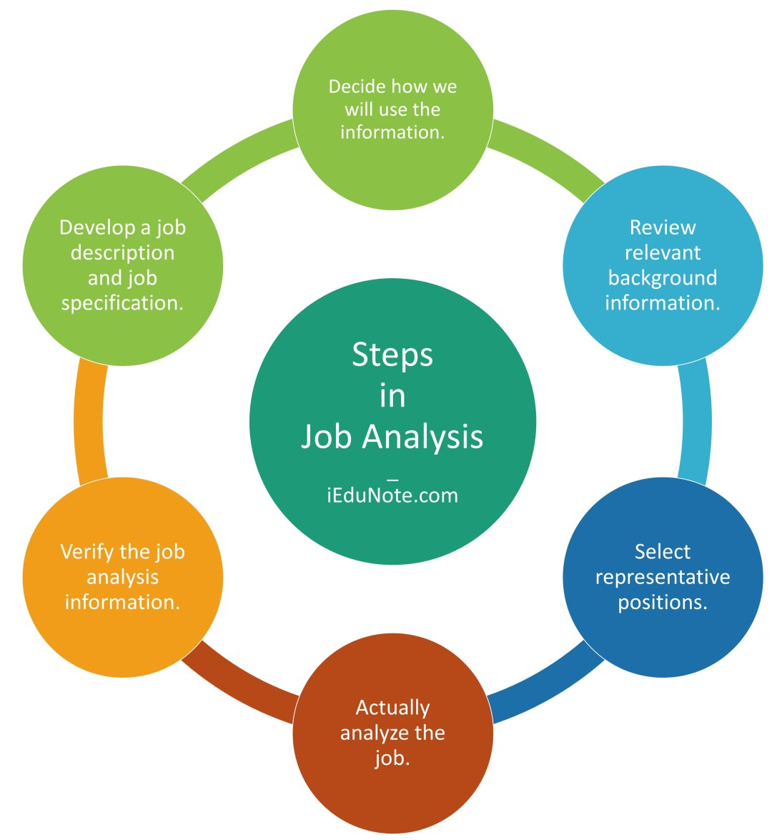
Steps of Job Analysis Process
https://www.iedunote.com/job-analysis

Slide 19
Steps of Job Analysis Process
Step 1: Decide how to use the information.
Decide how to use the information since it determines the data and how to collect it

Slide 20
Step 2: Review relevant background information
Review relevant background information, such as organization charts, process charts, and job descriptions. Organization charts show the organization-wide division of work, with titles of each position and interconnecting lines that report to and communicate with whom.

Slide 21
Step 3: Select representative positions
Select representative positions. There may be too many similar jobs to analyze them all

Slide 22
Step 4: Analyze the job
Analyze the job by collecting data on job activities, required employee behaviors, working conditions, and human traits and abilities needed to perform the job. For this step, use one or more of the job analysis methods.

Slide 23
Step 5: Verify the job analysis information
Verify the job analysis information with the worker performing the job and with his immediate supervisor. This will help confirm that the information is factually correct and complete.

Slide 24
Step 6: Develop a job description and job specification
Develop a job description and job specification.
The job description is a written statement describing the job’s activities and responsibilities and its important features, such as working conditions and safety hazards.
Job specification summarizes the personal qualities, traits, skills, and background required to complete the job. It may be in a separate document or the same document as the job description.

Slide 25
Methods of job analysis
Direct observation- is particularly useful in jobs that consists primarily of observable physical activity like draftsman, mechanics etc. One approach to this method is by observing the worker on the job during a complete work cycle.

Slide 26
Maintenance of Long Records
In this technique the workers are asked to maintain and keep daily records or list of activities they are doing on that day. For every activity he engages in the employee records the activity in the list given.

Slide 27
Questionnaires
Many companies use job analysis questionnaires to secure information on job requirement relating to typical duties and tasks, tools and equipments used

Slide 28
Critical Incident Technique
The critical incident technique for job analysis is especially useful for scientific analysis, and selection research.
In this technique, incidents are short examples of successful or unsuccessful job behavior. After many incidents are collected they are classified into behavioral categories.
These categories describe specific desired job behaviors and can be useful in recruitment and selection decisions.

Slide 29
Techniques of data collection for job analysis
Interviews
There are two types of interviews which can be used for collection of data for job analysis, viz., individual interviews (with groups of employees who do the same job) and supervisory interviews (with one or more supervisors who are thoroughly knowledgeable about the job being analyzed) The interviewer has to collect accurate and complete data and information by creating favorable attitude among employees and supervisors

Slide 30

Job analysis
A process of examining jobs in order to identify their main features, in particular the duties they fulfill, the results they are expected to achieve, the major tasks undertaken, and the job’s relationships with other jobs in the organizational hierarchy
https://www.pexels.com/photo/people-in-the-office-discussing-a-project-7688336/

Slide 31
References
Aswathappa, K, (2014). Human Resource Management, New Delhi, Tata McGraw Hill
Bruno S. Frey, Margit Ostzerloh (2002) "Successful management by motivation : balancing intrinsic and extrinoic incentives, springer-verlag Berlin, Heidelberg, New York, 2002, Pg. 53-54
Biswanath Ghosh, Compensation and Reward Management, New Delhi, Sterling, 2012, Pp. 2 – 3.
Biswanath Ghosh, Ibid, Pp. 43-46.
Tangthong, Sorasak, A causal model of compensation and benefits and reward management on organizational effectiveness of MNCs, Asian Journal of Management Research, Vol. 5, No. 1, January 2014, Pp. 44-65.

Slide 32
References
Tangthong, Sorasak, A causal model of compensation and benefits and reward management on organizational effectiveness of MNCs, Asian Journal of Management Research, Vol. 5, No. 1, January 2014, Pp. 44-65.
Bhattacharyya, Dipak Kumar, Compensation Management, New Delhi, Oxford University Press, 2013, Pp. 11-12.
Biswanath Ghosh, Compensation and Reward Management, New Delhi, Sterling, 2012, Pp. 95.
Singh, BD, Compensation Reward Management, 2nd ed, New Delhi, Excel Books, 2012, Pp.232-236.

Slide 33
References
RF-Studio (2020).https://www.pexels.com/photo/photo-of-women-at-the-meeting-3810792/
https://www.iedunote.com/job-analysis
Tima Miroshnichenko (2021).https://www.pexels.com/photo/a-woman-in-plaid-blazer-using-her-laptop-and-mobile-phone-6693656/
Thirdman(2021). https://www.pexels.com/photo/a-group-of-people-having-a-meeting-in-the-office-7652137/
Andrea Piacquadio(2020). https://www.pexels.com/photo/man-in-black-jacket-standing-under-the-vehicle-3807120/
Bac Bobk(2020). https://www.pexels.com/photo/people-in-the-office-discussing-a-project-7688336/

