Slide 1
Business Finance
Week 3
Introduction to the Concept of Time Value of Money
Lecturer: Dr. Charity Njoka (PhD)

Slide 2
Intended Learning Outcomes
By the end of this lecturer , you should be able to,
Explain meaning of time value of money and its role in finance.
Explain the concept of future value and perform compounding calculations.
Explain the concept of present value and perform discounting calculations.

Slide 3
Introduction
A dollar today is worth more than a dollar tomorrow.
An individual would prefer to receive money now rather than that same amount later.
A dollar today is more valuable than a dollar tomorrow, because
1. The dollar in hand can be put to immediate productive use, and,
2. a dollar in hand is free from the uncertainties of future expectations (It is a sure dollar).

Slide 4
Time Value of Money Techniques
Financial values and decisions can be assessed by using either
Future value (FV) techniques or
Present value (PV) techniques.

Slide 5
Future Value Techniques
FV or terminal value, is the value at some time in future of a present sum of money, or a series of payments or receipts.
It is amount of money an investment will grow to over some period of time at some given interest rate

Slide 6
Present Value Techniques
The Present Value (PV) is the current value of a future amount of money, or a series of future payments or receipts.
Present value is just like cash in hand today.

Slide 7
Future Value Concept (Compounding)
.
The future value (FV) is the amount to which an investment will grow after earning interest.
Knowing the future value enables investors to make sound investment decisions based on their anticipated needs.
However, external economic factors, such as inflation, can adversely affect the future value of the asset/investment by eroding its value.

Slide 8
1. Future Value of Single Amount/Lumpsum
The future value (FV) of a single amount is the amount to which an investment will grow after earning interest if invested for a given period.
For example, money deposited in a bank for one year

Slide 9
Illustration :Future Value of Single Amount
Suppose you have $100 invested in a bank account and that the banks are currently paying an interest rate of 6 percent per year on deposits.
Answer the following three questions,

Slide 10
What is your interest after one year? How much money will you have in the bank account at year end?
Solution
Amount of money in the bank= Interest + Principal amount
Interest = interest rate * initial investment; = 0.06 * $100 = $6.
The value of your investment will grow to $106 by the end of the year
ie $100 +$6 = $106

Slide 11
How much money will you have in the bank at end of second year if you don’t withdraw?
Solution
Your balance, now $106, will continue to earn interest of 6 %
So interest in Year 2 = 0.06 *$106 = $6.36.
So by the end of the year the value of your account will grow to $106 + $6.36 = $112.36.
Thus the initial $100 investment grows twice by a factor 1.06:
Value of account after 2 years = $100 *1.06 *1.06 = $100 * (0.06)2 = $112.36

Slide 12
How much money will you have in the bank at end of third year if you don’t withdraw?
Solution
If you keep your money invested for a third year,
your investment multiplies by 1.06 each year for 3 years.
By the end of the third year it will total $100 *(1.06)³ = $119.10.

Slide 13
If your investment horizon is t years?
If your investment horizon is t years, the original $100 investment will grow to $100 *(1.06)^{t}
For an interest rate of r and a horizon of t years, the future value of your investment will be
Future value of $100 = $100 * (1 + r)^{t}

Slide 14
Types of Interest Calculations
Simple interest. Here interest is calculated on the original investment, the principal amount or amount of loan.
Compound interest. Here interest is calculated on the principal / original amount and the interest of previous periods. This is compounding

Slide 15
Summary
The future value (FV), or compound value, of a present amount, Po, is found as follows.
At end of Year 1, FV₁ =P_{o} (1+r) = Po (1+r)¹
At end of Year 2, FV₂ =FV₁ (1+r) = P_{o}(1+r) (1+r) = Po ( 1+r)²
At end of Year 3, FV₃ = FV₂ (1+r) = Po ( 1+r) ( 1+r) (1+r) = Po (1+r)³
A general equation for the FV at end of t periods can therefore be formulated as,
FV_{t} = Po ( 1+r)^{t}

Slide 16
Illustration
If I invest $1,000 today at 8%, and there is no withdrawal,
Required:
What will it be worth in 1 year?
What will it be worth in 2 years?
What will it be worth in 3 years?

Slide 17
Steps
  Identify the key variables
    Cash flow
    Interest rate
    Time in years
  Determine the FV using Formula
  Multiply cash flow by FV factor from the FV Table

Slide 18
Steps- Solution
Cash Flows
  $1,000 to be paid now
  Cash Receipts are positive numbers
Interest Rate = 8% p.a
Time in Years = 1,2,3

Slide 19
FV using Formula
At end of Year 1, FV₁ =100 (1+8%) = 100 (1+8%)¹ =108
At end of Year 2, FV₂ =108 (1+8%) = 100(1+8%) (1+8%)
= 100 ( 1+8)² = 116.64
At end of Year 3, FV₃ = FV₂ (1+r) = 100 ( 1+8%) ( 1+8%) (1+r8%) = 100 (1+8)³ = 125.97

Slide 20
Extract of Future Value of Single Amount

Slide 21
Solution :FVIF Tables
We read the interest factor from the Table, intercept
of 8% and the specific period
Year I – FVIF _{8%,1}= 100* 1.08 = 108
Year 2 – FVIF _{8%,2}= 100* 1.1664 = 116.64
Year 3 – FVIF _{8%,3}= 100* 1.2597 = 125.97

Slide 22
    Future Value of Annuity
Annuity is a cash flow stream in which the cash flows are regular and happen at regular intervals
For example, a pensioner receiving $100,000 per year for ten years after his retirement.
However an annuity has to satisfy some conditions:-

Slide 23
    Conditions for Future Value of Annuity
  The periodic payment must be equal in amount
  The time period between payments should be constant
  The interest rate per year remains constant
  The interest is compounded at the end of each time period

Slide 24
Types of Annuities
The two basic types of annuities are the ordinary annuity
and the annuity due.
1 An ordinary annuity is an annuity where the cash flow occurs at the end of each period.
2. An annuity due is where cash flows occur at the beginning of each period.
3. Perpetuity- Cash flows occur throughout with no end

Slide 25
Ordinary Annuity Illustration
Paul wants to buy a car in four years’ time, so he setting aside $3,000 (in a bank account) at the end of every year in order to buy the dream car.
If the savings earn interest of 8 percent a year,
How much money will be in the bank account at the end of the four years, assuming that there are no withdrawals from the bank?
.

Slide 26
Ordinary Annuity Illustration Solution
The first year’s savings will earn interest for 3 years,
The second will earn interest for 2 years,
The third will earn interest for 1 year, and
The final savings in Year 4 will earn no interest.
Hence the sum of the future values of the four payments is
($3,000 *1.08) ³+ ($3,000 *1.08)² + ($3,000 *1.08)¹ + $3,000 = $13,518

Slide 27
Future Value of Ordinary Annuity Formula,
FVA ordinary of $1 = ((1 + r)^{t} – 1 ( compounding Factor)
r
Where r= rate of return/ discount rate
t= the number of times money is earning interest
FVA ordinary = A * (1 + r)^{t} – 1
r
Hence the future value of an annuity of $ 3000 for 4 years can be calculated as follows, $ 3000* (1 + r)^{t} -1
r
= $ 3000* (1 + 8%)⁴ -1
8% = $13,518 *

Slide 28
FV Table of Ordinary Annuity Extract
We read the FVIFA , he intersect of 4 yrs and 8%=4.506
The FVA will be 3000* 4.506=$13,518
No. of Years/Periods | Interest Rate per Year/ Period
 | 5% | 6% | 7% | 8% | 9% | 10%
1 | 1.000 | 1.000 | 1.000 | 1.000 | 1.000 | 1.000
2 | 2.050 | 2.060 | 2.070 | 2.080 | 2.090 | 2.100
3 | 3.153 | 3.184 | 3.215 | 3.246 | 3.278 | 3.310
4 | 4.310 | 4.375 | 4.440 | 4.506 | 4.573 | 4.641
5 | 5.526 | 5.637 | 5.751 | 5.867 | 5.985 | 6.105
10 | 12.578 | 13.181 | 13.816 | 14.487 | 15.193 | 15.937

Slide 29
PRESENT VALUE OF MONEY

Slide 30
Present Value Concept (Discounting)
The process of finding present values (PV) is referred to as discounting. It is the inverse of compounding
It seeks to answer the question. “If I can earn r % on my money, what is the most I will be willing to pay now for an opportunity to receive FV shillings n periods from now?”
The annual rate of return r % is referred to as the discount rate, required rate of return, cost of capital, or opportunity cost.
The present value is the value today of a given future amount.

Slide 31
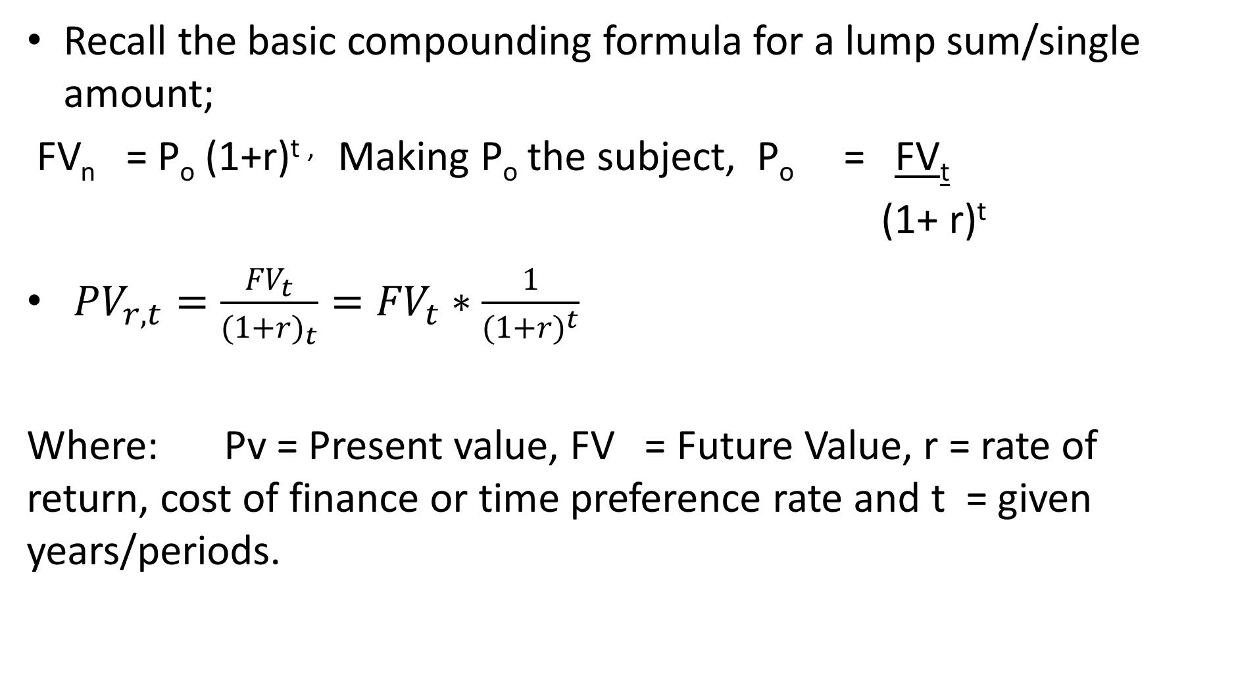
Present Value of single Amount Formula
Recall the basic compounding formula for a lump sum/single amount;
FV_{n} = P_{o} (1+r)^{t ,} Making P_{o} the subject, P_{o} = FV_{t}
(1+ r)^{t}
${PV}_{r,t}=\frac{{FV}_{t}}{{(1+r)}_{t}}={FV}_{t}∗\frac{1}{{(1+r)}^{t}}$
Where: Pv = Present value, FV = Future Value, r = rate of return, cost of finance or time preference rate and t = given years/periods.

Slide 32
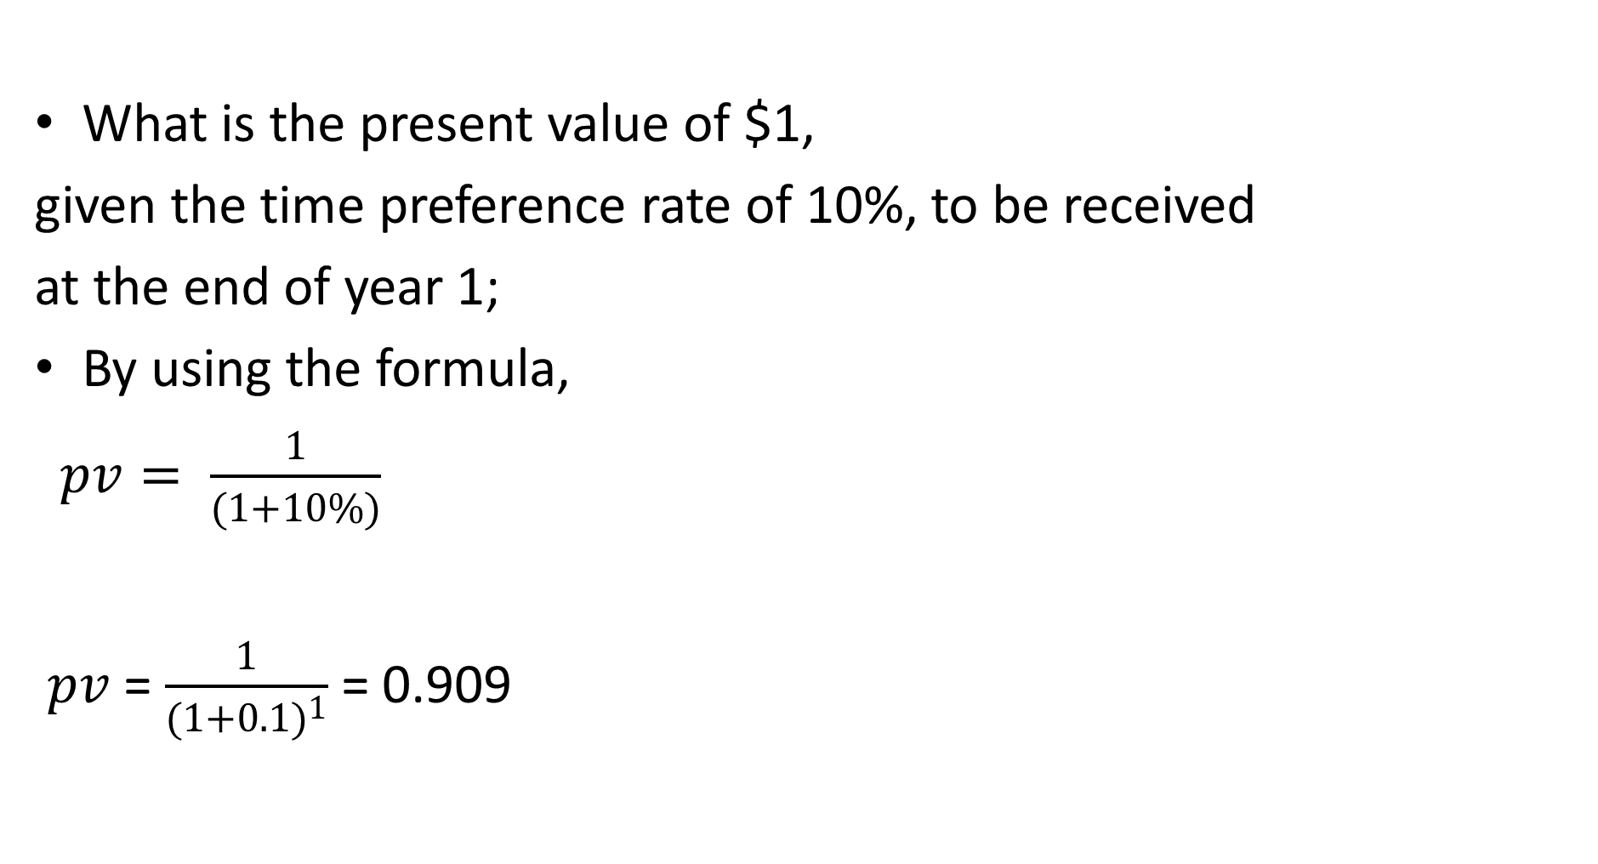
Present Value of single Amount Illustration
What is the present value of $1,
given the time preference rate of 10%, to be received
at the end of year 1;
By using the formula,
$pv= \frac{1}{(1+10\%)}$
$pv$ = $\frac{1}{{(1+0.1)}^{1}}$ = 0.909

Slide 33
Compute the Present Value of a $100 Cash Flow for the Following Combinations of Discount Rates and years:
a) . r = 8 percent. t = 5 years =100* 0.681= 68.1
b) . r = 7 percent. t = 10 years=100* 0.508=50.8
No. of Years | Interest Rate per Year
 | 5% | 6% | 7% | 8% | 9% | 10%
1 | 0.952 | 0.943 | 0.935 | 0.926 | 0.917 | 0.909
2 | 0.907 | 0.890 | 0.873 | 0.857 | 0.842 | 0.826
3 | 0.864 | 0.840 | 0.816 | 0.794 | 0.772 | 0.751
4 | 0.823 | 0.792 | 0.763 | 0.735 | 0.708 | 0.683
5 | 0.784 | 0.747 | 0.713 | 0.681 | 0.650 | 0.621
10 | 0.614 | 0.558 | 0.508 | 0.463 | 0.422 | 0.386

Slide 34
Present Value of Annuities
An annuity is an equally spaced level stream of cash flows.
For example, a 4-year car loan might require 48 equal monthly payments of say $ 1000 per month.
Any such sequence of equally spaced, level cash flows is called an annuity.

Slide 35
Types of Annuities
Ordinary Annuity
Occur at the end of the period (a week, month, year). For example; salaries, dividends etc
Annuity Due
Occur at the beginning of the period (a week, month, year etc). For example, Rent Payments.
Delayed Annuity
Occur at the end of the period but DO NOT start in the first period (a week, month, year,).
Perpetuity. This is a stream of level cash payments that never ends. It is an annuity that never ends, in other words lasts forever.

Slide 36
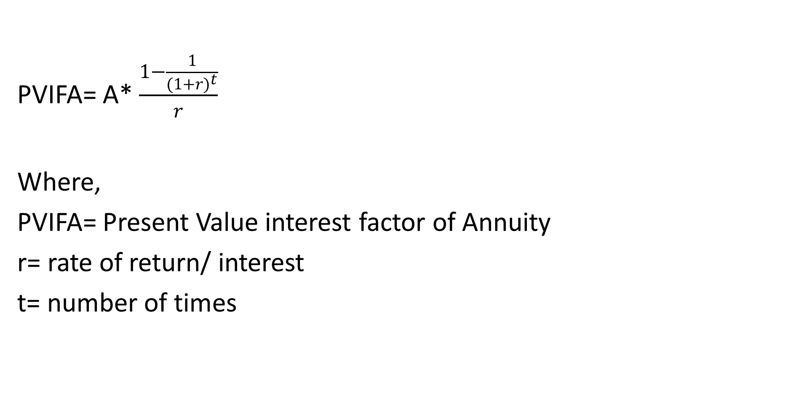
Present Value of Ordinary Annuity Formula
PVIFA= A* $\frac{1−\frac{1}{{(1+r)}^{t}}}{r}$
Where,
PVIFA= Present Value interest factor of Annuity
r= rate of return/ interest
t= number of times
.

Slide 37
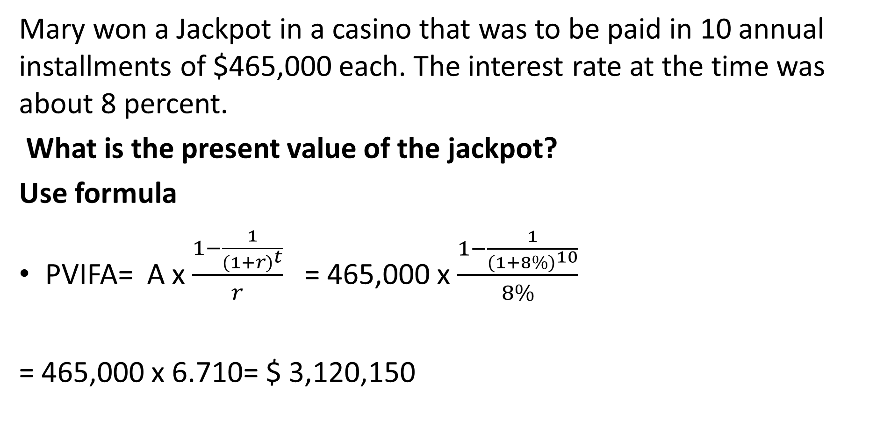
Present value of ordinary Annuity illustration
Mary won a Jackpot in a casino that was to be paid in 10 annual installments of $465,000 each. The interest rate at the time was about 8 percent.
What is the present value of the jackpot?
Use formula
PVIFA= A x $\frac{1−\frac{1}{{(1+r)}^{t}}}{r}$ = 465,000 x $\frac{1−\frac{1}{{(1+8\%)}^{10}}}{8\%}$
= 465,000 x 6.710= $ 3,120,150
.

Slide 38
Extract of Present Value of Annuity Factors (Ordinary)
We read the PVIFA , the intersect of 10 periods and 8%=6.710
= 465,000* 6.710= $ 3,120,150
No. of Years | Interest per year/ period
 | 5% | 6% | 7% | 8% | 9% | 10%
1 | 0.952 | 0.943 | 0.935 | 0.926 | 0.917 | 0.909
2 | 1.859 | 1.833 | 1.808 | 1.783 | 1.759 | 1.736
3 | 2.723 | 2.673 | 2.624 | 2.577 | 2.531 | 2.487
4 | 3.546 | 3.465 | 3.387 | 3.312 | 3.240 | 3.170
5 | 4.329 | 4.212 | 4.100 | 3.993 | 3.890 | 3.791
10 | 7.722 | 7.360 | 7.024 | 6.710 | 6.418 | 6.145

Slide 39
Formula of PV of Perpetuity
.
Yr |  | 1 | 2 | 3 | 4 | 5 | 6 | Present Value
1 | Perpetuity (Ordinary) | $ 1 | $ 1 | $ 1 | $ 1 | $ 1 | $ 1 | 1/ r
2 | Perpetuity (Delayed) | - | - | - | $ 1 | $ 1 | $ 1 | 1/r(1 + r)³

Slide 40
Summary
.
Money has time value.
A dollar today is more valuable than a dollar tomorrow
We use rate of interest to express the time value of money.
Simple Interest may be defined as Interest that is calculated as a simple percentage of the original principal amount.
Compound interest is calculated on total of previously earned interest and the Original Principal.

Slide 41
Summary Ctd
Present value factors are reciprocals of future value factors
Interest rates and future value are positively related
Interest rates and present value are negatively related
Time period and future value are positively related
Time period and present value are negatively related

Slide 42
THE END
We have come to the end of Lecture three
It was nice having you in this class
See you in the next class

Slide 43
REFERENCES
Business Finance, Eddie McLaney, Prentice Hall, 11th Edition, 2017
Fundamentals of Financial Management, Brigham, Eugene F. and Joel F. Houston, Concise 5th Edition, Thomson South-Western, Mason, Ohio, 2006.
Any other Text book on Business Finance
Present value and Future Value Tables

