Slide 1
Business Finance
Week 4
Application of Time Value of Money
Lecturer: Dr. Charity Njoka (PhD)

Slide 2
Intended Learning Outcomes
By the end of this lecturer , you should be able to:
Apply time value of money to accumulate a future sum
Apply time value of money to prepare loan amortization schedules,
Apply time value of money to determine interest rates and growth rates.

Slide 3
Introduction
Time Value Future value and present value techniques have a number of important applications in finance.
These Include,
Deposits needed to accumulate a future sum,
(2) Interest or growth rates
(3) Loan amortization, and
(4) Finding an unknown number of periods.

Slide 4
A. Deposits Needed To Accumulate A Future Sum
1 Asset acquisition
An investor may be interested in acquiring some property some time in future.
Hence will need to accumulate money for the project.

Slide 5
Illustration
Suppose you want to buy a house 5 years from now, and you estimate that an initial down payment of $20,000 will be required at that time. To accumulate the $ 20,000, you wish to make equal annual end-of-year deposits into an account paying annual interest of 6 percent.
Required.
Determine what size annuity will result in a single amount equal to $20,000 at the end of year 5

Slide 6
Solution
This is a future value of $ 20,000 that needs to be accumulated through equal periodical savings at the end of every period.
Hence what amount need to be saved on periodical basis (Ordinary annuity)?
We can use FVIFA Table or Formula

Slide 7

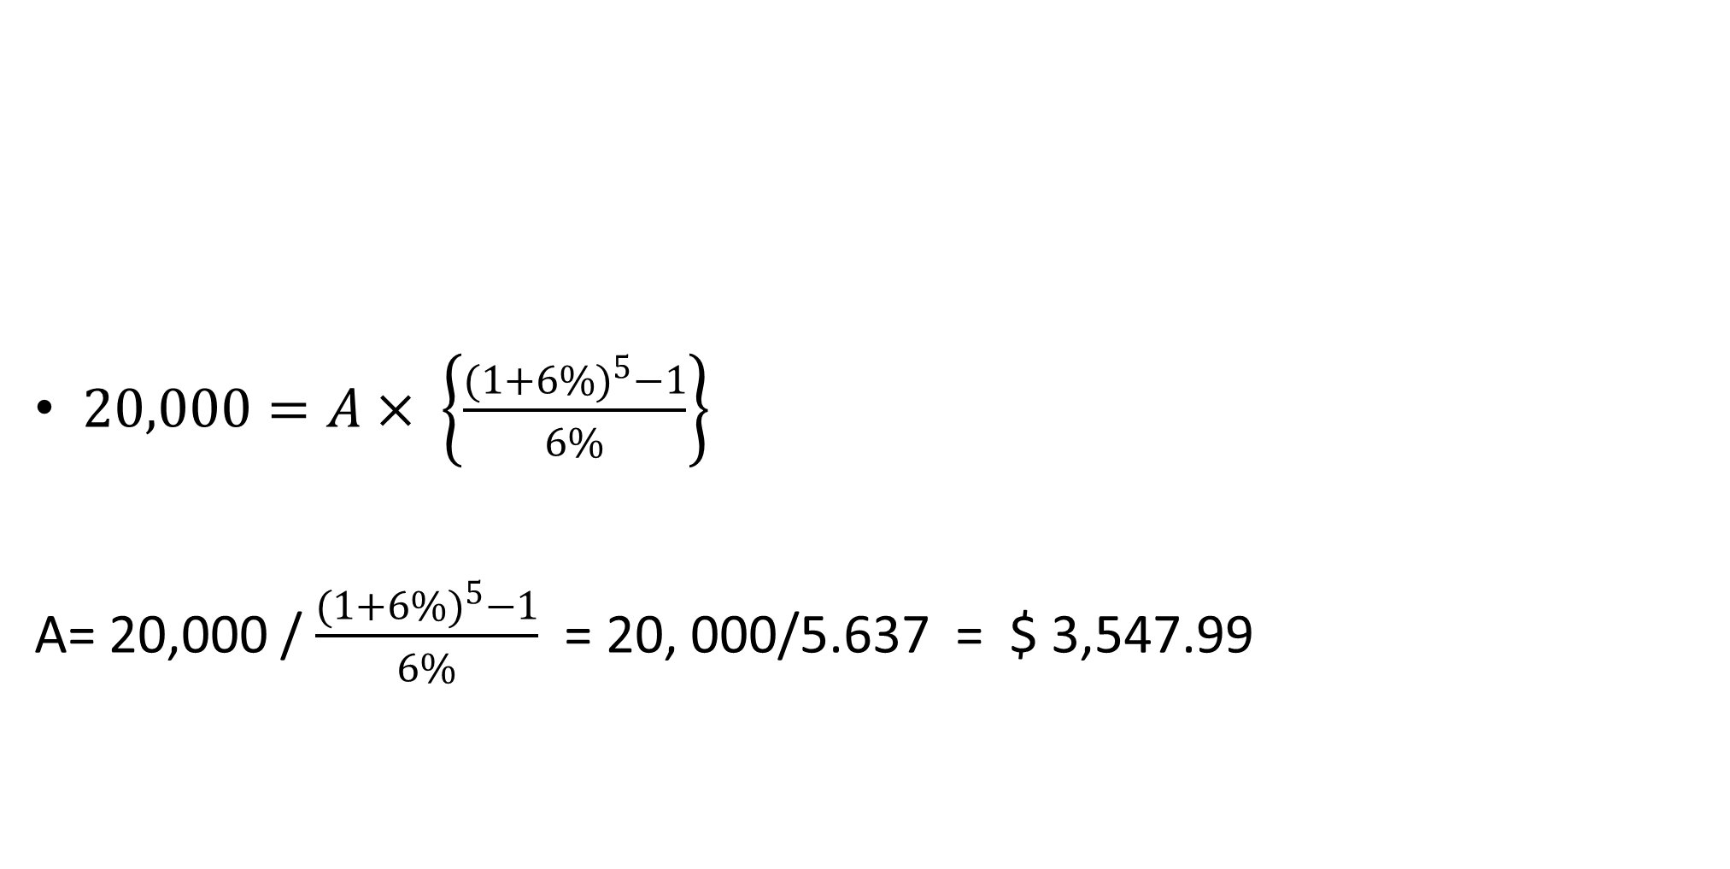
Solution-Formula
$20,000=A× \left\{\frac{{(1+6\%)}^{5}−1}{6\%}\right\}$
A= 20,000 / $\frac{{(1+6\%)}^{5}−1}{6\%}$ = 20, 000/5.637 = $ 3,547.99
$$FVA=A× \left\{\frac{{\left(1+r\right)}^{t}−1}{r}\right\}$$

Slide 8
Solution- FVA
Solution- FVIFA Table
FVA_{t} = A * (FVIFA _{r,t})
FVIFA 6%,5yrs= 5.637
A = FVA_{t} / (FVIFA _{r,t})
A= 20,000/5.637= 3,547.99
No. of Years | Interest Rate per Year
 | 5% | 6% | 7% | 8% | 9% | 10%
1 | 1.000 | 1.000 | 1.000 | 1.000 | 1.000 | 1.000
2 | 2.050 | 2.060 | 2.070 | 2.080 | 2.090 | 2.100
3 | 3.153 | 3.184 | 3.215 | 3.246 | 3.278 | 3.310
4 | 4.310 | 4.375 | 4.440 | 4.506 | 4.573 | 4.641
5 | 5.526 | 5.637 | 5.751 | 5.867 | 5.985 | 6.105
10 | 12.578 | 13.181 | 13.816 | 14.487 | 15.193 | 15.937

Slide 9
2.Sinking Fund Problems
A financial manager may have to determine the amount of annual payments so as to accumulate a specified sum of money on a future date to redeem an existing liability or provide funds for replacement of an existing asset.
A company has $ 200,000, 6% bonds outstanding today. The company has to redeem the bonds after 5 years and establishes a Sinking Fund to provide funds for redemption. Sinking Fund Investments earn interest @ 10% p.a. The investments are made at the end of each year.
Required: What annual payment must the firm make to ensure that the needed $ 200,000 is available on the designated date?

Slide 10
Solution
A = FVA₅ / FVIFA, _{10, 5 yrs}
Referring to the FVIFA tables we find that at
(i) 10 percent and n = 5 years,
the compound value of an annuity of $. 1, is 6.105.
... A = 200,000/6.105 = $. 32,760.03
Hence, the firm should make annual payment of $ 32,760.03 for 5 years.

Slide 11
Illustration
A company has raised a loan of $ 500,000 from a financial institution at 8% p.a. rate of interest.
The amount has to be paid back in 5 equal annual installments. What shall be the size of installment?

Slide 12
Solution
FVA_{t} = A * (FVIFA _{r,t})
Referring to the FVIFA Tables at (r) 8 percent and n, 5 years, we get 3.993
A = 500,000/3,993 = A =$ 125,219.13
So, the firm should pay an annual installment of $. 125,219.13 for 5 years.

Slide 13
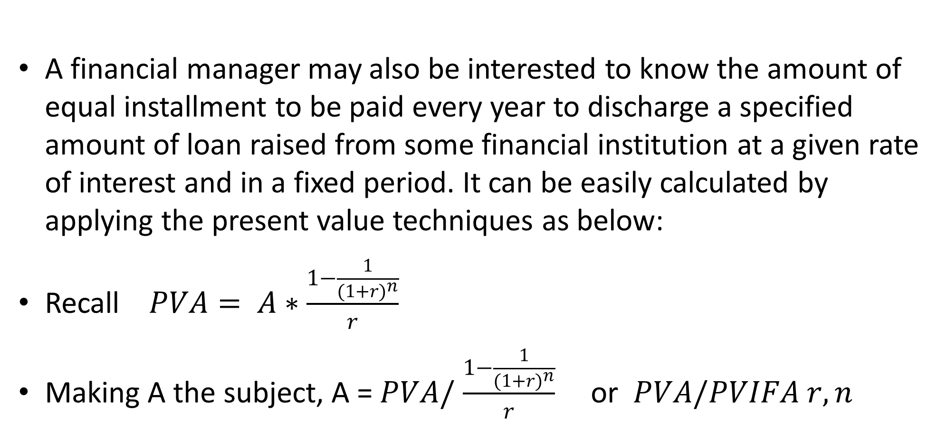
  3. Capital Recovery Problems:
A financial manager may also be interested to know the amount of equal installment to be paid every year to discharge a specified amount of loan raised from some financial institution at a given rate of interest and in a fixed period. It can be easily calculated by applying the present value techniques as below:
Recall $PVA= A∗\frac{1−\frac{1}{{(1+r)}^{n}}}{r}$
Making A the subject, A = $PVA/$ $\frac{1−\frac{1}{{(1+r)}^{n}}}{r}$ or $PVA/PVIFA r,n$

Slide 14
Illustration
Yvonne bought an asset costing $13,000 by making a down payment of $ 3,000 and agreeing to make equal annual payment for 4 years.
How much would be each payment if the interest on unpaid amount be 14% compounded annually?

Slide 15
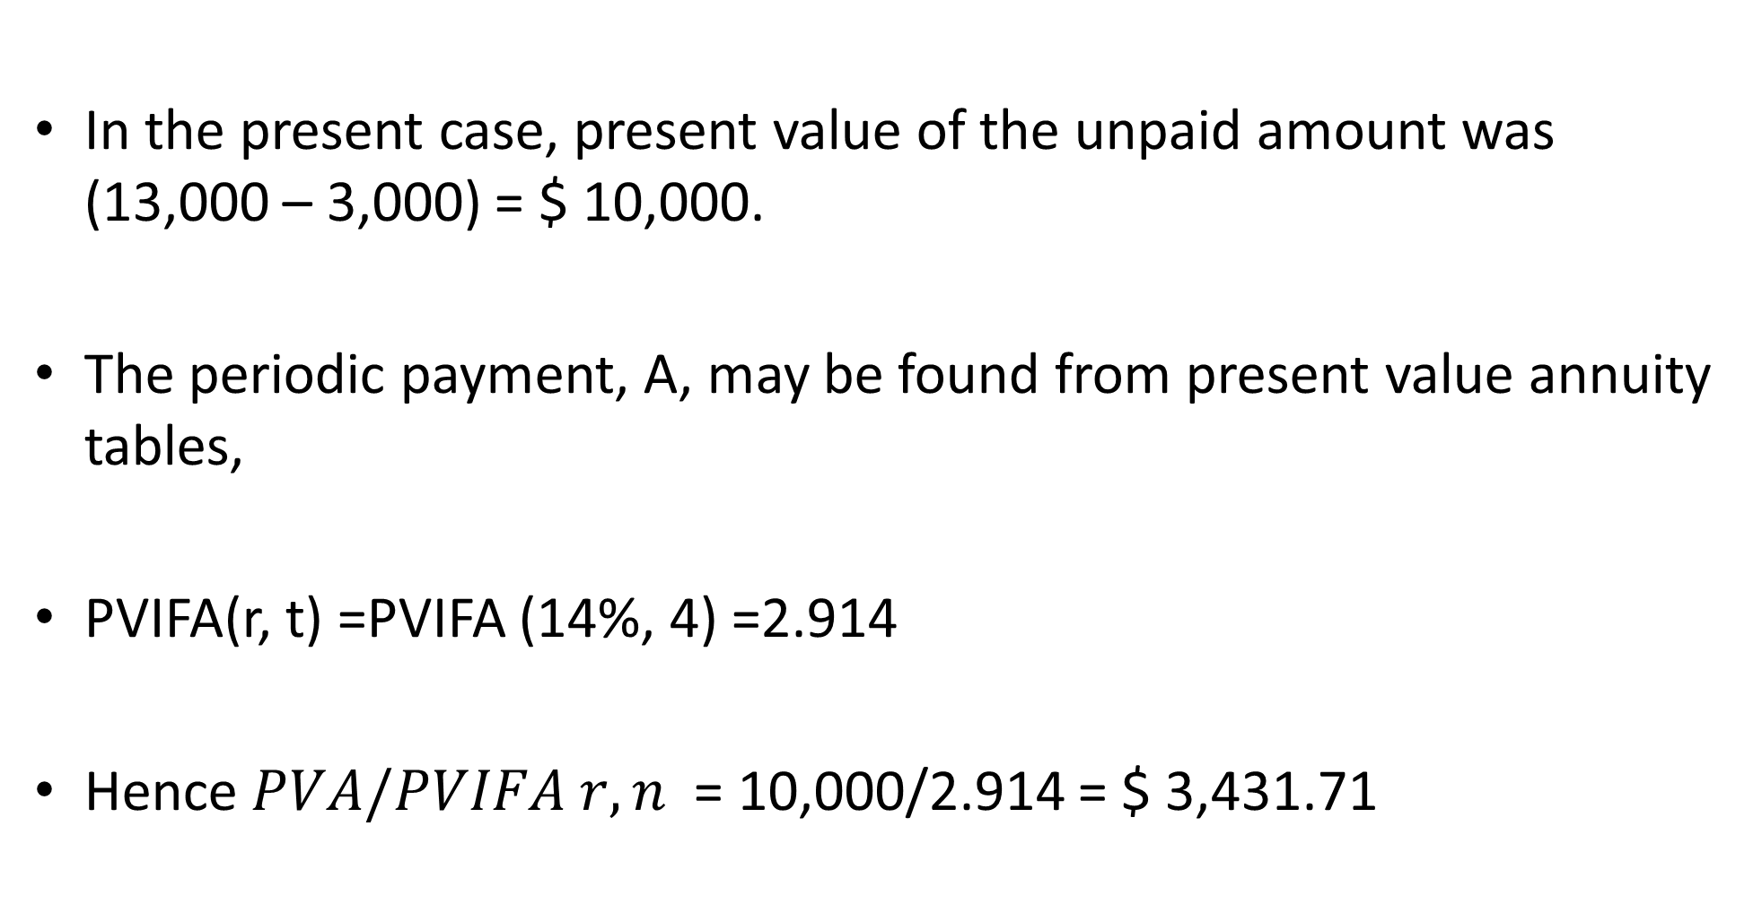
Solution
In the present case, present value of the unpaid amount was (13,000 – 3,000) = $ 10,000.
The periodic payment, A, may be found from present value annuity tables,
PVIFA(r, t) =PVIFA (14%, 4) =2.914
Hence $PVA/PVIFA r,n$ = 10,000/2.914 = $ 3,431.71

Slide 16
Solution- PVIFA Table
No. of Years | Interest Rate per Year
 | 5% | 6% | 7% | 10% | 12% | 14%
1 | 0.952 | 0.943 | 0.935 | 0.909 | 0.893 | 0.877
2 | 1.859 | 1.833 | 1.808 | 1.736 | 1.690 | 1.647
3 | 2.723 | 2.673 | 2.624 | 2.487 | 2.402 | 2.322
4 | 3.546 | 3.465 | 3.387 | 3.170 | 3.037 | 2.914
5 | 4.329 | 4.212 | 4.100 | 3.791 | 3.605 | 3.433
10 | 7.722 | 7.360 | 7.024 | 6.145 | 5.650 | 5.216

Slide 17
B-INTEREST OR GROWTH RATES
1 Compound Growth Rate Problems:
Sometimes a finance manager may have to calculate the compound rate of growth over a period of time, e.g.; for sales or profits.
He can easily calculate such compound rate of growth by making use of future Value Factor Tables

Slide 18
Illustration
From the following data available for ABSAD Co. Ltd,
you are required to calculate compound rate of growth in profits.
Years | 2018 | 2019 | 2020 | 2021 | 2022 | 2023
Profits ($,000) | 60 | 65 | 75 | 87 | 98 | 100

Slide 19
Solution:
Profits have grown form 60 in 2018 to 100 in 2023,
Hence PV= 60 and FV is 100
FV = PV (FVIF _{r,t})
Where, FVIF _{r,t} is future value factor at (r) percent and (t) period.
100 = 60(FVIF _{r,t})
FVIF _{r,t} = 100/60 = 1.666

Slide 20
FVIF Table Extract
Using FVIF Tables for 6 years ,the nearest value to
1.666 is 1.67 at 9%,
Hence the compound rate of growth is nearly 9%.
No. of Years | Interest Rate per Year
 | 5% | 6% | 7% | 8% | 9% | 10%
1 | 1.0500 | 1.0600 | 1.0700 | 1.0800 | 1.0900 | 1.1000
2 | 1.1025 | 1.1236 | 1.1449 | 1.1664 | 1.1881 | 1.2100
3 | 1.1576 | 1.1910 | 1.2250 | 1.2597 | 1.2950 | 1.3310
4 | 1.2155 | 1.2625 | 1.3108 | 1.3605 | 1.4116 | 1.4641
5 | 1.2763 | 1.3382 | 1.3382 | 1.4026 | 1.5386 | 1.6105
6 | 1.3401 | 1.4185 | 1.5007 | 1.5869 | 1.6771 | 1.7716
10 | 1.6289 | 1.7908 | 1.7908 | 1.9672 | 2.3674 | 2.5937

Slide 21
  C. Determining Interest or Growth Rate
=
It is often necessary to calculate the compound annual interest or growth rate implicit in a series of cash flows.
We can use either PVIFs or FVIFs tables.

Slide 22
Illustration
=
Roy wishes to find the rate of interest or growth rate of the following series of cash flows

Slide 23
Solution using PVIF

Slide 24
Solution using FVIF
Note that we can alos use the FVIF
(1,520,000/1,250,000) is 1.216. .
In the row for 4 year in table of Table for FVIFs, the factor for r5% is 1.2155 almost equal to 1.216.
We estimate the growth rate to be 5% as before
=

Slide 25
3. Interest Rate Problems
The time value techniques of compounding and present value can also be applied to calculate the implicit rate of interest in certain situations.
Sometimes a situation may arise in which the the future value of a present sum as well as the number of time periods involved is known but the compound/future value interest rate implicit in the situation is not known.

Slide 26
Illustration 1
An investment company offers to pay $. 20,304 at the end of 10 years to investors who deposit annually $. 1000.
What interest rate is implicit in the offer?

Slide 27
Solution:
Future Value of an Annuity, FVA = A (FVIFA_{r, t})
Where, A = Annual Payment
FVA _{r, t} = Future value Annuity Factor at (i) rate of interest and (t) period.
Substituting the values, 20,304 = 1000 (FVIFA _{r} _{t, =} _{10 years})
or FVIFA _{r} _{t} = 20,304/1,000 = 20.304

Slide 28
Using FVIFA Table
Using Future value Annuity Factor Tables, we find that when t = 10 years and FVIF = 20.304, the rate of interest is 15%.
No. of Years | Interest Rate per Year
 | 5% | 6% | 7% | 10% | 14% | 15%
1 | 1.000 | 1.000 | 1.000 | 1.000 | 1.000 | 1.000
2 | 2.050 | 2.060 | 2.070 | 2.100 | 2.140 | 2.150
3 | 3.153 | 3.184 | 3.215 | 3.310 | 3.440 | 3.473
4 | 4.310 | 4.375 | 4.440 | 4.641 | 4.921 | 4.993
5 | 5.526 | 5.637 | 5.751 | 6.105 | 6.610 | 6.742
10 | 12.578 | 13.181 | 13.816 | 15.937 | 19.337 | 20.304

Slide 29
Illustration 2
A company offers to pay $ 4,007 annually for 5 years for a deposit of $ 16,000 with the company.
What interest rate do you earn on the deposit?
Solution:
PV =(A)( PVIFA _{r} _{t})
or, 16,000 = 4,007 (PVIFA _{r} _{t})
or PVIFA _{r} _{t} = 16,000/4,007 = 3.993

Slide 30
Solution CTD- PVA Table reading
We read 3.993 from PVA table- The rate is 8%

Slide 31
Illustration 3
Agnes was offered an opportunity to invest $100, 000
today with an assurance of receiving exactly $ 300,000
in eight years.
Required. Determine the interest rate
Solution
FV₈ = Po × FVIF_{r,8} as follows.
FV₈ = P₀ (FVIF _{r, 8} )
300,000 = 100,000 (FVIFK_{k,8})
FVIF_{r, 8} = 300,000 / 100,000 = 3.000

Slide 32
Solution CtD – FVIF Table reading
Reading across the 8-period row in the FVIF tables
the factor that comes closest to our value of 3 is 3.059

Slide 33
Solution CtD
To be more precise, of where, 3,000 lies, we can
calculate the rate that lies between 14% and 15% .
At 14% the factor is 2.8526 and at 15% the factor is 3.059
FVIFr,8 = (1+r)⁸
(1+r)⁸ = 3
(1+r) = 3^{1/8} = 30.125
1+r = 1.1472
k = 0.1472 = 14.72%

Slide 34
Loan Amortizing
Discounting and compounding concepts cab be used determining the payments required for an installment – type loan.
The distinguishing features of this loan is that it is repaid in equal periodic (monthly, quarterly, semiannually or annually) payments that include both interest and principal.
Such arrangements are prevalent in mortgage loans, auto loans, consumer loans etc.

Slide 35
Loan Amortization Defn
The term loan amortization refers to the computation of equal periodic loan payments.
These payments provide a lender with a specified interest return and repay the loan principal over a specified period.
.

Slide 36
Loan Amortization Defn CtD
The loan amortization process involves finding the future payments, over the term of the loan, whose present value at the loan interest rate equals the amount of initial principal borrowed
Amortizing a loan actually involves creating an annuity out of a present amount.

Slide 37
Illustration
Determine the equal end of the year payment necessary to amortize fully a $ 600,000, 10% loan over 4 years.
Assume payment is to be rendered
annually,
semi-annually.

Slide 38
Solution - Annual repayments
Annual repayments
First compute the periodic payment using formula/ Equation
A = PVA_{t} /PVIFA_{r,t.}
Using tables we find the PVIFA_{10%,4yrs} = 3.170, and
we know that PVA_{t} = $.600,000
A = 600,000/3.170 = $ 189, 274 per year.
.

Slide 39
Loan Amortization schedule-Annual Repayments
 |  |  | Payments
End of year | Loan payment | Beg. Of year principal | Interest | Principal | End of year principal.
 |  |  | [10%x (2)] | [ (1) – (3) | [ (2) – (4)]
 | (1) | (2) | (3) | (4) | (5)
1 | 189,274 | 600,000 | 60,000 | 129,274 | 470,726
2 | 189,274 | 470726 | 47,073 | 142,201 | 328,525
3 | 189,274 | 328525 | 32,853 | 156,421 | 172,104
4 | 189,274 | 172104 | 17,210 | 172,064 | -

Slide 40
Solution – Semi-Annual Repayments
ii)For semi-annual repayments the number of periods,
n, is 8 and the discount rate is 5%.
Lets compute the periodic payment using equation
A = PVA_{n} /PVIFA_{k,n.}
Using tables we find the PVIFA_{5%, 8 periods} =6.4632, and
we know that PVA_{n} = $ 600,000
A = 600,000/6.4632 = $ 92,833 per year.

Slide 41
Loan Amortization schedule-Semi-Annual Repayments
 |  |  | Payments
End of period (6months) | Loan payment | Beg. Of year principal | Interest | Principal | End of period principal.
 |  |  | [5%x (2)] | [ (1) – (3) | [ (2) – (4)]
 | (1) | (2) | (3) | (4) | (5)
1 | 92,833 | 600,000 | 30,000 | 62,833 | 537,167
2 | 92,833 | 537,167 | 26,858 | 65,975 | 471,192
3 | 92,833 | 471,192 | 23,559 | 69,274 | 401918
4 | 92,833 | 401, 918 | 20,096 | 72,737 | 329,181
5 | 92,833 | 329,181 | 16,459 | 76,374 | 252,807
6 | 92,833 | 252,807 | 12,481 | 80,192 | 172,615
7 | 92,833 | 172,615 | 8,631 | 84,202 | 88,413
8 | 92,833 | 88,413 | 4,421 | 88,412 | -0-

Slide 42
SUMMARY
TVM techniques are used to assess the impact of proposed actions.
Firms’ long lives and their important decisions affect their long-term cash flows, thus effective application of TVM is extremely important.

Slide 43
SUMMARY- CtD
TVM techniques enable financial managers to evaluate cash flows occurring at different times - to combine, compare, and evaluate them and link them to the firm’s overall goal
Using TVM techniques, we can measure the firm’s value and evaluate the impact that various events and decisions on the firm
An understanding of TVM techniques and an ability to apply them are needed in order to make intelligent value-creating decisions.

Slide 44
THE END
We have come to the end of Lecture five
It was nice having you in this class
See you in the next class

Slide 45
REFERENCES
Financial Management, Pandey. I.M., 2021, Pearson Education India, New Delhi
Financial Management: Principles and Applications. Sheridan Titman, Arthur J. Keown, and John D. Martin, 2019,Pearson Education India, New Delhi.
Lectures on Corporate Finance, Bassaersts, P, Bernt O, World Scientific publishing Co.pte td, 2006
Principles of Corporate Finance, Brealey, Myers & Allen, the McGraw-Hill Companies, Inc., 2007.

