Slide 1
Business Finance
Week 5
Valuation of Securities
Lecturer: Dr. Charity Njoka (PhD)

Slide 2
Intended Learning Outcomes
By the end of this lecturer , you should be able to:
Distinguish among the various valuation concepts.
Describe the key inputs in, and the basic valuation model.
Apply the basic valuation model to the valuation of bonds, preferred stock, and ordinary shares

Slide 3
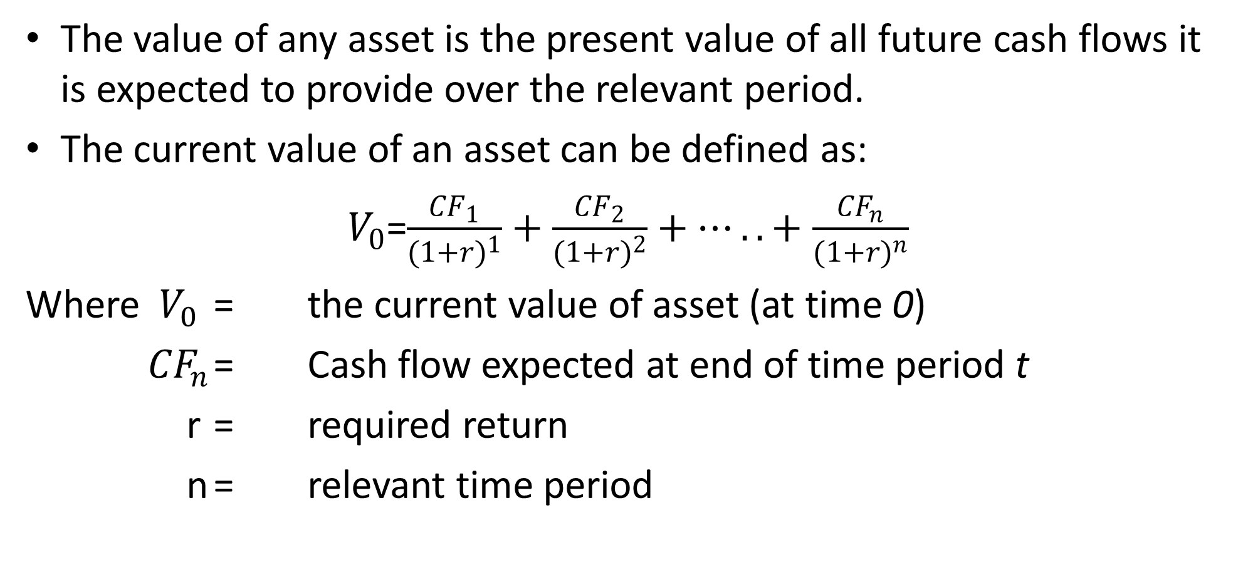
Introduction
The value of any asset is the present value of all future cash flows it is expected to provide over the relevant period.
The current value of an asset can be defined as:
$V_{0}$=$\frac{{CF}_{1}}{{(1+r)}^{1}}+$ $\frac{{CF}_{2}}{{(1+r)}^{2}}+…..+$ $\frac{{CF}_{n}}{{(1+r)}^{n}}$
Where $V_{0}$ = the current value of asset (at time 0)
${CF}_{n}$ = Cash flow expected at end of time period t
r = required return
n = relevant time period

Slide 4
Introduction CtD
Using PVIF notation the basic valuation equation can be stated as;
Firm’s long term securities include bonds, preferred stock and ordinary shares.
The simplest and most common type of bond is the one that pays the bondholder 2 types of cash flows:
  Periodic interest
  Face value of bond at maturity
CF₁ x (PVIF_{r,1}) + CF₂ x (PVIF_{r,2}) +…+ CF_{n} x (PVIF_{r,t})

Slide 5
Bond Valuation
Bonds are long-term debt instruments used by
business and government to raise money.
Most bonds:
  Pay interest semi-annually
  Have an initial maturity rate of 10-30 years
  Have a given par or face value that must be repaid at maturity

Slide 6
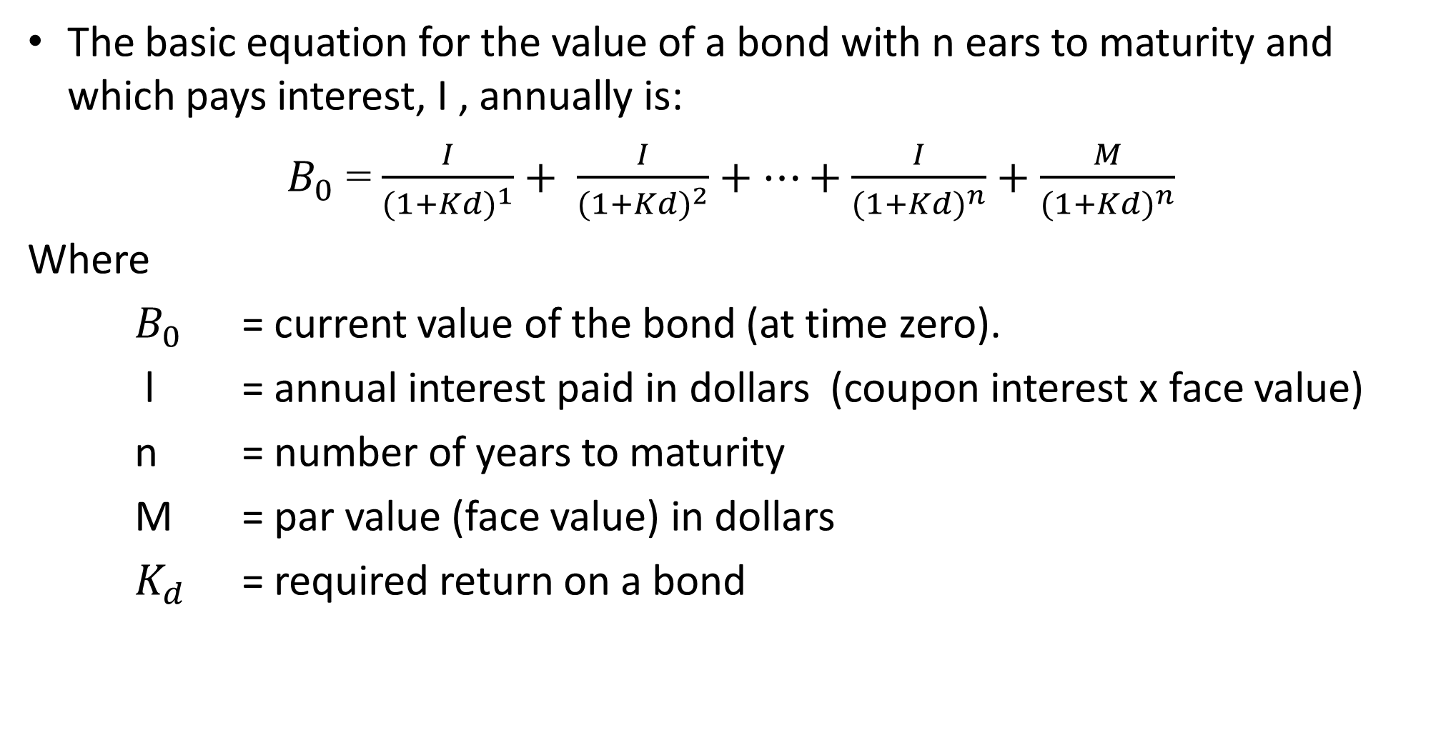
Bond Valuation CtD
The basic equation for the value of a bond with n ears to maturity and which pays interest, I , annually is:
$B_{0}$ = $\frac{I}{{(1+Kd)}^{1}}+ \frac{I}{{(1+Kd)}^{2}}+…+\frac{I}{{(1+Kd)}^{n}}+\frac{M}{{(1+Kd)}^{n}}$
Where
$B_{0}$ = current value of the bond (at time zero).
l = annual interest paid in dollars (coupon interest x face value)
n = number of years to maturity
M = par value (face value) in dollars
$K_{d}$ = required return on a bond

Slide 7
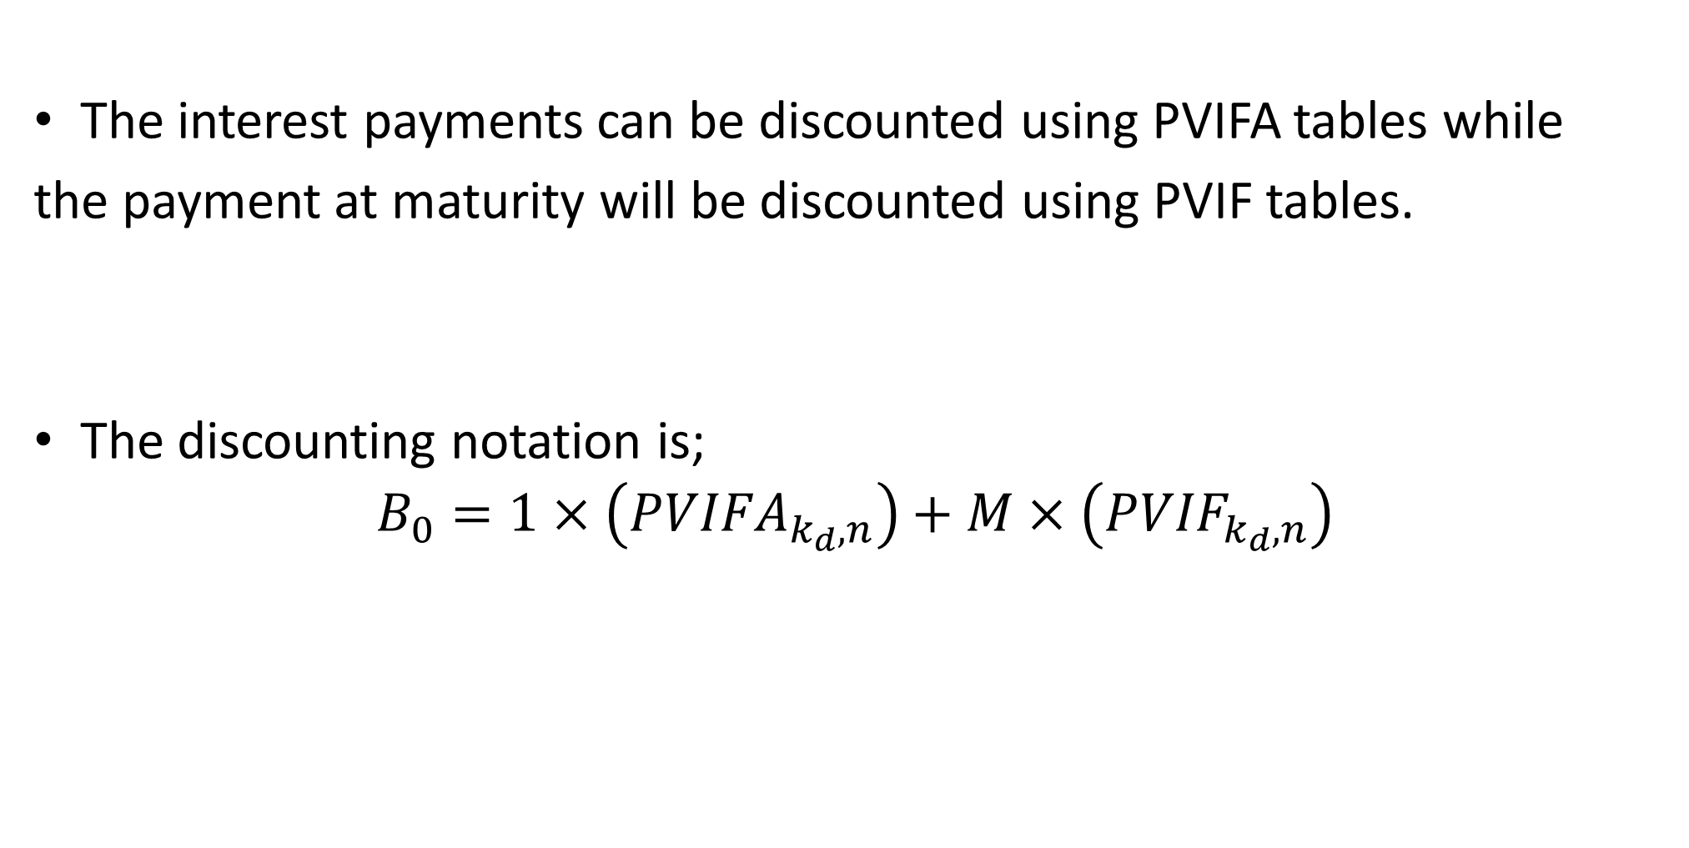
Bond Valuation CtD
The interest payments can be discounted using PVIFA tables while
the payment at maturity will be discounted using PVIF tables.
The discounting notation is;
$$B_{0}=1×\left({PVIFA}_{k_{d},n}\right)+M×\left({PVIF}_{k_{d},n}\right)$$

Slide 8
Bond Valuation Illustration
Milland Company has issued a 10% coupon interest rate, 10 year bond with a $ 1000 par value, which pays interest annually.
The required rate of return of similar bonds is 10%.
Required:
What is the value of the bond?

Slide 9
Solution
I = par value x coupon rate = 1000*10% = $ 100
M = 1000
k_{d} = 10%
n = 10 years
Substituting the values in the valuation formula for bonds leads to,
B₀ = 100 x (PVIFA_{10%,10yrs}) + 1000x (PVIF_{10%,10yrs})
= 1000 x 6.145 + 1000 x .386 =$1000.50.
NB: The answer is the same as the par value of $ 1000 except for rounding differences

Slide 10
Factors Affecting the Value of Bonds
In practice, the value of a bond in the market is rarely equal to its par value. This depends on:
a) Required Returns and Bond Values
The required return on bond may differ from the coupon interest rate thus the bond value will differ from its par value.

Slide 11
Why the Required Return differs from Coupon Rate
The required return may differ due to:
  Changed economic times since the bind was issued, causing a shift in cost for long-term funds
  The firm’s class risk may change

Slide 12
a) Required Returns and Bond Values
When the required return is greater the coupon interest rate, the bond value, will be less than its par value , and the bond sells at a discount . (Selling below the Par value).
When the required return falls below the coupon interest rate, the bond value, will be greater than par, and the bond sells at a premium equal to (Selling above the par value)

Slide 13
Illustration- Required return> Coupon Rate
In in the example of Milland Company,
the required return is 12%, (greater than coupon rate of 10%),
what would be the value of the bond?

Slide 14
Illustration solution
B₀ = 100 x (PVIFA_{12%,10yrs}) + 1000x (PVIF_{12%,10yrs})
= 100 x 5.650 + 1000 x .322 = $.887.00.
The bond will sell at a discount of $.113 (1000-887)
The bond is said to be a discount bond.

Slide 15
Illustration- Required Return< Coupon Rate
If in the example of Milland Company,
the required return is 8 %, (lower than coupon rate of 10%),
what would be the value of the bond?

Slide 16
Illustration- solution
The value would be:
B₀ = 100 x (PVIFA_{8%,10yrs}) + 1000x (PVIF_{8%,10yrs})
= 100 x 6.710 + 1000 x .463 = $1134.00
The bond will sell at a premium of $134 (1134 – 1000).
The bond is called a premium bond
NB: There is inverse relationship between value of a bond and the required rate of return.

Slide 17
Factors Affecting the Value of Bonds CTd b) Time to maturity and Bond Values
The value of bond will approach par value as the passage of time moves the bond’s value closer to maturity
  i.e. when required return equals the coupon rate the bond’s value remains at par until it matures.

Slide 18
Perpetual Bonds
This is a bond that never matures- a perpetuity.
The present value of a perpetual bond is equal to the capitalized value of an infinite stream of interest payments.
If a bond promises, fixed annual interest payment, I, forever its value at investors required rate of return, k_{d}, is:

Slide 19
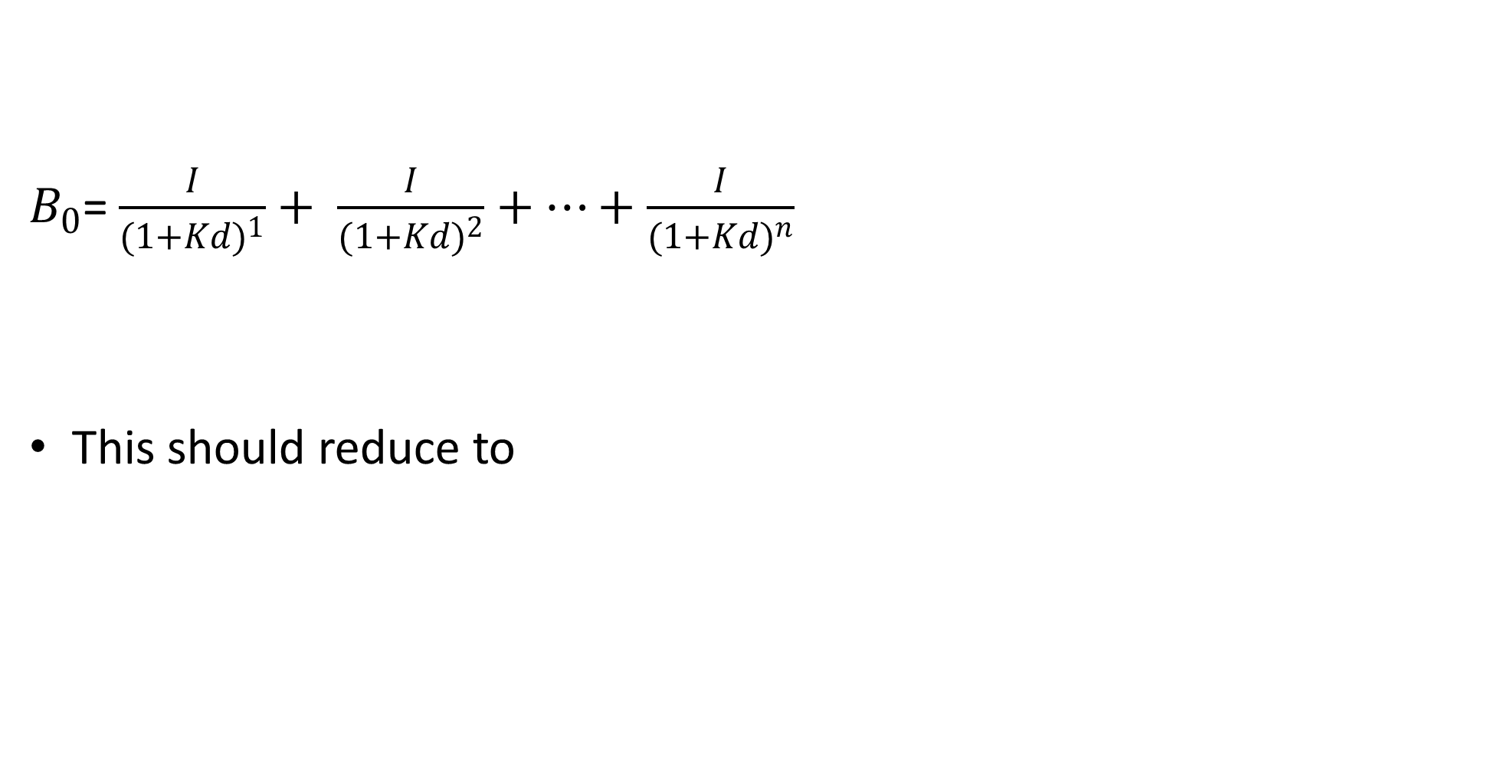
Perpetual Bonds Valuation
$B_{0}$= $\frac{I}{{(1+Kd)}^{1}}+ \frac{I}{{(1+Kd)}^{2}}+…+\frac{I}{{(1+Kd)}^{n}}$
This should reduce to

Slide 20
Illustration
You intend to buy a bond that pays $ 500 per year forever.
Required
If your required rate of return is 12%, what is the maximum you should pay for the bond?
Solution:
The PV of the security would be
B₀ = 500/0.12 = $4,166.7
This is the amount you will be willing to pay for this bond.

Slide 21
Zero Coupon Rate Bonds
=
Zero coupon rate bonds make no periodic interest payment
It is normally a bond that is sold at a deep discount from its face value.
The bond is redeemed at face value upon its maturity.

Slide 22
Zero Coupon Rate Bonds Valuation
=
The valuation formula for a zero coupon bonds is truncated version of that used for normal interest paying bond.
The present value of interest payment is not considered leaving only the payment at maturity.
Therefore, =

Slide 23
Illustration- Zero Coupon Bond
ABCO Ltd., issues a zero coupon bond having a 10 year maturity and a face value of $ 1000. Investors require a return of 12%. How much should an investor pay for the bond?
B₀ = 1000/(1.12)¹⁰
= 1000 (PVIF_{12%,10yrs})
= 1000 x 0.322
= $322
The bond is worth $ 322.

Slide 24
Semi-Annual Compounding Interest
Most bonds pay interest twice a year therefore leading to changes in valuation.
Notice that the assumption of semi-annual accounting once taken applies even to the maturity value.
=

Slide 25
Illustration
10% coupon bonds of ABCO Ltd., have 12 years to maturity and annual required rate of return is 14%.
What is the value of a $ 1000 par value bond that pays interest semi-annually?
=50 (11.469) + 1000 (.197) = $770.4

Slide 26
Preference Shares
This is a type of stock that promises a fixed dividend but at the discretion of the Board of directors.
It has preference over ordinary shares in the payment of dividends and claims on the assets.
It has no maturity date (unless redeemable) and
Gives the fixed nature of the dividend is similar to a perpetuity.

Slide 27
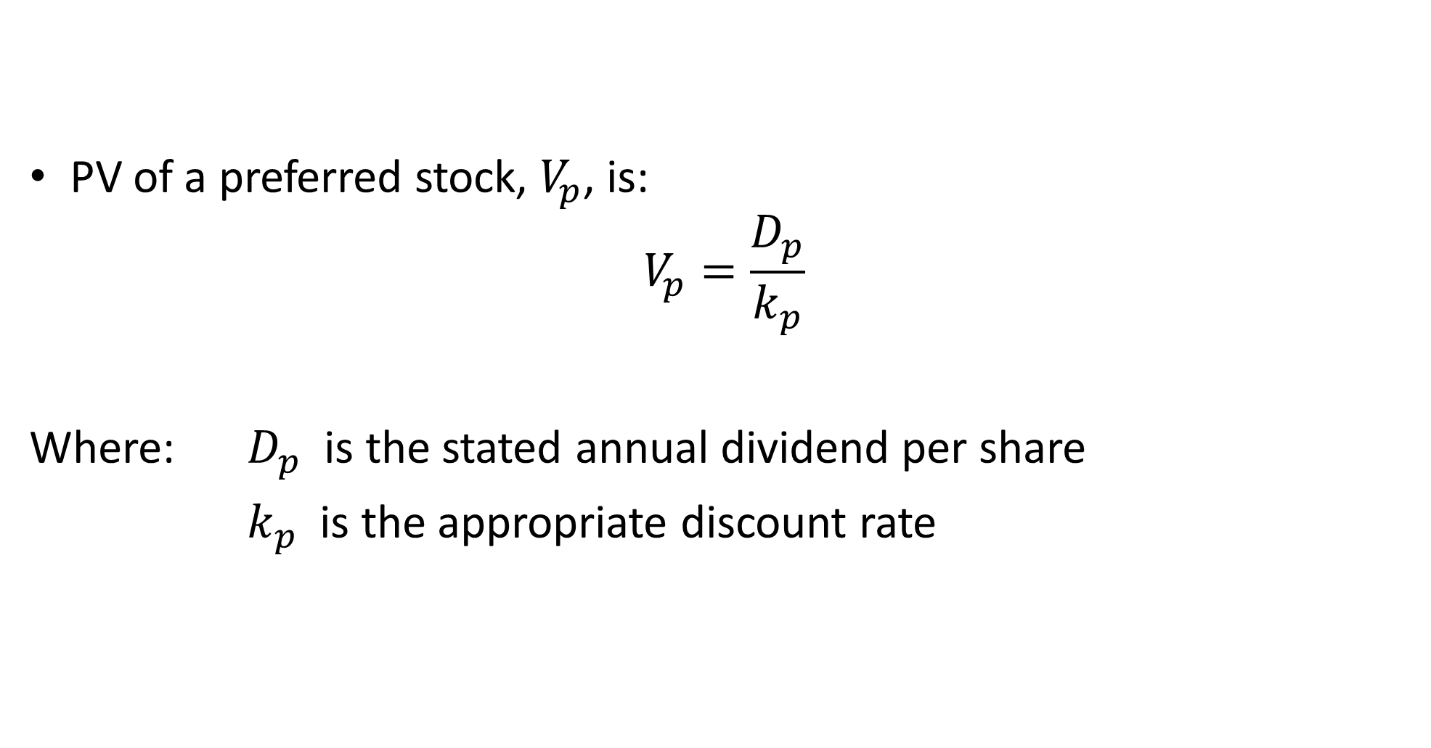
Preference Shares Valuation
PV of a preferred stock, $V_{p}$, is:
$$V_{p}=\frac{D_{p}}{k_{p}}$$
Where: $D_{p}$ is the stated annual dividend per share
$k_{p}$ is the appropriate discount rate

Slide 28
Illustration – Preference Shares
A company had issued a 9% $100 par value preference shares and an investors require a rate of return of 14% on this investment.
Find the value of a preference share to investors.
Solution D_{p} = 9% x 100 = $9
k_{p} = 14
The value of the preference share is,
V_{p} = 9/0.14
= $ 64.29

Slide 29
Valuation of Ordinary Shares
Common shareholders expect to be rewarded through periodic cash dividends and an increasing share value.
It is the expectation of future to dividends and a future selling price (which itself is based on future dividends) that gives value to a share.
Cash dividends are broadly defined to mean all cash distributions and are the foundation for valuation of shares.

Slide 30
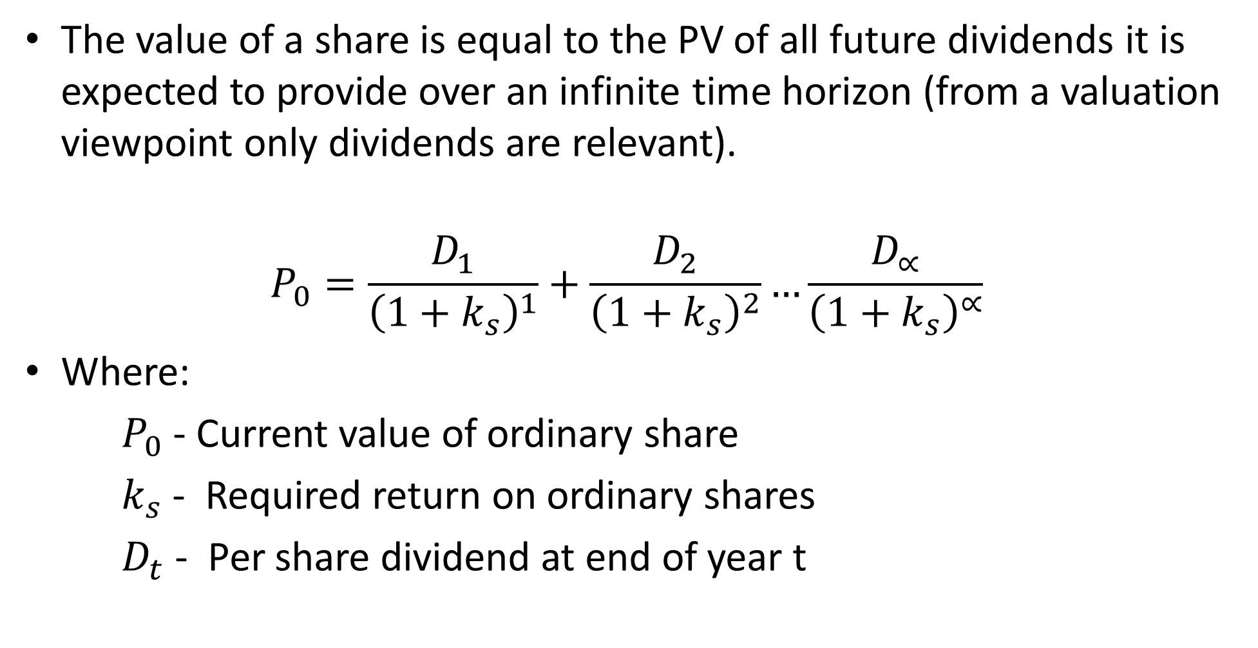
Basic Stock/Share Valuation Equation
The value of a share is equal to the PV of all future dividends it is expected to provide over an infinite time horizon (from a valuation viewpoint only dividends are relevant).
$$P_{0}=\frac{D_{1}}{{\left(1+k_{s}\right)}^{1}}+\frac{D_{2}}{{\left(1+k_{s}\right)}^{2}}…\frac{D_{∝}}{{\left(1+k_{s}\right)}^{∝}}$$
Where:
$P_{0}$ - Current value of ordinary share
$k_{s}$ - Required return on ordinary shares
$D_{t}$ - Per share dividend at end of year t

Slide 31
  Share Valuation Equation- Dividend assumptions
To estimate the value of ordinary stock there are three dividend growth assumptions:
  Zero growth in dividends
  Constant growth in dividends
  Variable growth phases

Slide 32
Common Stock Valuation (Zero Growth Valuation)
Zero growth common stock assumes that the expected future dividend per period will be the same and it will last forever.
Zero growth assumes a constant, non-growing dividend stream i.e. D₁ = D₂ = … = D_{α} = D. The dividend stream is a perpetuity and can be valued as such i.e.
where
k_{s} =the required rate of return on common stock per period

Slide 33
    Illustration- Zero growth Dividend
The dividend of DenT Company is expected to remain constant at $3 indefinitely.
If required return on its stock is 15% , whats the value of the share
The value of its ordinary share would be $20 i.e.

Slide 34
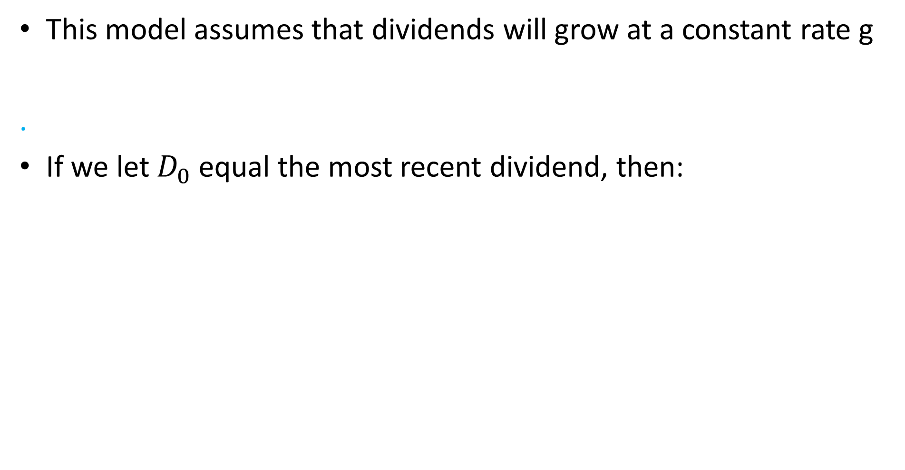
Constant Growth Model
This model assumes that dividends will grow at a constant rate g
.
If we let $D_{0}$ equal the most recent dividend, then:

Slide 35
Constant Growth Model CtD
The equation can be rewritten as:
D₁ is the coming year’s dividend
k_{s} is the required return on the stock
g is the constant growth rate in dividends
This equation is known as Gordon’s model, a common name for the constant growth model.

Slide 36
Illustration- Constant growth model
Lama Company has paid the following dividends over the past years
Year Dividend per share
2012 1.00
2013 1.05
2014 1.12
2015 1.20
2016 1.29
2017 1.40
The average growth of dividends for the past five years is expected to persist in the foreseeable future. You are required to determine the value of the company’s shares after payment of the dividend of 2017.

Slide 37
Illustration -Solution
First find the average rate of growth in dividend over last five years.
Let the average growth rate be g.
Then the dividend of year 2017 denoted by D₂₀₁₇ is found by growing the dividend of year 2013 as follows:
D₂₀₁₇ = D₂₀₁₃ x (1+g)⁵
(1+g) ⁵ = D₂₀₁₇/D₂₀₁₃
= 1.40

Slide 38
Illustration –Solution CtD
By looking across the table for FVIFs (in the 5-year row) the factor closest to 1.40 for 5 years is 7%.
Therefore, g is 0.07.
=$18.75 is the value of the stock

Slide 39

Variable Growth Model
Dividends initially grow at a supernormal rate for a number of years followed by normal growth rate into the foreseeable future.
Po= Value of share
gs= Initial supernormal Growth
gn = Normal growth

Slide 40
Steps
1. Find the value of dividends at the end of each year D_{t}, during the initial growth years 1 to n by
D_{t} = D₀ x (1 + g_{s})^{t}

Slide 41


Steps CtD
2. Find present value of the dividends expected
during the initial growth phase i.e.
=

Slide 42

Steps CtD:
3. Find value of stock at the end of the initial growth phase i.e
(Same as Gordon’s constant growth model)
Next we discount P_{n} to the present ie
.
4. Add the PVs in 2 and 3 to find the value of the stock

Slide 43
Illustration-Variable Growth
WAKE Industries has just paid the 2014 annual dividend of $ 1.50 per share.
The firm’s financial manager expects that these dividends will increase at 10% annual rate over the next 3 years.
At the end of 3 years, (end of 2017) the growth rate will decline to 5% in future. The firm’s required rate of return is 15%.
Estimate the current value of Weka share i.e. the value at end of 2014 (P₀ = P₂₀₁₄).

Slide 44
Solution
Find value of cash dividends in each of the next 3 year
and their PVs at end of year 2014 as below:
Remember D₀ =D₂₀₁₄ =$1.50
Year(t) | End of year | Dividend =D₀ (1.1)^{t} |  | Present value
1 | 2015 | 1.65 | 0.870 | 1.44
2 | 2016 | 1.82 | 0.756 | 1.38
3 | 2017 | 2.00 | 0.658 | 1.32
Present value of dividends during initial growth phase |  |  |  | $ 4.14

Slide 45
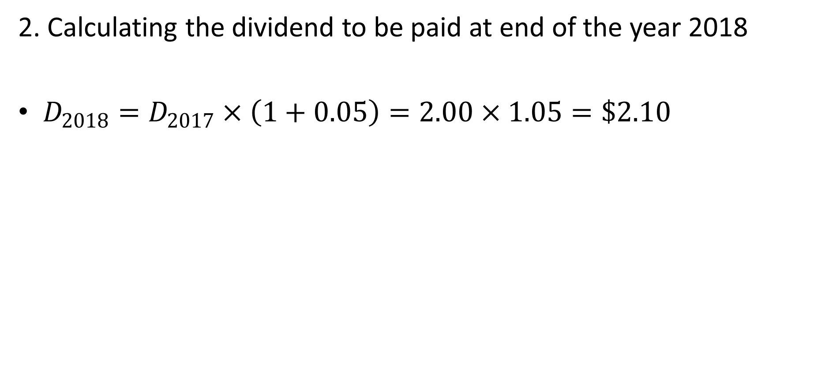
Solution CtD
2. Calculating the dividend to be paid at end of the year 2018
$D_{2018}=D_{2017}×\left(1+0.05\right)=2.00×1.05=\$2.10$

Slide 46
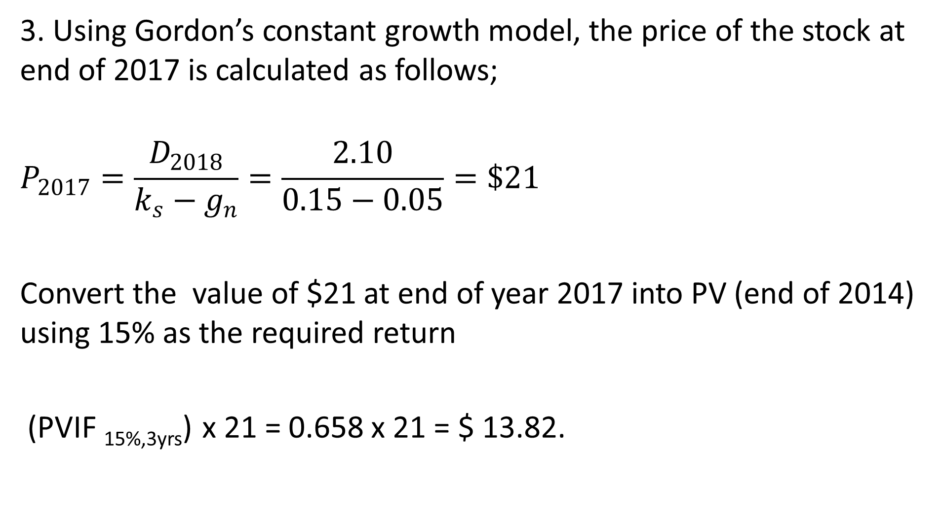
Solution CtD
3. Using Gordon’s constant growth model, the price of the stock at end of 2017 is calculated as follows;
$$P_{2017}=\frac{D_{2018}}{k_{s}−g_{n}}=\frac{2.10}{0.15−0.05}=\$21$$
Convert the value of $21 at end of year 2017 into PV (end of 2014) using 15% as the required return
(PVIF _{15%,3yrs}) x 21 = 0.658 x 21 = $ 13.82.

Slide 47
Solution CtD
4. Finally, we add the present values to get the value of the stock i.e.
P₂₀₁₄ = 4.14 + 13.82 = $ 17.96

Slide 48
THE END
We have come to the end of Lecture five
It was nice having you in this class
See you in the next class

Slide 49
REFERENCES
Financial Management , Pandey. I.M., 2021, Pearson Education India, New Delhi
Financial Management: Principles and Applications. Sheridan Titman, Arthur J. Keown, and John D. Martin, 2019,Pearson Education India, New Delhi.
Financial Management,,M.Y. Khan. M. Y and Jain. P.K., 2018, McGraw Hill Education, New Delhi
Fundamental of Financial Management Eugene F. Brigham, Joel F. Huston, 2018, , Cengage Learning India, New Delhi.
Principles of Corporate Finance, Richard Brealey, Stewart Myres & Franklin Allen, 2019, Mc Graw Hill, New Delhi .

