Slide 1
Business Finance
Week 8
Introduction to the Concept of Cost of Capital
Lecturer: Dr. Charity Njoka (PhD)

Slide 2
Intended Learning Outcomes
By the end of this lecturer , you should be able to:
1. Understand the meaning and application of cost of capital.
2. Compute specific costs of capital.

Slide 3
Introduction
The cost of capital is the cost of having capital for long period from different sources of finance.
It is the return expected by the providers of capital (i.e. shareholders, lenders and the debt-holders) to the business as a compensation for their contribution to the total capital.
Cost of capital is also known as ‘cut-off’ rate, ‘hurdle rate’, ‘minimum rate of return’ etc.
The cost of capital of a project is the minimum required rate of return expected on funds committed to the project.

Slide 4
Significance of Cost of Capital
Evaluation of investment options-The estimated benefits (future cash-flows) from available investment opportunities (business or project) are converted into the present value of benefits by discounting them with the relevant cost of capital
Performance Appraisal-Cost of capital is used to appraise the performance of a particulars project or business. The performance of a project or business in compared against the cost of capital which is known here as cut-off rate or hurdle rate. A high cost of capital is an indicator of high risk

Slide 5
Significance of Cost of Capital-Ctd
3. Designing of optimum credit -While appraising the credit period to be allowed to the customers, the cost of allowing credit period is compared against the benefit/ profit earned by providing credit to customer of segment of customers
4. Capital Structure-policy-Cost of capital is also used in capital structure decisions to determine the mix of various components in the capital structure.
5. In making lease or buy decisions-In lease or buy decisions the cost of debt is used as the discounting rate.
:

Slide 6
Determination of the Cost of Capital
The cost of capital can either be explicit (direct) or implicit (indirect). Explicit cost of capital- cash outflow of an entity which is clear and obvious
Implicit cost (not a cash outflow- is an opportunity loss of foregoing a an investment opportunity for another
The two factors which are considered to determine the cost of capital are:
(i) Source of Finance
(ii) Reciprocal payment of the using finance.

Slide 7
Cost of Long Term Debt
Long term debt includes long term loans from the financial institutions, capital from issuing bonds or bonds
Features of Bonds
Face Value:
Interest (Coupon) Rate:
Maturity period
Redemption Value
Benefit of tax shield

Slide 8
Face Value
Bonds are denominated with some value; this denominated value is called face value of the bond.
Interest is calculated on the face value of the bonds.
E.g. If a company issue 9% Non- convertible bonds of $ 100 each, this means the face value is $ 100 and the interest @ 9% will be calculated on this face value.

Slide 9
Interest (Coupon) Rate
Each bond bears a fixed interest (coupon) rate (except Zero coupon bond and Deep discount bond).
Interest (coupon) rate is applied to face value of bond to calculate interest, which is payable to the holders of bonds periodically.
For example, If a company issue 9% Non- convertible bonds of $ 100 each, this means the face value is $ 100 and the interest @ 9% will be calculated on this face value.
Interest will be 9% x 100= 9

Slide 10
Maturity period
Bonds are of two types- i) Redeemable and ii) Irredeemable
Redeemable Bonds- These have a fixed maturity period for redemption.eg 5 year Bonds are redeemable after 5 years
Irredeemable bonds- maturity period is not defined and it is taken as infinite.

Slide 11
Redemption Value
Redeemable bonds are redeemed on its specified maturity date.
Based on the debt covenants the redemption value is determined.
Redemption value may vary from the face value of the bond.
Mostly, redemption value is the par value

Slide 12
Benefit of tax shield
The payment of interest to the bond holders are allowed as expenses for the purpose of corporate tax determination.
Hence, interest paid to the bond holders save the tax liability of the company.
Saving in the tax liability is also known as tax shield

Slide 13
Illustration-tax shield
There are two companies namely X Ltd. and Y Ltd. The capital of the X Ltd is fully financed by the shareholders whereas Y Ltd uses debt fund as well.
For Y Ltd, tax shield (tax saving) is $14 ($ 40 paid as interest × 35% tax rate). Therefore the effective interest is $ 26 only.
Details | X ltd | Y ltd
Earnings before interest and Tax | 100 | 100
Interest | - | (40)
Profit before Taxes | 100 | 60
Tax @ 35 | (35) | (21)
Profit after Tax | 65 | 39

Slide 14
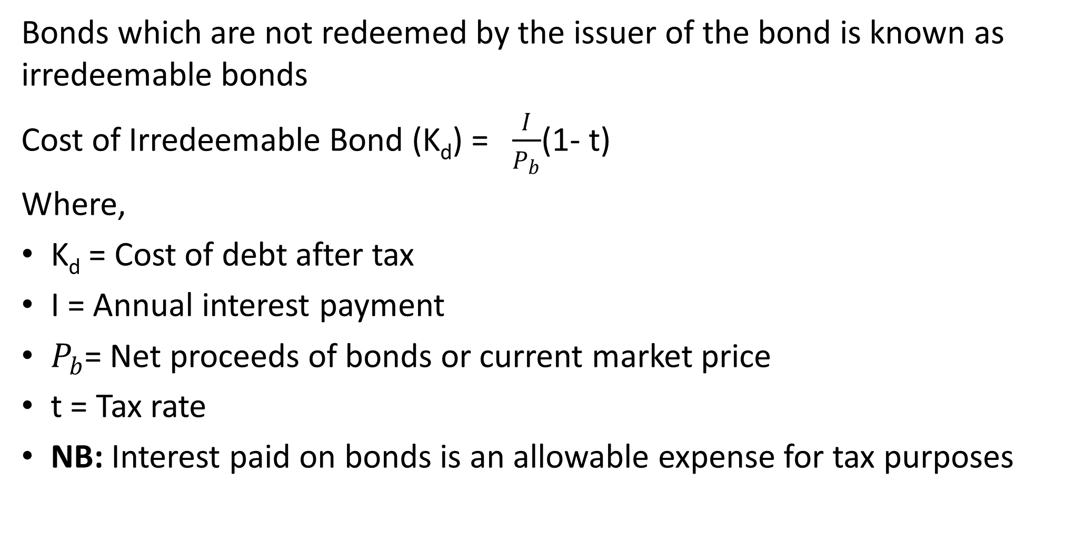
Cost of Irredeemable Bonds
Bonds which are not redeemed by the issuer of the bond is known as irredeemable bonds
Cost of Irredeemable Bond (K_{d}) = $\frac{I}{P_{b}}$(1- t)
Where,
K_{d} = Cost of debt after tax
I = Annual interest payment
$P_{b}$= Net proceeds of bonds or current market price
t = Tax rate
NB: Interest paid on bonds is an allowable expense for tax purposes

Slide 15
Illustration
A company has issued 1,000, 15% bonds of the face value of $100 each at a discount of $5. Par value
Under-writing and other costs are $ 5,000 for the total issue.
The interest per annum of $15,000 is therefore the cost of $ 90,000, actually received by the company.
This is because interest is a charge on profit and every year the company will save $ 7,500 as tax, assuming that the income tax rate is 50%.
Hence the after tax cost of $ 90,000 is $ 7,500 which comes to 8.33%.

Slide 16
Features of this bond
Par Value= 100 X 1000= $ 100,000
Net proceeds= 100-5=95 x 1000= $ 95,000
Interest = 15% x 100, 000= 15,000
Tax shield ( Savings on taxes) 50% x 15,000= 7,500
Effective Cost = 7,500/90,000= 8.3%

Slide 17
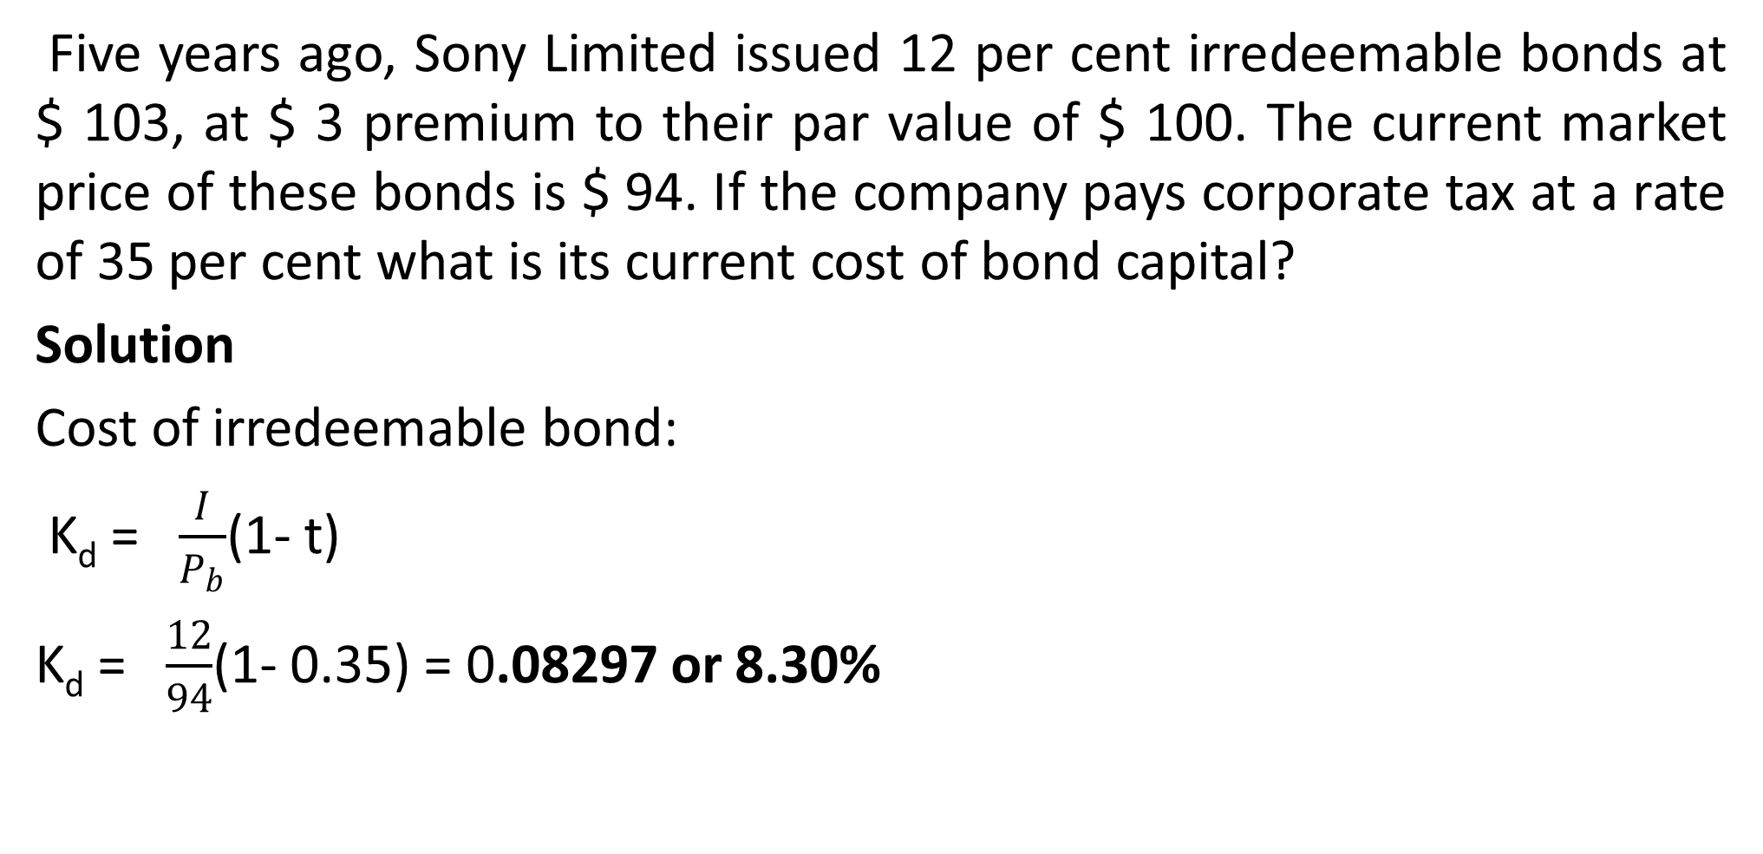
Illustration
Five years ago, Sony Limited issued 12 per cent irredeemable bonds at $ 103, at $ 3 premium to their par value of $ 100. The current market price of these bonds is $ 94. If the company pays corporate tax at a rate of 35 per cent what is its current cost of bond capital?
Solution
Cost of irredeemable bond:
K_{d} = $\frac{I}{P_{b}}$(1- t)
K_{d} = $\frac{12}{94}$(1- 0.35) = 0.08297 or 8.30%

Slide 18
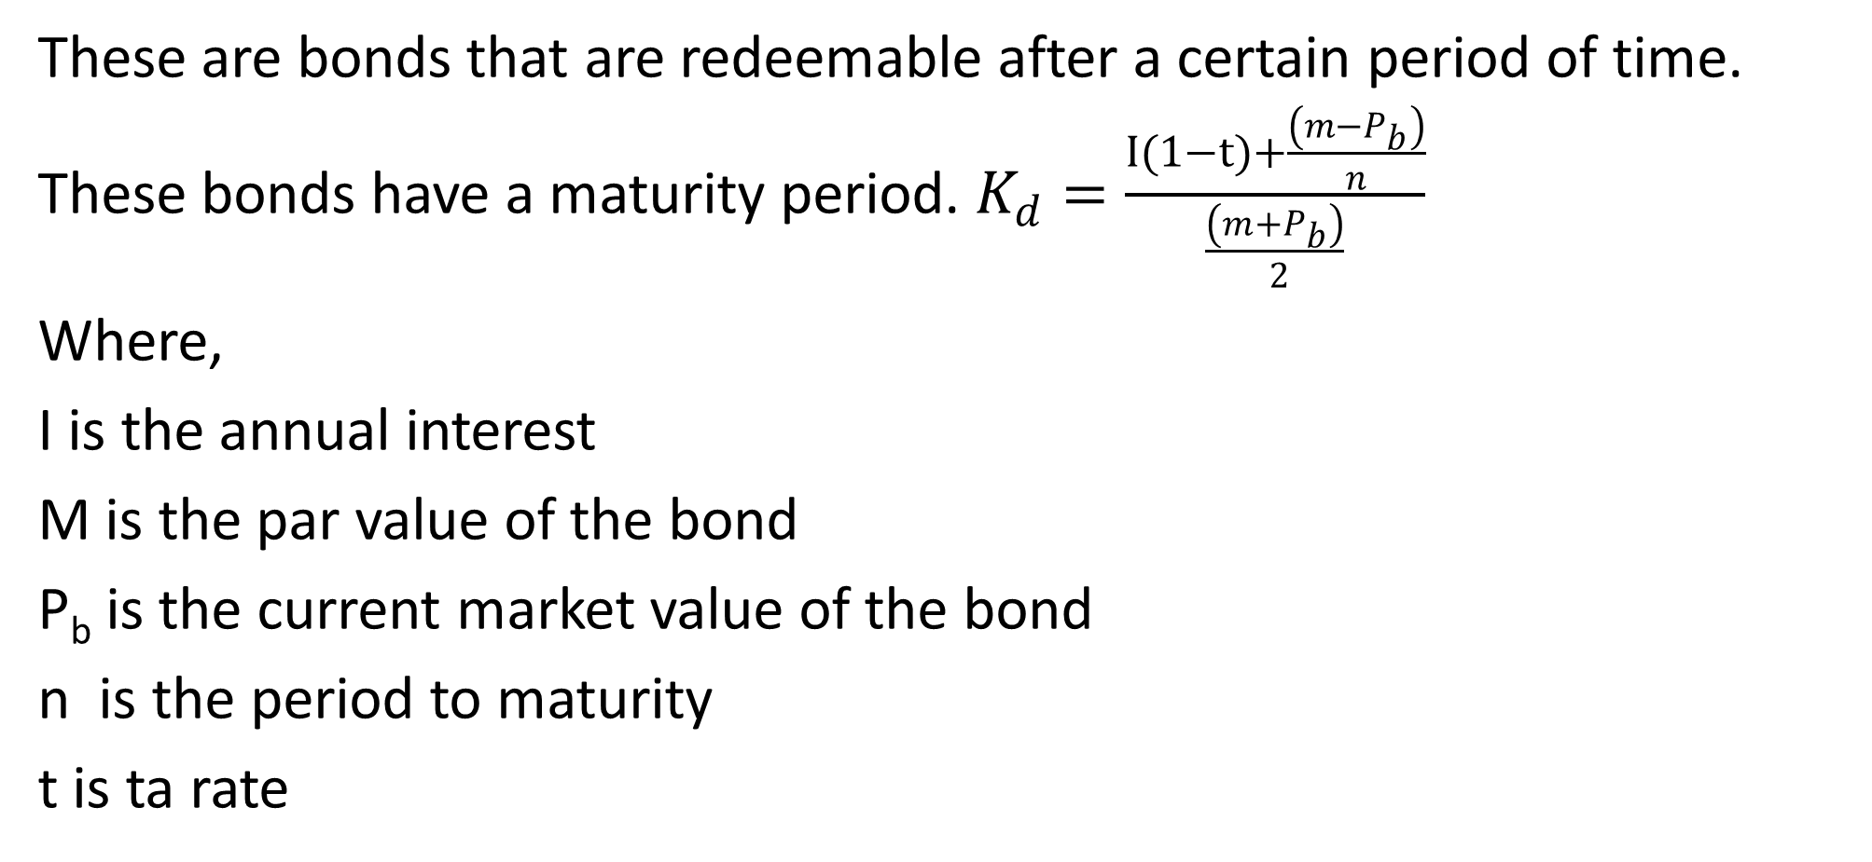
Cost of Redeemable Bonds
These are bonds that are redeemable after a certain period of time. These bonds have a maturity period. $K_{d}=\frac{I(1−t)+\frac{\left(m−P_{b}\right)}{n}}{\frac{\left(m+P_{b}\right)}{ 2}}$
Where,
I is the annual interest
M is the par value of the bond
P_{b} is the current market value of the bond
n is the period to maturity
t is ta rate

Slide 19
Illustration
A company issued 10,000, 10% bonds of $ 100 each at a premium of 10% for a period of 5 years.
Compute the cost of bonds assuming 35% as tax rate.

Slide 20
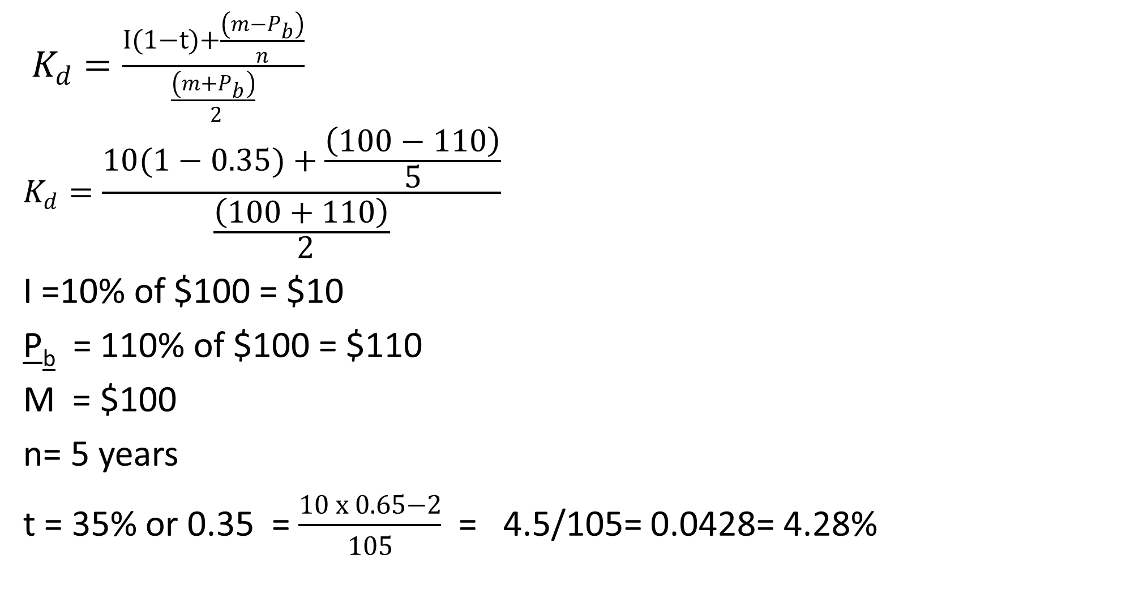
Solution
$K_{d}=\frac{I(1−t)+\frac{\left(m−P_{b}\right)}{n}}{\frac{\left(m+P_{b}\right)}{ 2}}$
$$K_{d}=\frac{10(1−0.35)+\frac{\left(100−110\right)}{5}}{\frac{\left(100+110\right)}{ 2}}$$
I =10% of $100 = $10
P_{b} = 110% of $100 = $110
M = $100
n= 5 years
t = 35% or 0.35 = $\frac{10 x 0.65−2}{105}$ = 4.5/105= 0.0428= 4.28%

Slide 21
Cost of Preference Shares (K_{p})
The preference share capital is paid dividend at a specified rate on face value of preference shares.
The payment of dividend to the preference shareholders are not charged as expenses but treated as appropriation of after tax profit.
Hence, dividend paid to preference shareholders does not reduce the tax liability to the company.
Like the bonds, Preference share capital can be categorized as redeemable and irredeemable

Slide 22
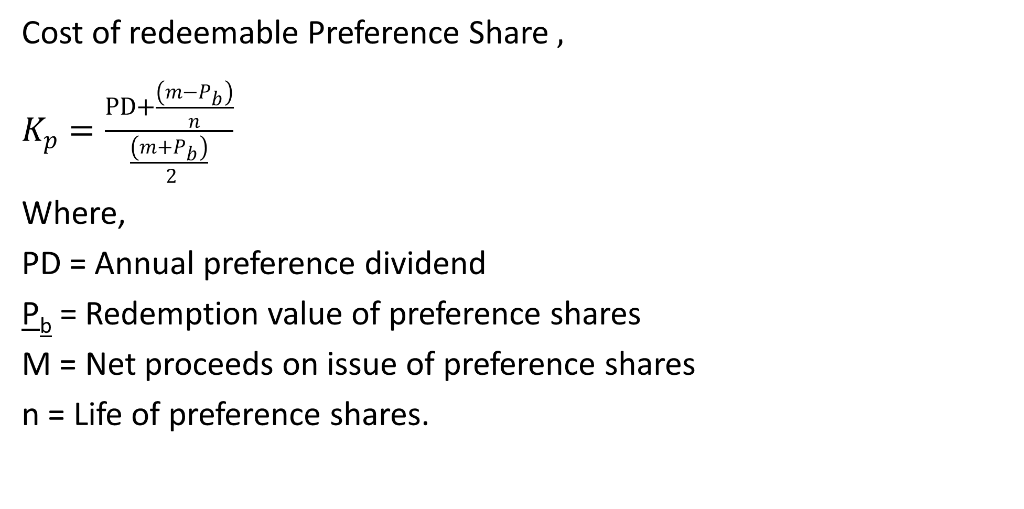
Cost of Redeemable Preference Shares
Cost of redeemable Preference Share $,$
$K_{p}=\frac{PD+\frac{\left(m−P_{b}\right)}{n}}{\frac{\left(m+P_{b}\right)}{ 2}}$
Where,
PD = Annual preference dividend
P_{b} = Redemption value of preference shares
M = Net proceeds on issue of preference shares
n = Life of preference shares.

Slide 23
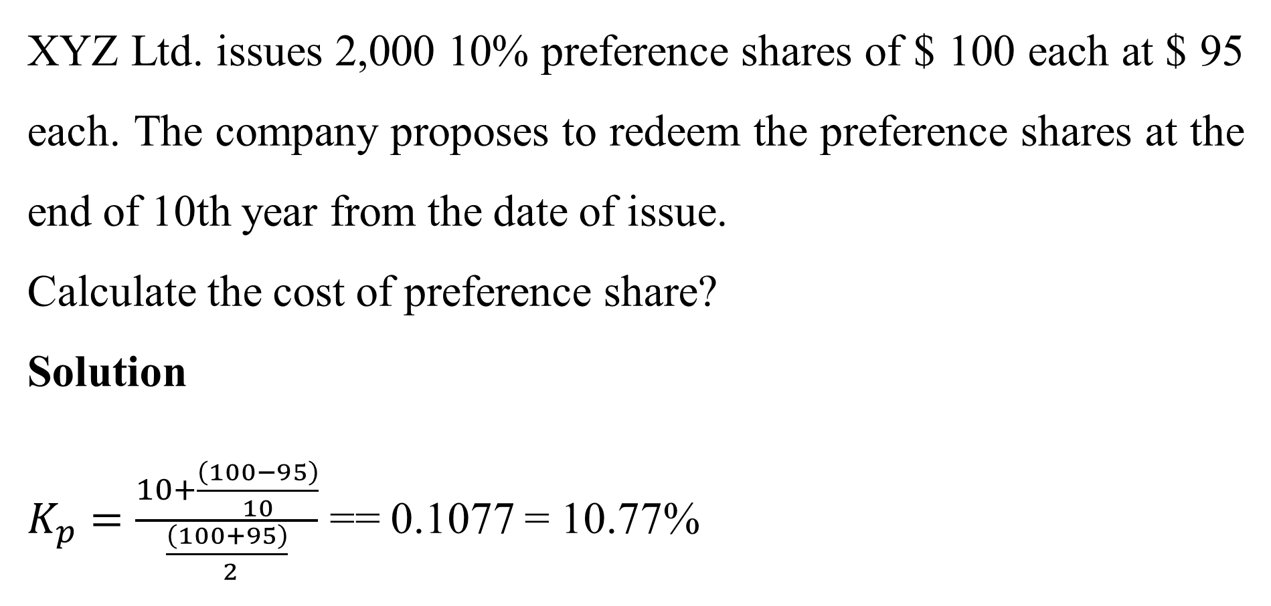
  Illustration
XYZ Ltd. issues 2,000 10% preference shares of $ 100 each at $ 95 each. The company proposes to redeem the preference shares at the end of 10th year from the date of issue.
Calculate the cost of preference share?
Solution
$K_{p}=\frac{10+\frac{\left(100−95\right)}{10}}{\frac{\left(100+95\right)}{ 2}}$ == 0.1077 = 10.77%

Slide 24
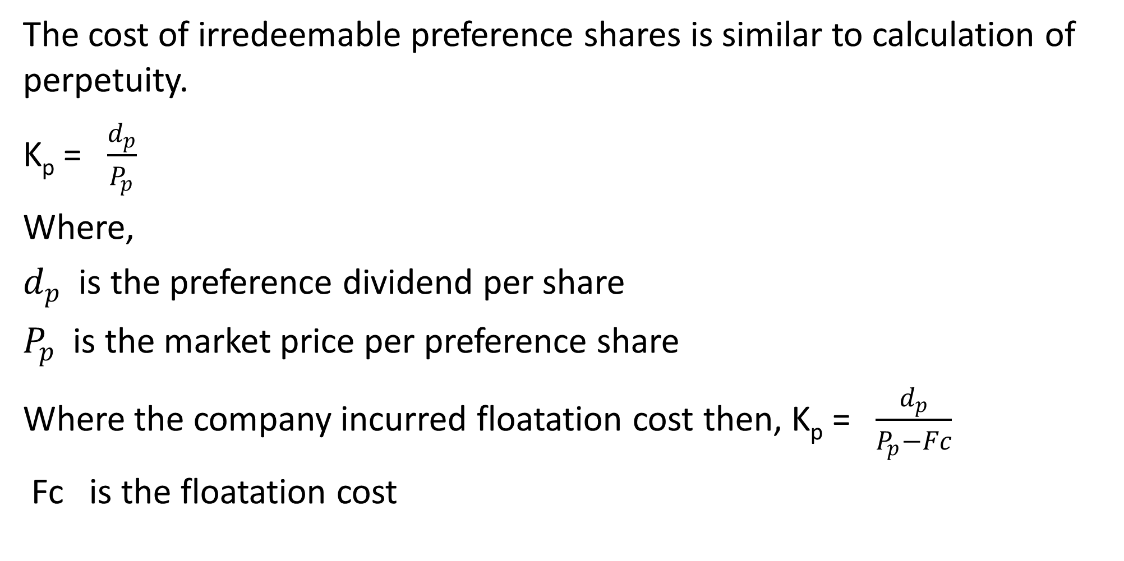
Cost of Irredeemable Preference Shares
The cost of irredeemable preference shares is similar to calculation of perpetuity.
K_{p} = $\frac{d_{p}}{P_{p}}$
Where,
$d_{p}$ is the preference dividend per share
$P_{p}$ is the market price per preference share
Where the company incurred floatation cost then, K_{p} = $\frac{d_{p}}{P_{p}−Fc}$
Fc is the floatation cost

Slide 25
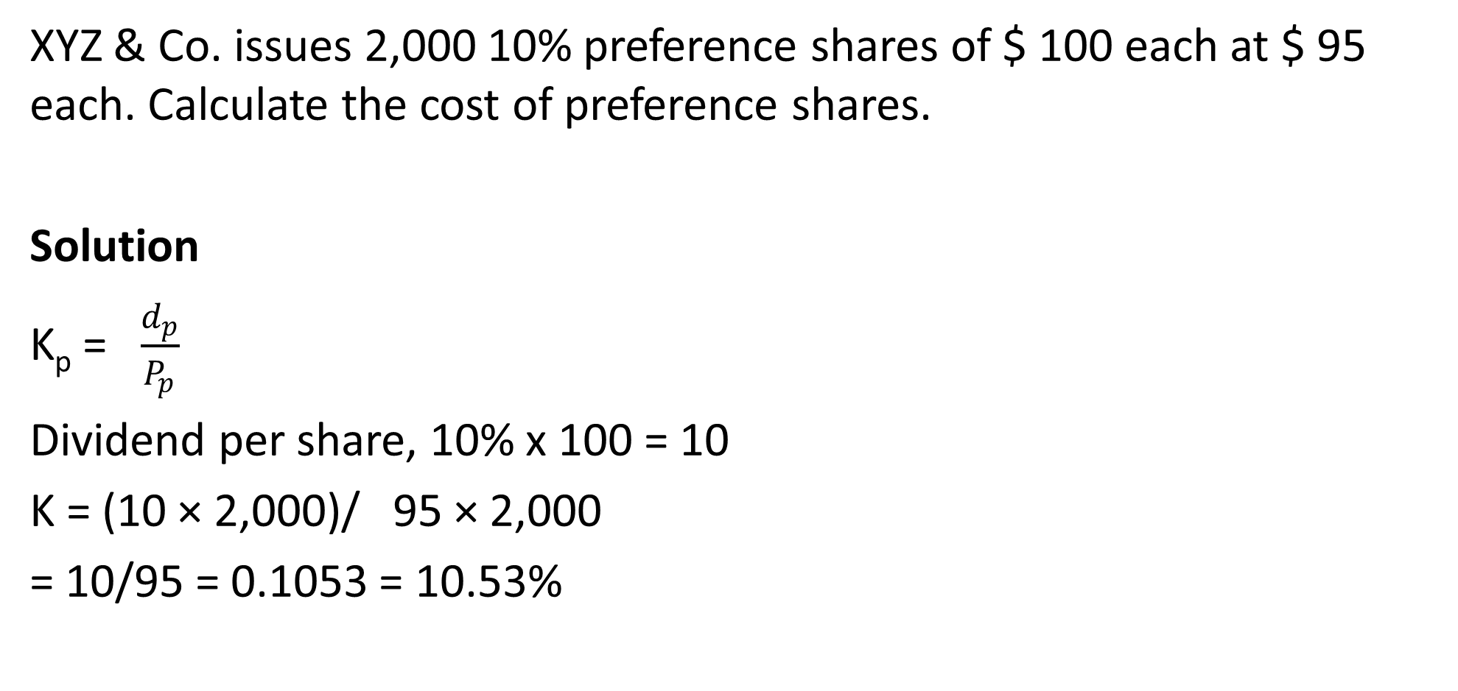
  Illustration-No floatation costs
XYZ & Co. issues 2,000 10% preference shares of $ 100 each at $ 95 each. Calculate the cost of preference shares.
Solution
K_{p} = $\frac{d_{p}}{P_{p}}$
Dividend per share, 10% x 100 = 10
K = (10 × 2,000)/ 95 × 2,000
= 10/95 = 0.1053 = 10.53%

Slide 26
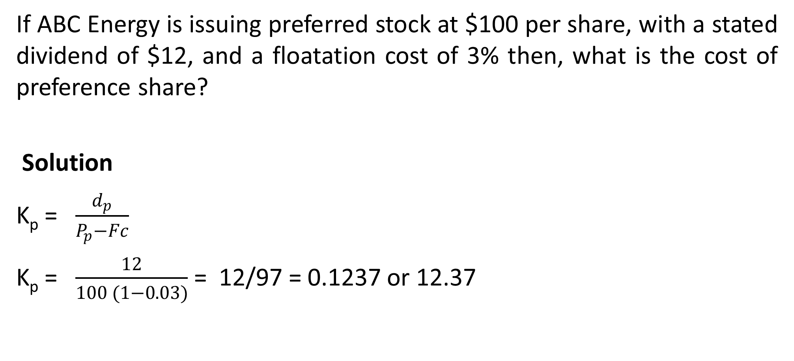
Illustration –With floatation costs
If ABC Energy is issuing preferred stock at $100 per share, with a stated dividend of $12, and a floatation cost of 3% then, what is the cost of preference share?
Solution
K_{p} = $\frac{d_{p}}{P_{p}−Fc}$
K_{p} = $\frac{12}{100 (1−0.03)}$ = 12/97 = 0.1237 or 12.37

Slide 27
Cost of Ordinary Shares/Equity (K_{e})
Due to relative higher risk, equity shareholders expect higher return hence, the cost of capital is also high.
Cost of equity capital is the rate of return which equates the present value of expected dividends with the market share price.
Dividend Price approach (Dividend Valuation Model) is one of methods of determining cost of equity
The model has 2 approaches; i)Dividend Price approach with constant dividend(Zero growth in dividend) and ii) Dividend Price approach with constant growth ( dividend grows at a constant rate)

Slide 28
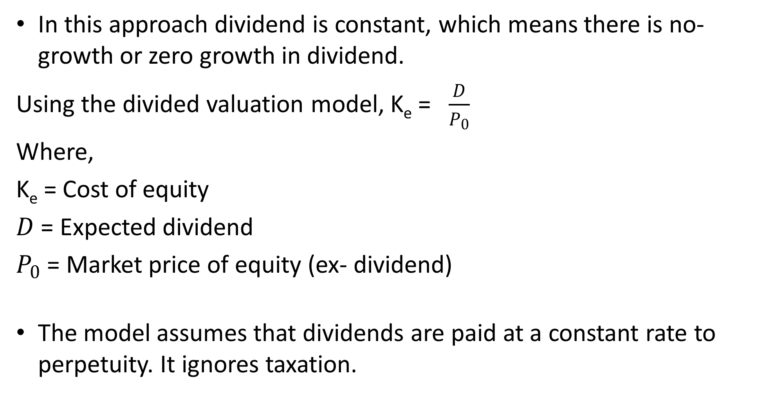
Dividend Price Approach with Constant Dividend
In this approach dividend is constant, which means there is no-growth or zero growth in dividend.
Using the divided valuation model, K_{e} = $\frac{D}{P_{0}}$
Where,
K_{e} = Cost of equity
$D$ = Expected dividend
$P_{0}$ = Market price of equity (ex- dividend)
The model assumes that dividends are paid at a constant rate to perpetuity. It ignores taxation.

Slide 29
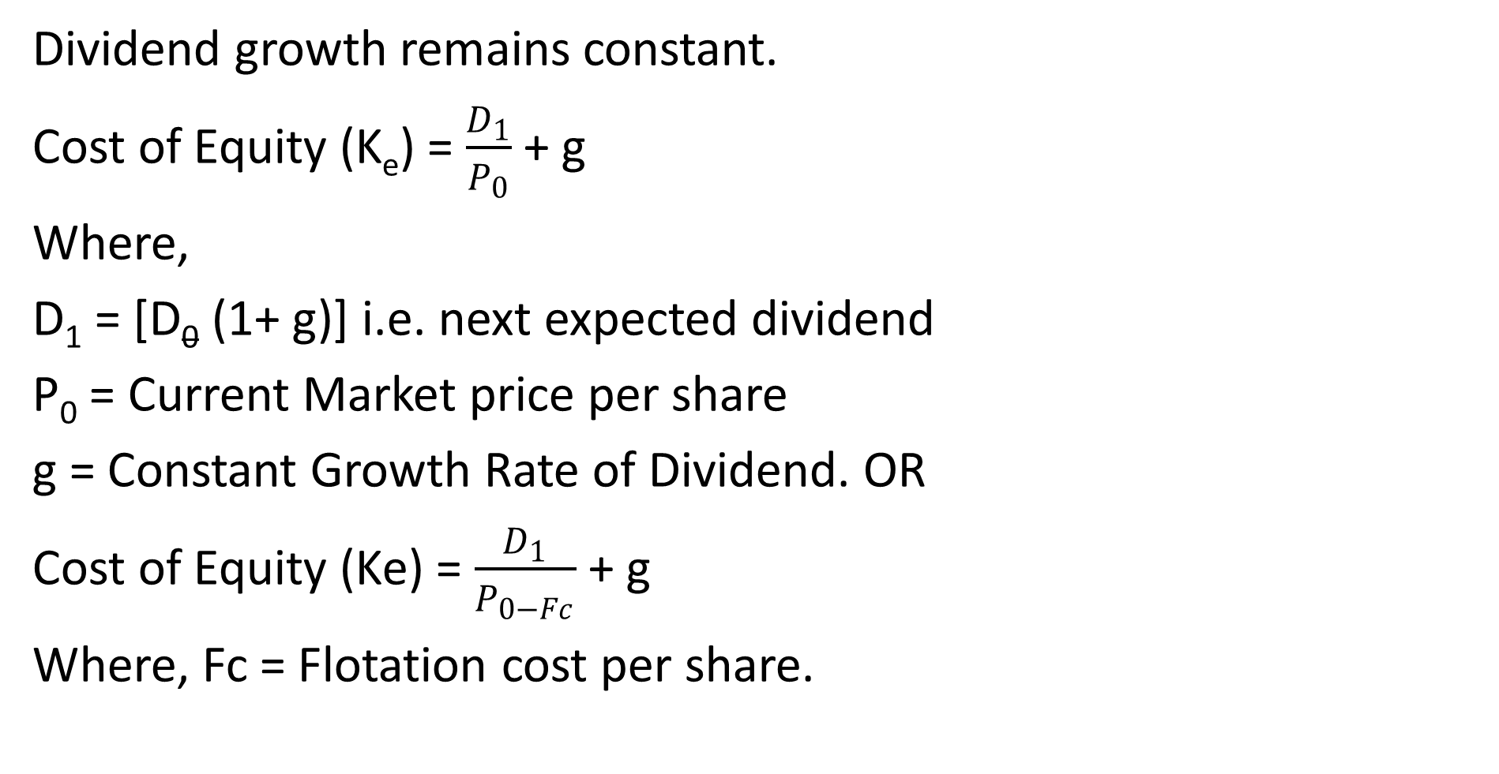
Dividend Price Approach with Constant Growth
Dividend growth remains constant.
Cost of Equity (K_{e}) = $\frac{D_{1}}{P_{0}}$ + g
Where,
D₁ = [D₀ (1+ g)] i.e. next expected dividend
P₀ = Current Market price per share
g = Constant Growth Rate of Dividend. OR
Cost of Equity (Ke) = $\frac{D_{1}}{P_{0−Fc}}$ + g
Where, Fc = Flotation cost per share.

Slide 30
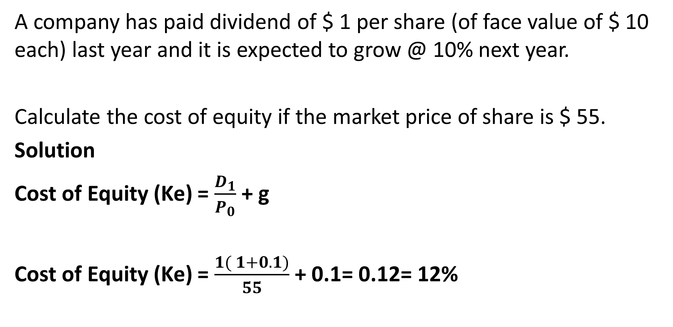
Illustration
A company has paid dividend of $ 1 per share (of face value of $ 10 each) last year and it is expected to grow @ 10% next year.
Calculate the cost of equity if the market price of share is $ 55.
Solution
Cost of Equity (Ke) = $\frac{D_{1}}{P_{0}}$ + g
Cost of Equity (Ke) = $\frac{1( 1+0.1)}{55}$ + 0.1= 0.12= 12%

Slide 31
Cost of Retained Earnings
It is the opportunity cost of dividends foregone by shareholders.
The cost of retained earnings is often used interchangeably with the cost of equity, as cost of retained earnings is nothing but the expected return of the shareholders
The Cost of Retained Earnings (Ks) is calculated just like the cost of equity shares ie
Cost of Retained Earnings (Ks) = Cost of Equity Shares (Ke)

Slide 32
Illustration
ABC Company provides the following details:
D₀ = $ 4.19, P_{b} = $ 50, g = 5%
Calculate the cost of retained earnings.

Slide 33
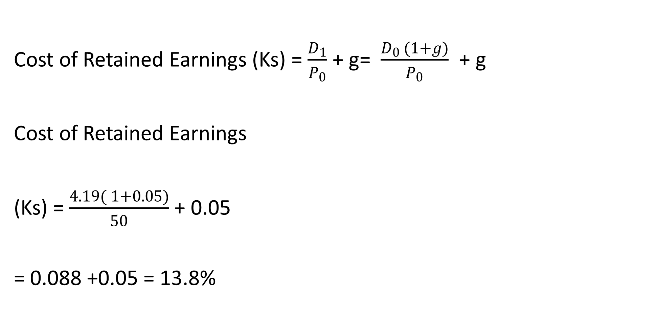
Solution
Cost of Retained Earnings (Ks) = $\frac{D_{1}}{P_{0}}$ + g= $\frac{D_{0 }(1+g)}{P_{0}}$ + g
Cost of Retained Earnings
(Ks) = $\frac{4.19( 1+0.05)}{50}$ + 0.05
= 0.088 +0.05 = 13.8%

Slide 34
THE END
We have come to the end of Lecture Eight
It was nice having you in this class
See you in the next class

Slide 35
REFERENCES
Financial Management: Principles and Applications. Sheridan Titman, Arthur J. Keown, and John D. Martin, 2019,Pearson Education India, New Delhi.
Financial Management,,M.Y. Khan. M. Y and Jain. P.K., 2018, McGraw Hill Education, New Delhi
Fundamental of Financial Management Eugene F. Brigham, Joel F. Huston, 2018, , Cengage Learning India, New Delhi.
Principles of Corporate Finance, Richard Brealey, Stewart Myres & Franklin Allen, 2019, Mc Graw Hill, New Delhi .

