Slide 1
Business Finance
Week 9
Composite Cost of Capital
Lecturer: Dr. Charity Njoka (PhD)

Slide 2
Intended Learning Outcomes
By the end of this lecturer , you should be able to:
1 Calculate Weighted average cost of capital (WACC) and
2. Calculate weighted marginal cost of capital (WMCC)

Slide 3
Introduction
Weighted average cost of capital WACC is also known as the overall cost of capital of having capitals from the different sources
It weighs the cost of capital of a particular source of capital with its proportion to the total capital.
The weighted average cost of capital for a firm is of use in two major areas:-
1. In consideration of the firm’s position;
2. Evaluation of proposed changes necessitating a change in the firm’s capital.

Slide 4
Steps to calculate WACC
Step 1: Calculate the total capital from all the sources.
(i.e. Long term debt capital + Pref. Share Capital + Equity Share Capital + Retained Earnings)
Step 2: Calculate the proportion (or %) of each source of capital to the total capital.
For example= Equity Share Capital
Total Capital (as calculated in step 1)

Slide 5
Steps to calculate WACC-Ctd
Step 3: Multiply the proportion as calculated in Step 2 above with the respective cost of capital.
(i.e. Ke × Proportion (%) of equity share capital (for example) calculated in Step 2 above)
Step 4: Aggregate the cost of capital as calculated in Step 3 above. This is the WACC.
(i.e. Ke + Kd + Kp + Ks as calculated in Step 3 above)

Slide 6
Illustration
Capital Component Cost of | Cost of Capital | % of Total Capital Structure | Total
Retained Earnings | 10% (Kr) | 25% (Wr) | 2.50% (Kr × Wr)
Equity Share Capital | 11% (Ke) | 10% (We) | 1.10%(Ke × We)
Preference Share Capital | 9% (Kp) | 15% (Wp) | 1.35% (Kp × Wp)
Long term debts | 6% (Kd) | 50% (Wd) | 3.00%(Kd × Wd)
Total (WACC) |  |  | 7.95%

Slide 7
Illustration
Bahati Company has the following capital structure.
Source Amount
Bonds 8,000,000
Preference capital 2,000,000
Retained earnings 4,000,000
Ordinary share capital 6,000,000
20,000,000
The component costs of capital are; kd is 6%, kp is 10.5%, kr is 14%,ks is 17.2%
Compute the WACC.

Slide 8
Solution
WACC(K_{o} )= w_{d}k_{d}+ w_{p}k_{p} + w_{r}k_{r} + w_{s}k_{s}
The w_{d},w_{p},w_{r},w_{s} are the weights of the specific sources of capital whose sum is 1.
WACC (k_{o} ) = 6 ( 8m) + 10.5( 2m ) +14( 4m) +17.2 ( 6m)
20m 20m 20m 20m
WACC (k_{o} ) = 11.41%

Slide 9
Significance of WACC
The weighted average cost of capital can be used to evaluate the performance of management.
Since it is a historic cost it is not useful in investment decisions as it is irrelevant.
3. WACC can be used as a hurdle rate against which to assess return on investment capital performance.
4. Investors use WACC as a tool to decide whether or not to invest. The WACC represents the minimum rate of return at which a company produces value for its investors.

Slide 10
Problems in Determination of WACC
These mainly relate to:-
Computation of equity capital and;
2. Assignment of weights to the cost of specific source of financing. Assignment of weights can be possible either on the basis of historical weighting or marginal weighting.

Slide 11
Choice of weights
There is a choice weights between the book value (BV) and market value(MV).
Book Value (BV): Book value weights is operationally easy and convenient. While using BV, reserves such as share premium and retained profits are included in the BV of equity, in addition to the nominal value of share capital
2.Market Value (MV): Market value weight is more correct and represent a firm’s capital structure. Reserves such as share premium and retained profits are ignored as they are in effect incorporated into the value of equity.

Slide 12
Illustration
A company has the following capital structure
 | $
Bonds ($ 100 per bond) | 5,00,000
Preference shares ($ 100 per share) | 5,00,000
Equity shares ($ 10 per share) | 10,00,000

Slide 13
Illustration- Ctd
The market prices of these securities are:
Bonds $ 105 per bond
Preference shares $ 110 per preference share
Equity shares $ 24 each.

Slide 14
Illustration- Ctd
Additional information:
(1) $ 100 per bond redeemable at par, 10% coupon rate, 4% floatation costs, 10 year maturity.
(2) $ 100 per preference share redeemable at par, 5% coupon rate, 2% floatation cost and 10 year maturity.
(3) Equity shares has $ 4 floatation cost and market price $ 24 per share.
(4) The next year expected dividend is $ 1 with annual growth of 5%. The firm has practice of paying all earnings in the form of dividend.
(5) Corporate tax rate is 50%. Compute WACC

Slide 15
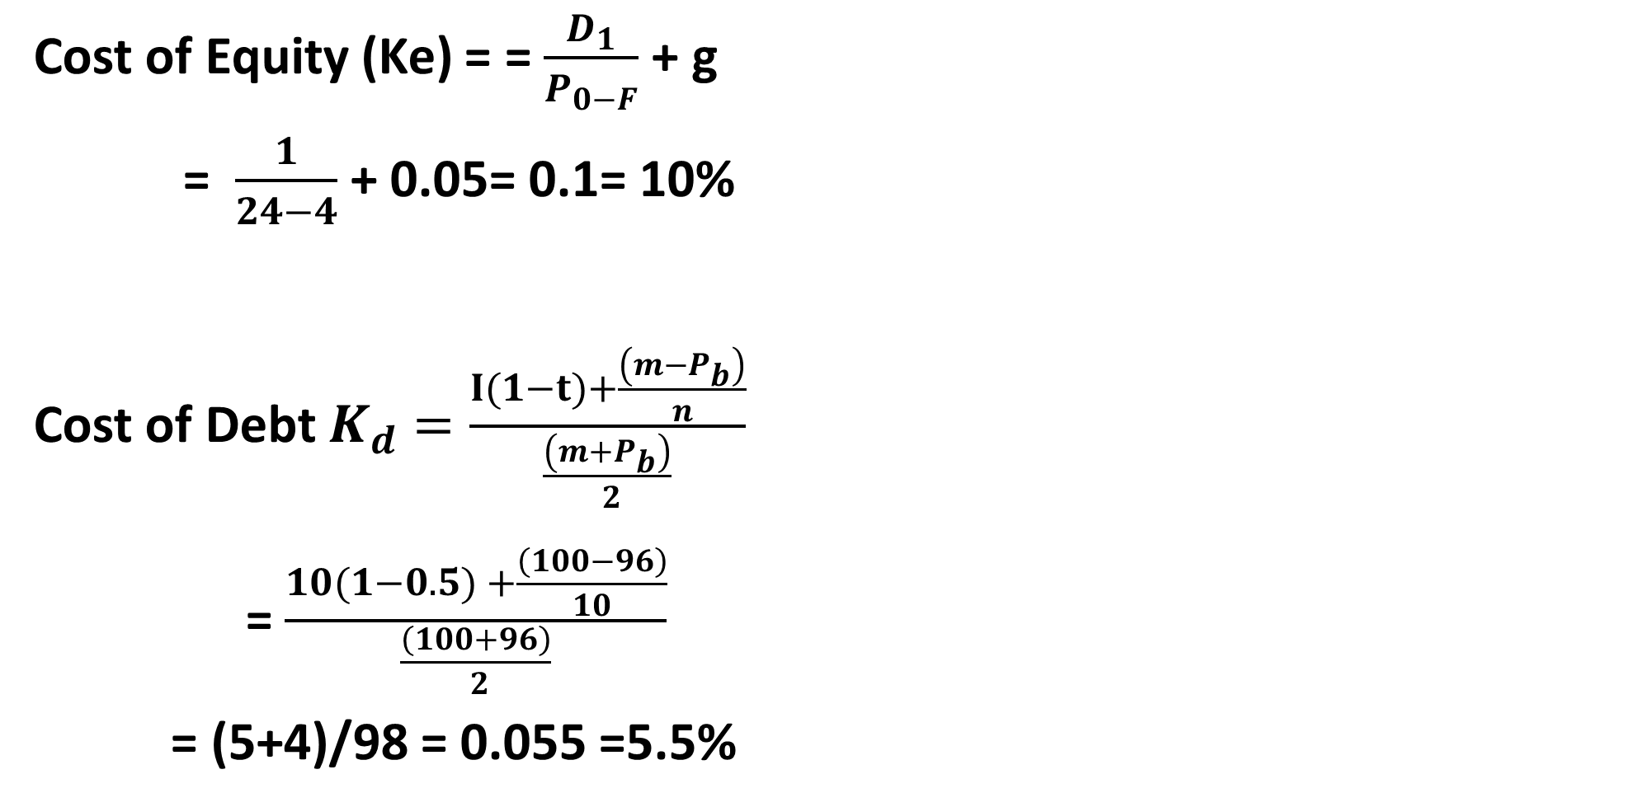
Solution
Cost of Equity (Ke) = = $\frac{D_{1}}{P_{0−F}}$ + g
= $\frac{1}{24−4}$ + 0.05= 0.1= 10%
Cost of Debt $K_{d}=\frac{I(1−t)+\frac{\left(m−P_{b}\right)}{n}}{\frac{\left(m+P_{b}\right)}{ 2}}$
= $\frac{10(1−0.5) +\frac{\left(100−96\right)}{10}}{\frac{\left(100+96\right)}{ 2}}$
= (5+4)/98 = 0.055 =5.5%

Slide 16
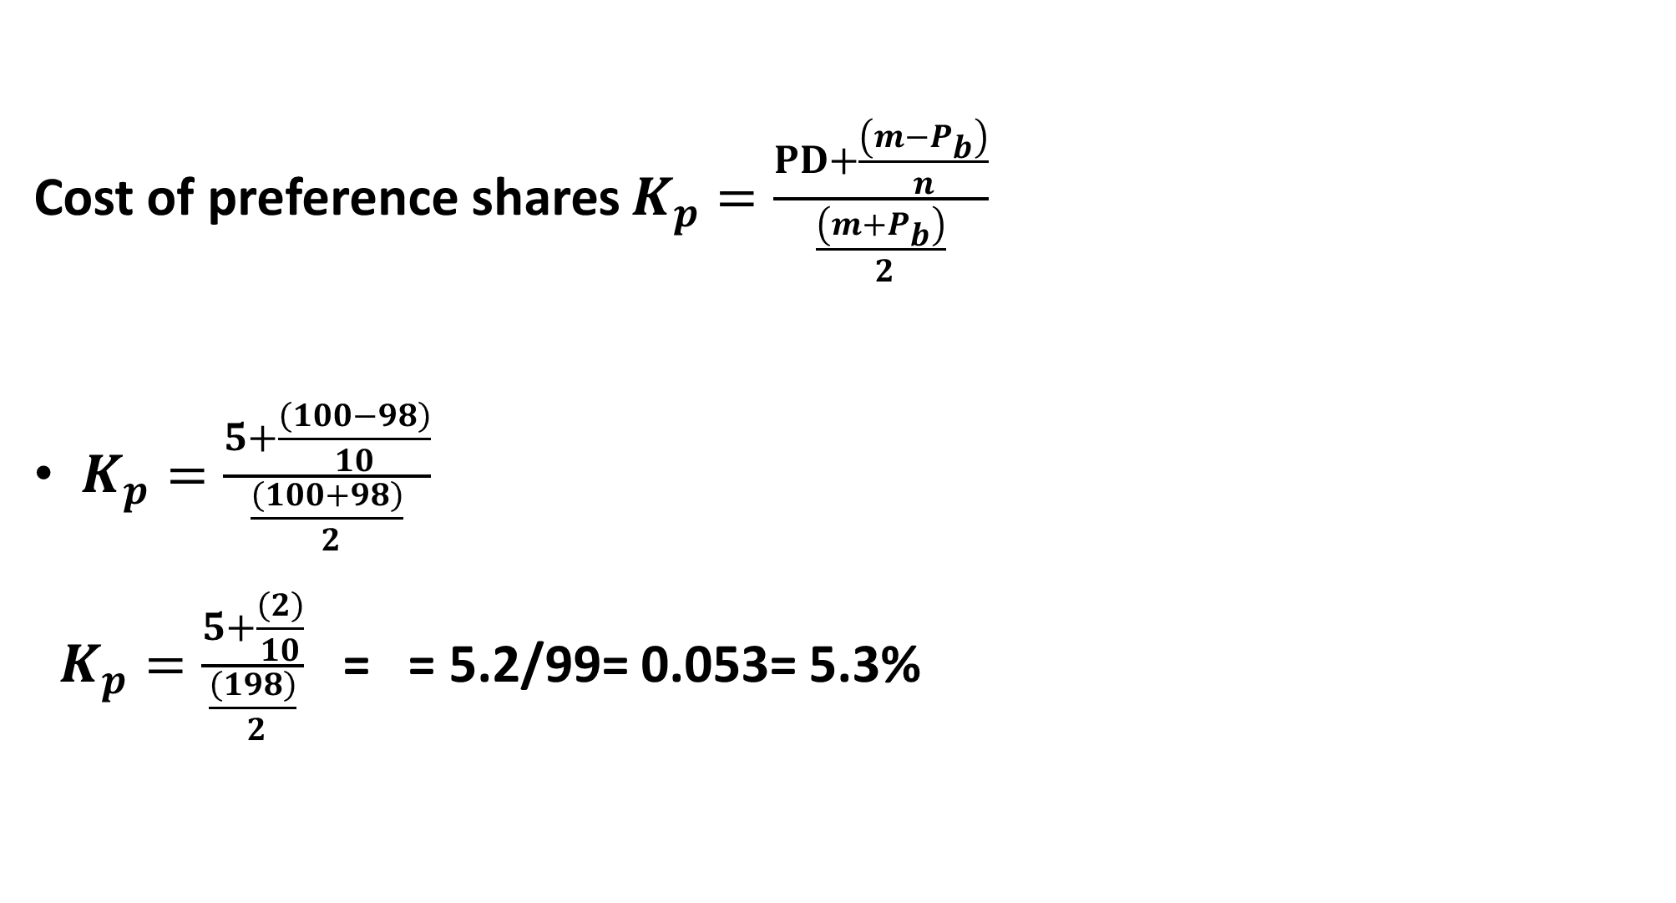
Solution -Ctd
Cost of preference shares $K_{p}=\frac{PD+\frac{\left(m−P_{b}\right)}{n}}{\frac{\left(m+P_{b}\right)}{ 2}}$
$K_{p}=\frac{5+\frac{\left(100−98\right)}{10}}{\frac{\left(100+98\right)}{ 2}}$
$K_{p}=\frac{5+\frac{\left(2\right)}{10}}{\frac{\left(198\right)}{ 2}}$ = = 5.2/99= 0.053= 5.3%

Slide 17
Calculation of WACC using Book Value weights
WACC (Ko) = 0.0769 or 7.69%
Source of Capital | Book Value | Weights | After Tax Cost of Capital | WACC
10% Bonds | 5,00,000 | 0.25 | 0.055 | 0.0137
5% Preference shares | 5,00,000 | 0.25 | 0.053 | 0.0132
Equity shares | 10,00,000 | 0.50 | 0.10 | 0.0500
 | 20,00,000 | 1.00 |  | 0.0769

Slide 18
Calculation of WACC using Market Value weights
WACC (Ko) = 0.085 or 8.5%
Source of Capital | Book Value | Weights (a) | After Tax cost of Capital (b) | WACC c=(a) x (b)
10% Bonds ($105× 5,000) | 5,25,000 | 0.151 | 0.055 | 0.008
5% Preference shares ($110× 5,000) | 5,50,000 | 0.158 | 0.053 | 0.008
Equity shares ($24× 1,00,000) | 24,00,000 | 0.691 | 0.10 | 0.069
 | 34,75,000 | 1.000 |  | 0.085

Slide 19
Marginal Cost of Capital (MCC)
MCC is the cost of raising an additional dollar of capital- It is referred to as the cost incurred in raising new funds.
The marginal weights represent the proportion of funds the firm intends to employ.
Thus, the problem of choosing between the book value weights and the market value weights does not arise in the case of marginal cost of capital computation.
To calculate the marginal cost of capital, the intended financing proportion should be applied as weights to marginal component costs

Slide 20
Illustration
ABC Ltd. has the following capital structure
The company share has a market price of $ 23.60.
Next year dividend per share is 50% of year 2022 EPS
 | $
14% Bonds | 30,000
11% Preference shares | 10,000
Equity Shares (10,000 shares) | 160,000
 | 200,000

Slide 21
Illustration-Ctd
The following trend of EPS for the preceding 10 years is
expected to continue in future
The company issued new bonds carrying 16% rate of interest and the current market price of bond is $ 96.
Preference share $ 9.20 (with annual dividend of $ 1.1 per share) were also issued. The company is in 50% tax bracket.
2013 | 2014 | 2015 | 2016 | 2017 | 2018 | 2019 | 2020 | 2021 | 2022
1.00 | 1.10 | 1.21 | 1.33 | 1.46 | 1.61 | 1.77 | 1.95 | 2.15 | 2.36

Slide 22
Illustration-Ctd- Required
Calculate after tax:
(i) Cost of new debt
(ii) Cost of new preference shares
(iii) New equity share (consuming new equity from retained earnings)
(B) Calculate marginal cost of capital when no new shares are issued.

Slide 23
Illustration-Ctd- Required
C) How much can be spent for capital investment before new ordinary shares must be sold. Assuming that retained earnings for next year’s investment are 50 percent of 2022
(D) What will the marginal cost of capital when the funds exceeds the amount calculated in (C), assuming new equity is issued at $ 20 per share?

Slide 24
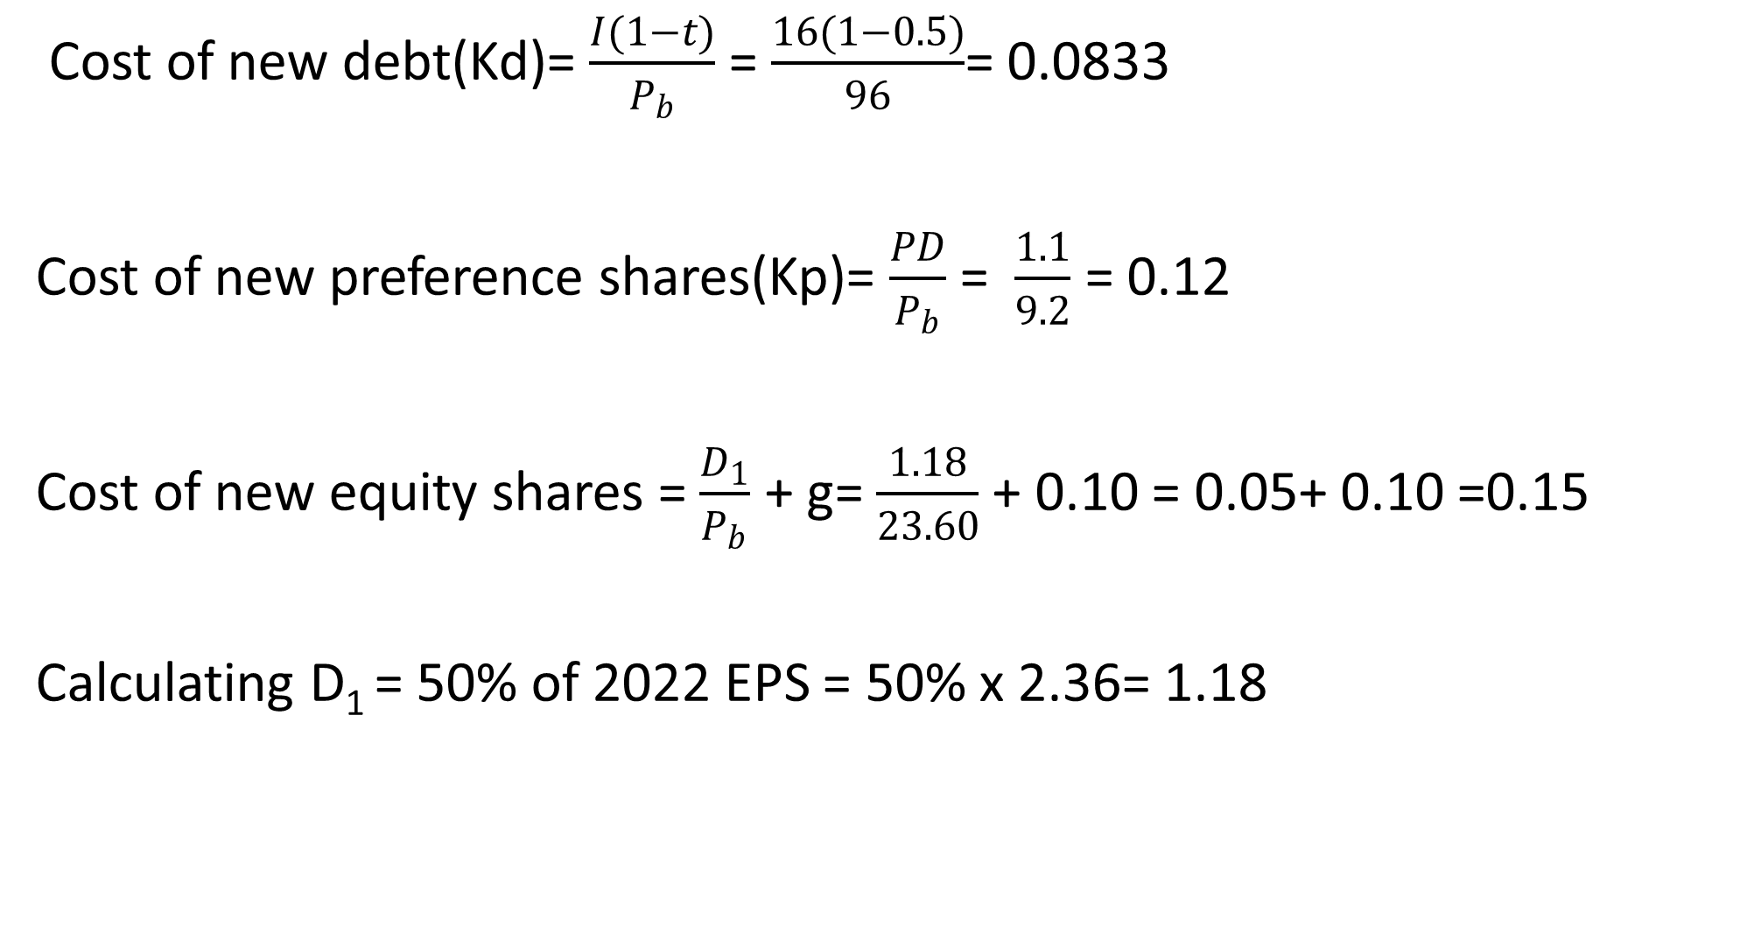
Solution-A- Various Costs of funds
Cost of new debt(Kd)= $\frac{I(1−t)}{P_{b}}$ = $\frac{16(1−0.5)}{96}$= 0.0833
Cost of new preference shares(Kp)= $\frac{PD}{P_{b}}$ = $\frac{1.1}{9.2}$ = 0.12
Cost of new equity shares = $\frac{D_{1}}{P_{b}}$ + g= $\frac{1.18}{23.60}$ + 0.10 = 0.05+ 0.10 =0.15
Calculating D₁ = 50% of 2022 EPS = 50% x 2.36= 1.18

Slide 25
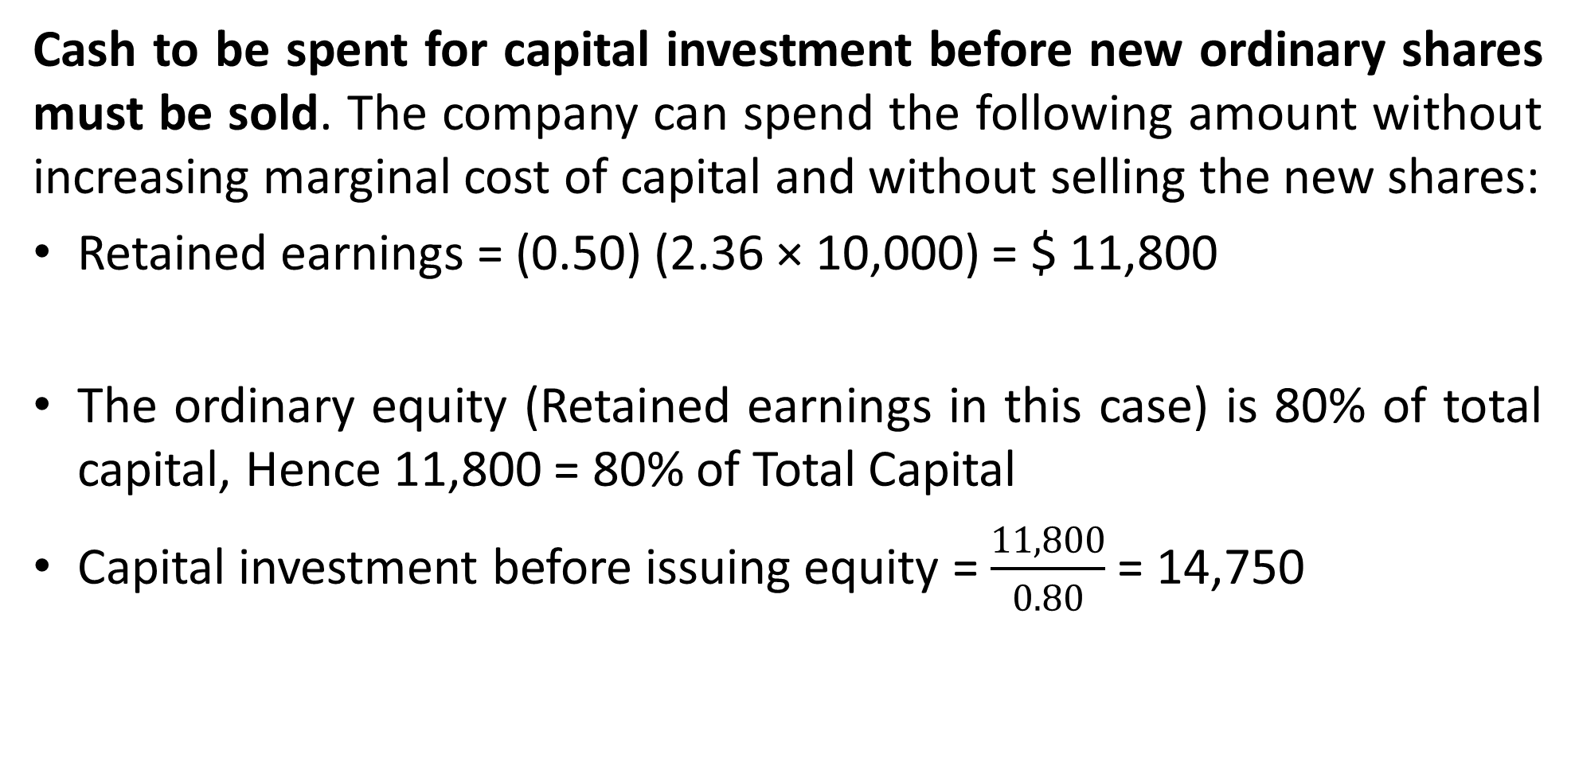
Solution – C
Cash to be spent for capital investment before new ordinary shares must be sold. The company can spend the following amount without increasing marginal cost of capital and without selling the new shares:
Retained earnings = (0.50) (2.36 × 10,000) = $ 11,800
The ordinary equity (Retained earnings in this case) is 80% of total capital, Hence 11,800 = 80% of Total Capital
Capital investment before issuing equity = $\frac{11,800}{0.80}$ = 14,750

Slide 26
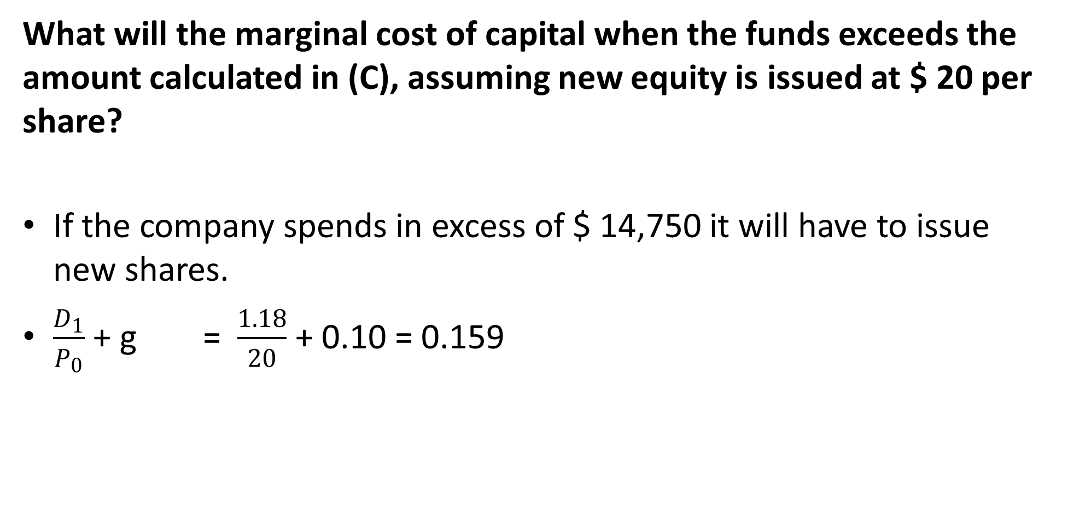
Solution-D
What will the marginal cost of capital when the funds exceeds the amount calculated in (C), assuming new equity is issued at $ 20 per share?
If the company spends in excess of $ 14,750 it will have to issue new shares.
$\frac{D_{1}}{P_{0}}$ + g = $\frac{1.18}{20}$ + 0.10 = 0.159

Slide 27
  Solution D- MCC
The marginal cost of capital will be :
Type of Capital (1) | Proportion (2) | Specific Cost (3) | Product (2)x(3) =(4)
Bonds | 0.15 | 0.0833 | 0.0125
Preference shares | 0.05 | 0.1200 | 0.0060
Equity shares | 0.80 | 0.1590 | 0.1272
 |  |  | 0.1457

Slide 28
Illustration
Makeen Investments Ltd. wishes to raise funds amounting to $10 million to finance a project in the following manner:
$.6 million from debt; and
$.4 million from floating new ordinary shares.
The present capital structure of the company is made up as follows:
600,000 fully paid ordinary shares of $10 each
Retained earnings of $4 million
200,000, 10% preference shares of $20 each.
40,000 6% long term bonds of $150 each.

Slide 29
  Illustration-Ctd
The current market value of the company’s ordinary shares is $60 per share. The expected ordinary share dividends in a year’s time is $2.40 per share. The average growth rate in both dividends and earnings has been 10% over the past ten years and this growth rate is expected to be maintained in the foreseeable future.
The company’s long term bonds currently change hands for $100 each. The bonds will mature in 100 years. The preference shares were issued four years ago and still change hands at face value.

Slide 30
Illustration-Ctd
Required:
i)Compute the component cost of:
  Ordinary share capital;
  Debt capital
  Preference share capital.
ii) Compute the company’s current weighted average cost of capital.
iii) Compute the company’s marginal cost of capital if it raised the additional $10 million as envisaged. (Assume a tax rate of 30%).

Slide 31
Solution- Cost of Equity

Slide 32
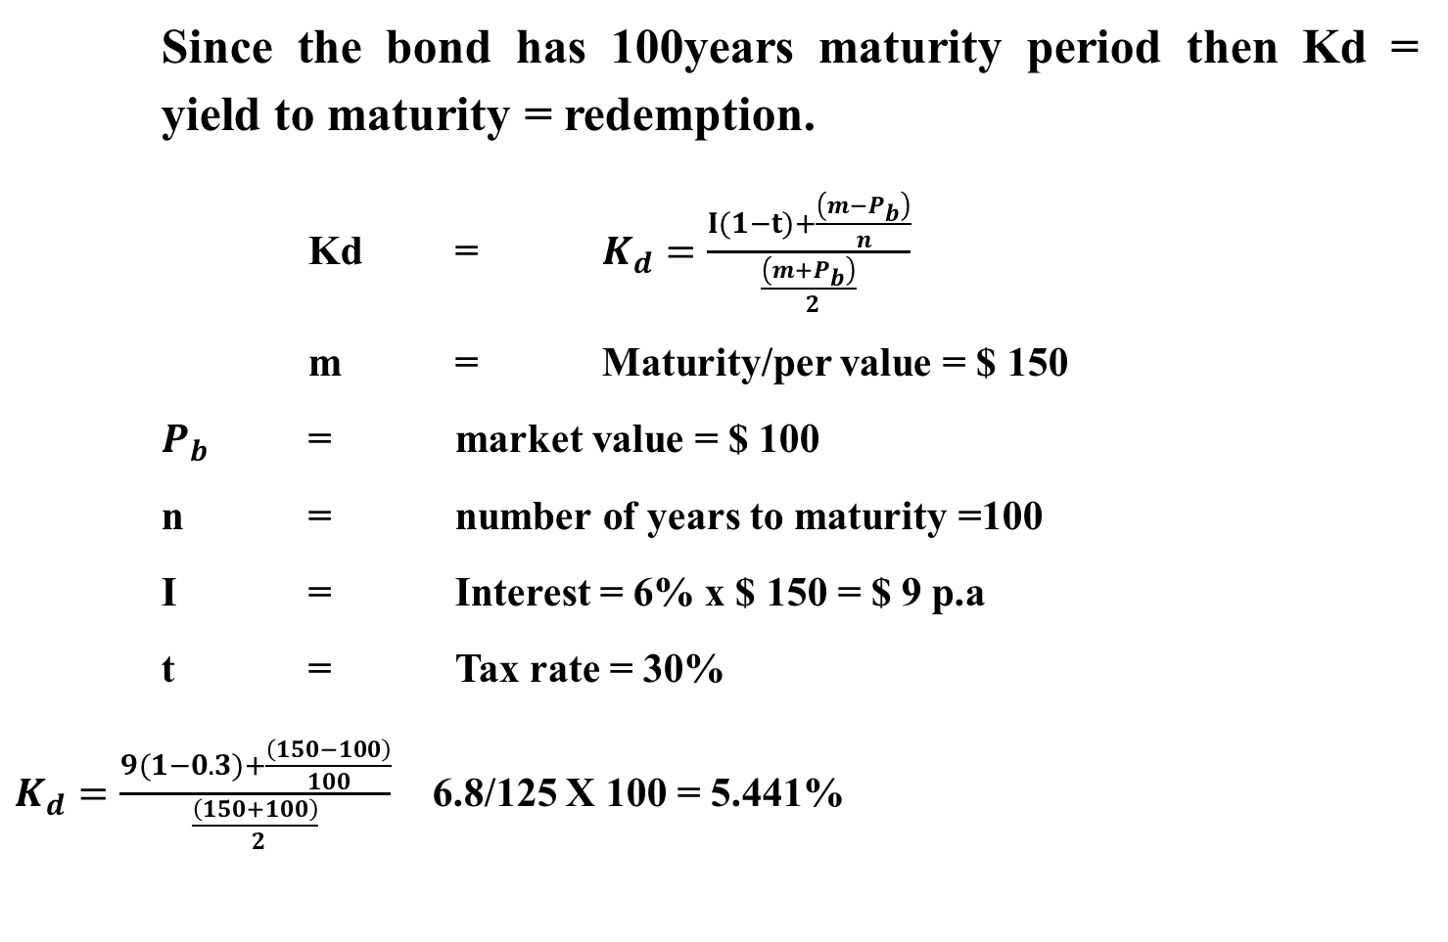
Solution- Cost of debt capital (Kd)
Since the bond has 100years maturity period then Kd = yield to maturity = redemption.
Kd = $K_{d}=\frac{I(1−t)+\frac{\left(m−P_{b}\right)}{n}}{\frac{\left(m+P_{b}\right)}{ 2}}$
m = Maturity/per value = $ 150
$P_{b}$ = market value = $ 100
n = number of years to maturity =100
I = Interest = 6% x $ 150 = $ 9 p.a
t = Tax rate = 30%
$K_{d}=\frac{9(1−0.3)+\frac{\left(150−100\right)}{100}}{\frac{\left(150+100\right)}{ 2}}$ 6.8/125 X 100 = 5.441%

Slide 33
Solution- Cost of preference share capital (kp)
Cost of preference share capital Kp
Kp = Coupon rate = 10% since MPS = par value

Slide 34
WACC or overall cost of capital Ko
‘000
M.V of equity = 600,000 shares x $ 60 MPS 36
M.V of debt = 40,000 bonds x $100 4
M.V of preference shares = 200,000 shares x $ 20 4
44
Ke = 14%
Kd = 5.44%
Kp = 10%
Ko = WACC =14%(36/44) + 5.44% (4/44) +10%(4/44) = 12.86%

Slide 35
MCC if $ 10 m is raised
The $ 10M will be raised as follows:
$ 6M from debt
$ 4M from shares
Since there are no floatation costs involved then:
Marginal cost of debt = 5.4%
Marginal cost of ordinary share capital = 14%
Therefore MCC is 14%(4/10) + 5.4%(6/10 ) = 8.86%

Slide 36
THANK YOU
We have come to the end of Lecture Nine
It was nice having you in this class
See you in the next class

Slide 37
REFERENCES
Financial Management: Principles and Applications. Sheridan Titman, Arthur J. Keown, and John D. Martin, 2019, Pearson Education India, New Delhi.
Financial Management,,M.Y. Khan. M. Y and Jain. P.K., 2018, McGraw Hill Education, New Delhi
Fundamental of Financial Management Eugene F. Brigham, Joel F. Huston, 2018, , Cengage Learning India, New Delhi.
Principles of Corporate Finance, Richard Brealey, Stewart Myres & Franklin Allen, 2019, Mc Graw Hill, New Delhi .

