Slide 1
Business Finance
Week 11
Risk and Return
Lecturer: Dr. Charity Njoka (PhD)

Slide 2
Intended Learning Outcomes
By the end of this lecturer , you should be able to:
1 . Define risk and return
2. Calculate risk and return of a single asset.
3. Calculate risk and return of a portfolio
4. Discuss the different types of investor attitudes toward risk.

Slide 3
Introduction
Valuation and an understanding of the trade-off between risk and return form the foundation for maximizing shareholder wealth.
Markowitz, derived the expected rate of return for a portfolio of assets and an expected risk measure.
Under the Markowitz assumptions, a single asset or portfolio of assets is considered to be efficient if no other asset or portfolio of assets offers higher expected return with the same (or lower) risk, or lower risk with the same (or higher) expected return

Slide 4
The concept of Risk and Return
The concept of risk and return in finance is an analysis of the likelihood of challenges involved in investing while measuring the returns from the same investment.
The underlying principle is that high-risk investments give better returns to investors and vice-versa. Hence, the price of the risk is reflected in the returns.
Hence the consideration of probability of occurrence of events/ cash-flows or returns in investments .

Slide 5
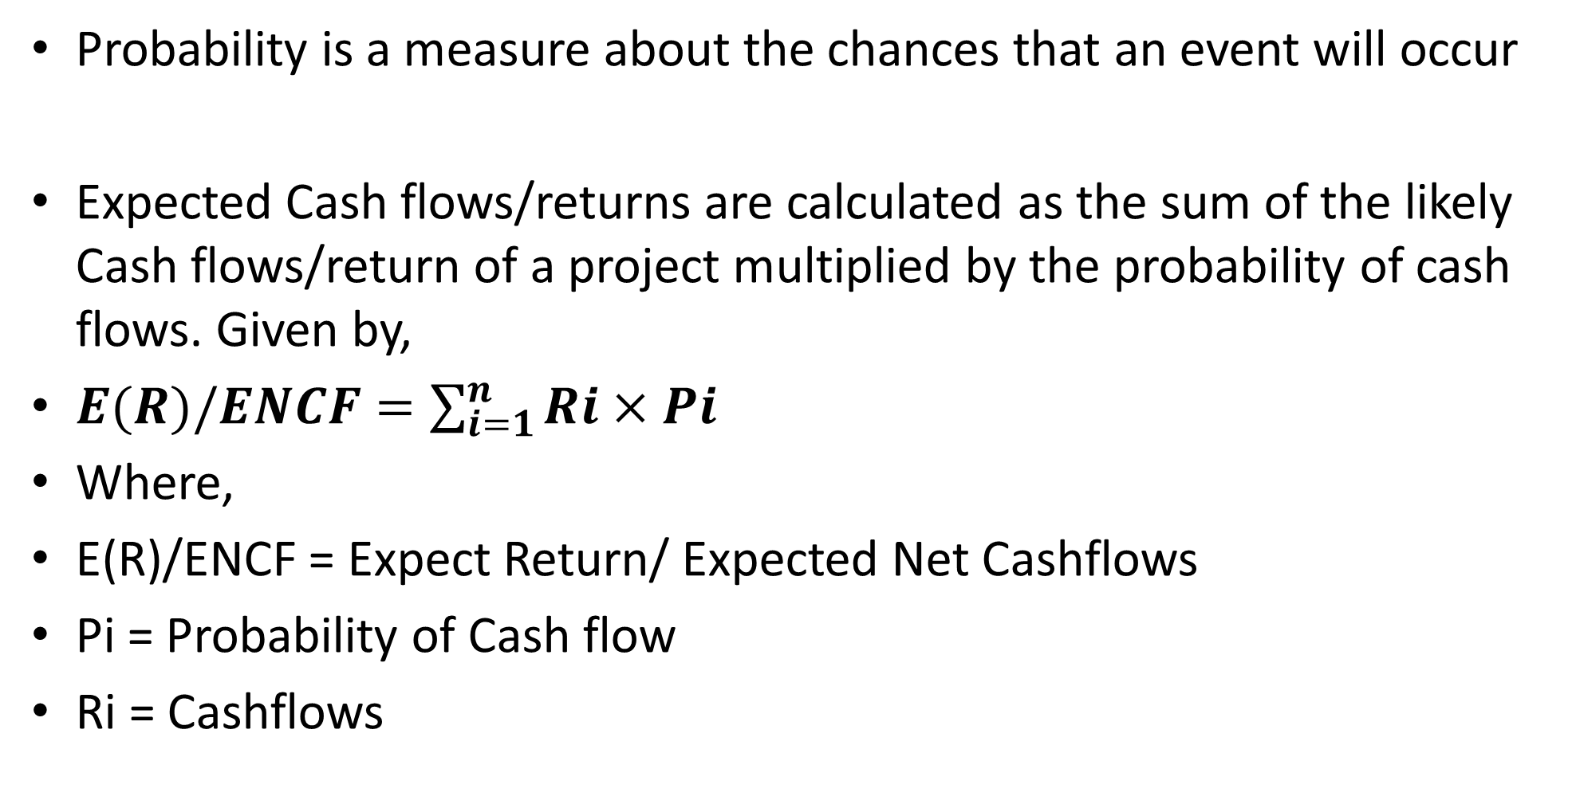
Probability
Probability is a measure about the chances that an event will occur
Expected Cash flows/returns are calculated as the sum of the likely Cash flows/return of a project multiplied by the probability of cash flows. Given by,
$E(R)/ENCF=\sum_{i=1}^{n}{Ri×Pi}$
Where,
E(R)/ENCF = Expect Return/ Expected Net Cashflows
Pi = Probability of Cash flow
Ri = Cashflows

Slide 6
Illustration
Calculate the expected cash flows for project BEE
Assumption(1) | Cash Flows ($) (2) | Probability(3) | Expected Cashflow($) (2x3)
Best | 300,000 | 0.3 | 300,000 × 0.3= 90,000
High | 200,000 | 0.6 | 200,000 ×0 .6=120,000
Low | 120,000 | 0.1 | 1,20000 × 0.1=12,000
Expected Net cashflow (ENCF) = 232,000

Slide 7
Attitudes towards Risk
Three possible attitudes towards risk can be identified. These are:
(a) Risk aversion- prefers less risky investment
(b) Desire for Risk -prefer risk
(c) Indifference to Risk - indifferent to risk

Slide 8
Illustration –Attitude towards risk
States of nature Project A's Project B's Probability
Cashflow Cashflow
Optimistic prediction $ 900,000 600,000 0.2
Moderate prediction 600,000 600,000 0.6
Pessimistic prediction 300,000 600,000 0.2
Required:
a) Calculate the expected cashflows
b) Which project appeals to i) Risk averter and ii) Risk seeker investor?

Slide 9
Solution
The expected cashflows would be computed as follows:
Project A
Expected cashflow = 900,000 (0.2) + 600,000 (0.6) + 300,000 (0.2)
= $ 600,000
Project B
Expected cashflow = 600,000 (0.2) + 600,000 (0.6) + 600,000 (0.2)
= $ 600,000
Therefore, the two projects have the same expected cashflows ($ 600,000).

Slide 10
Solution Ctd
However, Project A is a riskier project since there is a chance that the cashflow might be $ 300,000.
Project B on the other hand is a less risky project since we are sure that $ 600,000 will be received.
b) A risk seeker would choose Project A
A risk averter would choose Project B.
A risk neutral decision maker would be indifferent between the two projects since the expected cashflows are equal

Slide 11
Measurement of Risk
A number of basic statistical devices may be employed to measure the extent of risk inherent in any given situation.
Three important measures are:
1. Variance /Standard Deviation
2 Coefficient of Variation
3 Beta (ß) – This is widely used with portfolios-a group of assets/investments held together. This is measure of non- diversifiable risk.

Slide 12

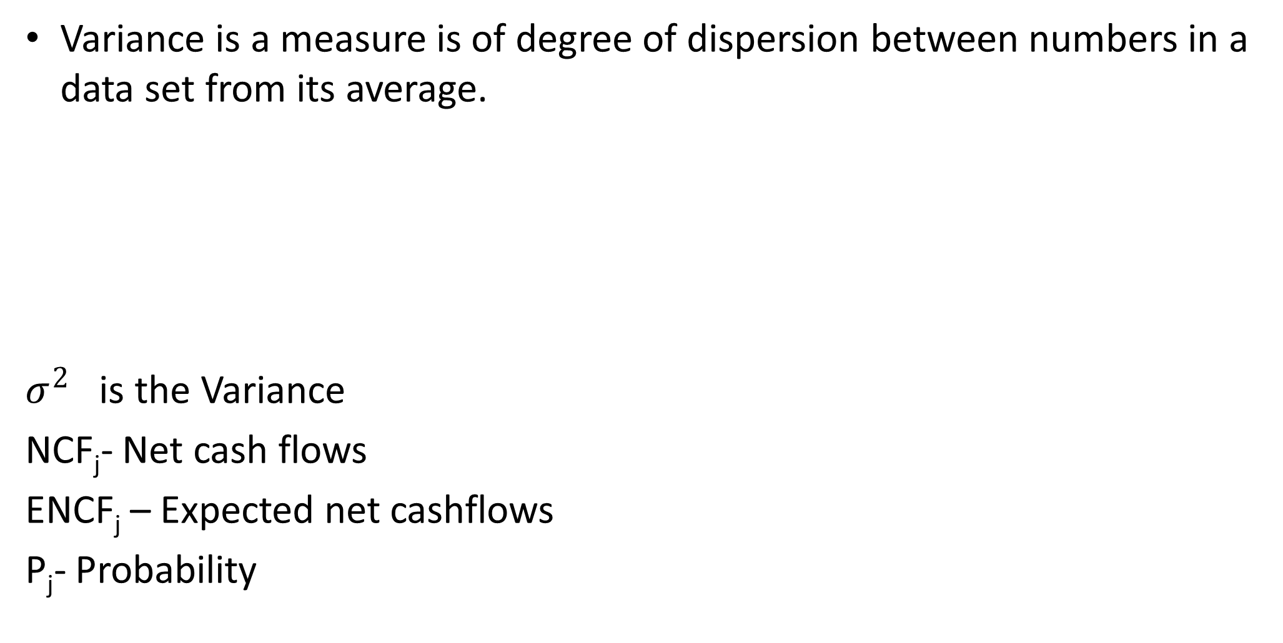
Variance -Single Asset
Variance is a measure is of degree of dispersion between numbers in a data set from its average.
$σ^{2}$ is the Variance
NCF_{j}- Net cash flows
ENCF_{j} – Expected net cashflows
P_{j}- Probability
$$σ^{2}=\sum_{j=1}^{n}{{\left({NCF}_{J}−ENCF\right)}^{2}}P_{j}$$

Slide 13
Variance – Interpretation
Variance of Zero indicates that cashfllows would be generated over the lifetime of the project would be the same.
A large variance indicates that there will be large variability between cashflows of different years
A small variance indicates that there will be cashflows will a somewhat stable throughout the life of the project.

Slide 14
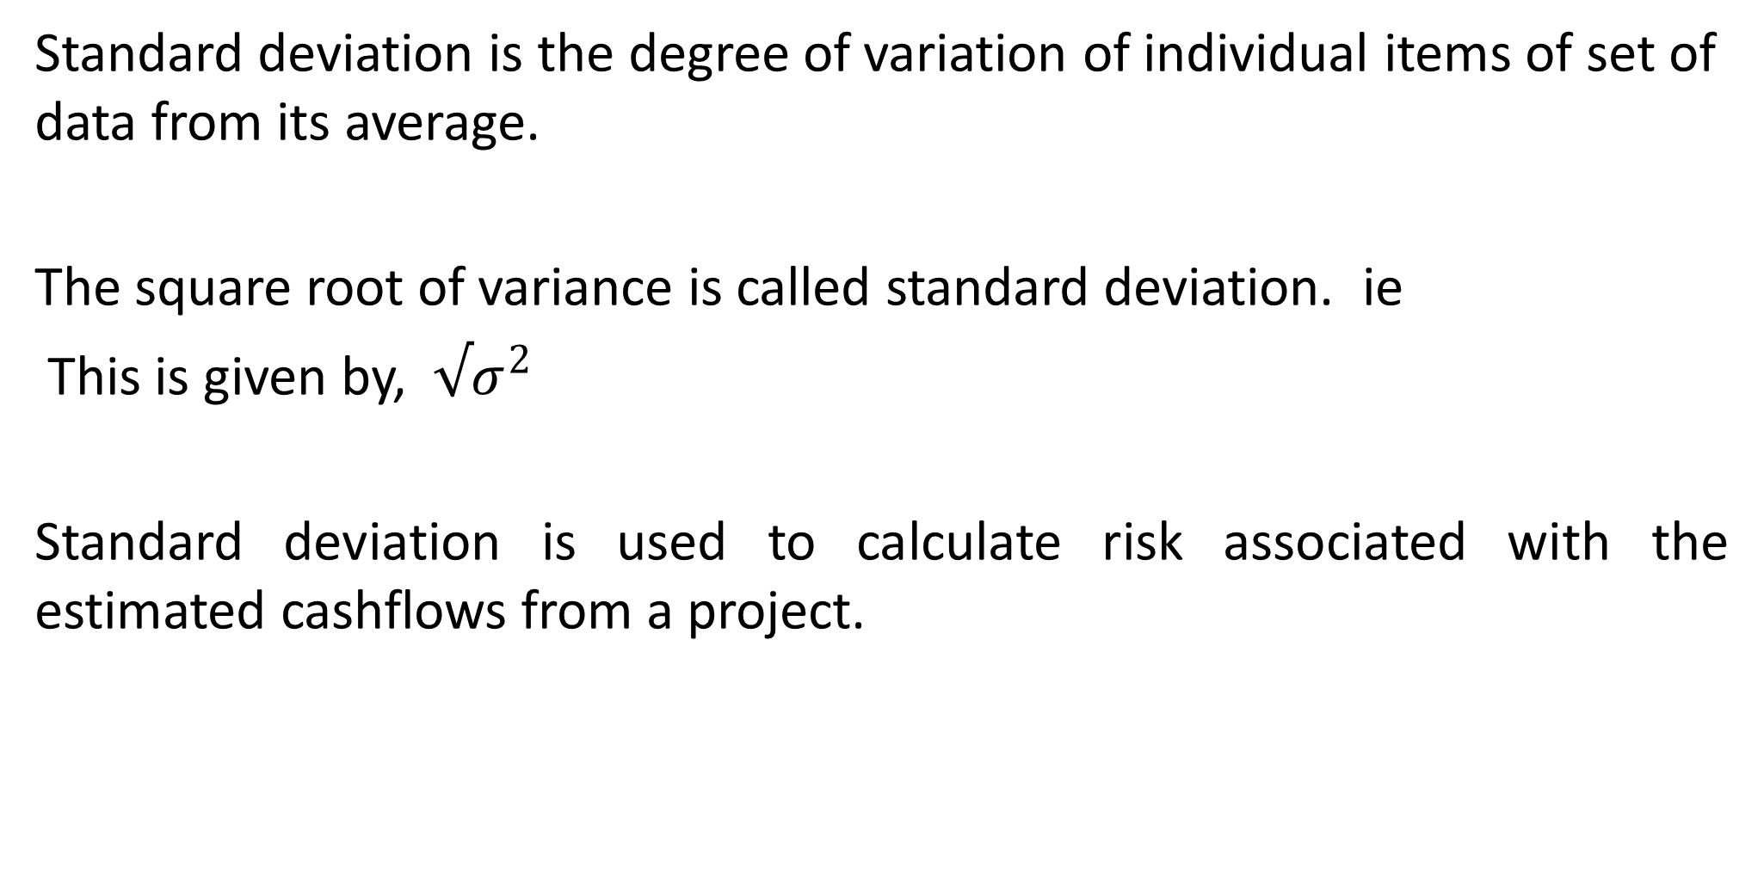
Standard Deviation- Single Asset
Standard deviation is the degree of variation of individual items of set of data from its average.
The square root of variance is called standard deviation. ie
This is given by, ${√σ}^{2}$
Standard deviation is used to calculate risk associated with the estimated cashflows from a project.

Slide 15
Illustration
An investment with the following possible outcomes and probabilities of outcomes is as shown
States of nature Probability Outcome $`000'
Pessimistic 0.2 300
Moderate 0.6 600
Optimistic 0.2 900
Required: Calculate the standard deviation of the investment

Slide 16
Solution- Steps
Step One: Calculate the expected cashflow
Expected value (ED) = ΣDP
Where, D is the outcome
P is the probability
ED is the expected outcome
Step 2: Calculate the Variance then find the square root to get the standard deviation.
Use the formula

Slide 17
Solution-Step 1
The expected value is therefore $ 600,000.

Slide 18
Solution-Step 2
The std dev is $ 6,000 (square root of the variance of $ 36,000,000)
Possible outcomes Prob.
(D) P (D)-600) ((D)-600))² Pi ((D-600))²
300 0.2 -300 90,000 18,000
600 0.6 0 0 0 0
900 0.2 300 90,000 18,000
Variance, $ 36,000

Slide 19
Illustration
Calculate the variance and standard deviation of each project
Project A |  |  | Project B
Year | Cashflows $ | Probability |  | Cashflows $ | Probability
1 | 8,000 | 0.1 |  | 24,000 | 0.1
2 | 10,000 | 0.2 |  | 20,000 | 0.15
3 | 12,000 | 0.4 |  | 16,000 | 0.50
4 | 14,000 | 0.2 |  | 12,000 | 0.15
5 | 16,000 | 0.1 |  | 8,000 | 0.1

Slide 20
Solution
First calculate each projects expected cash flows
Project A |  |  |  | Project B
Year | Cashflows $ | Probability | Expected cashflows |  | Cashflows $ | Probability | Expected cashflows
1 | 8,000 | 0.1 | 800 |  | 24,000 | 0.1 | 2,400
2 | 10,000 | 0.2 | 2,000 |  | 20,000 | 0.15 | 3,000
3 | 12,000 | 0.4 | 4,800 |  | 16,000 | 0.50 | 8,000
4 | 14,000 | 0.2 | 2,800 |  | 12,000 | 0.15 | 1,800
5 | 16,000 | 0.1 | 1,600 |  | 8,000 | 0.1 | 800
ENCF |  |  | 12,000 |  |  |  | 16,000

Slide 21
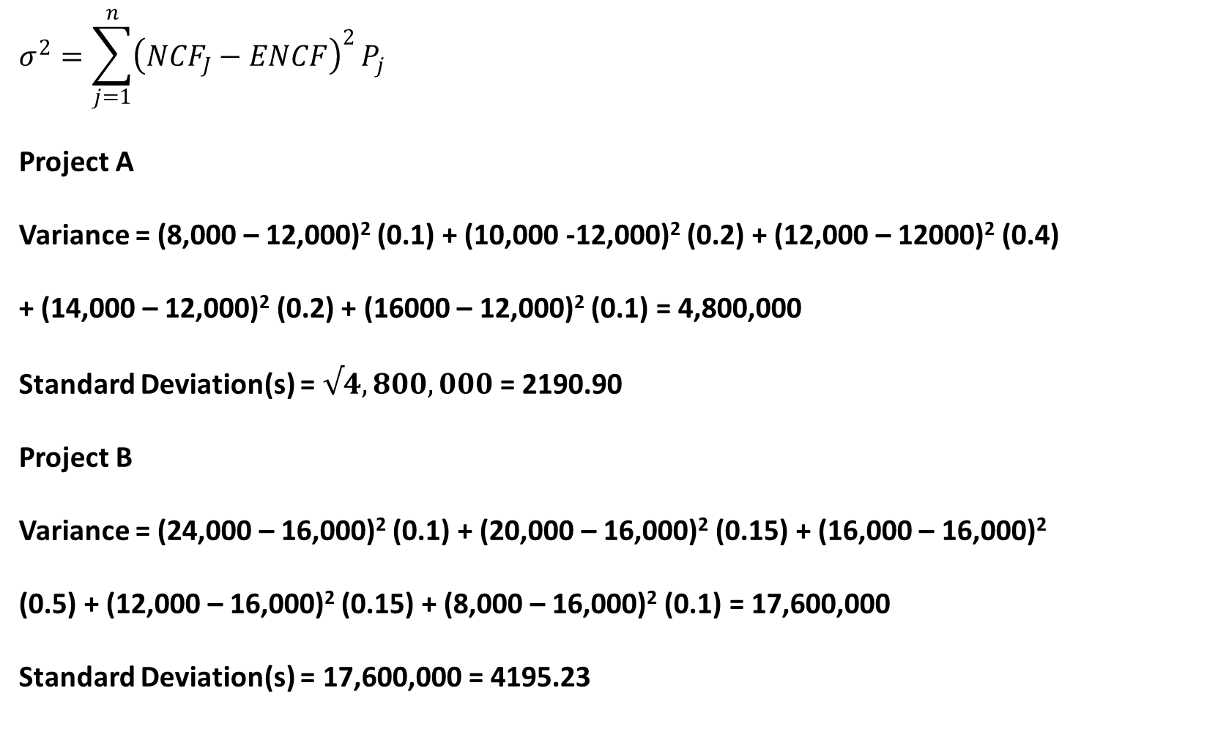
Solution-
$$σ^{2}=\sum_{j=1}^{n}{{\left({NCF}_{J}−ENCF\right)}^{2}}P_{j}$$
Project A
Variance = (8,000 – 12,000)² (0.1) + (10,000 -12,000)² (0.2) + (12,000 – 12000)² (0.4)
+ (14,000 – 12,000)² (0.2) + (16000 – 12,000)² (0.1) = 4,800,000
Standard Deviation(s) = $√4,800,000$ = 2190.90
Project B
Variance = (24,000 – 16,000)² (0.1) + (20,000 – 16,000)² (0.15) + (16,000 – 16,000)²
(0.5) + (12,000 – 16,000)² (0.15) + (8,000 – 16,000)² (0.1) = 17,600,000
Standard Deviation(s) = 17,600,000 = 4195.23

Slide 22
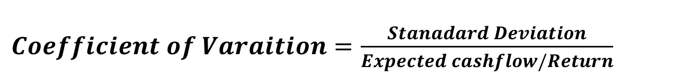
Coefficient of Variation
Coefficient of Variation (CV) enables the management to calculate the risk borne by the concern for every unit of estimated return from a particular investment. It is given by,
$Coefficient of Varaition=\frac{Stanadard Deviation}{Expected cashflow/Return}$

Slide 23
Illustration
Consider, two projects with the following expected outcome and standard deviation.
Project Expected value Stad Dev
Y $ 6,000 600
Z $ 600 190
On the basis of expected outcome, one would choose Y, since it has higher outcome. But on the basis of Risk- std dev, one would choose Z, since it has the lowest risk.

Slide 24
Solution Ctd
To decide which of the two projects, is a more risky project we need to compute the C.V
Project X
CV = 600 = 0.100
6,000
Project Z
CV = 190 = 0.317
600
Generally, the larger the coefficient of variation, the greater the risk. Therefore, Project Z carries a greater risk than Project Y.

Slide 25
Return Analysis
Some investment. carry a predetermined fixed rate of
return that is usually payable periodically eg bonds
For some investments like ordinary shares, there is no assurance of periodical payments as dividends,
Investing in the shares of companies have higher risks than fixed income instruments.
Return can be calculated based on historical basis and on future basis.

Slide 26
Expected Return- Illustration
a) Compute the expected return of each asset
b) Standard deviation of each asset.
Probability Rate of return (%) A B C D
0.1 10.0% 6.0% 14.0% 2.0%
0.2 10.0 8.0 12.0 6.0
0.4 10.0 10.0 10.0 9.0
0.2 10.0 12.0 8.0 15.0
0.1 10.0 14.0 6.0 20.0

Slide 27
Solution-Expected Return
E(R_{A}) = 10(0.1) + 10(0.2) + 10(0.4) + 10(0.2) + 10(0.1) = 10%
E(R_{B}) = 6(0.1) + 8(0.2) + 10(0.4) + 12(0.2) + 14(0.1) = 10%
E(R_{C}) = 14(0.1) + 12(0.2) + 10(0.4) + 8(0.2) + 6(0.1) = 10%
E(R_{D}) = 2(0.1) + 6(0.2) + 9(0.4) + 15(0.2) + 20(0.1) = 10%

Slide 28
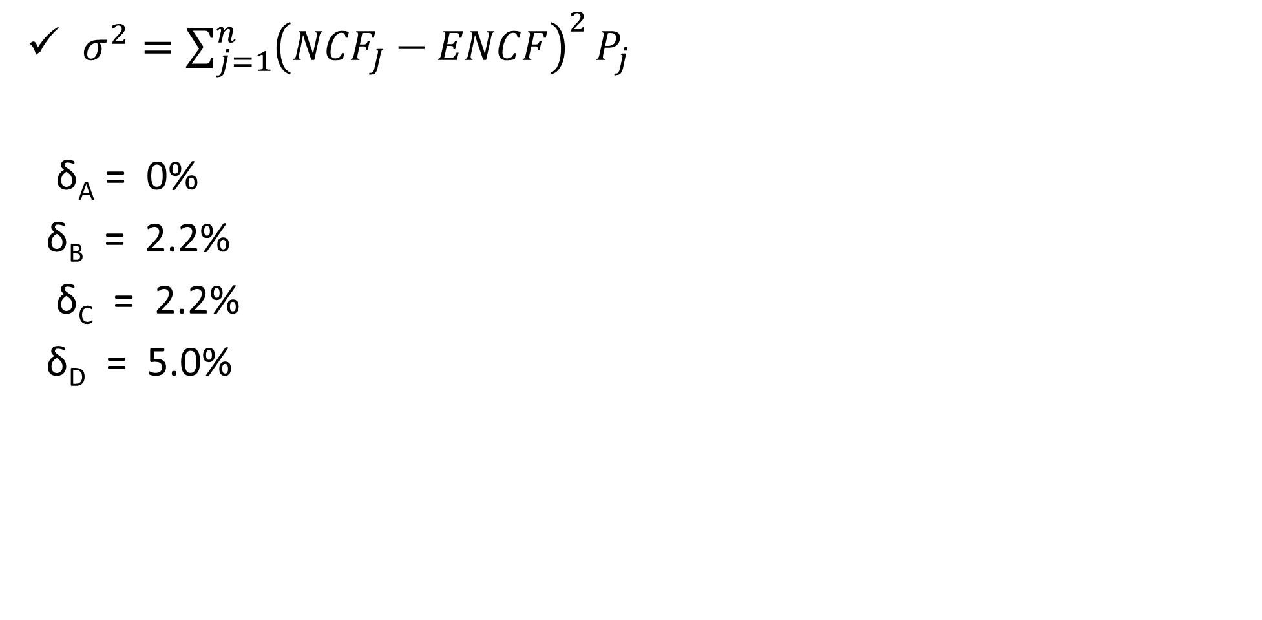
Solution –Std Dev
✓ $σ^{2}=\sum_{j=1}^{n}{{\left({NCF}_{J}−ENCF\right)}^{2}}P_{j}$
δ_{A} = 0%
δ_{B} = 2.2%
δ_{C} = 2.2%
δ_{D} = 5.0%

Slide 29
Expected Return of a Portfolio
A portfolio’s expected return is the weighted average of the expected return of each asset held in isolation. This is given by:
(R_{P}) = E(αX_{A} + ßX_{B}) ...
Where (E(R_{P}) is the expected portfolio return
α is the investment in asset A
ß is the investment in asset B
X_{A} is the expected return of asset A
X_{B} is the expected return of asset B
The formula can be simplified as
(R_{P}) = αEX_{A} + ßEX_{B} ... Notethat α + ß = 1

Slide 30
  Illustration
From the two investments, A and B, expected return of a portfolio of the two assets
Investment Expected Return (%) Proportion
A 10 2/3
B 20 1/3
Solution
Note α = 2/3 ß = 1/3. EX_{A} = 10 EX_{B} = 20
E(R_{P}) = 2 (10%) + 1 (20%) = 13.3%
3 3

Slide 31
Portfolios’ Standard Deviation
The portfolio standard deviation is not a weighted average of standard deviations of assets held in isolation.
This is because of the inter-relatedness of the assets, which reduces the risk when assets are held together ( correlation)
Portfolio risk is actually influenced by
1. Correlation coefficient/ Covariance
2. Weight of each asset in the portfolio
3. The risk- standard deviation of each asset in the portfolio

Slide 32
  Correlation coefficient
A correlation coefficient is a statistical measure of the degree to which changes to the value of one variable predict change to the value of another.
The coefficient of correlation (τ) lies between -1 and +1.
If τ_{AB} = +1, this means that A and B are perfectly positively correlated and therefore the outcomes of A and B move in the same direction at the same time.
If τ_{AB} = -1, then A and B are perfectly negatively correlated and their results are inversely related. That is they move in opposite directions simultaneously.

Slide 33
Std Dev of a Portfolio
Where a is the weight of/amount invested in asset A
b is the weight of/amount invested in asset B
δ_{A} is the standard deviation of A
δ_{B} is the standard deviation of B
τ_{AB} is the correlation coefficient of asset A and B
$$δ_{A+B} =\sqrt{a^{2}{δ^{2}}_{A}+b^{2}{δ^{2}}_{B}+2\left(γ_{AB}\right)\left(a\right)\left(b\right)\left(δ_{A}\right)\left(δ_{B}\right)}$$

Slide 34
Illustration
Consider two investments A and B each having the following characteristics:
Investment Expected Return (%) Proportion
A 20 2/3
B 40 1/3
Compute the portfolio standard deviation if the correlation coefficient between the assets is
a. 1
b. 0
c. -1

Slide 35

Solution
a. If r_{AB} = 1
δ_{A+B} = √(0.036 +0.036) = 26.8%
b. If r_{AB} = 0 then
δ_{A+B} = √(0.036) = 18.7%
c. If r_{AB} = -1
δ_{A+B} = √(0.036 - 0.036) = √0 = 0 No risk at all

Slide 36
Covariance and Correlation Coefficient
The covariance is a measure which reflects both
the variance of an asset's returns and
the tendency of those returns to move up
and down at the same time other assets move up or down

Slide 37
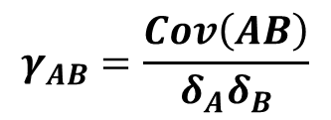
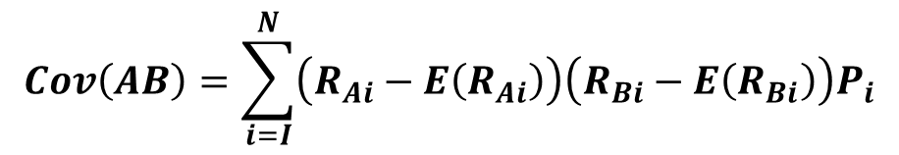
Covariance Formula
$$Cov\left(AB\right)=\sum_{i=I}^{N}{\left(R_{Ai}−E\left(R_{Ai}\right)\right)\left(R_{Bi}−E\left(R_{Bi}\right)\right)P_{i}}$$
Cov (AB) is the covariance between And B
R_{Ai} is the return on asset A under the Ith state.
E(R_{A}) is the expected return of A
R_{Bi} is the return on asset B under the ith state
E(R_{B}) is the expected return of B
P_{i} is the probability of the ith state.
$$γ_{AB}=\frac{Cov\left(AB\right)}{δ_{A}δ_{B}}$$

Slide 38
Illustration
Prob Rate of return (%)
A B C
0.1 10.0% 6.0% 14.0%
0.2 10.0 8.0 12.0
0.4 10.0 10.0 10.0
0.2 10.0 12.0 8.0
0.1 10.0 14.0 6.0
Required: a. Compute the expected return and standard deviation of each asset. b. Compute the covariance of asset i.A and B ii. B and C
c. Compute the correlation coefficient of the combination of assets in b above.

Slide 39
Solution- Expected Return
E(R_{A}) = 10(0.1) + 10(0.2) + 10(0.4) + 10(0.2) + 10(0.1) = 10%
E(R_{B}) = 6(0.1) + 8(0.2) + 10(0.4) + 12(0.2) + 14(0.1) = 10%
E(R_{C})= 14(0.1) + 12(0.2) + 10(0.4) + 8(0.2) + 6(0.1) = 10%

Slide 40

Solution- Std Dev
δ_{A} = since (R_{Ai} - E(R)_{A}) = 0%
δ_{B} = √4.8 = 2.2%
δ_{C} = 2.2%

Slide 41

Solution- Covariance
Cov (AB) : Since (R_{Ai} - ER_{A}) = 0, Cov(AB) = 0
Cov(BC)=(6-10)(14-10)(0.1) + (8-10)(12-10)0.2 + (10-10)(10-10)0.4 + (12-10)(8-10)0.2 + (14-10)(6-10)0.1 = -4.8

Slide 42
Solution-Correlation coefficient i. τ_{AB} = Cov_{(AB)} = 0 = 0 δ_{A}δ_{B} (0)(2.2) ii. τ_{BC} = Cov_{(BC)} = -4.8 = -1.0 δ_{B}δ_{C} (2.2)(2.2)

Slide 43
Efficient Portfolio
Efficient portfolios -portfolio which provide the highest expected return for any degree of risk, or the lowest degree of risk for any expected return.
The risk can be divided into two: a. The diversifiable (unsystematic) risk- can be mininised by increasing number of assets in the portf b The non-diversifiable (systematic) risk.

Slide 44
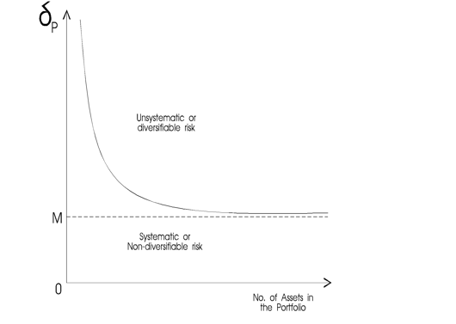
Types of Risks

Slide 45
Summary
1.Risk comes in two types:
• Diversifiable (non-systematic)
• Non-diversifiable (systematic)
2. Diversification reduces (diversifiable) risk.
3. Risk of a portfolio is influenced by
-Weight of individual assets
-Correlation coefficients
-Risk of individual assets

Slide 46
THANK YOU
We have come to the end of Lecture Eleven
It was nice having you in this class
See you in the next class

Slide 47
REFERENCES
Brealey, Myers & Allen, Principles of Corporate Finance, the McGraw-Hill Companies, Inc., 2007.
Gitman,L & Zutterc C.Principles of Managerial Finance, 14th ed. Pearson Education Limited, 2015
Van Horne, James C, .Fundamentals of Financial Management 13th ed. Pearson Education Limited, 2005

