Slide 1
Business Finance
Week 12
Working Capital Management
Lecturer: Dr. Charity Njoka (PhD)

Slide 2
Intended Learning Outcomes
By the end of this lecture , you should be able to:
Understand fundamental decision issues in working capital management – and the trade-offs involved in making these decisions.
2. Discuss how to determine the optimal level of current assets.
3 Illustrate the application of working capital management in business decision making

Slide 3
Introduction
Two major concepts of working capital – net working capital and gross working capital.
To accountants working capital is net working capital, difference between current assets and current liabilities
Financial analysts, on the other hand, mean current assets when they speak of working capital

Slide 4
Introduction-Ctd
Current assets include inventory/ stock, receivables/debtors, cash or cash equivalents, and prepaid expenses.
Working capital involves i) setting target levels of each category of current assets and ii), exploring how current assets will be financed.

Slide 5
Financing Current Assets
Current assets require financing by use of either
current funds or long term funds.
Three major approaches to financing current assets are:
Matching Approach
Aggressive Approach
Conservative Approach

Slide 6
Matching Approach
Here the firm adopts a financial plan which involves the matching of the expected life of assets with the expected life of the source of funds raised to finance assets.
The firm, therefore, uses long term funds to finance permanent assets (non –current assets and permanent current assets) and short-term funds to finance temporary assets.

Slide 7
Aggressive Approach
Here a firm depends relatively more on short-term sources than warranted by the matching plan.
Under this approach the firm finance not only its temporary current assets but also a part of permanent current assets with short-term sources of finance

Slide 8
Conservative Approach
Here a firm depends more on long-term financial sources for meeting its financial needs.
Here fixed assets, permanent current assets and even a part of temporary current assets is provided with long-term sources of finance and this make it less risky nature.
Advantage - in the absence of temporary current assets, a firm can invest surplus funds into marketable securities and store liquidity.

Slide 9
Risk-Return Trade-off of the 3 Approaches:
The conservative approach is a low return-low risk approach - uses more of long-term funds which are now more expensive than short-term funds. Long term finds don’t require payment within a year
The aggressive approach on the other hand is a highly risky approach and also a high return approach the reason being that it relies more on short-term funds that are less costly but riskier.
The matching approach is in between because it matches the life of the asset and the life of the funds financing the assets.

Slide 10
Determinants of Working Capital Needs
a) Nature and size of the business.
b) Firm’s manufacturing cycle
c) Business fluctuations
d) Production policy
e) Firm’s credit policy
f) Availability of credit
g) Growth and expansion activities.

Slide 11
Importance of Working Capital Management
1) Time devoted to working capital management-A large portion of a financial manager’s time is spent on working capital decisions.
2) Investment in current assets-. These investments tend to be relatively volatile and can easily be misappropriated by the firm’s employees.
3)Importance to small firms -A small firm may minimise its investments in non- current assets, but it cannot avoid investment in current assets
4) Relationship between sales and current assets- direct and close, changes in current assets directly affects the level of sales.

Slide 12
Cash and Marketable Securities Management
Management of cash is an important function of the finance manager.
It is concerned with the managing of:-
(i) Cash flows into and out of the firm;
(ii) Cash flows within the firm; and
(iii) Cash balances held by the firm at a point of time by financing deficit or investing surplus cash.

Slide 13
Objectives of cash management for a Business
To provide adequate cash to each of its units;
No funds are blocked in idle cash; and
The surplus cash (if any) should be invested in order to maximize returns for the business.
NB: A cash management scheme therefore, is a delicate balance between the twin objectives of liquidity and costs.

Slide 14
The Need for Cash
There are three basic considerations in determining the amount of cash or liquidity as
1. Transaction need: Cash required for the day-to-day expenses and other debt payments
2. Speculative needs: Cash may be held in order to take advantage of profitable opportunities.
3. Precautionary needs: Cash may be held to act as for providing safety against unexpected events.

Slide 15
Cash Cycle and Cash Turnover
Cash Cycle - amount of time that elapses from the point when the firm makes a cash outlay to purchase raw materials to the point when cash is collected from the sale of finished goods produced using those raw materials (in case of a manufacturing frim)
Cash turnover on the other hand refers to the frequency of a firm’s cash cycle during a year.

Slide 16
Illustration
Kenny ltd purchases raw materials on credit and sells its merchandise on credit. The credit terms requires payment within 30 days of a purchase while the firm currently requires its customers to pay within 60 days of a sale. On average the firm takes 35 days to pay its accounts payable and the average collection period is 70 days.
On average, 85 days elapse between the point at which raw material is purchased and the point the finished goods are sold.
Required
Determine the i) cash conversion cycle and the ii) cash turnover.

Slide 17
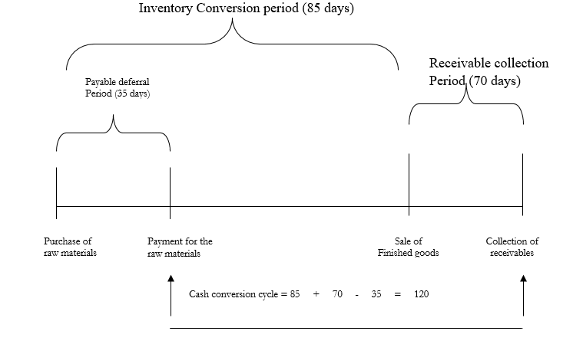
Solution

Slide 18
Solution
Cash conversion cycle = 85 + 70 – 35 = 120 days
b) Cash turnover = 360
Cash conversion cycle
360/120 =3 times

Slide 19
The Cash Budget Purposes
It shows the firm’s projected cash inflows and outflows over some specified period.
1. Coordinate the timings of cash needs- identifies periods of shortage of cash or an abnormally large cash requirements
2. It also helps to pinpoint period(s) when there is likely to be excess cash;
3. It enables firm which has sufficient cash to take advantage like cash discounts on its accounts payable
4. It helps to plan/arrange adequately needed funds (avoiding excess/shortage of cash) on favorable terms.

Slide 20
Baumol’s Model
According to this model, optimum cash level is that level of cash where the carrying costs and transactions costs are the minimum.
The carrying costs refer to the cost of holding cash, namely, the interest foregone on marketable securities.
The transaction costs refer to the cost involved in getting the marketable securities converted into cash.

Slide 21
Baumol’s Model Ctd
The Baumol’s model assumptions are:
1. The firm uses cash at a steady predictable rate
2. The cash outflows from operations also occurs at a steady rate
3. The cash net outflows also occur at a steady rate.

Slide 22

Baumol’s Model – Optimal Cash
C* is the optimal amount of cash to be raised by selling marketable securities or by borrowing.
b is the fixed cost of making a securities trade or of borrowing
T is the total annual cash requirements
i is the opportunity cost of holding cash (equals the interest rate on marketable securities or the cost of borrowing)

Slide 23
Total cost of holding cash balance
Total cost of holding cash balance is equal to holding or carrying cost plus transaction cost.
TC= Total Cost
C = Total annul Cash requirement
I = Opportunity cost/ Interest rate
b = Fixed cost per trade
x

Slide 24
Illustration
ABEND Ltd. makes cash payments of $10,000 per week. The interest rate on marketable securities is 12% and every time the company sells marketable securities, it incurs a cost of $ 20.
Required
a) Determine the optimal amount of marketable securities to be converted into cash every time the company makes the transfer.
b) Determine the total number of transfers from marketable securities to cash per year.
c) Determine the total cost of maintaining the cash balance per year.
d) Determine the firm’s average cash balance.

Slide 25

Solution

Slide 26


Solution Ctd

Slide 27
Miller-Orr Model
Daily net cash follows a trendless random walk.
Accordingly Miller-Orr Model sets higher and lower control units, H and L respectively, and a target cash balance, Z.
When the cash balance reaches H, then H-Z dollars are transferred from cash to marketable securities.
Similarly, when the cash balance hits L then Z-L dollars are transferred from marketable securities cash.

Slide 28
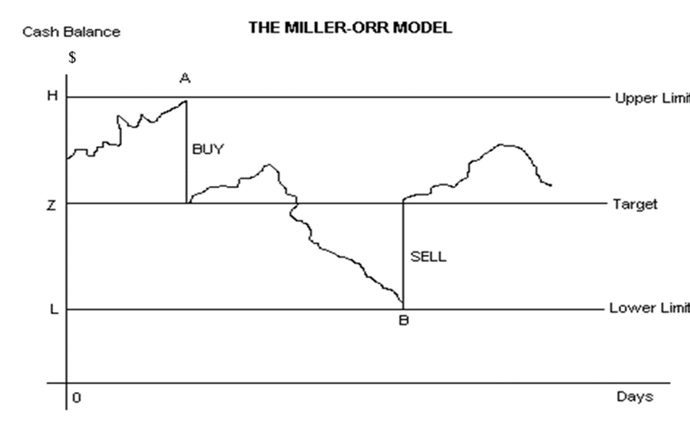
Diagram

Slide 29

M-0 Model
The target balance, Z, is given by the following formula:

Slide 30
Illustration
EXEE management has set the minimum cash balance to be equal to $ 10,000. The standard deviation of daily cash flow is $ 2,500 and the interest rate on marketable securities is 9% p.a. The transaction cost for each sale or purchase of securities is $ 20.
Required
a. Calculate the target cash balance
b. Calculate the upper limit
c. Calculate the average cash balance
d. Calculate the spread

Slide 31
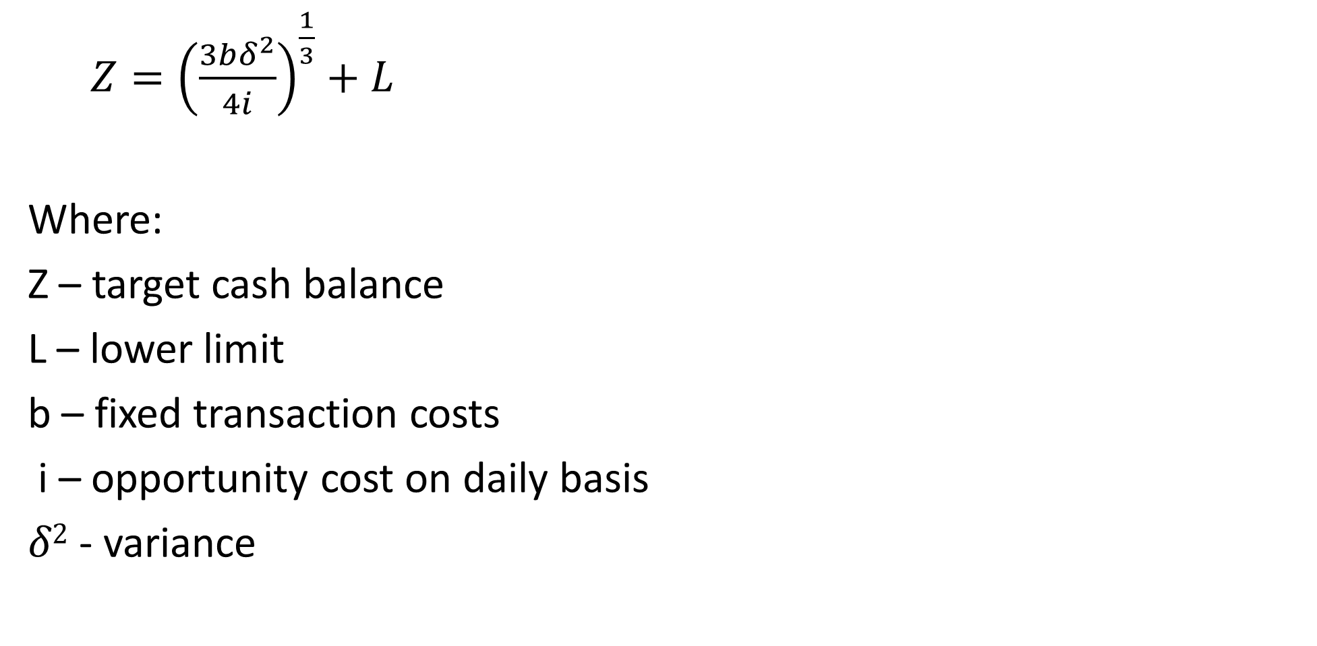
Target Cash Balance Formula
$Z={\left(\frac{3bδ^{2}}{4i}\right)}^{\frac{1}{3}}+L$
Where:
Z – target cash balance
L – lower limit
b – fixed transaction costs
i – opportunity cost on daily basis
$δ2$ - variance

Slide 32
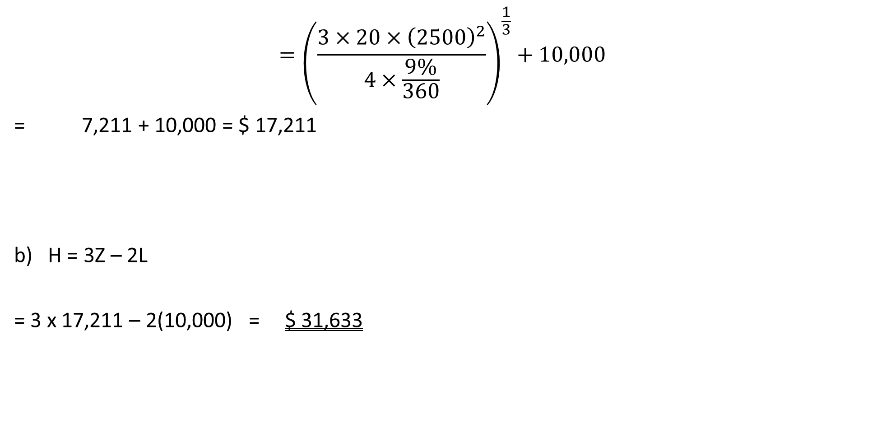
Solution
$$={\left(\frac{3×20×{\left(2500\right)}^{2}}{4×\frac{9\%}{360}}\right)}^{\frac{1}{3}}+10,000$$
= 7,211 + 10,000 = $ 17,211
H = 3Z – 2L
= 3 x 17,211 – 2(10,000) = $ 31,633

Slide 33

Solution Ctd
C)
=[(4 x 17,211)- 10,000] / 3 = 19,615
d) The spread = H – L
= 31,633 – 10,000
= $ 21,633
If the cash balance rises to 31,633, the firm should invest $ 14,422 (31,633 – 17,211) in marketable securities and if the balance falls to $ 10,000, the firm should sell $ 7,211(17,211 – 10,000) of marketable securities.

Slide 34
Cash Management Techniques
The basic strategies in managing its cash are:
To pay account payables late ,without damaging the firm’s credit rating and take advantage of any favourable cash discounts offered.
ii)Turnover inventory as quickly as possible, but avoid stockouts which might result in loss of sales or shutting down
iii) Collect accounts receivable as quickly as possible without losing future sales because of high pressure collection techniques- use cash discounts to accomplish this objective.

Slide 35
Other Strategies
Direct debit: I.e., authorization for the transfer of funds from the purchaser’s bank account.
(ii) Integrated Voice Response - uses of human operators and a computer based system allowing customers to make payment over phone, generally by credit card.

Slide 36
Other Strategies Ctd
(iii) Collection by a third party- collected by an authorized external firm. Cash, cheque, credit card or Electronic fund transfer.
Lock Box Processing: Under this system an outsourced partner captures cheques and invoice data and transmits the file to the client firm for processing in that firm’s systems.
(v) Payments via Internet.

Slide 37
Management of Inventories
Inventory management covers
fixation of minimum and maximum levels,
determining the size of inventory to be carried,
deciding about the issues, receipts
and inspection procedures,
determining the economic order quantity,
proper storage facilities,
keeping check over obsolescence and
ensuring control over movement of inventories..

Slide 38

Basic Economic Order Quantity (EOQ) Model
Where: Q is the economic order quantity
D is the annual demand in units
C_{o} is the cost of placing and receiving an order
C_{n} is the cost of holding inventories per unit per order

Slide 39
Total holding cost

Slide 40
Re order level

Slide 41
EOQ Assumptions
i) The demand is known and constant over the year
ii) The ordering cost is constant per order and certain
iii) The holding cost is constant per unit per year
iv) The purchase cost is constant (Thus no quantity discount)
v) Back orders are not allowed.

Slide 42
Illustration
CEEDAC Ltd requires 2,000 units of a component which costs $ 50 each. The items are available and leadtime in one week. Each order costs $ 50 to prepare & process while the holding cost is $15 per unit per year for storage plus 10% opportunity cost of capital.
Required
a) How many units should be ordered each time an order is placed to minimize inventory costs?
b) What is the reorder level?
c) How many orders will be placed per year?
d) Determine the total relevant costs.

Slide 43

Solution-
Where: D = 2,000 units
C_{o} = $ 50
C_{n} = $ 15 + 10% x 50 = $ 20
L = 7 days

Slide 44
Solution- Ctd

Slide 45
Management of Account Receivable
Firms offer credit to current customers and attract new ones most firms find it necessary to offer credit.
Accounts receivable management begins with the decision on whether or not to grant credit.
The total amount of receivables outstanding at any given time is determined by:
a) The volume of credit sales
b) The average length of time between sales and collections.
Accounts receivables =Credit sales per day xLength of collection period

Slide 46
Average collection Period
Depends on: a) Credit standards which is the maximum risk of acceptable credit accounts b) Credit period which is the length of time for which credit is granted c) Discount given for early payments d) The firm’s collection policy.

Slide 47
Credit Policy-Linient policy
Results in increased sales
Can result in increased costs such as:
1. Increased bad debt losses
2. Opportunity cost of tied up capital in receivables
3. Increased cost of carrying out credit analysis
4. Increased collection cost
5. Increased discount costs to encourage early payments
.

Slide 48
Types of Risks
Evaluation of Investment in Receivables
Involves the following steps:
Estimation of incremental operating profits from increased sales
Estimation of incremental investment in account receivable
Estimation of incremental costs
Comparison of incremental profits with incremental costs

Slide 49
Credit Terms
Credit terms involve both the length of the credit period and the discount given.
The terms 2/10, n/30 means that a 2% discount is given if the bill is paid before the tenth day after the date of invoice otherwise the net amount should be paid by the 30th day.
A firm should look at the profitability caused by longer credit and discount period or a higher rate of discount against increased cost.

Slide 50
Illustration
ZED Ltd is evaluating two proposed credit policies.
The firm has annual credit sales of $ 5000,000 dollars and accounts receivable turnover ratio of 4 times a year.
The current level of loss due to bad debts is $ 150,000.
The firm is required to give a return of 25% on the investment in new accounts receivables.
The company’s variable costs are 70% of the selling price.
Given the following information, which is the better option?

Slide 51
Solution
 | Present Policy | Policy Option I | Policy Option II
Annual credit sales | 5,000,000 | 6,000,000 | 6,750,000
Accounts receivable turnover ratio | 4 times | 3 times | 2.4 times
Bad debt losses | 150,000 | 300,000 | 450,000

Slide 52
Solution
 | Particulars | Present Policy | Policy Option I | Policy Option II
 |  | $ | $ | $
A | Expected Profit:
 | (a) Credit Sales | 5,000,000 | 6,000,000 | 6,750,000
 | (b) Total Cost other than Bad Debts:
 | (i) Variable Costs | 3,500,000 | 4,200,000 | 4,725,000
 | c) Bad Debts | 150,000 | 300,000 | 450,000
 | d) Expected Profit [(a) – (b) – (c)] | 1,350,000 | 1,5000,000 | 1,575,000
B | Opportunity Cost of Investments in Receivables | 218,750 | 350,000 | 492,188
C | Net Benefits (A – B) | 1,131,250 | 1,150,000 | 1,082,812

Slide 53
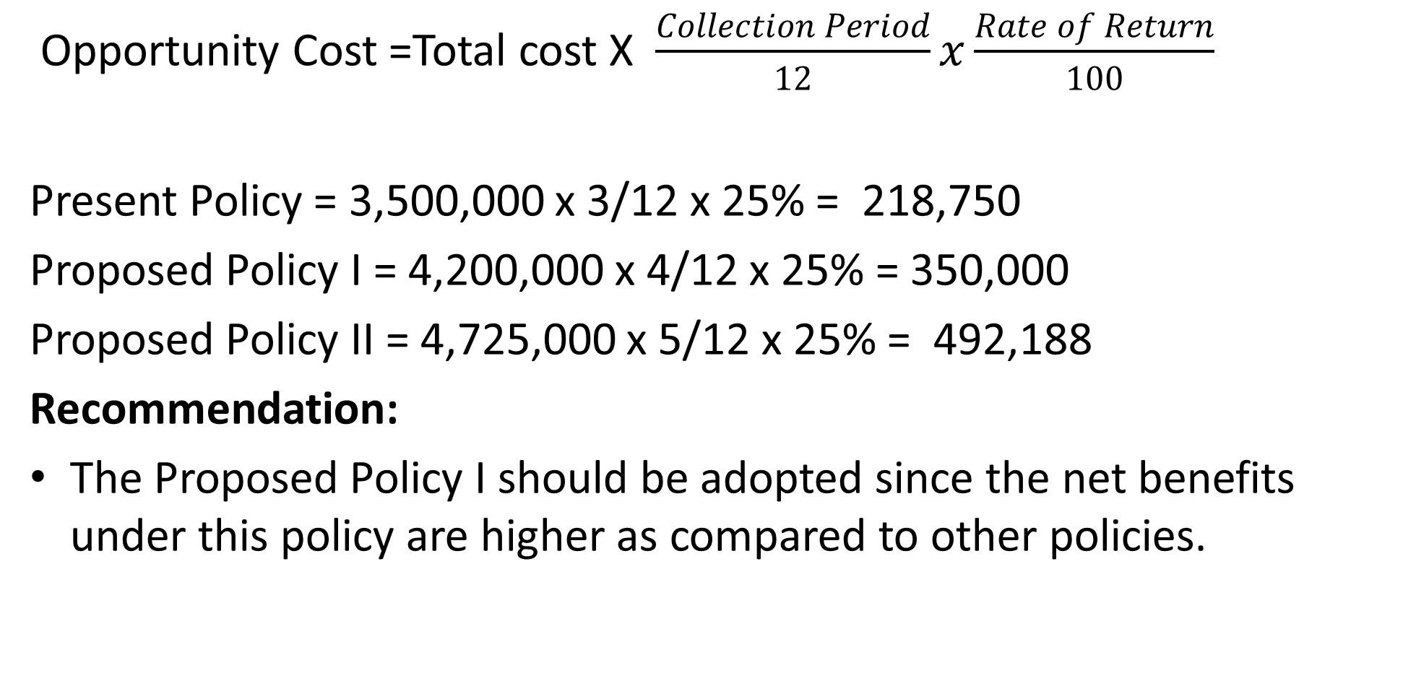
Solution - Opportunity Cost of Average Investments
Opportunity Cost =Total cost X $\frac{Collection Period}{12}x\frac{Rate of Return}{100}$
Present Policy = 3,500,000 x 3/12 x 25% = 218,750
Proposed Policy I = 4,200,000 x 4/12 x 25% = 350,000
Proposed Policy II = 4,725,000 x 5/12 x 25% = 492,188
Recommendation:
The Proposed Policy I should be adopted since the net benefits under this policy are higher as compared to other policies.

Slide 54
Summary
Working Capital Management involves managing the balance between firm’s short-term assets and its short-term liabilities.
From the value point of view, Working Capital can be defined as Gross Working Capital or Net Working Capital.
From the point of view of time, the term working capital can be divided into two categories viz., Permanent and temporary
To decide the levels and financing of current assets, the risk return trade off must be taken into account.
In determining the optimum level of current assets, the firm should balance the profitability – Solvency tangle by minimizing total costs.

Slide 55
THANK YOU
We have come to the end of Lecture Twelve
It was nice having you in this class

Slide 56
REFERENCES
Financial Management: Principles and Applications. Sheridan Titman, Arthur J. Keown, and John D. Martin, 2019,Pearson Education India, New Delhi.
Financial Management,,M.Y. Khan. M. Y and Jain. P.K., 2018, McGraw Hill Education, New Delhi
Fundamental of Financial Management Eugene F. Brigham, Joel F. Huston, 2018, Cengage Learning India, New Delhi.
Van Horne, James C, .Fundamentals of Financial Management 13th ed. Pearson Education Limited, 2005

