Slide 1

FINANCIAL ACCOUNTING:
WEEK 7: PERIODIC MEASUREMENT AND END OF PERIOD ADJUSTMENTS
BY DR. JOHN MUHOHO KIMANI

Slide 2
LEARNING OBJECTIVES:
Upon completion of this topic you should be able to:
Explain the reasons for making provision for bad and doubtful debts
Explain the reasons for making provision for depreciation on fixed assets
Explain the methods for calculating provision for depreciation
Distinguish between accrued, revenues and expenses
Correctly, account for accrued revenues and expenses
Correctly account for prepaid expenses

Slide 3
INTRODUCTION
Revenue and costs must be recognized as they are earned or incurred, not as money is received or paid. They must be matched with one another so far as their relationship can be established or justifiably assumed, and dealt with in the profit and loss account of the period to which they relate.

Slide 4
INTRODUCTION
Therefore, all incomes and expenses that relate to a particular financial period will be matched together to determine the profit for the year.
Following from the previous lessons, after the ledger accounts have been balanced and an entity is approaching the end of year, certain transaction and processes must be carried out before an entity prepares its end of year financial statements.

Slide 5
INTRODUCTION
The additions and subtractions in this case are the ones referred to as end of year adjustments because they must happen at the end of the year to ensure that all revenues have been matched with all expenses in the year and also assets and liabilities have been properly valued to reflect the true and fair view of the entity in all aspects of assets, capital and liabilities.

Slide 6
ADJUSTMENTS
These adjustments involve:
Bad debts written off
Provision for Bad and doubtful debt
Depreciation
Appreciation
Accrued expenses
Accrued revenues
Prepaid expenses
Prepaid revenues

Slide 7
ADJUSTMENTS
These points are explained in details below.
BAD & DOUBTFUL DEBTS
Some debtors may not pay up their accounts for various reasons e.g. a credit customer (debtor) may go out of business. When a debtor is not able to pay up his/her account this becomes a bad debt. Therefore, the business/firm should write it off from the accounts and thus it becomes an expense that should be charged in the profit & loss account.

Slide 8
ADJUSTMENTS
When a debtor is completely unable to pay the amount owing will be written off as a bad debt. A bad debt is treated as an expense in the income statement. The treatment of bad debt as follows:
Dr: Income statement xx
Cr: Debtors account xx
The amount of the provision will then be deducted from the debtors in the statement of financial position (Balance Sheet). In the subsequent provision only increase or decreases in the provision are considered with an increase in provision being treated as an expense in the income statement while a decrease in provision is treated as an income.

Slide 9
ADJUSTMENTS
Sometimes a bad debt written off is recovered in future. This is referred to as bad debt recovered. If a debt previously written off is recovered it is treated as an income in the income statement and it will be recorded as follows:-
Dr: Cash/bank A/C xx
Cr: Income statement xx

Slide 10
ADJUSTMENTS
In practice a firm may also be unable to collect all the amounts due from credit customers (debtors). This is because a section of the debtors will not honour their obligations. The problem posed by this situation is that it is difficult to identify the debtors who are unlikely to pay their accounts.
Furthermore, the amount that will not be collected may also be difficult to ascertain. These debts that the firm may not collect are called doubtful debts. A firm should therefore provide for such debts by charging the provision in the profit and loss account. Provision for doubtful debts maybe specific or general. Specific relate to a debtor whom we can identify and we are doubtful that he may pay the debt (if one of our debtors goes out of business).

Slide 11
ADJUSTMENTS
DOUBTFUL DEBTS
A provision for doubtful debts can either be for a specific or a general provision. A specific provision is where a debtor is known and chances of recovering the debt are low. The general provision is where a provision is made on the balance of the total debtors i.e. Debtors less Bad debts and specific provision.

Slide 12
ADJUSTMENTS
DOUBTFUL DEBTS
The accounting treatment of provision for doubtful debts depends on the year of trading and the entries will be as follows. If it is the 1st year of trading (1st year of making provision):
i. Debit P&L a/c.
ii. Credit provision for doubtful debts (with total amount of the provision).
In the subsequent periods, it will depend on whether if it is an increase or decrease required on the provision.

Slide 13
ADJUSTMENTS
DOUBTFUL DEBTS
If it is an increase:
i. Debit P&L a/c.
ii. Credit provision for doubtful debts (with increase only).
If it is a decrease:
i. Debit provision for doubtful debts.
ii. Credit P&L a/c (with the decrease in provision only).

Slide 14
ADJUSTMENTS
DOUBTFUL DEBTS
EXAMPLE
Debtors x
Bad debts (x)
x
Specific Provision (x)
x
General Provision (x)
x

Slide 15
ADJUSTMENTS
A firm started trading in the year 2019, the balance on the debtor’s account was $.400, 000, bad debts amounting to $40, 000 were written off from this balance, there was a specific provision of $.50, 000 to be made to one of the debtors and a general provision of Sh.5% was to be made on the balance of the debtors. The ledger accounts of 2019 were as follows:

Slide 16
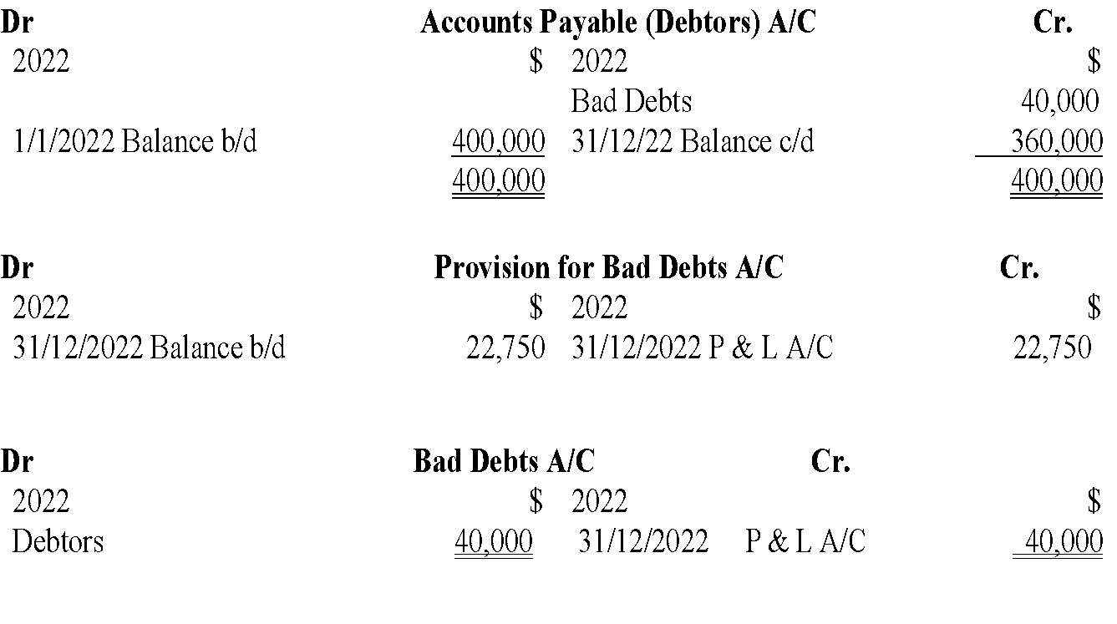
ADJUSTMENTS
Receivable

Slide 17
ADJUSTMENTS
NB: The Bad Debts for any given year is treated as an expense in the income statement and adjusted with the Total Debtors (Accounts Receivable) in the entity’s Balance sheet. The Provision for bad debts is adjusted with the Total debtors and compared with the previous year’s provision for bad and doubtful debts to establish whether the provision increased or decreased.

Slide 18
ADJUSTMENTS
If the current year provision is more than the previous period, then the difference is treated as an expense in the Income statement and the total provision for the current year deducted from the Total Debtor in the Balance sheet.
If the current year’s provision decreased, then the difference is treated as an income into the income statement and the provision for the year still deducted from the total debtors in the balance sheet to obtain the total debtors (Accounts receivable) for the current period.

Slide 19
ADJUSTMENTS
There are other forms of allowances such as the allowance for discounts among others. But this lesson concentrated on the above sub-topics as given in the objectives. The others will be featured in the income statement constructing and the balance sheet in the subsequent topics.

Slide 20
ADJUSTMENTS
Returns inwards and returns outwards
Returns Inwards
Return inwards refers to credit sales that have been returned by customers. Return inwards is deducted from the sales in the income statements.
Returns Outwards
Return outwards refers to credit purchases that were returned to suppliers. Return outwards is deducted from purchases in the income statement.

Slide 21
ADJUSTMENTS
Discount allowed and Discount received
Discount allowed
Discount allowed refers to the rebate or allowance granted to customers. It may be given to customers to encourage them to buy in bulk or to pay their dues promptly. Discount allowed is treated as an expense in the income statement. It will be deducted from the gross profit
Discount received
Discount received refers to rebate or allowance received from the suppliers. Discount received is treated as an income in the income statement. It will be added to the gross profit.

Slide 22
ADJUSTMENTS
Carriage inwards and carriage outwards
Carriage inwards
Carriage inward refers to the transport cost or expense on purchases. It will be added to the purchases in the income statement.
Carriage outwards
Carriage outwards refers to transport costs or expenses on sales. It is treated as an expense on the income statement and will be deducted from the gross profit.

Slide 23
ADJUSTMENTS
DEPRECIATION
It is the loss of value of a non-current asset throughout its period of use by the firm. IAS 16 on property, plant and equipment defines depreciation as the allocation of a depreciable amount of a non-current asset over its estimated useful life.
Under the matching concept, all incomes or revenues and expenses for a particular period should be reported in the financial statements and because depreciation is an expense of the business therefore, it will be charged in the profit and loss account.

Slide 24
ADJUSTMENTS
Causes of Depreciation
1. Physical Factors
• Wear and tear: Some non-current assets depreciate or lose value due to use overtime e.g. machinery and motor vehicles.
• Rot/decay/rust: This happens on assets that are not well maintained by the firm e.g. some machines.

Slide 25
ADJUSTMENTS
Causes of Depreciation
2. Economic Factors
• Inadequacy: Some assets lose value due to them becoming inadequate e.g. when a business grows or expands then some buildings may become inadequate due to space. Also, some machines are unable to manufacture a large number of goods.
• Obsolescence: Some assets become obsolete due to change in technology or different methods of production e.g. computers.

Slide 26
ADJUSTMENTS
Causes of Depreciation
3. Time Factors
Some assets have a legal fixed time e.g. properties on lease.
4. Depletion
This occurs when some assets have a wasting character due to extraction of raw materials, minerals or oil. Such assets include mines, oil wells, and quarries.

Slide 27
ADJUSTMENTS
Methods of Calculating Depreciation
These are the methods developed to assist in estimating the amount of depreciation to be charged in the profit and loss account as an expense.
The methods chosen by a firm should be in accordance with the agreed accounting practice, accounting standards and suit the firm’s non-current assets. There are two main methods of estimating depreciation and five others that will apply in a firm’s situation.

Slide 28
ADJUSTMENTS
The common methods of depreciation include:
Sum of the digits methods – uses a formula.
Revaluation method – applies to a non-current asset of low value.
Machine-Hour method – depreciation is based on number of hours a machine is expected to operate (manufacturing process).
Unit of output method – depreciation is based on the number of units a machine is expected to produce.
Depletion of units – depreciation is based on number of units extracted from the asset.

Slide 29
ADJUSTMENTS
The common methods of depreciation include:
Straight line method (on cost method)
Reducing balance method
Depreciation fund method
Repairs Provision method

Slide 30
ADJUSTMENTS
Sum of digits method
This method determines the sum of the years (digits) and then allocated depreciation based on the total sum. The sum is determined by (n (n+1)/2.
Where n refers to the number of years of the economic life e.g. for the above example the sum of digits will be 5(5+1)/2= 15. Assume further that the salvage value was sh. 250,000. The total depreciation of sh. 750,000 (1,000,000-250,000) will be allocated as follows using sum of digits

Slide 31
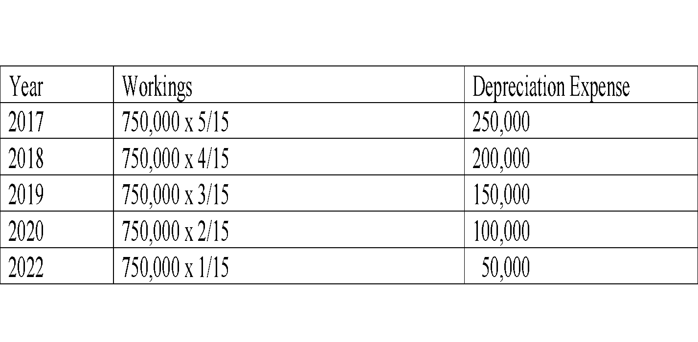
ADJUSTMENTS
Sum of digits method

Slide 32
ADJUSTMENTS
Revaluation method
This method uses professional valuation at the beginning and at the end of the period. Depreciation will be the difference between the valuation at the beginning of the period and that at the end of the period. e.g. the value of the asset at the begging of 2017 is $. 1,000,000 suppose at the end of December 2017 valuation is done and the value found to be $ 880,000, depreciation will be sh. 120,000. This will be repeated for all the years.

Slide 33
ADJUSTMENTS
The Straight-Line Method
This method ensures that a uniform amount of depreciation is charged in the P&L a/c for a particular asset and is based on the following formula:
Depreciation for year = Cost of asset – Residual Value
Estimated useful life
=
$.100, 000- $.20, 000
8
= $10,000 per year

Slide 34
ADJUSTMENTS
Cost of Asset – Residual Value
Residual Value
The amount the firm expects to sell the asset after the period of use in the firm, also called Sales Value / Scrap Value.
Estimated Useful Life
The period the asset is expected to be used in the firm.

Slide 35
ADJUSTMENTS
Example 1
A firm buys a machine for $.100, 000 which it expects to use in the firm for eight years. After the eight years the machine will be sold for$.20, 000. Under the straight-line method, the depreciation amount will be computed as follows:
This means for this asset $10, 000 will be charged in the profit and loss account as depreciation expense on the machine.

Slide 36
ADJUSTMENTS
The straight-line method assumes that benefits accruing on use of a non-current asset are spread out evenly over the life of the asset e.g. buildings use straight-line method.
Percentage rate based on cost as opposed to number of years can also be used to calculate the depreciation.

Slide 37
ADJUSTMENTS
Reducing Balance Method
The firm determines a fixed percentage rate that is applied on the cost of the asset during the first period of use. The same rate is applied in the subsequent financial periods but the rate is applied on the reduced value of the asset. (Cost of asset – total depreciation provided to date).
This method ensures that higher amount of depreciation are charged in the P&L account in the earlier periods of use and lower amounts in the latter periods of use as shown in the following example:

Slide 38
ADJUSTMENTS
Example 2
Assume a firm buys machinery for $.100, 000 and provides depreciation on machines at 20% p.a. on reducing balance method. The depreciation charged to the P&L will be as follows for the next 3 years.

Slide 39
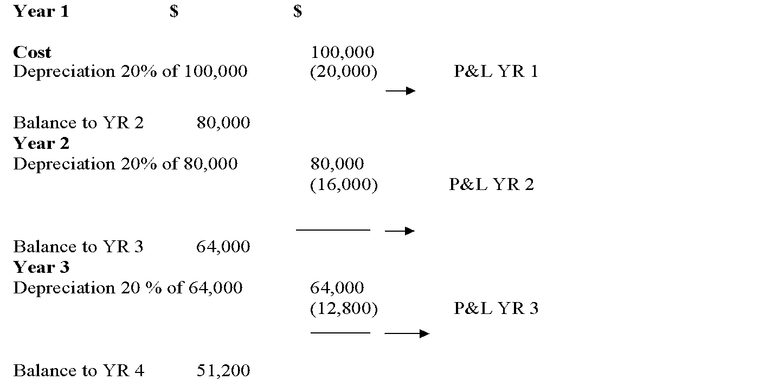
ADJUSTMENTS
Example 2

Slide 40
ADJUSTMENTS
Reducing balance method (diminishing balance method) assumes that benefits accruing from the use of an asset are higher in the first periods of use and lower in the latter period’s e.g.
Fixtures, furniture and fitting.
Plant and machinery.
Motor vehicles.

Slide 41
ADJUSTMENTS
Accounting Treatment on Depreciation
When non-current assets are depreciated, a new account for each type of asset is opened; this account is called a provision for depreciation whereby the following entries will be made:
Debit – P&L a/c
Credit – Provision for depreciation a/c
With the amount of depreciation charged for the period.

Slide 42
ADJUSTMENTS
Example on straight-line method
The entries will be as follows: Debit – P&L a/c with $.10, 000
Credit – Provision for depreciation.
Machines a/c with $.10, 000 being depreciation provided for the machine.

Slide 43
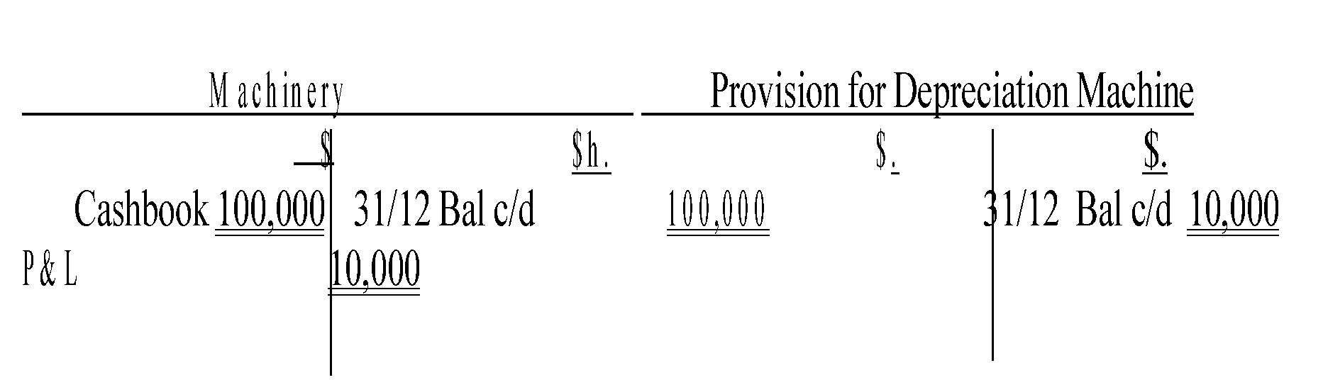
ADJUSTMENTS
Example on straight-line method
The ledger accounts will be as follows:

Slide 44
ADJUSTMENTS
Example on straight-line method
The final accounts extracts will be shown as follows:
(a) Profit And Loss Account (Extract) for the year ended 31st December 2022

Slide 45
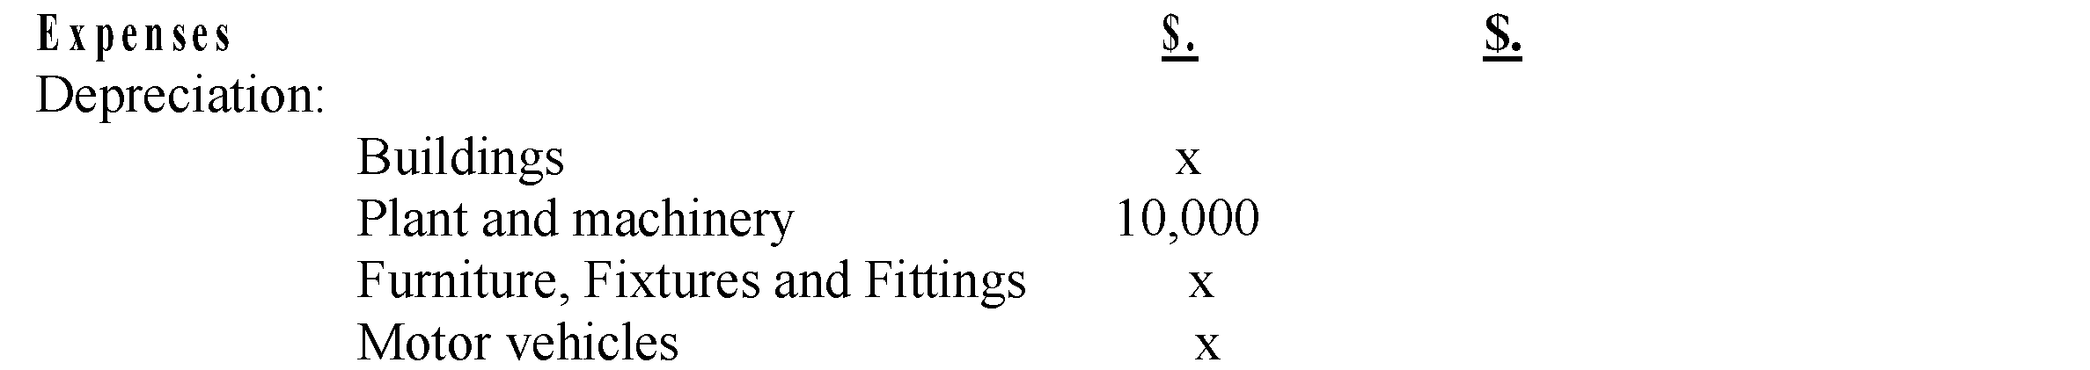
ADJUSTMENTS
Example on straight-line method

Slide 46
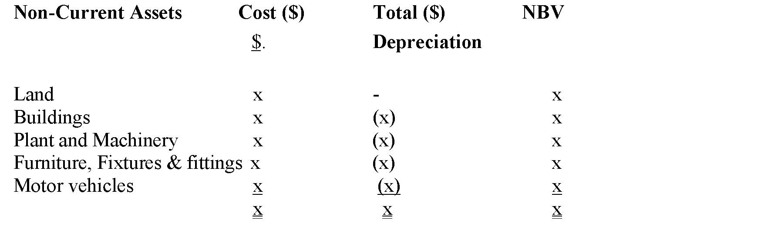
ADJUSTMENTS
(b) Statement of financial position (Extract) as at

Slide 47
ADJUSTMENTS
NBV: Net Book Value
Example 3
A company starts in business on 1 January 2022. You are to write up the motor cars account and the provision for depreciation account for the year ended 31 December 2022 from the information given below. Depreciation is at the rate of 20 per cent per annum. Using the basis of one month’s ownership needs one month’s depreciation.
2022 Bought two motor vans for $.12, 000 each on 1 January bought one motor van for $.14, 000 on 1 July.

Slide 48
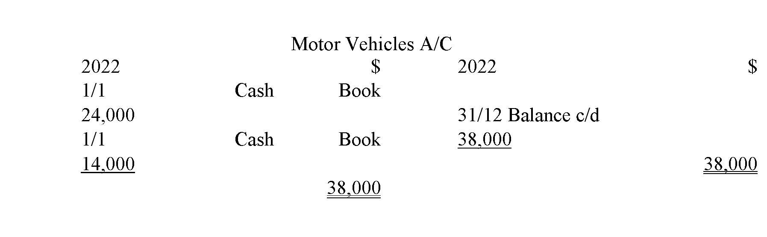
ADJUSTMENTS
Example 3

Slide 49
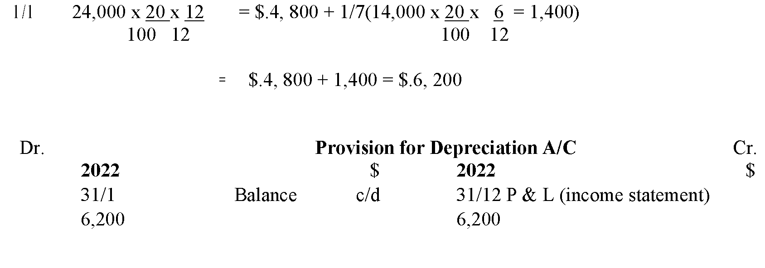
ADJUSTMENTS
Calculation for depreciation

Slide 50
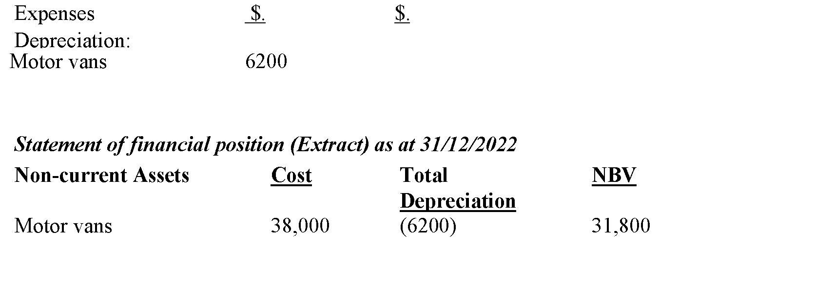
ADJUSTMENTS
Income Statement (P&L a/c) (Extract) for the period ended 31st December 2022.

Slide 51
ADJUSTMENTS
Example 4
A company starts in business on 1 January 2019, the financial year end being 31 December. You are to show:
a. The plant account.
b. The provision for depreciation account.
c. The statement of financial position extracts for each of the years 2019, 2020, 2021, 2022.

Slide 52

ADJUSTMENTS
Example 4
The machinery bought was:
Depreciation is at the rate of 10 per cent per annum, using the straight-line method, plant being depreciated for each proportion of a year.

Slide 53
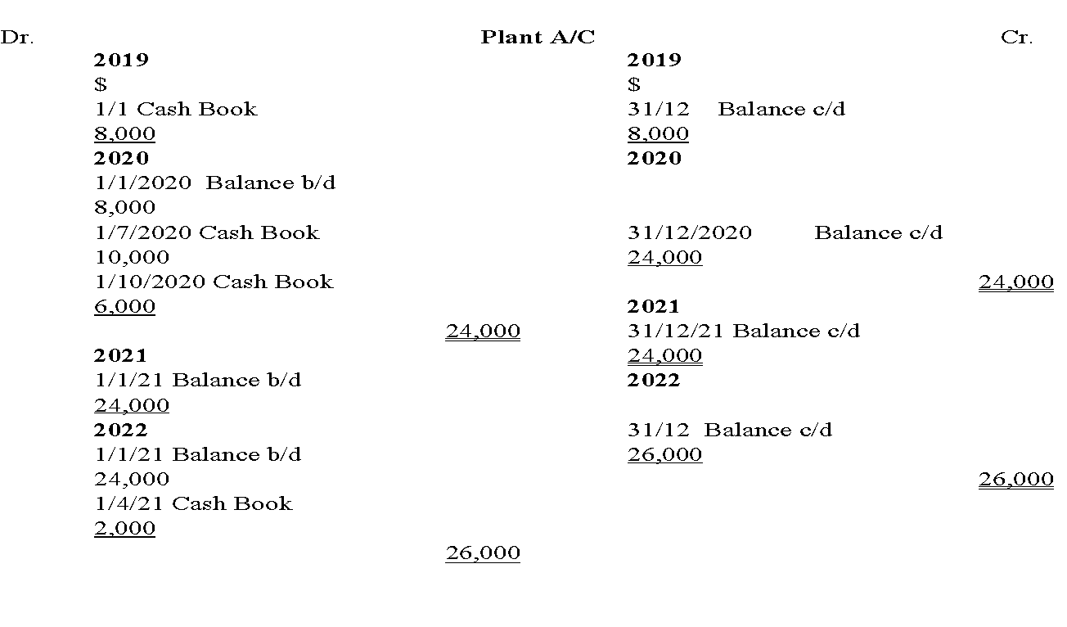
ADJUSTMENTS
Example 4

Slide 54
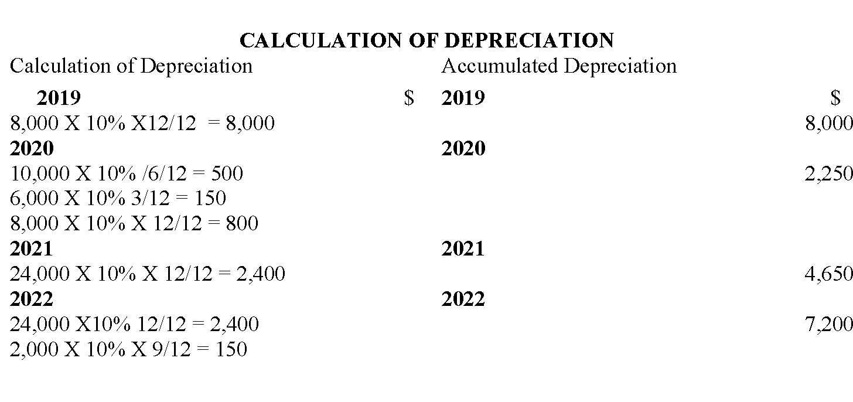
ADJUSTMENTS
Example 4

Slide 55
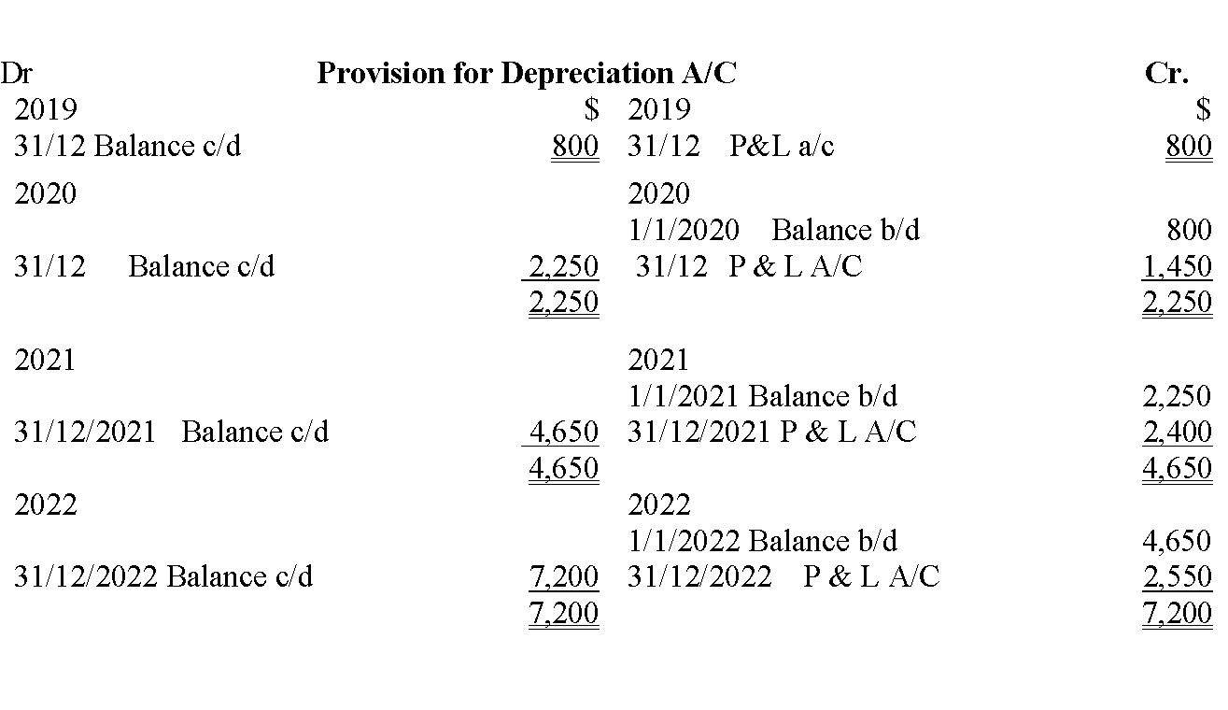
ADJUSTMENTS
Example 4

Slide 56
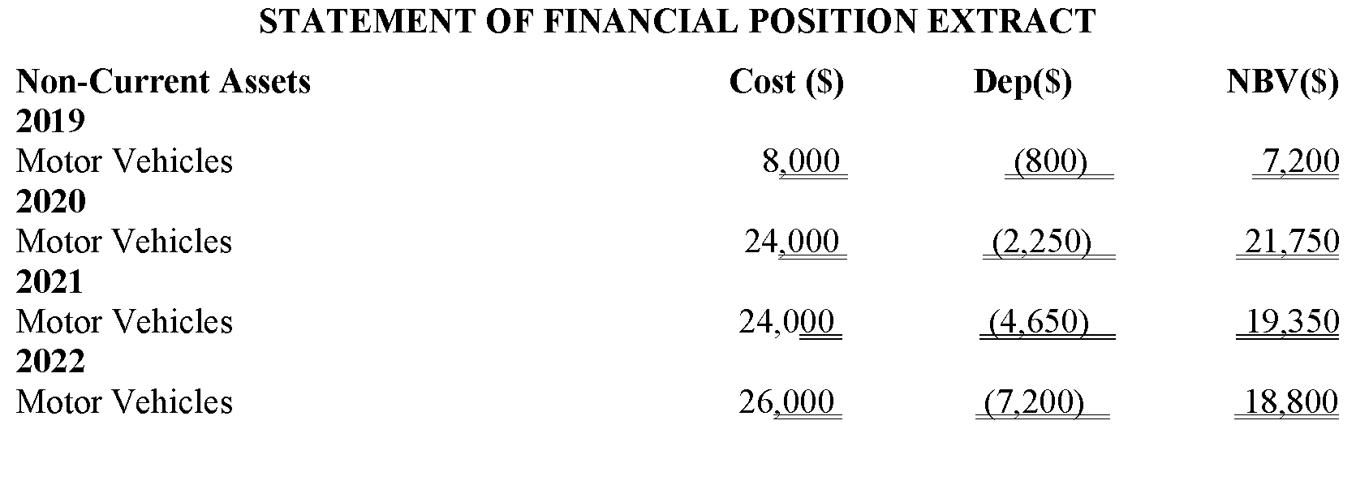
ADJUSTMENTS
Example 4

Slide 57
ADJUSTMENTS
DISPOSALS OF ASSETS
A firm may dispose off its non-current assets in the following 3 ways:
Selling the asset.
Asset being written-off from damage/accident/theft.
Asset is scrapped/not used anymore.
When an asset is disposed and is no longer used by the firm, the appropriate entries should be made in the asset account and the total depreciation provided to date on the asset and the entries required will depend on the type of disposal.

Slide 58
ADJUSTMENTS
DISPOSALS OF ASSETS
When the asset is sold, the following entries will be made:
(a) Debit – asset disposal a/c Credit – asset a/c
With the cost of the asset being disposed.
(b) Debit – provision for depreciation of asset a/c. Credit – asset disposal a/c
With the total depreciation provided to date on the asset.
(c) Debit – cashbook.
Credit – asset disposal a/c

Slide 59
ADJUSTMENTS
With the cash received on disposal.
When an asset is written off as a result of damage/accident/theft. If it was insured and the insurance company accept liability but by the end of the period the insurance company has not yet paid.
(a) Debit – asset disposal a/c Credit – asset a/c
With the cost of the asset damaged.
(b) Debit – provision for depreciation of asset a/c Credit – asset disposal a/c
(c) Debit – insurance receivable a/c Credit – asset disposal a/c

Slide 60
ADJUSTMENTS
With the amount expected from the insurance.
If the insurance pays before the end of the financial period, it will not be necessary to create an insurance debtor so the following entries will be made:
Debit – cashbook.
Credit – asset disposal a/c
If the asset is not used anymore or scrapped by the firm, the appropriate entries will be made in the asset account and provision for depreciation a/c only.
Debit – asset disposal a/c
Credit – asset a/c

Slide 61
ADJUSTMENTS
With the cost of the asset no longer in use.
Debit – provision for depreciation for asset Credit – asset disposal a/c
With the total depreciation provided to date.
The balance in the disposal a/c after the above entries will either be a debit balance or a credit balance. A credit balance represents a profit on disposal, which is reported in the profit and loss a/c together with other incomes. The entry will be:
Debit – asset disposal a/c
Credit – P&L a/c

Slide 62
ADJUSTMENTS
With the balance in the account.
A debit balance in the asset disposal a/c is loss on disposal which is reported in the P&L a/c as an expense and therefore the entry will be.

Slide 63
ADJUSTMENTS
Example 5:
A firm has a motor vehicle costing $.10, 000 total depreciation provided to date is $.8, 000. The firm decides to trade in the motor vehicle with a new one the value of the new one being $.5, 000.
The supplier of the new vehicle, agree with the firm that the old motor vehicle is worth $.3,000; therefore, the difference will be paid by cash.

Slide 64
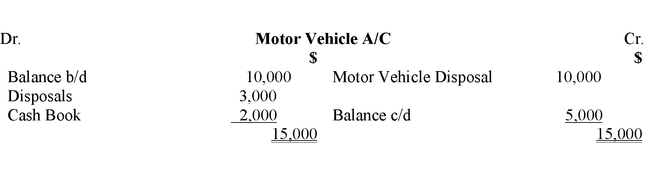
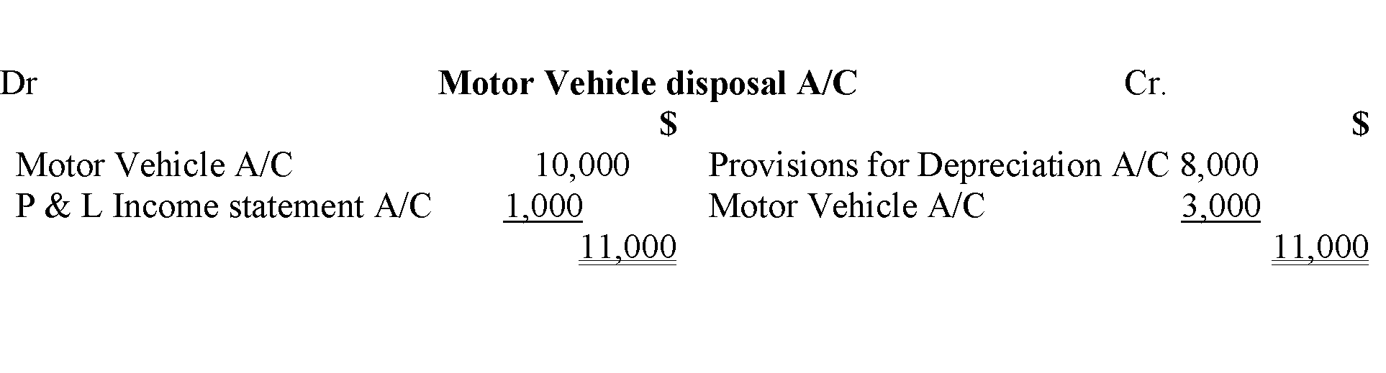
ADJUSTMENTS
Example 5:

Slide 65
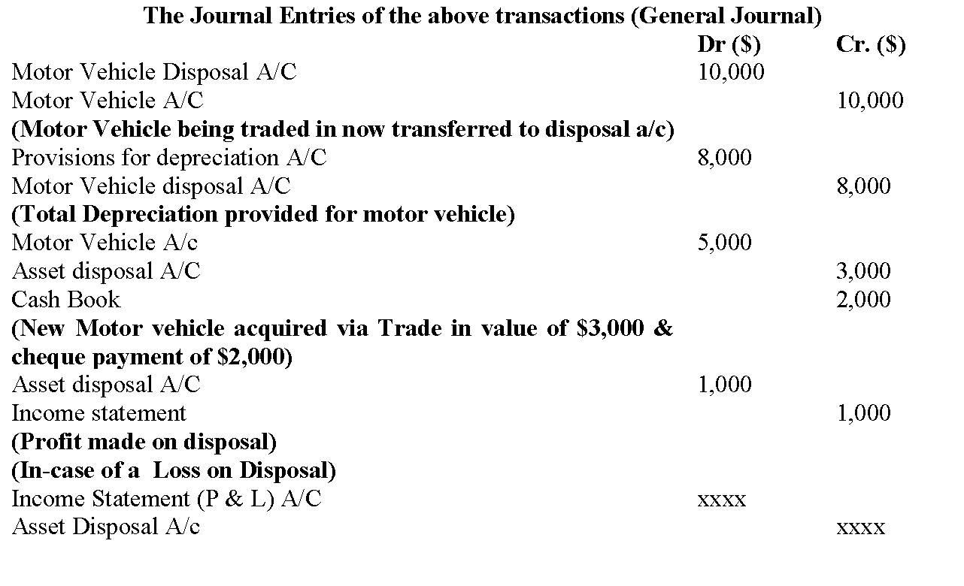
ADJUSTMENTS
Example 5:

Slide 66
ADJUSTMENTS
NB:
If the firm trades in an old asset for a new one, the following entries will be made in addition to the movements in the asset and depreciation a/c.
Debit – asset a/c (value of the new asset)
Credit – cashbook (cash paid as difference of new value i.e. trade in value of old asset) Asset disposal a/c (with trade-in value of old asset)

Slide 67
ADJUSTMENTS
ACCRUALS (Revenues and Expenses)
Revenue (Income);
Accrued Income
This is income that relates to the current year but cash has not yet been received. An accrued income should be reported in the profit & loss account and the same income will be shown in the balance sheet as a current asset.

Slide 68
ADJUSTMENTS
EXAMPLE 6
A firm lets out part of its properties and receives rent of $.20, 000 per month, assuming that this is the first year of renting and rent is received in arrears (rent 4 January is received early Feb). in the year 2022

Slide 69
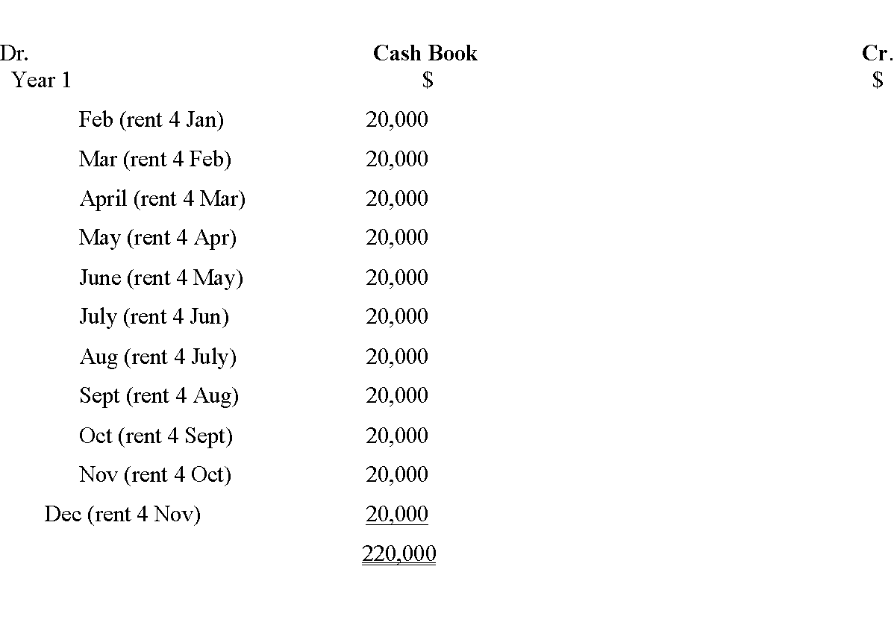
ADJUSTMENTS
EXAMPLE 6

Slide 70
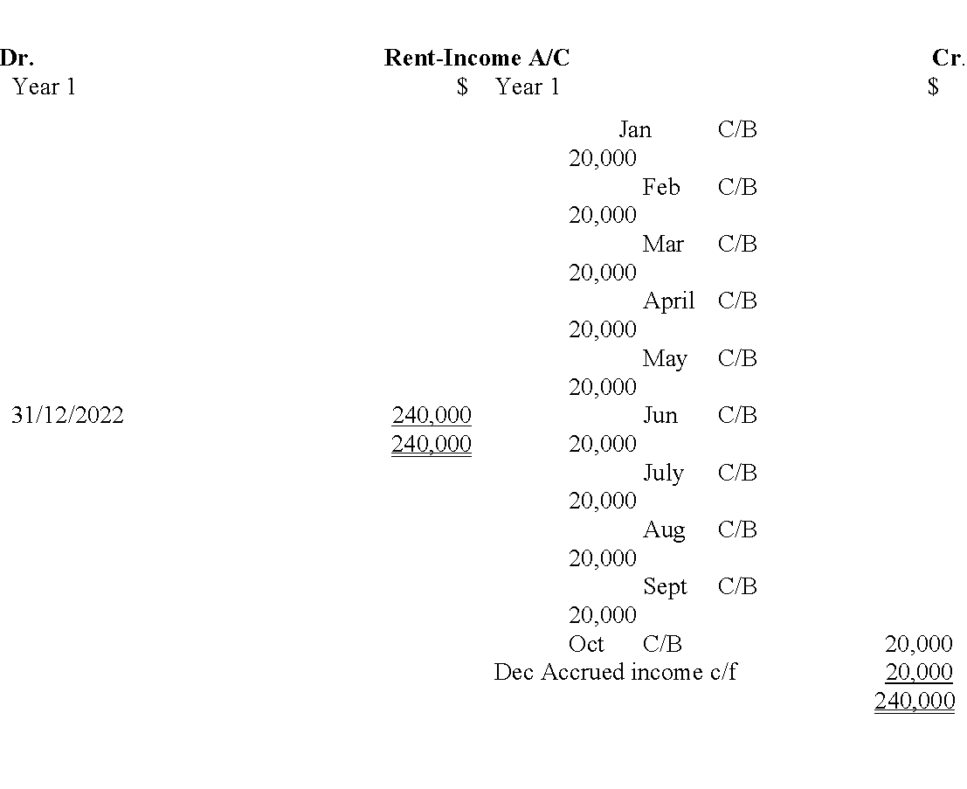
ADJUSTMENTS
EXAMPLE 6

Slide 71
ADJUSTMENTS
EXAMPLE 6
Although the cashbook is showing that rent received amounts $220,000, the full rental income of $240,000 will be reported in the Profit & Loss a/c as rent income and the accrued rent for Dec of $.20,000 will be reported in the balance sheet as a current asset.

Slide 72
ADJUSTMENTS
Expenses: Accrued Expenses
An accrued expense is an expense that is payable or due for payment but has not yet been paid during that period. An accrued expense should be charged in the P&L account and shown in the Statement of Financial Position as a current liability.
Assume in the above example that the firm is meant to pay the rent, thus it becomes an expense with the facts still the same i.e. $.20, 000 payable in arrears. The ledger account will be as follows.

Slide 73
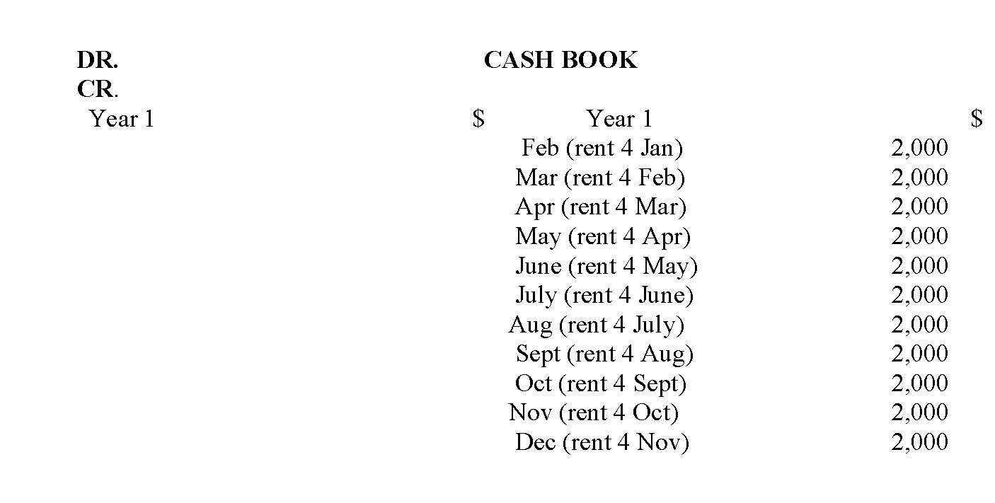
ADJUSTMENTS
Expenses: Accrued Expenses

Slide 74
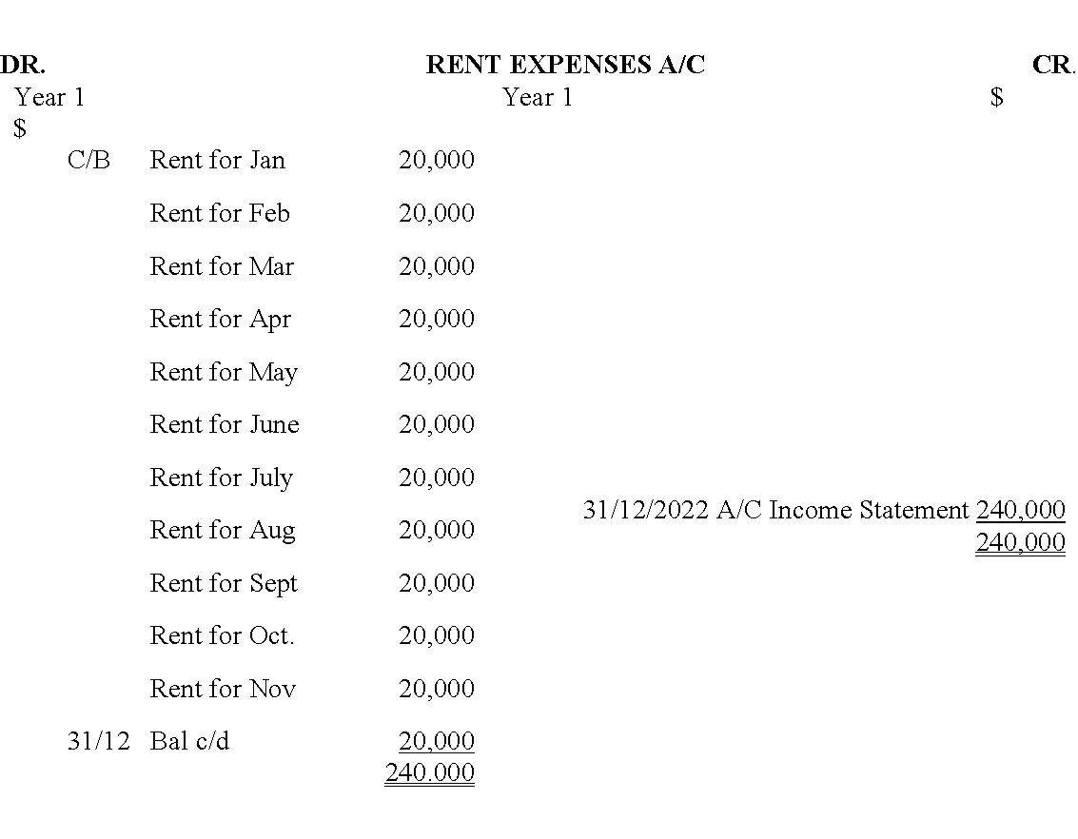
ADJUSTMENTS
Expenses: Accrued Expenses

Slide 75
ADJUSTMENTS
PREPAYMENTS
PREPAID INCOME
This is income that is not yet due but cash has been received for it. This happens where an income is payable in advance e.g. Rent payable 3 months in advance. A prepaid income should not be reported in the current financial period but should be carried forward and reported in the period it relates to.
The accounting treatment will be to show it as a current liability.

Slide 76
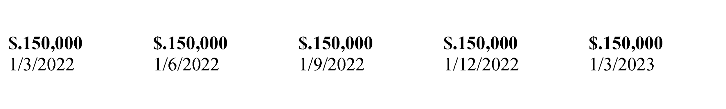
ADJUSTMENTS
Example 7:
A firm receives rent income of $.50, 000 per month payable quarterly in advance. Assuming that the firm’s rental income began in 1st March and the financial year, end is on 31st December 2022. The ledger accounts will be:

Slide 77
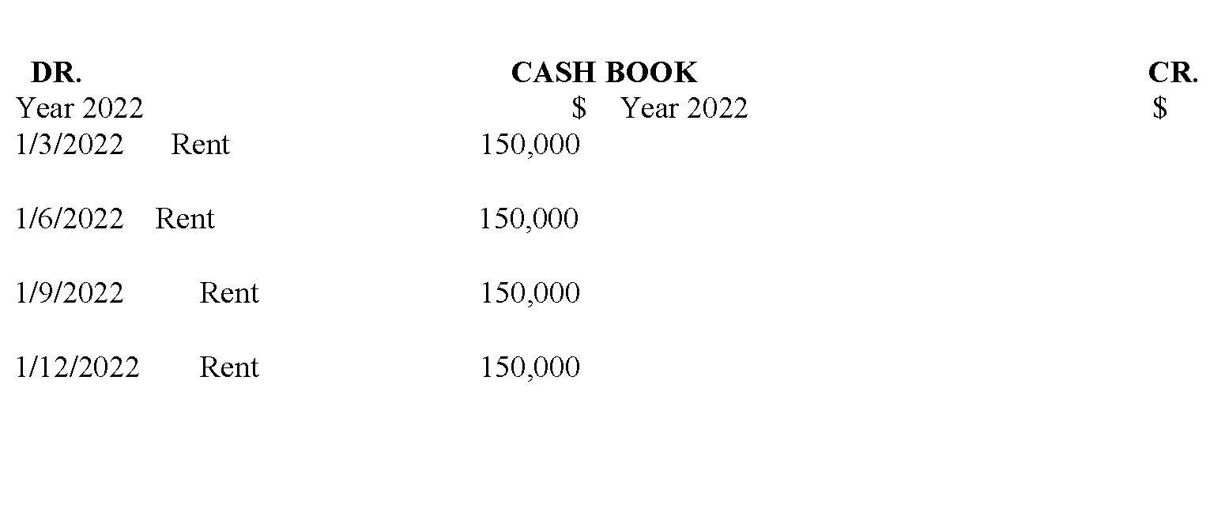
ADJUSTMENTS
Example 7:

Slide 78
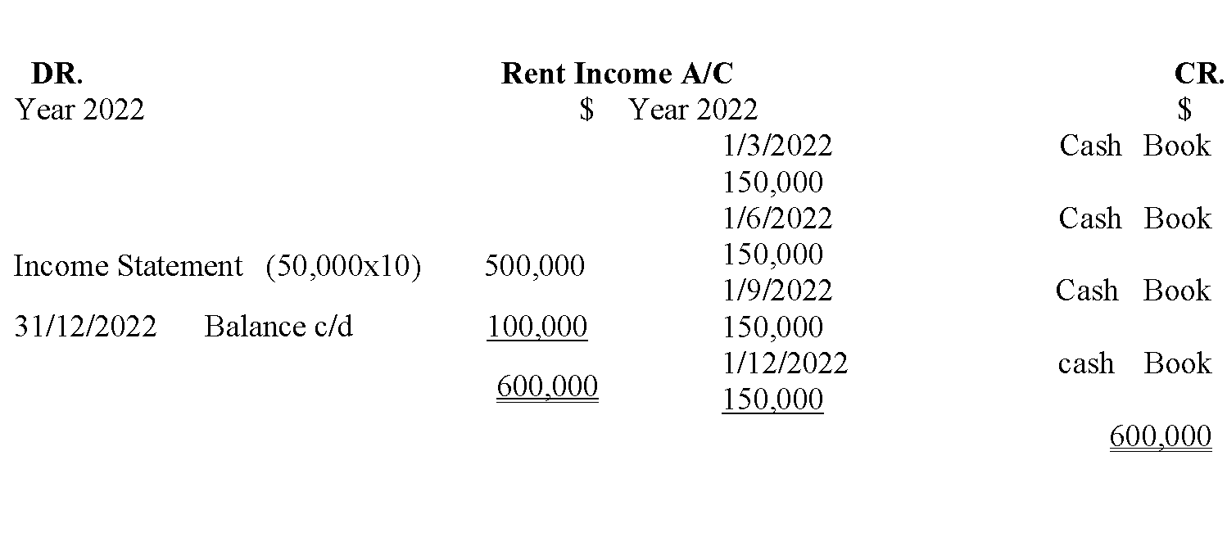
ADJUSTMENTS
Example 7:

Slide 79
ADJUSTMENTS
Example :
Rent for the 4 quarters of 12 months has been received as per the cashbook but because the end of the financial year is at 31 Dec, rent for 2 months is pre-paid. This $.10, 000 is not charged in the P&L but is carried forward as current liability in the balance sheet.

Slide 80
ADJUSTMENTS
PREPAID EXPENSES
A prepaid expense is an expense that is not payable but cash has already been paid. A prepaid expense should not be charged in the P&L a/c but should be carried forward to the next financial period and should be shown in the balance sheet as a current asset.

Slide 81
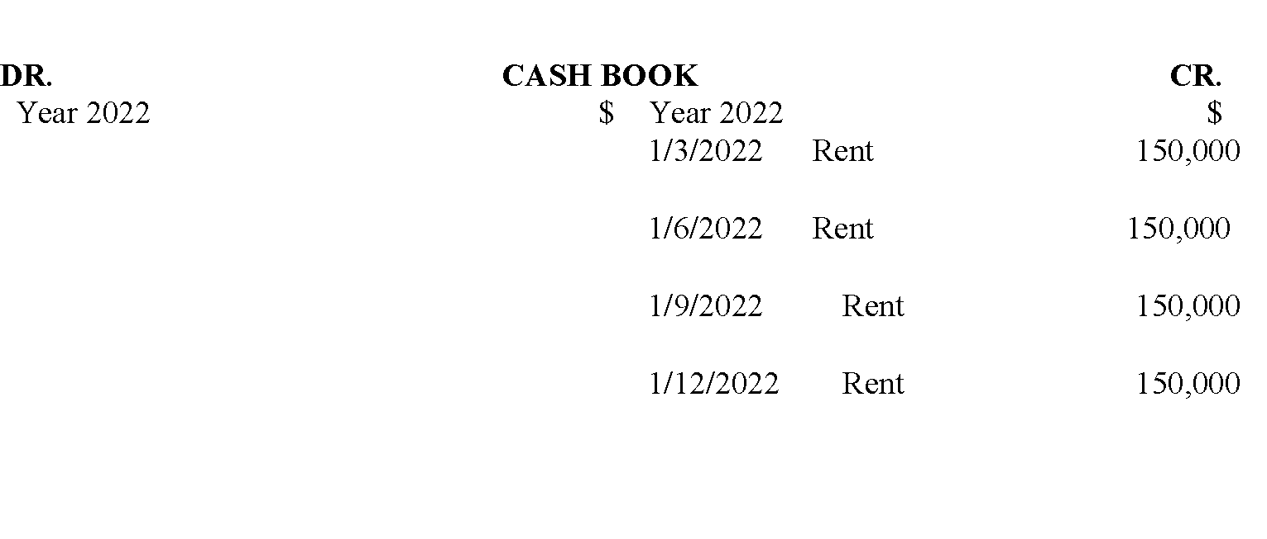
ADJUSTMENTS
Example 8
Assume as in the previous illustration, that all the facts are as stated except that rent is an expense. The ledger accounts is as follows:

Slide 82
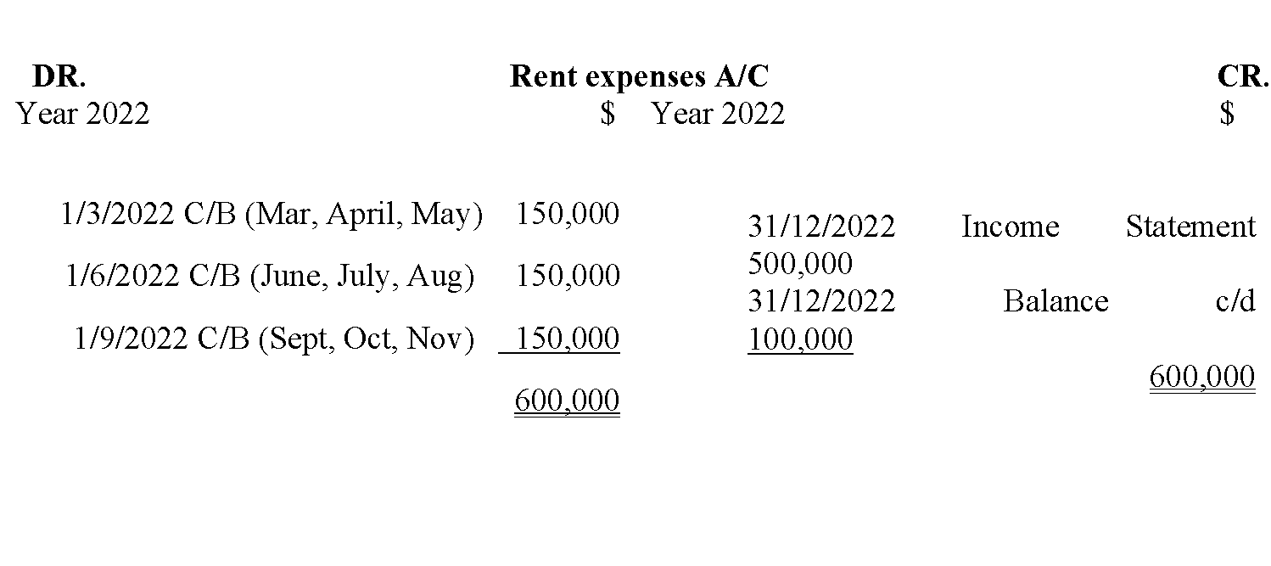
ADJUSTMENTS
Example 8
Assume as in the previous illustration, that all the facts are as stated except that rent is an expense. The ledger accounts is as follows:

Slide 83
ADJUSTMENTS
NB:
Rent of $100,000 for 2 months is carried forward to the next financial period and shown in the balance sheet as a current asset.
Accrued Incomes and Expenses and Prepaid Incomes and Expenses are shown in the Balance Sheet as follows:

Slide 84
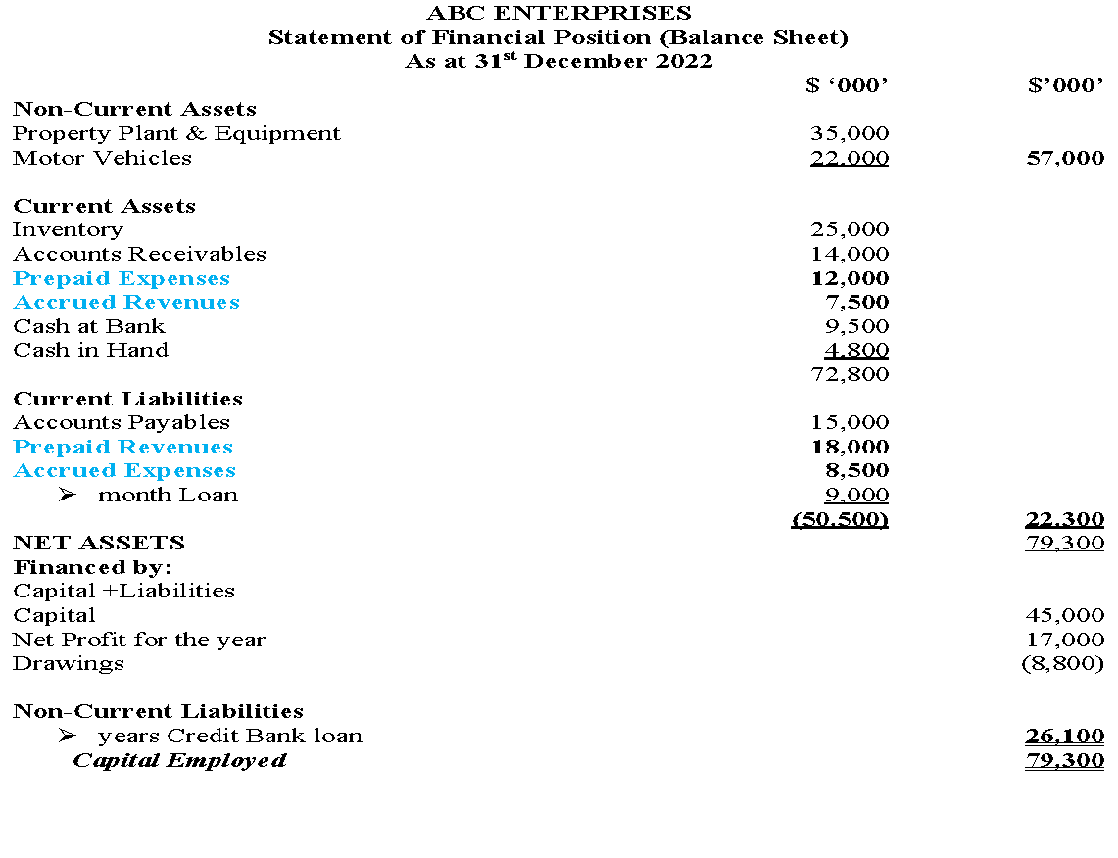

Slide 85
ADJUSTMENTS
NB:
Check on the highlighted items in blue fonts (The Prepaid & accrued incomes and the accrued and prepaid expenses)

Slide 86
References
IASB. (n.d.). international financial reporting. https://www.ifrs.org
McCallig, J. (2008). Introductory financial accounting: Using international financial reporting standards. John McCallig.
Williams, J., Haka, S., Bettner, M. S., Meigs, R. (2002). Financial accounting. Irwin/McGraw-Hill.

Slide 87
WEEK 7: LESSON
END OF PRESENTATION

