Slide 1

FINANCIAL ACCOUNTING:
WEEK 8: PREPARATION OF THE STATEMENT OF FINANCIAL POSITION
BY DR. JOHN MUHOHO KIMANI

Slide 2
LEARNING OBJECTIVES:
Upon completion of this topic you should be able to:
Explain Statement of Financial Position
Explain the importance of a Statement of Financial Position
Prepare a Statement of Financial Position (Balance Sheet) from information given in trial balances
Appreciate Recommended Format of Statement of Financial Position

Slide 3
INTRODUCTION
A balance sheet ( Statement of Financial Position) is a financial statement that provides a snapshot of a company's assets, liabilities, and equity at a given point in time A statement of financial position shows the well-being or lack of in terms of assets, capital and liabilities.

Slide 4
INTRODUCTION
It is commonly referred to as a balance sheet (BS) or an ACCOUNTING EQUATION (ASSETS= LIABILITIES + EQUITY).
Preparation of financial statements is one of the last steps in the accounting cycle, using information from the previous statements to develop the current financial statement.

Slide 5
INTRODUCTION
Using statement of financial position, decision makers can be able make various decisions after conducting various analysis. For example appreciating the Liquidity position of the company, Leverage level of a company or asset utilization efficiency.

Slide 6
INTRODUCTION
Business owners may not need all the details, but they definitely need to understand the true view of their current financial and cash positions. These insights are crucial when making business operation decisions. IAS 1 specifies the minimum information which must be shown on the face of the Statement of Financial Position. It does not specify the order in which information is to be presented.

Slide 7
INTRODUCTION
The statement requires entities to separate out:
Non–current assets, the usual sort of fixed assets such as property, plant, equipment, plant and machinery, motor vehicles, intangible assets, goodwill, etc.
Current assets; inventories, trade receivables, cash and cash equivalents.
Current liabilities; trade payables, bank overdrafts and taxation.
Non–current liabilities; bank loans and long-term provisions.
Equity; Share capital, share premium reserves and retained earnings.

Slide 8
INTRODUCTION
NB: IAS 1 does not prescribe the format of the Statement of Financial Position. Assets can be presented current then non-current, or vice versa, and liabilities and equity can be presented current then non-current then equity, or vice versa. A net asset presentation (assets minus liabilities) is allowed.

Slide 9
The Purpose of a Statement of Financial Position
1. A Statement of Financial Position (SoFP) gives a comprehensive overview of the health of a business
Your SoFP should display in a manner that is easy to read and follow the business’ assets, liabilities, earnings, and equity. Assets include cash, land, infrastructure, and equipment.

Slide 10
The Purpose of a Statement of Financial Position
1. A SoFP gives a comprehensive overview of the health of a business
Assets may be tangible or intangible, movable, or immovable. Liabilities include the payroll, utilities, interest, employee medical insurance, building rent as well as any contributions you’re making to pension plans. Equity refers to what’s left after liabilities have been subtracted from the assets. And finally, retained earnings is the profit that the business gets to keep, these are earnings that are not shared with the shareholders.

Slide 11
The Purpose of a Statement of Financial Position
2. A Statement of Financial Position may be used to meet financial obligations
Interested parties looking to buy your business may want to understand how they will be able to meet their financial obligations. Perhaps they will want to sell shares of the company. They can only do this if they have an idea of the company’s financial position.

Slide 12
The Purpose of a Statement of Financial Position
2. A Statement of Financial Position (SoFP) may be used to meet financial obligations
From the SoFP, they’ll be able to analyse potential rates of return and also have a snapshot of the capital structure. As a buyer what are you hoping to achieve with the business in the next few years? Do you want to grow the business beyond its current setup? Given the liabilities and assets in possession do they give you leeway to expand or debts may restrict your ambitious goals. The statement of financial position can be a powerful toll to unlock such uncertainties.

Slide 13
The Purpose of a Statement of Financial Position
3. A Statement of Financial Position may be used to secure lines of credit
According to a survey carried out by the Small Business ( SMEs) Administration, a lot of money is loaned to small businesses every year. Unfortunately very few SMEs successfully manages to service their loans on time . Most of them end up not being able to service their loans and end up in trouble with their financiers .

Slide 14
The Purpose of a Statement of Financial Position
3. A Statement of Financial Position may be used to secure lines of credit
It’s not hard to see that investors are very happy to seed money into ventures that look lucrative and promise to deliver credible returns. One of the biggest reasons sole proprietorships and partnerships find it difficult to secure lines of credit is a failure to show a balance sheet.

Slide 15
The Purpose of a Statement of Financial Position
3. A Statement of Financial Position may be used to secure lines of credit
The ability to show creditors good accounting records gives them the confidence to release funds. A business’ balance sheet will be able to demonstrate that the business is in a good place and has the potential to become bigger with the right financial muscle backing it up.

Slide 16
The Purpose of a Statement of Financial Position
4. A Statement of Financial Position can show areas that need improvement
A Statement of Financial Position is like a doctor’s report. It shows the areas that need improvement, the areas that are in good shape, and those that could do with a little more attention. To add on, the Statement of Financial Position can also highlight specific places that are causing the business to lose money.

Slide 17
The Purpose of a Statement of Financial Position
4. A Statement of Financial Position can show areas that need improvement
Perhaps its overhead costs which need to be lowered – moving into a smaller space, downsizing the company, or finding contractors with cheaper equipment to hire. Maximizing value can only happen when you can clearly see what’s working and what’s not.

Slide 18
The Purpose of a Statement of Financial Position
5. A Statement of Financial Position shows a good financial practice
If the corporation is already listed on the stock exchange or you’re still in the initial stages of preparing to go public, your financial statements will be appraised to ensure that everything checks out.

Slide 19
The Purpose of a Statement of Financial Position
5. A Statement of Financial Position shows a good financial practice
Government agencies, stock, and banking regulators use a company’s balance sheet to screen for possible financial malpractice. Fraudulent activities can often be tracked on balanced sheets. By regularly going through a public company’s balance sheet, stock market regulators are able to detect any financial malpractice and call to order any entity in practice of such malpractices.

Slide 20
The Purpose of a Statement of Financial Position
6. Win the trust of your suppliers with audited SoFPs
Most businesses rely on suppliers and creditors to stay afloat. If you’re running an operation that needs you to purchase raw materials from another company, having good credit (which can be shown by your balance sheet) is a surefire way to win their trust. Suppliers want to do business with companies they know are reliable and trustworthy. Hence the importance of a SoFP can never be overestimated if you’re building a business.

Slide 21
The Purpose of a Statement of Financial Position
7. A Statement of Financial Position allows for efficient business management
In order to manage the company efficiently, it is key to know the numbers – debt funding status, current cash flow, asset investments, status of trade receivables, and company liquidity situation. Planning for future expansion is only possible if you know how the company is doing. Looking at the balance sheet as a buyer you might also be able to see whether or not there is a future in the entity or otherwise.

Slide 22
Many standards make various stipulations relating to the information to be presented in the Balance Sheet (Statement of financial position) as highlighted below:
The statement of financial position should include line items that present the following amounts (IAS 1:54):
property, plant and equipment;
investment property;
intangible assets;
financial assets (excluding amounts shown under investments, trade and other receivables and cash and cash equivalents);

Slide 23
Groups of contracts within the scope of IFRS 17 that are asset, disaggregated as required by IFRS 17:78;
investments accounted for using the equity method;
biological assets within the scope of IAS 41 Agriculture (IAS 41);
inventories;
trade and other receivables;
cash and cash equivalents;

Slide 24
The total of assets classified as held for sale and assets included in disposal groups classified as held for sale in accordance with IFRS 5 Non current assets held for sale and discontinued operations (IFRS 5);
trade and other payables;
provisions;
financial liabilities (excluding amounts shown under trade and other payables and provisions);
groups of contracts within the scope of IFRS 17 that are liabilities, disaggregated as required by IFRS 17:78;

Slide 25
Liabilities and assets for current tax, as defined in IAS 12 Income Taxes (IAS 12);
deferred tax liabilities and deferred tax assets, as defined in IAS 12;
liabilities included in disposal groups classified as held for sale in accordance with IFRS 5;
non-controlling interests, presented within equity; and
issued capital and reserves attributable to equity holders of the parent.

Slide 26
Current assets
An asset should be classified as current when it satisfies any of the following criteria:
it is expected to be realised in, or is intended for sale or consumption in, the entity’s normal operating cycle;
it is held primarily for the purpose of being traded;
it is expected to be realised within 12 months after the balance sheet date; or
it is cash or a cash equivalent (as defined in IAS 7) unless it is restricted from being exchanged or used to settle a liability for at least 12 months after the balance sheet date.
All other assets should be classified as non-current (IAS 1:66).

Slide 27
Current assets
Current assets include assets (such as inventories and trade receivables) that are sold, consumed or realised as part of the normal operating cycle even when they are not expected to be realised within 12 months after the balance sheet date. Current assets also include assets held primarily for the purpose of being traded (financial assets within this category are classified as held for trading in accordance with IFRS 9) and the current portion of non-current financial assets (IAS 1:68).

Slide 28
Current assets
IAS 1 uses the term ‘non-current’ to include tangible, intangible and financial assets of a long-term nature. It does not prohibit the use of alternative descriptions as long as the meaning is clear (IAS 1:67).

Slide 29
Current liabilities
A liability should be classified as current when it satisfies any of the following criteria:
it is expected to be settled in the entity’s normal operating cycle;
it is held primarily for the purpose of being traded;
it is due to be settled within 12 months after the balance sheet date; or

Slide 30
Current liabilities
A liability should be classified as current when it satisfies any of the following criteria:
or
the entity does not have an unconditional right to defer settlement of the liability for at least 12 months after the balance sheet date. Terms of a liability that could, at the option of the counterparty, result in its settlement by the issue of equity instruments do not affect its classification.
All other liabilities should be classified as non-current (IAS 1:69).

Slide 31
Non - current liabilities
Non-current liabilities are long-term liabilities, which are financial obligations of a company that will come due in a year or longer.
A company will classify a liability as non-current if it has a right to defer settlement for at least 12 months after the reporting date. This right may be subject to a company complying with conditions (covenants) specified in a loan arrangement.

Slide 32
FORMAT OF STATEMENT OF FINANCIAL POSITION
Company Accounts
Company is an organization that has a separate legal entity and has limited liability. Companies are majorly classified into two public and private. By separate legal entity it means that the company can enter into binding obligations on its own account and can be sued or be sued to that regard. Limited liability on the other hand implies that shareholders liability will only be limited to the extent of their shareholding

Slide 33
Types of companies
Companies can be classified as either Private or public
The differences between the two can be summarized as follows
Public company
1. They have no maximum limit for membership
2. Their membership is open to the public
3. Can raise capital through the issue of shares to the public
4. There is free transfer of shares amongst shareholders

Slide 34
Types of companies
Private company
1. Has a maximum limit of 50 members
2. Membership is only open for relatives or close associate of the existing members
3. Cannot raise capital from the members of the public
4. Transfer of shares is restricted and must be authorized

Slide 35
Company’s capital
The major types of capitals that a company has are:
1)Loan capital (debentures)
This is capital borrowed from creditors which will be repaid later at an interest. It’s actually a liability to the company.

Slide 36
Company’s capital
2) Share capital
To become an owner of any company a person must have contributed to its capital. To facilitate this there total capital required by the company is divided into small units or shares. One becomes a member of a company (shareholder) by purchasing one or more of the shares. Share capital is thus the capital raised from members of the company.

Slide 37
Company’s capital
2) Share capital
As expected shareholders expect return on their investment. Thus the profits made by the company are distributed to the shareholders in proportion to the number of shares held. The profit distributed to the shareholders is referred to as a divided. This amount is determined and proposed to the shareholders for approval by the directors. The shareholders; however, are only allowed to review the proposal downwards. The accounting for and distribution of profits shall be covered comprehensively later on.

Slide 38
Company’s capital
Types of Share Capital
i) Preference shares
ii) Ordinary shares
Preference shares
Holders of these shares receive their dividend at an agreed rate before the ordinary shareholders receive anything.
Ordinary shares
The ordinary shareholders receive their dividends after the preference shareholders, if there is any profit it left.

Slide 39
Company’s capital
Preference shares
Holders of these shares receive their dividend at an agreed rate before the ordinary shareholders receive anything.
Ordinary shares
The ordinary shareholders receive their dividends after the preference shareholders, if there is any profit it left.

Slide 40
The preference shares are further divided into:
Cumulative preference shares
These are preference shares who have agreed percentage of dividend accumulates over the period they are fully paid.
Non-cumulative preference shares
These are preference shares which if not paid the percentage of divided agreed upon in a given period lose the right to claim such dividends ever again in future periods.

Slide 41
The preference shares are further divided into:
Participating preference shares
These are shares that receive an agreed percentage of dividends before the ordinary shareholders and still receive a portion of the remaining profits being distributed to the ordinary shareholders.
Non-participating preference shares
These are the preference shares that receive only the agreed percentage of dividend, no more.

Slide 42
The preference shares are further divided into:
Redeemable and Irredeemable preference shares
Redeemable preference shares refer to preference shares that will be paid back at some point in future or after agreed period of time. While irredeemable preference shares are those that are held to perpetuity.

Slide 43
Share capital
Authorized share capital
This is the amount of capital that the company is allowed to issue as indicated in its Articles of Association. A company may issue only a portion of the authorized share capital to shareholders. The remaining capital not issued remains as security to the company in case more capital is needed in future, and only then shall it be issued.

Slide 44
Share capital
Authorized share capital
However, no company is allowed to issue more shares than the amount authorized. The authorized share capital is normally shown in the statement of financial position under the equities section but its value is not summed up together with the rest of the equity items.

Slide 45
Share capital
Issued share capital
This is the part of the share capital that has already been issued to the shareholders.
Unissued share capital
This is that part of the authorized share capital that has not been issued to the share holders
Note Issued share capital + Unissued share capital = Authorized Share Capital

Slide 46
Share capital
Called up share capital
Once the company issues the capital to the shareholders it may not require them to pay for the whole amount for the shares purchased. Instead it may prescribe that certain amounts be paid first and the rest to be paid when the company requires. The total amount that a company has already requested to be paid on the shares, up to a specified date is referred to as the called up share capital.

Slide 47
Share capital
Uncalled up share capital
This is that part of the issued share capital for which the shareholders have not been required to make payments
Note called up capital + uncalled up capital = Issued share capital

Slide 48
Share capital
Paid up share capital
It’s that part of the issued share capital for which calls have been made and payments of the calls actually received by the company.
Calls in arrears
Out of the called up capital, not all of it is paid for. The balance of called up capital that remains unpaid is referred to as calls in arrears.
Note paid up capital + Calls in arrears = Called up Capital

Slide 49
Share capital
Calls in advance
Some shareholders may pay for the outstanding amount on their shares even before makes the calls for it. Such payments are referred to as the calls in advance.

Slide 50
Share capital
The following example will help illustrate the above terms.
Intel Solutions Ltd was formed with the legal right to be able to issue 400000 shares of $. 4 each. However they actually issued 300000 of which none was fully paid. So far Intel Solutions Ltd has made calls of $ 3 per share. All shares have been paid by the shareholders except for Sh 150000 shares whose shareholders have only paid $ 1 per share.

Slide 51
Share capital
Required:
a) Authorized share capital
b) Issued share capital
c) Unissued share capital
d) Called up capital
e) Uncalled up capital
f) Calls in arrears
g) Paid up capital.

Slide 52
Solution
Authorized share capital = 400,000 x $.4 = $.1, 600,000
Issued share capital = 300,000x $. 4 = $. 1,200,000
Unissued share capital = 100,000x $.4 = $. 400,000
Remember
Issued capital + Unissued capital = Authorized share Capital
1,200,000 + 400,000 = $. 1,600,000
Called up Capital= 300,000 x $. 3 =$. 900,000
Uncalled up capital= Sh. 300,000 x $. 1 = $. 300,000

Slide 53
Solution
Remember
Called up capital + Uncalled up capital = Issued share capital
$. 900,000 + $. 300,000 = $. 1,200,000
Paid up capital = (150,000 x $. 3 + 150,000 x $. 1) = $. 600,000
Call in arrears = 150,000 x $. 2 = $. 300,000
Remember
Paid up capital + calls in arrears = called up capital
$.600, 000 + $. 300,000 = $. 900,000

Slide 54
Reserves
These are funds that the business sets aside for purposes of future financial obligations and
Appear in the financed-by section of the Statement of financial position.
They are categorized into two:
Capital reserves
Revenue reserves

Slide 55
Reserves
Revenue reserves: these are the reserves which can be distributed to the shareholders if need be in a form such as bonus shares. They are generally used for the expansion or purchase of non-current assets. They include:
• Retained profits – this is the balance after appropriations
• General reserves

Slide 56
Capital reserves: capital reserves on the other hand cannot be distributed to the shareholders.
They include:
• Share premium
This represents the amount paid on the issued shares above their par value. It arises when a company issues shares at a price that is above its par value e.g. if a company issues 200,000 shares of sh 10 par at sh. 12.5, the difference between the issue price sh. 12.5 and sh. 10 the par value is the share premium i.e. the total share premium in this case will be sh. 500,000

Slide 57
Capital reserves: capital reserves on the other hand cannot be distributed to the shareholders.
They include:
• Revaluation reserve
This represents the amounts by which assets appreciate after a revaluation is done. For example if land in the books of a company has book value of $, 2,000,000 and after a valuation the value increases to $. 2,500,000 then a revaluation reserve of $. 500,000 is said to arise.

Slide 58
Capital reserves: capital reserves on the other hand cannot be distributed to the shareholders.
They include:
• Capital redemption reserve fund
This represents the amount transferred from the retained earnings to finance the redemption of preference shares. If the amount is transferred to cater for the redemption of debentures, the reserve created for that purpose is referred to as the Debenture redemption fund.

Slide 59
Statement of Financial Position
The Statement of financial position of a company is also similar to that of a partnership except for the capital section of the Statement of financial position. For company the capital section is also referred to as the ‘financed by’ section. Just as the name suggests, this section shows the funds used to finance the net assets. This stems from the basic accounting equation where:
Capital = assets – liabilities = net assets

Slide 60
Statement of Financial Position
Therefore the figure obtained for net assets must necessarily tally with that in the financed by section i.e. all other factors e.g. errors held constant, the statement of financial position should balance.
The general format of a statement of financial position is as follows:

Slide 61
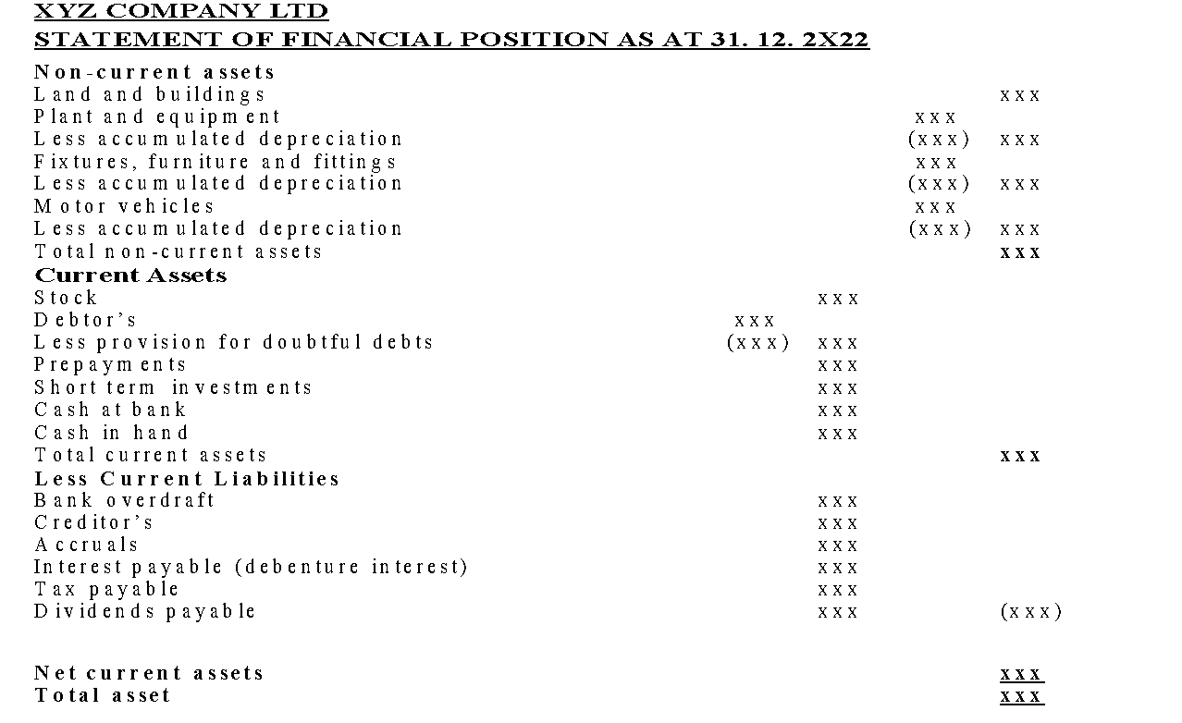
Statement of Financial Position

Slide 62
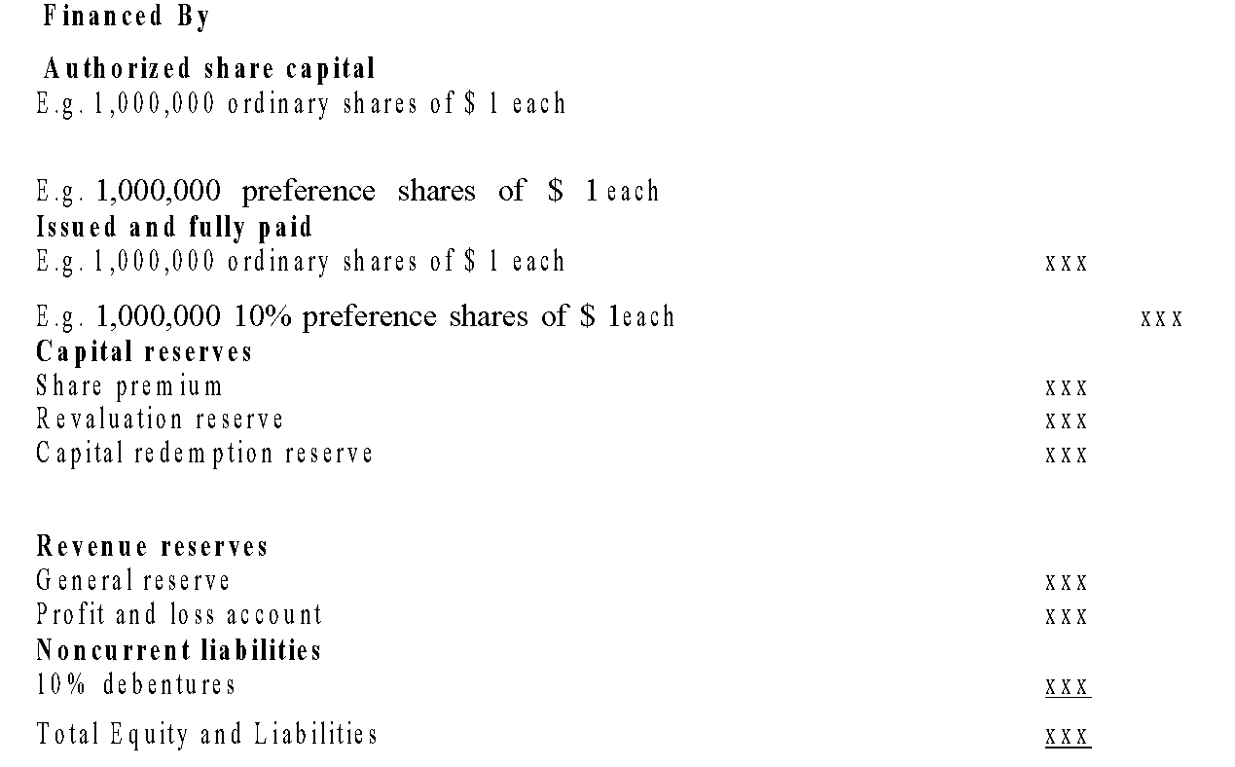
Statement of Financial Position

Slide 63
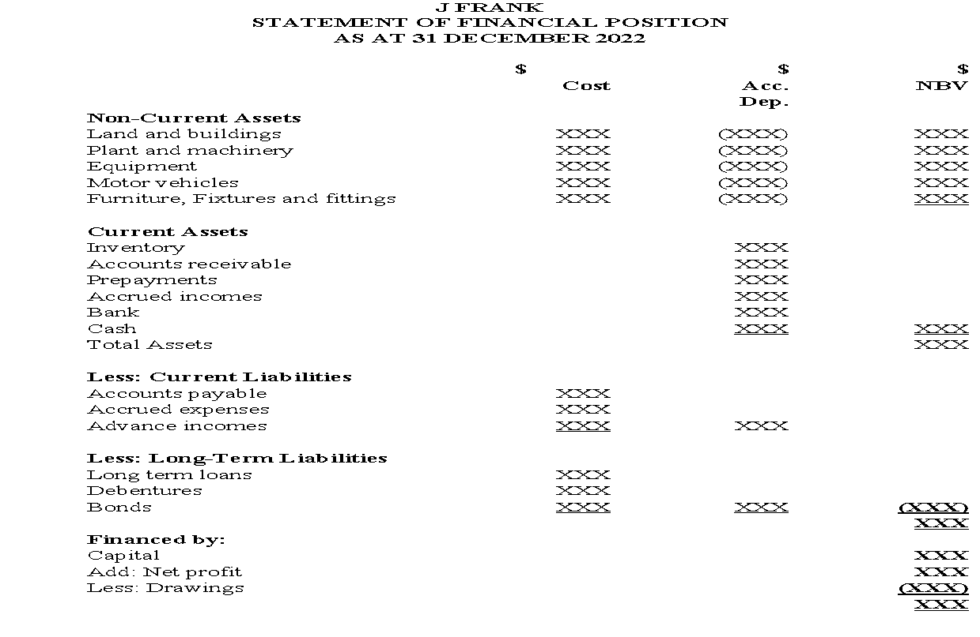
Sole Proprietor : Sample statement of financial position

Slide 64
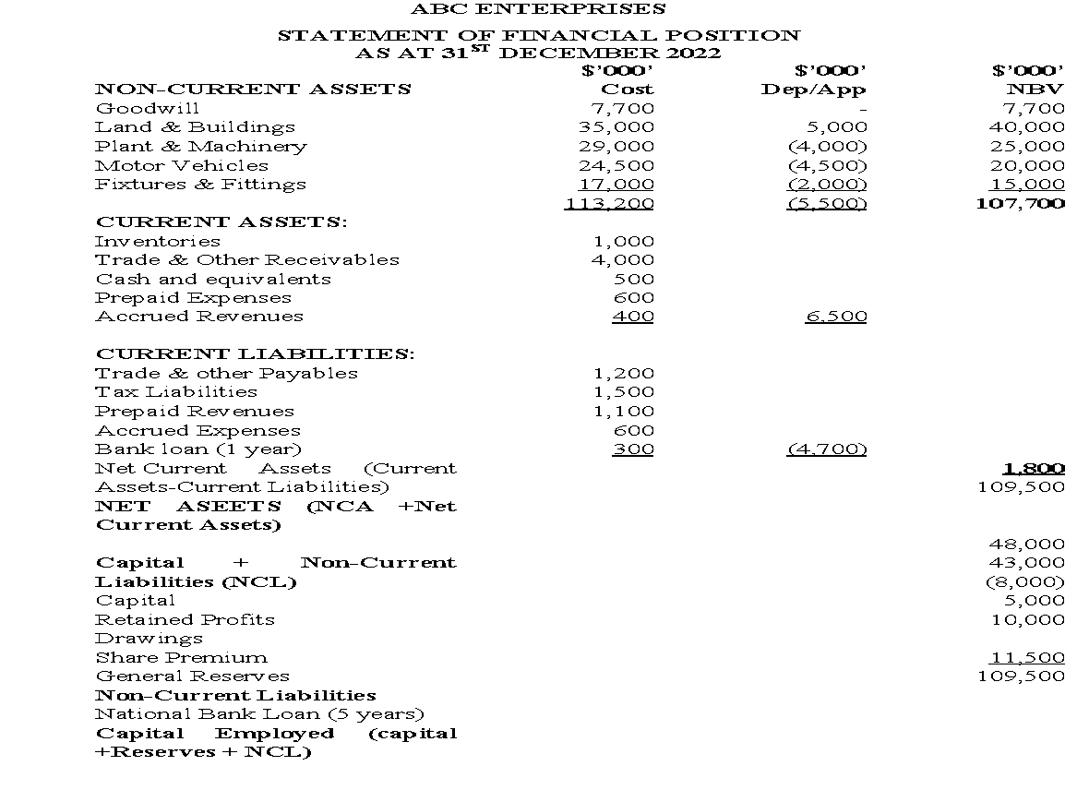

Slide 65
ILLUSTRATIONS ON PREPARATION OF STATEMENT OF FINANCIAL POSITION
EXAMPLE ONE:
Daewoo Enterprises is a medium size entity operating in the out skirts of Seoul city. The following trial balance was extracted from their books for the year ending 31 October 2021.

Slide 66
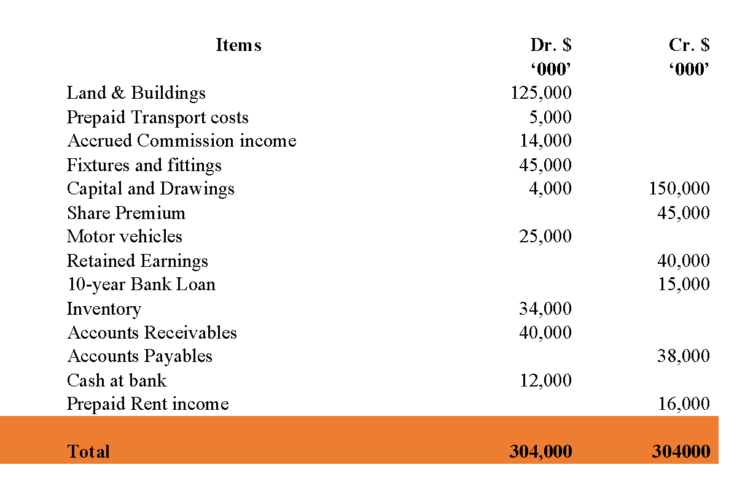
EXAMPLE ONE:

Slide 67
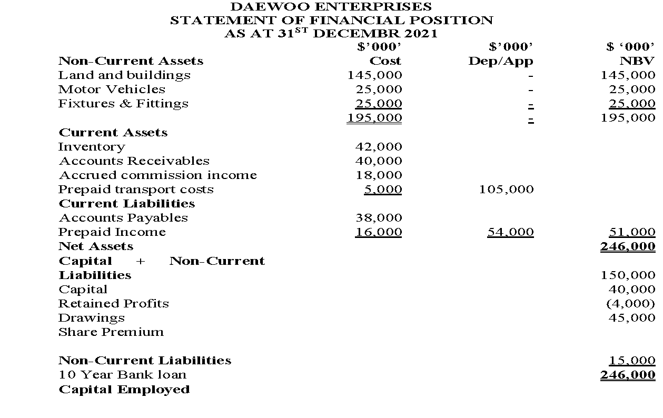
EXAMPLE ONE:

Slide 68
ILLUSTRATIONS ON PREPARATION OF STATEMENT OF FINANCIAL POSITION
EXAMPLE TWO:
The following information was obtained from the books of Southern Enterprises for the year ended 30th September 2021 showing the Trial balance for the same period.

Slide 69
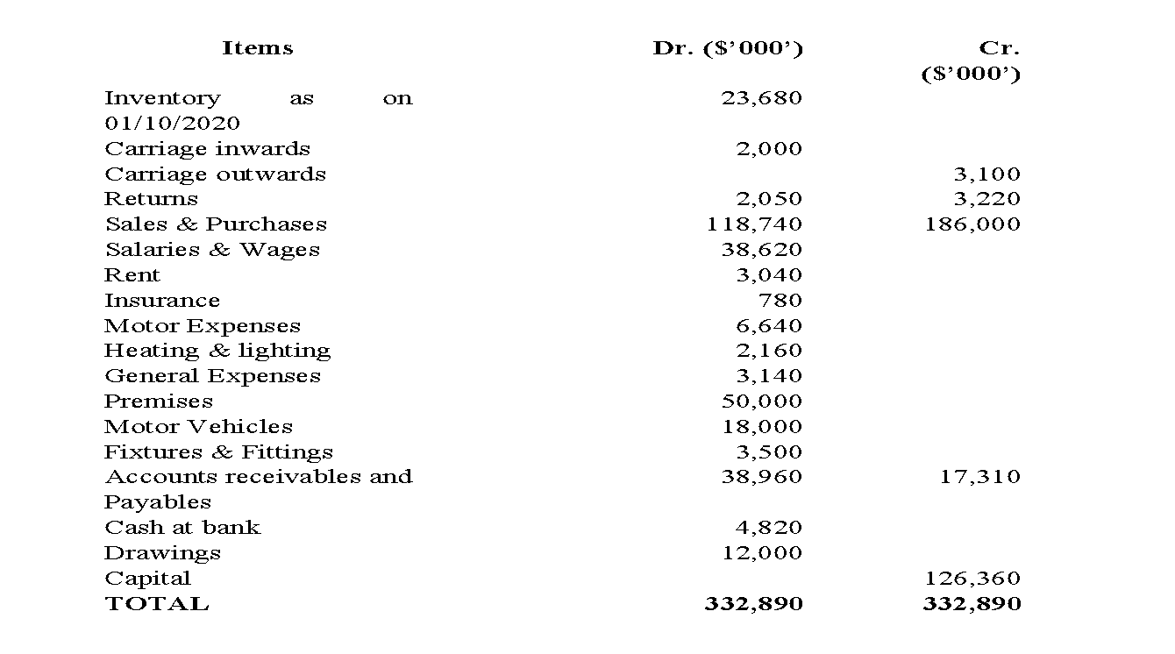
EXAMPLE TWO:

Slide 70
EXAMPLE TWO:
Required:
Prepare the statement of Financial Position as at 30th September 2021 for the Southern Enterprises.

Slide 71
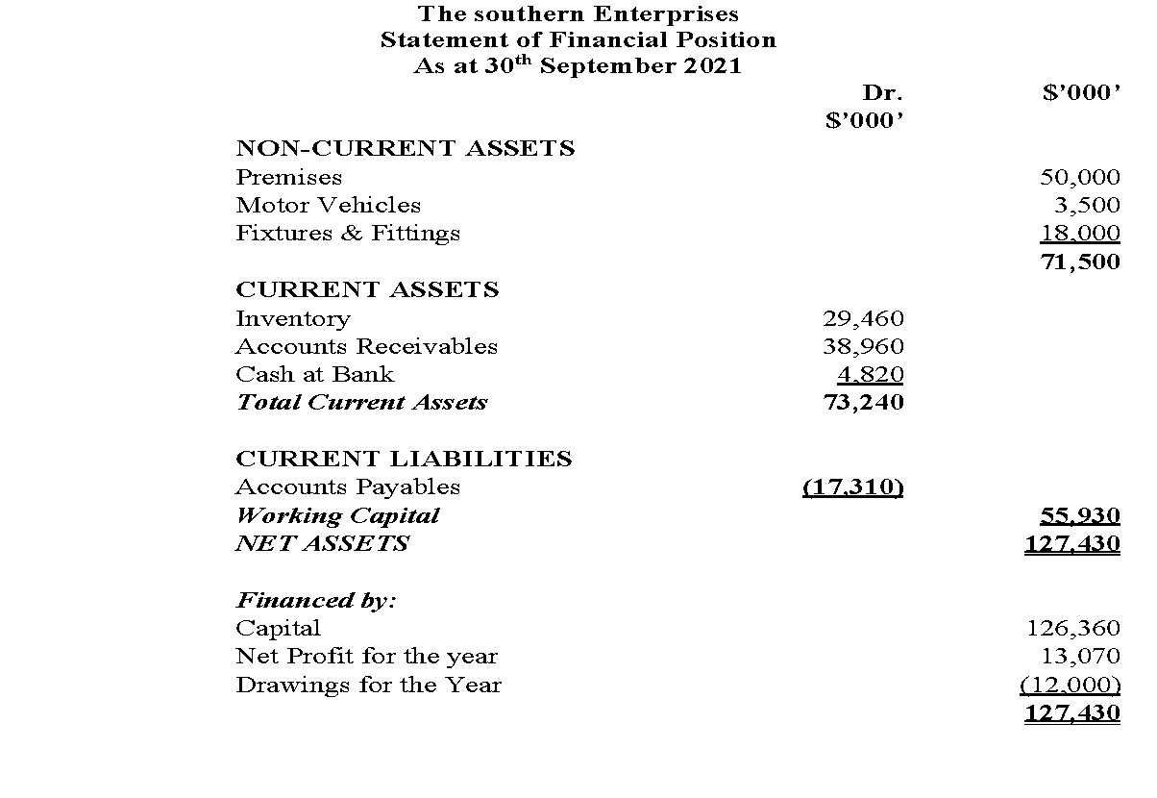
SUGGESTED SOLUTION

Slide 72
References
IASB. (n.d.). international financial reporting. https://www.ifrs.org
McCallig, J. (2008). Introductory financial accounting: Using international financial reporting standards. John McCallig.
Williams, J., Haka, S., Bettner, M. S., Meigs, R. (2002). Financial accounting. Irwin/McGraw-Hill.

Slide 73
WEEK 8: LESSON
END OF PRESENTATION

