Slide 1

FINANCIAL ACCOUNTING:
WEEK 9: PREPARATION OF THE STATAMENT OF COMPREHENSIVE INCOME
BY DR. JOHN MUHOHO KIMANI

Slide 2
LEARNING OBJECTIVES:
Upon completion of this topic, you should be able to:
Explain the meaning of the Statement of comprehensive Income
Preparing of gross profit
Appreciating Cost of Goods Sold ( Cost of Sales)
Prepare a Comprehensive Statement of Comprehensive Income

Slide 3
INTRODUCTION
A statement of comprehensive income is a broad financial metric that includes all incomes and expenses that affect a company's financial standing over a period. Comprehensive income is the sum of a company's net income and other comprehensive income. For companies, comprehensive income sheds light on changes in equity. Since it includes net income and unrealized income and losses, it provides the big picture of a company's value.

Slide 4
INTRODUCTION
Shareholders and investors mostly use this financial statement to determine a comprehensive understanding of a company's financial health. Learning how this statement works can help you create more accurate financial reports that give investors a better analysis of a company's performance.

Slide 5
Comprehensive income is a figure that represents the combined net income and other comprehensive income of a company. Companies use it to measure the changes in their equity over a certain period, and it includes net and unrealized income to provide a more comprehensive understanding of a company's value. Investors use comprehensive income to help them evaluate a company's performance compared to others, and it gives these stakeholders more information about the overall financial outlook of their investment.

Slide 6
Profit and Loss Account:
Initially, enterprises and organisation used to prepare a trading account which involved establishment of the Gross Profit and then Prepare a Profit and Loss account separately. In modern times this has however changed and the TWO accounts are combined to for a Statement of comprehensive Income for the given period.

Slide 7
Profit and Loss Account:
The Profit and Loss account shows the net profit or net loss that the business has made from all the activities during a financial period. The net profit (or loss) is determined by deducting all the expenses from all the incomes of the same financial period.
In practice, the trading account is combined together with the net profit and loss account into one report called comprehensive statement of income (formerly, trading, profit and loss account) .

Slide 8
Importance of the statement of Comprehensive Income to users;
Comprehensive income allows companies to report more than just their net income. It also allows companies to disclose noncash items. like depreciation and amortization, regularly. Companies may use comprehensive income for tax purposes, and it can help them follow the Financial Accounting Standards Board's accounting standards. In addition to its importance as an accounting entry, it's important for investors because it gives them a complete picture of a company's profitability. Comprehensive income can be useful for analyzing earnings stability over time.

Slide 9
Importance of the statement of Comprehensive Income to users;
The financial statement includes positive and negative items, such as losses and profits. It also helps investors understand how much of the company's total earnings come from its accounting and operating decisions. Comprehensive income also helps understand how a company performs relative to its competitors.
The statement of comprehensive income weighs all the expenses incurred by an entity and the incomes gained by the same. When the total revenues outweigh the total expenses, an entity makes profit and loss if the total revenues outweigh the total expenses.

Slide 10
ADJUSTMENTS TO FINANCIAL STATEMENTS
Revenue and costs must be recognized as they are earned or incurred, not as money is received or paid. They must be matched with one another so far as their relationship can be established or justifiably assumed, and dealt with in the profit and loss account of the period to which they relate. Therefore, all incomes and expenses that relate to a particular financial period will be matched together to determine the profit for the year.

Slide 11
ADJUSTMENTS TO FINANCIAL STATEMENTS
Before I delve into the format and deliberations on the comprehensive income, let me remind you of the changes which need to be taken care of before the income statement is made. These adjustments as covered in lessen week seven (7) change the figures in the Income statement and eventually the statement of financial position and the statement in changes in equity. These adjustments include; accrued expenses, accrued incomes, prepaid expenses, prepaid incomes, depreciation and appreciation of assets, bad debts and provision for bad and doubtful debts.

Slide 12
ADJUSTMENTS TO FINANCIAL STATEMENTS
The income statement according to the IAS1 is prepared using the follow format:
The income statement presents revenue, expenses, and net income. The components of the income statement include: revenue; cost of sales; sales, general, and administrative expenses; other operating expenses; non-operating income and expenses; gains and losses; non-recurring items; net income; and EPS.

Slide 13
Components of an Income Statement
The income statement may have minor variations between different companies, as expenses and income will be dependent on the type of operations or business conducted. However, there are several generic line items that are commonly seen in any income statement.
The most common income statement items include:

Slide 14
Components of an Income Statement
Revenue/Sales
Revenue/Sales is the company’s revenue from sales or services, displayed at the very top of the statement. This value will be the gross of the costs associated with creating the goods sold or in providing services. Some companies have multiple revenue streams that add to a total revenue line.

Slide 15
Components of an Income Statement
Cost of Goods Sold (COGS)
Cost of Goods Sold (COGS) is a line-item that aggregates the direct costs associated with selling products to generate revenue. This line item can also be called Cost of Sales if the company is a service business. Direct costs can include labor, parts, materials, and an allocation of other expenses such as depreciation (see an explanation of depreciation below).

Slide 16
Components of an Income Statement
Cost of Goods Sold (COGS)
Cost of Goods Sold (COGS) is a line-item that aggregates the direct costs associated with selling products to generate revenue. This line item can also be called Cost of Sales if the company is a service business. Direct costs can include labor, parts, materials, and an allocation of other expenses such as depreciation (see an explanation of depreciation below).

Slide 17
Components of an Income Statement
Cost of Goods Sold (COGS)
Gross Profit
Gross profit is calculated by subtracting Cost of Goods Sold (or Cost of Sales) from Sales Revenue.
A gross profit margin is: Gross profit (Sales Revenue – COS/COGS) x 100
Sales Revenue

Slide 18
Components of an Income Statement
Cost of Goods Sold (COGS)
The ratio indicate the ability of the firm to control cost of sales expenses e.g gross profit margin of 40% means 60% of sales revenue was taken up by cost of sales while 40% was the gross profit. This means only 40 % is available to meet other operating expenses.
However if the cost of sales was 40% , the gross profit margin will be 60% , this leaves an organization with more resources to meet operational expenses and higher chances of something being left as net profit ( Retained earnings)
Prudence business management entails keeping COS /COGS at management level.

Slide 19
Components of an Income Statement
Gross Profit
Gross profit is calculated by subtracting Cost of Goods Sold (or Cost of Sales) from Sales Revenue.

Slide 20
Components of an Income Statement
Marketing, Advertising, and Promotion Expenses
Most businesses have some expenses related to selling goods and/or services. Marketing, advertising, and promotion expenses are often grouped together as they are similar expenses, all related to selling.

Slide 21
Components of an Income Statement
General and Administrative (G&A) Expenses
Selling, general, and administrative (SG&A Expenses) section that contains all other indirect costs associated with running the business. This includes salaries and wages, rent and office expenses, insurance, travel expenses, and sometimes depreciation and amortization, along with other operational expenses. Entities may, however, elect to separate depreciation and amortization in their own section.

Slide 22
Components of an Income Statement
EBITDA
While not present in all income statements, EBITDA stands for Earnings before Interest, Tax, Depreciation, and Amortization. It is calculated by subtracting SG&A expenses (excluding amortization and depreciation) from gross profit.

Slide 23
Components of an Income Statement
Depreciation & Amortization Expense
Depreciation and amortization are non-cash expenses that are created by accountants to spread out the cost of capital assets such as Property, Plant, and Equipment (PP&E)).

Slide 24
Components of an Income Statement
Operating Income (or EBIT)
Operating Income represents what’s earned from regular business operations. In other words, it’s the profit before any non-operating income, non-operating expenses, interest, or taxes are subtracted from revenues. EBIT is a term commonly used in finance and stands for Earnings before Interest and Taxes.

Slide 25
Components of an Income Statement
Interest
Income expense: It is common for companies to split out interest expense and interest income as a separate line item in the income statement. This is done in order to reconcile the difference between EBIT (Earnings Before Interest and Tax) and EBT. (Earnings Before Tax) Interest expense is determined by the debt schedule.

Slide 26
Components of an Income Statement
Other Expenses
Businesses often have other expenses that are unique to their industry. Other expenses may include fulfillment, technology, research and development (R&D), Stock-based compensation (SBC), Impairment charges, gains/losses on the sale of investments, foreign exchange impacts, and many other expenses that are industry or company-specific.

Slide 27
Components of an Income Statement
EBT (Pre-Tax Income)
EBT stands for Earnings before Tax, also known as pre-tax income, and is found by subtracting interest expense from Operating Income. This is the final subtotal before arriving at net income.

Slide 28
Components of an Income Statement
Income Taxes
Income Taxes refer to the relevant taxes charged on pre-tax income. The total tax expense can consist of both current taxes and future taxes.

Slide 29
Components of an Income Statement
Net Income (Retained Profit)
Net Income is calculated by deducting income taxes from pre-tax income. This is the amount that flows into retained earnings on the balance sheet, after deductions for any dividends.

Slide 30
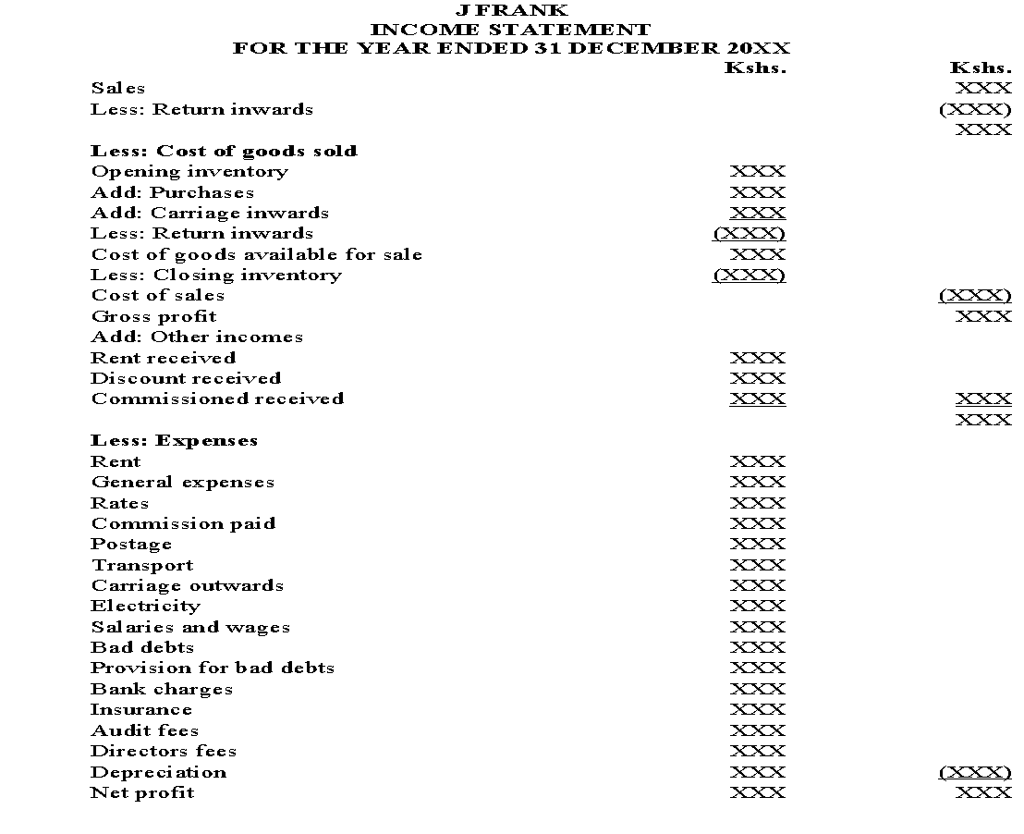
$
SAMPLE INCOME STATEMENT FOR A SOLE TRADER
$

Slide 31
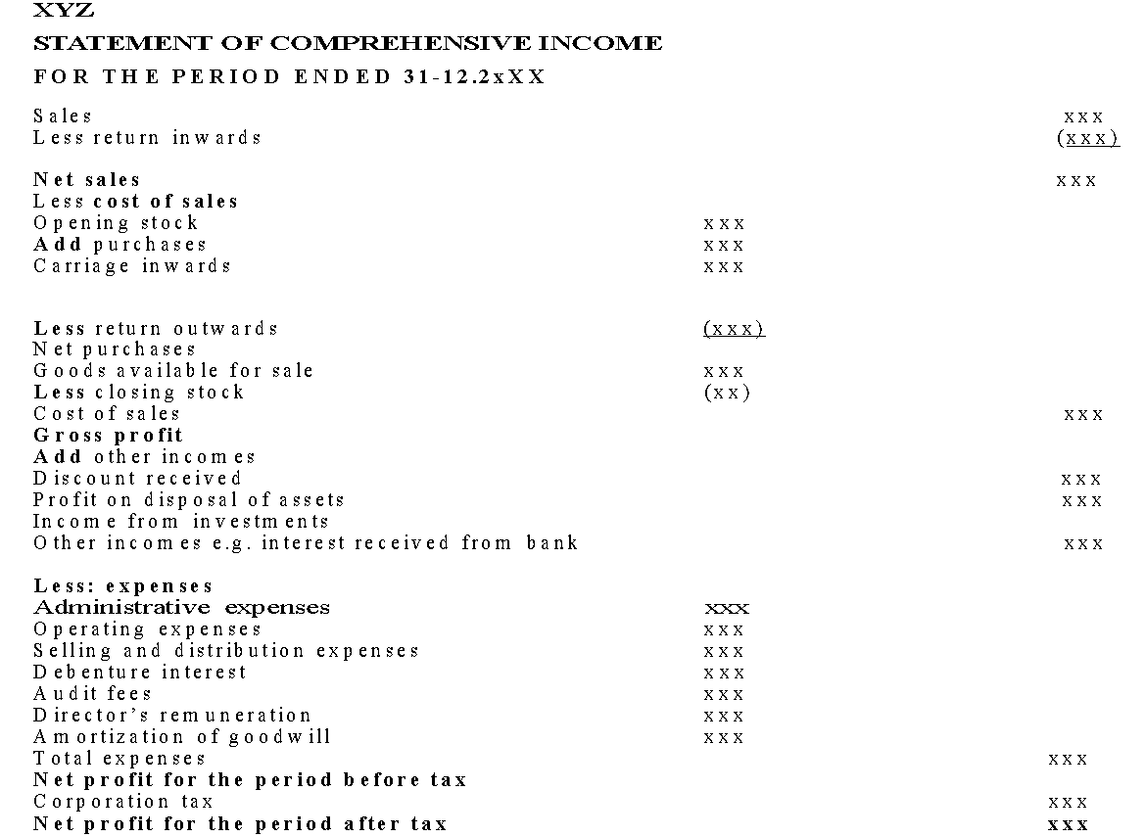
SAMPLE INCOME STATEMENT FOR A COMPANY

Slide 32
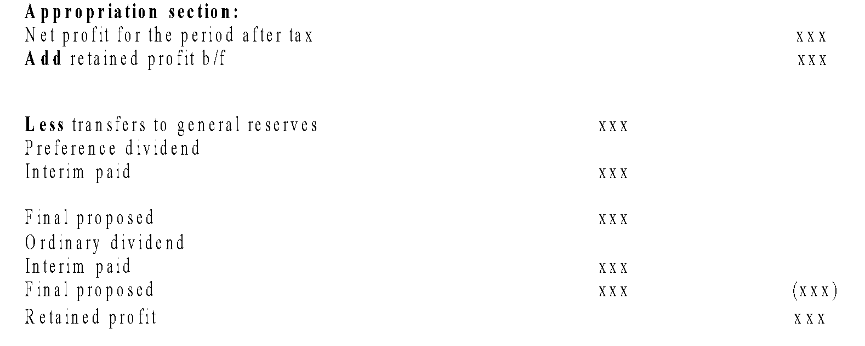
SAMPLE INCOME STATEMENT FOR A COMPANY (CONT’D)
Continued from previous slide

Slide 33
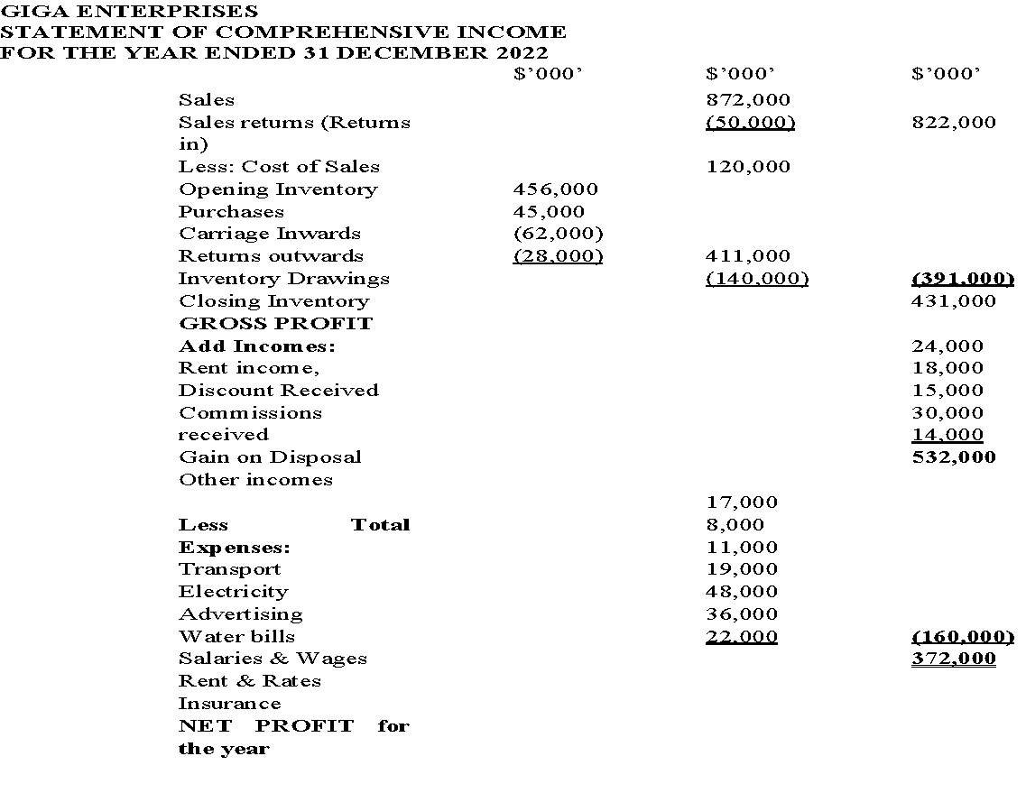
PRACTICAL EXAMPLE OF AN INCOME STATEMENT

Slide 34
ILLUSTRATIONS ONE: (WITH ADJUSTMENTS)
Equatorial Enterprises is a medium enterprise running a supply chain store. The following information relates to its activities for the year ended 31st December 2022.
Required:
(a) Prepare Equatorial Enterprises statement of Comprehensive Income and
(b) Prepare the statement of Financial position for the given financial year (SFP).

Slide 35
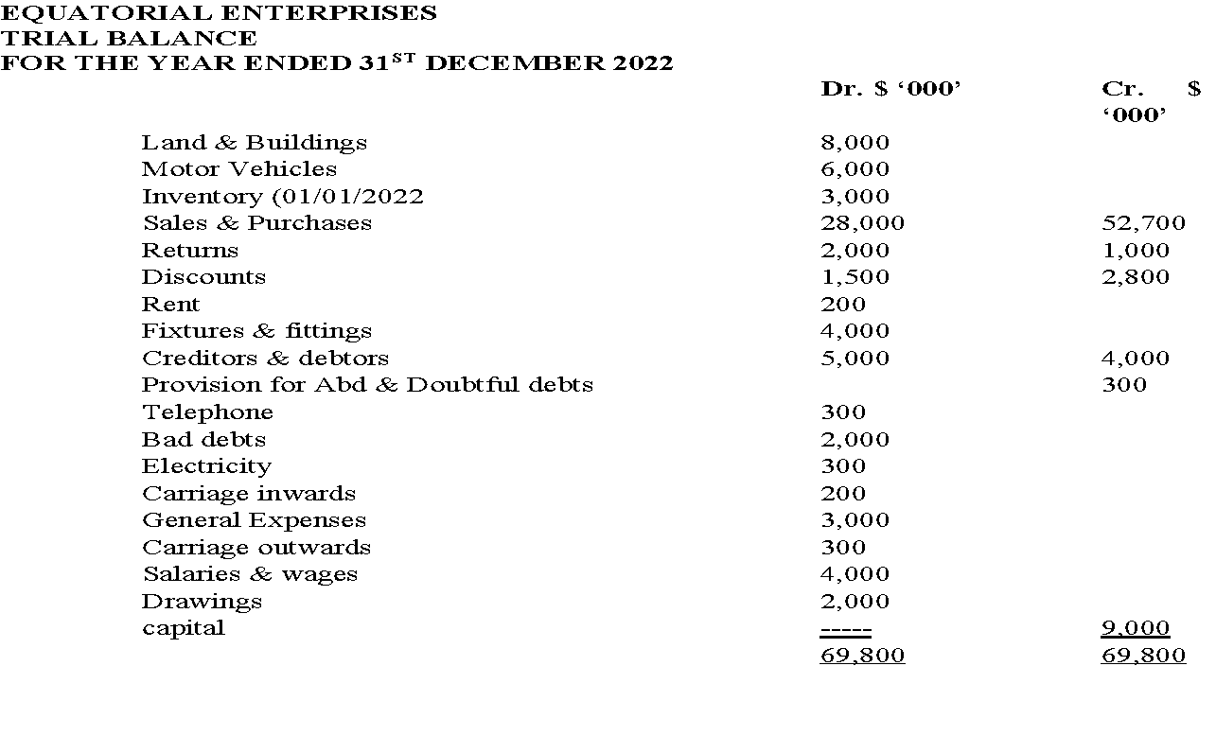
ILLUSTRATIONS ONE: (WITH ADJUSTMENTS)

Slide 36
ADDITIONAL INFORMATION:
(i) Inventory as at 31/12/2022 was $ 2,000,000.
(ii) Provision for bad and doubtful debts is to be increased to 5%.
(iii) Rent outstanding at the end of the year amounted to $150,000 while salaries and wages paid in advance amounted to $ 160,000.
(iv) Electricity and telephone bills prepaid were $50,000 and $ 150,000 respectively

Slide 37
ADDITIONAL INFORMATION:
(v) General expenses in arrears in the year amounted to $200,000.
(vi) Depreciation on non-current assets is to be provided as follows: Motor vehicles and fixtures and fittings at 15% p.a. on cost. The rest remains unchanged.

Slide 38
SUGGESTED SOLUTION:
To solve such a case of financial accounting case, begin with the adjustments and establishing their effects on the individual items as listed in the trial balance as follows;

Slide 39
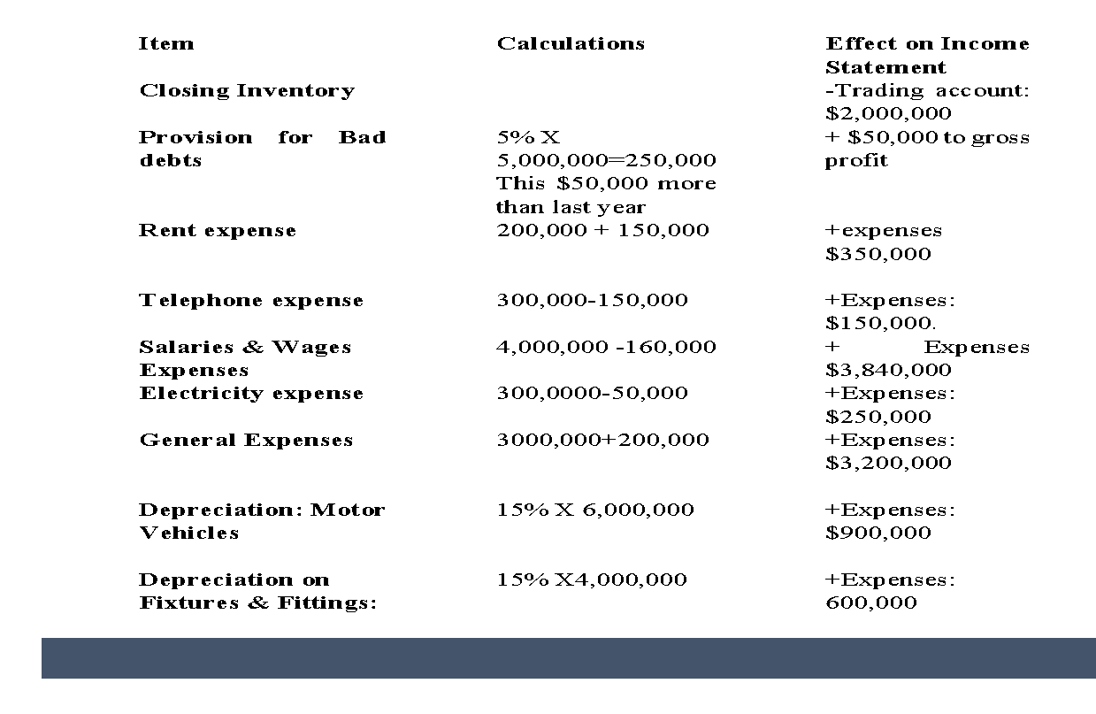
SUGGESTED SOLUTION:

Slide 40
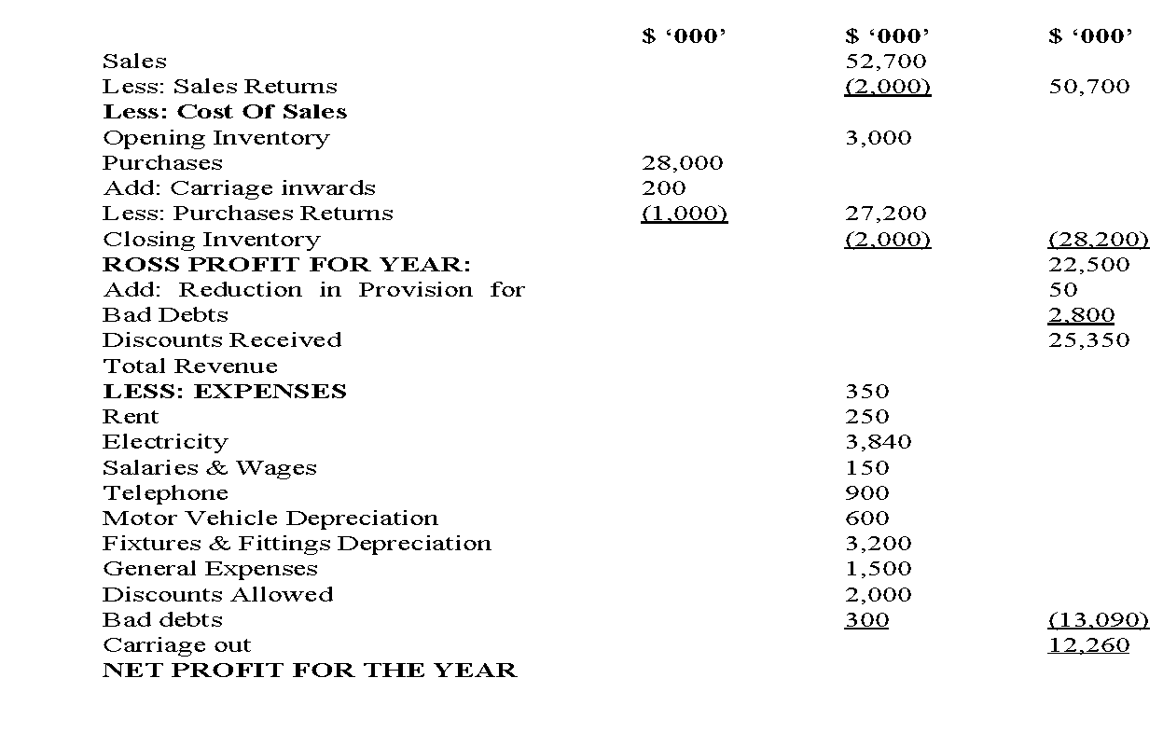
EQUATORIAL ENTERPRISES
STATEMENT OF COMPREHENSIVE INCOME
FOR THE YEAR ENDED 31ST DECEMBER 2022

Slide 41
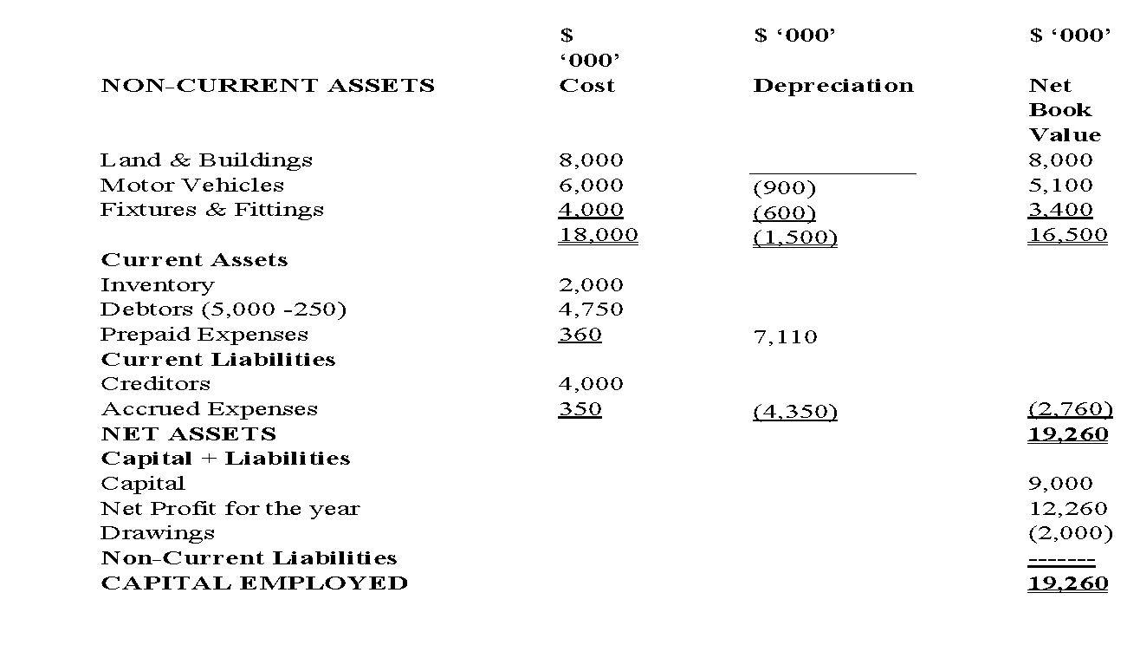
EQUATORIAL ENTERPRISES
STATEMENT OF FINANCIAL POSITION AS AT 31ST DECEMBER 2022

Slide 42
ILLUSTRATION TWO: (Without Adjustments)
The following Trial Balance relate to Upperhill Enterprises a medium Scale Enterprise in Seoul city, showing information for the period ended 31st December 2021.
Required:
Prepare the Statement of Comprehensive income and Statement of Financial Position as at 31st December 2021 for the Enterprise;
NB: Inventory in the premises on 31/12/2021 was $. 4,000,000

Slide 43
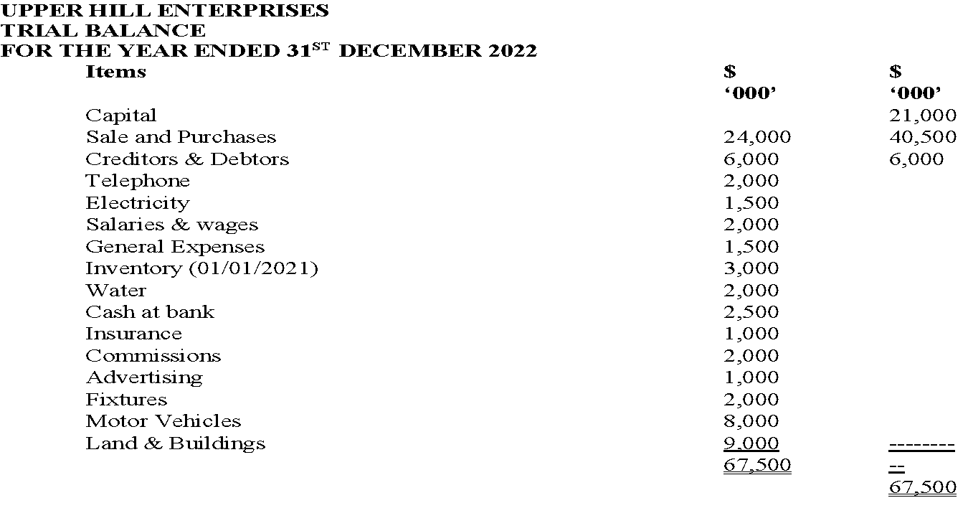
ILLUSTRATIONS TWO: (WITHOUT ADJUSTMENTS)

Slide 44
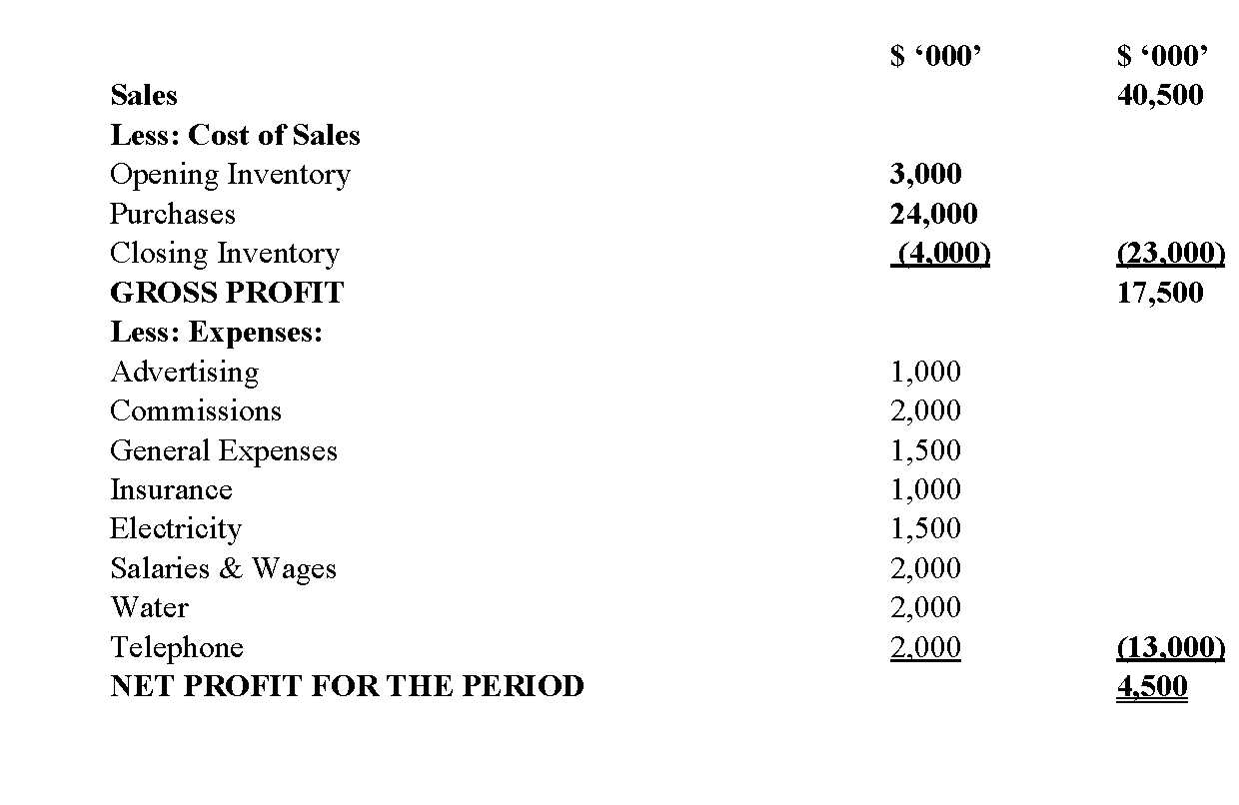
UPPER HILL ENTERPRISES
STATEMENT OF COMPREHENSIVE INCOME
FOR THE YEAR ENDED 31ST DECEMBER 2021

Slide 45
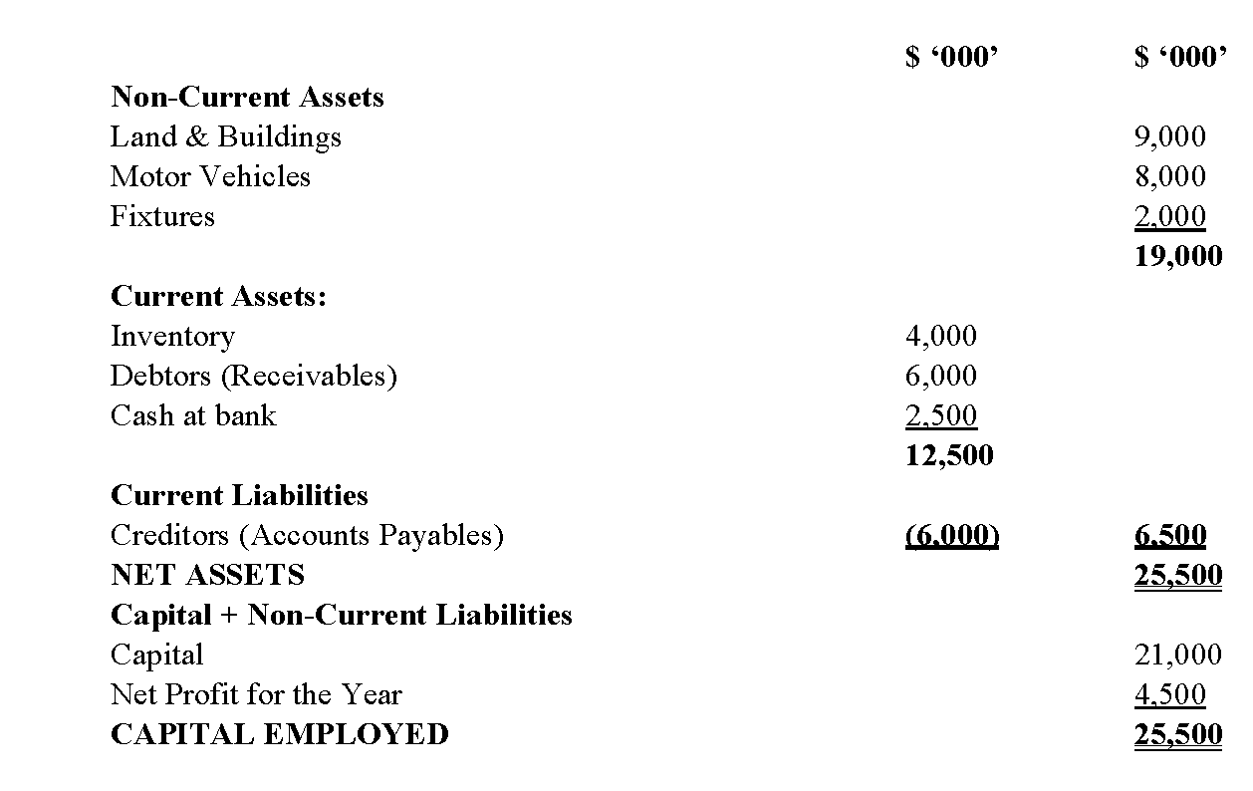
UPPER HILL ENTERPRISES
STATEMENT OF FINANCIAL POSITION AS AT 31ST DECEMBER 2021

Slide 46
References
IASB. (n.d.). international financial reporting. https://www.ifrs.org
McCallig, J. (2008). Introductory financial accounting: Using international financial reporting standards. John McCallig.
Williams, J., Haka, S., Bettner, M. S., Meigs, R. (2002). Financial accounting. Irwin/McGraw-Hill.

Slide 47
WEEK 9: LESSON
END OF PRESENTATION

