Slide 1

FINANCIAL ACCOUNTING:
WEEK 10: PREPARATION OF THE STATEMENT OF CASH FLOWS
BY DR. JOHN MUHOHO KIMANI

Slide 2
LEARNING OBJECTIVES:
Upon completion of this topic, you should be able to:
Introduction to Cash Flow financial statements
Understand the Cash Flow statement
Explain the Types of Cash Flow Statements in practice
Explain the need for Cash Flow statement
Explain the components of a Cash Flow Statement
Explain the Categories of the Cash Movement activities
Prepare a Cash Flow Statement for enterprises

Slide 3
INTRODUCTION
A business enterprise normally prepares the following two financial statements
(i) Profit or loss or income statement which helps to find out the profit or loss made as result of operations of the company over a specified period.
(ii) Balance sheet or financial position statement which reflects the state of asset and liabilities of company on a particular period.

Slide 4
INTRODUCTION
Another required financial statement is cash flow statement. This is requirement of International Accounting 7 (IAS 7) which was elaborated earlier in this course. In this course we shall refer the Statement of Cash flow as SCF.
The Statement of Cash Flow is a financial statement that shows all sources of cash (Cash inflow) and all the avenues or avenues of spending the cash (Cash outflow). The SCF shows all cash into an entity and all cash out of an entity.

Slide 5
IMPORTANCE OF CASH AND CASH EQUIVALENCE TO AN ORGANIZATION
Cash is the most important measure of liquidity status of an organization. Cash is an important measure to an organization just is blood to the body. Without cash, the organization will not be able to meet its obligations and will therefore be technically be dead, because the organization ceases to be a going concern when it fails to meet its financial obligations.

Slide 6
IMPORTANCE OF CASH AND CASH EQUIVALENCE TO AN ORGANIZATION
Cash is a necessary resource as well as a means for organisations to acquire more resources. For a well-managed cash resource, a company or organisation is able to buy assets, pay workers, service debt and regulate tasks. This cash management is an important and critical aspect in the whole area of working capital management.

Slide 7
IMPORTANCE OF CASH AND CASH EQUIVALENCE TO AN ORGANIZATION
A prudent working capital management allows a company to meet its maturing obligations as they fall due, thus ensuring stability.
Cash ratio = Cash in hand/bank + short term marketable securities
Current liabilities
This is a refinement of the acid test ratio indicating the ability of the firm to meet its current liabilities from its most liquid resources.

Slide 8
IMPORTANCE OF CASH AND CASH EQUIVALENCE TO AN ORGANIZATION
Short term marketable securities refers to short term investment of the firm which can be converted into cash within a very short period e.g commercial paper and treasury bills.

Slide 9
IMPORTANCE OF CASH AND CASH EQUIVALENCE TO AN ORGANIZATION
According to Keynes in his General Economic theory developed in 1990, business hold cash in order to fulfill various motives as follows; Precautionary motive, which means holding cash to meet future emergencies that may arise, transaction motive which means holding cash to meet current business operations needs and speculative motive which entails holding cash with the objective of securing profits or enabling an organization to be in a position to take advantage of emerging business opportunities.

Slide 10
IMPORTANCE OF CASH AND CASH EQUIVALENCE TO AN ORGANIZATION
Cash which is an internal source of financing is the cheapest source of financing in the organisation’s capital structure and according Pecking Order Theory, which was proposed by Myers and Mailuf (1984) , firms should opt to using internal financing to debt and equity financing as it is a cheaper source of financing.

Slide 11
NEED FOR CASH FLOW STATEMENT
Users of financial statements, require understanding how the business generated cash and how the cash was used. Unlike the income statement where profit reported is influenced by accounting policies and estimates, cash flow indicates the performance of the business enterprise without such influences, therefore provide a better perspective to evaluating the performance.
Remember that a business enterprise can be making profits, while at the same time suffering from cash crisis. This can lead to business enterprise wind up.

Slide 12
Indirect Method for Preparing the Cash Flow Statement
COMPONENTS OF A CASH FLOW
Cash flow statement summaries the cashbook, by reconciling the opening and closing balance of the cash and cash equivalents. Cash equivalents refer to liquid assets which can easily be transferred into cash and include;
(i) Cash
(ii) Demanded deposits in banks
(iii) Short term investments
(iv) Bank overdraft

Slide 13
COMPONENTS OF A CASH FLOW
The cash movement activities are classified into 3 categories
(i) Operating cash movement/ activities
(ii) Investing cash movement/ activities
(iii) Financial cash movement/ activities

Slide 14
a) Operating Activities
These are the core activities of any business. They reflect the main or ordinary business activities. They indicate the net amount generated from business customers, after meeting all the necessary expenses to raise that revenue. Operating cash flows are most importance because they indicate ability of the business to sustain its activities Operating cash flow can be determined directly or indirectly

Slide 15
a) Operating Activities
(i) Directly;
Cash received is compared with cash paid in ordinary activities of business, which can be determined from cash book or from control ledger. The format is as follows:
Cash paid for operating expense (XX)
XX

Slide 16
a) Operating Activities
(ii) Indirectly:
Companies may choose to use either the direct method or the indirect method when preparing the SCF section cash flows from operating activities. However, the indirect method is the dominant method used and the one we will explain. Under the indirect method, the SCF section cash flows from operating activities begins with the amount of net income, which is taken from the company's income statement.

Slide 17
a) Operating Activities
(ii) Indirectly:
Since the net income was based on the accrual method of accounting, the amount of net income must be adjusted to the cash amount. If an adjustment to the amount of net income is in parentheses, it is subtracted from net income. It indicates that the cash amount was less than the related amount on the income statement. Adjustments in parentheses can also be interpreted to be unfavorable for the company's cash balance.

Slide 18
a) Operating Activities
(ii) Indirectly:
An adjustment to net income that is not in parentheses is a positive amount, which indicates the cash amount was more than the related amount on the income statement. A positive adjustment can also be interpreted to be favorable for the company's cash balance. Under this method operating profits is reconciled with operating cash flow. Operating profit is profit before interest and tax (EBIT) which is adjusted with non -cash flow items. Non-cash items are as given below.

Slide 19
a) Operating Activities
(i) Non-cash expenses
These are items subtracted from P&L but do not involve payment. As a result, they should be added back. They include: depreciation, impairment losses, and losses on disposal among others. These refer to any cash paid in a period before it is recognized in the P&L statement. Mainly entail use of cash but no effect on profit as a result they should therefore be subtracted.

Slide 20
a) Operating Activities
(i) Non-cash expenses
Examples include-
• Increase in debtors:
• Increase in stock
• Increase in bills receivables
• Decrease in creditors
• Decrease in bills payables

Slide 21
a) Operating Activities
(ii) Prepayments
Cash received from customer XX
Cash received from other operating income XX
Cash paid to supplies (XX)
Cash paid to employee (XX)

Slide 22
a) Operating Activities
(iii) Accruals
They refer to revenues or expenses in the P&K recognized without necessary receiving /paying cash. As result they should be added back. They include:
• Decrease in stock,
• Decrease in debtors
• Decrease in bills receivables
• Increase in bills payables / Increase in creditors

Slide 23
a) Operating Activities
(iv) Investing activities:
Refer to cash generated or used in relation to fixed assets. Fixed assets investments define capacity to generate revenue. The capacity should be continuously enhanced and where necessary renewed. The investing activities section of the SCF reports the cash inflows and cash outflows related to the changes that occurred in the noncurrent (long-term) assets section of the balance sheet.

Slide 24
a) Operating Activities
(iv) Investing activities:
Examples of investing activities include the following:
➢ Capital expenditures (additions to property, plant and equipment)
➢ Proceeds from the sale of property, plant and equipment
➢ Purchase of long-term investments
➢ Proceeds from the sale of long-term investments

Slide 25
a) Operating Activities
(v) Financing activities
Refer to cash generated or used in relation to long-term source of capital due as issues of shares, repayments of lower and debtors among others.
The cash inflows and outflows from financing activities are related to the changes in the following balance sheet sections:
➢ Noncurrent (long-term) liabilities
➢ Stockholders' equity (or owner's equity)
➢ Loans and similar debt reported under current liabilities

Slide 26
a) Operating Activities
(v) Financing activities
Examples of the descriptions and amounts typically reported under cash flows from financing activities include the following:
➢ Proceeds from long-term debt
➢ Repayment of long-term debt
➢ Proceeds from issuing capital stock
➢ Payment of dividends
➢ Purchase of treasury stock & ➢ Change in short-term debt

Slide 27
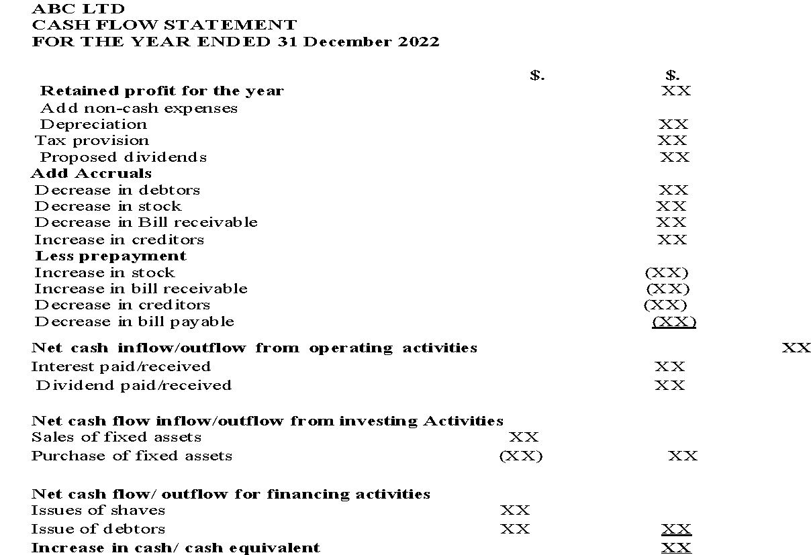
FORMAT OF CASH FLOW STATEMENT
)

Slide 28
ILLUSTRATION ONE
The following information was extracted from the records of Doverin Company Limited for the year ended: 31st December 2022.
Required:
Using the information provided, Prepare the Cash Flow Statement for Doverin Co. Limited for the given period:

Slide 29
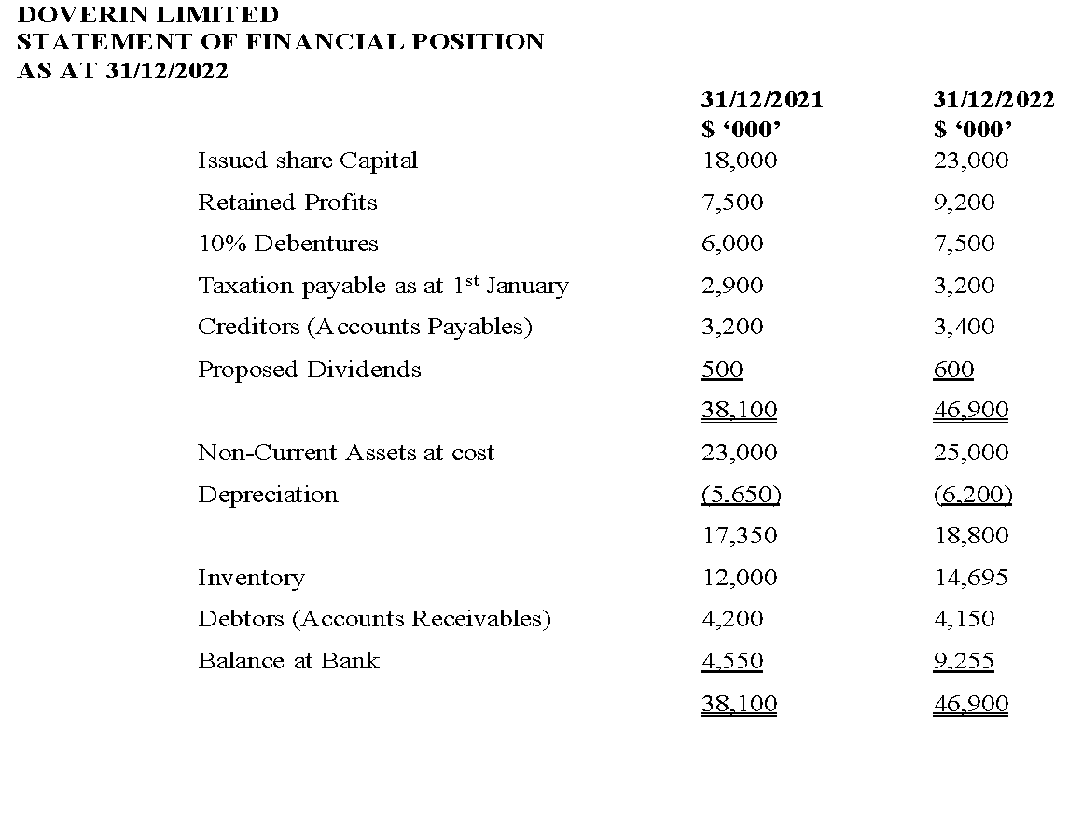
)

Slide 30
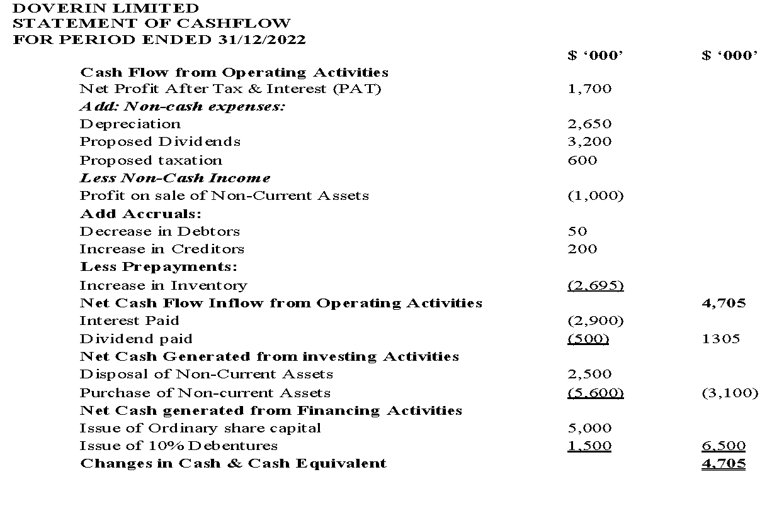
SUGGESTED SOLUTION (INCLUDING WORKINGS)
)

Slide 31
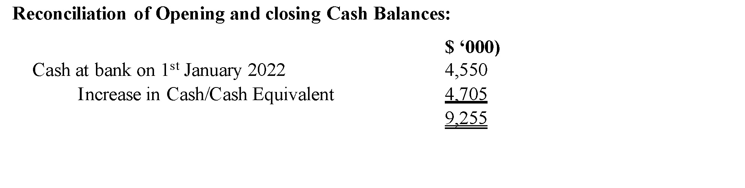
SUGGESTED SOLUTION (INCLUDING WORKINGS)
)

Slide 32
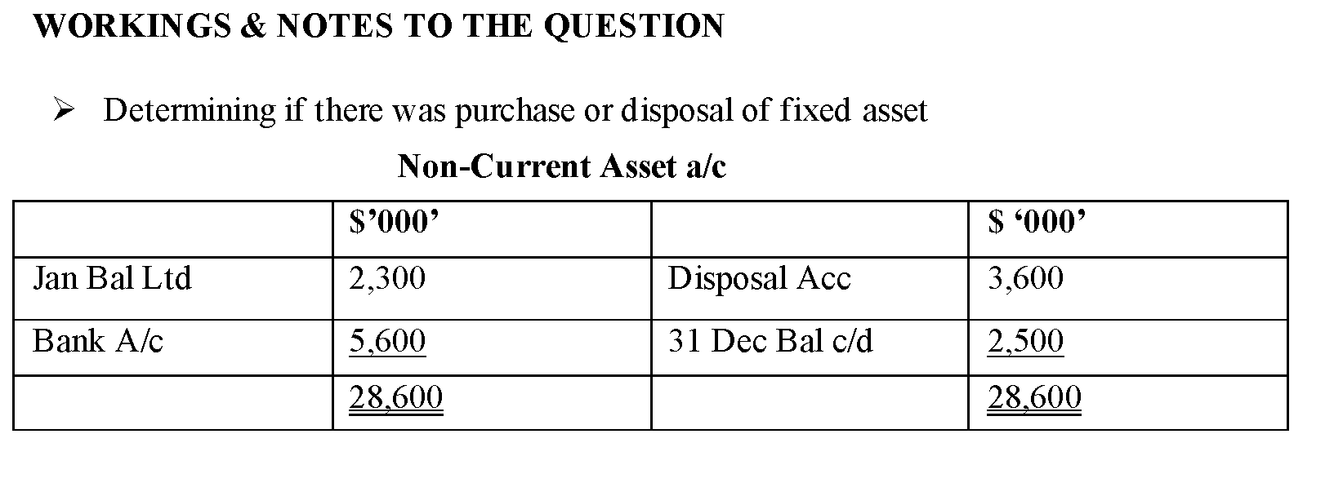
SUGGESTED SOLUTION (INCLUDING WORKINGS)
)

Slide 33
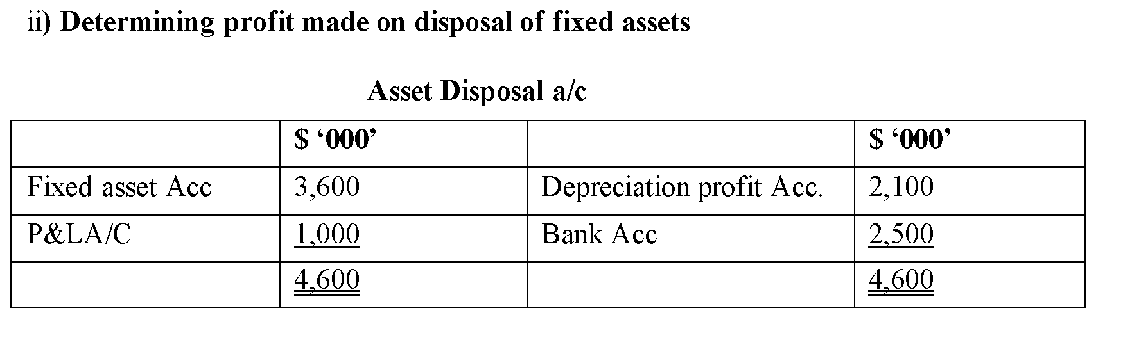
SUGGESTED SOLUTION (INCLUDING WORKINGS)
)

Slide 34
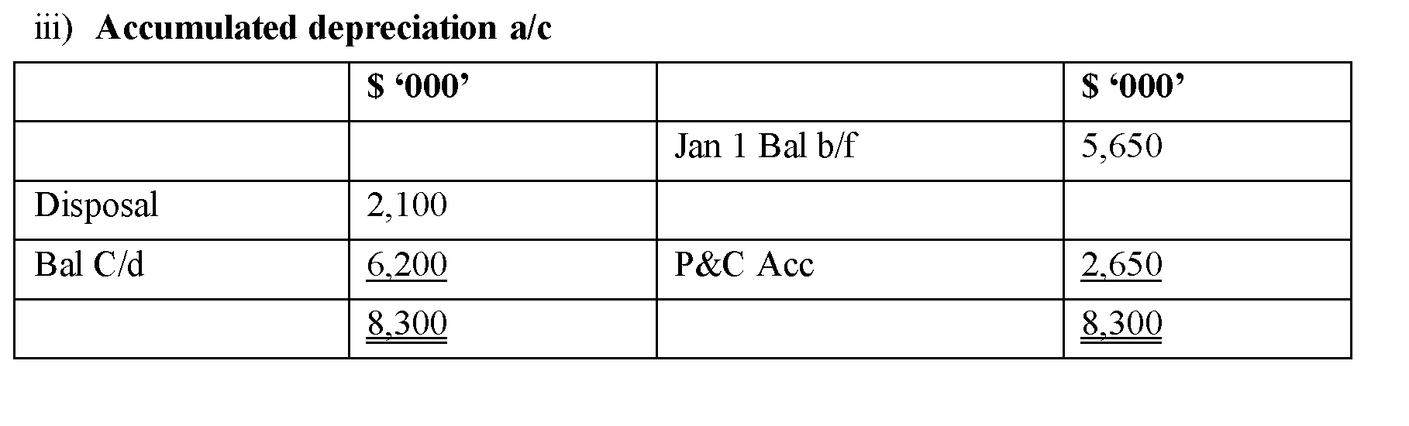
SUGGESTED SOLUTION (INCLUDING WORKINGS)
)

Slide 35
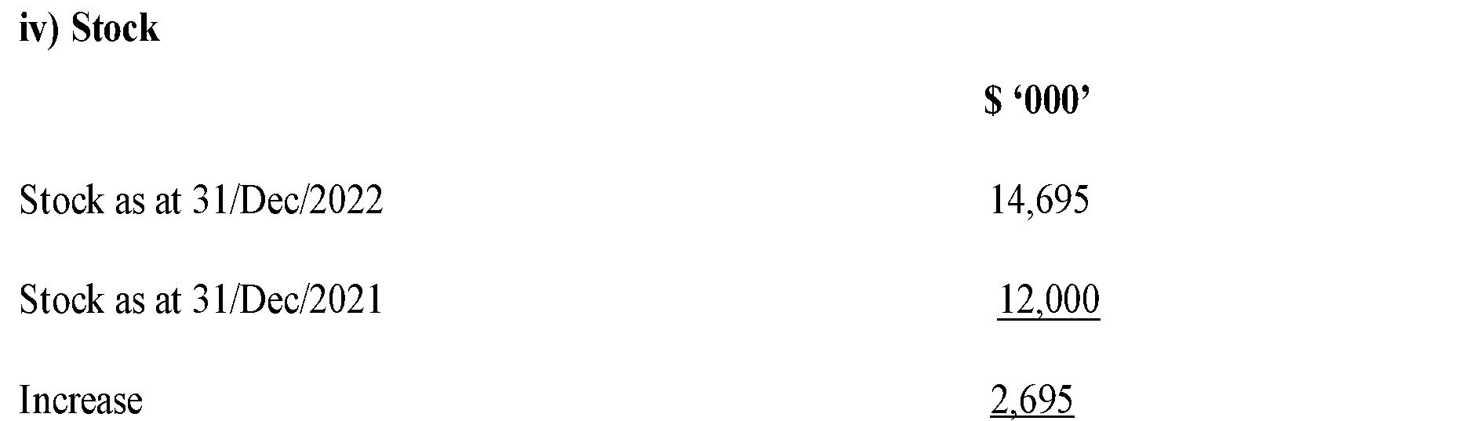
SUGGESTED SOLUTION (INCLUDING WORKINGS)
)

Slide 36
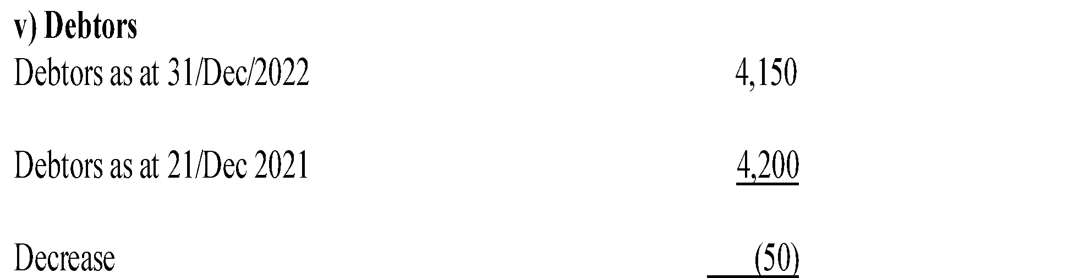
SUGGESTED SOLUTION (INCLUDING WORKINGS)
)

Slide 37
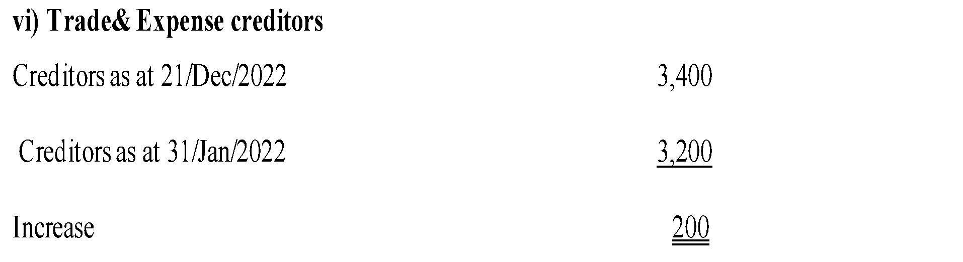
SUGGESTED SOLUTION (INCLUDING WORKINGS)
)

Slide 38
vii) Deprecations is an expense which reduces profit, but does not involve cash outflow, hence added back
viii) Taxation is paid in arrears i.e. tax for 2021 is paid in 2022, and for 2022paid in 2023
As a result, tax expenses for 2022 do not involve cash in 2022; hence it is not cash flow in 2022. But tax for 2021 is cash flow in 2022, hence that why it is subtracted

Slide 39
NB:
Propose dividends like tax are paid in arrears hence proposed divided for 2021 are cash flow in 2022. Proposed dividends for 2022 will be cash Outflow in 2023 due to this we add back proposed divided for2021 as they are paid in 2022
The items taxation, interest and divided are normally shown separately after net cash flow from operating activities but before net cash flow from investment.

Slide 40
ILLUSTRATION TWO
The following information was extracted from Tropical Limited a medium sized company in Nairobi Kenya for the years 2020 and 2021.

Slide 41
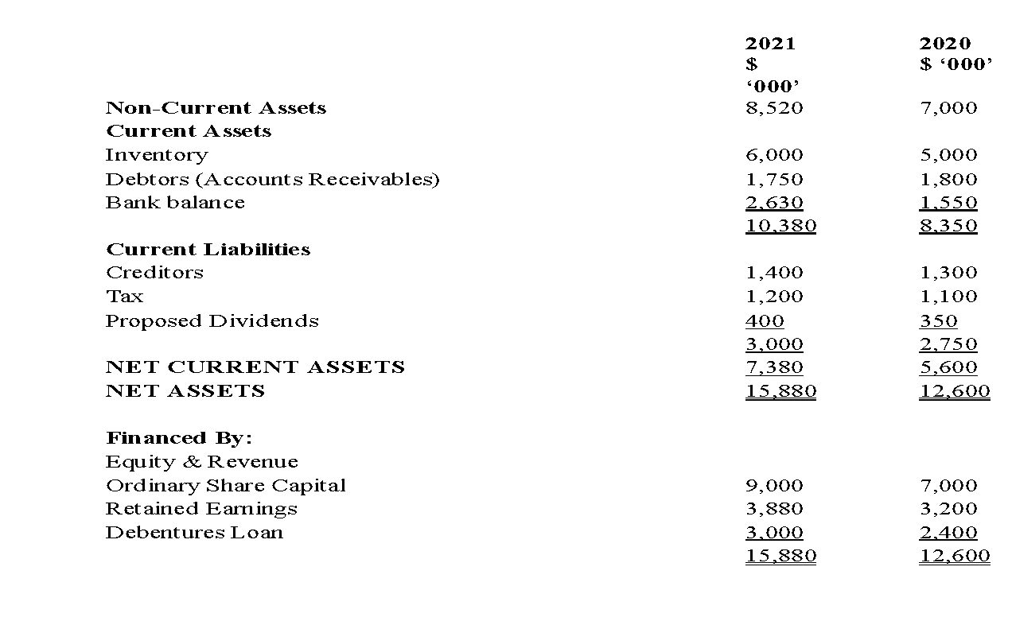
ILLUSTRATION TWO

Slide 42
ILLUSTRATION TWO
The following additional information is also given:
1. During the year ended 30th September 2021 fixed assets were purchased at a cost of
Sh.2700,000 while fixed assets whose original cost was Sh.1000,000 were disposed for Sh
750,.000 The net book value of the assets disposed were Sh.400, 000 and the profit on sale of the fixed asset has been included in the retained profits.

Slide 43
ILLUSTRATION TWO
The following additional information is also given:
2. Accumulated depreciation at 30 September 2021 was Sh.2500, 000 and Sh 2300,000 at September 20

Slide 44
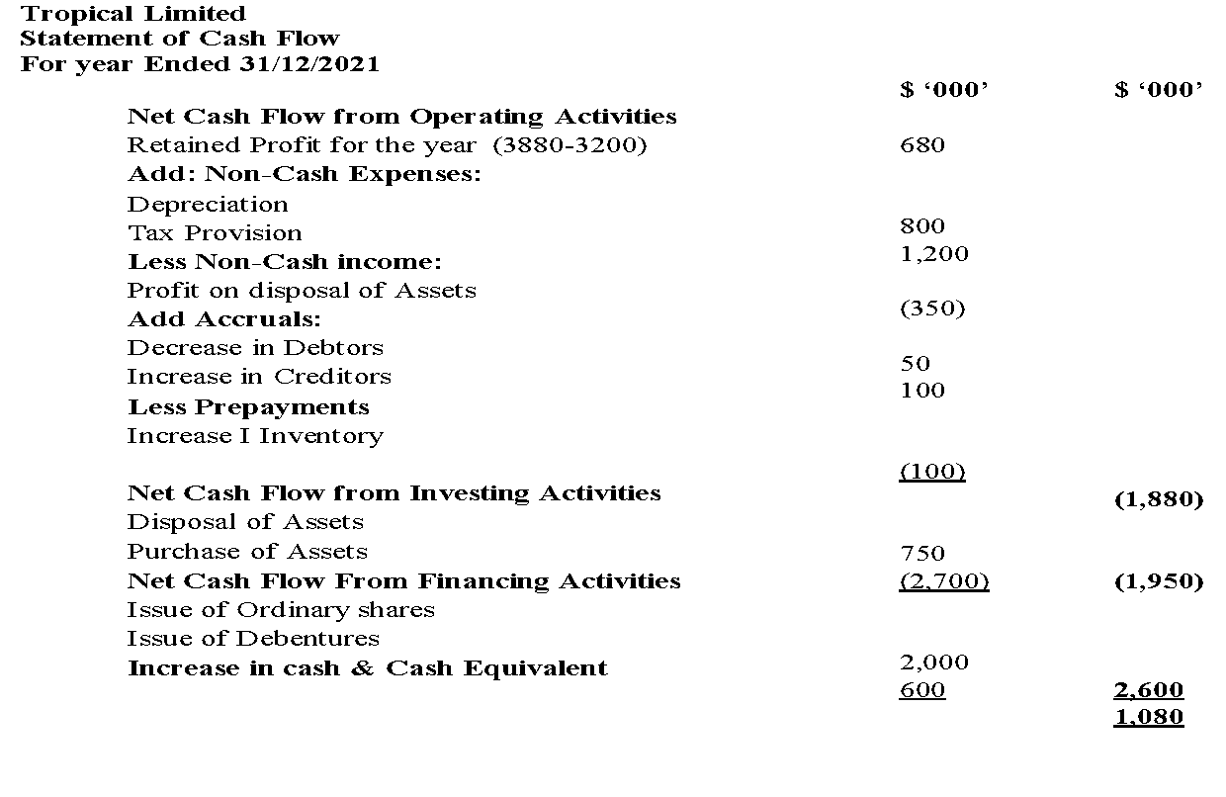
SUGGESTED SOLUTION

Slide 45
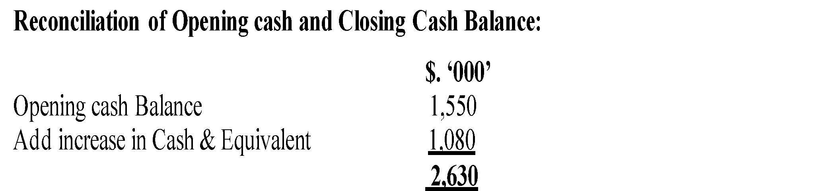
SUGGESTED SOLUTION

Slide 46
USES OF CASH FLOW STATEMENTS
Cash flow statements have many uses other than the legal need for some companies to prepare them. A few cases where a business might find them useful is answering such questions as below- Small businessman may want to know why he now has an overdraft. He started off the year with money in the bank, he has made profit and yet he now has a bank overdraft. Another businessman may want to know why the bank balance has risen even though the business is losing money.

Slide 47
USES OF CASH FLOW STATEMENTS
The partners in a business have put in additional capital during the year. Even so, the bank balance has fallen dramatically. They may want explanation as to how this has happened. A study of the final accounts themselves would not give them the information that they may needed. However, a study of the cash flow statement in each case will reveal the answer to their questions

Slide 48
USES OF CASH FLOW STATEMENTS
Besides the answers to such specific queries, cash flow statement should also help businesses to assess the following.
➢ The cash flows which the business may be able to generate in the future;
➢ How far the business will be able to meet future commitment, e.g. tax due, loan repayments, interest payments, contracts that could possible lose quite a lot of money;

Slide 49
USES OF CASH FLOW STATEMENTS
Besides the answers to such specific queries, cash flow statement should also help businesses to assess the following.
➢ How far future share issues may be needed or additional capital in the case of sole trader or partnership;
➢ A valuation of the business

Slide 50
References
IASB. (n.d.). international financial reporting. https://www.ifrs.org
McCallig, J. (2008). Introductory financial accounting: Using international financial reporting standards. John McCallig.
Williams, J., Haka, S., Bettner, M. S., Meigs, R. (2002). Financial accounting. Irwin/McGraw-Hill.

Slide 51
WEEK 10: LESSON
END OF PRESENTATION

