Slide 1
INDUSTRIAL MARKETING
LECTURE 1: INTRODUCTION TO INDUSTRIAL MARKETING
BY
DR. WANJIKU KINYANJUI

Slide 2
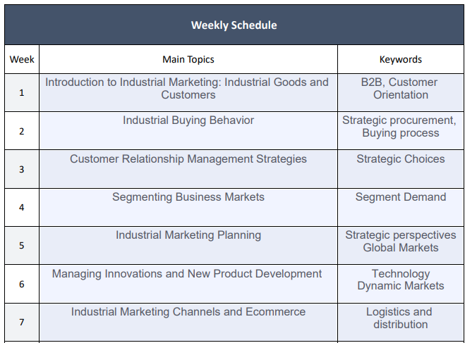
COURSE OVERVIEW
(Kinyanjui,2023)

Slide 3
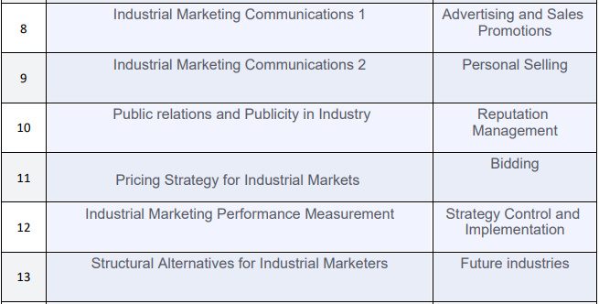
(Kinyanjui, 2023)

Slide 4
Introduction TO INDUSTRIAL MARKETING
The term industrial marketing infers to marketing that involves industrial products.
The products are produced by manufacturing firms and sold to other organizations or firms rather than to households.
These products are therefore not meant for consumption by the households, but are used to facilitate organizational productivity
Think about industries in your country

Slide 5
What is an industrial market?
An industrial market is also referred to as organizational marketing or business to business marketing(B2).
It is the market consisting of organizations which acquire goods and services to be used in the production of further products or services for sale or rent or lease to others.
It requires formal arrangements with detailed terms and conditions by way of contract or purchase order
Mention names of Industrial Marketers in your region/country

Slide 6
Industrial marketing defined
Industrial marketing can therefore be defined as the process of marketing goods, which are used in producing consumer goods or industrial goods, or business or personal services or which facilitate the operation of a business enterprise.
Industrial goods are purchased by a large number and variety of concerns operating in diverse fields.
Among these are the manufacturing industries, the mines and quarries, the construction industry, hotels, restaurants, theatres and others

Slide 7
INDUSTRIAL MARKETING VS. CONSUMER MARKETING
The meaning and interpretation of both terms are completely different.
The consumer market approach targets the end consumers, and employs such promotional strategies that focus on their needs, wants, wishes, desires, and emotions.
However, the selling time is very short, simple, easy, and limited; customers buy goods to satisfy their needs. For instance, products of daily necessities of life like

Slide 8
INDUSTRIAL MARKETING VS. CONSUMER MARKETING
The industrial market approach, as the name implies comprises mega orders, a complicated process of closing the deal, and their relationship last in the long term.
The target customers or clients are the other businesses, and they utilize materials or supplies to produce and manufacture their products and services for sale.
  Eg , automobile companies buy spare parts from the manufacturer of spare parts, and they produce cars and vehicles for sale.

Slide 9
Classification Of Industrial Products
Industrial products and services are classified into three broad groups.
Materials and parts
  These goods enter the product directly
  ◆ raw material ( basic products like vegetables , crude oil, fruits, )
  ◆ manufactured items ( juices, fuel oil, steel, chemicals)
  ◆ components parts ( semi finished parts like TV tubes , small motors , tyres)
  ◆ subassemblies ( semi finished goods like wire mesh)

Slide 10
2) Capital items
A capital good is a durable good that does not quickly wear out.
It is used in production of goods or services. These goods are used in production process.
◆ Light equipment or accessories ( hand tools, computer terminals.)
◆ Installations or heavy equipment's ( machines , turbines)
◆ plant and buildings ( offices, warehouses, parking lots , houses)

Slide 11
3) Supplies and services
These support the operations
  ◆ supplies – these are operating maintenance supplies like fuels , packaging materials, lubricants, paints, electrical items
  ◆ services – companies need a wide range of services like legal ,auditing, advertising, courier, marketing research agency

Slide 12
Types of exchange process
The Industrial marketing concept consists of different exchange processes with the customers. The needs and objectives of industrial buyers are satisfied through the following exchange processes.
  Product exchange process
  Information exchange process
  Societal exchange
  Financial exchange

Slide 13
Product Exchange Process
Product exchange is based on the ability of the seller to identify the buyers needs and the product‘s potential to meet those needs.
This results in positive image and customer loyalty only when the exchange is good in terms of price, quality, quantity, and after sale services.
Supply of raw materials to the organization to process them into finished goods for the end user or consumer

Slide 14
Information Exchange Process
When one organization gives the technical knowledge, economic consultancy or replies to organizational questions to another organization it is termed as information exchange.
This consists of technical, economic, and organizational questions pre and post sale maintenance and servicing information that must be exchanged to the participants of business organizations.
Products and services must be intended and designed to serve customers efficiently. To achieve this, buyers and sellers tend to work together, exchanging product specific information over long periods of time

Slide 15
Financial exchange process
Awarding credit facilities to an organization is financial exchange. Exchange of currencies between two organizations in two different countries is financial exchange process.
Yielding of credit or the need to exchange money from one currency to another at the time of dealing with foreign buyers is called as foreign exchange

Slide 16
Societal exchange process
Social exchange is significant in areas of reducing ambiguity between buyer and seller.
It is necessary and helps to avoid short-term difficulties in order to maintain a better relationship over a long period of time.
There are a number of factors in an agreement between buyers and sellers in the industrial market, they are based on negotiation, mutual trust or based on some legal criteria.

Slide 17
Industrial VERSES Consumer Markets CHARACTERISTICS
Characteristic | Industry Market Indicators | Consumer Market Indicators
Market Characteristic | Geographically concentrated Fewer buyers | Geographically disbursed Mass market
Product Characteristic | Technical complexity Customized | Standardized
(Kinyanjui,2023)

Slide 18
Characteristic | Industry Market Indicators | Consumer Market Indicators
Buyer Behavior | Involvement of various functional areas Rational purchase decisions Technical expertise needed Personal relationships are formed | Involvement of family members Purchase decisions are made based on physiological and social needs Less technical expertise needed Non-personal relationships
(Kinyanjui,2023)

Slide 19
Characteristic | Industry Market Indicators | Consumer Market Indicators
Channel Characteristics | More direct Fewer intermediaries/middlemen | Indirect Multiple layers of intermediaries
Promotional Characteristics | Emphasis on personal selling | Emphasis on advertising
Price Characteristics | Competitive bidding and negotiated prices List prices for standard products | List prices/ retail maximum prices(MRP)
(Kinyanjui,2023)

Slide 20
Types Of Industrial Customers
Institutional
Customers
Commercial Enterprises
Industrial Customer
Cooperatives
Government
Customers
(Kinyanjui,2023)

Slide 21
Types of industrial customers
Commercial Enterprises
Commercial enterprises are private sector, profit-seeking organisations such as HP, general motors who purchase industrial goods and/or services for purposes other than selling directly to ultimate consumers.
Commercial enterprises purchase products for different uses, it is more useful from a marketing point to define them in such a way as to understand their purchasing needs and how marketing strategy can be developed to meet their needs.

Slide 22
Government Organizations
Government agencies such as railways, department of telecommunication, defense, director general of supplies and disposal , transportation industry, electricity boards, and so on. These government units purchase almost all kinds of industrial products and services and they represent a huge market.

Slide 23
Institution Customers
Public and private institutions such as hospitals, schools, colleges, and universities are termed as institutional customers.
Some of these institutions have rigid purchasing rules and others have more flexible rules.
An industrial marketing person needs to understand the purchasing practice of each institute so as to be effective in marketing the products or services.

Slide 24
Cooperative Customers
Industrial marketers should study the purchasing practices of each cooperative society in order to become effective in marketing their goods and services.
For example, a flour cooperative factory may adopt a different buying practice while purchasing flour, machinery, compressors, etc.
Their purchase decisions will emphasize on factors like quality, delivery, price, payment terms, service and long-term relationship with suppliers.

Slide 25
Marketing Implications for Different Customer and Product Types
For large users selling is done directly from a seller to a buying organisation for materials and parts products.
While for smaller volume users, the standard raw materials or components are sold through industrial dealers or distributors, as it is cost effective

Slide 26
In the case of standard products, the factors, which influence buying decisions, with differing share of business for various suppliers, are product quality, performance, delivery dependability, price, payment terms, customer service and customer rapport.
Advertising and distribution through multiple channels all over the country becomes an important part of marketing strategy.

Slide 27
For capital items like heavy machinery and construction of factories and office buildings, direct selling with extensive interactions, involving top executives in both buying and selling organisations are very common.
Negotiations take considerable time on key factors such as price; return on investment, credit facilities, delivery period, installation time and third party certificate for previous jobs done.

Slide 28
The purchasing practices depend upon the nature of business and the size of the commercial enterprise as well as the volume, variety, and technical complexity of the products purchased.
In large and medium size organizations, the purchase decision makers hail from different departments such as production, materials, quality, finance/cost accounting, engineering and this also includes senior management executives

Slide 29
Material managers are professionals who are in charge of purchases, they must be well informed about price trends, commercial matters, and negotiating skills. They make use of in-house technical expertise when required.
Further, an industrial marketer must understand a set of formal purchasing procedure and documentation motioned in a commercial enterprise. An industrial marketer must understand a set of formal purchasing procedure and documentation motioned in a commercial enterprise.

Slide 30
Summary
Industrial marketing focuses on providing goods and services to other businesses rather than individual customers.
Selling in the industrial market is complicated by the broad spectrum of customers.
  Commercial enterprises, governmental organizations, institutions and cooperative societies who give buying responsibility to individuals or departments that are quite knowledgeable and well conversant in that specific market.
To formulate a successful industrial marketing strategy, it is essential to know the administration of the buying function in a diverse market.
and also to know the nature of the business, the size of the firm, and the volume, variety, and technical complexity of the products purchased by the industrial buyers

Slide 31
references
Michael D. Hutt, Thomas W. Speh, (2012), Business Marketing Management B2B, 10th Ed. or 11th Ed. South-Western Cengage Learning, ISBN-13: 978-0-324-58167-6
Oleksandr BOZULENKO, 2014. "Commercial enterprise: essential characteristics, functions, emphasis in grounding strategies for policy development," the USV annals of economics and public administration, vol. 14(1(19)), pages 62-70, June.
Piyush, Ajbani, L.A, Patole, S., & Sharma, V. (2017), Industrial Marketing: Instructional Material. Y. C. M. Open University, Nashik.
Zimmerman, A., & Blythe, J. Routledge. (2021). Business to Business Marketing Management: A Global Perspective (4th ed.). https://doi.org/10.4324/9781003164036

Slide 32
THANK YOU !

