Slide 1
INDUSTRIAL MARKETING
LECTURE 3:
CUSTOMER RELATIONSHIP MANAGEMENT
DR. WANJIKU KINYANJUI

Slide 2
Learning Objectives
By the end of this course, the learner should be able to understand:
The value of systematically monitoring the customer experience and the central role that business services assume in customer solutions.
2. The roles that service quality, customer satisfaction, and loyalty assume in service market success.
3. Significant factors to consider in formulating a service marketing strategy.
4. The determinants of new service success and failure

Slide 3
Introduction: Customer Experience
Services are fundamentally important to the customer experience that every business-to-business firm provides.
Customer experience encompasses every dimension of a company’s offering—product and service features, advertising, ease of use, reliability, the process of becoming a customer, or the way problems are resolved.

Slide 4
Customer Experience Maps
0
One way to understand the customer better is to “Map” out experiences at various “touchpoints.”
Touchpoints are spots where a seller has direct or indirect contact with the customer about the product or service over time.
The map points out what is most important in the seller/customers’ experience.

Slide 5
Ultimate Goal of Experience Map
0
The ultimate goal of an Experience Map is to identify:
Importance customers place on each element of the experience.
Customers’ expectations for each element.
The customers’ perception of firm’s performance versus competitors.
Once the map is developed, the next step is to meet with the customer and pare down the list to the most critical issues.

Slide 6
Customer Experience Life Cycle Map
0
A representative set of customer-company interactions
Relationship
initiation
Provider
evaluation
Account
setup
Order
placement
Product
reception
and use
Problem
resolution
Account
maintenance
Payment
The company exposes the customer to its marketing message
The customer seeks relevant information
The customer gets initial price and lead-time quotes
The customer puts out an RFP
The customer evaluates providers and negotiates terms and pricing
The customer selects the provider
The customer obtains materials for account setup
The customer provides account profile information
The company confirms setup and activation
The company performs courtesy follow-up
The customer requests product information
The customer selects the product
The customer places the order (fills out the order form
The customer prepares specialty documents when required (for example, for rush delivery)
The company and the customer arrange initial delivery terms
The customer tracks order status
The company and the customer arrange the final delivery terms
The customer receives and inspects the product
The customer refuses or accepts the product
The customer files a claim and obtains resolution
The customer notifies the company of a problem and obtains resolution
The customer seeks an invoice adjustment and obtains resolution
The customer receives and validates the invoice
The customer makes the payment
The customer maintains profile information
The customer maintains supplies
The company provides general support (not related to problems)
The customer obtains ongoing price quotes
SOURCE: David Rickard, “Winning by Understanding the Full Customer Experience,” The Boston Consulting Group, Inc., 2007, p. 6. Accessed at http://www.bcg.com

Slide 7
As global competition intensifies and product differentiation quickly fades, strategists at leading firms are giving increased attention to services, particularly a solution-centric mindset.
Rather than starting with the product, a solution-centered approach begins with an analysis of a customer problem and ends by identifying the products and services required to solve the problem.

Slide 8
Rather than transaction based, the focus of the exchange process is interaction based, and value is co-created by the firm together with the customer
Customer offerings represent an “integrated combination of products and services designed to provide customized experiences for specific customer segments.
Services, are a valuable basis for competitive advantage and an important driver of profitability.

Slide 9
From a Product to a Solutions Perspective
0
 | Product Perspective | Solutions Perspective
Value Proposition | Win by creating innovative products and enriching features of existing products | Win by creating and delivering superior customer solutions
Value Creation | Value is created by the firm | Value is co-created by the customer and the firm
Designing Offerings | Start with the product or service, and then target customer segments | Start with the customer problem, and then assemble required products and services to solve the problem
Company- Customer Relationship | Transaction-based | Interaction-based and centered on the co-creation of solutions
Focus on Quality | Quality of internal processes and company offerings | Quality of customer-firm interactions
Hutt & Speh, (2012)

Slide 10
Business Service Marketing
There are inherent differences between goods and services, providing a unique set of marketing challenges for service businesses and for manufacturers that provide services as a core offering.
Services are deeds, processes, and performances.
  For example, a management consultant’s core offerings are primarily deeds and actions performed for customers.

Slide 11
  The most basic, and universally recognized, difference between goods and services is intangibility.
  Services are more intangible than manufactured goods, and manufactured goods are more tangible than services.
  Because services are actions or performances, they cannot be seen or touched in the same way that consumers sense tangible goods.

Slide 12
Continuum – Tangible to Intangible
0
The Continuum suggest that there are very few pure products or very few pure services.
It’s a useful tool for understanding the product-service definition issue.
Many services are a combo of services and products. Example: hotels – offer sleeping service to food products

Slide 13
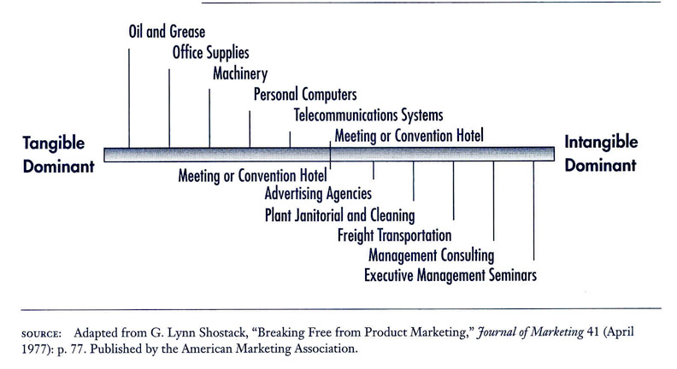
Business Product-Service Continuum – Tangibility Based
0

Slide 14
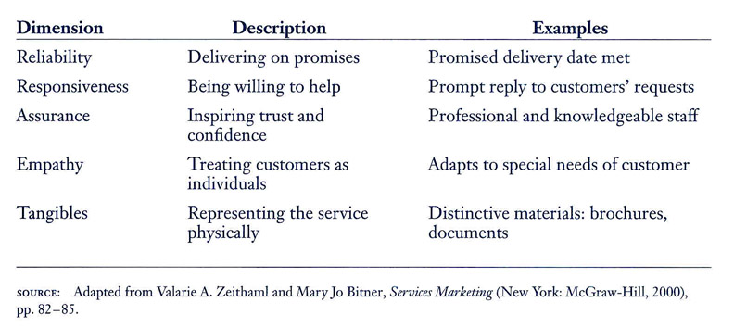
5 Dimensions of Service Quality
0

Slide 15
Customer Satisfaction and Loyalty
Customer-linking processes that affect satisfaction:
Basic elements of the product or service that customers expect all competitors to provide.
Basic support services, such as technical assistance or training, that makes product more effective.
A recovery process for quickly fixing product or service problems.
Extra-ordinary services that so excel in solving customers’ unique problems or in meeting customer needs that these services make the product or service seem customized.

Slide 16
Segmenting Services
Segmentation demands that a group must be large and homogeneous enough to support a marketing effort.
Service segments are often narrower because customers expect services to be customized
Service segmentation focuses on what business buyers expect as opposed to what they need.
Segmenting service markets help firms adjust their service capacity more effectively.

Slide 17
Developing the Service Package
0
The service package can be thought of as the product dimension of service, to include:
Essential concept of the service
Range of service provided
Quantity, quality and level of service
In addition:
Service package must consider some factors unique to services – personnel, physical product and a process for providing the service.

Slide 18
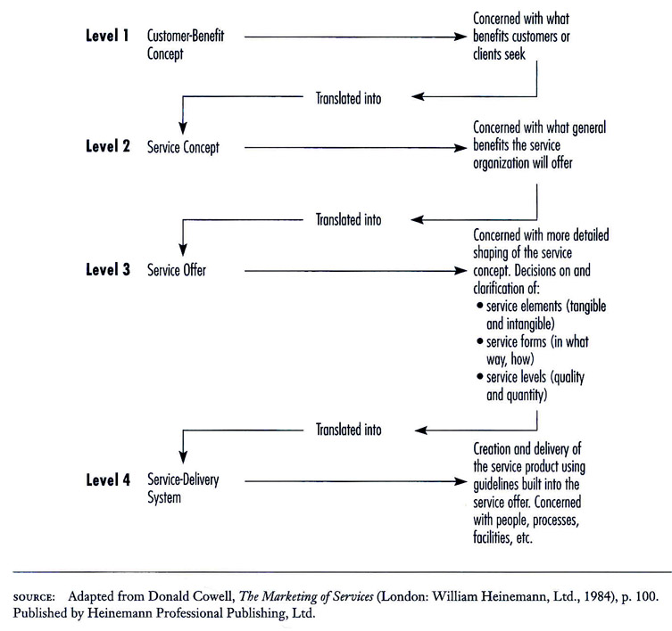
Conceptualizing the Service Product
0

Slide 19
Customer–Benefit Concept
0
Customer–Benefit Concept is understanding those service attributes that are important to the customer. They include…
Functional,
Effectual, and
Psychological components
… that result in a successful service experience.
Consistent quality is the goal so quality-control is of utmost importance.

Slide 20
Service Delivery System
0
The final element addresses: “How is the service going to be provided?”
This includes:
Jobs that qualified people are going to do
Necessary equipment, facilities and layout
Carefully developed procedures that allow for successful delivery of the service

Slide 21
Sales Force: Service-Savvy
0
Moving from product-related selling to product/service-related selling demands new approaches.
Services often requires:
  A long sales cycle
  A complex sales process
  Senior executives on both the selling and buying sides
To foster a successful relationship, many companies employ a diverse sales force where:
  One salesperson pursues for product sales
  Another provides the service with the goal of developing the relationship

Slide 22
Profitability of the Service
0
Many marketers offer a myriad of services such as:
Next-day delivery
Customized handling
Specialized labeling
Tracking
The question is:
Are these additional services profitable?

Slide 23
Service Promotion
0
Services are promoted in similar fashion as products. However, being intangible, the service should be associated to some tangible form by its marketers.
Example: Service marketers enhance differentiation by creating tangible clues such as:
  Logos
  Uniforms
  Building appearance
  Color schemes
  Or something specific to the service

Slide 24
Service Distribution
Distribution decisions in the service industry are focused on how to make the service package available and accessible to the user.
Direct sale may be accomplished by the user going to the provider
Services can also be delivered over the Internet or provided by channel members.

Slide 25
Pricing Business Services
Although product and service pricing policies and strategies share many common threads, the unique characteristics of services create some special pricing problems and opportunities.
As business marketers develop and price service offerings, they should give special attention to cost-to-serve particular customers and market segments.

Slide 26
Marketing Mix for Business Firms
Meeting the needs of service buyers effectively requires an integrated marketing strategy.
  target segments must be selected, and then a marketing mix must be tailored to the expectations of each segment.
  The business marketing manager must give special consideration to each of the key elements of the service marketing mix: development of service packages, pricing, promotion, and distribution.

Slide 27
As with any marketing situation, development of the marketing mix is contingent on the customer segment to be served.
Every facet of the service, as well as the methods for promoting, pricing, and delivering it, hinges on the needs of a reasonably homogeneous group of customers.

Slide 28
The goal of the services marketing program is to create satisfied customers. A key first step in creating strategies is to define the customer-benefit concept and the related service concept and offer.
Pricing concentrates on influencing demand and capacity as well as on the bundling of service elements.

Slide 29
Promotion emphasizes developing employee communication, enhancing word-of-mouth promotion, providing tangible clues, and developing interpersonal skills of operating personnel.
Distribution is accomplished through direct means, intermediaries, or the Internet.

Slide 30
Conclusion
Customer satisfaction represents the culmination of a set of customer experiences with the business-to-business fi rm.
A customer experience map provides a powerful platform for defining the most critical customer–company interactions, uncovering customer expectations, and spotting opportunities to create value and strengthen customer loyalty.

Slide 31
Service marketing can improve effectiveness by creating an organizational culture that fosters risk taking and innovation.
Successful new services respond to carefully defined market needs, capitalize on the strengths and reputation of the firm, and issue from a well-planned new-service-development process

Slide 32
References
Michael D. Hutt, Thomas W. Speh, (2012), Business Marketing Management B2B, 10th Ed. or 11th Ed. South-Western Cengage Learning, ISBN-13: 978-0-324-58167-6
Zimmerman, A., & Blythe, J. Routledge. (2021). Business to Business Marketing Management: A Global Perspective (4th ed.). https://doi.org/10.4324/9781003164036

Slide 33
THANK YOU !

