Slide 1
INDUSTRIAL MARKETING
LECTURE 5
INDUSTRIAL MARKETING PLANNING
LECTURER: DR. WANJIKU KINYANJUI

Slide 2
Learning Objectives
This topic provides a foundation for exploring business marketing strategy on a global scale based on the following objectives:
To understand the unique role of the marketing function in corporate strategy development for b2b planning
To create an understanding of the Organizational Buying Process as a strategic priority
To identify and explain the sources of competitive advantage by exploring the key components of a business model.

Slide 3
Strategy Defined
A strategy is a plan of action designed to achieve a long-term or overall aim.
A marketing strategy is a long-term plan for achieving a company's goals by understanding the needs of customers and creating a distinct and sustainable competitive advantage.
A business strategy outlines the specific ways in which an organisation plans to position itself, achieve its short-term and long-term goals, and grow over a period of time.

Slide 4
Introduction: Business Strategy
An organization's business strategy includes the kinds of businesses or markets to target:
the kinds of products or services to offer in these markets,
the actions needed to be performed to obtain customers and
the resources needed to be deployed to accomplish these actions

Slide 5
Strategic role of Marketing
The marketing function contributes to the planning process three levels within an organization.
This can be done by providing a detailed and complete analysis of customers and competitors and the firm’s distinctive skills and resources for competing in particular market segments.

Slide 6
Levels of Strategy
Strategic Planning takes place at three levels:
• Corporate Strategy
• Business- Level Strategy
• Functional Strategy

Slide 7
Corporate Strategy
A corporate strategy defines the business in which a company competes in by using resources to convert distinctive competences into competitive advantages .

Slide 8
At this level of strategy, the role of marketing is to
  assess market attractiveness and the competitive effectiveness of the firm,
  promote a customer orientation in managerial decision making, and
  formulate the firm’s overall value proposition and articulate it to the market and to the organization at large.

Slide 9
Business Strategy
A business strategy relates to how a firm competes in a given industry and positions itself against the competition
The focus of competition is not between companies; rather, it is between their individual business units.(SBUs)

Slide 10
Strategic Business Units(SBUs) are the organisational entities within an organisation that addresses a single business or collection of businesses
  A company can have as many as 40 strategic business units. Each develops a plan describing how it will manage its mix of products to secure a competitive advantage.

Slide 11
SBUs have a distinct mission, a responsible manager, its own competitors and is relatively independent of other business units
SBUs could be one or more divisions ,a product line within the division or a single product

Slide 12
There would be a marketing SBU function which contributes to the planning process by providing an overview of customers and competitors to the business
The marketing function can also guide on the company’s skills and resources for competing in the particular market segments.

Slide 13
Functional Strategy
Functional strategy centers on how resources allocated to the various functional areas can be used most efficiently and effectively to support the business-level strategy.
The primary focus of marketing strategy at this level is to allocate and coordinate marketing resources and activities to achieve the objectives within a specific product market

Slide 14
At the functional level planning must be a collaborative effort between all key functional areas . This can help reduce conflict that may occur when the tasks and objectives are unclear or different between the various departments.
The marketing department can ease conflict by building their marketing plans as per each functional area.

Slide 15
The business marketer should attempt to identify purchasing patterns that apply to the firm.
For example, the classes of industrial goods introduced in topic 1 involve varying degrees of technical complexity and financial risk for the buying organization.

Slide 16
Components of a Business Model
For a strategy to succeed, individuals must understand and share a common definition of a firm’s existing business concept.
A business concept or model consists of four major components
  Customer Interface
  Core Strategy
  Strategic Resources
  Value Network

Slide 17
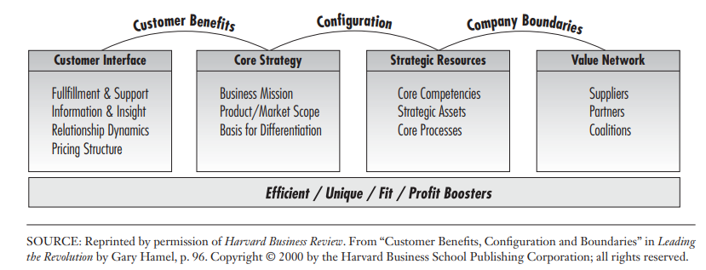
Business Model Components

Slide 18
Customer Interface - It comprises of four elements.
  Fulfilment and support,
  Information and insight,
  Relationship dynamics,
  Pricing structure

Slide 19
Core Strategy - determines how the company chooses to compete.
  Business Mission
  Product/Market Scope
  Basis for differentiation- describes how a company competes differently from its rivals

Slide 20
Strategic Resources
A business marketing firm gains a competitive advantage through its superior skills and resources.
The firm’s strategic resources include:
  core competencies,
  strategic assets, and
  core processes.

Slide 21
Value network seeks to forge relationships with suppliers and alliance partners and others in the value chain. This complements and further enriches the firm’s research base.
This seeks to find out what market opportunities might become available to a business “if we could ‘borrow’ the assets and competencies of other companies and integrate them with our own?

Slide 22
Key Models
Successful execution of strategy involves linking strategy to operations, using tools and processes like the balanced scorecard or strategy map. (Kaplan & Norton,2008).
The balanced scorecard converts a strategy goal into concrete objectives, and measures are organized into four different perspectives:
  Financial perspective
  Customer perspective
  Internal business process, and
  learning and growth.

Slide 23
The balance scorecard tells the story of the strategy, starting with the long-run financial objectives, and then linking them to the sequence of actions that must be taken with financial processes
Then, customers and employees and systems that deliver the desired long-run economic performance.

Slide 24
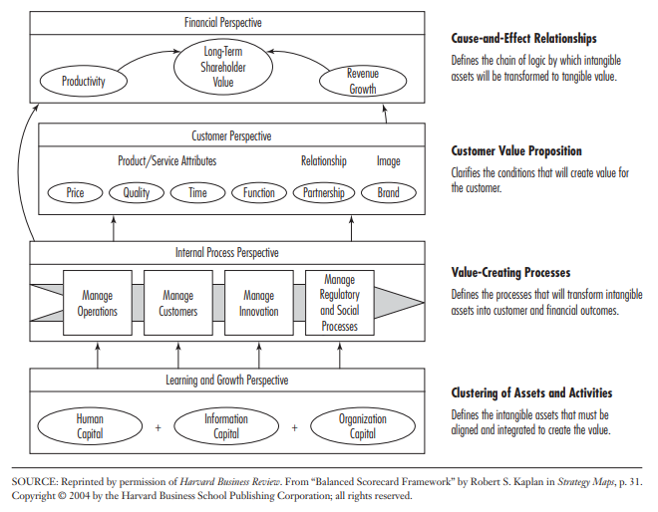
Balance Scorecard

Slide 25
The balanced scorecard seeks to match financial objectives to a business unit’s growth and life cycle stages.
Three stages of a business are isolated and linked to appropriate financial objectives:
Growth: Business units that have products and services with significant growth potential and that must commit considerable resources
Financial Objectives: Sales growth rate by segment; percentage of revenue from new product, services, and customers

Slide 26
Sustain: there are business units, which may be representing the majority of businesses within a firm. They expect to maintain or increase market share from year to year.
Financial Objectives: Share of target customers and accounts; customer and product-line profitability.
Harvest: Mature business units that warrant only enough investment to maintain production equipment and capabilities.
Financial Objectives: Payback; customer and product-line profitability.

Slide 27
Building a Strategic Map
A strategic map enables an organization to describe and illustrate,
  its objectives,
  initiatives and targets
  the measures used to assess performance (market share/customer surveys)
  the linkages that are the foundation for strategic direction.

Slide 28
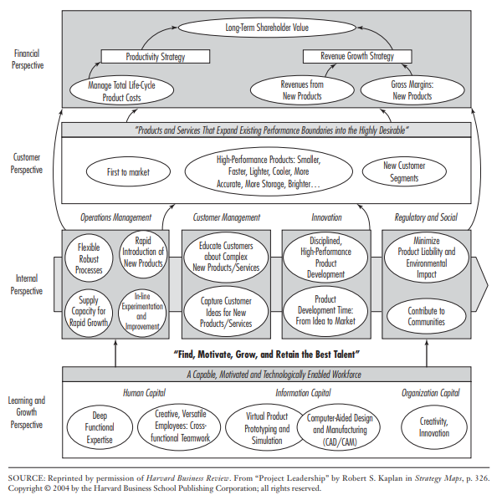
STRATEGY MAP TEMPLATE: PRODUCT LEADERSHIP

Slide 29
The strategy map template above is for a firm pursuing a product-leadership strategy.
Companies emphasize two performance levels in developing a financial strategy—a productivity strategy and a revenue-growth strategy
A value proposition for product leadership should be to have “Products and services that expand existing performance boundaries into the highly desirable.”

Slide 30
Conclusion
Business marketers primarily emphasize one of the following value propositions or customer strategies:
Low total cost,
Product leadership
Strategy involves choosing and developing a differentiated customer value proposition

Slide 31
Conclusion Contd
A strategic map provides a visual representation of a firm’s critical objectives and the cause-and-effect relationships among them that drive superior organizational performance.

Slide 32
Kaplan, R.S. and Norton, D.P. (2004) The Strategy Map: Guide to Aligning Intangible Assets. Strategy & Leadership, 32, 10-17.
http://dx.doi.org/10.1108/10878570410699825
Michael D. Hutt, Thomas W. Speh, (2012), Business Marketing Management B2B, 10th Ed. or 11th Ed. South-Western Cengage Learning, ISBN-13: 978-0-324-58167-6
Nyangon, Joseph & Byrne, John. (2018). Diversifying Electricity Customer Choice: Reving Up the New York Energy Vision for Polycentric Innovation. 10.5772/intechopen.76023.

