Slide 1
INDUSTRIAL MARKETING
LECTURE 6
MANAGING INNOVATIONS AND NEW PRODUCT DEVELOPMENT
LECTURER: DR. WANJIKU KINYANJUI

Slide 2
Learning Objectives
1.Recap of the types of Industrial Products
2. Learn how to build a strong business-to-business brand.
3. Identify with the strategic importance of providing competitively superior value to customers.
4. Identify various types of industrial product lines and the value of product positioning.
5. Understand the strategic approach for managing products positioning

Slide 3
Types of Industrial Products
Industrial goods and services can be conveniently classified into three broad groups; they are;
1.Materials and parts,
2.Capital Items, and
3.Supplies & services.

Slide 4
Materials & Parts:
Goods that enter the product directly consist of raw materials, manufactured materials and component parts.
The cost of these items is treated by the purchasing company as part of manufacturing cost.

Slide 5
Supplies & services
Every organization requires operating supplies such as paints, soaps, oils, greases, pencils, typewriter ribbons, printer cartridges, paper

Slide 6
Capital Items
Capital items are those which are used in the production processes and when they worn-out a portion of their original cost is assigned to the production process as deprecation. Capital items include;
a) Heavy Equipment/Installations,
b) Light equipment/Accessories)
c) Plant & Buildings

Slide 7
Building a strong business-to-business brand
A business marketer’s marketplace identity is established through its brand and through the products and services it offers.
Since brands constitute one of the most valuable intangible assets that a firm possesses, branding has emerged as a priority to marketing executives, CEOs, and the financial community

Slide 8
Some of the most valuable and powerful brands belong to business to-business firms: IBM, Microsoft, General Electric, Intel, Hewlett-Packard, Cisco, Google, Oracle, Canon,, Caterpillar (Hutt & Speh, (2012)

Slide 9
A brand, then, is a name, sign, symbol, or logo that identifies the products and services of one firm and differentiates them from competitors.
With proper and effective marketing strategies, a marketer can build or create brand assets and liabilities that can increase brand loyalty levels, names awareness and other brand associations.

Slide 10
Kevin, Lane & Keller(2007) defines customer based brand equity (CBBE) as the differential effect that customers’ brand knowledge has on their response to marketing activities and programs for that brand.
The CBBE model lays out a series of four steps for building a strong brand.
(1) develop deep brand awareness or a brand identity;

Slide 11
(2) establish the meaning of the brand through unique brand associations (points of difference)
(3) elicit a positive brand response from customers through marketing programs; and
(4) build brand relationships with customers, characterized by intense loyalty.

Slide 12
Brand Equity Integrative Model
To build and properly manage brand equity, Kevin Lane Keller and Donald R. Lehman (2006) provide an integrative model that can be used to isolate key dimensions of the brand management process. The model has 4 main variables:
  Company Actions
  What Customers Think and Feel
  What Customers Do
  How Financial Markets React

Slide 13
Types of Product Lines
Proprietary or catalog products.
These items are offered only in certain configurations and produced in anticipation of orders. Product-line decisions concern adding, deleting, or repositioning products in the line.

Slide 14
Custom-built products.
These items are offered as a set of basic units, with numerous accessories and options. The firm’s wide array of products provides retailers with an end-to-end solution, from data warehousing to the point-of service workstation at checkout.
The marketer offers the organizational buyer a set of building blocks. Product-line decisions center on offering the proper mix of options and accessories

Slide 15
Custom-designed products.
These items are created to meet the needs of one or a small group of customers. Sometimes the product is a unique unit, such as a power plant or a specific machine tool.
In addition, some items produced in relatively large quantities, such as an aircraft model, may fall into this category. The product line is described in terms of the company’s capability, and the consumer buys that capability. Ultimately, this capability is transformed into a finished good.

Slide 16
Industrial services
Rather than an actual product, the buyer is purchasing a company’s capability in an area such as maintenance, technical service, or management consulting.
**

Slide 17
Planning Industrial Product Strategy
Product positioning represents the place that a product occupies in a particular market; it is found by measuring organizational buyers’ perceptions and preferences for a product in relation to its competitors.
Since organizational buyers perceive products as bundles of attributes (for example, quality, service), the product strategist should examine the attributes that assume a central role in buying decisions.

Slide 18
The positioning process begins by identifying the relevant set of competing products and defining those attributes that are determinant attributes that customers use to differentiate among the alternatives

Slide 19
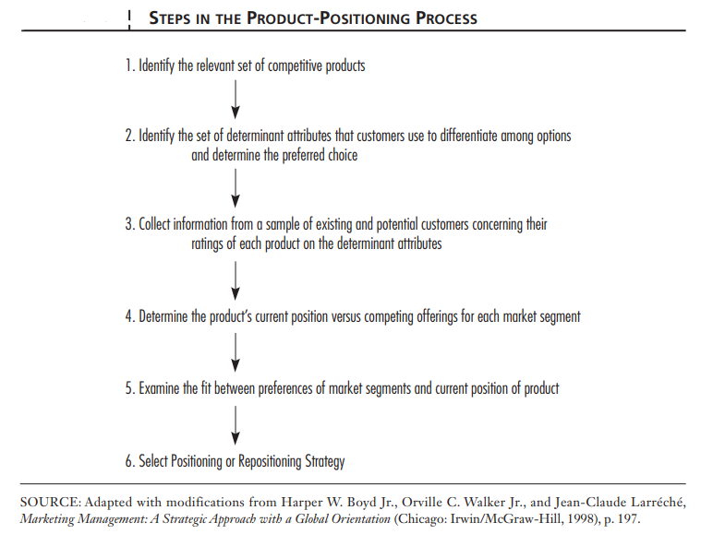

Slide 20
1. To identify the relevant set of competitive products, you need to understand the market in which your product operates.
Identify the product category: Determine the category in which your product belongs. For example, if you are selling smartphones, your product category would be mobile phones.
Identify the key features: Determine the key features that your product offers. For example, if your smartphone has a large display, high camera resolution, and long battery life, those are its key features.

Slide 21
Search for competing products: Use search engines and online marketplaces to find products that offer similar features to your product. Look at the specifications and features of these products to determine how they compare to your product.
Analyze the market: Look at the market share of competing products and their sales performance. This will help you understand which products are most popular among consumers.

Slide 22
Consider pricing:
Look at the pricing of competing products to determine how they compare to your product. If your product is priced higher than competing products, you need to consider whether your product offers enough additional value to justify the higher price.

Slide 23
Consider distribution channels:
Look at the distribution channels of competing products. If competing products are sold through different channels than your product, you need to consider whether your product is easily accessible to consumers.

Slide 24
By following these steps, you can identify the relevant set of competitive products and develop a positioning strategy that sets your product apart from the competition.

Slide 25
2. In B2B markets, customers use a combination of determinant attributes to differentiate products and make purchasing decisions
Price:
The price of a product is often a key determinant attribute in B2B markets. However, unlike in B2C markets, where customers may be more price-sensitive, in B2B markets, customers may be willing to pay more for a product that offers higher quality or better features.

Slide 26
Quality:
The quality of a product is also a determinant attribute in B2B markets. However, in B2B markets, customers may have more stringent quality requirements and may be more willing to pay a premium for a product that meets those requirements

Slide 27
Technical specifications:
In B2B markets, customers may be more concerned with the technical specifications of a product, such as its size, weight, power consumption, and compatibility with other equipment or systems.

Slide 28
Brand reputation:
Brand reputation is also a determinant attribute in B2B markets. Customers may prefer to work with companies that have a strong reputation for quality, reliability, and customer service

Slide 29
3. Collecting information from B2B customers about their ratings of each determinant attribute on the product can provide valuable insights that can inform product development, marketing, and sales strategies.
This can be done through various methods such as surveys, interviews, focus groups, and online reviews..

Slide 30
Here are some tips:
Identify the specific attributes that you want to collect information about. Based on your product and target market, identify the key determinant attributes that B2B customers use to differentiate products

Slide 31
4. Identify your key competitors: Determine who your primary competitors are in your target market. This can be done by conducting market research, analyzing industry reports, and reviewing your customer feedback.
Analyze your competitors' products: Evaluate your competitors' products and identify their strengths and weaknesses. Consider factors such as price, quality, features, and customer support.

Slide 32
Evaluate your own product: Assess your product's strengths and weaknesses compared to your competitors. Consider how your product compares in terms of the same factors you evaluated for your competitors.
Conduct a SWOT analysis: This can be useful in understanding how your product fits into the market and how it can be improved.

Slide 33
5. Identify your target market segments: Determine the different market segments that your product serves. This can be done through market research, customer feedback, and sales data analysis.
Analyze customer preferences: Analyze the preferences of each market segment to determine their key buying criteria. This can be done through surveys, focus groups, or customer interviews.

Slide 34
6. Positioning strategy is used when introducing a new product or service to the market, or when there is a need to differentiate an existing product from competitors.
It involves establishing a unique position for the product in the minds of the target market, based on its key features, benefits, and attributes. This strategy is typically used when the product is new, and there is no established position in the market.

Slide 35
Repositioning strategy, on the other hand, is used when a product's current position in the market is no longer effective or relevant.
It involves changing the product's image or perception in the minds of the target market to better align with their needs and preferences.
This strategy is typically used when the product's sales have declined, or when there are changes in the market that require a different approach.

Slide 36
Conclusion
Some of the most valuable and enduring global brands belong to business-to-business firms.
The power of a brand resides in the minds of customers through what they have experienced, seen, and heard about the brand over time.
The unifying goal for the business marketer: Provide superior market-perceived quality and value versus competitors.

Slide 37
Conclusion Contd.
Business marketers can strengthen customer relationships by providing value-added services and helping customers reduce operations costs.
In monitoring product performance and in formulating marketing strategy, the business marketer can profitably use product-positioning analysis.
By isolating a product’s competitive standing in a market, positioning analysis provides strategy insights to the planner

Slide 38
Kaplan, R.S. and Norton, D.P. (2004) The Strategy Map: Guide to Aligning Intangible Assets. Strategy & Leadership, 32, 10-17.
http://dx.doi.org/10.1108/10878570410699825
Kevin Lane Keller (2007)Strategic Brand Management . 3rd ed., Upper Saddle River, NJ: Prentice Hall.
Michael D. Hutt, Thomas W. Speh, (2012), Business Marketing Management B2B, 10th Ed. or 11th Ed. South-Western Cengage Learning, ISBN-13: 978-0-324-58167-6
Nyangon, Joseph & Byrne, John. (2018). Diversifying Electricity Customer Choice: Reving Up the New York Energy Vision for Polycentric Innovation. 10.5772/intechopen.76023.

