Slide 1
INDUSTRIAL MARKETING
LECTURE 9
INDUSTRIAL MARKETING COMMUNICATIONS 2
BY
DR. WANJIKU KINYANJUI

Slide 2
Learning Objectives
By the end of this topic, You should have understood:
the role of personal selling in the marketing strategy
the skills and characteristics of high-performing account managers
the nature of the sales management function
managerial tools that can be applied to sales force decision areas.

Slide 3
Personal Selling Defined
Personal selling is the interpersonal part of the promotion mix and can include:
Face-to-face communication
Telephone communication
Video or Web conferencing

Slide 4
A Salesperson is the link between the company and its customers who assist in producing customer value and company profit by:
Representing the company to customers
Representing customers to the company
Working closely with the marketing teams

Slide 5
Personal selling is the largest budget item in most business to business markets.
Salespeople earn high salaries, and need expensive back-up: company cars, administration assistance, smart phones, expensive computers, and other sales materials.
Allowing for travelling time, preparation time, and so forth, salespeople spend only a fraction of their time actually making sales presentations

Slide 6
Role of a sales person
• identify suitable possible customers
• identify problems that customers have or might have
• establish a dialogue with the potential customer
• identify solutions that are within the supplying firm’s capabilities
• represent the customer’s views to the supplying company
• ensure a smooth process of supply that meets the customer’s needs;
• solve any after-sales problems that may arise

Slide 7
Managing the Sales Force
Effective management of the industrial sales force is essential for a firm’s success.
Sales management requires proper planning, organizing, directing, and controlling of the personal selling efforts
Sales operations must be supervised to identify problem areas and to assess the efficiency, effectiveness, and profitability of personal selling.

Slide 8
Organizing the Sales Force
The business marketer can organize the sales force by:
  geographical location
  product type
  target market
Large industrial firms that market diverse product lines may use all three.

Slide 9
Key Account Management
Many Industrial business marketing firms find that a small proportion of customers account for a major share of the business.
These customers have a large purchasing power by virtue of their size, and they are searching for ways to leverage their suppliers’ capabilities to enhance the value they deliver to their own customers
In exchange for a long-term volume commitment, these customers expect the business marketing firm to offer additional value-added services that are not offered to other customers

Slide 10
Value Adding Services
Customer prioritization
Represents the degree to which firms prioritize customers by developing different value propositions for its top-tier versus bottom-tier customers

Slide 11
b) Key Accounts
Industrial firms have key account managers and customer teams composed of individuals from other departments like sales, marketing, finance, logistics, and other functional groups.
Key account managers are responsible for several important customers and report to a senior manager in the firm.
  purchases a significant volume as a percentage of a seller’s total sales
  involves several organizational members in the purchasing process
  buys for an organization with geographically dispersed units
  expects logistical support, inventory management, price discounts, and customized applications

Slide 12
c) Type of Relationship
This involves multiple goals.
To illustrate, firms may enter into a closer, long-term relationship to lower costs to both partnering firms.
-by reducing the seller’s marketing and logistics costs and reducing the buyer’s acquisition and production costs

Slide 13
d) Coordinated Action
To effectively deliver more value to an important customer,
  the interpersonal connections between the buying and selling firms must extend beyond the salesperson and the purchasing manager.
  frequent interactions between a team of functional experts from both organizations.
The key account manager assumes a lead role in coordinating selling center activities and facilitating these cross-firm communications among functional experts.

Slide 14
e) Selecting Key Accounts
If the industrial firm can have closer and important relationships with a small set of customers, each requiring a large investment, the choice of the key accounts is critical.
  the profit potential of a customer, measured in terms of incremental sales potential, and
  the degree to which a customer values the firm’s support services and is willing to pay a premium price for them

Slide 15
Account Management Success : Roles
Building Internal Relationships
High-performing account managers form more cross-functional and cross-unit ties within the organization
A diverse social network provides a manager with access to unique skills and knowledge.
Account managers with ties to a number of distinct knowledge pools in the organization can draw on a large array of skills, knowledge, and resources—thereby enhancing their customer responsiveness

Slide 16
b. Forging Relationships (Customer Organization)
Being centrally involved in a customer organization’s buying system improves an account manager’s ability to understand the customer’s requirements and business goals.

Slide 17
C. Managing the Customer Engagement Process
By developing a network of relationships both within the firm and within the customer organization, an account manager is ideally equipped to manage the customer engagement process.
Through these connections account managers receive vital information about emerging customer opportunities, customer requirements and solutions, and competitive challenges

Slide 18
d. Aligning and Crafting
A successful client engagement hinges on both customer knowledge and competitive intelligence.
High performers know more about client goals and the drivers of client profitability than low performers.
When creating a customer solution, a salesperson must act as a broker to gather an ad-hoc team of experts and coordinate the efforts of people who may not have met before.

Slide 19
With this knowledge managers align the capabilities of the firm to the goals of the customer.
High-performing account managers develop sound competitive intelligence and use this knowledge to outmaneuver their rivals in a particular client engagement.

Slide 20
e. Enhanced Internal Reputation
By building a strong network of relationships within both the firm and the customers firm, high-performing account relate well with colleagues
  better able to diagnose customer requirements,
  mobilize internal experts, and design the activities that are required to outsmart the rivals and create the desired customer solution.

Slide 21
Sales Force Administration
Successful sales force administration involves recruiting and selecting salespersons, then training, motivating, supervising, evaluating, and controlling them.
The industrial firm should foster an organizational climate that encourages the development of a successful sales force.

Slide 22
The recruiting process presents numerous trade-offs for the business marketer.
  Should the company seek experienced salespersons, or should it hire and train inexperienced individuals? The answer depends on the specific situation
  it varies with the size of the firm, the nature of the selling task, the firm’s training capability, and its market experience

Slide 23
Industrial firms need to prepare new salespersons adequately by designing a proper training program.
Periodic training is required to sharpen the skills of experienced salespersons, especially when the firm’s environment is changing rapidly.
Changes in business marketing strategy (such as, new products, new market segments) require corresponding changes in personal selling styles

Slide 24
Supervision and Motivation
The sales force must be directed in a way that is consistent with the company’s policies and marketing objectives.
Critical supervisory tasks are continued training, counseling, assistance and activities that help sales personnel plan and execute their work.
Supervision also sets sales performance standards, fulfills company policy and integrates the sales force with higher organizational levels

Slide 25
Socialization
Salespersons are likely to be anxious and frustrated when they are uncertain about the expectations of role partners or feel that role partners (for example, customers, superiors) are making incompatible and impossible demands.
An effective approach for reducing role ambiguity among new salespeople is training and socialization to offer sufficient information about role expectations and minimize potential confusion about performance requirements.

Slide 26
Evaluation and Control
A constant sales management responsibility is to monitor and control the industrial sales force at all levels whether national or regional level.
  To determine whether objectives are being attained
  to identify problems
  recommend corrective action
  keep the sales organization in tune with changing competitive and market conditions.

Slide 27
Models for Industrial Sales Force Management
The size of the sales force is used to determine the level of selling effort that the business marketer can use.
The selling effort is then organized by designating sales districts and sales territories.
Allocation decisions determine how the selling effort is to be assigned to customers, prospects, and products

Slide 28
Territory Sales Response
The level of sales in a particular territory can be influenced by:
  Environmental factors (e.g., health of economy, technology)
  Competition (e.g., number of competitive salespersons)
  Company marketing strategy and tactics
  Sales force organization, policies, and procedures
  Field sales manager characteristics
  Salesperson characteristics
  Territory characteristics (e.g., potential)
  Individual customer factors

Slide 29
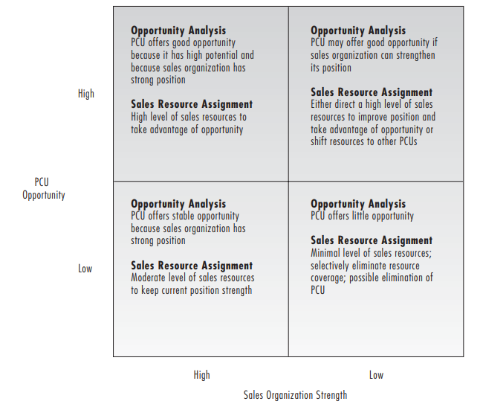
b) Sales Resource Opportunity Grid
A sales resource opportunity grid can be used to classify the business-to-business firm’s portfolio of Planning and Control Unit (PCU)
Hutt & Speh,2012

Slide 30
Conclusion
In industrial marketing, personal selling is a significant influence that drives demand.
With the enormous resources dedicated to personal selling and the quickly rising expense of in-person sales calls, the business marketer needs to closely oversee this function and make the most of existing technology in order to maximize sales force productivity.

Slide 31
In order to profitably service large customers with complex purchasing requirements, a growing number of business-to-business companies are also building a key account sales force, regardless of the structure of their sales staff.
The sales organization must be appropriately structured: hiring and selection, training, supervision, assessment, and control are all part of the continuous process of managing a sales team.

Slide 32
References
Michael D. Hutt, Thomas W. Speh, (2012), Business Marketing Management B2B, 10th Ed. or 11th Ed. South-Western Cengage Learning

